Slide 1
Q &A for the questions from CFS of April 29,2011
S. Fukuda
KEK

Slide 2
Current Status of DRFS
Based on Japanese CFS Tunnel Plan, new configuration of DRFS was presented at SCRF meeting in June 1, 2011. This is based on the NATM method of tunnel excavation and Japanese mountain cite employs this configuration.
In this configuration, there are lots of advantageous features for DRFS; radiation problem, maintainability and availability, possible revision of redundancy and so on.
For the CFS view points, there are lots of advantageous features comparing to previous 5.7m dia. single tunnel plan. Therefore we are now designing DRFS based on this new scheme.
On the other hand, for the world-wide consideration of DRFS, previous 5.7m dia. single tunnel configuration has an important role and for Q &A of DRFS, we try to answer questions based on the previous 5.7m dia. single tunnel plan.

Slide 3
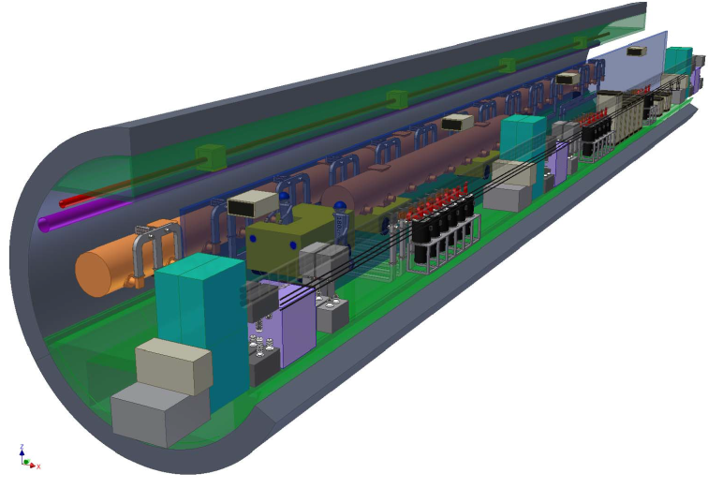
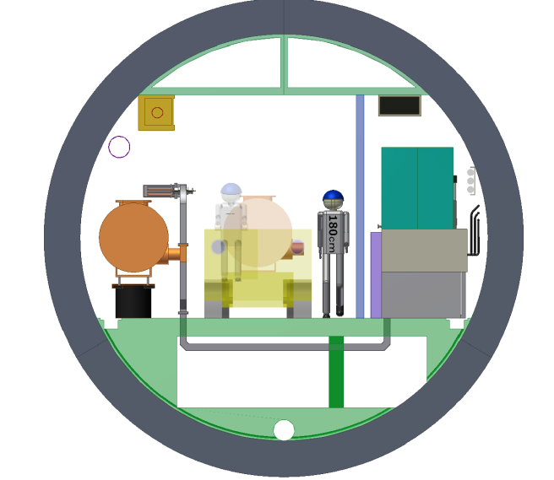
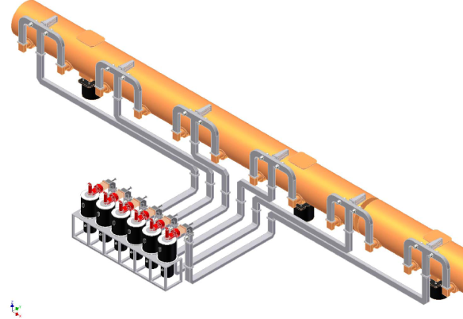
Previous 5.7m dia. Single tunnel plan
Single tunnel plan of 5.7m diameter in which cryomodule is on the floor is based on the presentation in BAW1 in Tsukuba in Sep. 8 2010. Alcove for local electricity is eliminated and each P/S accepts 6.6kV directly and changes to 420V. Low voltage line is generated locally. Radiation shield is changed to wall-like and height limitation in P/S room disappeared. Parts of klystrons are installed in bunch to make the maintenance space and consequently PDS became more complicated.
Due to the acceptance of cavity field variation, average power increased. In order to consist to SB2009 and low energy scheme, Average power increased due to the longer pulse width in BAW2 in Tsukuba in Jan. 18 2011.
Air Ventilation
Radiation Shield
Bunched klystrons and PDS
Cooling Water

Slide 4
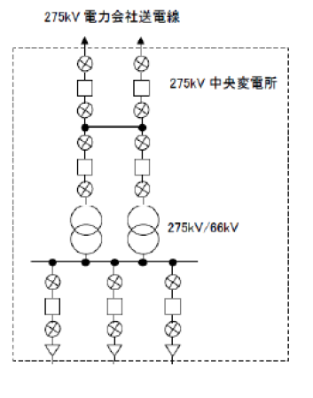
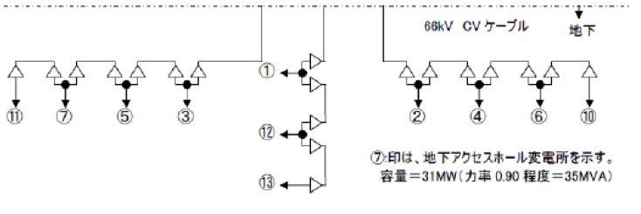
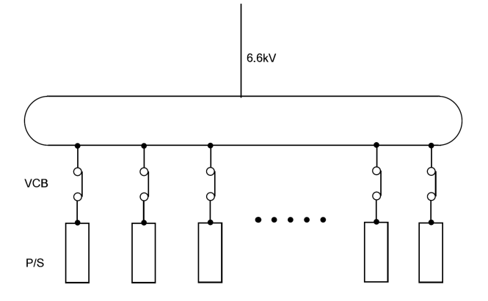
Electricity Distribution(Q1)
(Q):What is the interface point between the DRFS equipment for one RF unit and the CFS electrical distribution system.
(A):Yes, comparing with RDR layout, in DRFS scheme we eliminated the alcoves of CFS electricity after the discussion with Atsushi and CFS group to save the cost. (KEK: CFS Review June 10, 2010)
6.6 kV line is directly introduced to two VCBs of two power supplies (P/S) respectively. So electrical interface points is sub-electric center which has the transformers of 66kV to 6.6 kV in every 4.5km distance.
(A):In every front end of the electricity of P/S makes a low voltage line such as AC100V and AC200 V for the control and low voltage electricity.
Center:275kV
275kV->66kV
66kV->6.6kV in each 4.5km apart

Slide 5
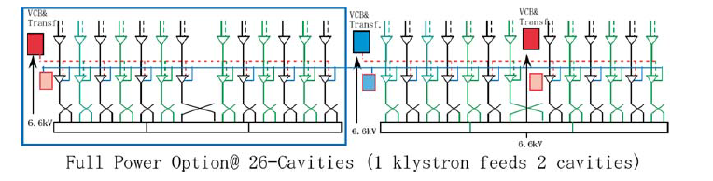
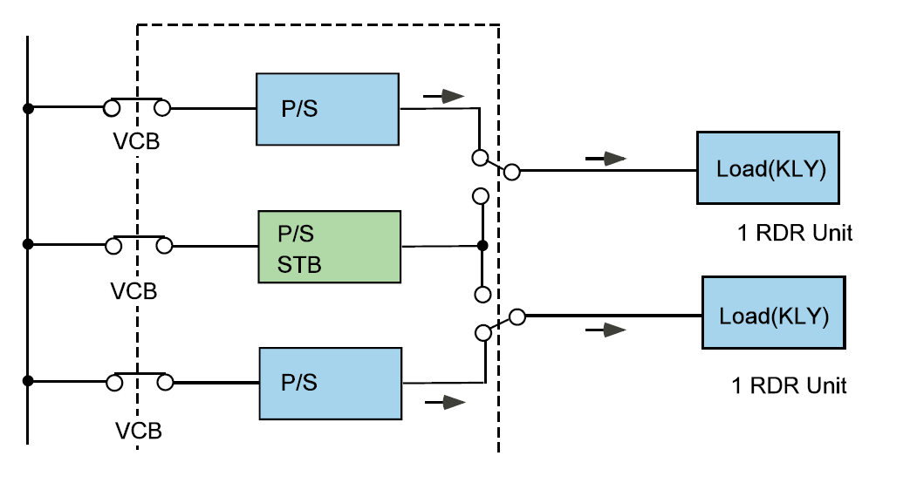
About the STB P/S as redundancy(Q1)
(Q); Our understanding is that there are two modulators, both fully powered, to provide redundancy, for each RF unit (three cryomodules) and CFS electrical power is supplied to those two modulators only. Is this correct?
(A) ; 3 power-supplies for 2 RDR units (six cryomodules system) is the minimum uints of DRFS HLRF system. This is the latest redundancy scheme. So in 2 RDR units (six cryomodules sytem), there are 2 hot P/S and 1 stand-by (STB) P/S.
2 RDR Units
Connection of hot P/S and loads

Slide 6
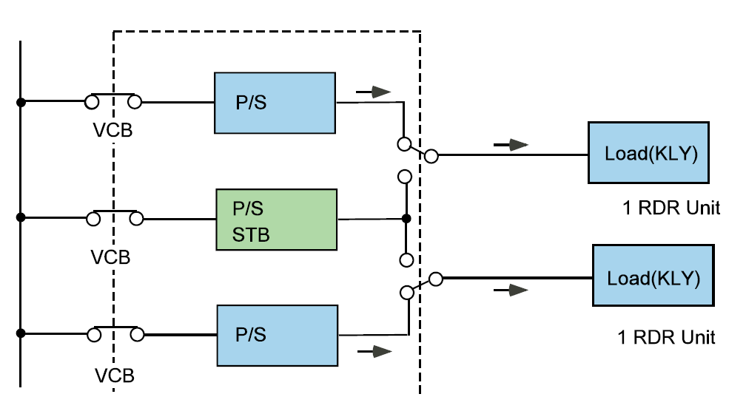
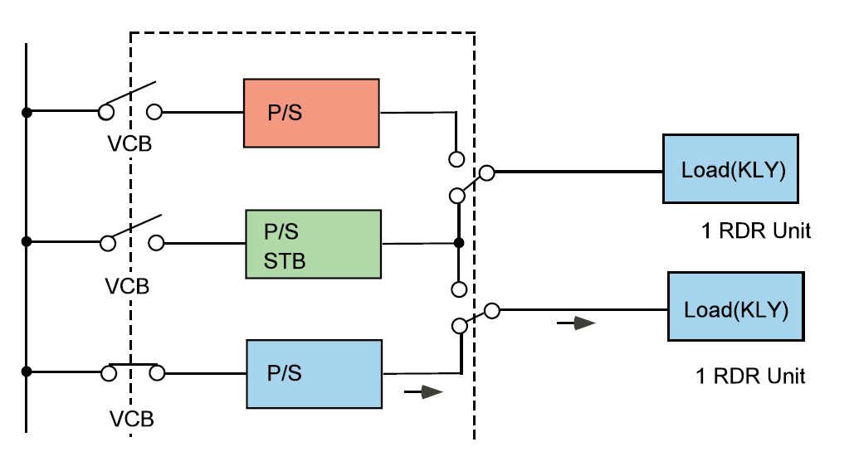
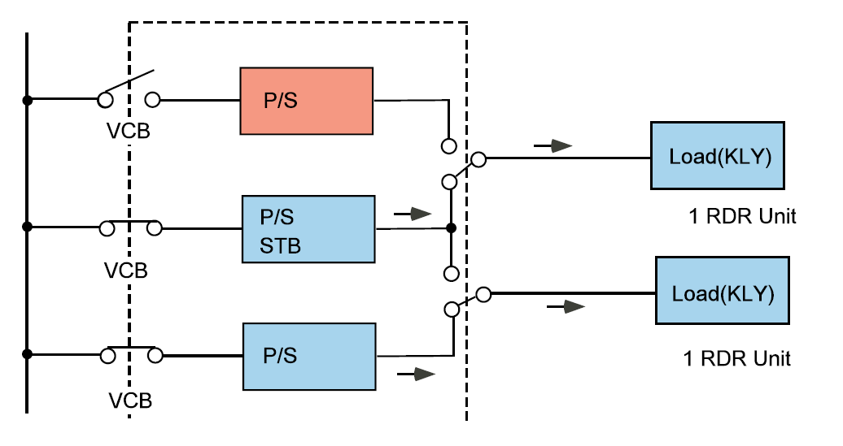
Switching from Failure one to STB unit(Q1)
(A) ; This 1 STB unit is some sense hot, but some sense not hot. It is keep alive but it is not connected to the real load (DFRS klystrons) and not fully powered. (these loads are common for P/S and STB P/S). If P/S has a fault and STB P/S is necessary, once VCB is off and connection change from previous P/S to new (STB) P/S is performed in low voltage and then STB VCB is on and gradually up to the rated voltage. This is done because of real hot swappable turn on and off is difficult due to the HV relay’s specification.
Failed
This sequence is same for the case of
MA modulator

Slide 7
Q2 & Q3
(Q2) Are the DRFS electrical connections to the power system, for the main linac, identical for each RF unit?
------Identical for each 2 RDR units
(Q3) What is the load specification for each DRFS electrical connection at the modulators to the power system in Volts and KW?
-----6.6kV, Heat table value+Beam power(kW)
see power table

Slide 8
Q4
(Q4) Do any of the electrical connections require special consideration such as Uninterruptable Power Supply, standby power, isolation transformer or special grounding?
---No

Slide 9
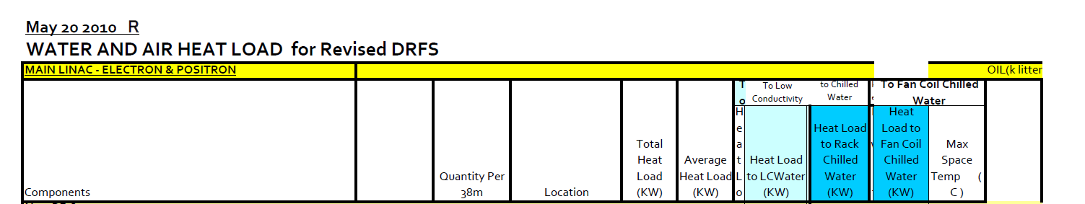
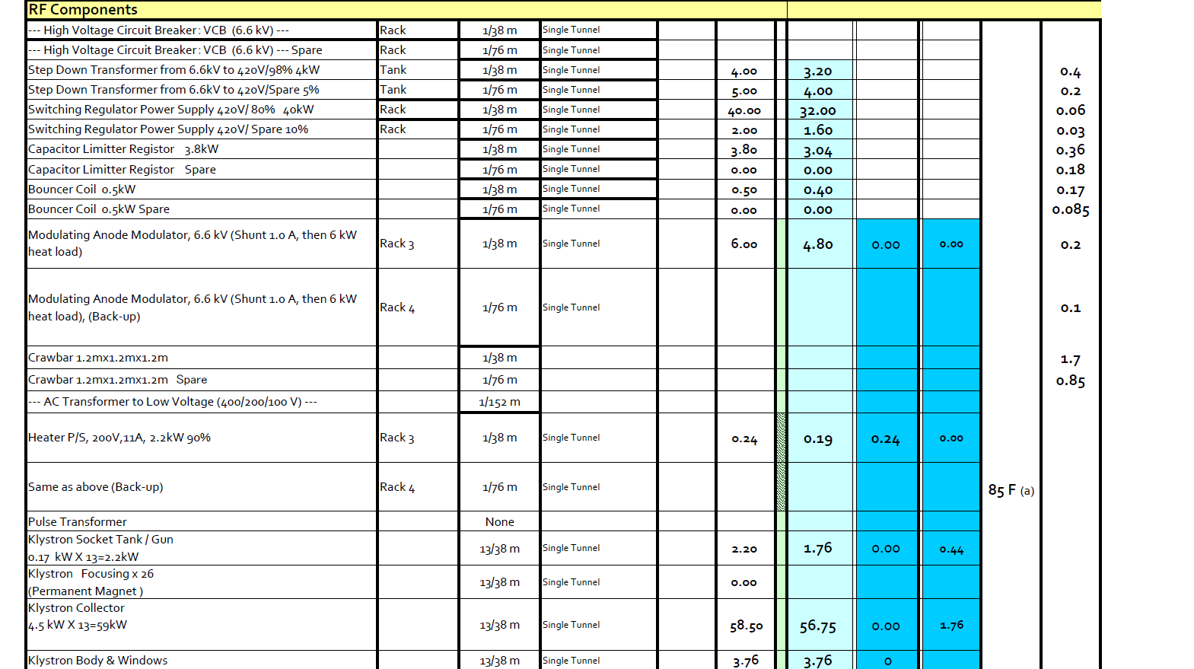
Heat Loss of STB Unit(Q1)
Heat Loads of STB
Modules are included
In the previous table
Indicated by spare or
Back-up.

Slide 10
Power Increase Requirement(1)
At BAW-2 held in SLAC in Jan. 18-22,2011, SB2009 and low energy 10Hz operation were discussed and we required to increase the power to match to the cavity condition to accelerate 4.5mA in DRFS. Mainly this situation is come from the requirement of pulse width expansion.
At the same time, accepting the cavity gradient variation of 31.5MV+-20% was discussed. This also resulted in the increase of power requirement. In this case, cavity sorting on 5 group gradient was proposed in DRFS to balance the power between cavities fed by the same klystron. Due to the Ql mismatch, it I s necessary to prolong pulse width and peak power increase.
In full energy scheme: For units for maximum power requirement,
Gradient of 31.5MV, 9mA, 5Hz, then pulse width of 1.565ms (Original)
Highest gradient group =31.5*120%, 9mA, 5Hz, then pulse width of 1.8ms
Required klystron power 850kW (13% overhead) and required power increase of 27%
In SB2009 and 10 Hz operation:
Gradient of 31.5MV, 9mA, 5Hz, then pulse width of 1.565ms (Original)
Highest gradient group =31.5*120%, 4.5mA, 5Hz, then pulse width of 2.3ms
Required klystron power 850kW (13% overhead) and required power increase of 44%
RF sources used in this operation are kept used in full energy operation. New rf sources have a capability mentioned above.

Slide 11
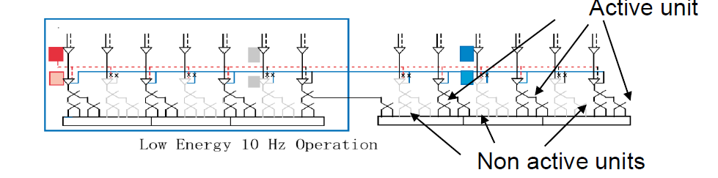
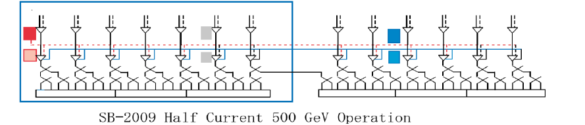
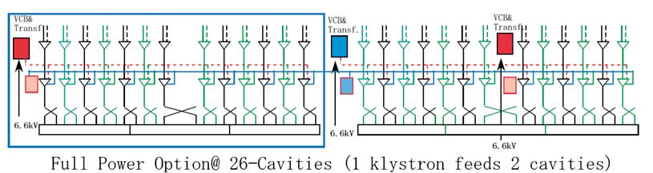
3 operation mode (Low Energy 10Hz, SB2009 and Full scheme) and DRFS Layout
(1) Low energy 10Hz operation: 250GeV, 4.5mA, 10Hz
All units have a capability of 2.3ms pulse width, 10Hz.
Facility requires 144% power capability.
Numbers of active klystrons are 50% to 70% depending on the sorted kly. group.
(2) Reduced bunch operation: 500GeV, 4.5mA, 5Hz
All units have a
capability of 2.3ms
pulse width, 5Hz.
Facility requires 144%
power capability.
Numbers of active
klystrons are same in
sorted kly. group.
Same units
(3) Full energy operation: 500GeV, 9mA, 5Hz
Increase units
Old units have same
capability, and new
units with 1.8ms pulse
width.
Facility for new units
requires 113%
power capability.

Slide 12
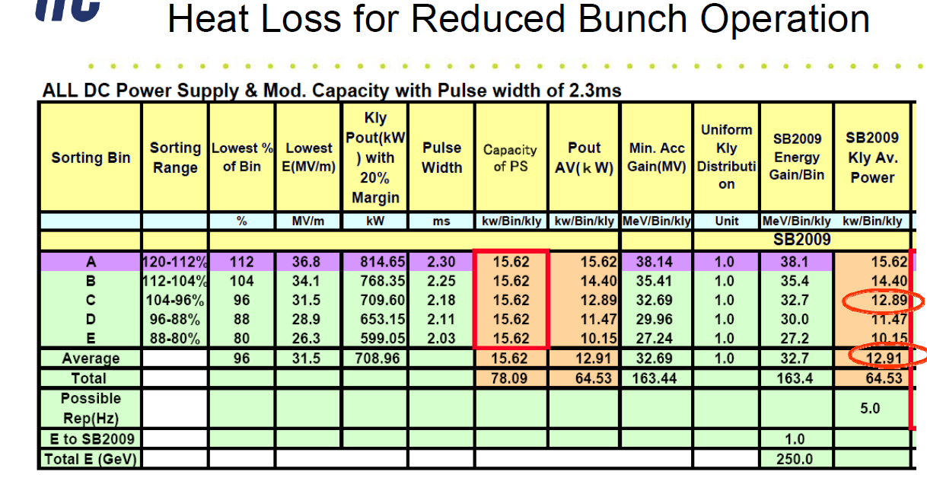
Power Increase Requirement(2)
Low power operation: Reduced power operation
HLRF manufactures maximum rating DC P/S, MA modulator and DRFS klystrons, which are available to peak power of 850kW and pulse width of 2.3ms for the low power reduced bunch operation and low energy 10 Hz operation. CFS Facility introduces the facility with maximum rating power, both for electricity and cooling .
Heat loss in the HLRF unit are different depending on the cavity gradient sorting group and shown in later.
Average power of total system is same as power of median sorted group in reduced bunch operation.
In Full Energy operation:
Units which were used in low energy 10Hz operation and reduced bunch operation are kept using in full energy operation. Though their capabilities are large, they are used in shorter pulse width of 1.8ms. Newly installed HLRF components are manufactured to operate with 1.8ms pulse width for the cost consideration.

Slide 13
Reinforcement of HLRF Unit
Specification of maximum rating unit

Slide 14
Power table for full energy scheme

Slide 16
Power Table of Full Energy Case
Data of Power table about DRFS is revised. New table includes the effect of cavity gradient variation. For each group of sorting, power data is different, but averaging all group is same as median group. Pulse width is increased to 1.8ms and output power from klystron is increased to 850kW.
RF Load heat table increases considering imperfect mismatching of cavity.
Collector loss power is calculated in the case of efficiency of 5% lower and then it increases.
Interpretation using average
Total Heat Load = 194.3 KW per RF
Heat from Racks =11.65/RF
Beam Power = 37 .12KW / RF
Total RF Power per RF (excluding Racks)~ 219.78 KW No of RF =560 (RDR) + 24 (RTML gave to ML during SB2009) = 584 So Total Plug Power = 219.78 x 584 = 128.3 MW

Slide 17
Power Table of Full Energy Case
Data of Power table about DRFS is revised. New table includes the effect of cavity gradient variation. For each group of sorting, power data is different, but averaging all group is same as median group. Pulse width is increased to 1.8ms and output power from klystron is increased to 850kW.
RF Load heat table increases considering imperfect mismatching of cavity.
Collector loss power is calculated in the case of efficiency of 5% lower and then it increases.
Interpretation using average
Total Heat Load = 194.3 KW per RF
Heat from Racks =11.65/RF
Beam Power = 37 .12KW / RF
Total RF Power per RF (excluding Racks)~ 219.78 KW No of RF =560 (RDR) + 24 (RTML gave to ML during SB2009) = 584 So Total Plug Power = 219.78 x 584 = 128.3 MW

Slide 18
Power table for reduced bunch operation

Slide 20
Power Table of Reduced Bunch Operation
Data of Power table about reduced bunch operation is revised based on BAW-2. New table includes the effect of cavity gradient variation. For each group of sorting, power data is different, but averaging all group is same as median group. Pulse width is increased to 2.3ms and output power from klystron is increased to 850kW.
RF Load heat table increases considering imperfect mismatching of cavity.
Collector loss power is calculated in the case of efficiency of 5% lower and then it increases.
Interpretation using average
Total Heat Load = 169.82 KW per RF
Heat from Racks =11.65/RF
Beam Power = 18.86KW / RF
Total RF Power per RF (excluding Racks)~ 177.04 KW No of RF =560 (RDR) + 24 (RTML gave to ML during SB2009) = 584 So Total Plug Power = 177.04 x 584 = 103.3 MW

Slide 21
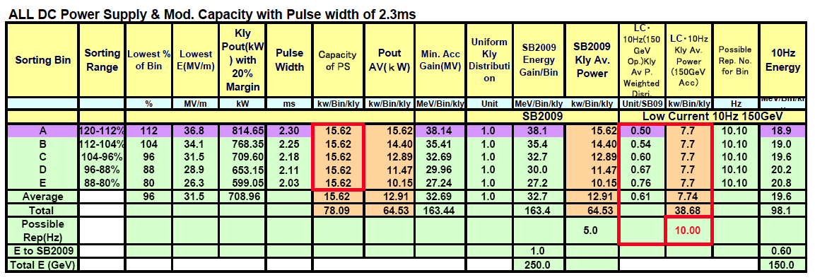
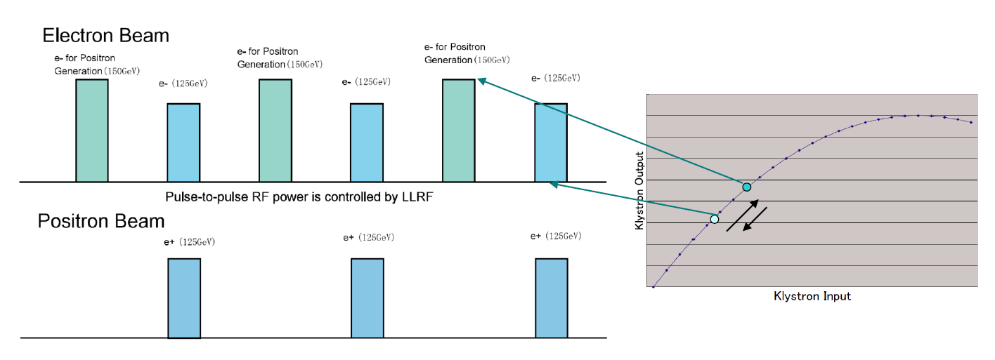
Low Energy 10 Hz Operation
Complicated operation is required. Active number of klystrons are different among the sorted group of cavity gradient. Acceleration of 150 GeV electron which produces positron and 125 GeV electron is different and pulse-to-pulse power handling is required. Another mode is possible and it is worth value to compare the passible shceme.

Slide 22
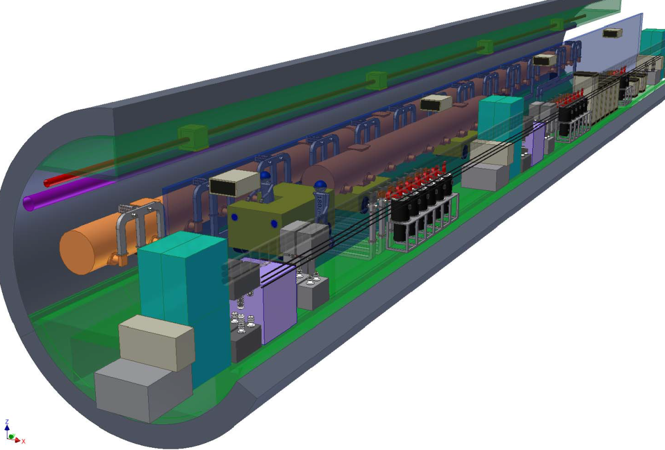
Layout of DRFS in 5.7m Single Tunnel
I believe Auto-cad data had already been sent by Miyahara before and basically almost same as before.
Today I just show you 2-D PDF data, because layout comprises of lots of drawings.
If you couldn’t read Auto-cad
drawing, we are ready to send
them again or 2-d DWG file.
Today I show yu 2-D PDF data
to explain you the DRFS.

Slide 23
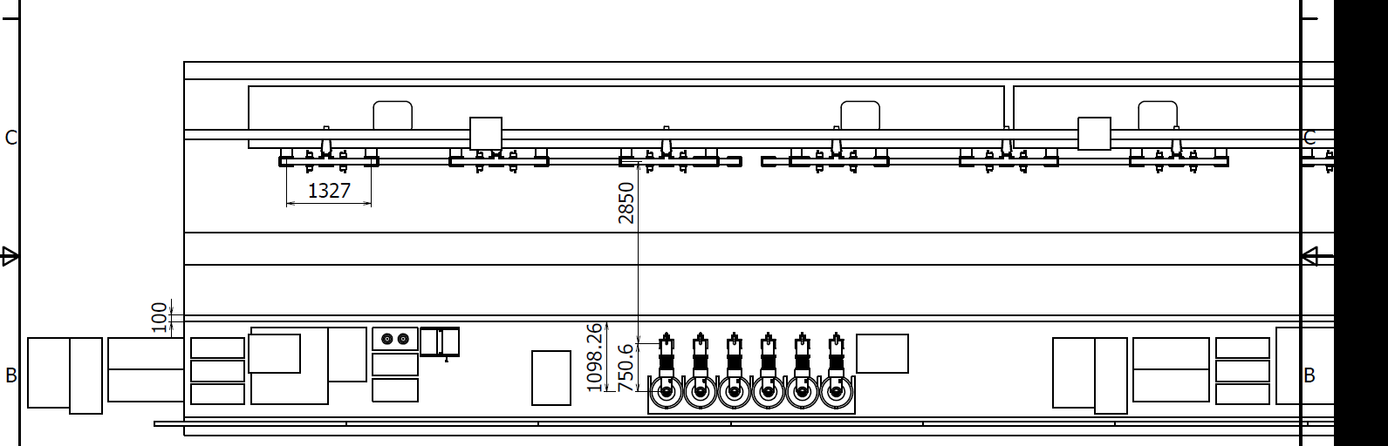
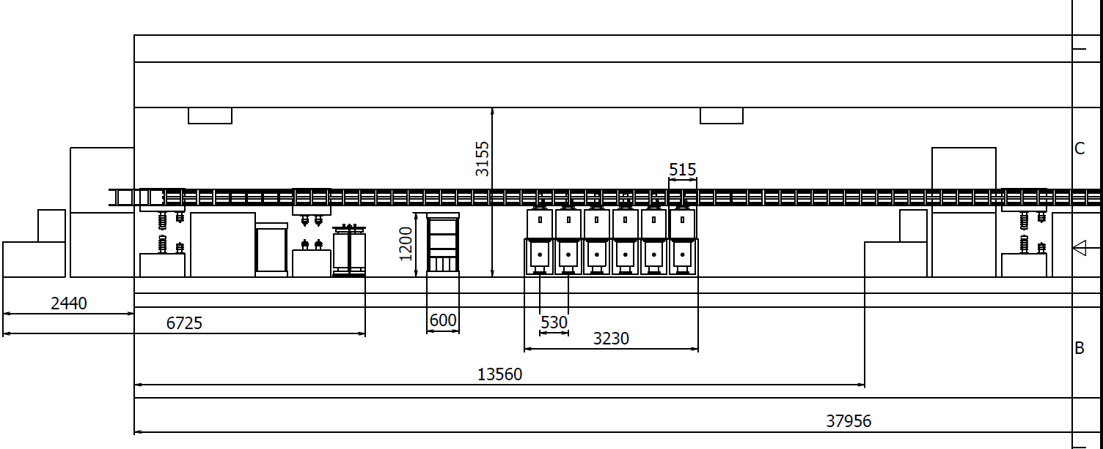
Layout 1/3

Slide 24
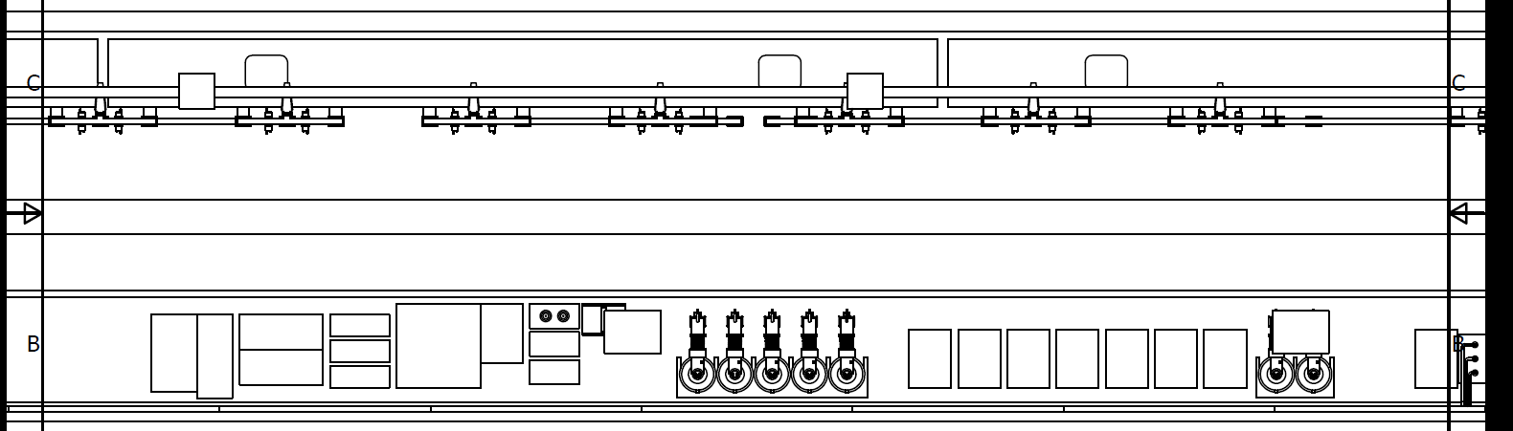
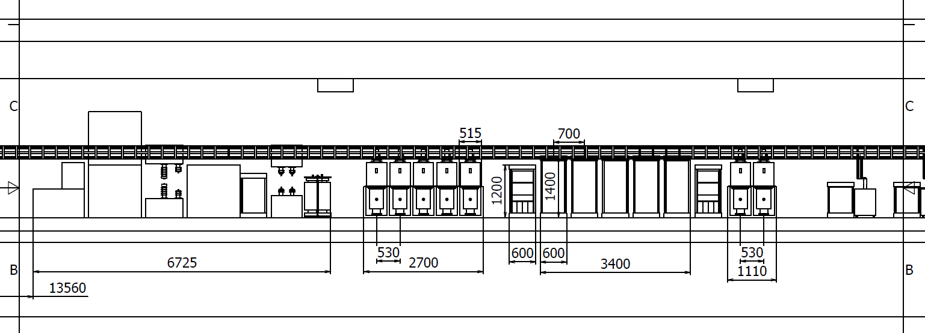
Layout 2/3

Slide 25
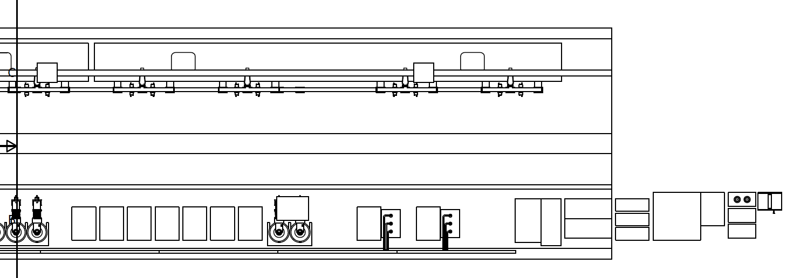
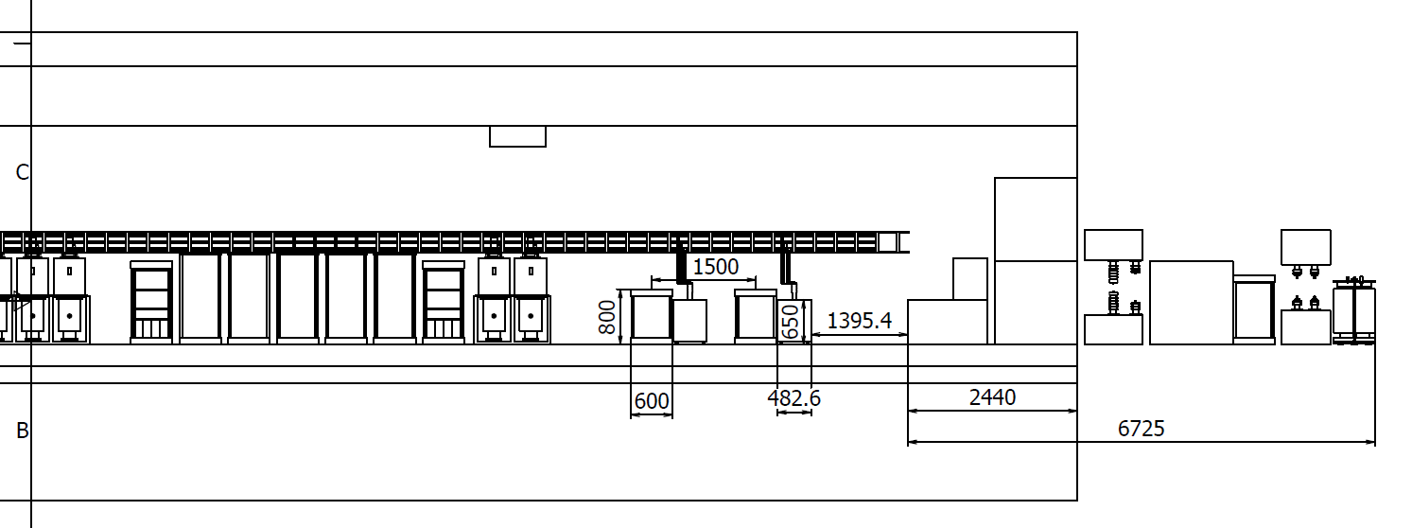
Layout 3/3

Slide 26
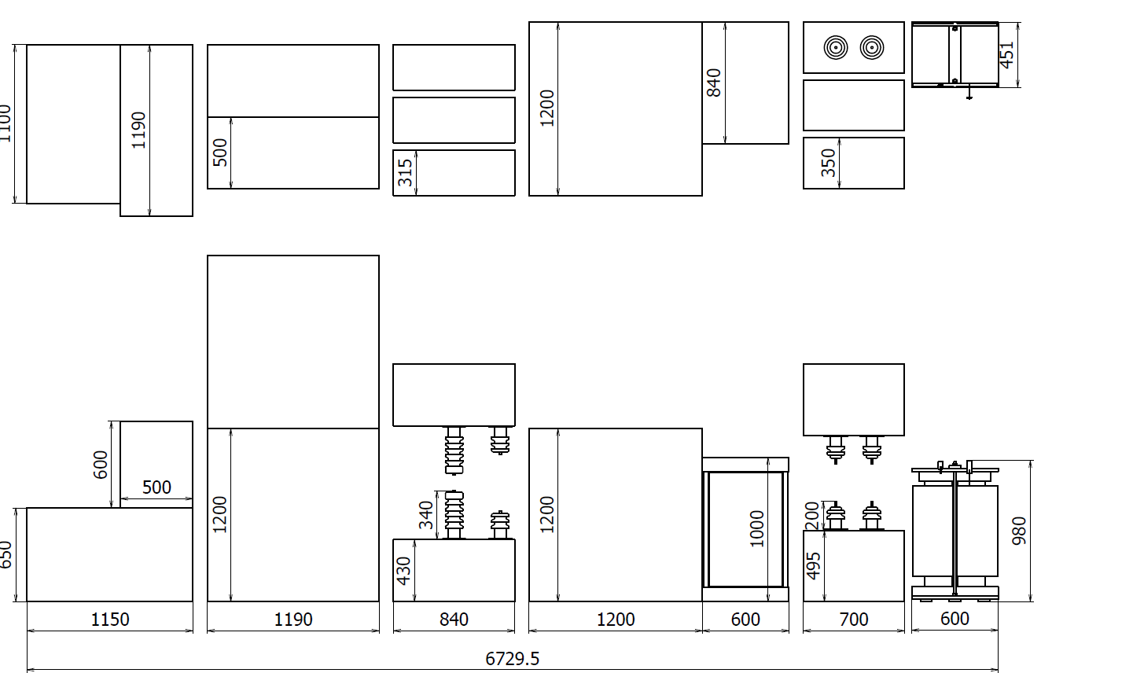
Layout of Power Supply

