Slide 1


FONT Meeting 29th June
Changes to the DAQ
Mikey Davis
29th July 2011
1/9

Slide 2
Experimental Lab Setup Before
Separate Test Setups
FONT4 Board
FONT5 Board
Lab PC
357 Clock
Trigger
Kentec
Lab Scope
“Collin’s Magic Box”
714 Clock
LO
Phaser
BPM
Mikey Davis
29th July 2011
2/9

Slide 3
Experimental Lab Setup Now
Same Test Setup
FONT4 Board
FONT5 Board
Lab PC
357 Clock
Digital Delay Generator
714 Clock
Kentec
BPM
“Collin’s Magic Box”
LO
Phaser (PC)
Mikey Davis
29th July 2011
3/9

Slide 4
Experimental Lab Setup
  Means you can test the setup as a whole
  This includes LO phasing scheme also controlled by PC
  Not good enough to do resolution tests (to much jitter)
Mikey Davis
29th July 2011
4/9

Slide 5
LO Phase Calibration
Mikey Davis
29th July 2011
5/9

Slide 6
Changes to the DAQ
  Gone through and tidied it up a bit in places
  Left the basic architecture the same
  Begun trying to automate some of the calibration methods
  Started with phasing the LO
  Automatically takes data files, then runs analysis script
  Controls LO Phase module from DAQ
Mikey Davis
29th July 2011
6/9

Slide 7
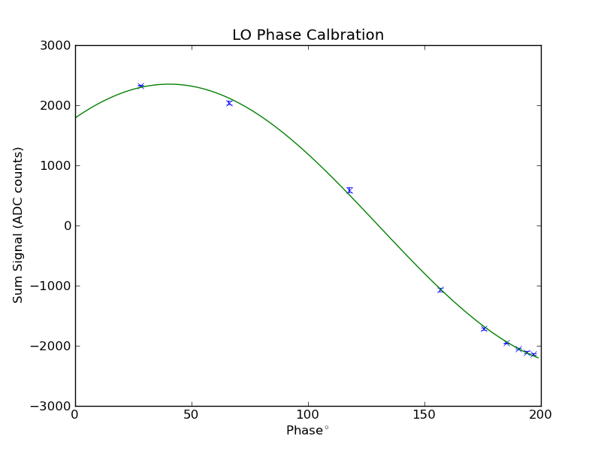
Changes to the DAQ
Mikey Davis
29th July 2011
7/9

Slide 8
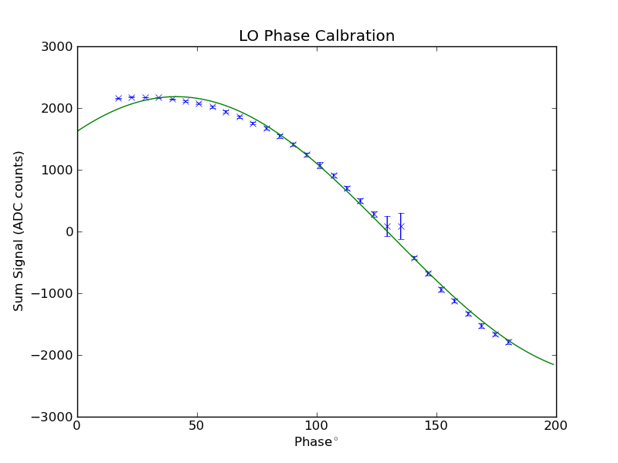
Changes to the DAQ
Mikey Davis
29th July 2011
8/9

Slide 9
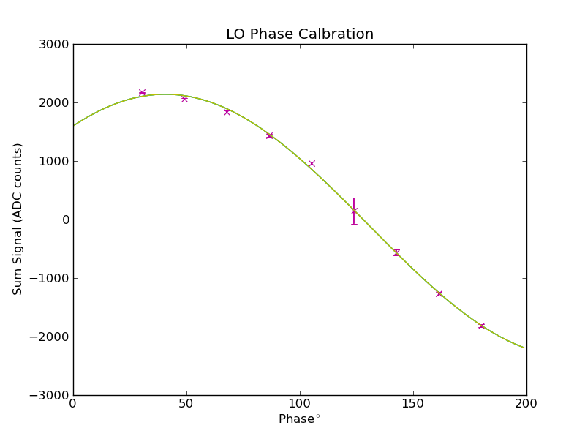
Changes to the DAQ
Mikey Davis
29th July 2011
9/9

