Slide 1
WW benchmark analysis: Progress report
Ron Cassell, Tim Barklow
8/4/11

Slide 2
Event Sample
Start with 10000 each w34974, w34975 (uddu events, alpha=0, 100% polarization)
End with 315 + 618 full energy WW and ZZ events.
933 evts reduced to 901 by reconstruction cuts.
Where do they go?

Slide 3
Event accounting
w34974 | Generated | Eevt>995. | cosΘmx<.97 | cosΘmx<.90
WW | 7808 | 1994 | 506 | 308
ZZ | 127 | 40 | 10 | 7
uDdU | 1968
γZ | 90
unknown | 7
w34975 | Generated | Eevt>995. | cosΘmx<.97 | cosΘmx<.90
WW | 1890 | 376 | 373 | 357
ZZ | 4628 | 1229 | 401 | 261
uDdU | 527
γZ | 2935
unknown | 20

Slide 4
“Perfect” reconstruction
Find pdg94 particles. If n != 2, fail.
Find parent quarks. If n != 2, only use quarks with 1 daughter. If n still != 2, fail.
Trace generator final state particles to pdg94.
Boost quarks and fs particles to pdg94 system, then attach fs particles to nearest q.
Jet 0 is max E jet in dijet with max cos(Θ), jet 1 partner, jet 2 maxE in other dijet, jet 3 partner
Should be no difference in jet 0,2 distributions or jet 1,3 distributions

Slide 5
Jet clustering from PFOs
Hemisphere cut: Use thrust axis, separate particles by dot product >< 0.
For each hemisphere: Boost to cm, find thrust axis, separate into hemisphere.
If # particles in any of the 4 jets < 2, fail.
Match to “perfect” with chisq.

Slide 6
Jet energy offsets and resolution

Slide 7
Procedure
Use the matched jets to find the errors in the 16 variables. (E,β,Θ,φ for each jet)
Not enough events for meaningful correlations in the covariance matrix, use diagonal for now.
Constrain ΣE = 1000, ΣPx = ΣPy = ΣPz = 0.
Motivation: Tim’s fast MC study of ZH at 350 GeV

Slide 8
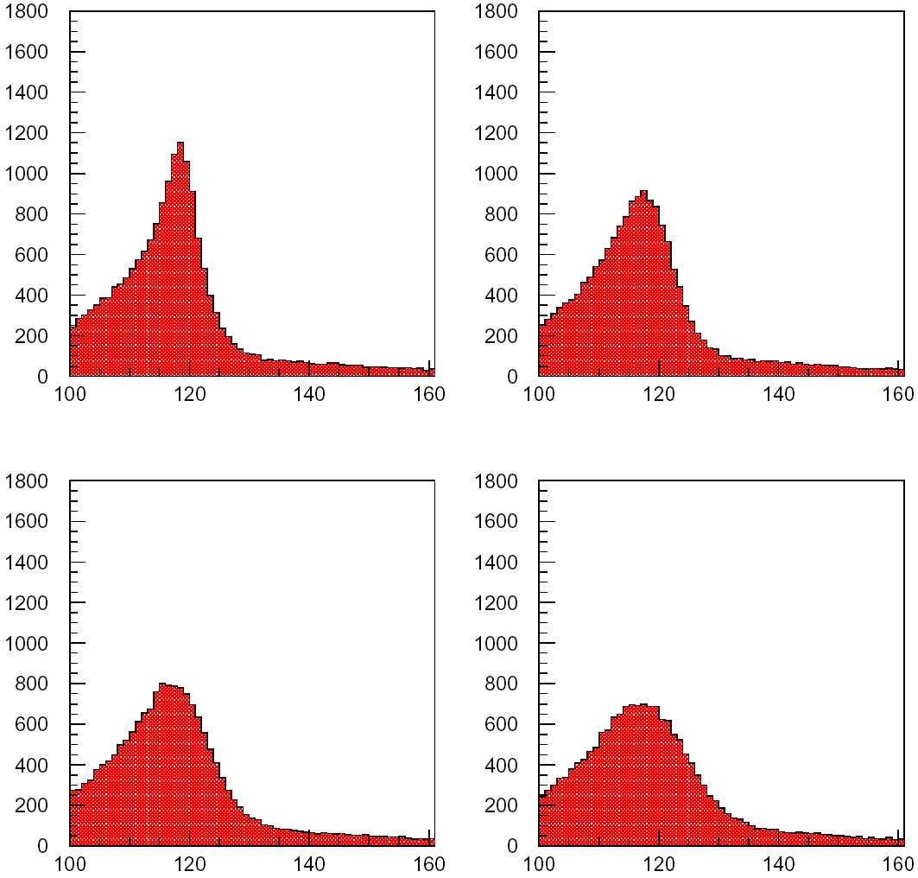
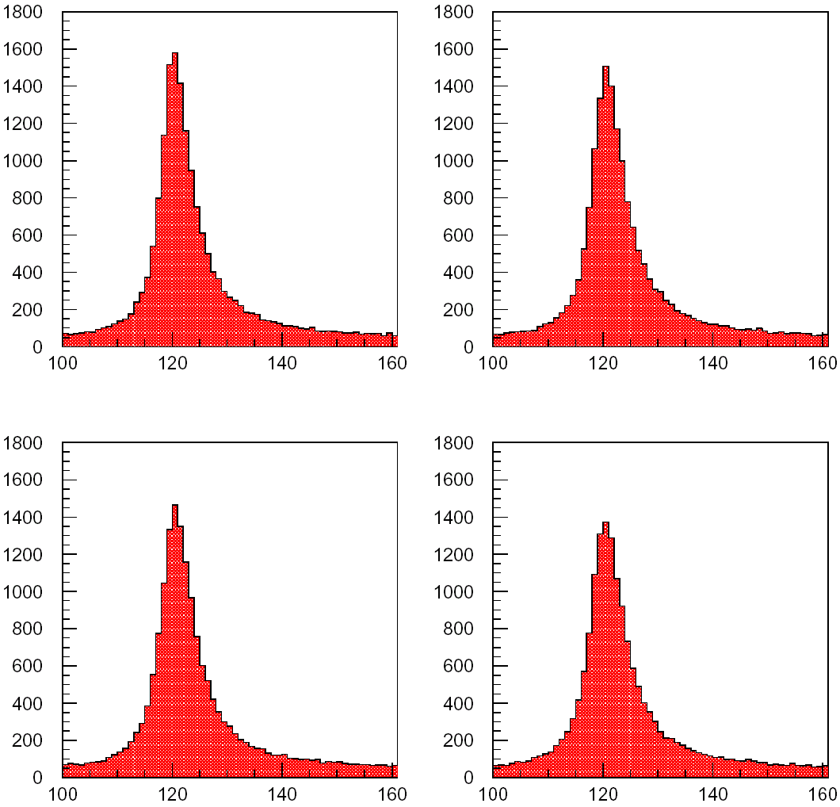
Reconstructed M_{bb}
4C Fitted M_{bb}
M_{bb} (GeV)
M_{bb} (GeV)
M_{bb} (GeV)
M_{bb} (GeV)

Slide 9
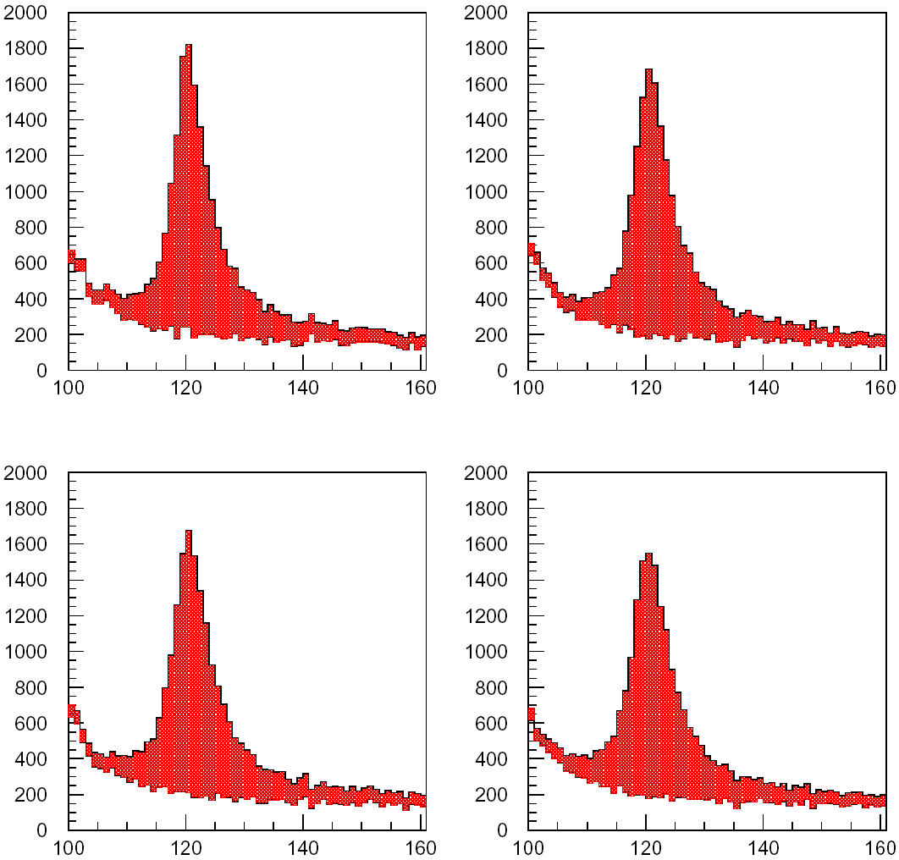
M_{bb} (GeV)
M_{bb} (GeV)
M_{bb} (GeV)
M_{bb} (GeV)

Slide 10
Prefit results: Energy

Slide 11
Prefit results: Beta

Slide 12
Prefit results: Theta

Slide 13
Prefit results: Phi

Slide 14
Prefit results: Mass

Slide 15
Observations
Offset in Energy expected.
Offset in Beta unexpected.
Offset in Mass opposite to what I expected.

Slide 16
4C fit results

Slide 17
4C fit results

Slide 18
Comments
Not the improvement we expected
Trying to understand:
Mass offset, beta offset.
If mass errors make sense.
To check fits, input correct beta values.

Slide 19
Fit check

Slide 20
Mass error checks
Can write out the full error propagation for dijet mass.
If we use mean values of the perfect distributions, and gaussian fits for the deltas, substituting these values gives ΔM/M = 7.4%. We measure 7.35%.
The breakdown: from ΔE: 5.4%, Δangles: 3.4%, Δβ: 3.7%
The constraints eliminate the ΔE error, but broaden slightly the other errors.
Should get to 5% after fit, but see 5.4%.

Slide 21
Next steps
100k of each polarization generated, need to process.
Should allow full covariance matrix calculation
Need to understand “low β” in reconstruction.

Slide 22
Backups

Slide 23
Jet Energy

Slide 24
Jet Beta

