Slide 1
ILC CFS AND GLOBAL
SYSTEMS MEETING
CONVENTIONAL FACILITIES
AND SITING GROUP
CFS Activities Update
V. Kuchler

Slide 2
Overview
  Central Region Integration Meeting
  ARUP Consulting Progress Review
  Asian Region CFS Group Update

Slide 3
Central Region Integration Meeting
  August 10 & 11 @ FNAL
  Attendees
    FNAL - M Ross, N Solyak, V Kuchler, T Lackowski, L Hammond, E Huedem
    Cornell – M Palmer
    ANL – Wei Gai
    SLAC – E Paterson, J Shepard (?), A Brachman(?), via Webex
    N/A – S Guiducci, T Peterson
  Area Systems Participating
    Damping Ring
    Ring to Main Linac (RTML)
    e+ Source
    e- Source (?)

Slide 4
Central Region Integration Meeting Schedule
  Wednesday, August 10
    Generally Technical Aspects of the Area Systems
    Equipment Layouts and Lattices
    Treaty Points Between Adjacent Area Systems
    CFS will Monitor Discussions
  Thursday, August 11
    CFS Focus
    ELTR & PLTR Layouts
    Heat and Electrical Loads
    Tunnel and Enclosure Criteria, Dimensions, etc.

Slide 5
ARUP Consulting Progress Review
  ARUP Currently has Two Tasks Under Contract
    Development of a Computer Model to Analyze Induced Stress from IR Construction
      CERN Geology Criteria will be Used in the Analysis
      CLIC IR Hall Configuration will be Used in the Analysis
      Additional Regional Geologies and IR Hall Configurations can be Analyzed Based on the Original Model
    Platform Design for Detector Movement to/from IP
      Based on ILD (15K T)
      Exploring Overall Platform Deflection & Floor Deflection Based on CERN Geology
      Reviewing Alternative Movement Strategies (ie Air Pads, Hillman Rollers)

Slide 6
ARUP Consulting Progress Review
  Attendance was Primarily CLIC Oriented
    CERN – J Osborne, M Gastal, A Herve, A Gaddi
    FNAL – V Kuchler
    SLAC – M Oriunno (SiD)
    DESY – K Sinram (ILD)
  ARUP is Just Starting the Work so Status is Preliminary
  M Oriunno Provided a Current Update of IR Hall Design
    Five ILC IR Options were Presented
    2 and 3 Shaft Options were Included
    Some Exiting Issues were not Included in the Shaft Analysis

Slide 7
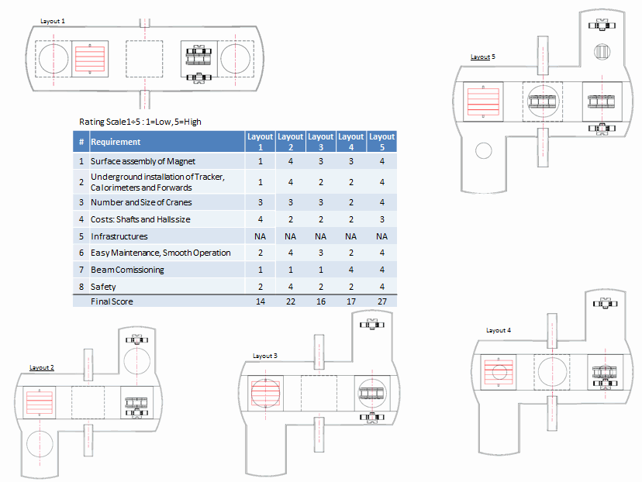

Slide 8
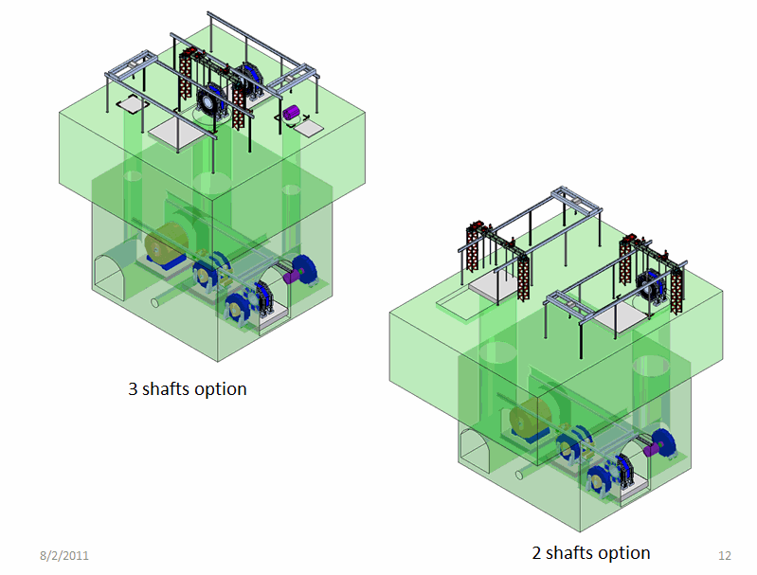

Slide 9
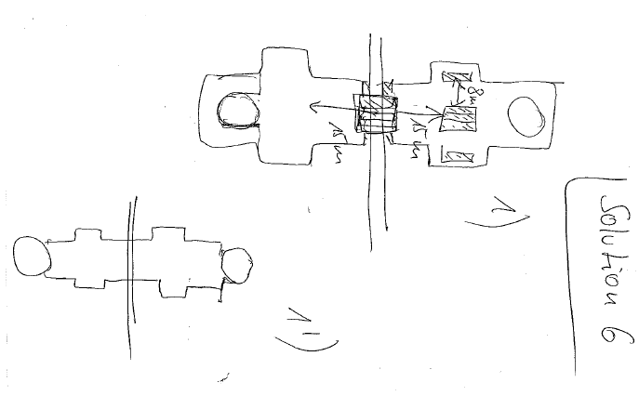

Slide 10
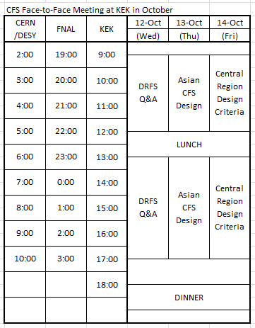
Asian Region CFS Group Update
  Scheduled for October 12-14 @ KEK
  Three Specific Topics will be Discussed
    DRFS Status
    Current Asian Design Status
    Central Region Design Criteria

Slide 11
Summary
  Workshops to Discuss and Finalize Central Region CFS Criteria Continue
  These Workshops will Provide CFS Area System Criteria and Should Prepare us for the BTR in at DESY in October
  ARUP Consulting will Provide Valuable Input to the IR Hall Design (and Bring the Detector Collaborations to Some Conclusions)
  With the Recent Extreme Difficulties in Japan, the October Review of the CFS Regional Effort will be Important to the Overall CFS TDR Effort

