Slide 1
357 MHz Sample Jitter
D. R. Bett

Slide 2
Sample input 357 MHz signal
Similar to previous tests, but use Long Train firmware (sample for ~10 µs)
Use Fourier analysis on collected data
Recall: two components
  Rapid 40 MHz oscillation
  Larger 500 kHz oscillation

Slide 3
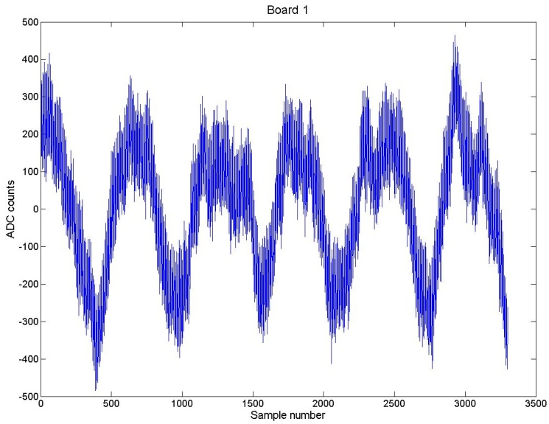
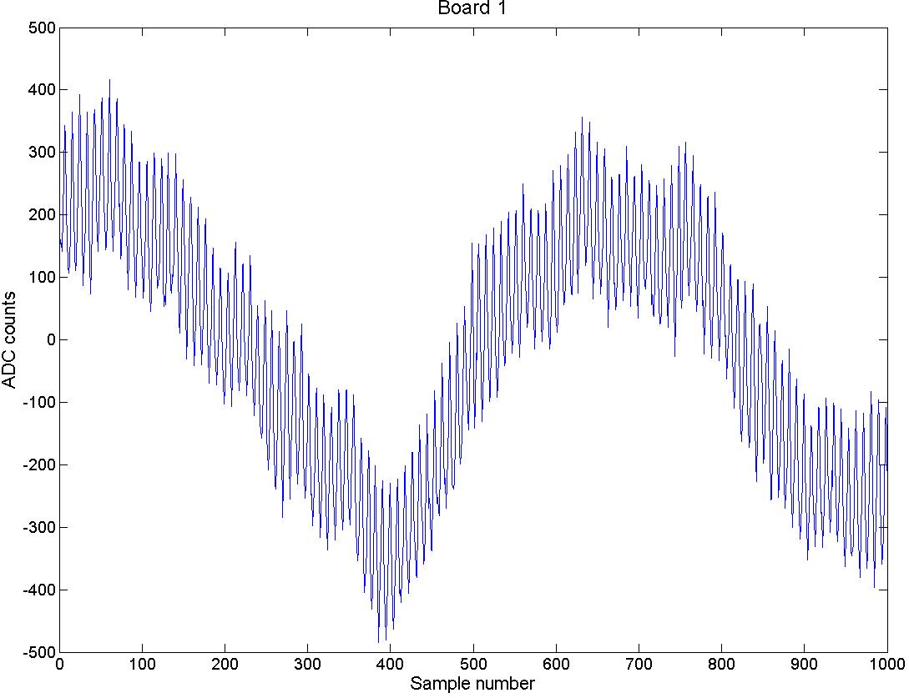
BOARD 1

Slide 4
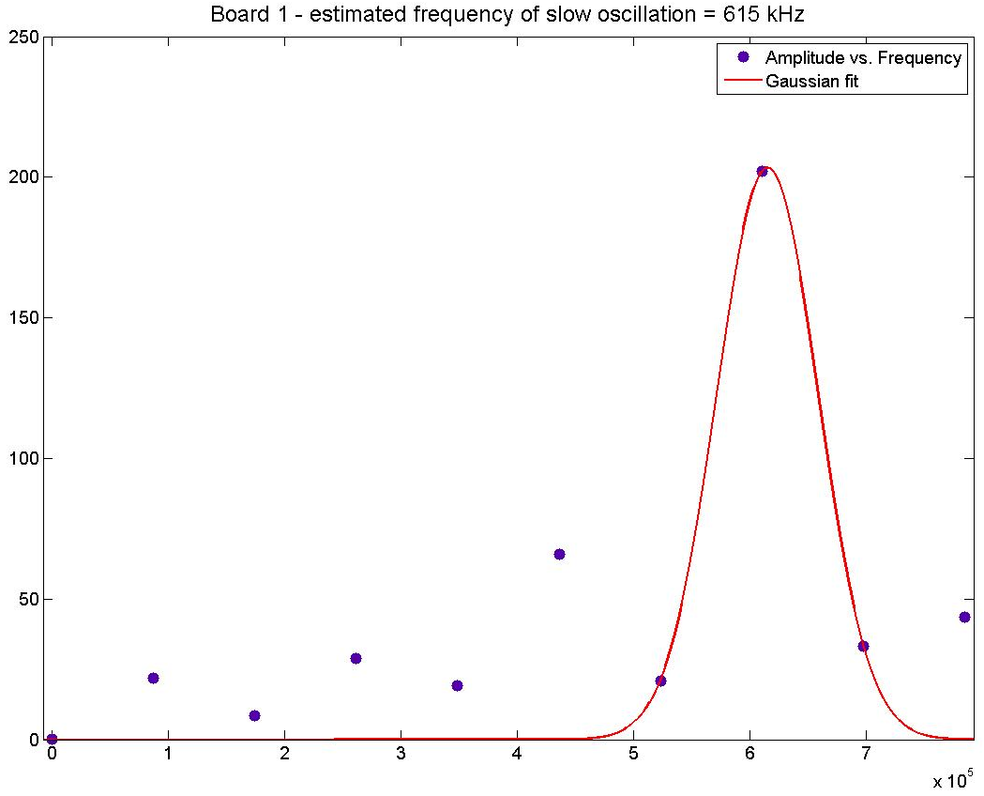
Amplitude of Fourier Transform
Frequency (Hz)

Slide 5
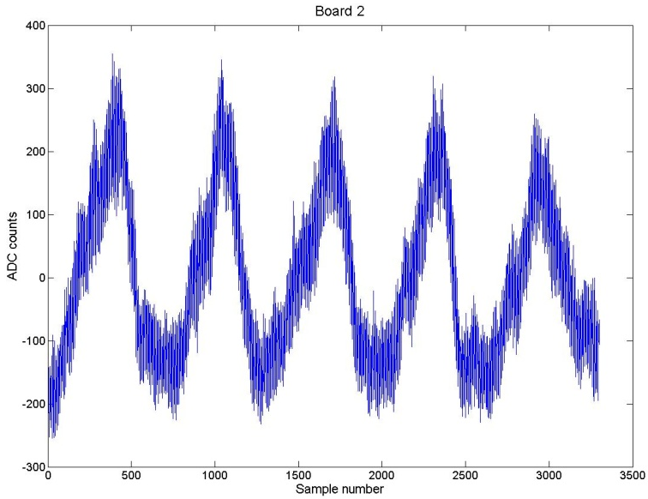
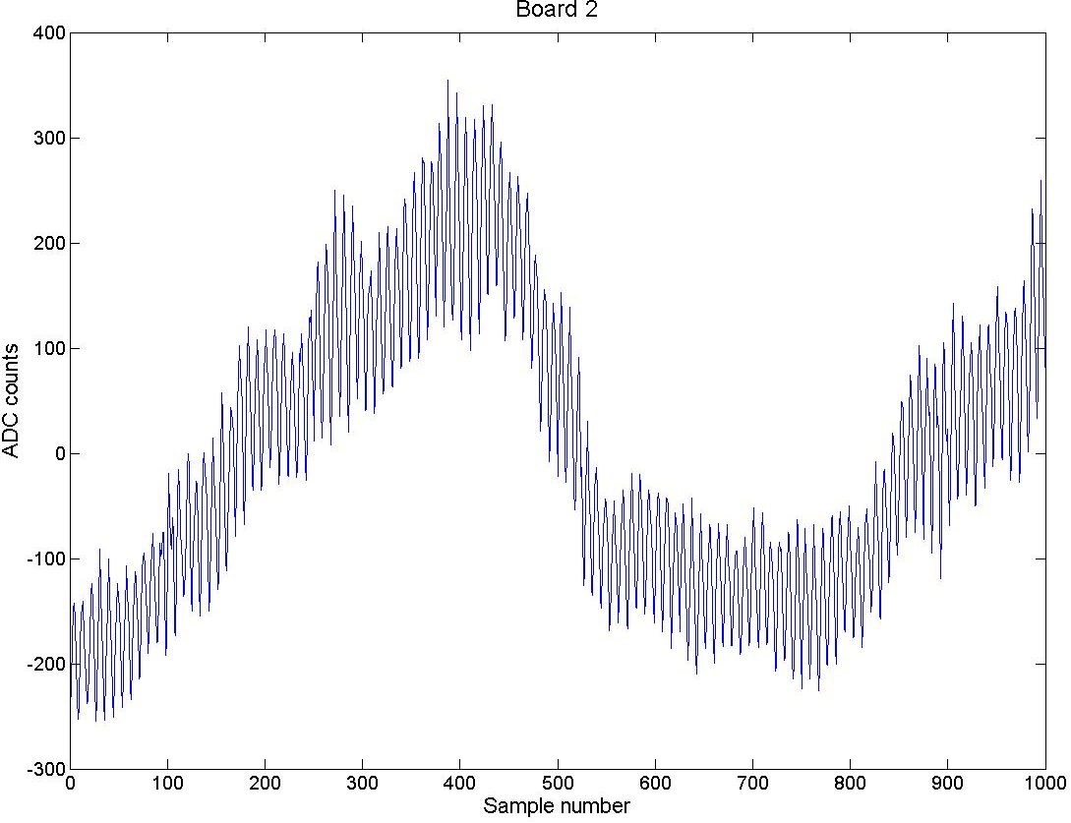
BOARD 2

Slide 6
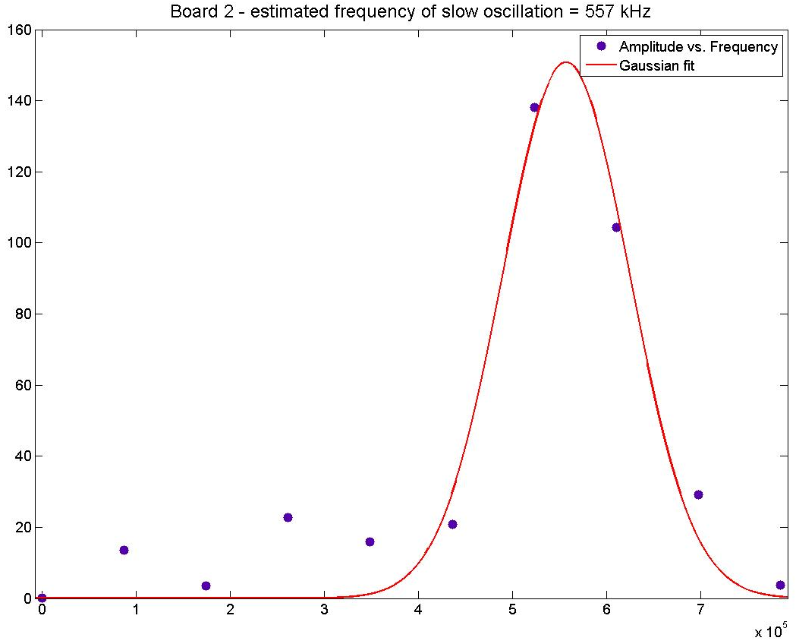

Slide 7
Conclusion
Cause of low freq. oscillations is ripple from 1V switching regulator (stated to switch at between 550 and 650kHz)
Colin may have hardware solution
What about high freq. component?

