Slide 1

Calorimetry for future Lepton Colliders
Edgar Nandayapa Supervisor: Hans Wenzel
August 9th , 2011

Slide 2




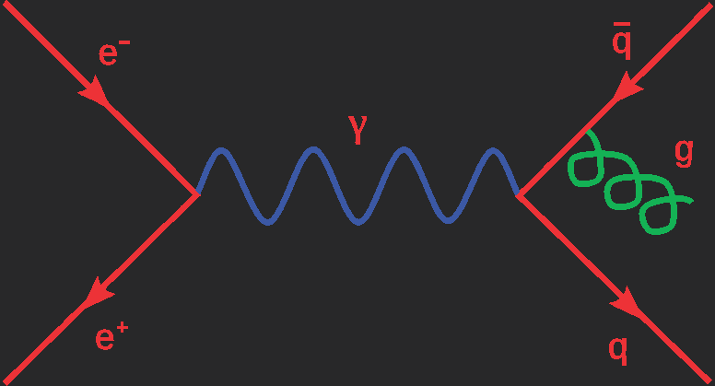
My Background

Slide 3
Motivations
The LHC promises to make some new exciting discoveries over the next few months/years
The nature of the collisions of the LHC limits detailed information from the particle shower
Linear colliders will follow up with any major discovery produced at the LHC
Linear colliders will have a very high precision
  Differentiate W and Z bosons decaying into hadronic jets

Slide 4
Outline
Terms and main processes
Simulation Details
Detector Construction
Dual readout correction
Resolution by integrating windows of time
Shower development by time

Slide 5
Terms
Electrons
  Elementary particle with a charge of -1
Pions
  Meson with zero spin and made of quarks up, down and antiup, antiquark
W and Z bosons
  Particles responsible for weak force interactions

Slide 6
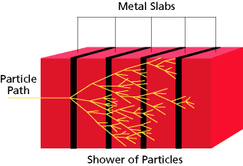
What is a calorimeter?
A calorimeter is a device that measures the amount of energy deposited in a certain material when a particle passes through it
Calorimeters used in this project measure scintillation and cerenkov photons
Calorimeter
Particle path
Shower of particles

Slide 7
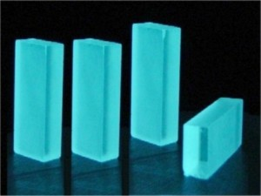
What is Scintillation?
  Flash of light proportional to the energy deposited on the crystal
  Measures the radiation length
  Used to measure the amount of electrons, positrons and photons produced
    Confined
    Almost perfect resolution

Slide 8
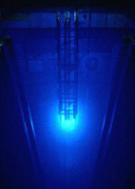
What are Cerenkov photons?
  Light created by the relativistic part of the shower
  Produced by Hadron showers
  Measures Interaction length
  Nuclear interaction length
    Long
    Poor resolution

Slide 9
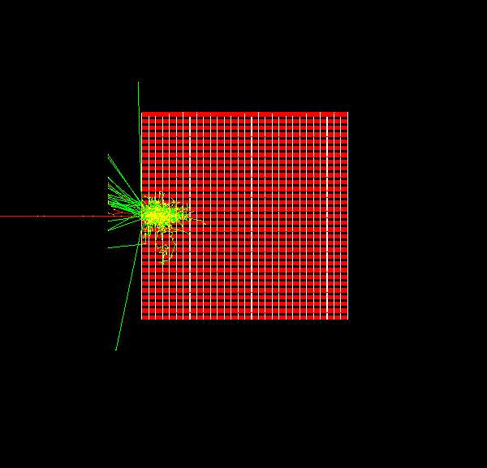
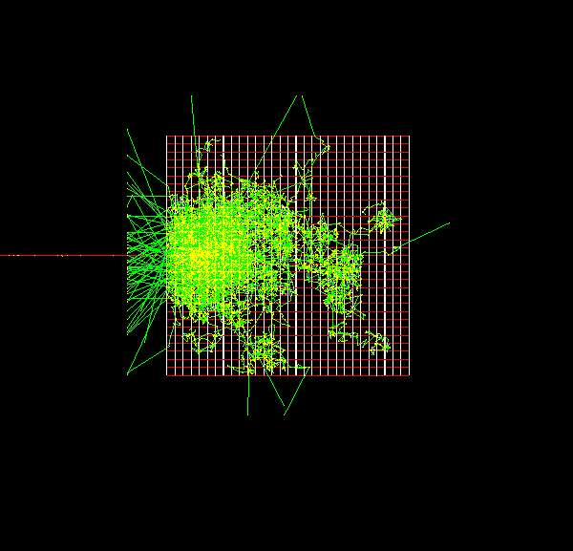
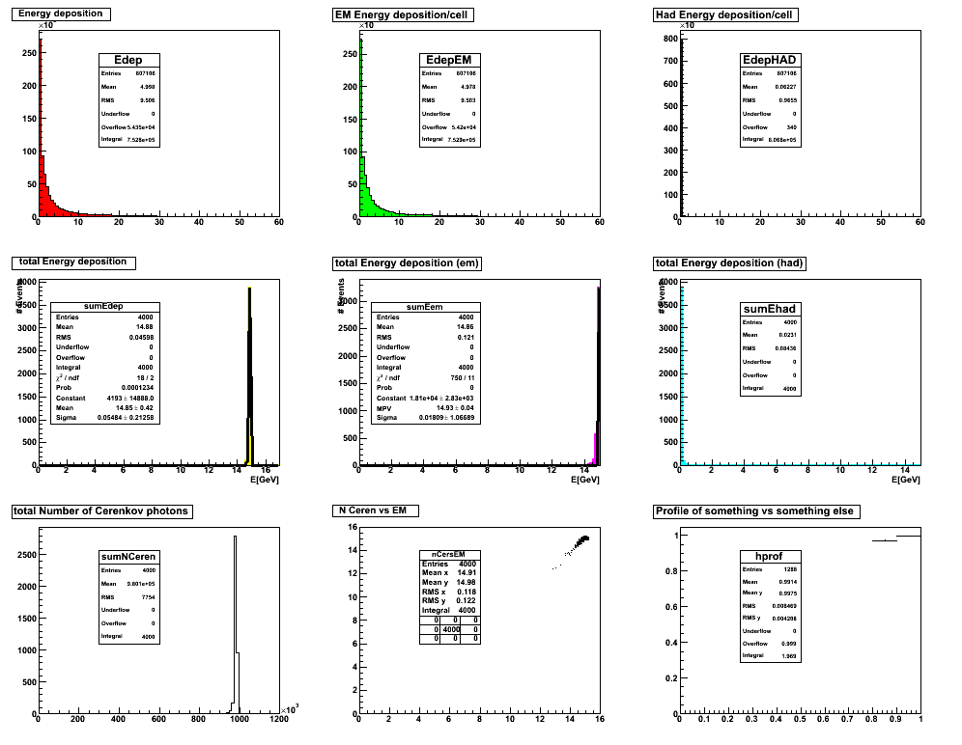
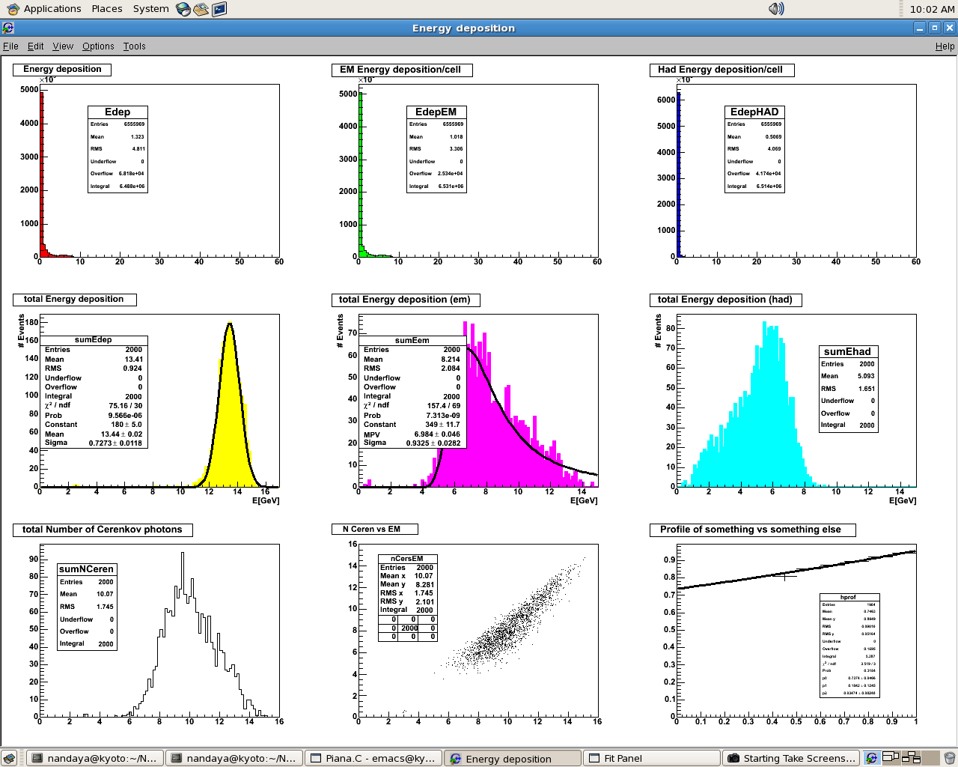
Shower Development
Electron at 15 GeV shower development PARAMETERS DESCRIBING SHOWER*
Pion at 15 GeV shower development

Slide 10
Simulation Software
Geant4
  Based on c++
  Simulation toolkit
    Geometry
    Physics processes
  Highly used in research
    High energy physics
    Medical research
    Space Science
    Technology development

Slide 11
Simulation Parameters
Dual Readout Calorimeter
  Detects Scintillation and Cerenkov photons
    Increase in precision
    Differentiation of W and Z bosons
  Materials
    BGO Crystal: Density 7.130 g/cm³, totally sampling
    Silicon: Density: 2.330 g/cm3
  Physics List QGSP_BERT

Slide 12
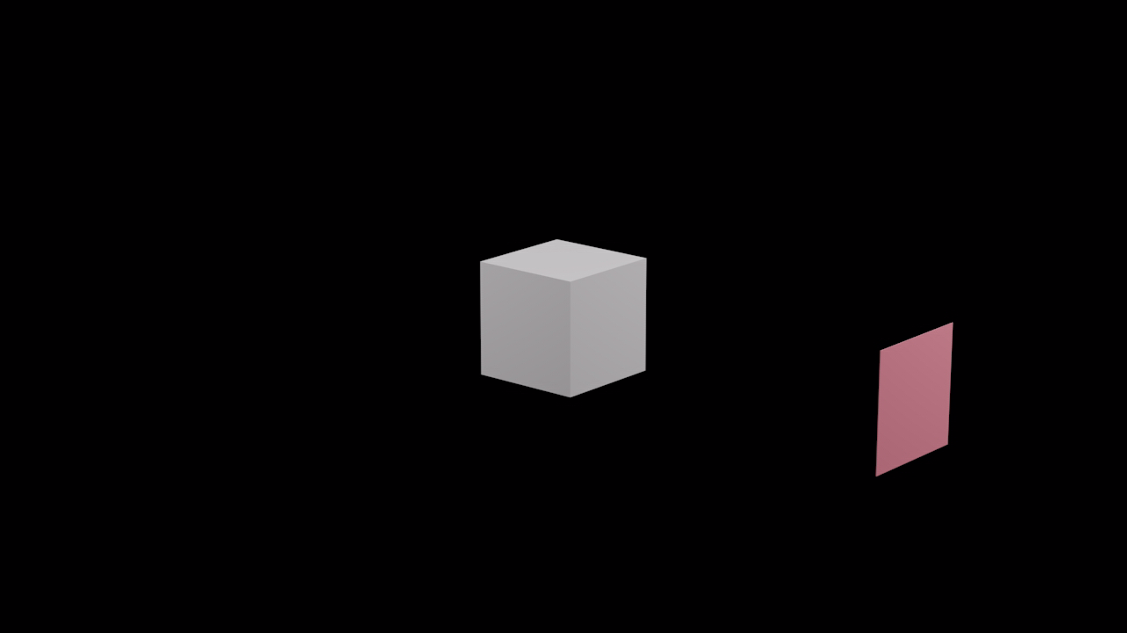
Detector Construction
Sillicon Sheet
BGO crystal
Sillicon

Slide 13
Dual Readout Correction
Purpose
  Combine information from the scintillation and Cerenkov processes to increase the energy resolution of pions
  Will be useful in the case of a Muon collider but requires fast timing as well

Slide 14
Dual Readout Correction (ctd)
Scintillation Information
Cerenkov Information
# Events
N Cerenkov
Obtained the Mean of the output energy deposited and the mean of the Cerenkov photons produced by electrons to make the calibration coefficients
4000 electrons
15 GeV

Slide 15
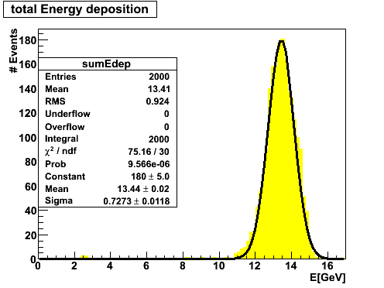
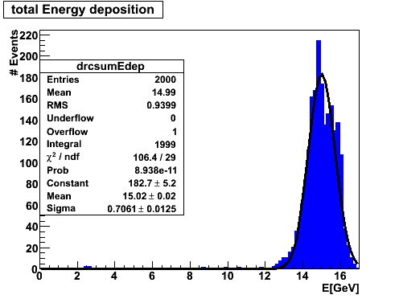


Dual Readout Correction (ctd)
$$\frac{N_{ceren}∙ C_{ceren}}{E_{out}∙ C_{Scint}}$$
$$\frac{E_{out}∙ C_{Scint}}{E_{in}}$$
This correction function is energy independent but we can
fit the data corrected for energy and cherenkov photons with a 2nd degree polynomial
Before Correction
After Correction
Improvement of 13.1% in resolution!
2000 Pions
15 GeV

Slide 16
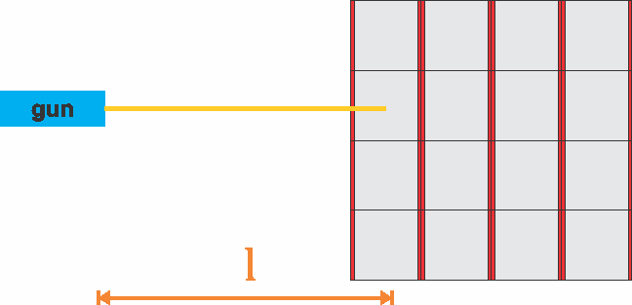


Time of Flight Correction
Corrects for the time the particle is moving through space
$$t^{′}= t_{g}−\frac{l}{c}$$
$t^{′}$ is the corrected time
$t_{g}$ is the global time (from tracking action)
L is the distance from the gun to the hit
c is speed of light

Slide 17
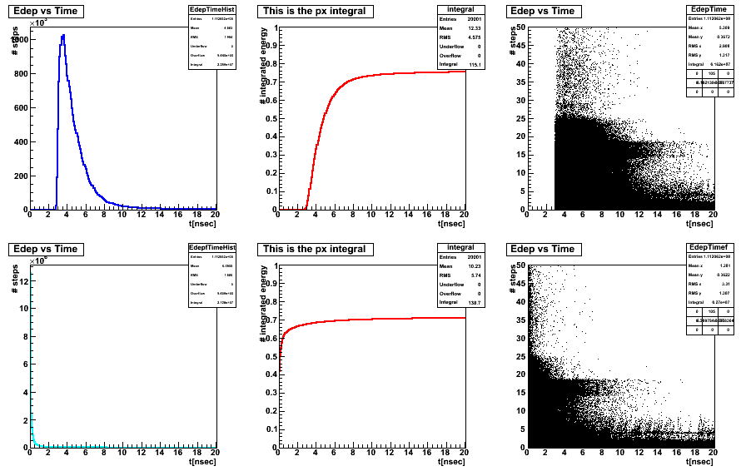
Time of Flight Correction (ctd)
Before Correction
After Correction

Slide 18
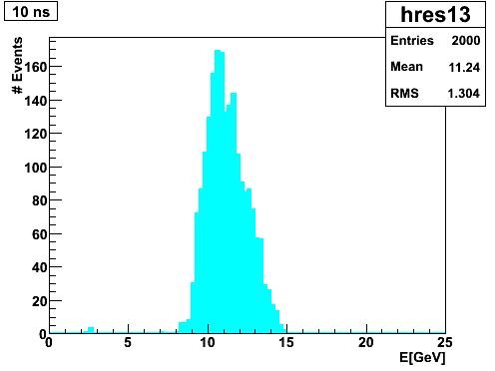
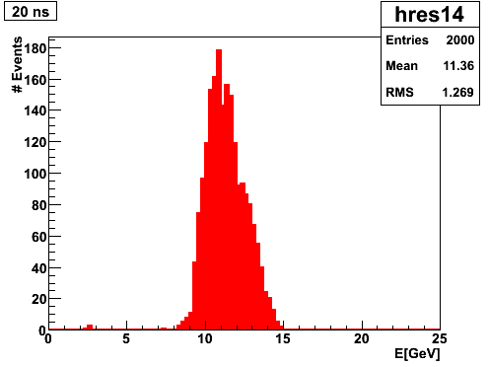
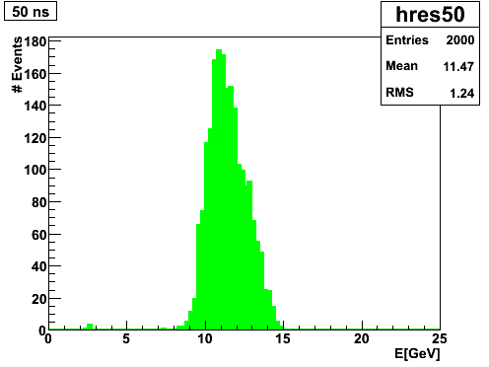
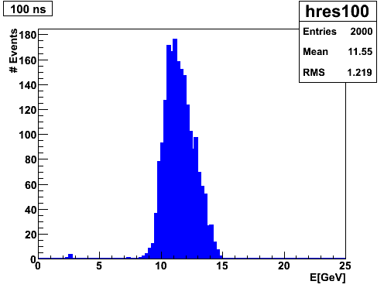
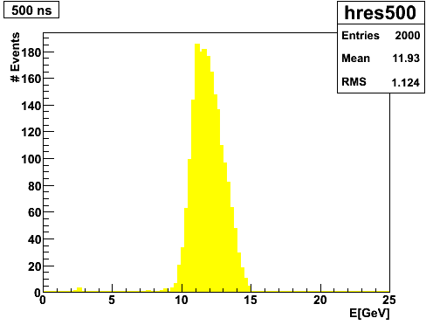
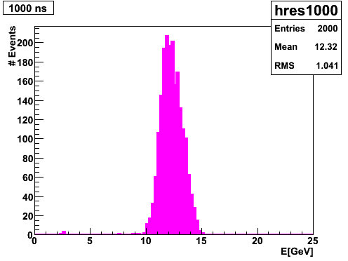
Resolution by time
<10 ns
<20 ns
<50 ns
<100 ns
<500 ns
<1000 ns
Diferent integrating windows of time were done. Gaussian-fit-sigma and the mean were used to compute the resolution.

Slide 19
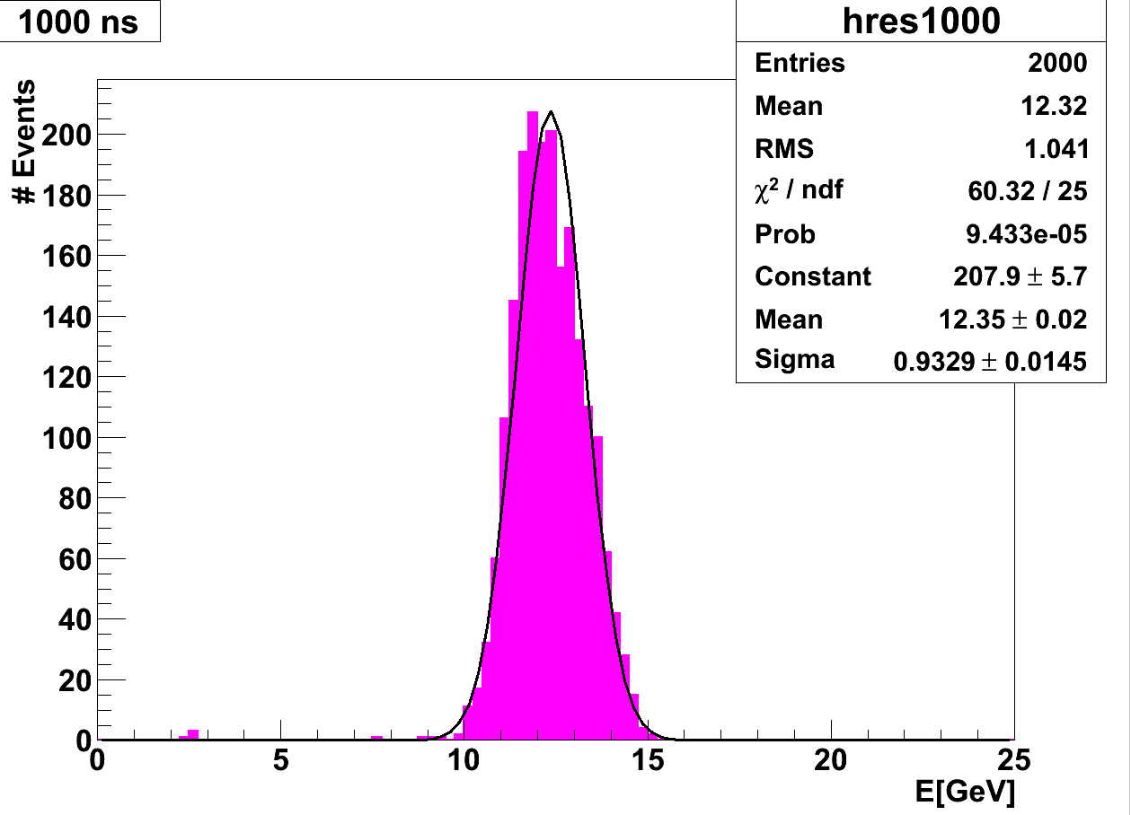
Sigma
Resolution =
Mean

Slide 20
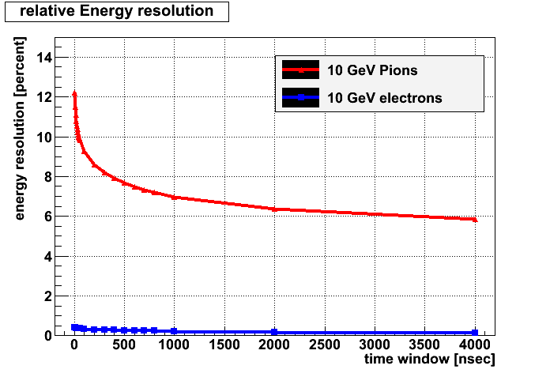
Resolution by time(ctd)
Resolution gets better as time passes

Slide 21
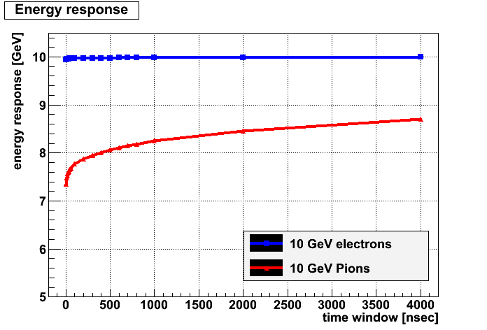
Shower development
Electron showers develop in the first few nanoseconds

Slide 22
Conclusions
Dual readout calorimeters do increase the resolution of the device and will be useful in a muon collider
They are also fast enough to make precise measurements of the showers
Electron showers develop faster than pion inside the calorimeter

Slide 23
Future Work
Use of different physics list (now using QGSP_BERT)
Use different materials (PbWO4, W, Iron, …)
Sample with active layer of plastic scintillator to see the effect of neutrons
Modify the Hit-class to include timing information

Slide 24

Questions

