Slide 1
Cooling and Heating Exercises
Adam Para, Fermilab
August 5, 2011

Slide 2
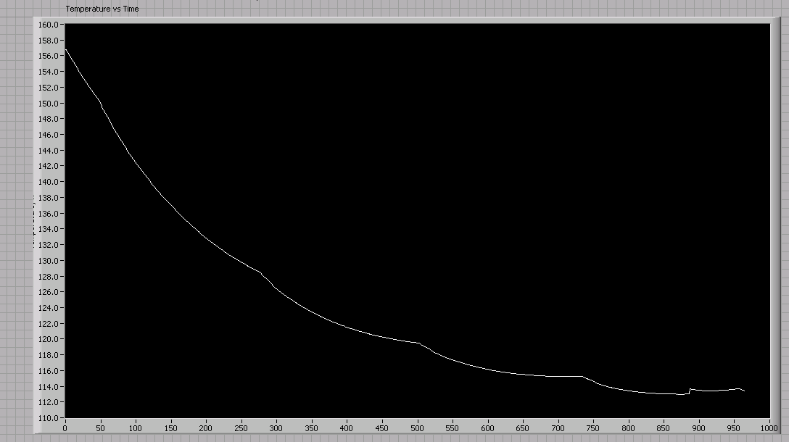
(Later stages of) Initial cooling:
Set point = 30K
Time axis in minutes
Refill
Set point = 113K

Slide 3
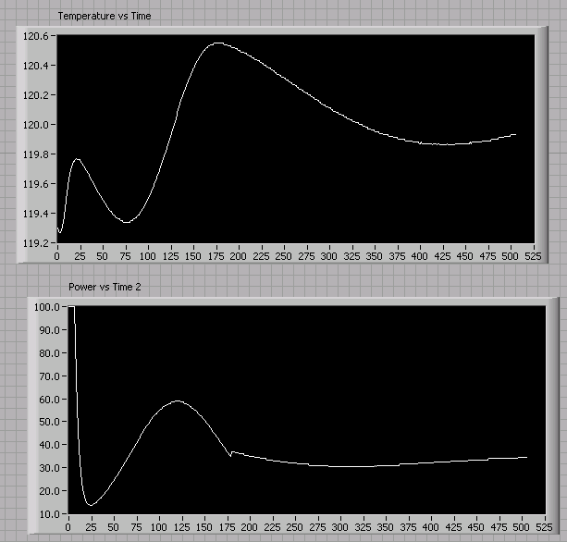
Initial temperature ~120K. Set point = 120 K,
turn on. Time axis in 0.1 minutes
Temperature
Power

Slide 4
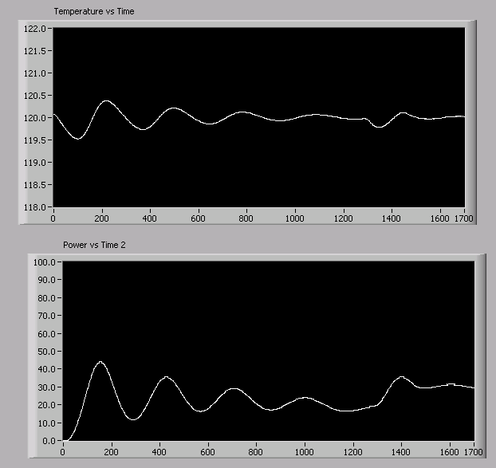
Initial temperature =120K. Set point = 120 K,
turn on. Time axis in 0.1 minutes
Refill
Temperature
Power

Slide 5
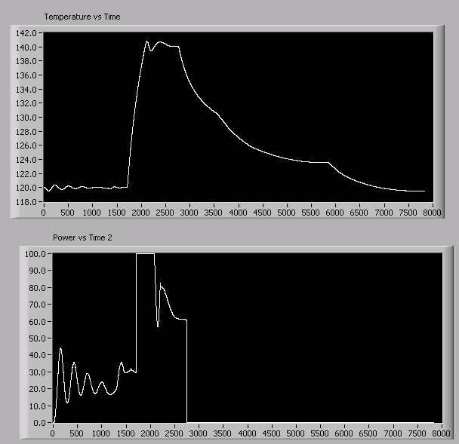
Change temperatures. Time axis in 0.1 minutes.
Set T=30K
Set T=140K
Temperature
Power

Slide 6
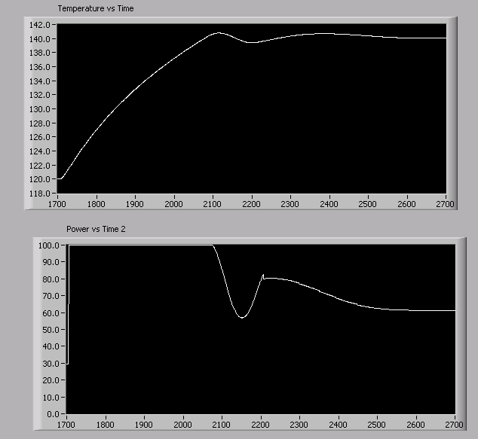
Change temperatures, by 20K. Time axis in 0.1 minutes
Temperature
Set T=140K
Power

Slide 7
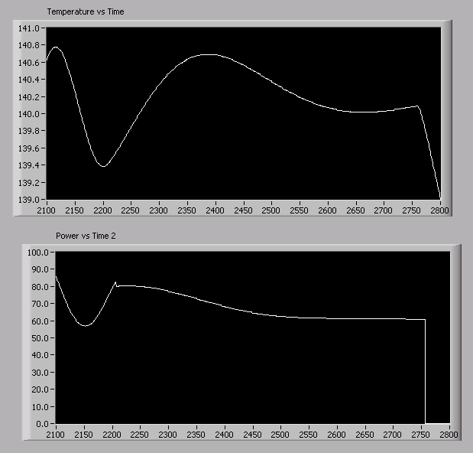
Change temperatures, by 20K, settling.
Time axis in 0.1 minutes
Set T=30K
Temperature
Power

Slide 8
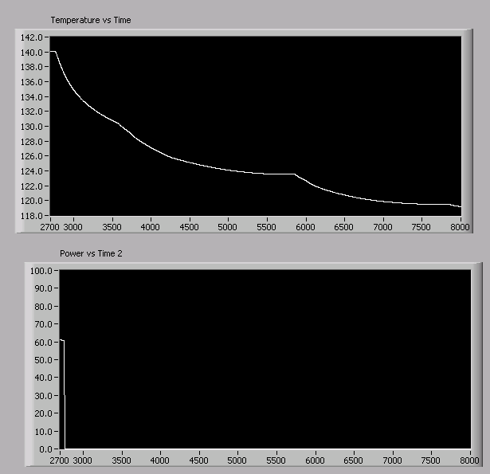
Cooling down from 140K.. Time axis in 0.1 min
Set T=30K
Refill
Temperature
Power

