Slide 1
ILC CFS / CLIC CES Studies for the Interaction Region :
Development with external design specialist, ARUP, of more in-depth civil engineering study of the IR
Task 1 : Design of the concrete Platform required for the push pull at ILC&CLIC
Task 2: Geology study of the rock mass surrounding the Experimental Area (CLIC)
Design Criteria described in “CERN ILC Design Basis Report Rev1 230611”
May 24 Kick off Meeting in Paris
July 25-26 Follow up meeting in London
Mid December Final meeting in London

Slide 2
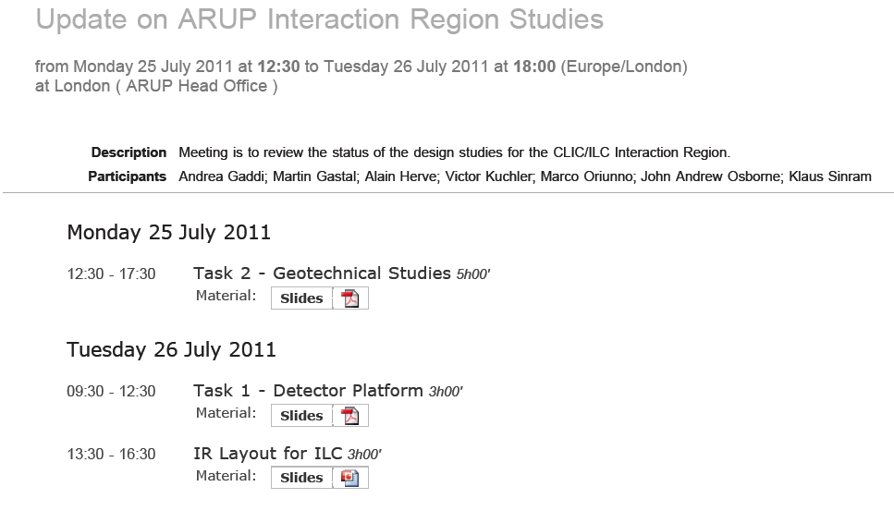

Slide 3
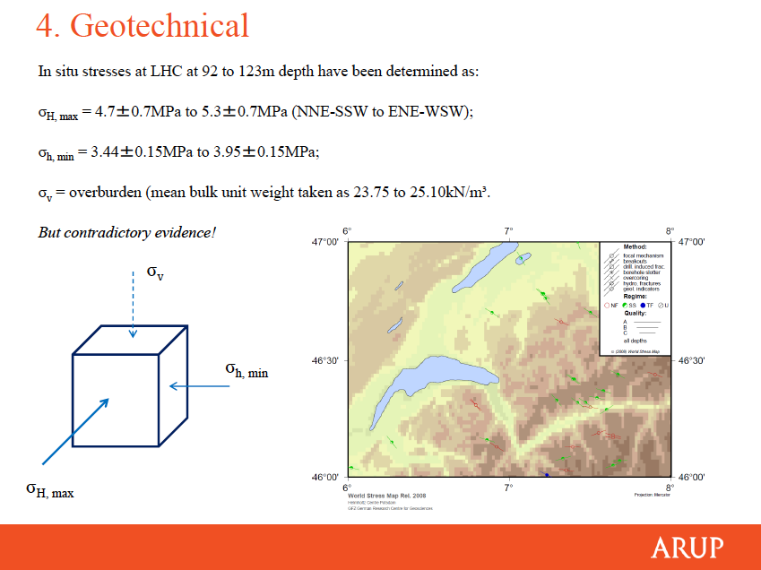
Task 2: Geology study of Experimental Area (CLIC)

Slide 4
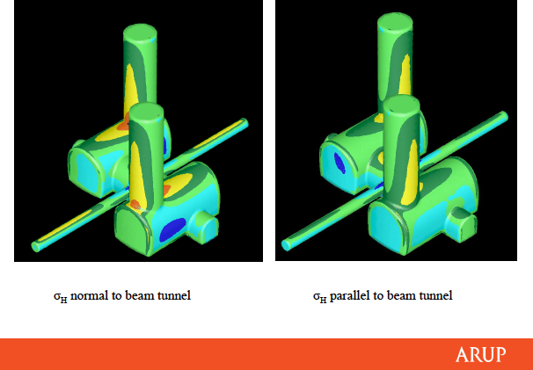
Task 2: Geology study of Experimental Area (CLIC)

Slide 5
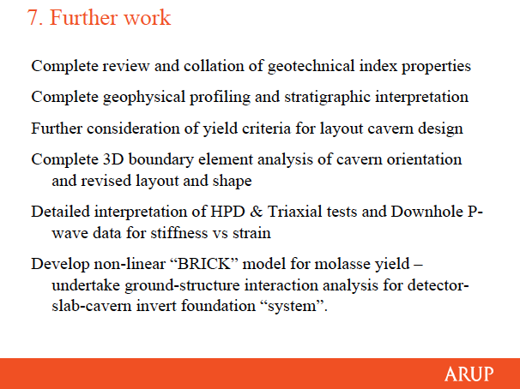
Task 2: Geology study of Experimental Area (CLIC)

Slide 6
Task 1: Platform Design
Preliminary FEA on a simplified model, no iron rebars – full concrete
Updates on the expected configurations of the detectors on the platform (Closed-Open)
Discussion on the static and dynamic requirements with floor deformations
Max def. will be ± 1 mm ”on beam”, ± 3 mm ”off beam”
First mode ~18 Hz, which is OK with req’s
Concrete damping ratio ~2%, Total damping depending on supports
Preliminary design of motion system with Rollers or Air Pads
Touch base with Hilman for medium size rollers
Integrated system Gripper jacks+Airpads from APS A.G.
Task 1+Task2 = Common agreement that the design of the cavern floor, Invert, is key : How much does the floor sink under 17 ktons ? Hysteresis effect of push-pull ? How the platform should accommodate all above ?

Slide 7
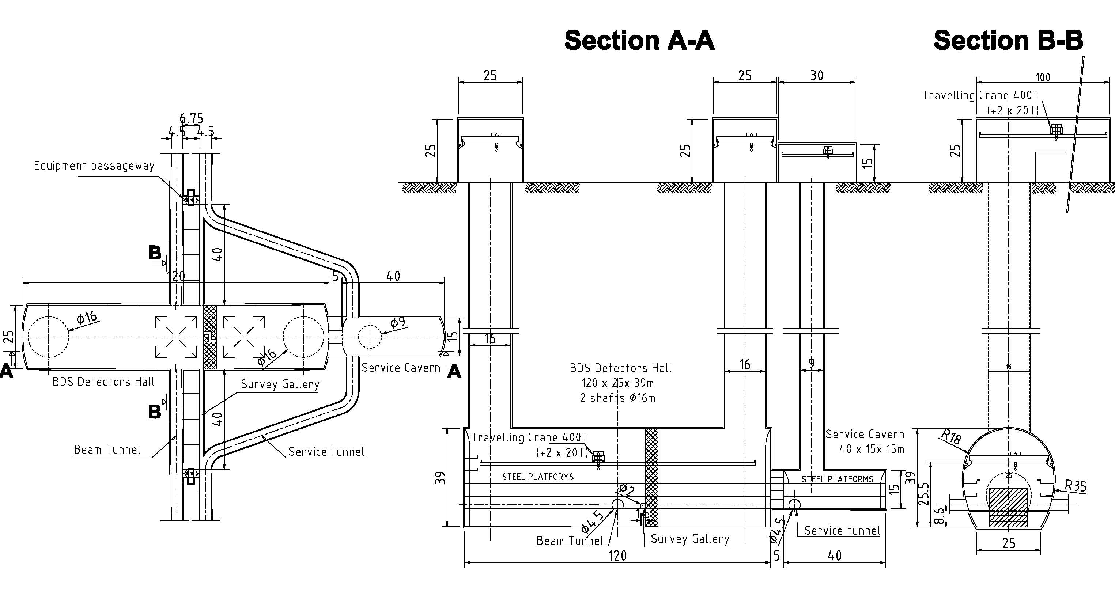
Internal meeting on July 26 afternoon:
IR Layout for ILC
Machine TDR and Detector DBDs expected end 2012
RDR Baseline declared obsolete
Need to work on a new, possibly optimized IR layout
Capitalize on Eng. Resources recently made available by ILC USA (SLAC & BNL)

Slide 8
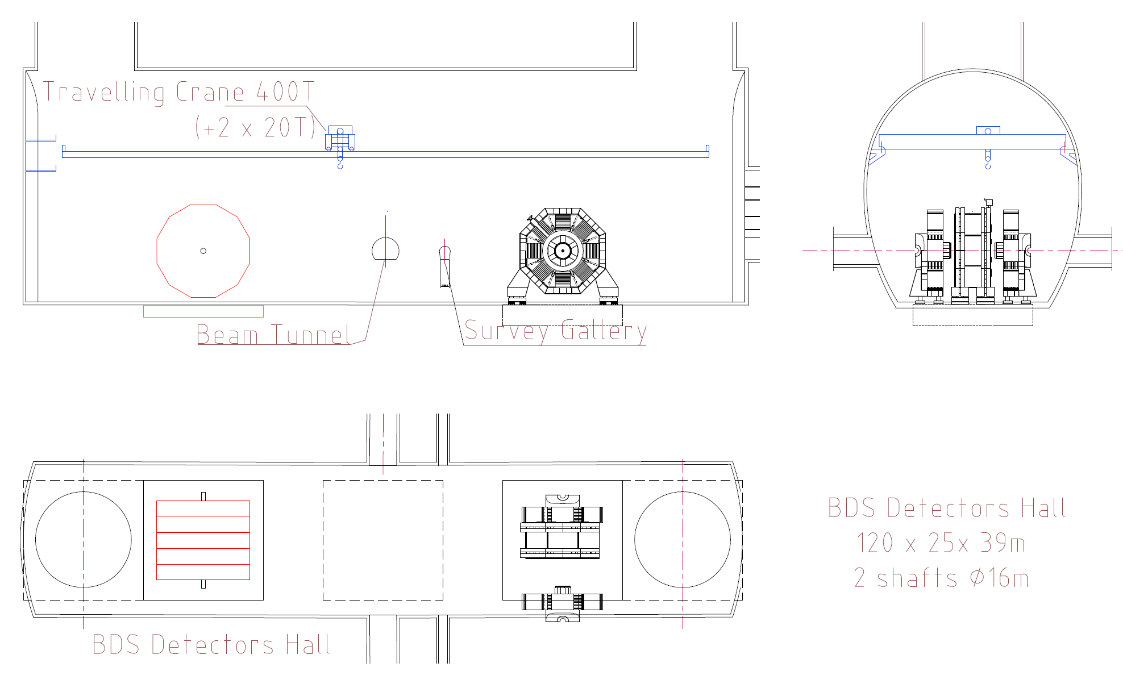
ILC RDR Layout vs. detectors
?
Layout 1
?

Slide 9
IR Layout : Minimal set of Requirements
(……by a Detector Point of View…...)
Surface assembly: Magnet
Underground installation: Tracker, Calorimeters and Forwards
Cranes: Number and Size
Costs: Shafts and Halls size
Infrastructures
Easy Maintenance, Smooth Operations
Safety
Possible Layouts
Civil Engineering
Specifications

Slide 10
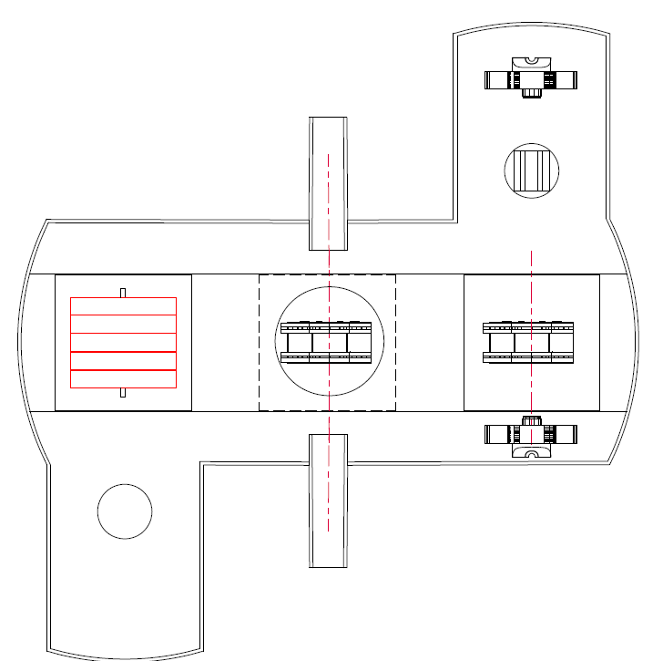
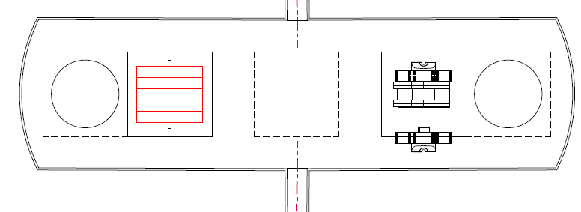
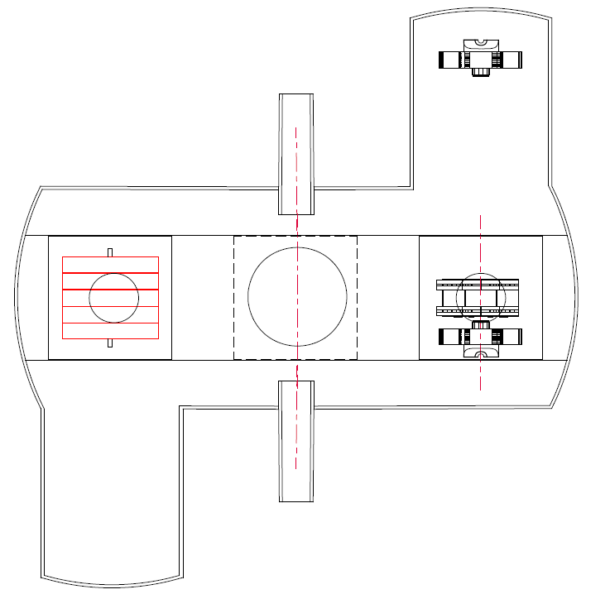
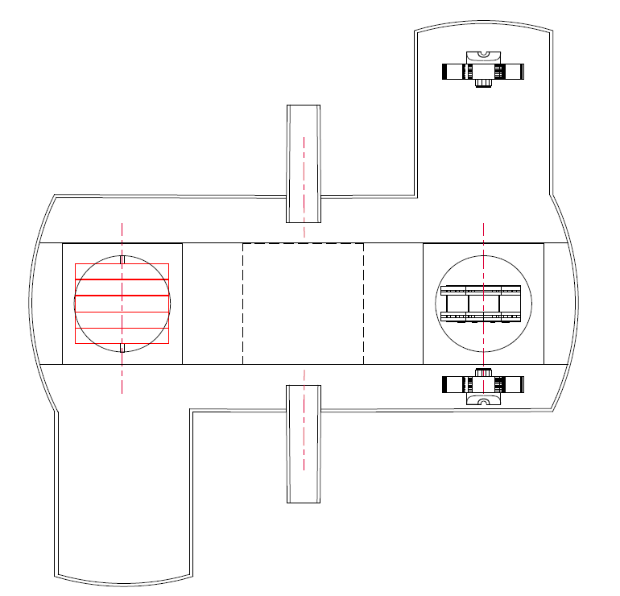
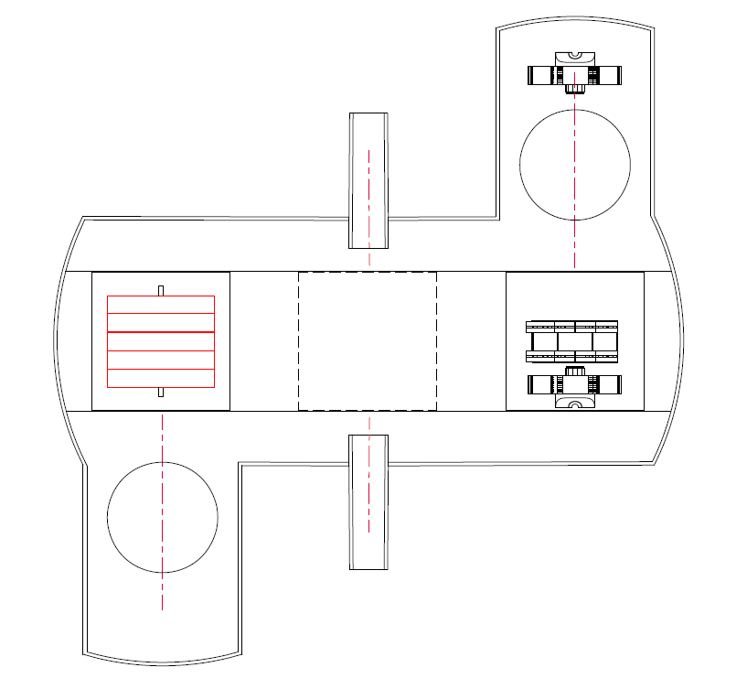
Layout 1
Layout 5
Rating Scale 1÷5 : 1=Low, 5=High
# | Requirement | Layout 1 | Layout 2 | Layout 3 | Layout 4 | Layout 5
1 | Surface assembly of Magnet | 1 | 4 | 3 | 3 | 4
2 | Underground installation of Tracker, Calorimeters and Forwards | 1 | 4 | 2 | 2 | 4
3 | Number and Size of Cranes | 3 | 3 | 3 | 2 | 4
4 | Costs: Shafts and Halls size | 4 | 2 | 2 | 2 | 3
5 | Infrastructures | NA | NA | NA | NA | NA
6 | Easy Maintenance, Smooth Operation | 2 | 4 | 3 | 2 | 4
7 | Beam Comissioning | 1 | 1 | 1 | 4 | 4
8 | Safety | 2 | 4 | 2 | 2 | 4
 | Final Score | 14 | 22 | 16 | 17 | 27
Layout 4
Layout 3
Layout 2

Slide 11
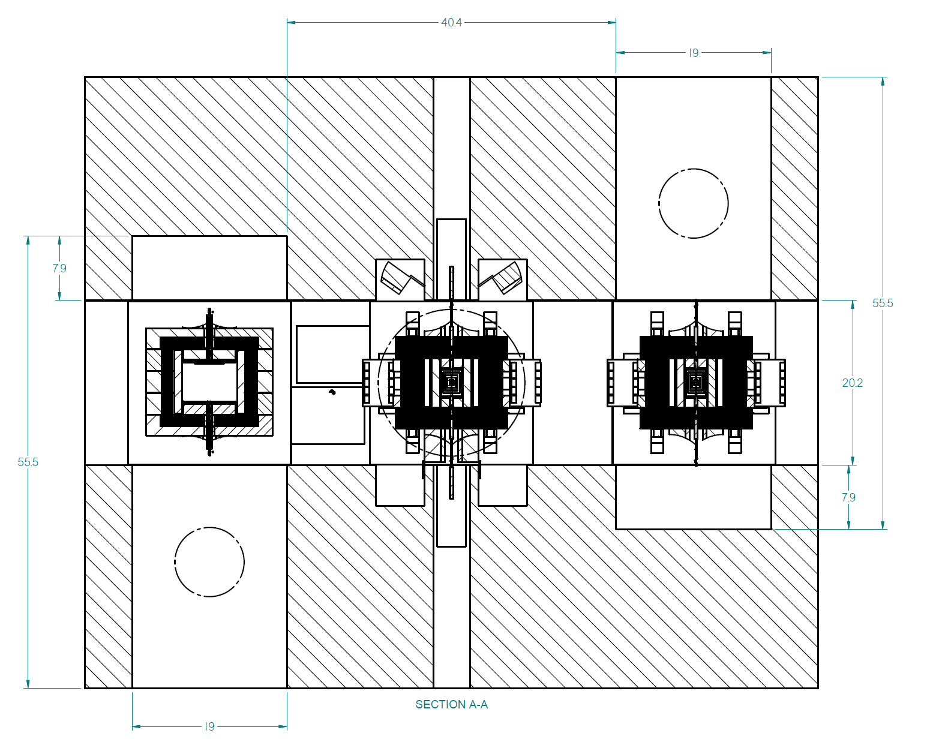
Ø18 m
Ø8.5 m
90 m

Slide 12
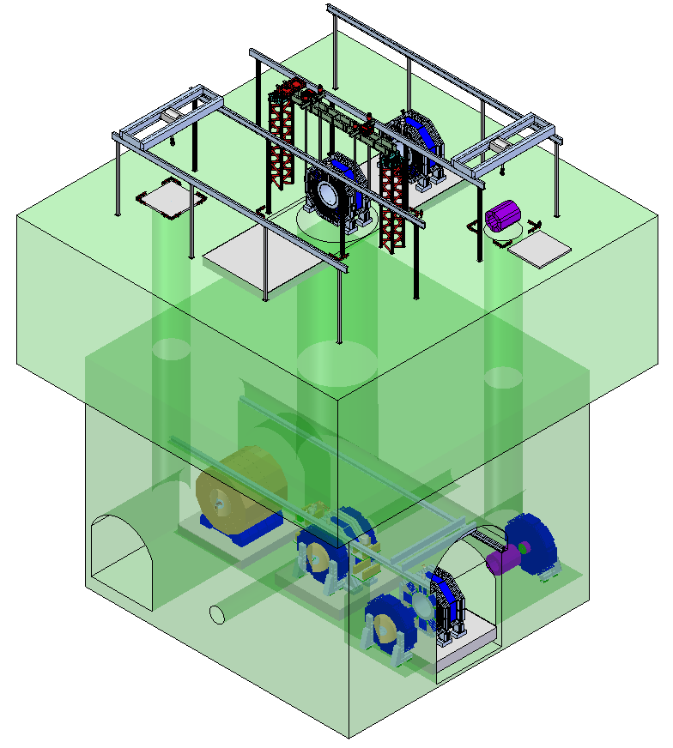
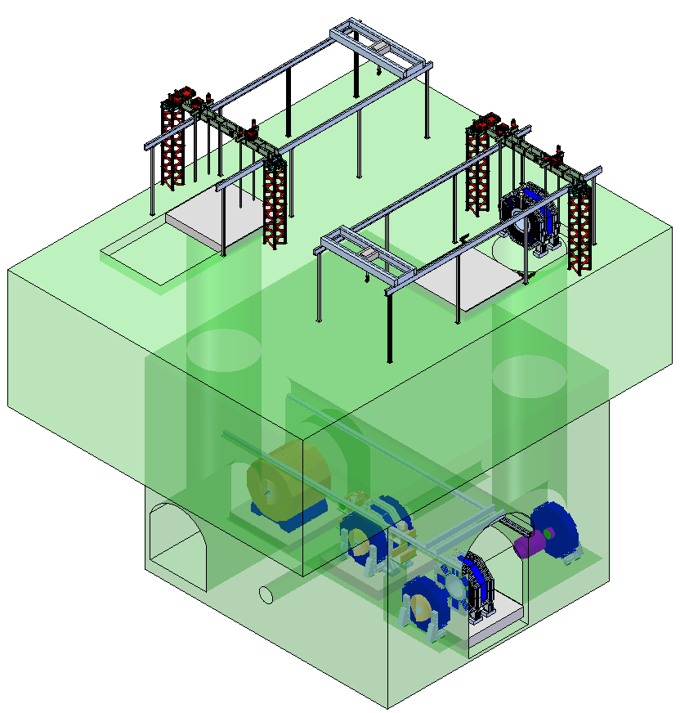
3 shafts option
2 shafts option

Slide 13
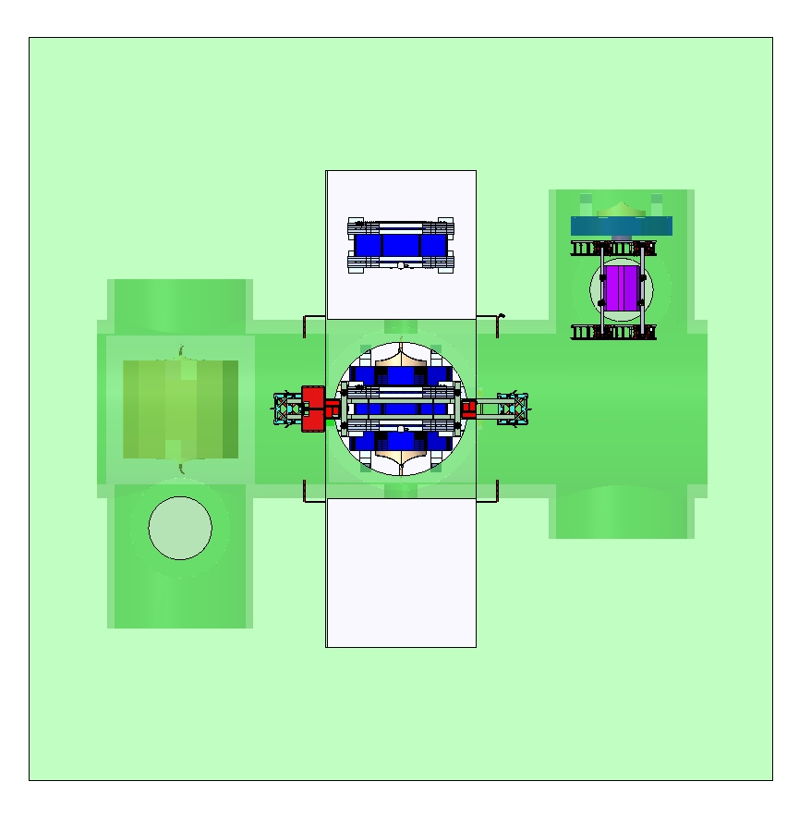
3 shafts option Iso view
4000 T Strand Jack system installed over main 18 m shaft.
400 T bridge crane works over assembly area and 8.5M shaft.

Slide 14
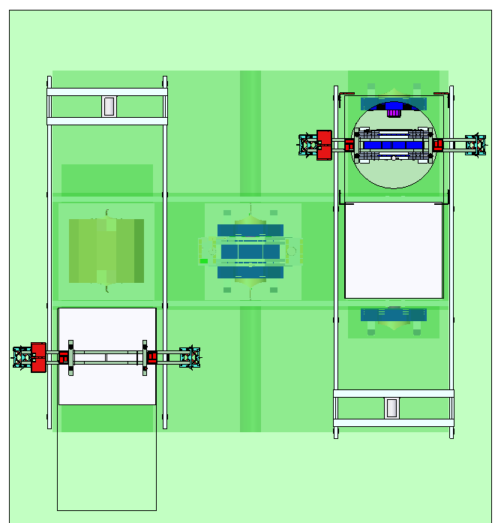
2 shaft option Iso view

Slide 15
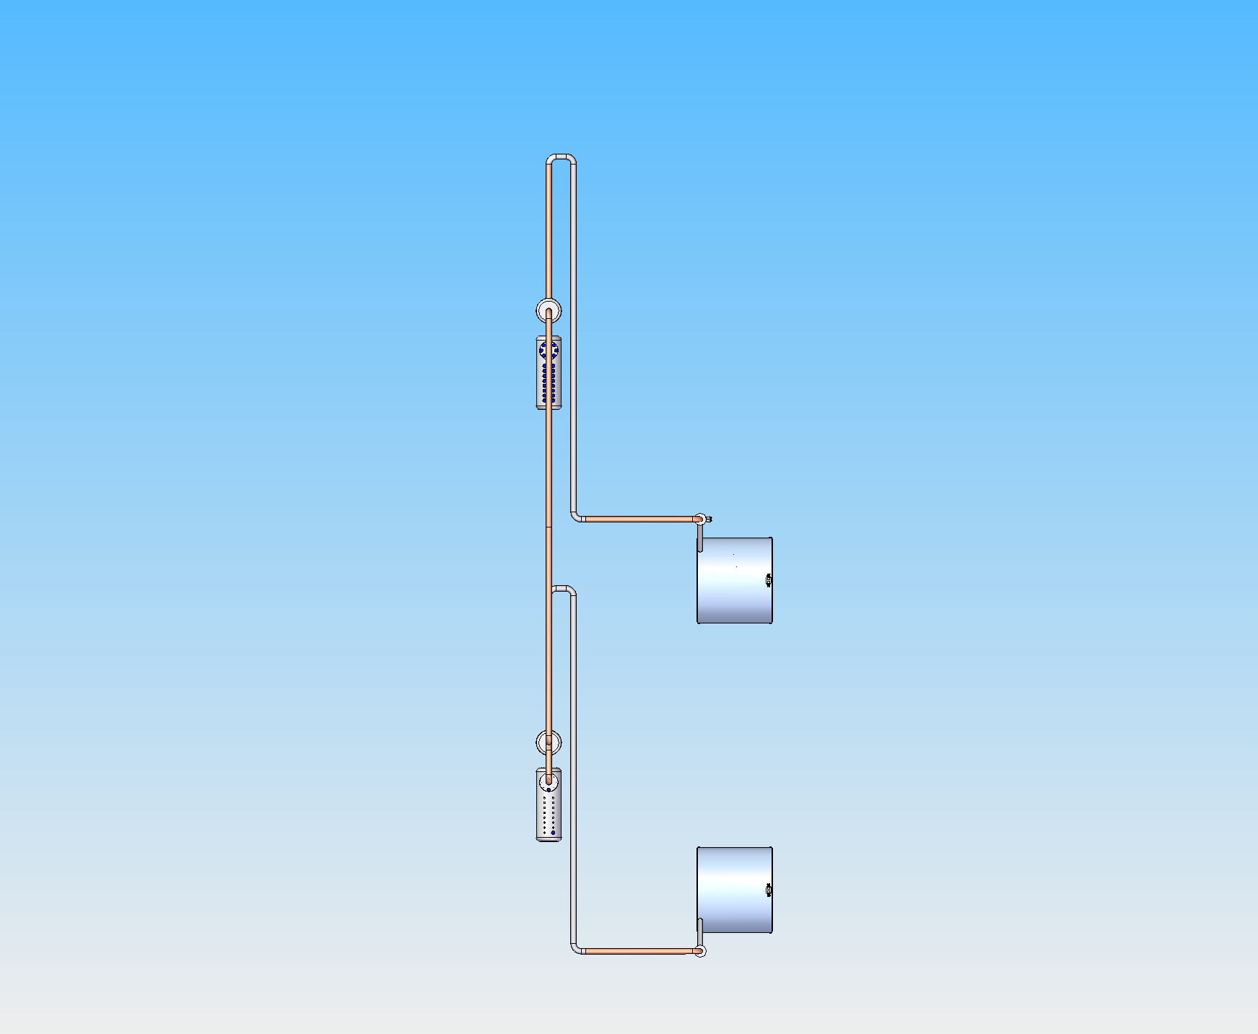
Flexible Cryo-line A
Cold box A
Solenoid Detector A
Interconnection
Beam Line
Cold box B
30 m
Solenoid Detector B
Garage

Slide 16
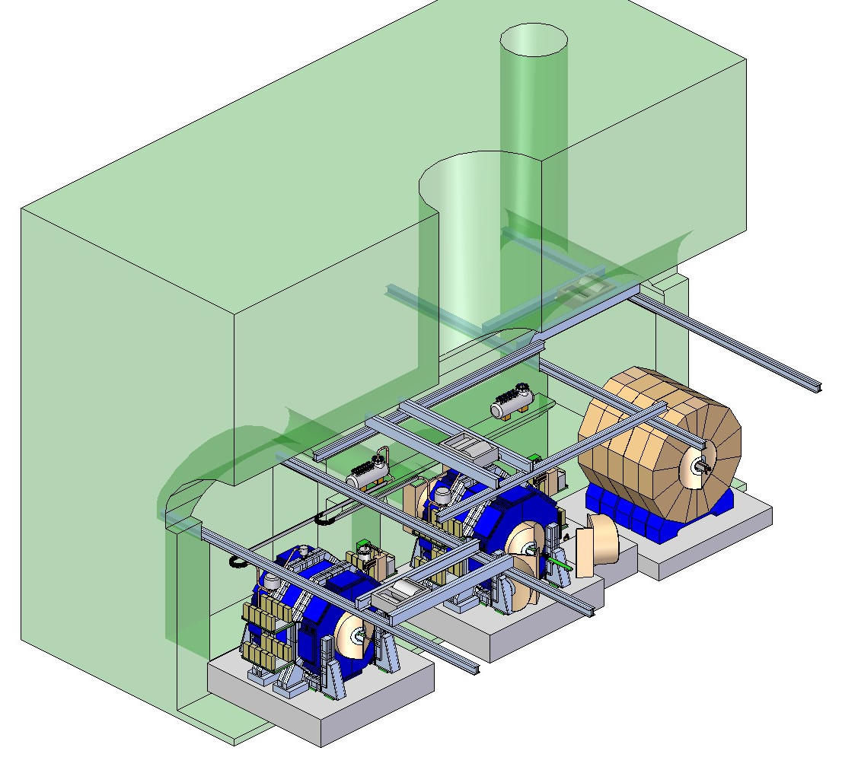

Slide 17
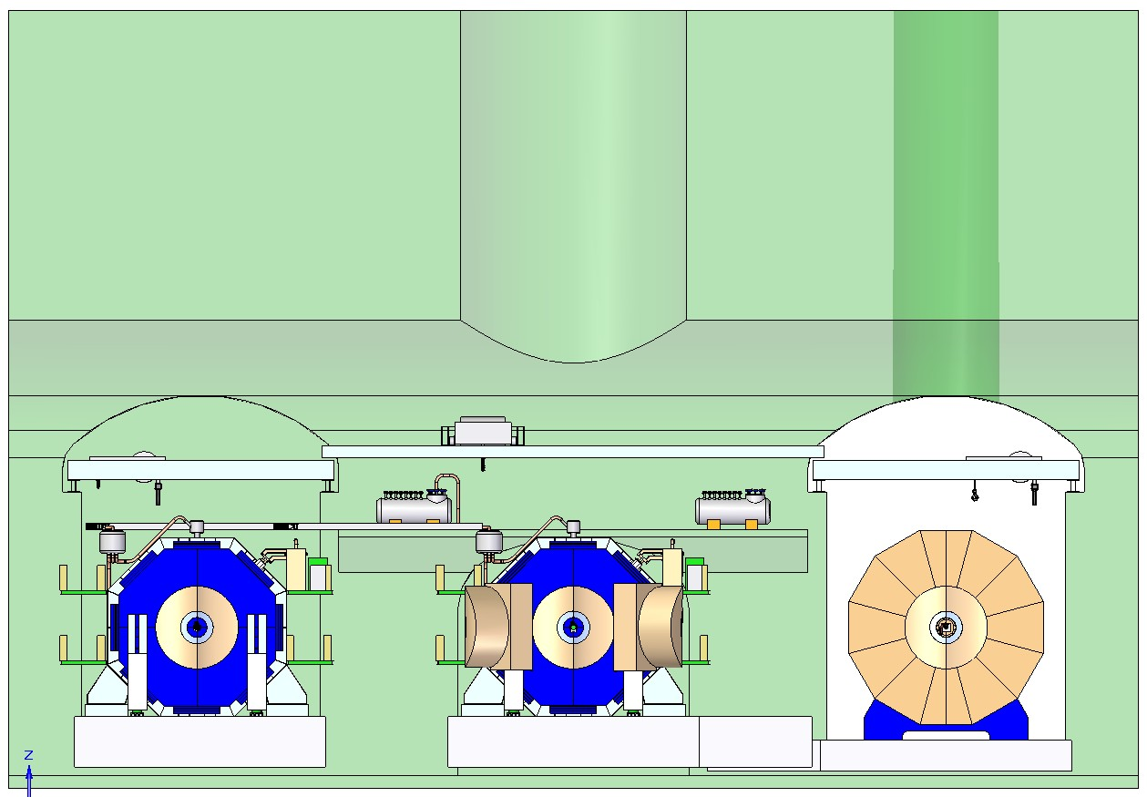

Slide 18
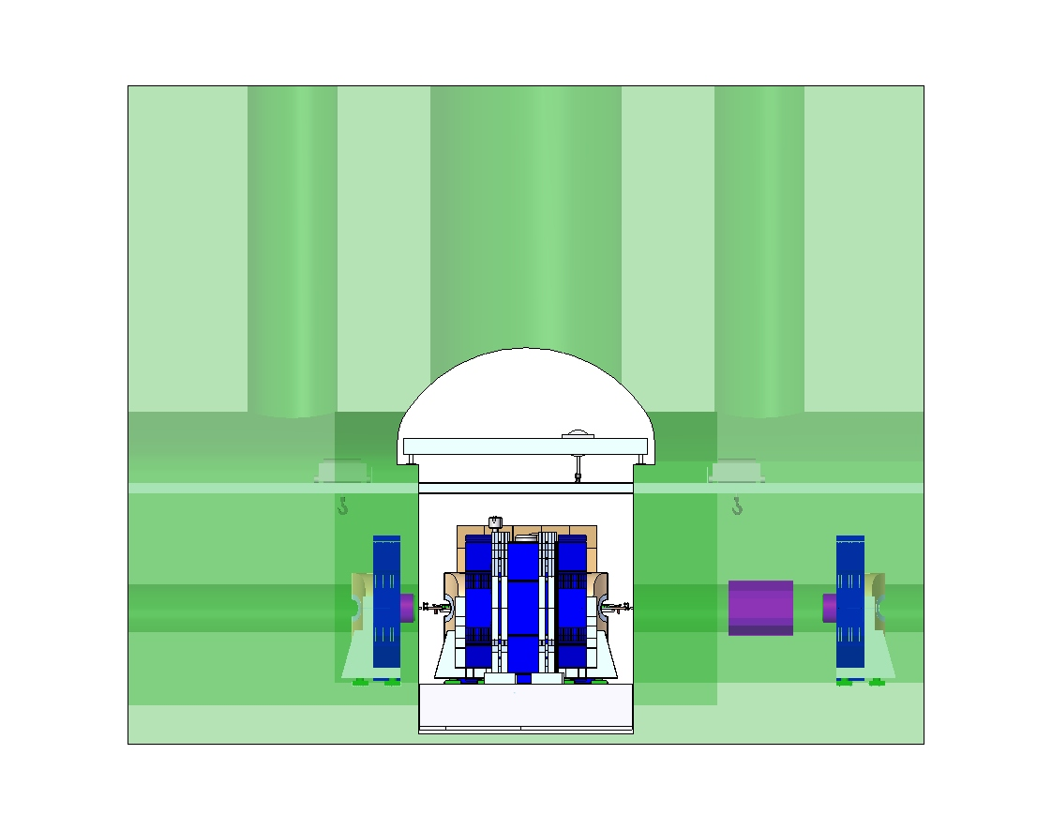
3 shafts, underground cranes

Slide 19
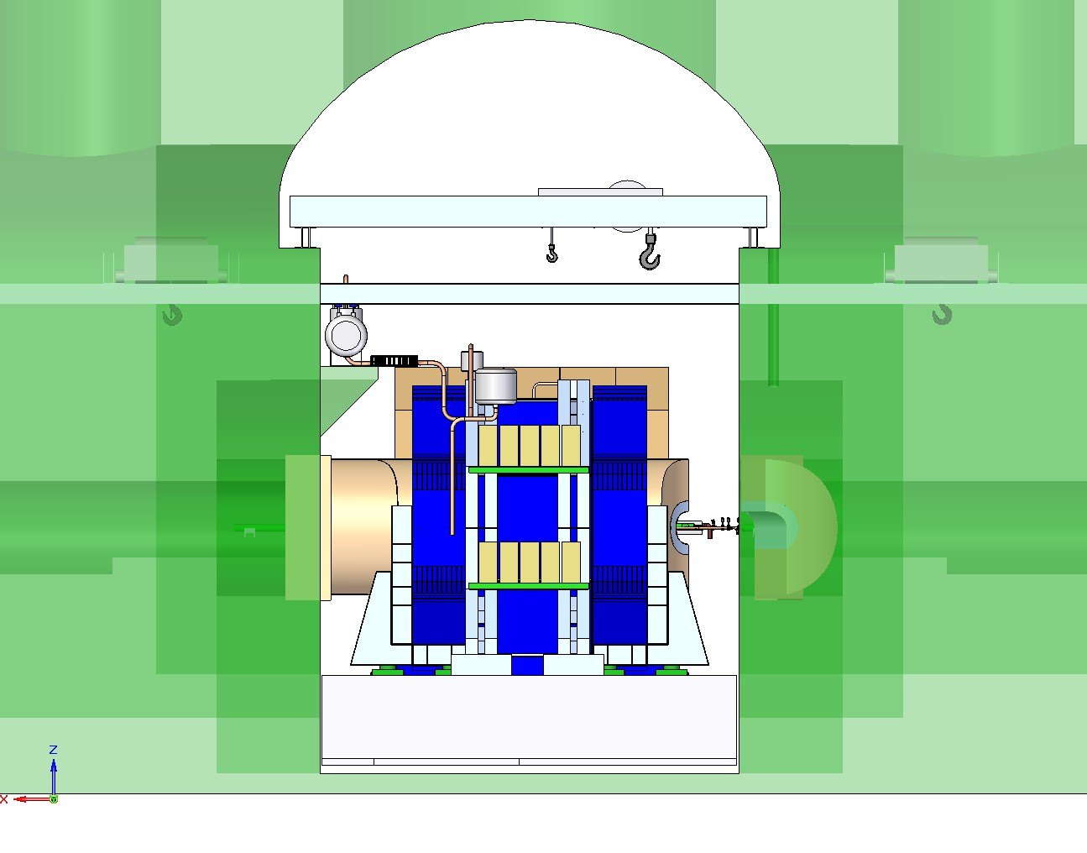

Slide 20
Comments: Good and Bad news
Good news: the proposed IR layouts are more similar to CLIC, still with substantial conceptual differences. Results of ARUP Task 2 can be used also for ILC
Bad news: the RDR Baseline of the IR layout is obsolete and we need to define a new one for the DBDs
Goals for LCWS11 :
Work around the Req’s and Spec’s of the proposed layouts
Handshake on one layout, which would be optimized over the next months for DBDs
Suggestions on wow proceed before and after LCWS11
Take advantage of the MDICTG forum for technical meetings with enlarged audience
Joint MDI/CFS meetings

