Slide 1
Timing Jitter
D. R. Bett

Slide 2
Timing Jitter
Two-pronged attack:
Hardware
  Colin added capacitance to board #2
Firmware
  Replace 40 MHz onboard oscillator with signal generated from 357 MHz
  EXCEPTIONS: reset_ctrl, DCM, LEDs

Slide 3
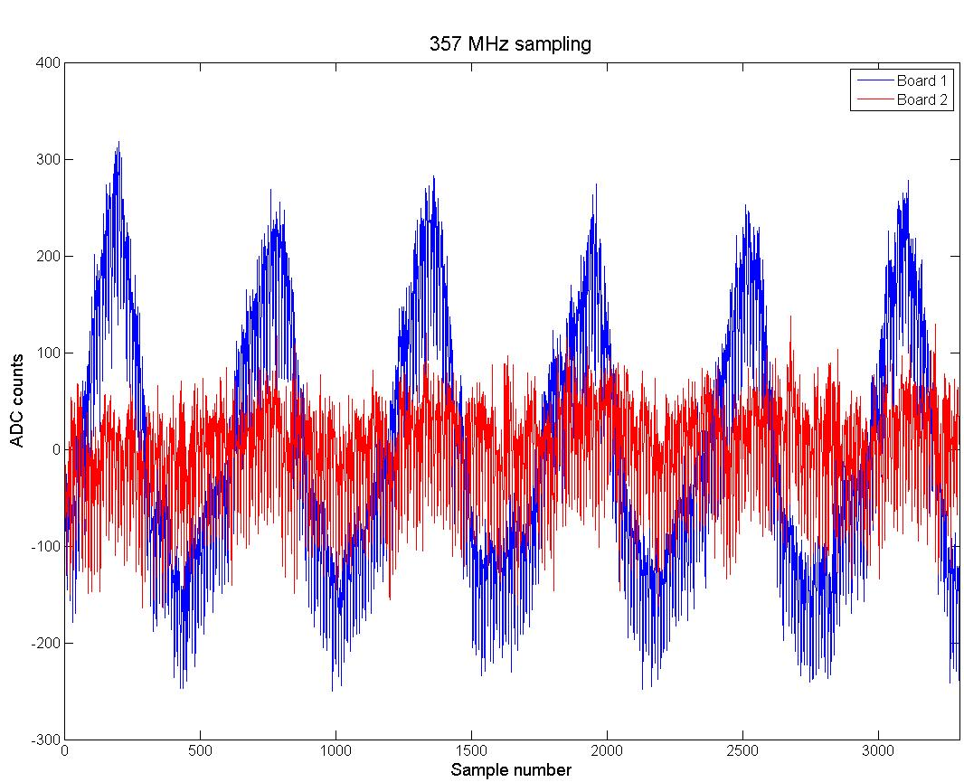

Slide 4
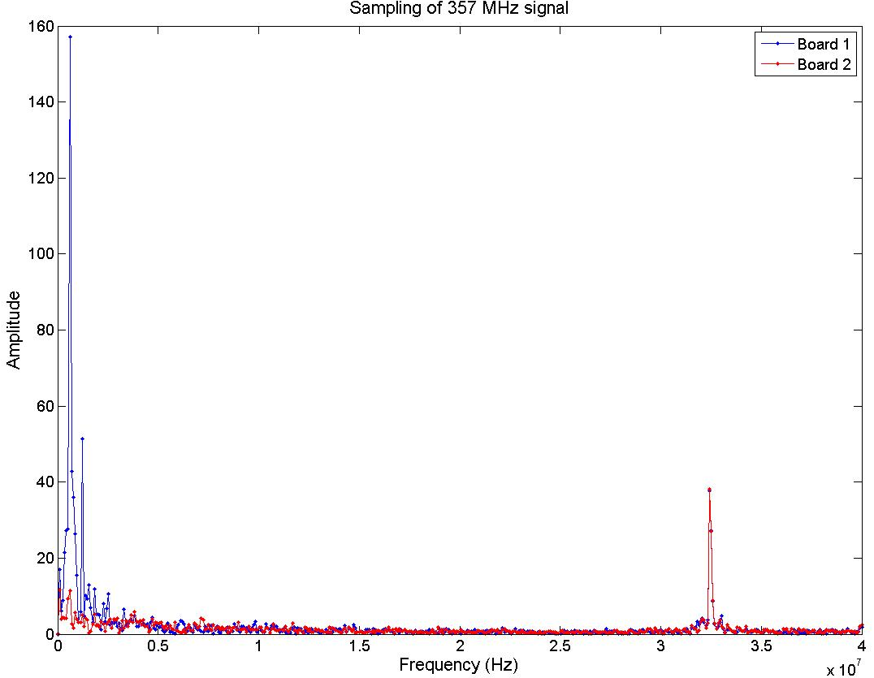
~550 kHz oscillation
reduced by factor ~15
no effect on
slow clock
(~32.5 MHz)

