Slide 1


Simulations of Cherenkov Fast Timing Detectors in Geant4
Chris Nicholson
Mentor: Mike Albrow
Summer 2011

Slide 3
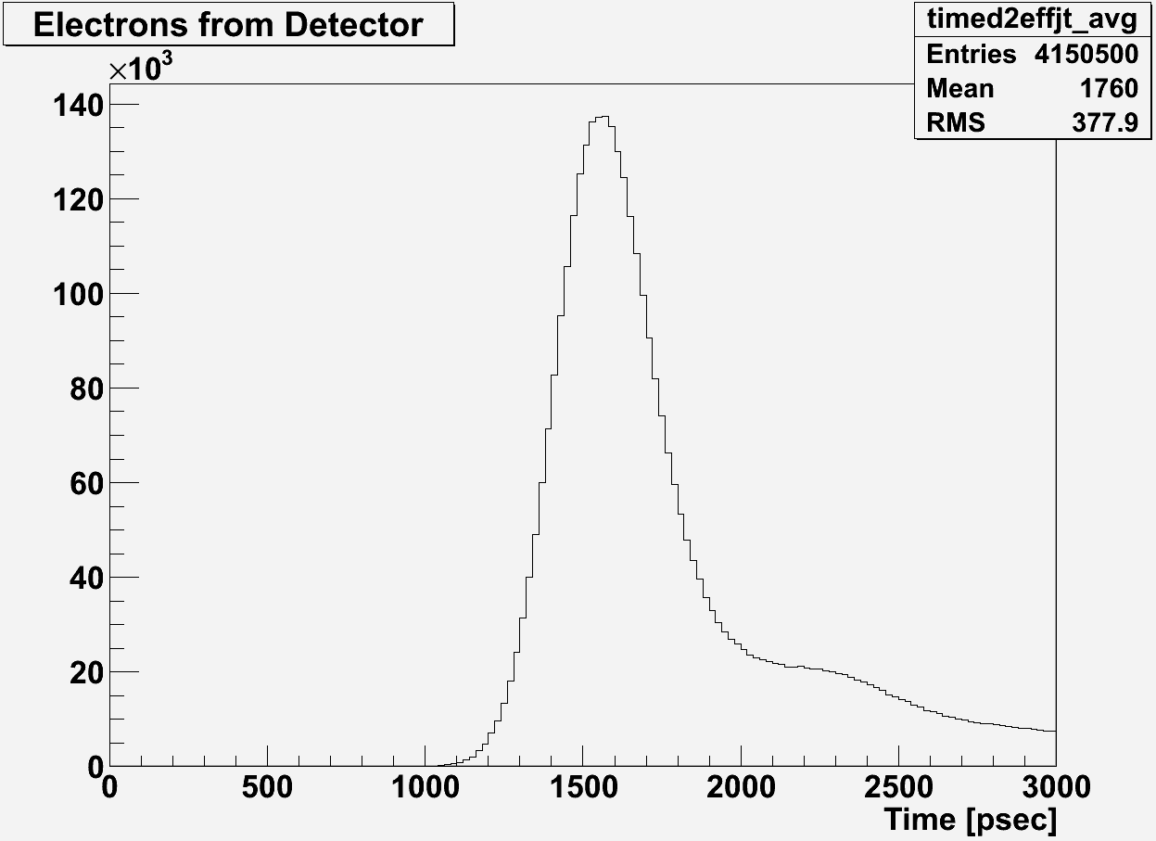
Simulated Pulse
50% pulse height
Time of pulse

Slide 6
Final Remarks
Will do a quick resolution scan with QE curve of MPPC reduced to level of Photek
Thanks to all for their help

