Slide 1
Preliminary Results
Random Vibration Analysis
EX-6 Shield Block
John Amann, Kirk Bertsche
SLAC ILC MDI
8-11-11

Slide 2
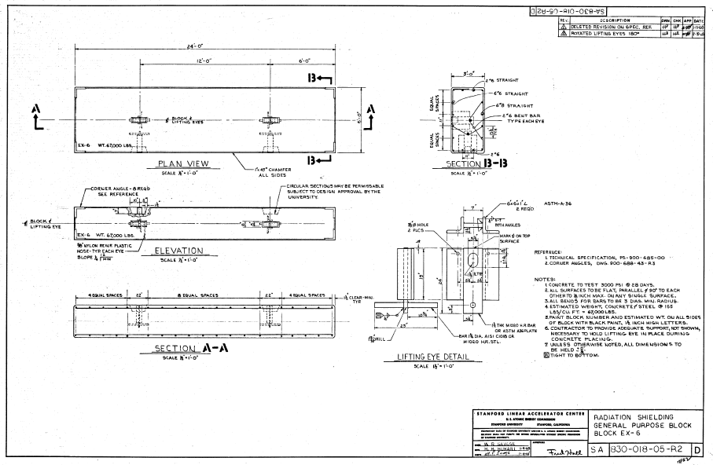
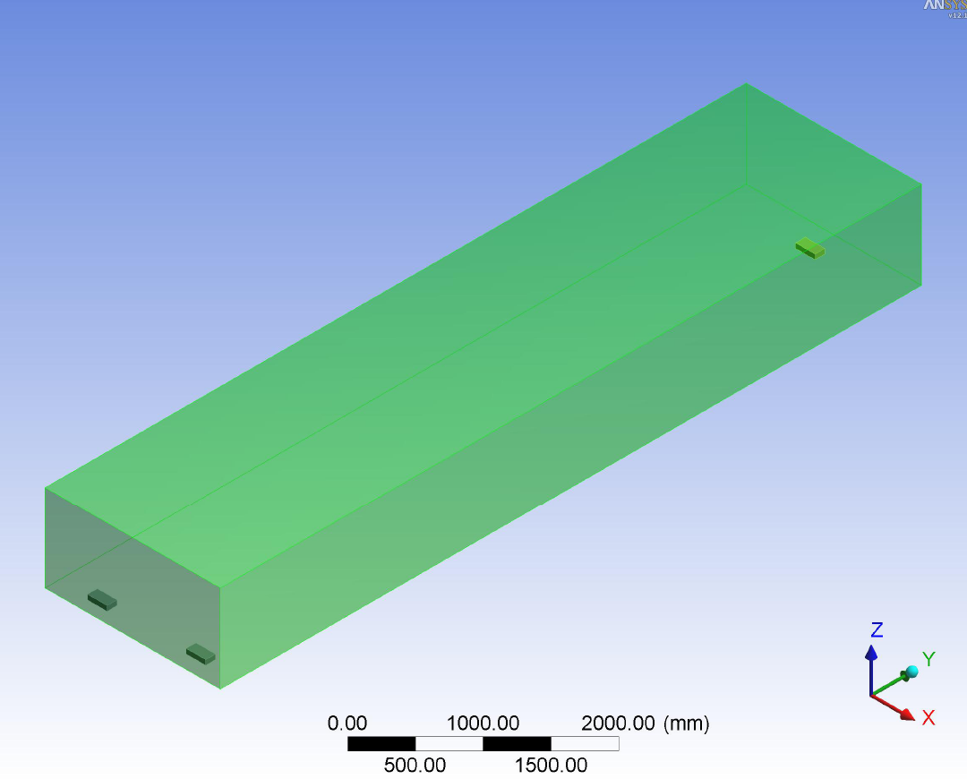
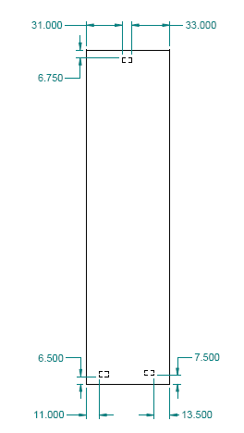
EX-6 Shield Block

Slide 3
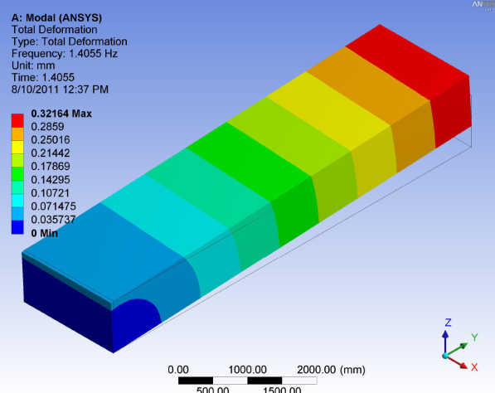
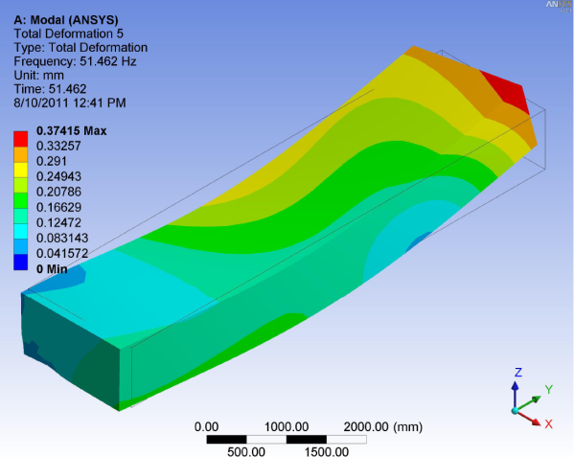
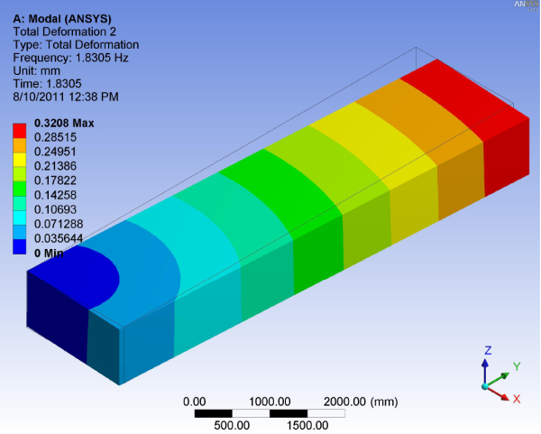
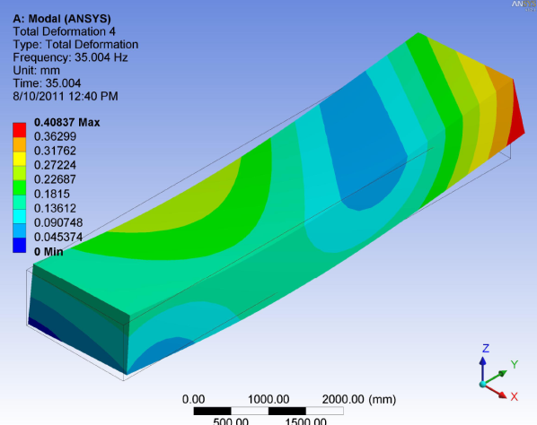
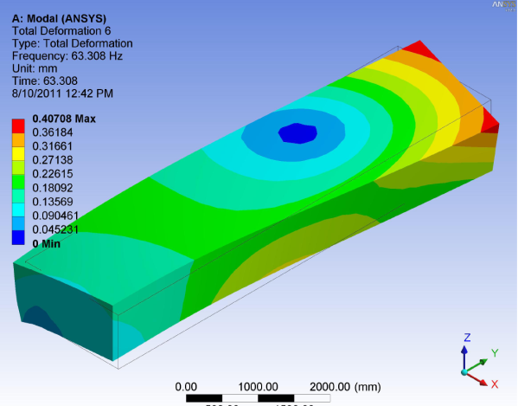
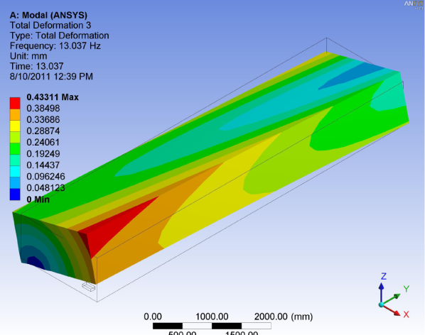
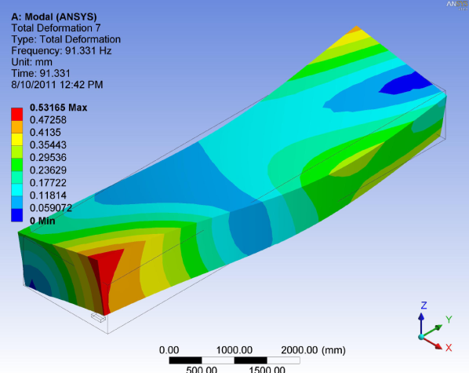
Mode Shapes

Slide 4
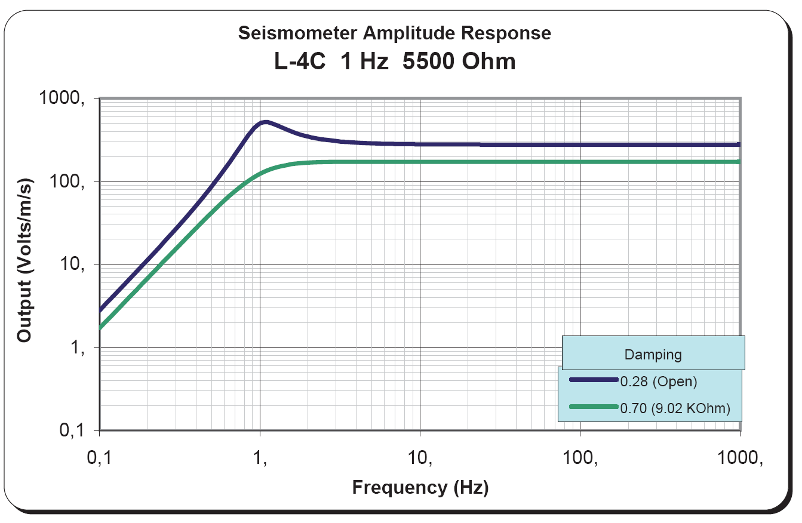
Seismometer Response

Slide 5
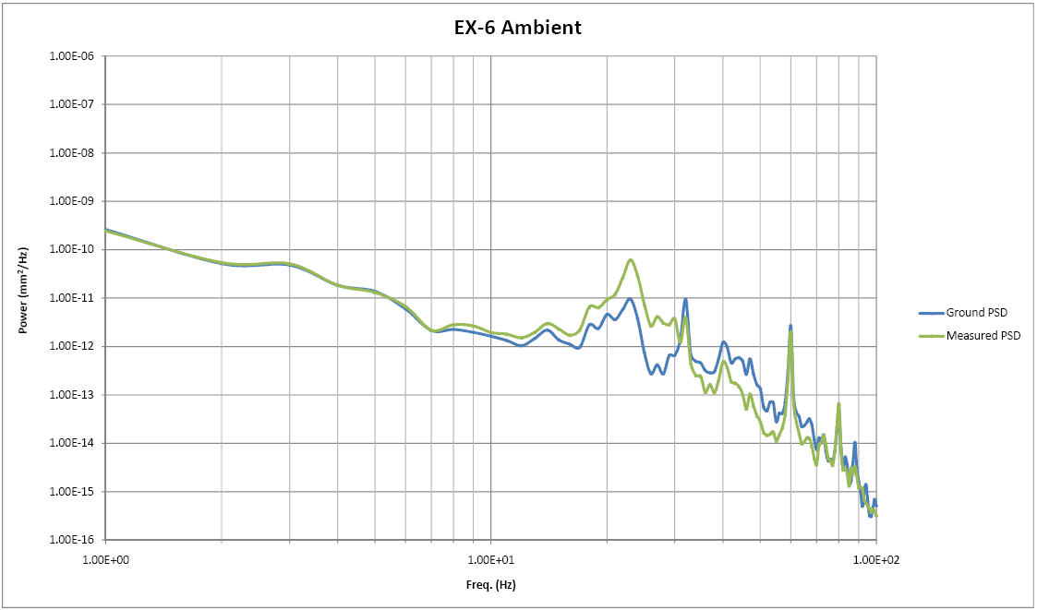
EX-6 PSD (data from Kirk)

Slide 6
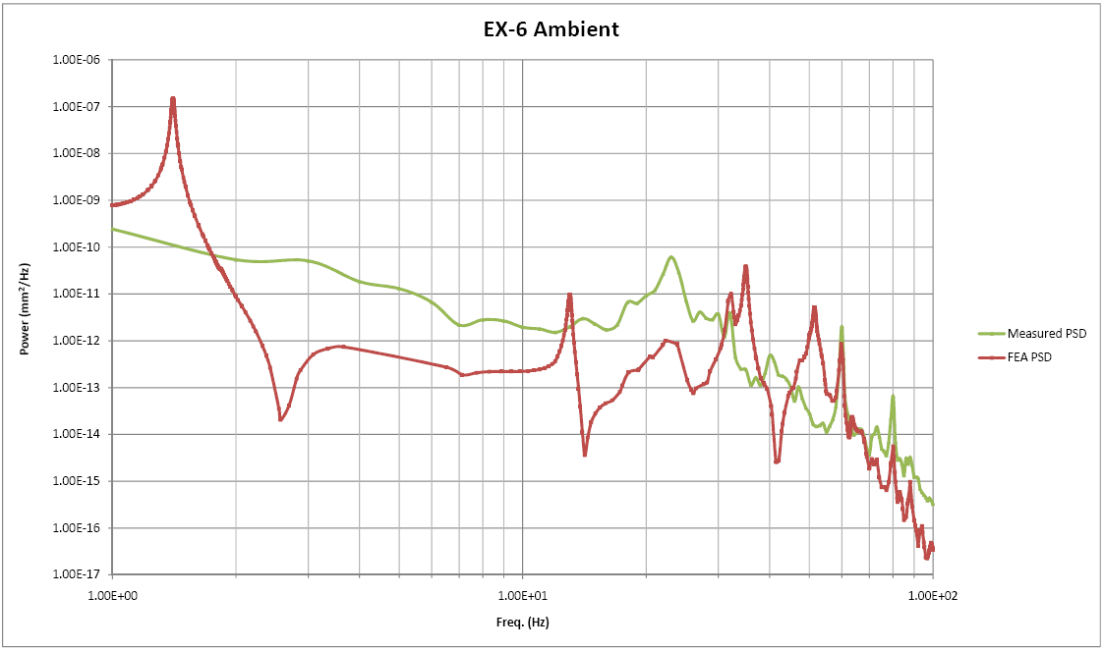
EX-6 PSD (data from Kirk) vs. FEA PSD

Slide 7
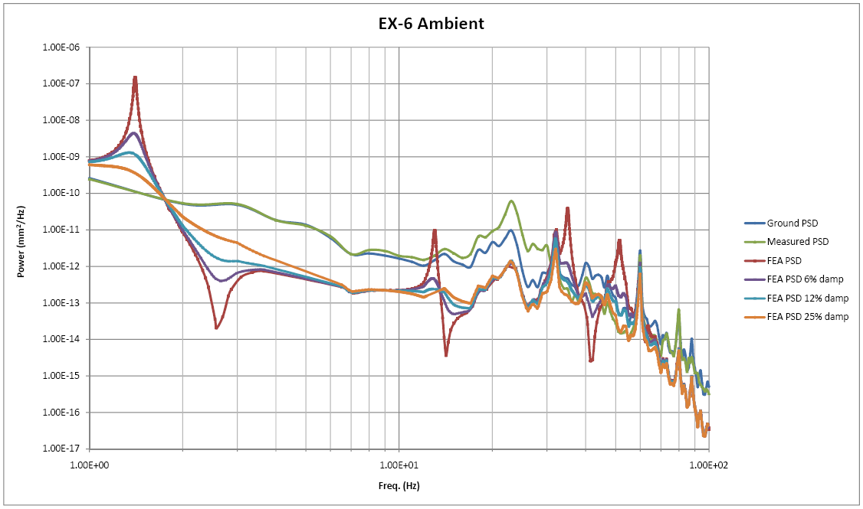
EX-6 PSD (data from Kirk) vs. FEA PSD

Slide 8
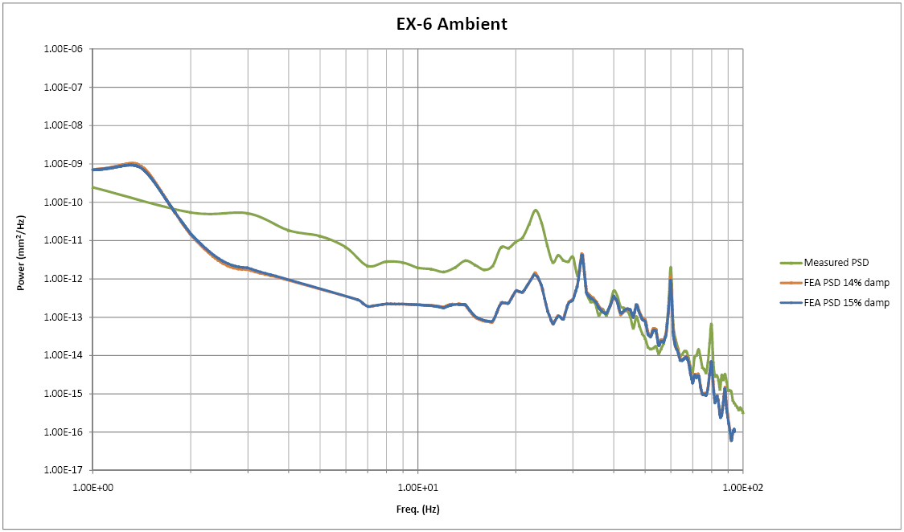
EX-6 PSD (data from Kirk) vs. FEA PSD

