Slide 1
Beampipe and LumiCal
19.0 cm
16.2 cm
19/171.75 = 0.111
103 mr
2.0 cm
98.5 mr
6.0 cm
1.2 cm
158 cm
171.75 cm
6.28 cm
20.24 cm = 2.0/tan(98.5mr)
LumiCal fiducial angle in LOI: 46 ∼ 86 mrad

Slide 2
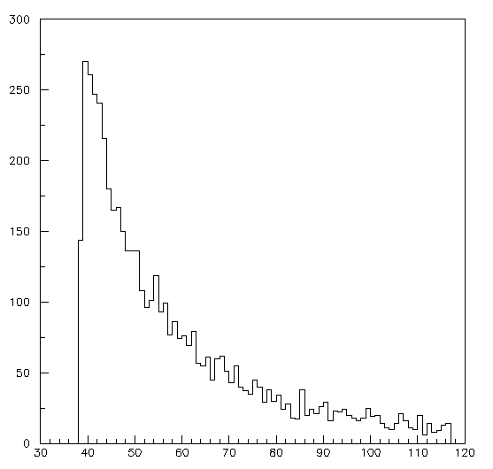
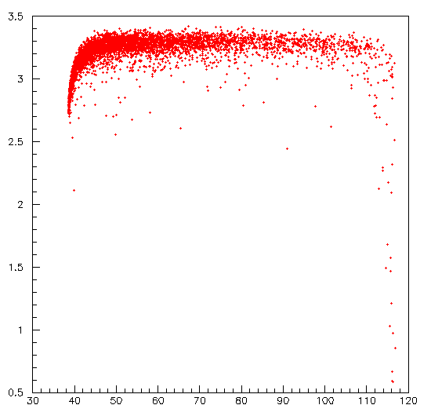
250 GeV e- with 1/θ³ distribution
44 mrad
112 mrad
1/θ³
E (GeV)
θ (mrad)
θ (mrad)

Slide 3
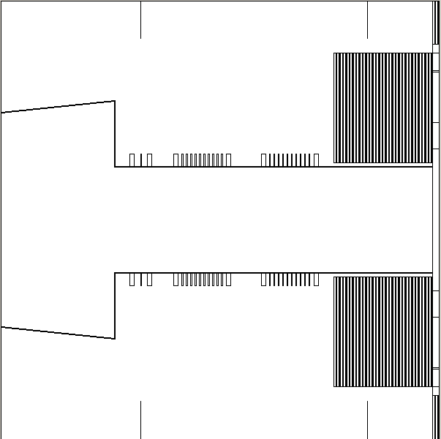
Implications of beampipe engineering
Any beampipe materials will reduce the small angle acceptance.
Updated Geant geometry
Need to fix parameters.
Bellow locations.
How many bellows.
56 mrad
Bhabha rate/BX ∼ 8(1/θ_{min}² -1/θ_{max}²)
θ_{min} = 46 → 56 mrad
2.7×10⁻³/Bx → 1.5 ×10⁻³/Bx

Slide 4
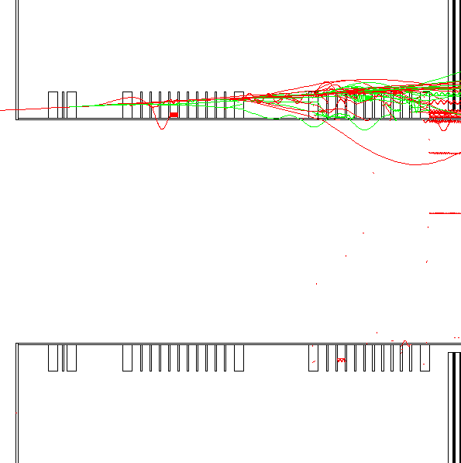
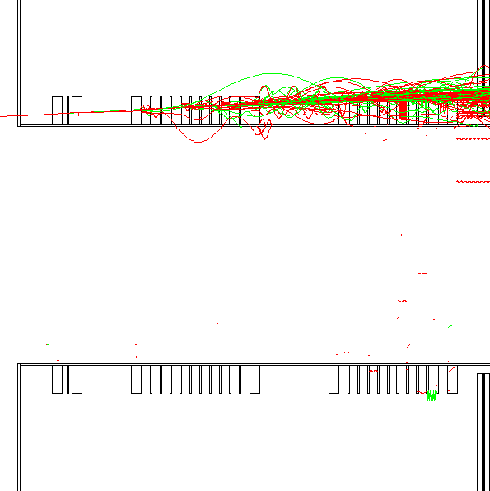
e+/e- only. Photons are not shown.

