Slide 1
40 MHz Firmware
D. R. Bett

Slide 2
FIRMWARE SCHEMATIC
NORMAL
IDELAYCTRL
clk200
clk40_s
IBUFG
clk40_ibufg
DCM
BUFG
clk40
357 delay
reset ctrl
adc blocks
uart
DAQ RAMs
uart decoder
ctrl regs
feedback
trim DACs
DAQ sequencer
timing synch
store_strb
(detect falling edge)

Slide 3
FIRMWARE SCHEMATIC
NO 40 MHz
IDELAYCTRL
clk200
clk40_s
IBUFG
clk40_tmp
DCM
BUFG
clk357
PLL ADV
BUFG
clk40_ibufg
BUFGCE
clk40
357 delay
reset ctrl
adc blocks
uart
DAQ RAMs
(~)
uart decoder
ctrl regs
DAQ sequencer
feedback
(detect falling edge)
trim DACs
store_strb
timing synch

Slide 4
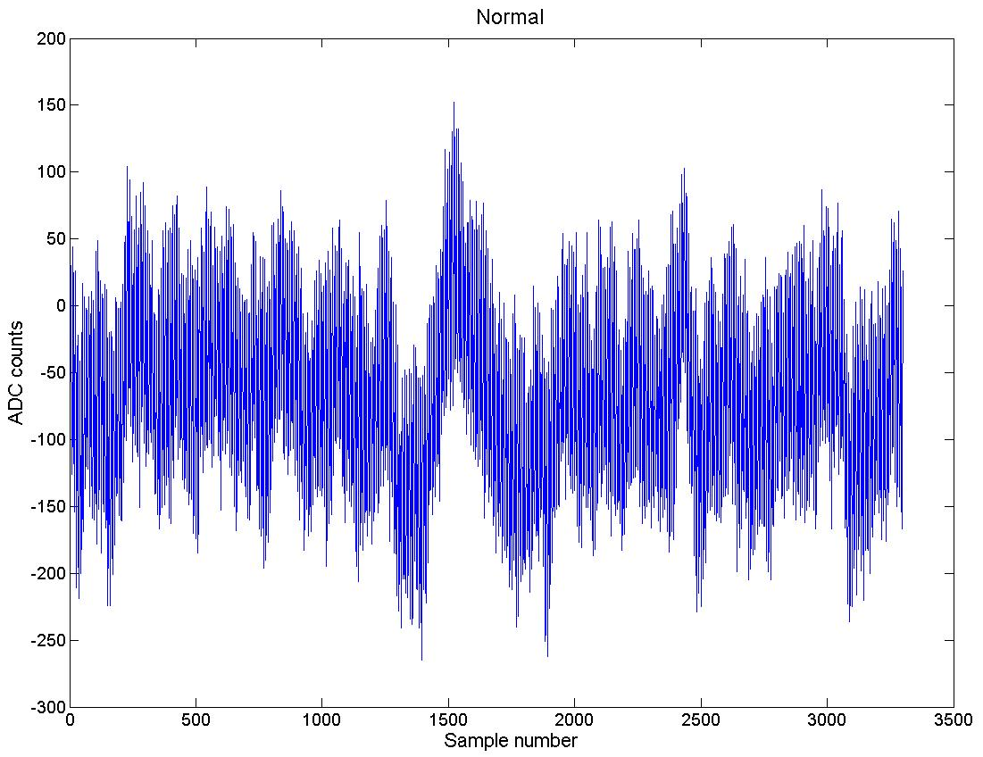
input ±1200 counts
σ_{y} = 70
σ_{t} ~ 25 ps

Slide 5
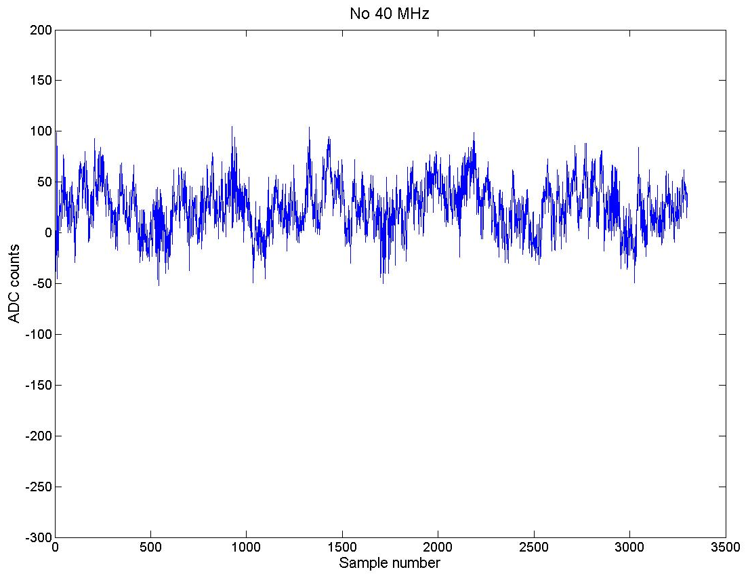
input ±1200 counts
σ_{y} = 25
σ_{t} ~ 9 ps

Slide 6
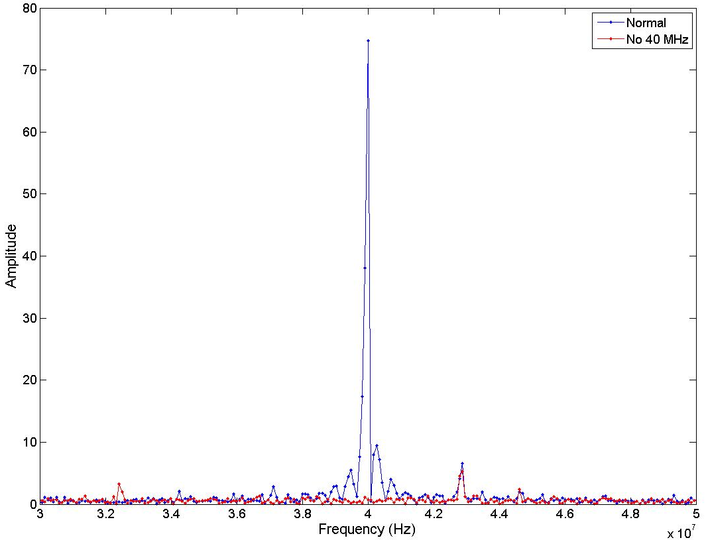
small oscillation at ~43 MHz

Slide 7
Conclusion
Firmware fix for the 40 MHz oscillation
Will try and apply to old firmware versions

