Slide 1
FONT4 Testbench
D. R. Bett

Slide 2
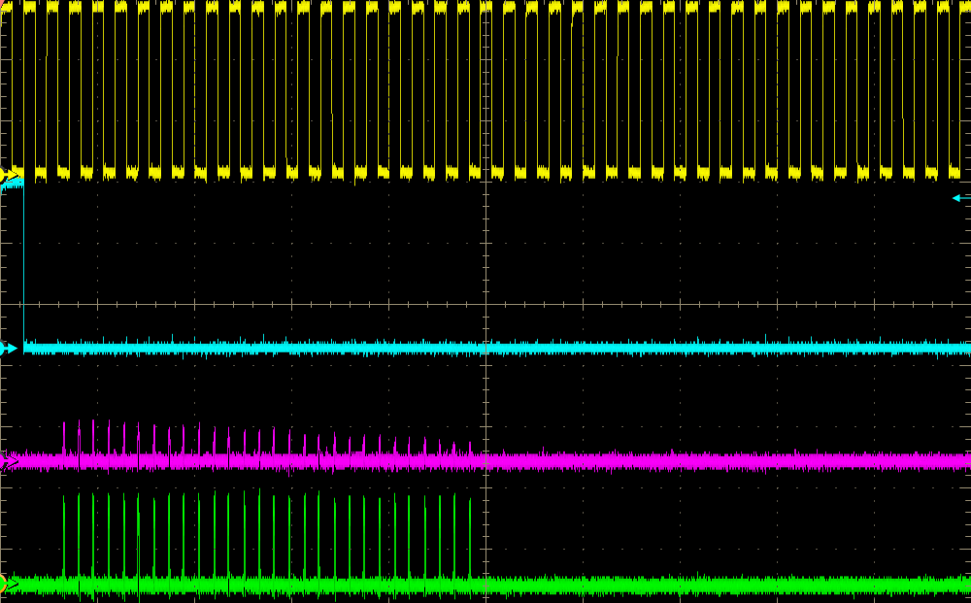
ring clock x2
trigger x2
difference
sum

Slide 3
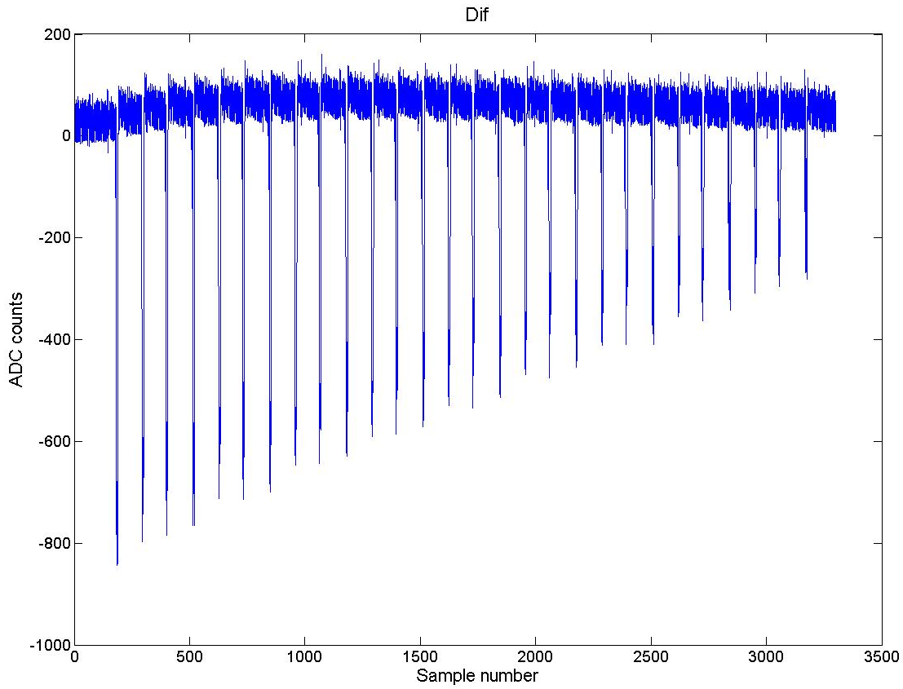
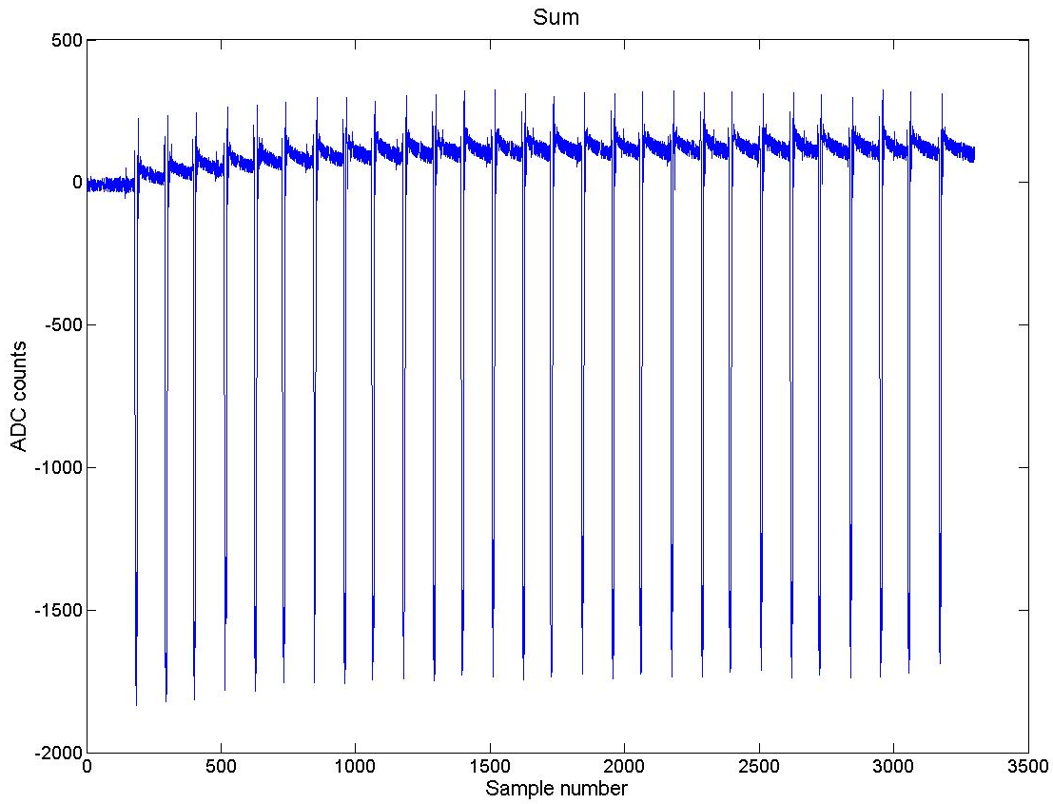
Example output from FONT5 board
Adjustable parameters:
bunch spacing
bunch pathology (i.e. amplitude, evolution with time)

