Slide 1
ILC CFS AND GLOBAL
SYSTEMS MEETING
CONVENTIONAL FACILITIES
AND SITING GROUP
GENERAL STATUS UPDATE
V. Kuchler

Slide 2
Overview
  Preparation for LCWS2011 at Granada
  Preparation for DRFS Review at KEK
  Preparation for Central Region BTR at DESY

Slide 3
Preparation for LCWS 2011
  CFS Participation
    FNAL - V Kuchler, T Lackowski, L Hammond, R Wielgos
    CERN – J Osborne, M Gastal
    Webex – E Huedem
  CFS Parallel Session Schedule is Not Yet Finalized
  Joint Sessions with Other Groups are Being Coordinated
    Central Region Area Systems (Sources, Damping Ring, RTML, BDS)
    High Level RF (Klystron Cluster and DRFS)
    MDI, SiD and ILD Detectors

Slide 4
Preparation for DRFS Review at KEK
  Original Topic has been Expanded
  CFS Participation
    FNAL – V Kuchler, R Wielgos
    Webex – T Lackowski, E Huedem, L Hammond
  Three General Topics
    DRFS
    Asian CFS Design
    Central Region Design Criteria

Slide 5
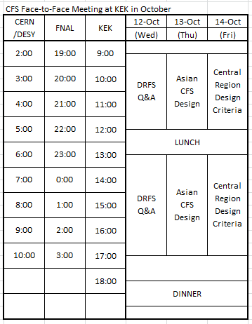

Slide 6
Preparation for Central Region BTR at DESY
  Mini-Workshops have been Held at FNAL
    Damping Ring Layout, Dimensioning and Criteria
    RTML Layout, Dimensioning and Criteria
    e+ Source Layout, Dimensioning and Criteria
  e- Source and BDS Still Needs CFS Contact
  CFS Webex Meetings are Planned to Include MDI/Detector Participation in September

