Slide 1
NML Studies

Slide 2
Tests at NML
Forward, reflected and probe calibrations
Loop gain calibrations
  Set gain outside of controller to 1.0
Crosstalk measurements
  ~80dB
Long term Drift measurements
RF coupling between cavities
  Very low
Microphonic measurements
LFD compensation studies
Attempt at lower klystron power studies

Slide 3
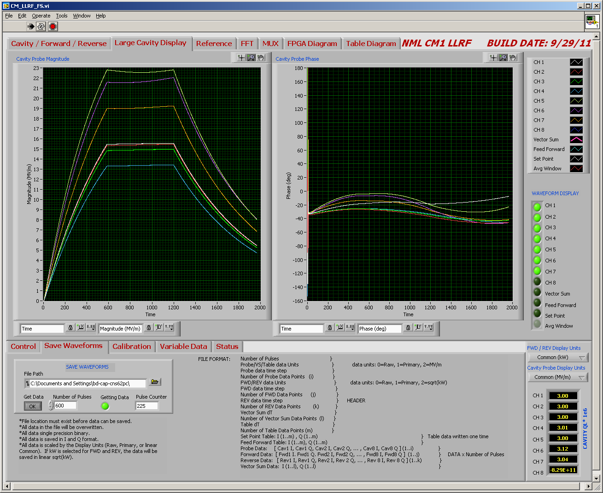
CM1 Feedback and Piezo control Off
Notes:
No feedback

Slide 4
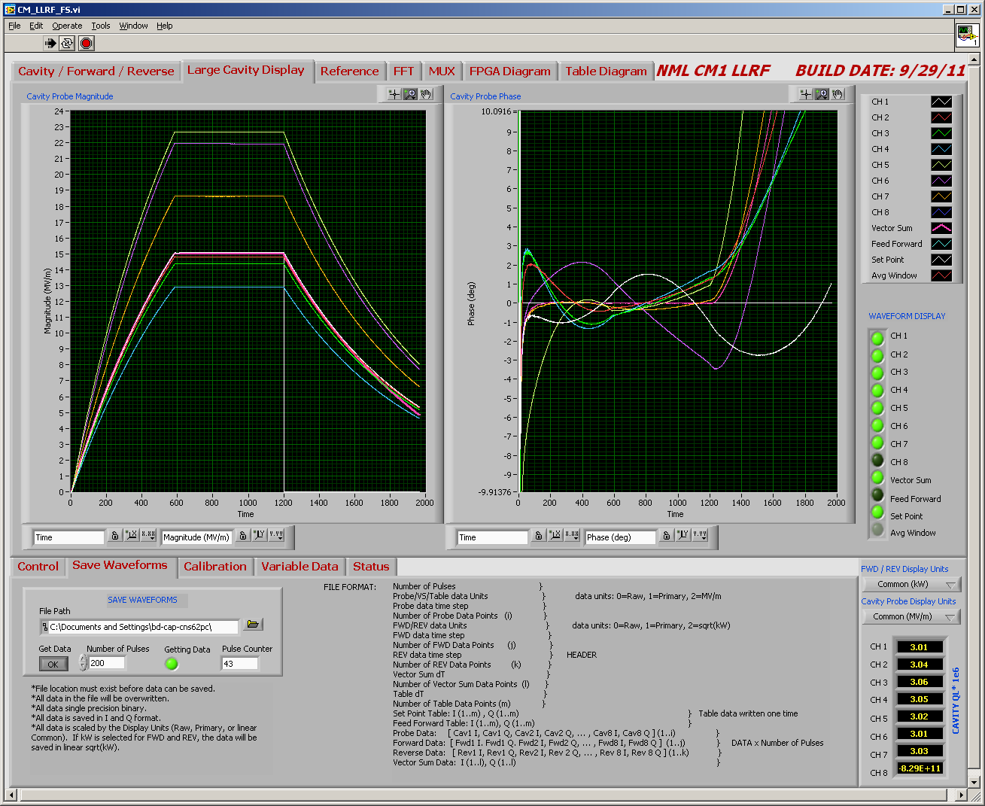
Preliminary Results
Feedback and Active Detuning Compensation On
Notes:
Piezo and feedback operating together. Cav 1 is not under piezo control after phase shifter control

Slide 5
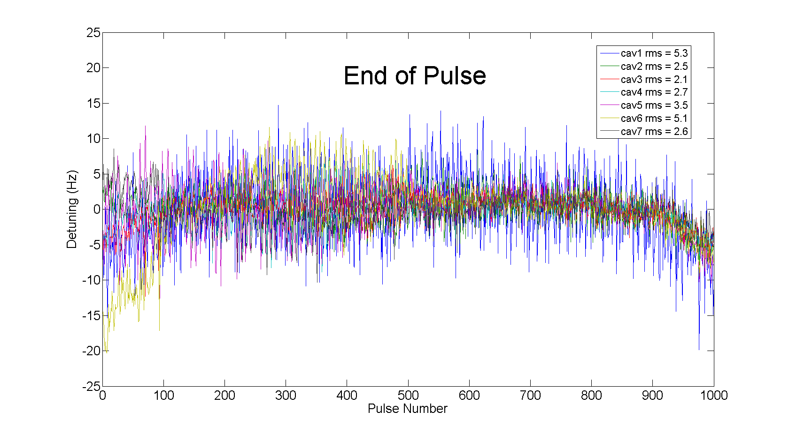
Mircrophonic detuning for 7 cavities
1000 second period, 1 Hz rep rate
Cavity 1 does not have active detuning compensation (control case)
Cavity Detuning
Feedback and Piezzo Control On

Slide 6
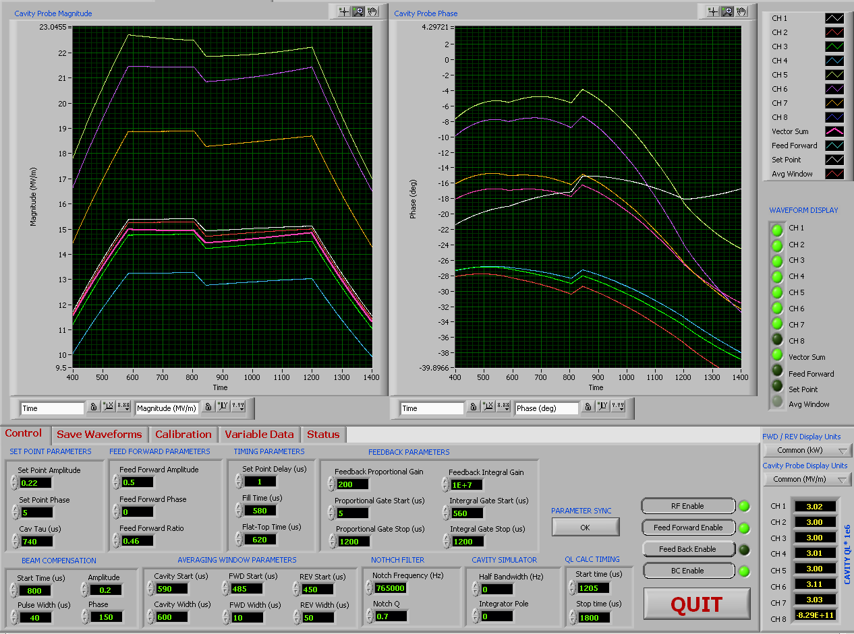
Disturbance Response
40% drop in RF voltage @150 degree phase angle
40 μsec pulse width
No feedback
Notes:
Disturbance .2 150 degrees

Slide 7
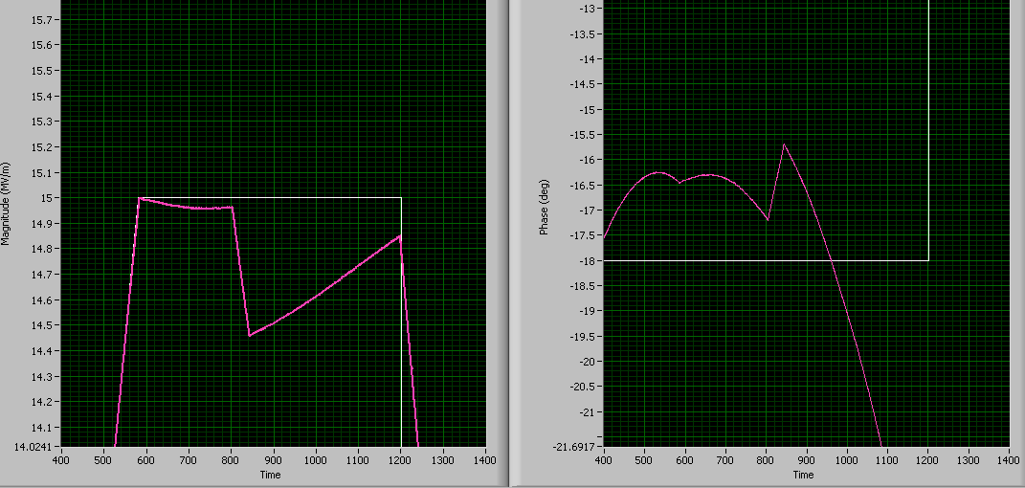
Disturbance with only Vector Sum Shown
Gradient drops 0.5 MV/m and shifts 1.5 degrees during 40μs
Notes:
Closeup of disturbance

Slide 8
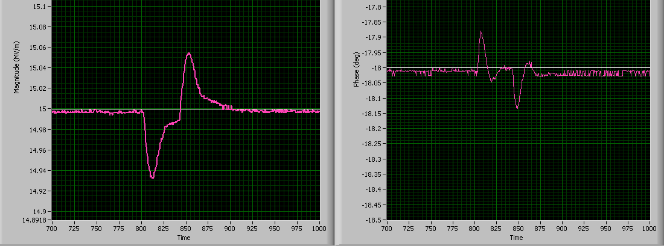
Disturbance Response with Feedback On
Calibrated Proportional gain = 200, Integral gain = 1e7
0.06 MV/m, 0.13 deg peak
Notes:
Compensated fb 200, 1e7

Slide 9
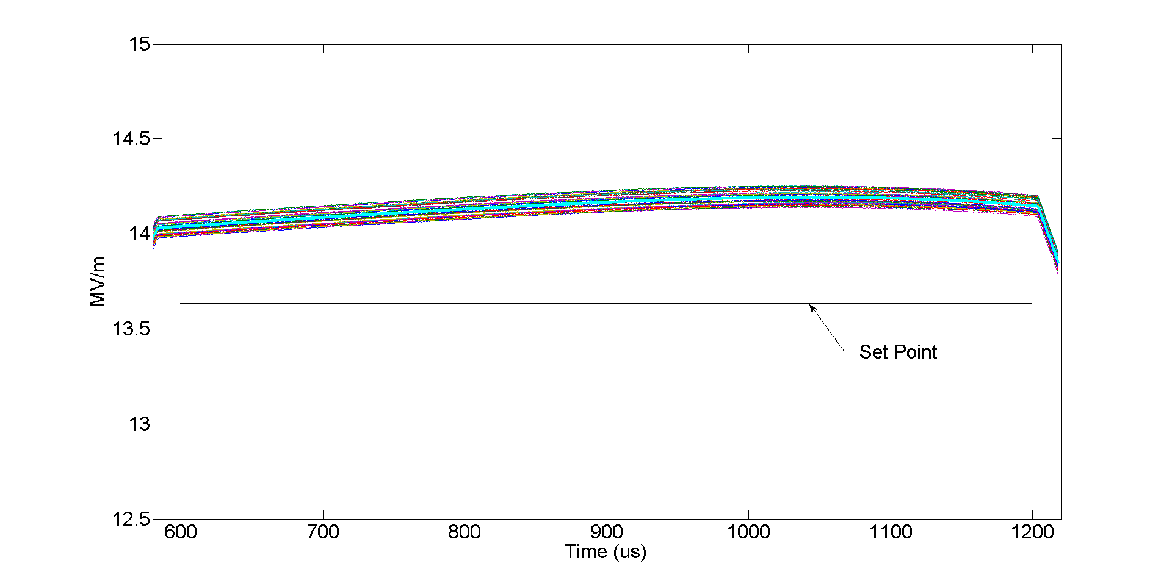
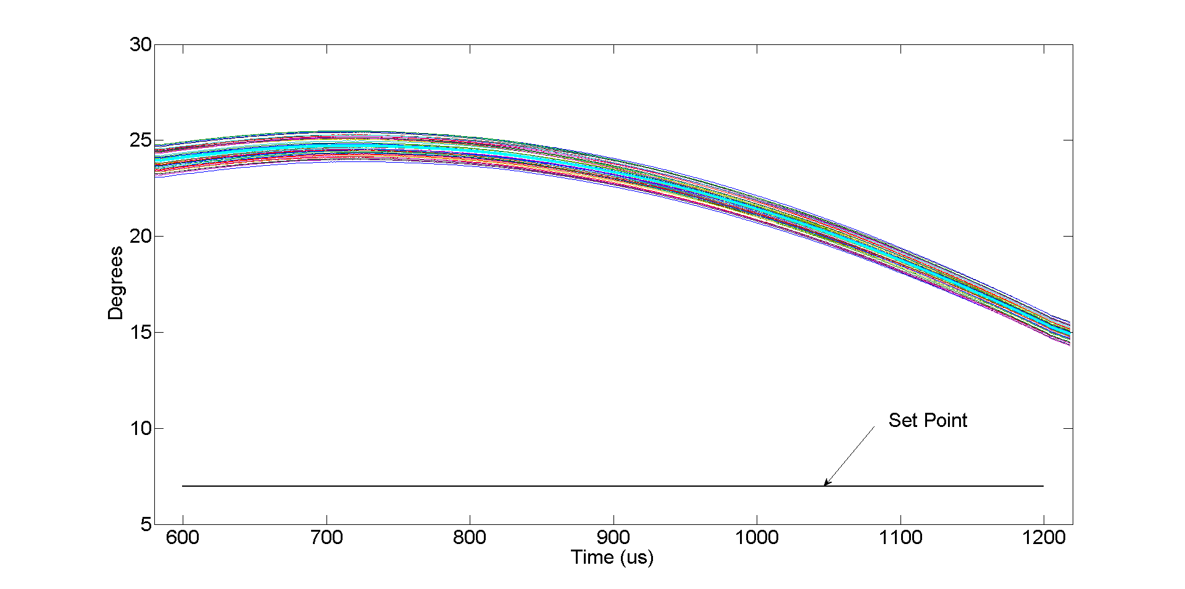
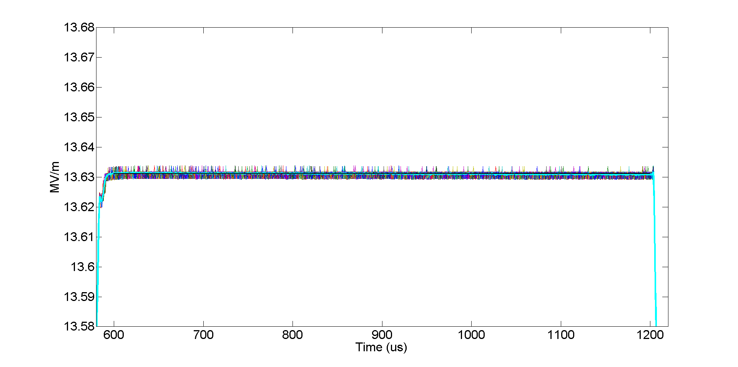
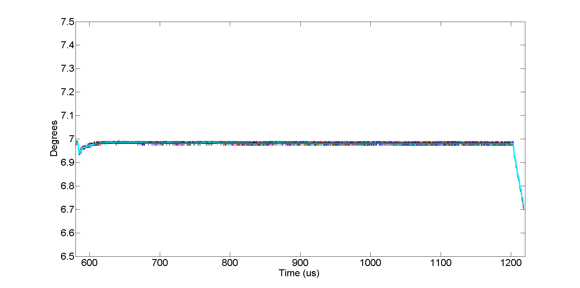
50 pulse overlay -Cryomodule 1 with seven cavities in vector sum
Vector Sum Magnitude
Vector Sum Phase
Feedback
OFF
With
Feedback
P = 100
I = 7.5e6
Vector Sum Magnitude
Vector Sum Phase
Vector Sum Magnitude
Vector Sum Phase
Vector Sum Magnitude
Vector Sum Phase
Without
Feedback
Without
Feedback
Without
Feedback
With
Feedback
P = 100
I = 7.5e6
With
Feedback
P = 100
I = 7.5e6
With
Feedback
P = 100
I = 7.5e6

Slide 10
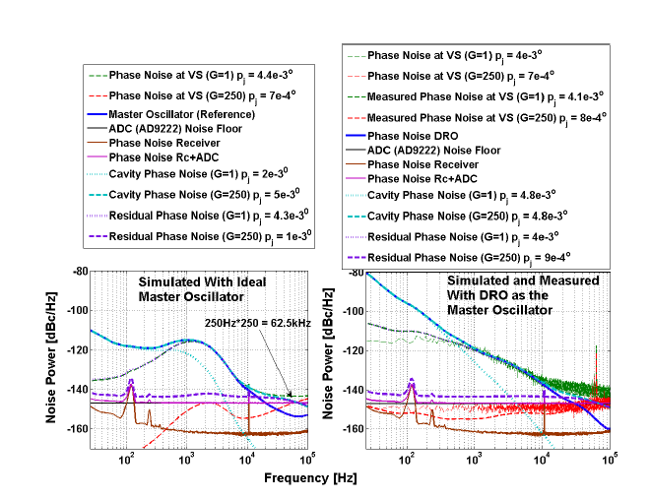
Calculated Phase Noise Contributions at Various Points
Theoretical Noise Levels
Measured Noise Levels
With high loop gain the noise floor is completely dominated by the receiver noise [10Hz – 100 kHz].
If the front-end is properly designed the limitation of the receiver is the ADC.
MO
MO
ADC+Rc
Residual Noise
Residual Noise
ADC+Rc

Slide 11
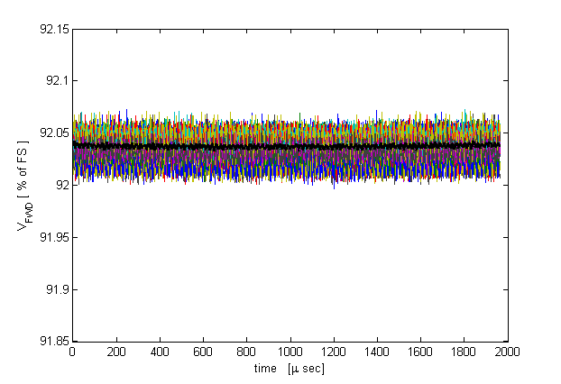
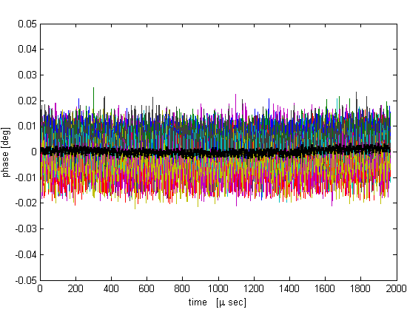
Fermilab ILTCA receiver chain noise
12 bit ADC, 62.5 MHz F_{s}
1.3Ghz RF
Amplitude
Phase
5 minute data
5 minute data
± 0.025 % p2p
0.009 % RMS
average
± 0.02 deg p2p
average
0.005 deg RMS

Slide 12
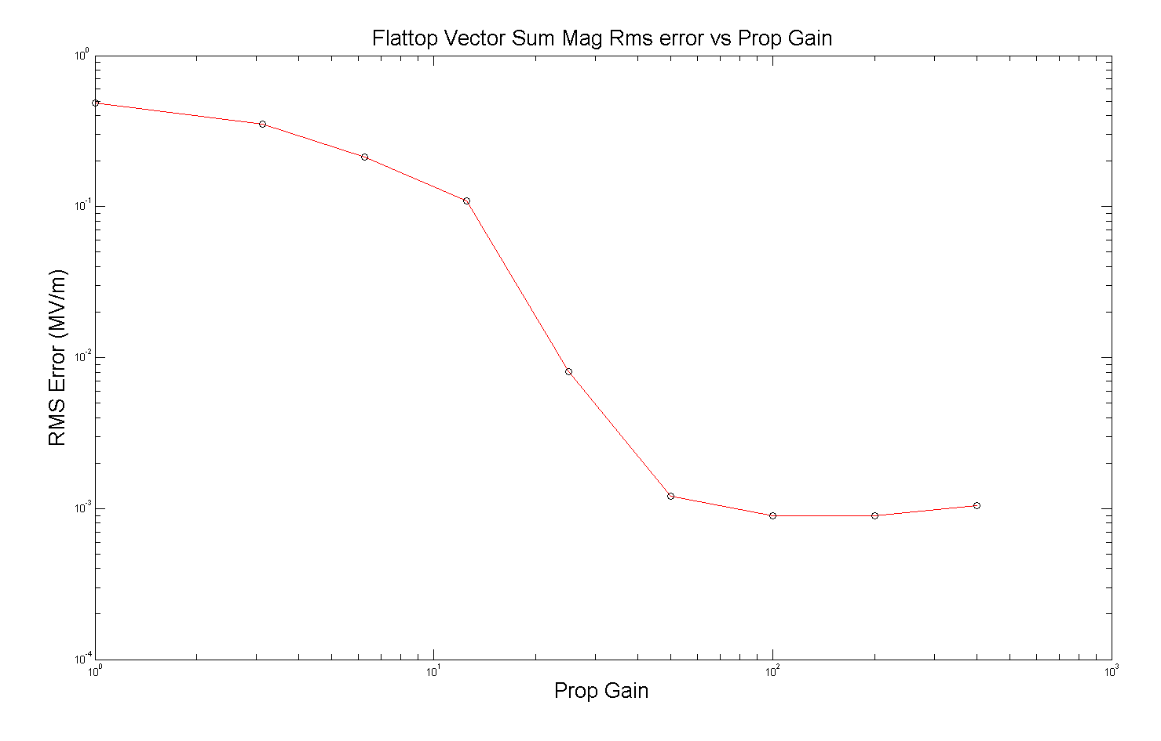
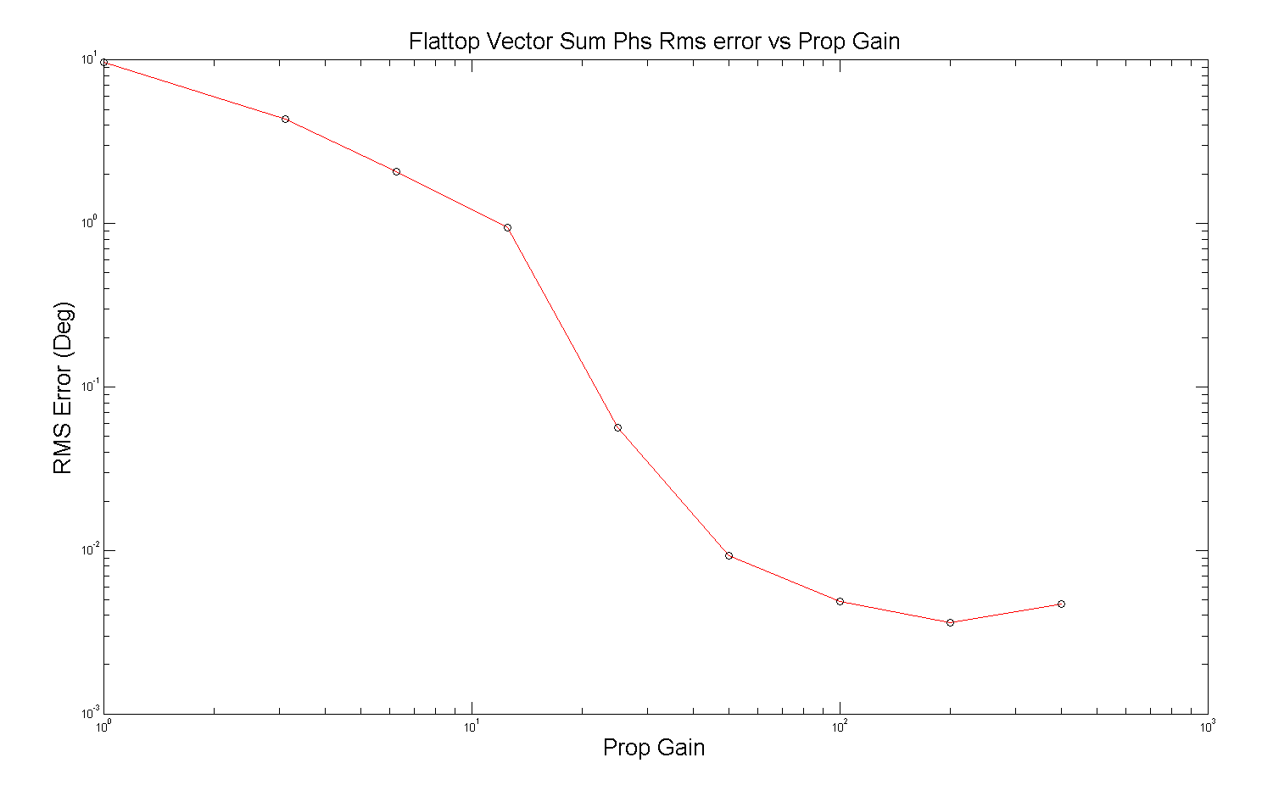
Flattop Vector Sum RMS Error vs Gain
(Igain = Pgain x 7.5e4)
Internal measured loop error
Receiver noise is below this level
RMS error at low gain is dominated by static errors and cavity tilts
0.007% RMS
0.004 deg RMS

Slide 13
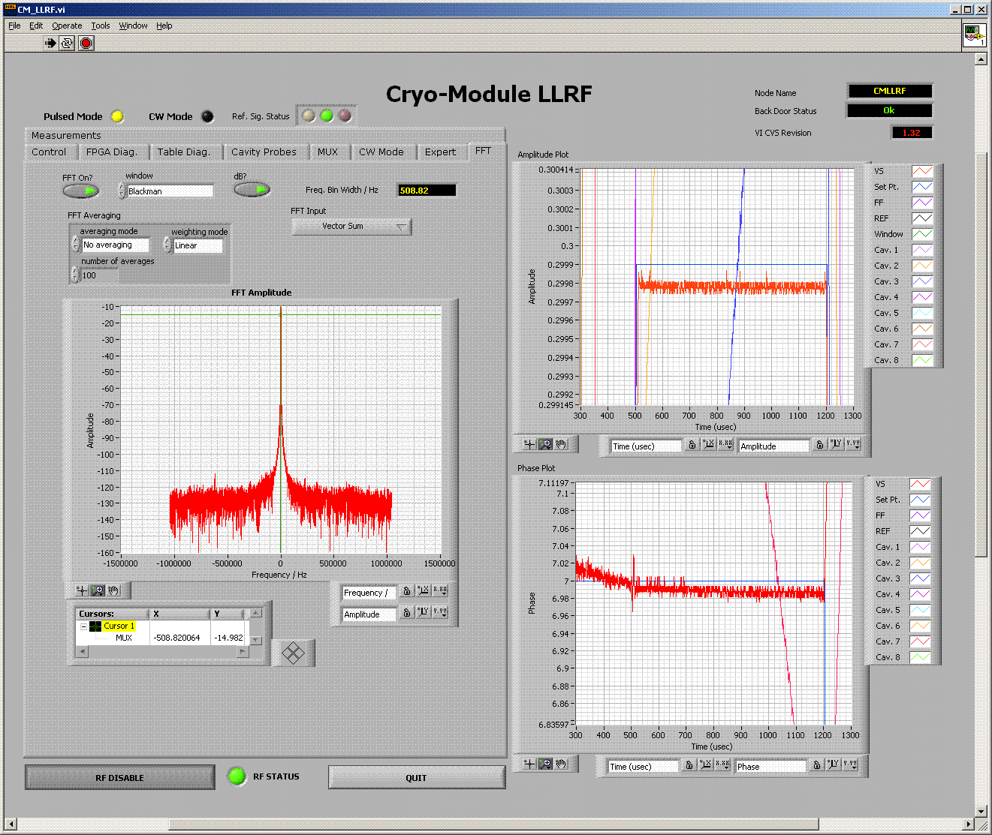
Closed loop Spectrum
Noise floor is about -150dBFS/Hz

