Slide 1
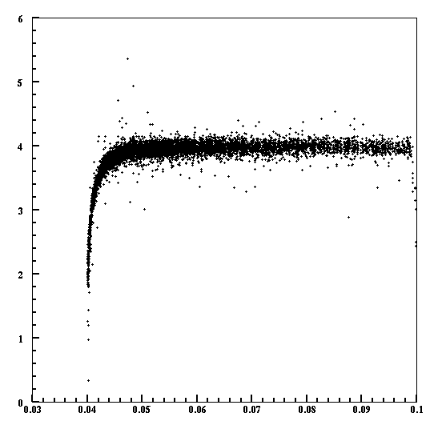
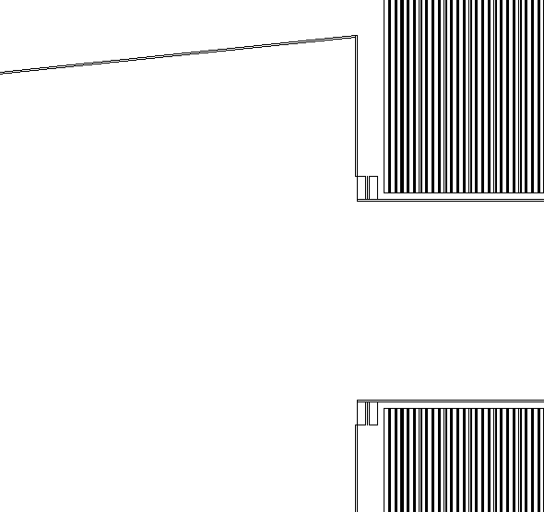
Bhabha rate
Looks good to 46 mrad.
47.5 mrad
Edep (GeV)
θ (rad.)

