Slide 1
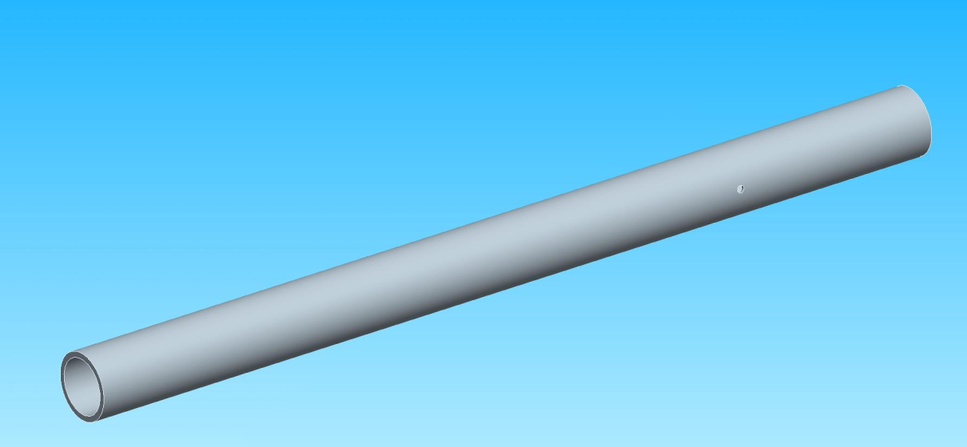
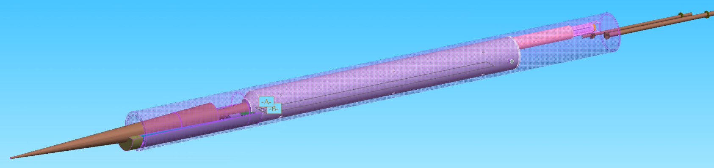
QD0 Support Tube Proposal
Rev. A

Slide 2
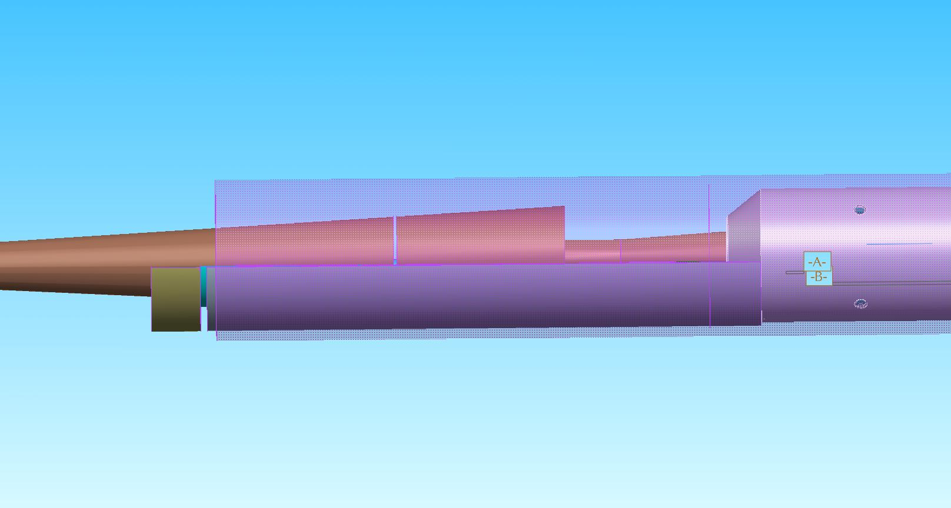
Support Tube Placement
Support Tube I.D. Ø390 mm
O.D. Ø470.8 mm
50 mm
QD0 Ø390 mm
1490 mm
Support Tube I.D. Ø420 mm
O.D. Ø470.8 mm

Slide 3
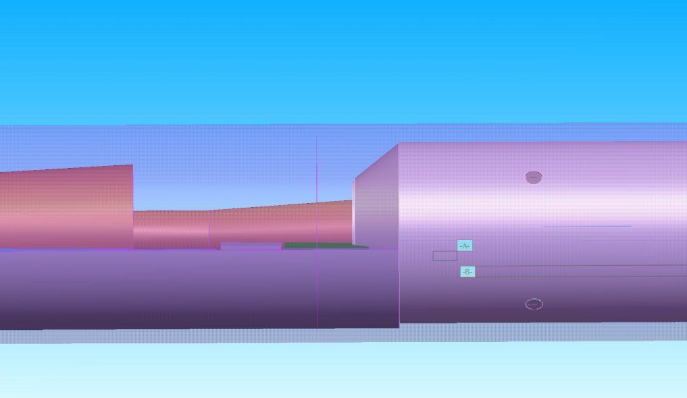
Support Tube Placement
Support Tube is oversized on the QDO side to allow for flex of the support tube without stress being applied to QD0.
Vacuum tube and support will be sized to fit in the Ø390 mm end of the support tube
Bellows will be used to connect the end of QD0 to the vacuum tube support structure.
50 mm
QD0 Ø390 mm
Support Tube I.D. Ø420 mm
O.D. Ø470.8 mm
Support Tube I.D. Ø390 mm
O.D. Ø470.8 mm

Slide 4
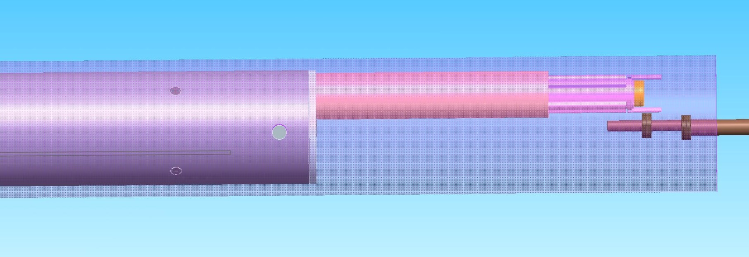
Support Tube Placement
The back of QD0 will be attached to the support tube via bolts to allow for rotation due to the deformation of the support tube.
Bolt Hole Rotation Pt.
Support Tube I.D. Ø420 mm
O.D. Ø470.8 mm
QD0 Ø390 mm
1374 mm

Slide 5
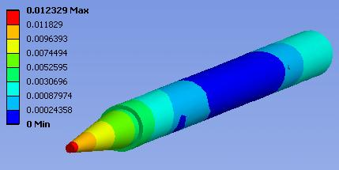
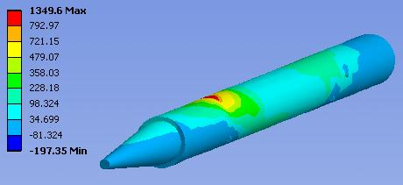
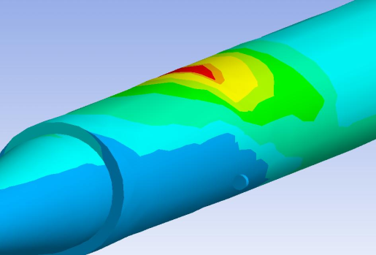
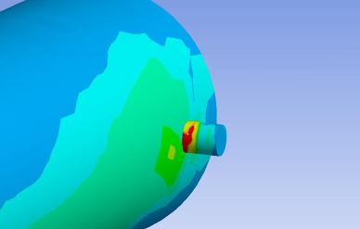
Support Tube Analysis (Door Closed)
Deformation & Stress

Slide 6
Support Tube Analysis (Door Open)
Deformation
SLIDE TO COME

Slide 7
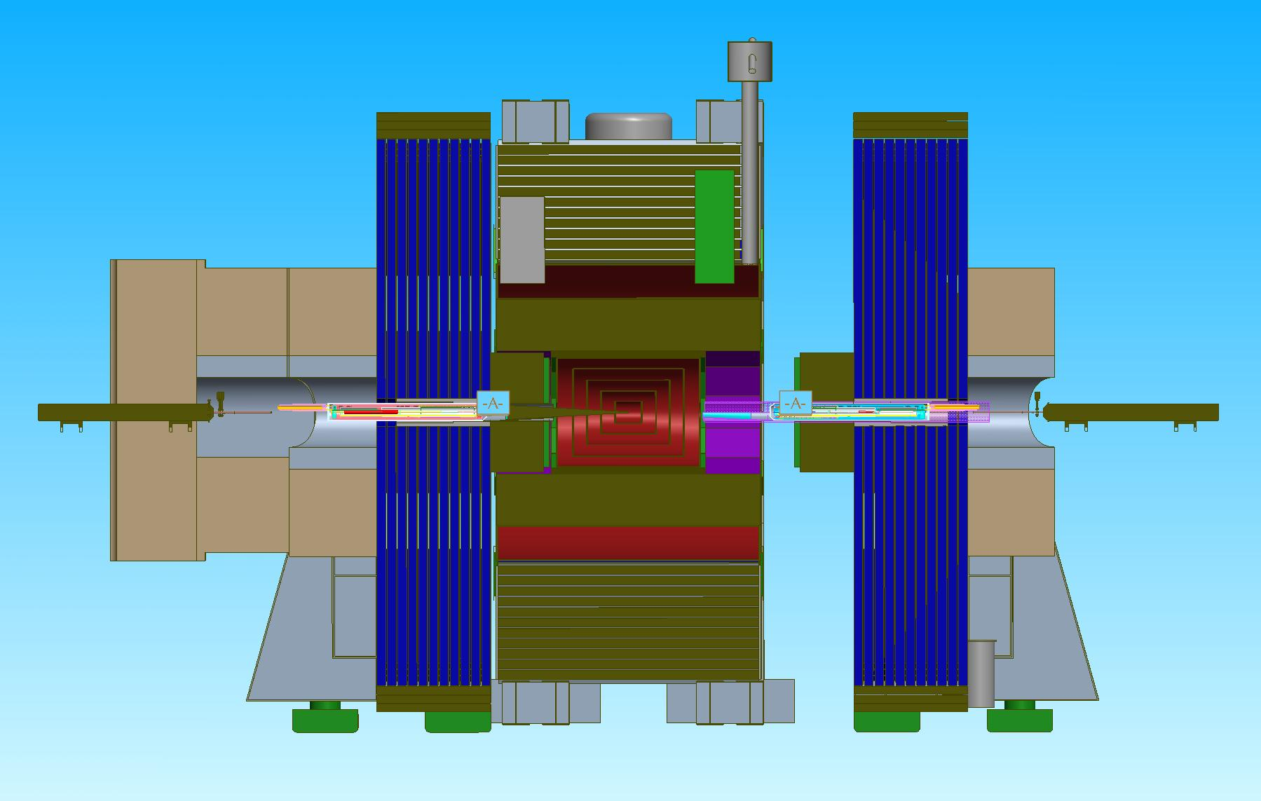
Support Tube Support Points
CLOSED
OPEN

