Slide 1



Phase stability of CLIC Drive Beam
Alexander Gerbershagen
University of Oxford, FONT group
CERN, BE-ABP-CC3 group
22/09/2011
Phase Stability of CLIC Drive Beam
1
Notes:
1

Slide 2
Content
Introduction
Part 1: Modelling of the error, consider 4 steps:
1. Drive beam accelerator
2. Compressor chicane
3. Combination scheme
4. PETS -> main linac
Part 2: Correcting the errors: feedforward system
Apply feedforward using phase monitor
Summary, Conclusions and Outlook
22/09/2011
Phase Stability of CLIC Drive Beam
2

Slide 3
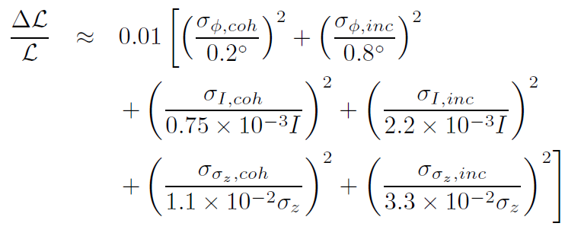
Introduction
Drive beam phase stability is a critical issues for CLIC design
  bunch charge and phase errors contribute quadratically to luminosity loss
  error of the bunch length
  => error of the bunch form factor
  => increase bunch charge to maintain accelerating gradient => further luminosity loss
From:
D.Schulte et al., ”Status of the CLIC Phase and Amplitude Stabilisation Concept” for LINAC10, CERN-ATS-2010-226
22/09/2011
Phase Stability of CLIC Drive Beam
3

Slide 4
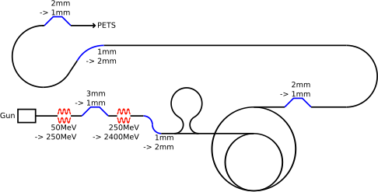
Introduction: Tolerances
Emittance ε_{x,y} ≤ 150μm
Transverse jitter ≤ 0.3σ
Current stability 0.75 x 10⁻³
Phase stability 0.2° @ 12GHz
Bunch length stability 1%
RF power stability 0.2%
RF phase stability 0.05°
Phase stability 2.5° @ 12GHz
0.2° @ 1GHz
Plot by D. Schulte
22/09/2011
Phase Stability of CLIC Drive Beam
4

Slide 5
Part 1: Modelling of the errors: developed program tool
22/09/2011
Phase Stability of CLIC Drive Beam
5

Slide 6
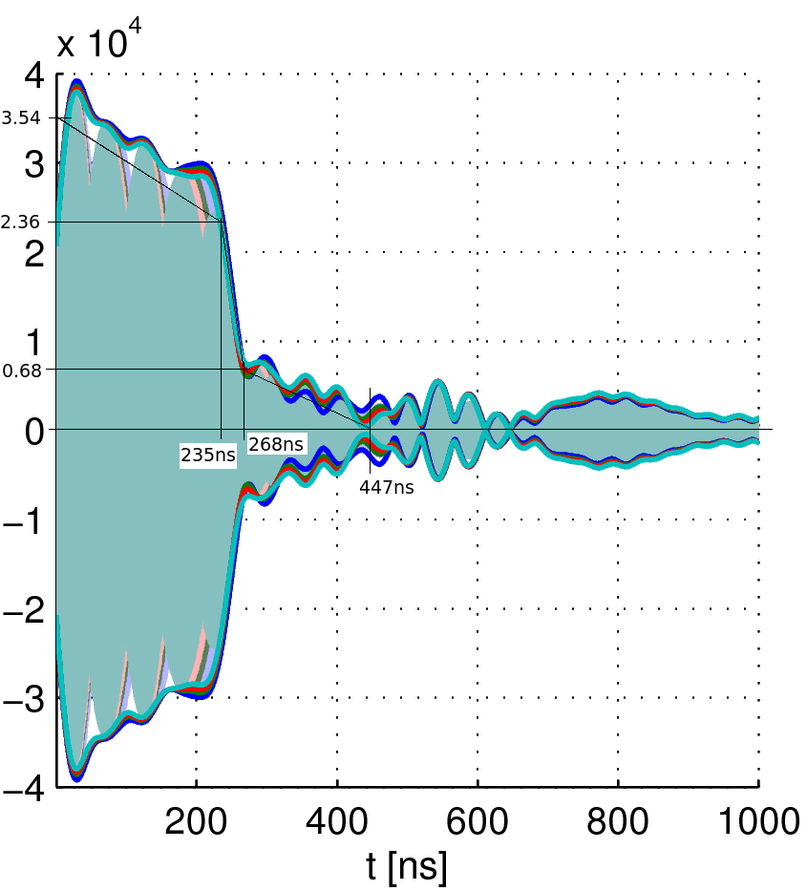
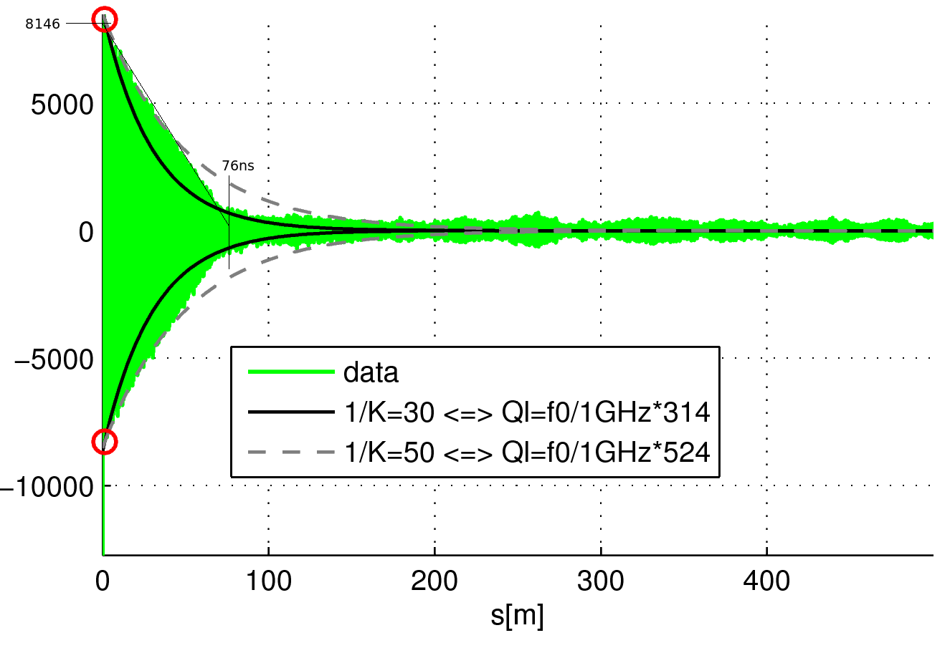
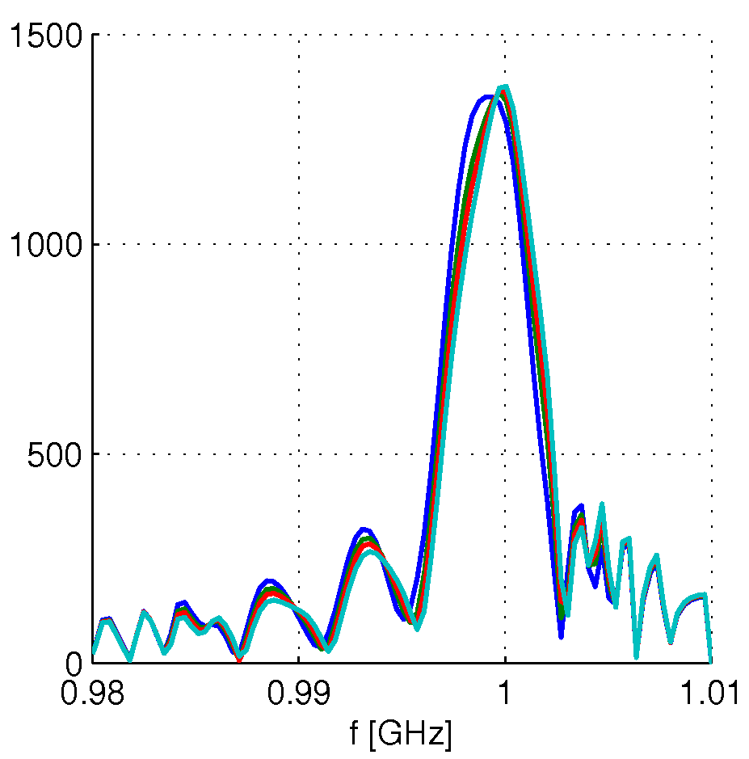
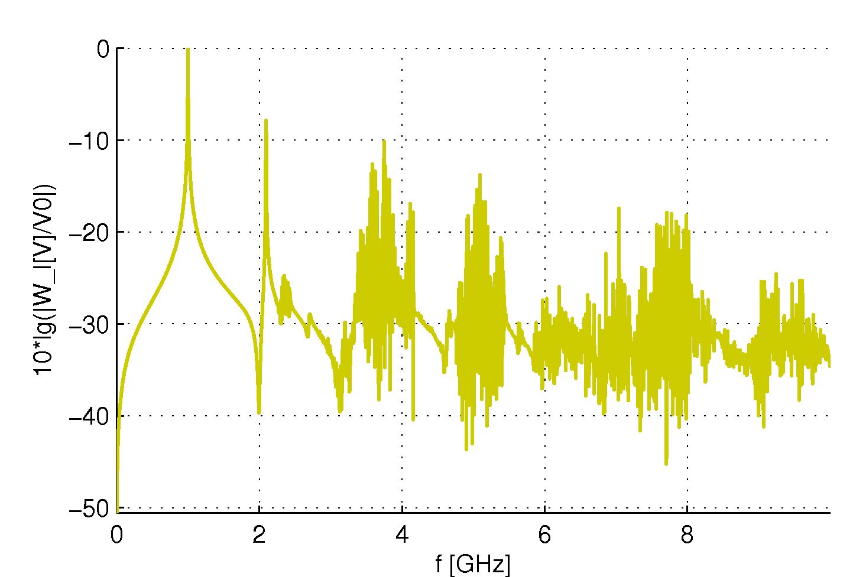
Modelling of the errors:
Step 1 – drive beam accelerator
Bunch charge errors cause beam loading error in DB accelerator
Calculated in frequency domain, then fft to time domain
Higher order resonances included in wake fields calculation
3 points per sinus wave, hence strong beating in RF potential
RF potential
Wake potential
RF potential (V)
Wake potential (V)
Simulation by R.Wegner
22/09/2011
Phase Stability of CLIC Drive Beam
6

Slide 7
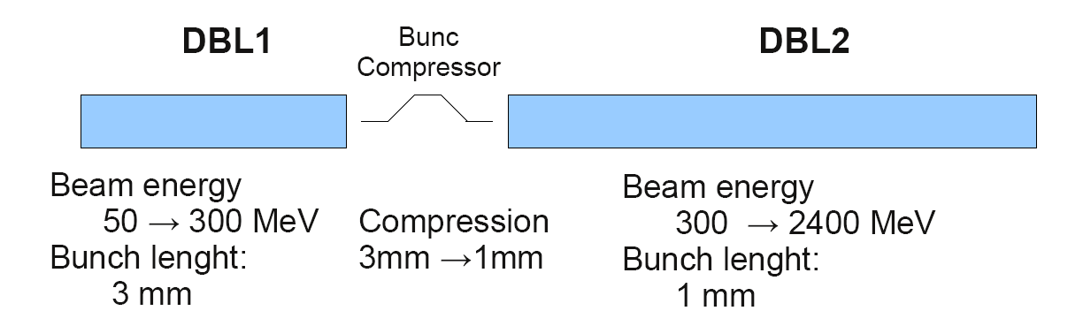
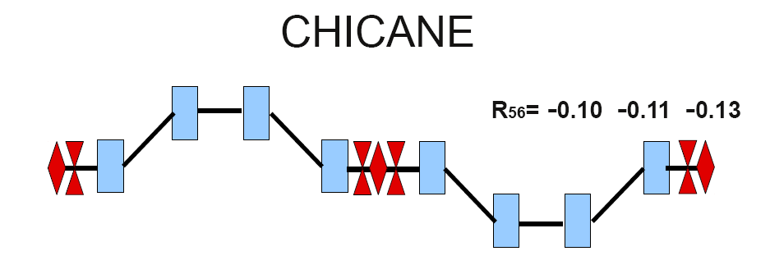
Modelling of the errors:
Step 2 – chicane
A.Aksoy comes to conclusion that best stability
is provided by chicane with R₅₆=-0.1
22/09/2011
Phase Stability of CLIC Drive Beam
7

Slide 8
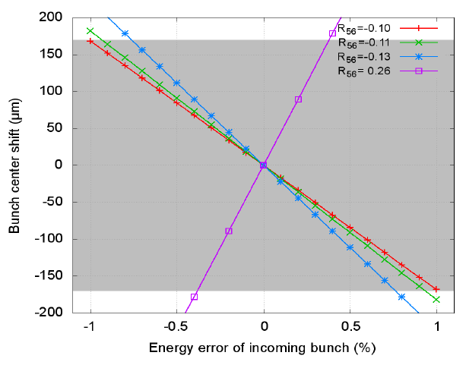
Modelling of the errors:
Step 2 – chicane
Beam loading error causes a phase shift in the chicane
Phase Stability of CLIC Drive Beam
22/09/2011
Simulation by A. Aksoy
8

Slide 9
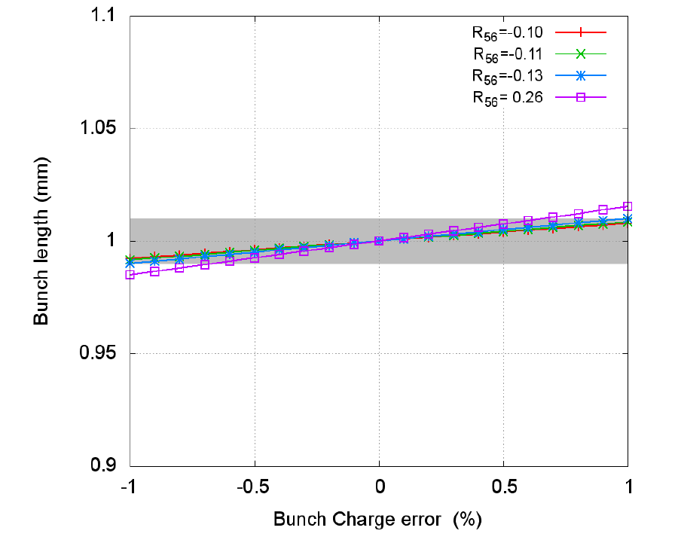
Modelling of the errors:
Step 2 – chicane
Bunch length variation tolerance of 1% dictates single bunch charge tolerance of 1%
Coherent bunch charge error must be <0.1%, as dictated by MB decelerator
Phase Stability of CLIC Drive Beam
22/09/2011
Simulation by A. Aksoy
9

Slide 10
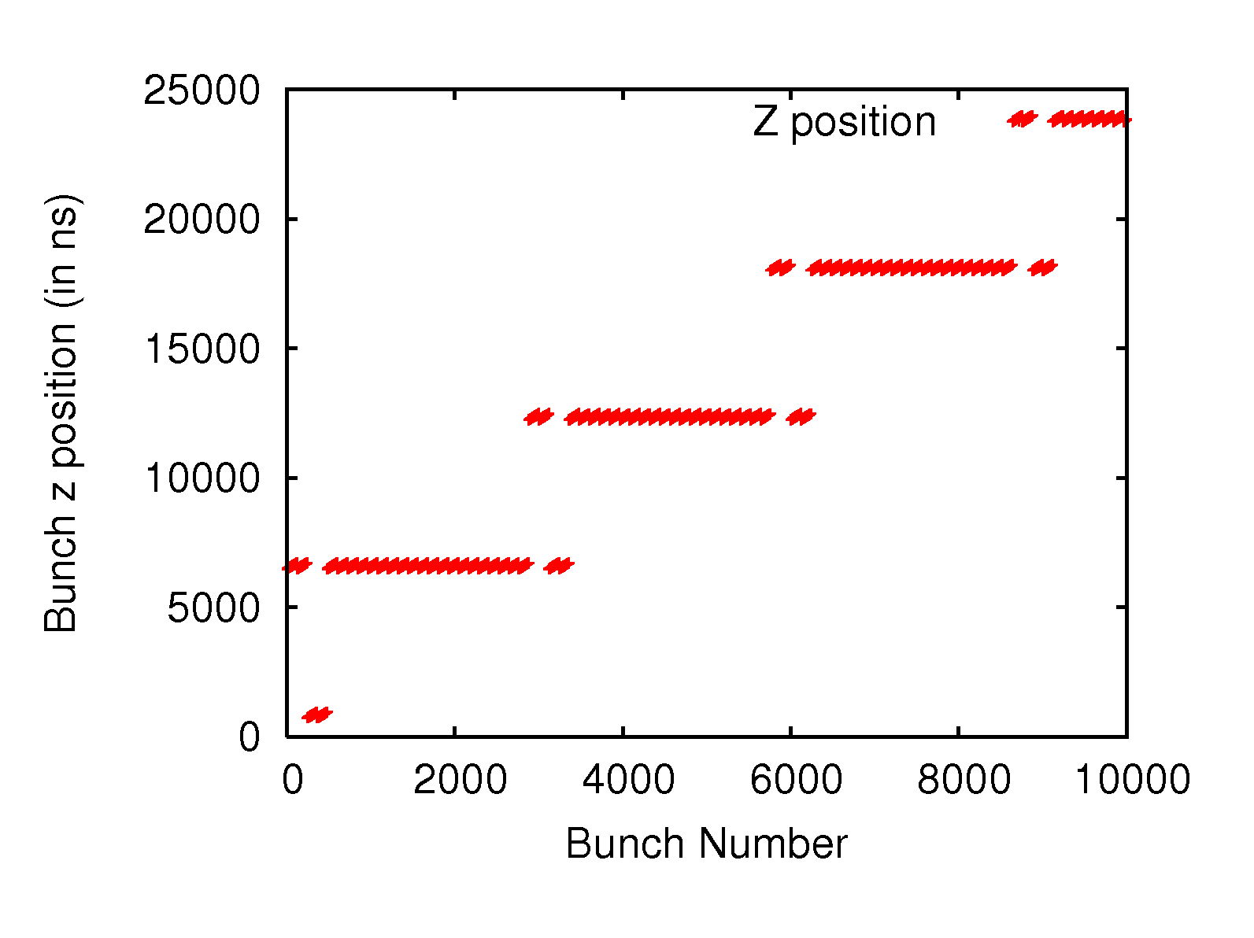
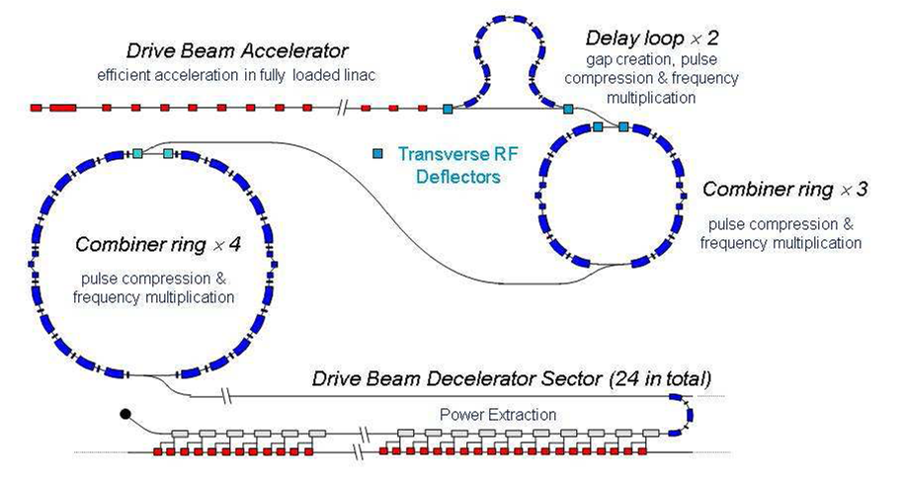
Modelling of the errors:
Step 3 – combination scheme
Bunches are recombined in the combination scheme in a non-trivial way
because of the principle of operation of the first combiner ring
22/09/2011
Phase Stability of CLIC Drive Beam
10

Slide 11
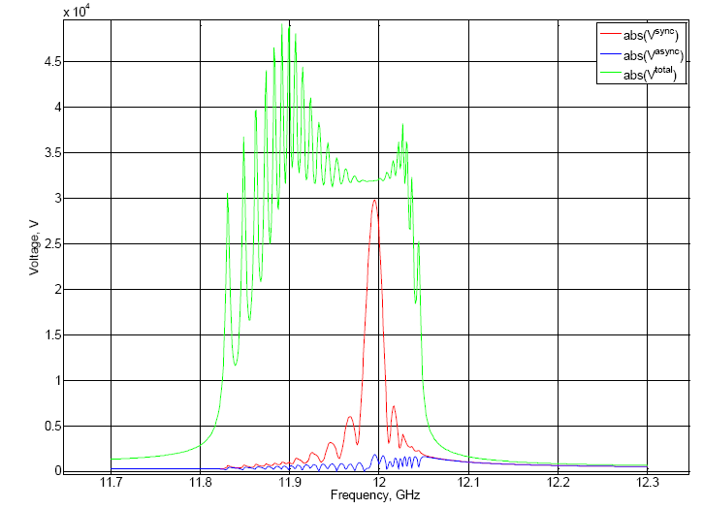
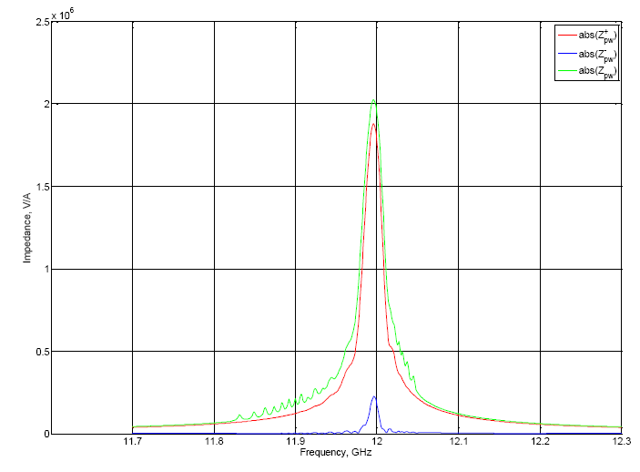
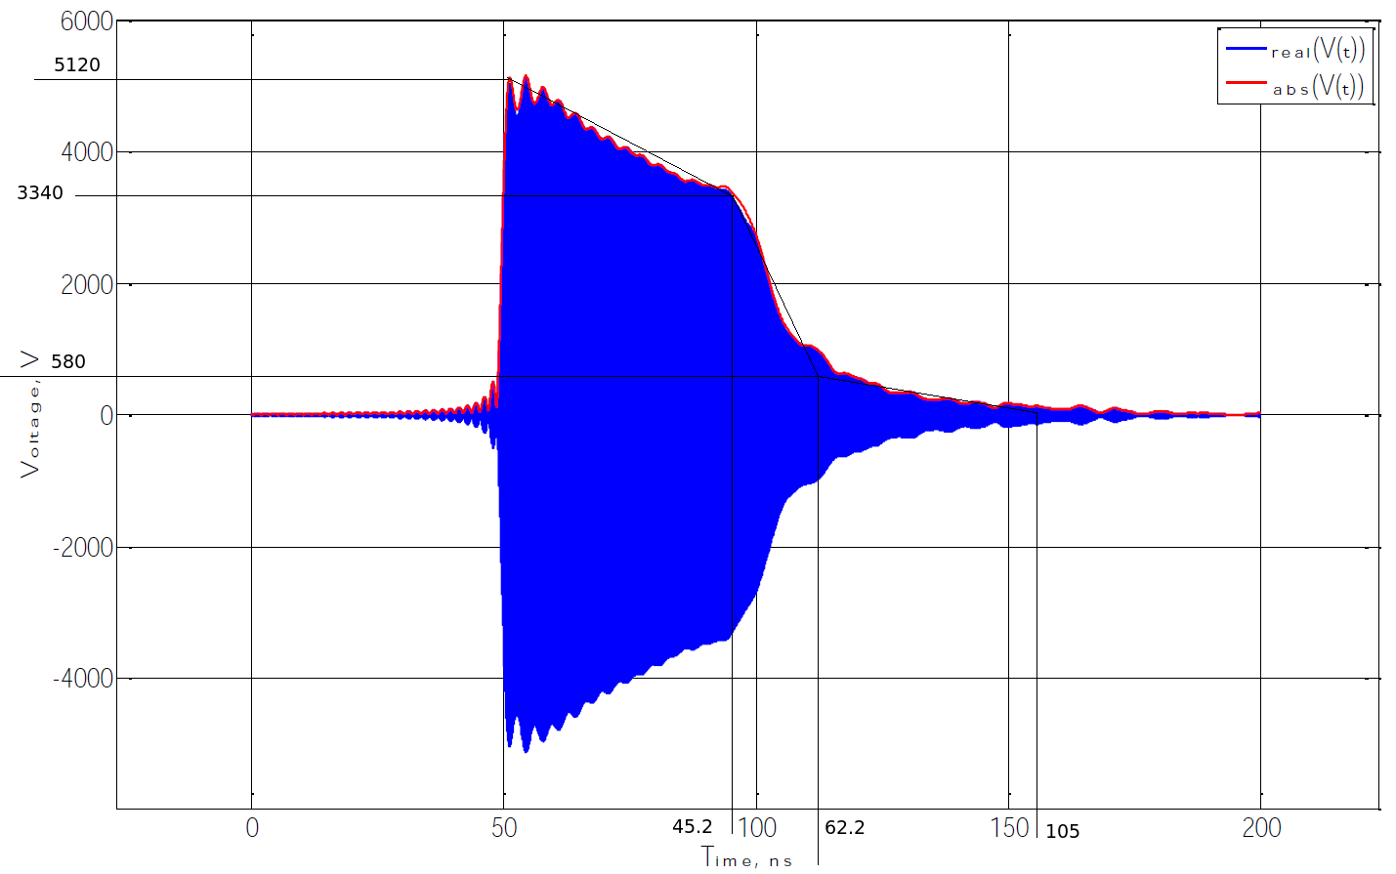
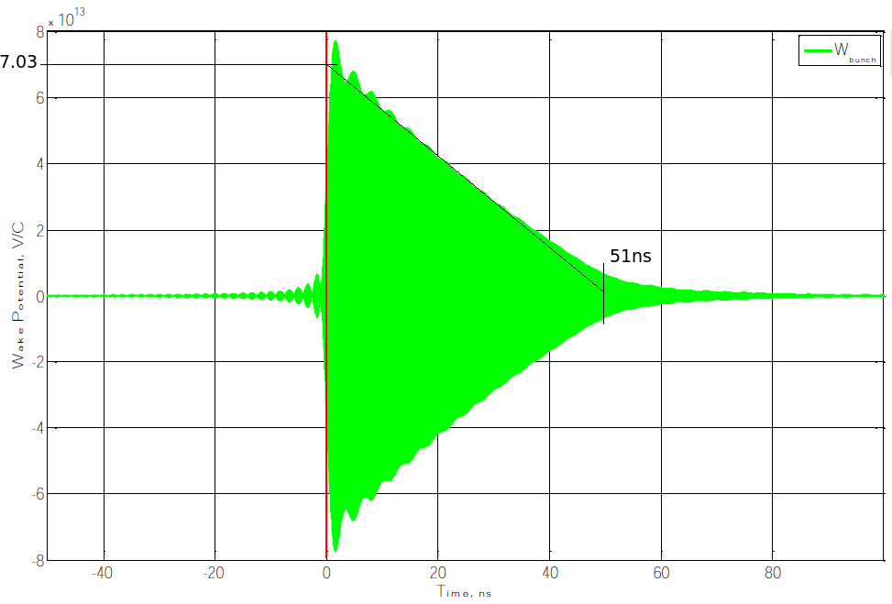
Modelling of the errors:
Step 4 – main beam accelerator
Interval 11.7 GHz – 12.3 GHz
Calculate in frequency domain, then fft
Simulation by O. Kononenko
22/09/2011
Phase Stability of CLIC Drive Beam
11

Slide 12
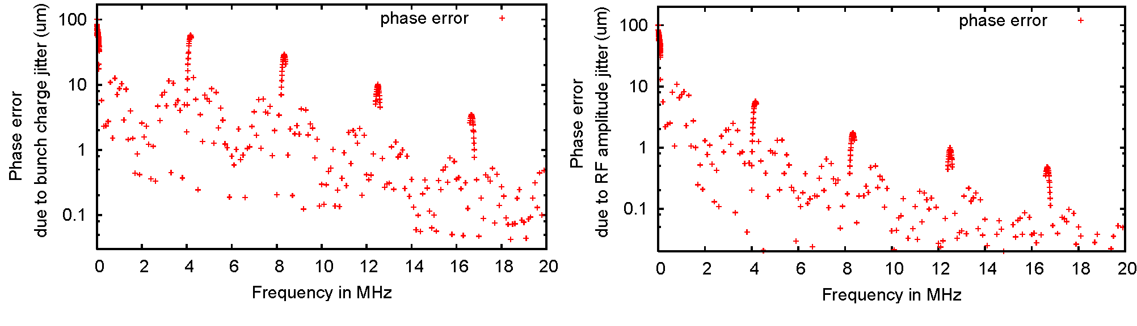
Modelling of the errors:
Result
Phase error generated by
0.1% bunch charge error 0.05% drive beam RF amplitude error
Peaks from 240ns long trains in combination scheme
Suppression of peaks from 240ns drive beam accelerating structures
Suppression of high frequencies by convoluting the signal with main beam
accelerating structure RF filling
22/09/2011
Phase Stability of CLIC Drive Beam
12

Slide 13
Part 2: Correcting the errors
22/09/2011
Phase Stability of CLIC Drive Beam
13

Slide 14
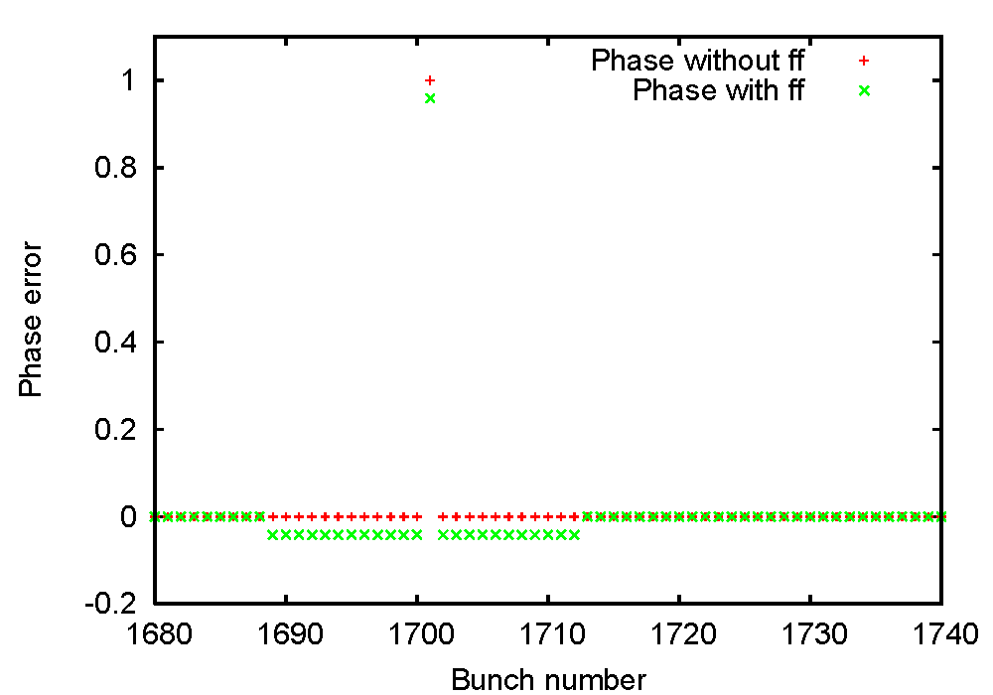
Feedforward system
What is a feedforward system?
folder options
Linear rise in xns
Efficiency depends on the averaging time
Correction can be applied before the bunch with the measured error
22/09/2011
Phase Stability of CLIC Drive Beam
14

Slide 15
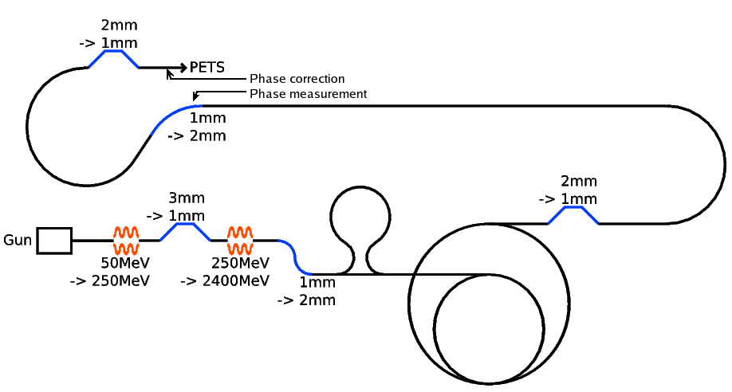
Feedforward system
folder options
22/09/2011
Phase Stability of CLIC Drive Beam
15

Slide 16
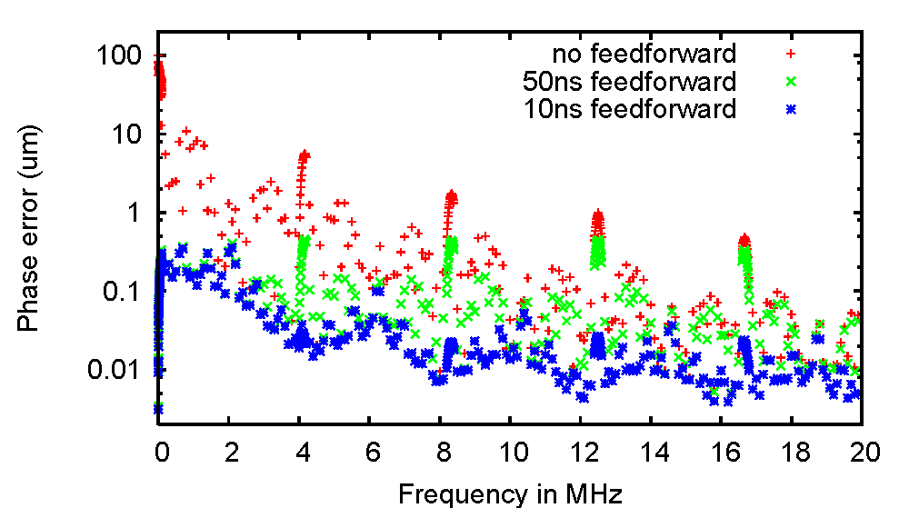
Feedforward averaging time
Phase error generated by 0.05% drive beam RF amplitude error
14 μm
Higher bandwidth feedforward performs better correction at high frequencies
22/09/2011
Phase Stability of CLIC Drive Beam
16

Slide 17
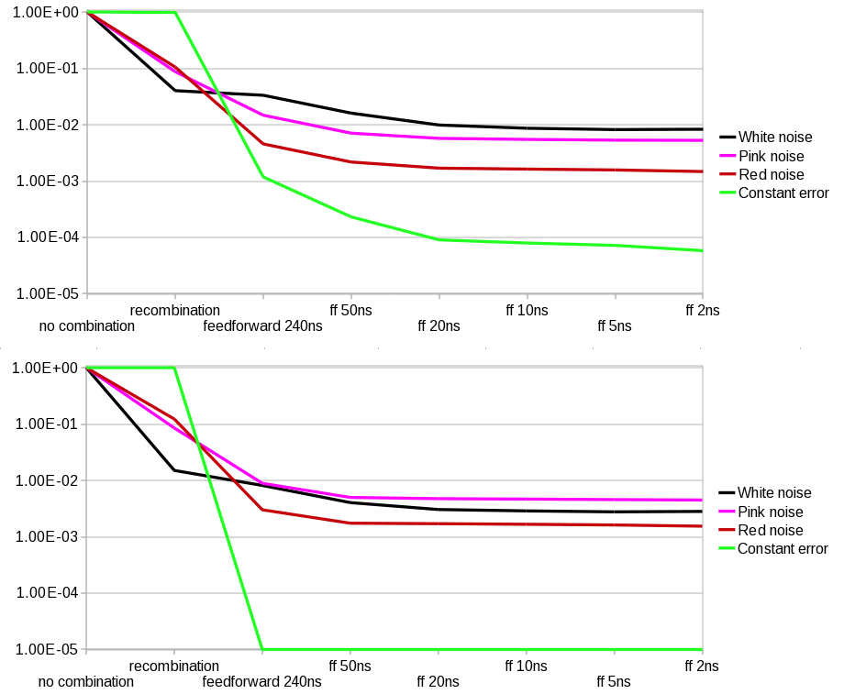
Different types of noise
Phase error
generated by :
0.1% bunch
charge error
0.05% drive beam RF amplitude error
22/09/2011
Phase Stability of CLIC Drive Beam
17

Slide 18
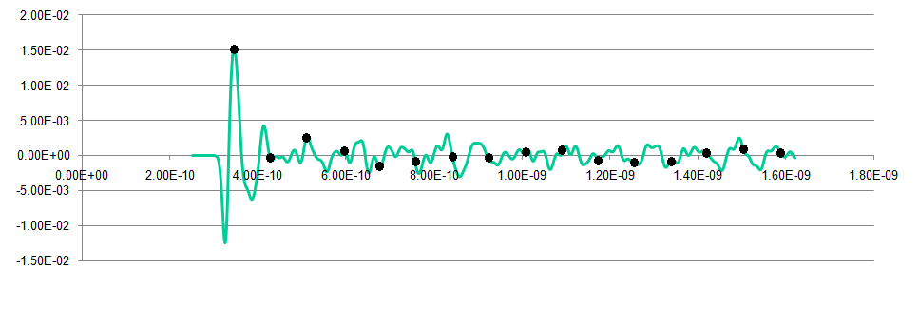
Phase monitor
Phase monitor impulse response
Put first bunch of the correction on maximum
Problem: sum of all corrections is 0.572 (normalized to maximum value)
Possible solution: set the first bunch so that the total sum is 1
22/09/2011
Phase Stability of CLIC Drive Beam
18

Slide 19
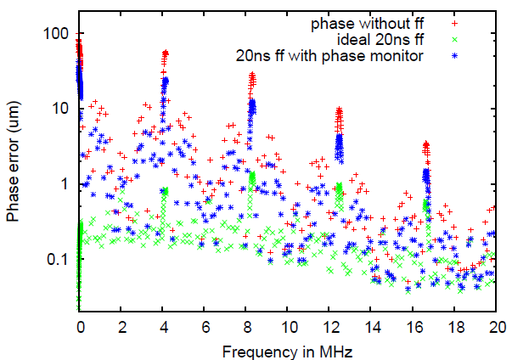
Phase monitor
Phase error generated by 0.1% bunch charge error
Rebecca Black
=> Improvement of phase monitor is required
22/09/2011
Phase Stability of CLIC Drive Beam
19

Slide 20
Summary of the study
Part 1: Developed program tool calculates 1st order effects of
1. Drive beam accelerator
2. Compressor chicane
3. Combination scheme
4. PETS -> main linac.
The resulting error function with peaks at frequencies resonant to 240ns, declining at higher frequencies
Part 2: Feedforward needs to have a high bandwidth
(dependent on type of noise, e.g. for white noise
~10ns for factor 10 correction)
Improvement of phase monitor is required
22/09/2011
Phase Stability of CLIC Drive Beam
20

Slide 21
Conclusions and Outlook
Phase error is reduced by factor 10 due to filtering
Additional factor 10 with help of the feedforward system
New tolerances dictated by the constraints from the second order effects, e.g.
  scale errors
  feedforward resolution
  feedforward capture range
Next steps
  For CLIC:
    Include second order effects into the program tool
    Use the results for main beam studies
  For CTF3:
    Adopt the program for simulations of CTF3 phase error
    Compare predictions with CTF3 results
    Install first feedforward prototype
22/09/2011
Phase Stability of CLIC Drive Beam
21

