Slide 1
Transverse Beam Jitter Propagation in Multi-bunch Operation at ATF2
Javier Resta López
IFIC (CSIC-UV), Valencia, Spain
FONT meeting,
Oxford, 23-09-2011

Slide 2
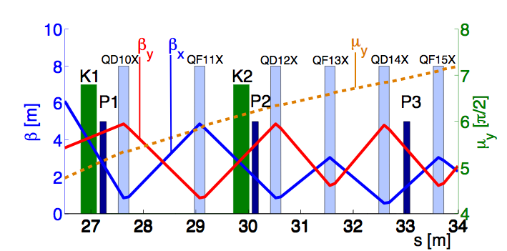
Intra-train feedback system
Optics layout

Slide 3
Transverse jitter propagation
Let us assume a beam pulse consisting of multiple bunches, each bunch centroid characterised by a vector y=(y, y’). An ensemble of y and y measurements performed over many beam pulses can be characterised statistically by the following covariance matrix
Position and angle jitter:
If R(s₁|s₀) is the 2x2 transfer matrix of the transport line from point s₀ to point s₁, the covariance matrix is transformed as follows:
R(s₁|s₀)^{T} being the traspose matrix of R.

Slide 4
Transverse jitter propagation (another way to calculate it)
If the optics of the transfer line is known, from the rms position measurements by three different
BPMs, σ₍₁₎=<y₁²>^{1/2}, σ₍₂₎=<y₂²>^{1/2}, σ₍₃₎=<y₃²>^{1/2}, the position and angular jitter can be calculated
at any other point i^{th} of the beamline:
where M is the following matrix:
where the terms R_{33,(j)} and R_{34,(j)} are the terms corresponding to the transfer matrix from j^{th} BPM
(j=1,2,3) to the point i^{th} where we want to evaluate the jitter values: σ_{(i)}=<y_{i}²>^{1/2}, σ’_{(i)}=<y’_{i}²>^{1/2}.

Slide 5
Vertical jitter measurements (“Golden set”)
16th April 2011:
ATF2 operation conditions:
1.3 GeV 3-bunch trains
154 ns bunch separation
1.56 Hz frequency repetition rate at ATF.
FB system operated in coupled FB mode corrects simultaneously y and y’
Interleaving measurements with FB switched off (FB OFF) and on (FB ON).
BPM resolution estimated to be better than 0.4 micrometres for P2 and about 1 micrometre for P3
Set of measurements of 1000 pulses

Slide 6
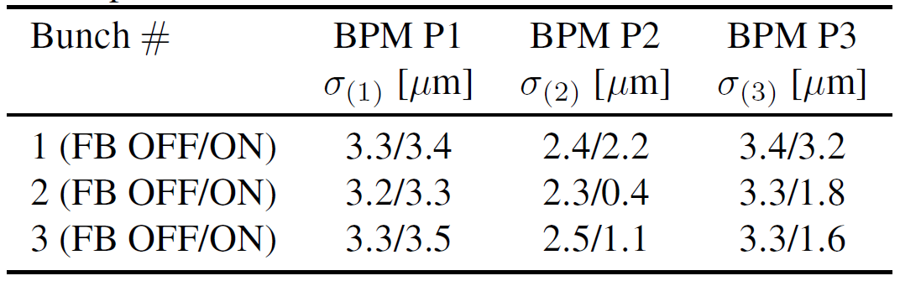
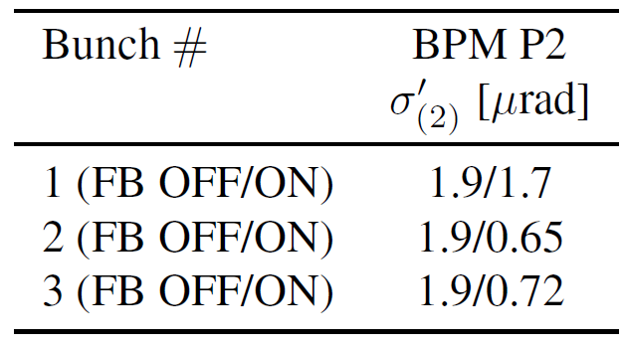
Vertical jitter measurements (“Golden set”)
16th April 2011
Vertical position jitter
Vertical angle jitter at P2

Slide 7
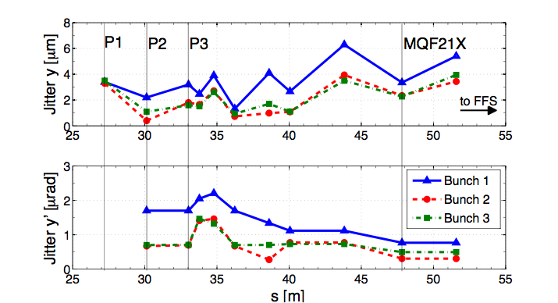
Position and angle jitter in the ATF2 EXT line (Evaluation using nominal lattice)
FB ON

Slide 8
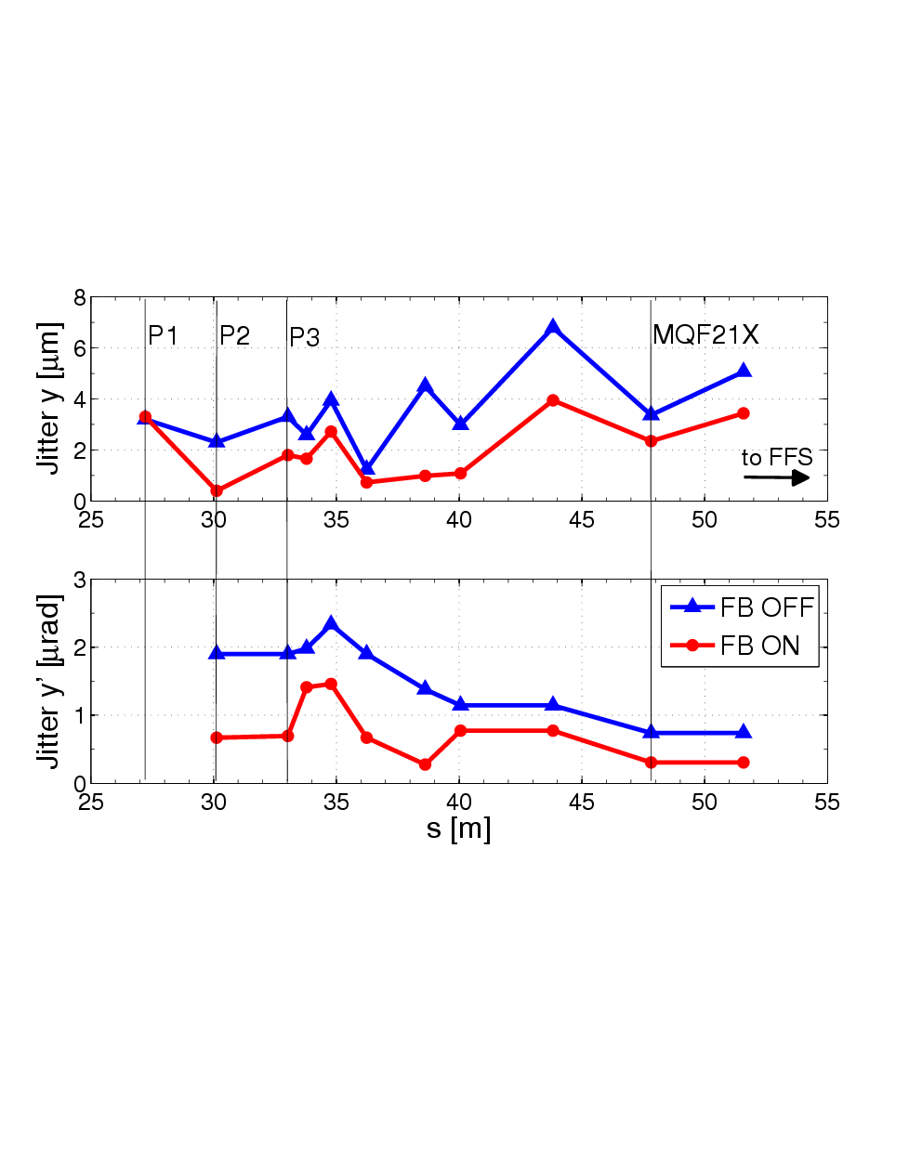
Position and angle jitter in the ATF2 EXT line (Evaluation using nominal lattice)
For bunch 2

Slide 9
Tracking simulations and jitter evaluation
Vertical offset distributions tracked through ATF2 starting from P2.
For the initial offset distribution we can generate a bivariate normal distribution based on the information on rms position and angle jitter measured at P2:
where ρ=<yy’>/(σ₍₂₎σ’₍₂₎) is the y-y’ correlation factor: ρ=0.85 (FB OFF), ρ=0.03 (FB ON)
Tracking study using the code MAD and nominal ATF2 optics.

Slide 10
Tracking simulations and jitter evaluation
Example: Propagation for a distribution of 200 vertical offsets:

Slide 11
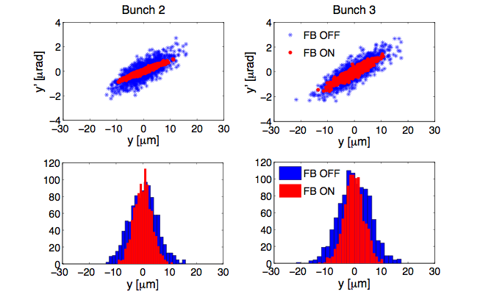
Tracking simulations and jitter evaluation
At FFS entrance
For distribution of 1000 pulses

Slide 12
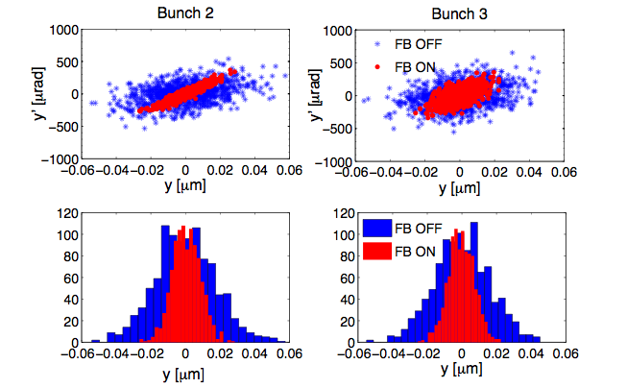
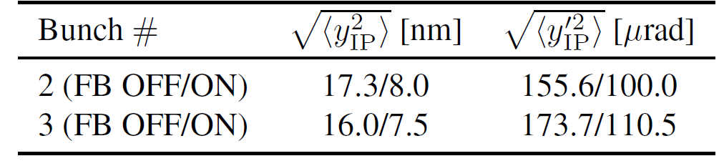
Tracking simulations and jitter evaluation
At IP
For distribution of 1000 pulses

Slide 13
Tracking simulations and jitter evaluation
Correction ratio at FFS entrance (marker BEGFF):
Correction ratio at IP:
The phase advance between BEGFF and IP is 7π/2 for the nominal optics;
position jitter correction at BEGFF transfers as angle jitter correction to the IP,
and vice versa

Slide 14
FlightSim 16 April 2010 v4.4/BX2p5BY1 lattice - Position
Glenn Christian
Crosschecking
with
Flight-simulator
(Lucretia)
IP
correction
factor ≈ 1.9

Slide 15
FlightSim 16 April 2010 v4.4/BX2p5BY1 lattice - Angle
Glenn Christian
Crosschecking
with
Flight-simulator
(Lucretia)
IP
correction
factor ≈ 1.6

Slide 16
Conclusions
Intra-train FB system located in the ATF2 EXT line has been tested, operating with ILC-like short trains in 3-bunch mode with 154 ns bunch separation.
This FB system reaches a factor 5 position jitter reduction and a factor 3 angle jitter reduction at BPM P2.
Simulation studies of jitter propagation, assuming no extra source of jitter downstream of the FB system, give a correction ratio FB OFF/ON of about 2 for position jitter and of about 1.5 for angle jitter at the IP.
The intra-train FB system in the ATF2 EXT line has the potential to stabilise the beam to below 10 nm at the IP.
These results are very encouraging and provide an important step towards the achievements of the ATF2 second goal.

Slide 17
Future plans
Improvement of the FONT BPM resolution for P3.
Reproduce the good results given by the “golden set”
Jitter measurements with other available BPMs downstream of the FB system and comparison with simulation results.
Measurements of the transverse emittance with the OTRs in the EXT line, and measurements of the x and y beam jitter with the FONT BPMs. In this way we can get a complete characterisation of the beam in the EXT line, and to obtain scaling factors emittance/jitter. Collaboration IFIC (Valencia) – JAI (Oxford).
Detailed study of possible jitter sources: EXT kicker, DR instabilities, etc.

