Slide 1

CFS Interaction Region Studies :
ARUP task 1 - Design Concept for Detector Movement Platform
ARUP task 2 - Layout of CLIC complex based on CERN Geology
John Osborne : CERN

Slide 2
Cavern Design
Yung Loo
Eden Almog
Matt Sykes

Slide 3
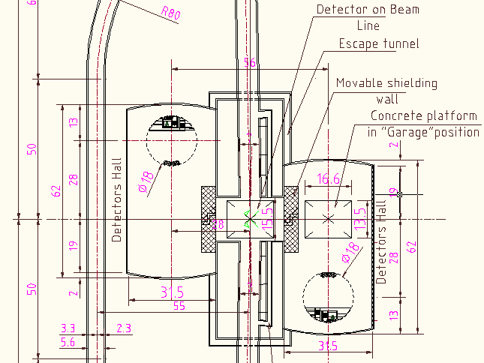
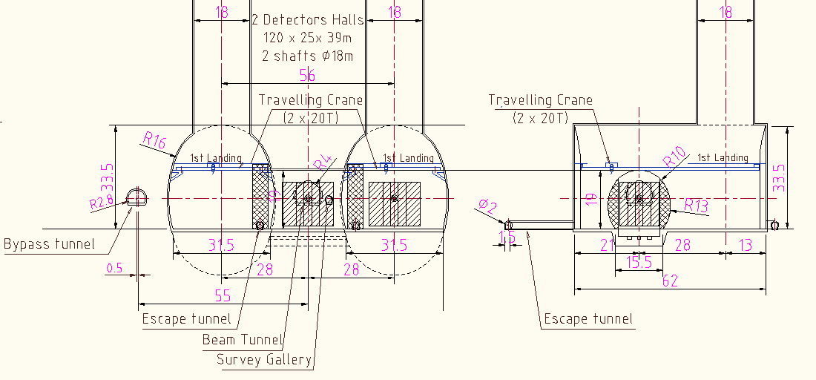
CLIC
Geometry
(Version G)

Slide 4
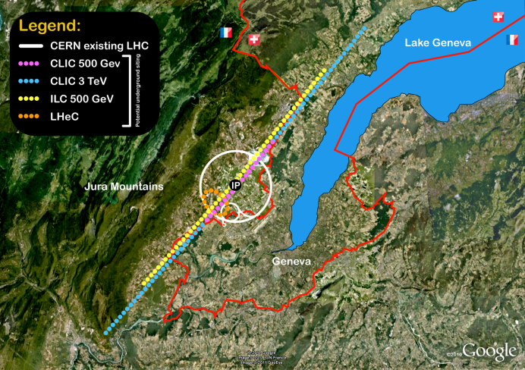
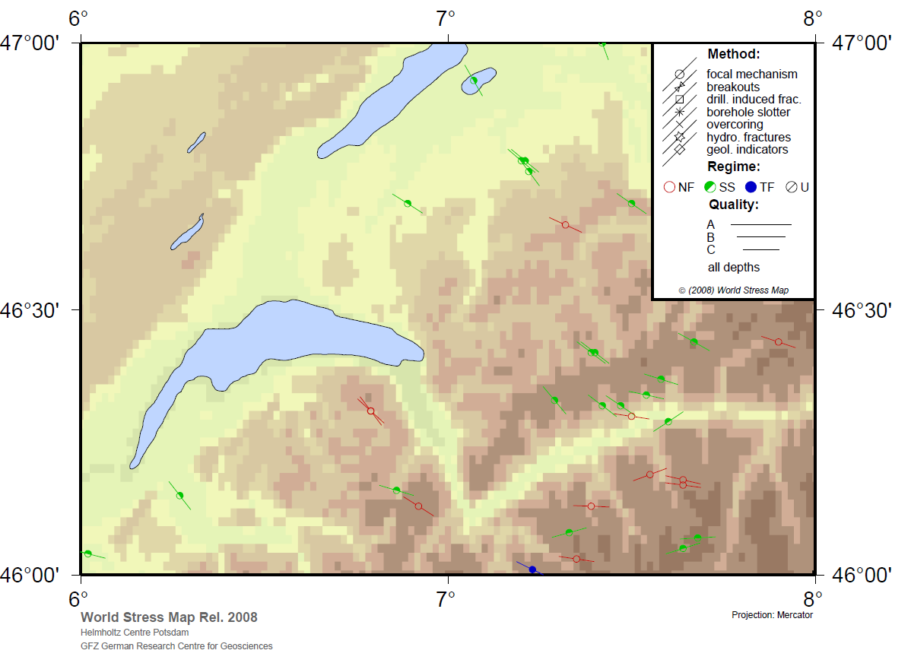
Progress Meeting, CERN (2nd August 2011)
CERN, Arup, Geoconsult and local geologist.
Agreed in-situ stress field direction perpendicular to beam line.
Agreed design parameters based on CMS geotechnical reports and professional opinion of Local Geologist.
Molasse Excavation Damage Zone (EDZ agreed to be critical for both cavern and slab design). Arup will investigate in detail.
Separation between CLIC service caverns seen by Arup as important factor in determining EDZ extent.
Monitoring data for static loading in CMS and ATLAS suggests minor secondary consolidation.
Notes:
Rock at depth is subjected to stresses resulting from the weight of the overlying strata and from locked in stresses of tectonic origin.

Slide 5
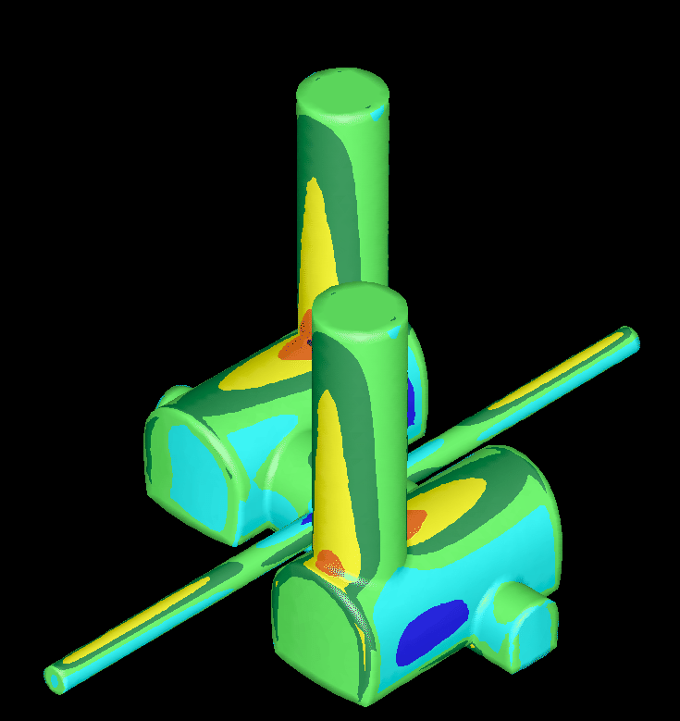
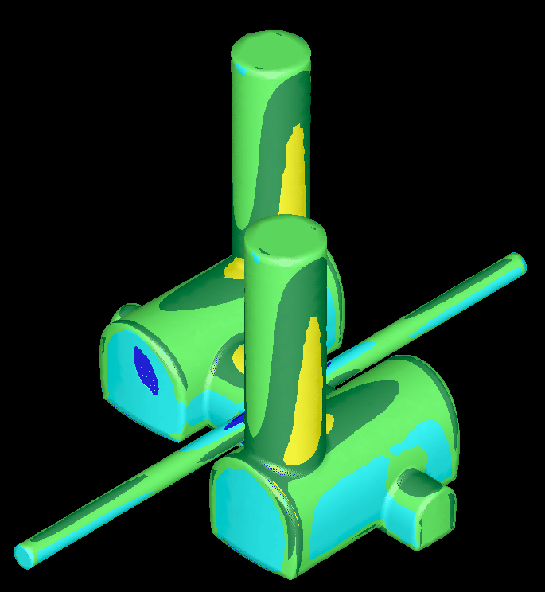
σ_{H} normal to beam tunnel
σ_{H} parallel to beam tunnel
In-situ stress field direction perpendicular to beam line.
IR cavern is ‘protected’ by assembly caverns.
Notes:
If σ_{H} normal to beam line: Beneficial for IR Cavern, not so good for Shaft/Crown Intersection

Slide 6
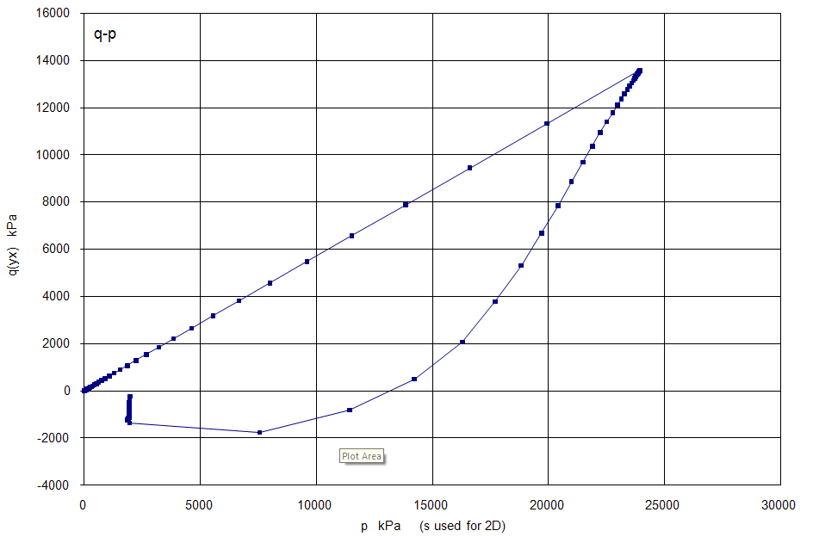
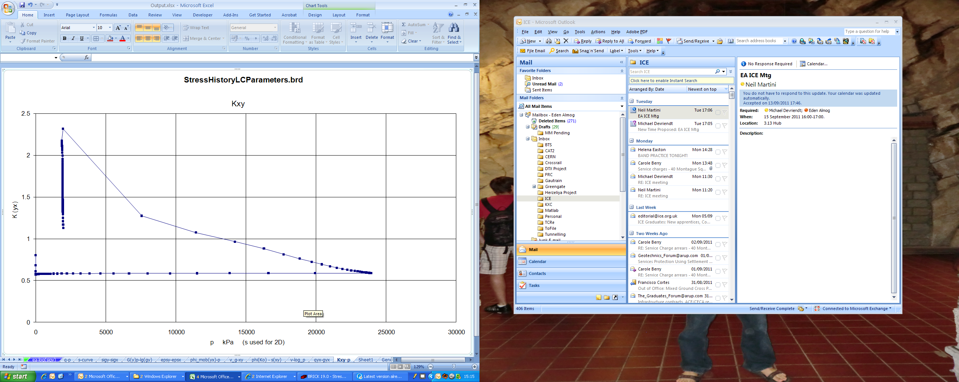
Simulated Stress History
Assumed stress path:
Stage | Name | Cavern Depth (m) | Soil Effective Weight (kN/m^3) | Vertical Effective Stress (kPa)
1 | Deposition of Molasse Rocks (2km) | 2060 | 16 | 33000
2 | Erosion | 60 | 16 | 1000
3 | Assumed deposition of 20m Moraine deposits | 80 | 11 | 1200
Simulated Current Stress State
Ko = 1.1 – 1.5 depending on Moraine deposition history
Molasse rock can be considered as a ‘Super consolidated silty clay’, not necessarily a rock, more like London Clay with 2km consolidation.
Ko is the ratio of vertical & horizontal stress.
Notes:
Molasse can be considered similar to a highly consolidated London Clay in terms of behaviour. Up to 2km of overburden in the past. Ko value determined = ratio vertical/horizontal stress.

Slide 7
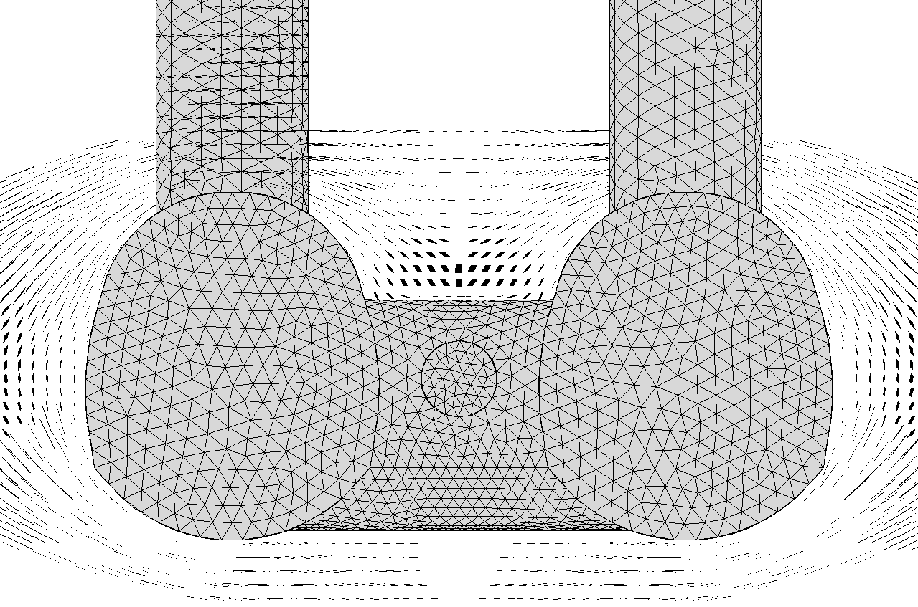
Layout G – Principal Stress Trajectories
Arching from caverns combine to increase stress
onto crown

Slide 8
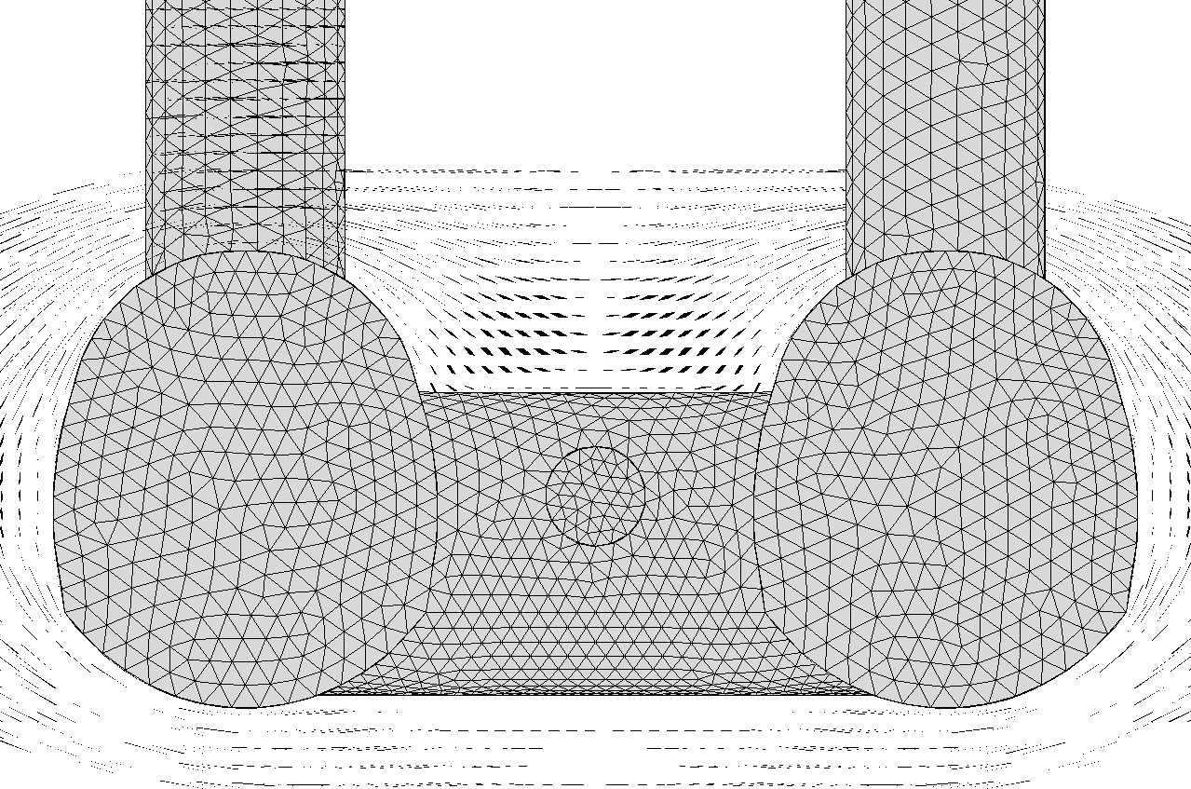
Layout G + 10m – Principal Stress Trajectories
Decreased stress on crown as less stress combination
Decreased Stress means simpler lining/rock support and less risk of Rock Yield

Slide 9
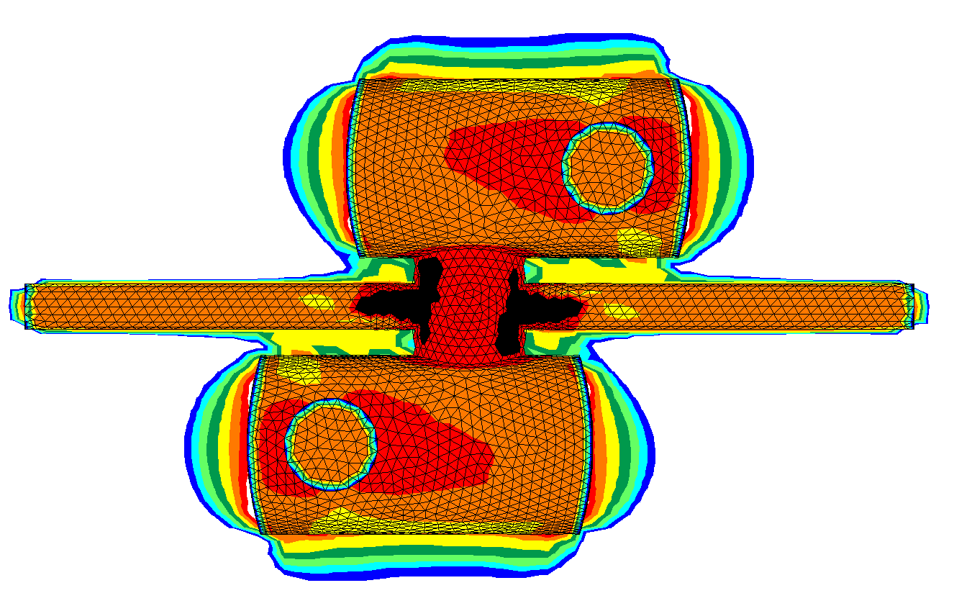
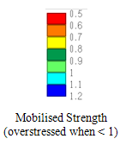
Layout G
Notes:
Black is bad

Slide 10
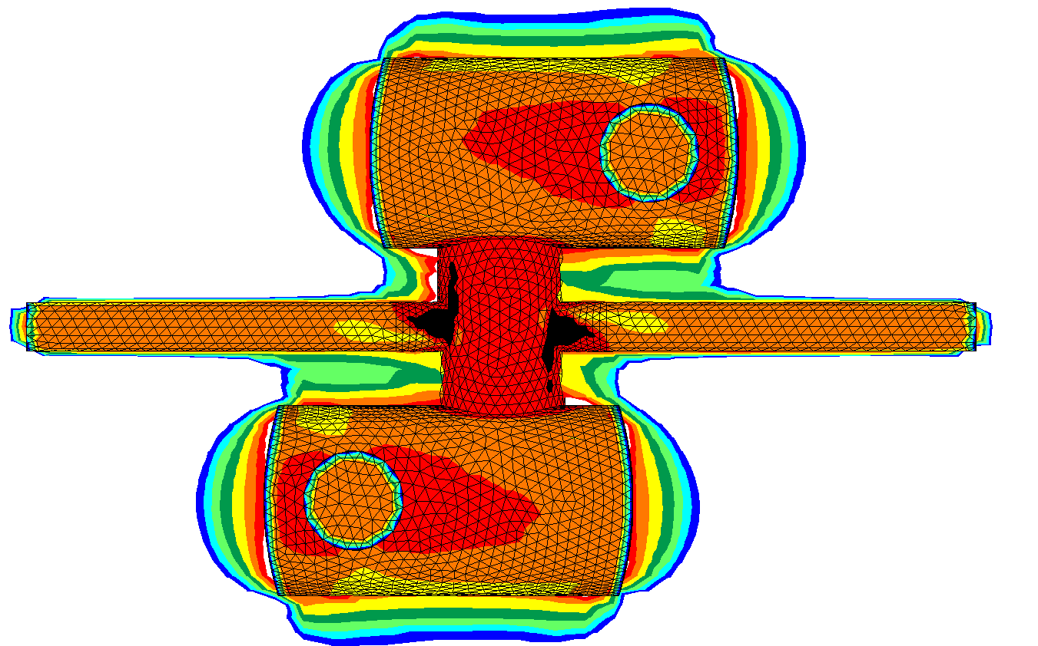
Layout G +10m Interaction Cavern Enlargement
Reduced stress means simpler cavern support/lining and less rock yielding

Slide 11
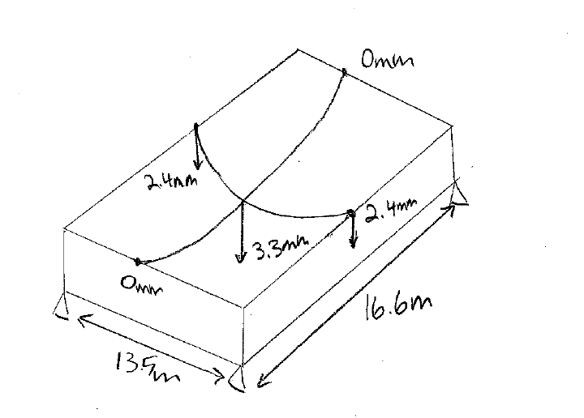
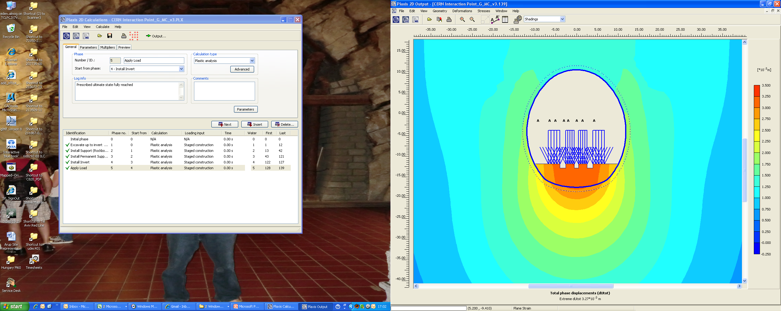
Extrapolated Invert Deformations
2D Soil-Structure Interaction Model
5.5m
Longitudinal: 3.3mm / 16.6m = 0.2mm/m x 20m = 4mm/20m > 0.5mm/20m (deformation criteria from concrete slab design)
Transversal: 3.3mm-2.4mm / 13.5m = 0.07 x 20 = 1.4mm/20m > 0.5mm/20m.
Unacceptable invert deformation. Highlights the need to sequence cavern construction
Interaction Cavern Invert Performance
Notes:
0.5mm/20mm invert deformation. Slab on the RHS is the 5.5m invert. Here we are outside the criteria of 0.5mm/20m from slab design. Is total deflection slab + invert ??

Slide 12
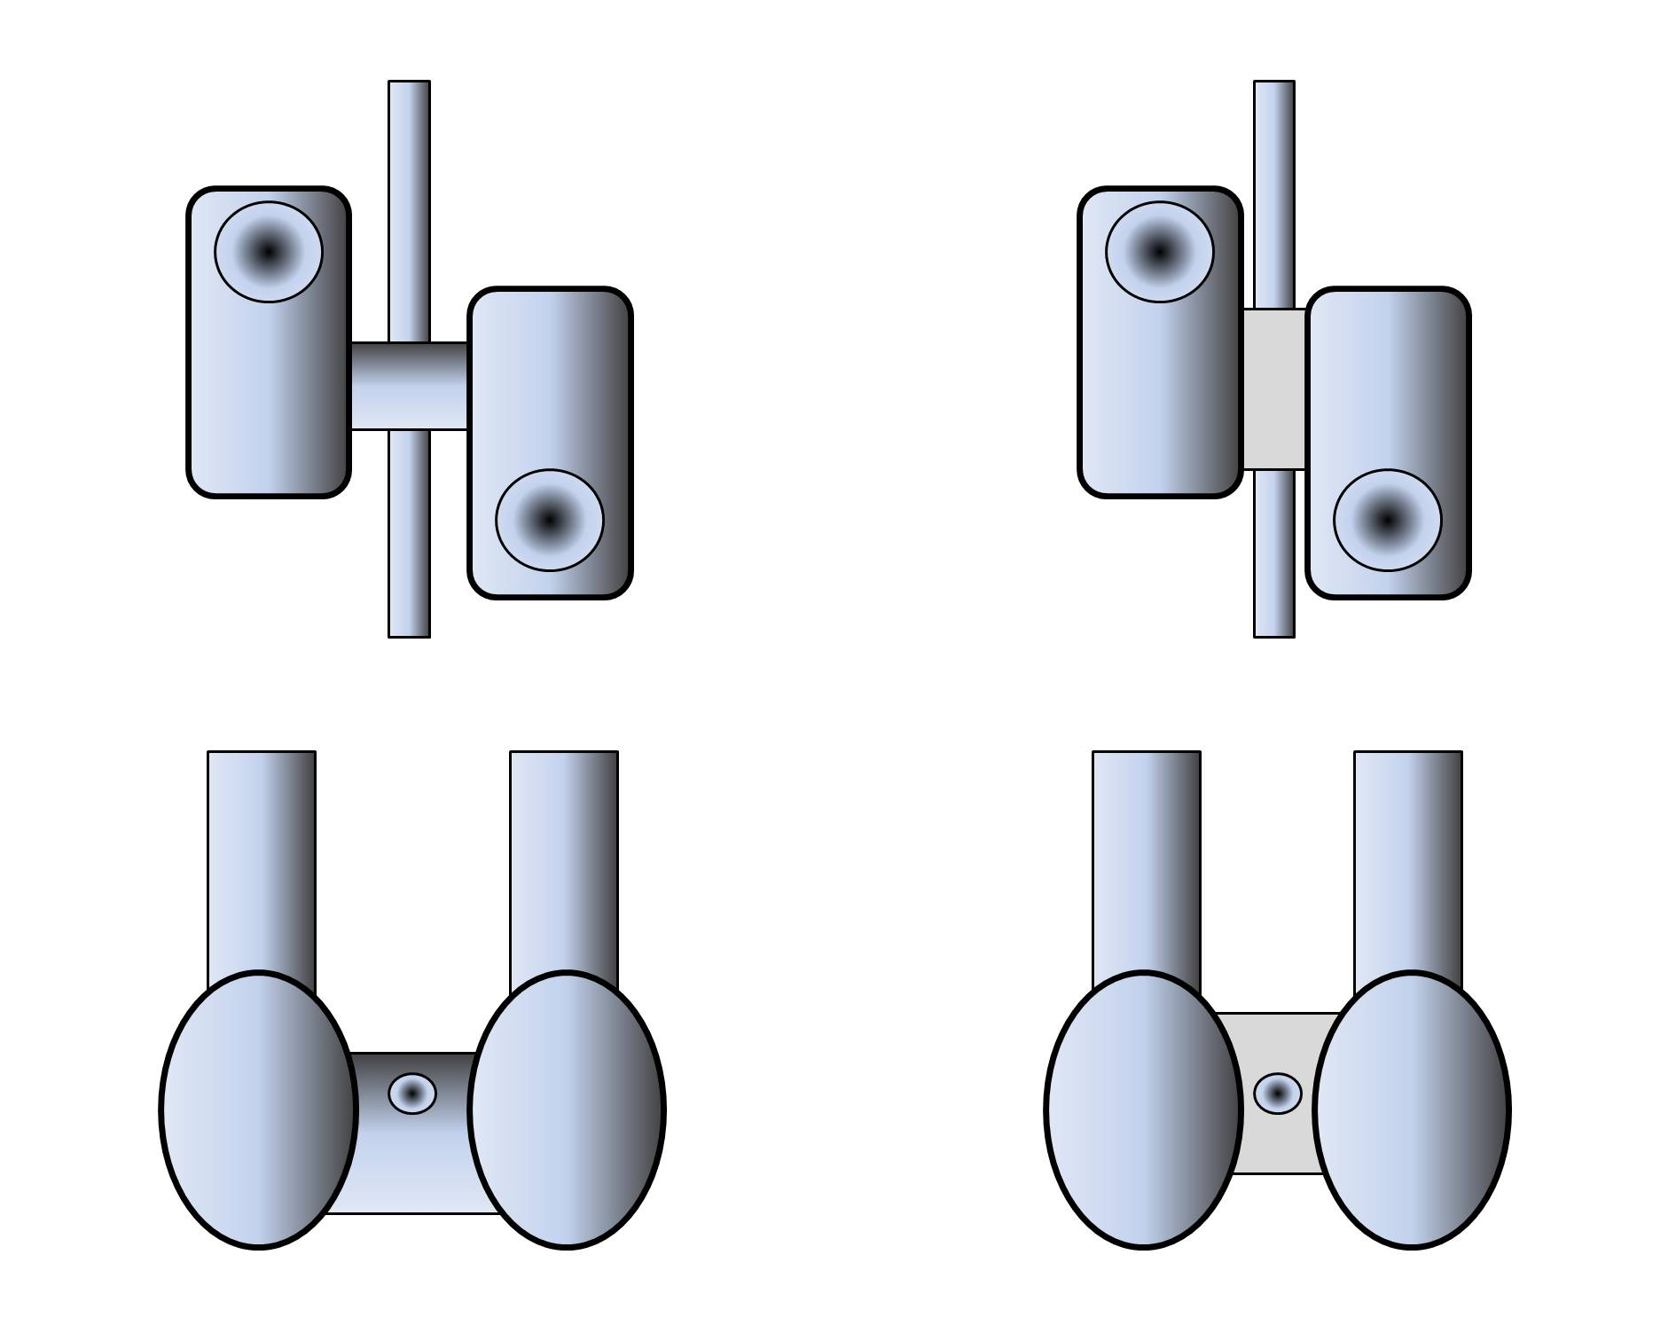
Revision G
Caverns Moved Closer
~20m separation
Concrete Pillar, separation governed by detector proximity
High Stress around IR
‘Pillar’ alternative to be studied
Notes:
Possible alternative is to replace the “normal” transfer tunnel ie sprayed concrete lining, rockbolts etc with a massive concrete pillar. Here much more stress can transferred onto the transfer tunnel.

Slide 13
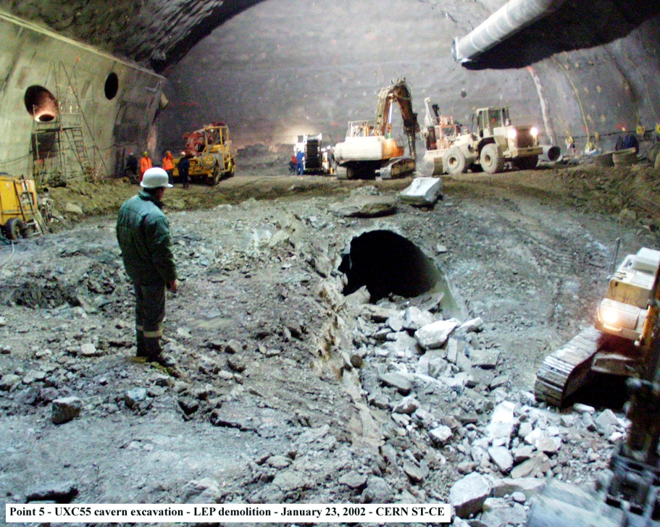
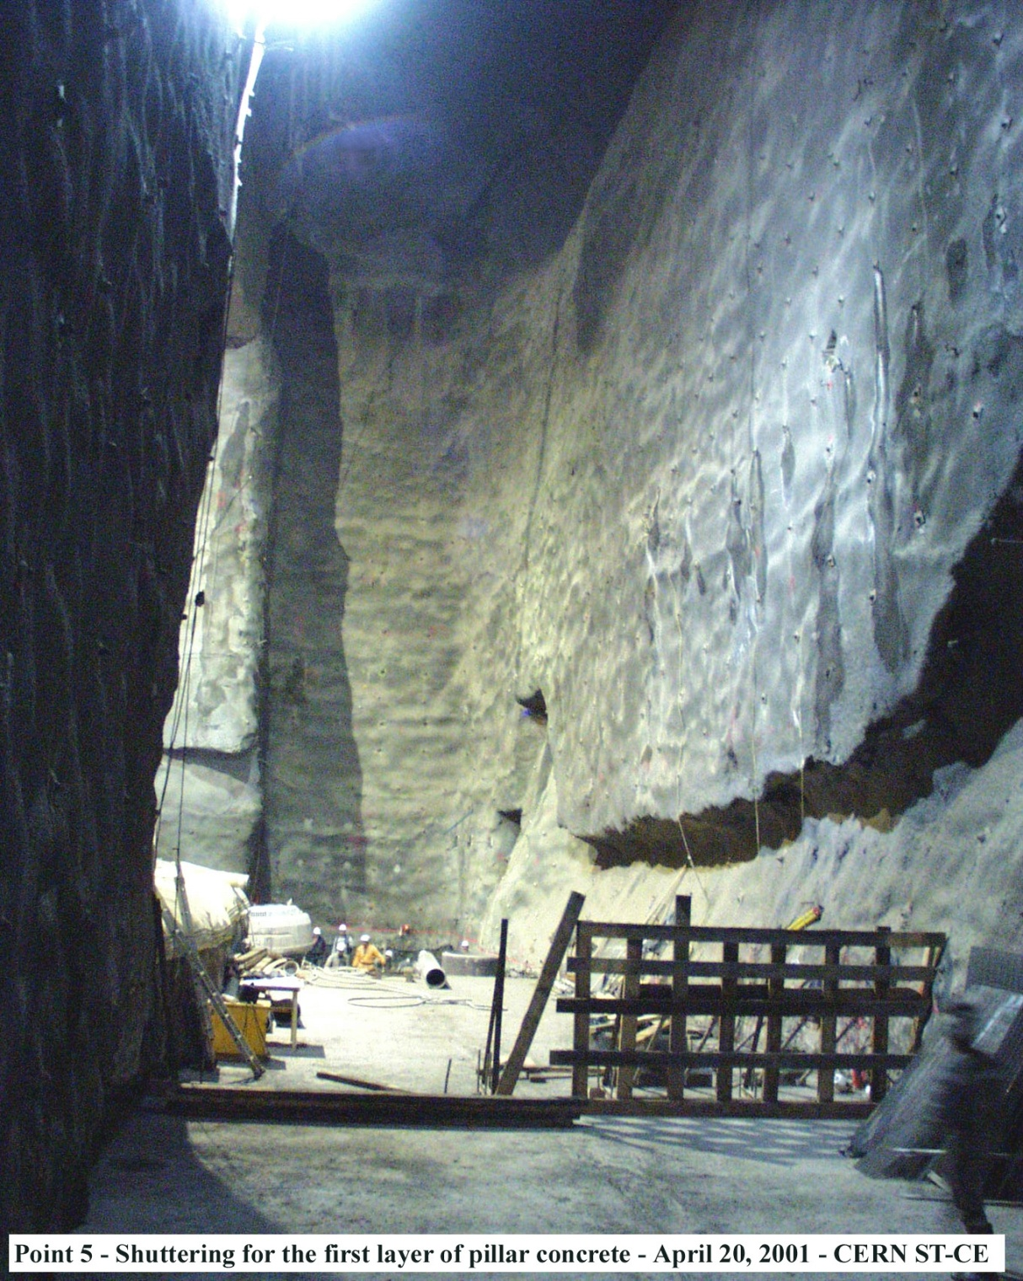
Similar to CMS ‘Pillar’

Slide 14
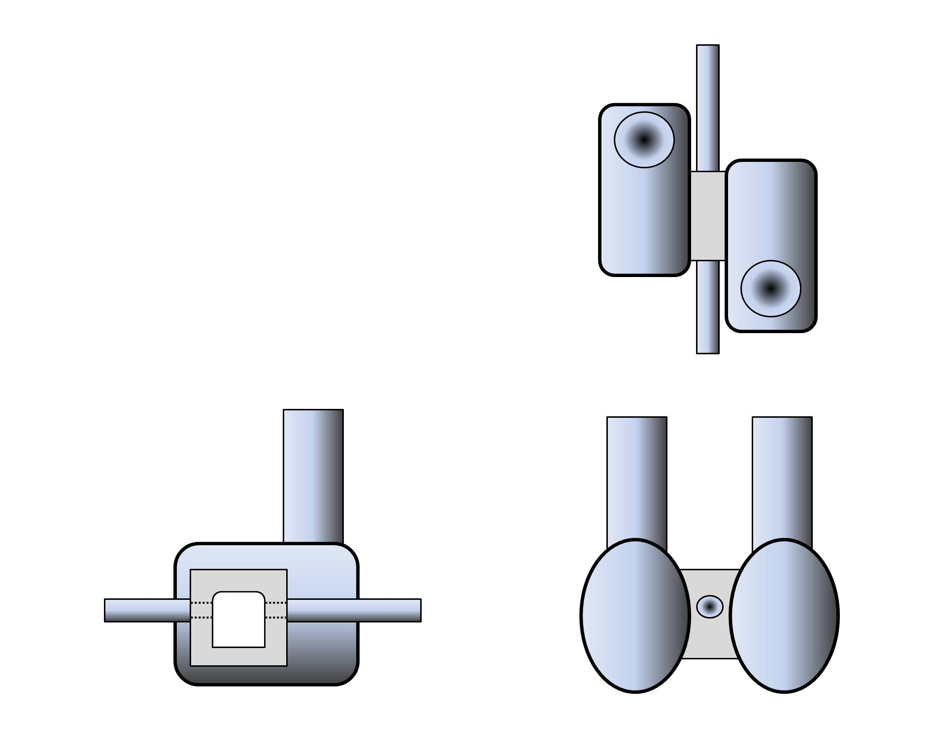
Potential Advantages:
Reduces lining stress around caverns
Slab foundations likely to be extremely stiff
The pillar could have Vertical walls
Minimum travel time and umbilical lengths
Final focus magnets ‘within’ the same volume
Construction sequence critical to reduce Rock Yield
A
Section A-A
A
Notes:
Section A-A could house the ‘focus magnets’ within the same concrete volume. This is more stable, no differential settlements, vibration ?

Slide 15
Task 2 – Study Summary
Compile Geotechnical Database
Review Monitoring Data
Review Geotechnical Testing Data
Review Previous Experience
Geological correlation between CERN sites
Completed
Geotechnical Review
Underway
Not Started
Geometry
3D Stress Analysis
Estimated Support Pressure
Conservative 2D FE Model
Sequenced Excavation 2D FE Models:
* Transfer cavern first
* Transfer cavern after service caverns
Yield Control by Cavern Construction Sequence
Pillar Option
Cavern Design
Present study outcomes - 5th to 6th December 2011, London
Long term creep issues still to be fully understood, in-situ testing specification will be developed
Notes:
Creep tests required

Slide 16
Detector Movement System
Andrew Cunningham

Slide 17
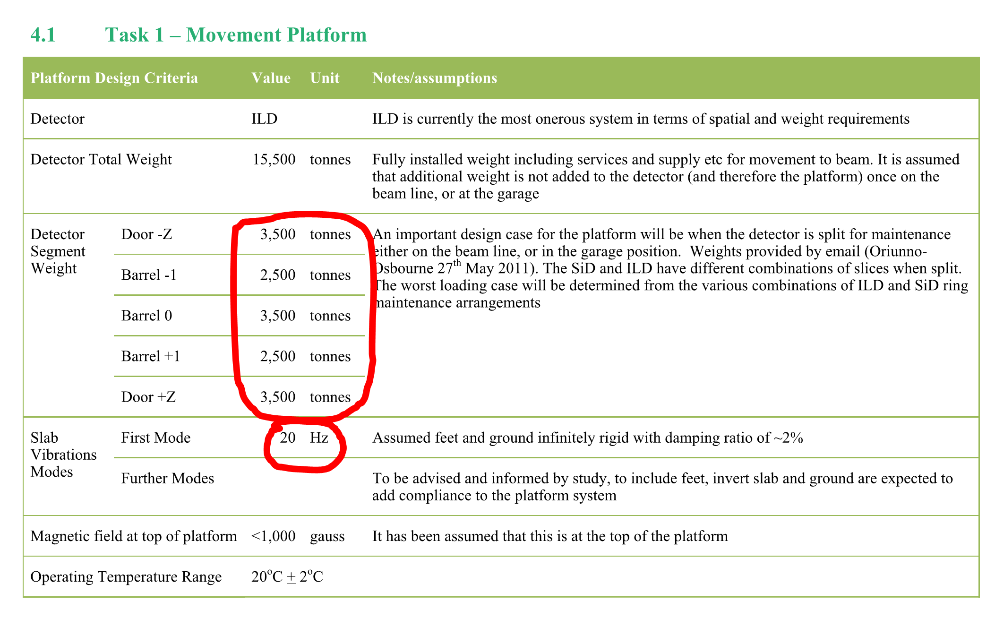
Summary of Requirements

Slide 18
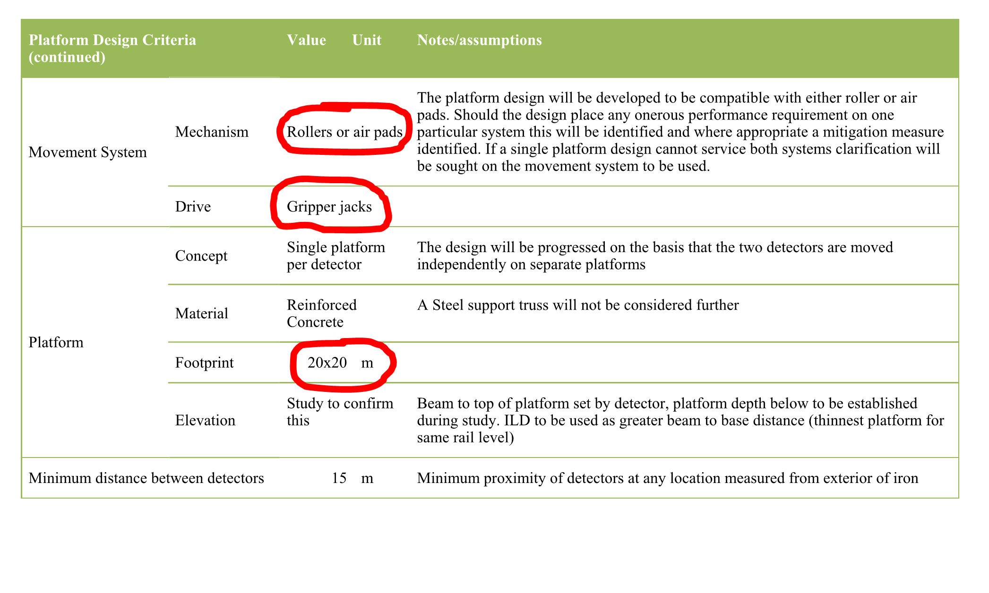
Summary of Requirements
Notes:
20m x 20m use for slab study

Slide 19
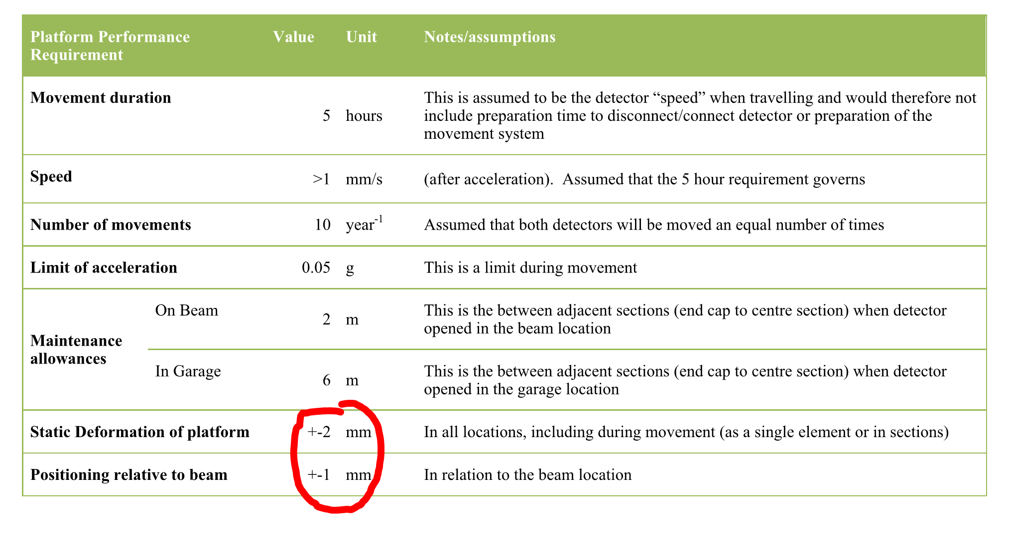
Summary of Requirements

Slide 20
Top Loads on the Slab

Slide 21
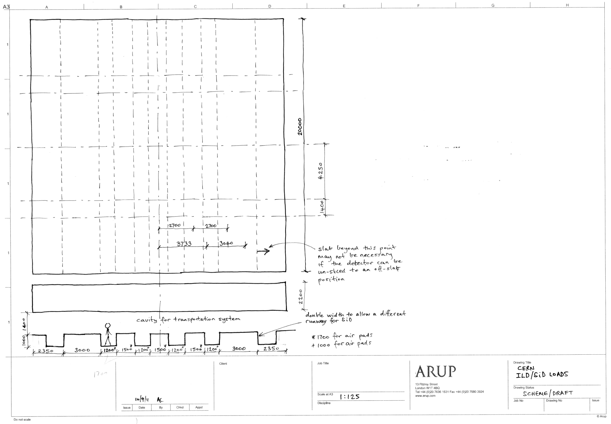
ILD top loads when detector slices all closed
Direction of travel
17.5MN
12.5MN
17.5MN
12.5MN
17.5MN
3500
ILD loads when moving/closed
Position of permanent support for ILD (preliminary)
17.5MN
12.5MN
17.5MN
12.5MN
17.5MN
Notes:
From Klaus. One the main objectives is confirmation that these loads/positions are correct

Slide 22
ILD top loads when un-slicing
12.5MN
12.5MN
17.5MN
12.5MN
12.5MN
Direction of travel
5MN
5MN
ILD loads when moving/closed
5MN
5MN
Position of permanent support for ILD (preliminary)
4750
Range of positions (assumed 2000)
12.5MN
12.5MN
17.5MN
12.5MN
12.5MN
Notes:
Pick dots moved, because load is transferred onto airpads from permanent supports

Slide 23
Slab Flex with ILD
A lot of slab is outside the permanent supports and the detector envelope (is it all necessary?)
The top loads change position significantly during un-slicing (assumed 2m)
Effect of un-slicing on slab flexure ongoing

Slide 24
SiD top loads when detector closed
2100
25MN
25MN
Direction of travel
SiD loads when moving/closed
Position of permanent support for SiD
25MN
25MN
2200 ILD
3800 Sid

Slide 25
SiD top loads when un-slicing
6775
3700
2100
12.5MN
12.5MN
Direction of travel
2000
2000
6.25MN
6.25MN
6.25MN
6.25MN
4700
SiD loads when un-slicing
represents range of positions
Position of permanent support for SiD
(preliminary)
6.25MN
6.25MN
6.25MN
6.25MN
12.5MN
12.5MN
2200 ILD
3800 Sid

Slide 26
Slab Flex with SiD
A large range of top load positions
This does not easily allow for significant optimisation in terms of support position.
  If we optimise for the closed case we are far from optimum for the un-sliced case.
Study of effect of scenarios ongoing
  Because SiD is on a deep slab at present we may be ok to meet the deflection limits

Slide 27
Slab flex limits are critical
Ability to move loads on and off the slab without deflecting more than +/-2mm
Ability to jack the system onto pads/rollers without it deflecting more than +/-2mm
Ability to move the slab over undulations without it deflecting more than +/-2mm

Slide 28
Slab flexure critical – but what is its definition?
Design using +/-2mm over slab
If the slab was smaller eg. 14x14m would it still be +/-2mm
If yes, can we not just apply the +/-2mm over that part of the slab which is under the detector?
Is it possible to get a better understanding of the deflection criteria eg. relative movement at points on the detector?
Does +/- 2mm mean that some part can go up by 2mm and some down by 2mm => 4mm amplitude?
Is the deflection limit to be applied during un-slicing?

Slide 29
Slab Flex Analysis

Slide 30
Slab flex limits are critical
This roller/pad arrangement will cause significant deflection when jacking
Direction of travel
detector loads
roller/air-pad loads
This roller/pad arrangement will reduce deflection significantly

Slide 31
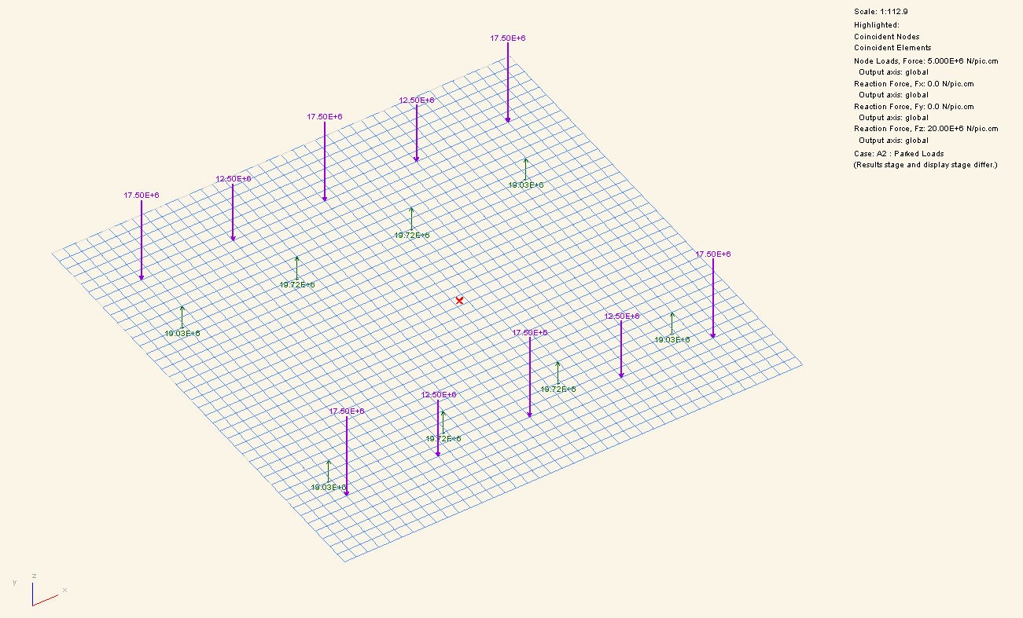
Initial supports positioned to balance mid slab Moment
Effect of moving the detector onto the slab
This does not work!
(see next slide)
Notes:
First assumption with supports positioned to minimise slab dead weight (with ILD)

Slide 32
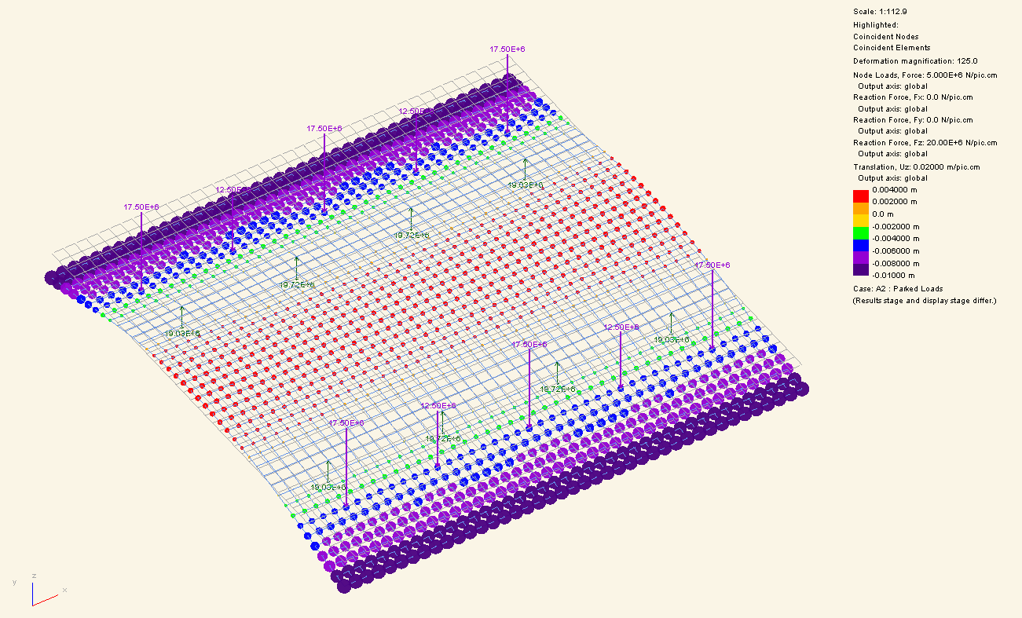
Effect of moving the detector onto the slab
Slab flex 14mm
Model summary:
Loads as shown
E = 32GPa
Slab 20x20mx2.2m
Notes:
Purple is down 10mm, red in centre is up by 4mm, so flex 14mm

Slide 33
Conclusion on support locations
The permanent supports need to be close to being under the top loads from the detector
This conflicts with the desire to minimise the deflections due to the self weight of the slab
Also, optimisation needs to consider the un-slicing of the detector

Slide 34
A refined support system for ILD
Step 1: ILD Slab on permanent supports (without detector)
Step 2: Put ILD(closed) loads on top of slab
Step 3: Jack onto transportation system
Step 4: Consider un-slicing (to be done)

Slide 35
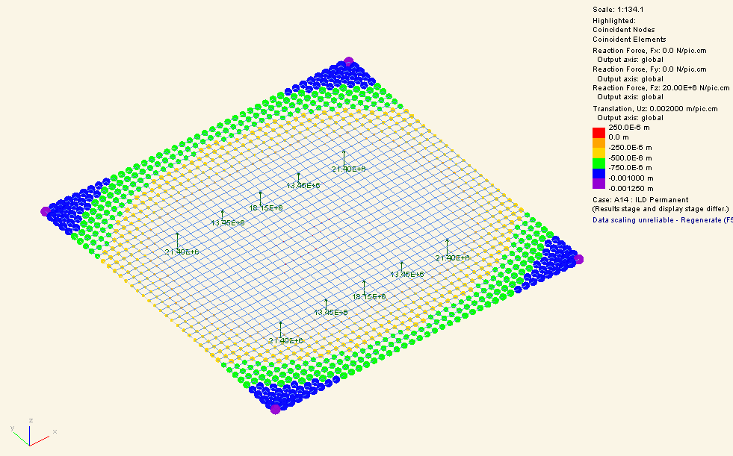
Step 1: ILD Slab on permanent supports (without Detector)
Slab on permanent supports (directly under the top loads for ILD closed)
The top surface of the slab can be defined as level and perfectly flat at this stage in its life
But note this is a long term load case and the value will increase with creep - ongoing
Model summary:
E = 32GPa
Slab 20x20mx2.2m
Load = Slab self weight
Flexure = 0.25mm up to 1.25mm down = 1.5mm amplitude
Notes:
Permanent means ‘fixed’ supports under the slab ie NOT during slab movement. Concrete Creep (50% 1st year, 25 % 2 year…..). Blue is down (just weight of slab).

Slide 36
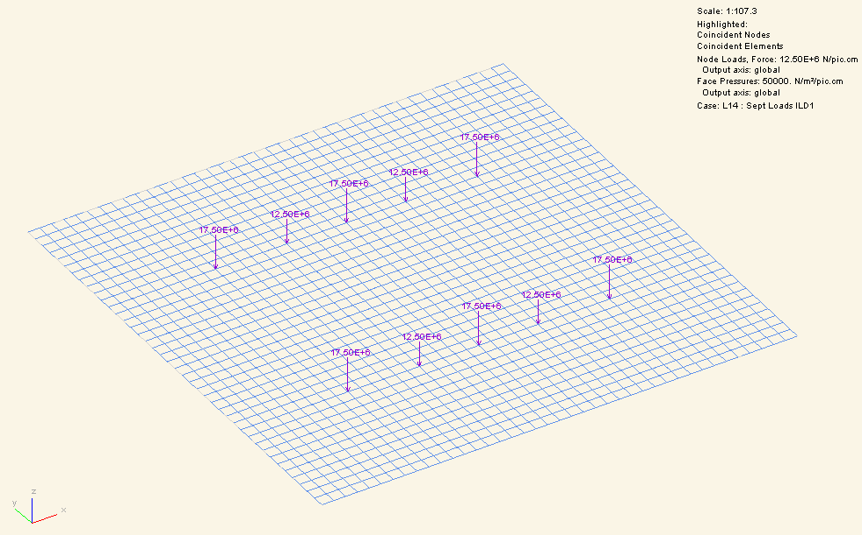
Step 2: Put ILD(closed) loads on top of slab
This has negligible displacement effect because the loads are (nearly) directly above the supports

Slide 37
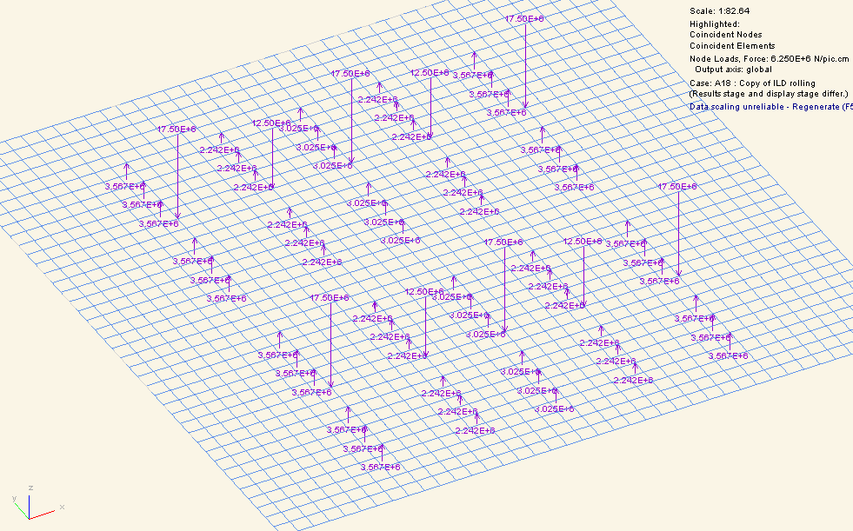
Step 3: Jack onto transportation system
ILD (closed) effect upon top surface of jacking onto the transportation system
Model summary:
E = 32GPa
Slab 20x20mx2.2m
Load = Slab self weight + ILD (closed) top loads
See next slide for displacement as a result of step 3

Slide 38
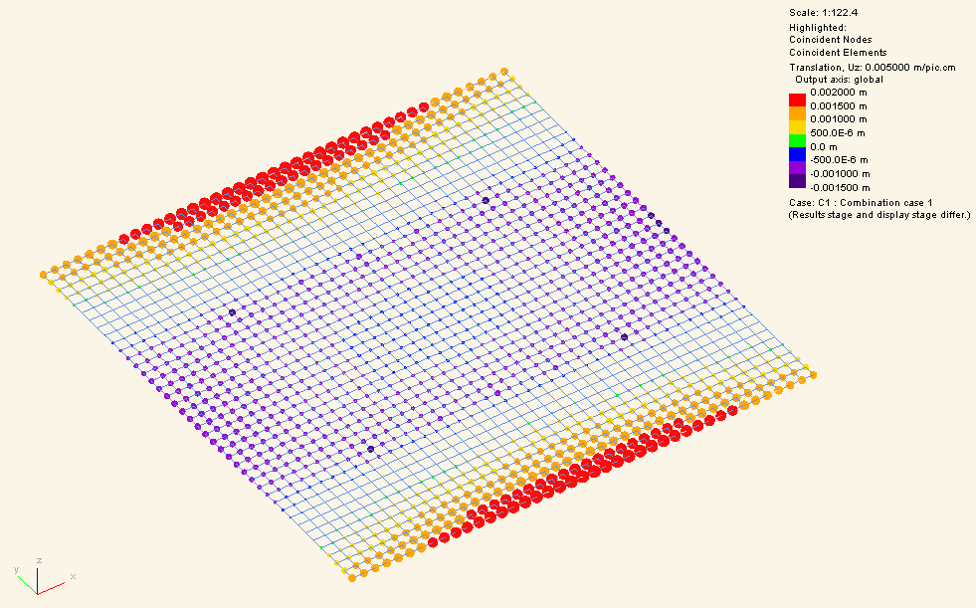
Step 3 (continued)
ILD (closed) effect upon top surface of jacking onto the transportation system
Flexure = +1.9mm to -1.0mm
This meets the +/- 2mm tolerance
Note if the slab were smaller the reported deflection would drop significantly.
Push-Pull direction
Model summary:
E = 32GPa
Slab 20x20mx2.2m
Load = [Slab self weight + ILD (closed) top loads + jack supports] – [Slab self weight on permanent supports]
Notes:
Red is up 1.9mm. Flex is on the slab perimeter, so is this important ?

Slide 39
Sid Work ongoing
Presently the system is being optimised for ILD
  Initial assumption that SiD will be less critical due to deeper slab (3.8m versus 2.2m deep)
  Verification to be completed

Slide 40
Un-slicing
Un-slicing causes top loads to move away from the permanent supports.
Because of this, un-slicing would cause displacement limits to be exceeded if supported only by the permanent supports.
Hence props may be required when un-slicing (under the appropriate points for ILD/SiD as per the loading drawing)
  Alternatively the slab could be made smaller and unsliced to off the slab, or
  The slab may get thicker
Un-slicing work ongoing
Notes:
+/- 2mm applies to all slab or just under the detector ?

Slide 41
Conclusion on ILD movement
Can achieve disp limits of +/-2mm when moving
BUT slab perimeters may exceed +/-2mm limit when on permanent supports due to concrete creep. This may lead to a need to:
    Make the slab smaller and un-slice to off the slab
    Thicken the slab
When un-slicing the detector we may need to take steps to limit deflections
    Prop under un-sliced top loads
    Make slab smaller and un-slice to off the slab
    Thicken the slab
    Definition required on +/-2mm limit.....

Slide 42
Support System During Movement

Slide 43
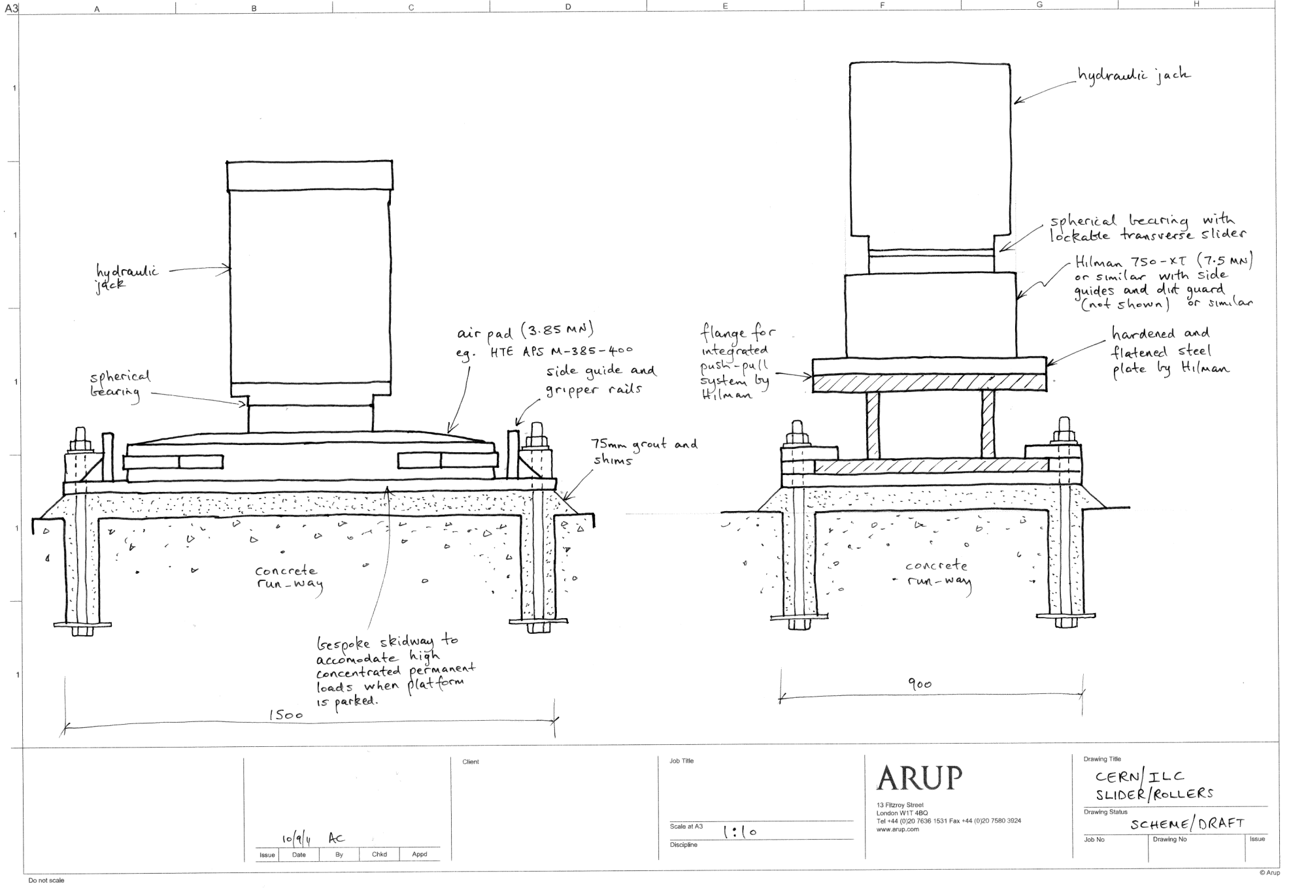
Pads and Rollers

Slide 44
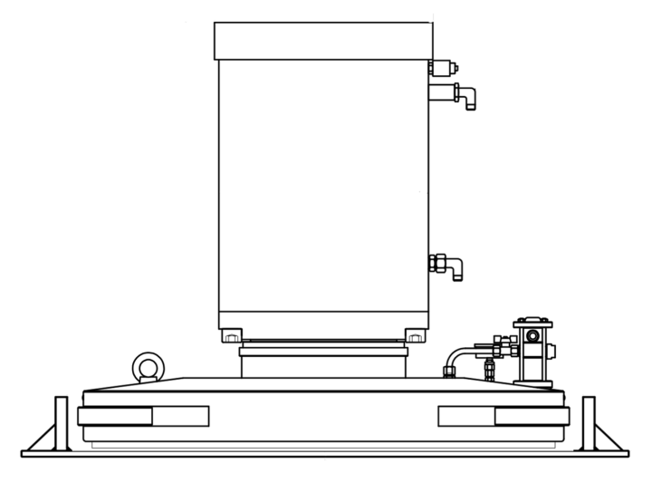
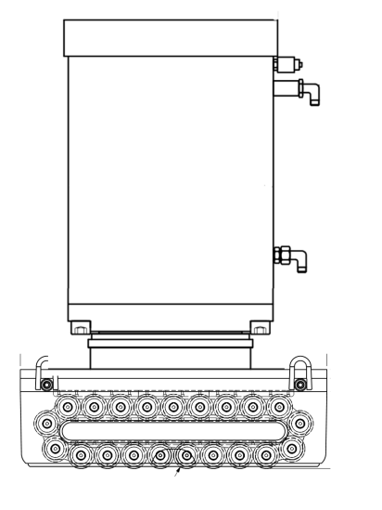
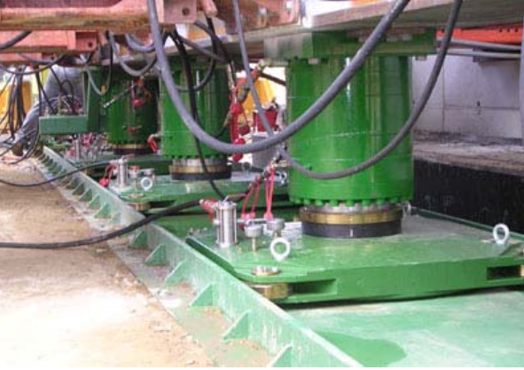
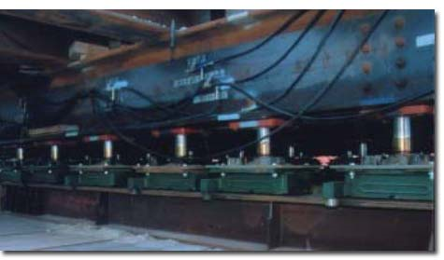
The movement support system
Air pads or rollers

Slide 45
Meeting with Hilman Rollers 15 Sept 2011
Self-driven rollers now available presently in use in the nuclear industry;
Heavy version to be confirmed (only 100 tonne presently available);
Hilman advised 3% friction for indoor use;
Hilman provide a suitable hydraulic push-pull system
  Awaiting details from Hilman;
Hilman provide a lateral slider (necessary for final lateral adjustment)
  This locks during main movement but can be unlocked to allow lateral adjustment. Awaiting details from Hilman.

Slide 46
Comparison ot the two
Air pads or rollers
Pads | Rollers
Min 60 required (for ILD, no redundancy) | Min 18 required (for ILD)
No hardened track->can accommodate minor steps | Specialist hardened and flattened track
Design for 1% friction | Design for 3% friction
Pressure infrastructure | Larger propulsion infrastructure
Run-away | Higher friction ->less run-away
Notes:
No redundancy on air pad numbers. 3.85MN airpads. 1KTon for rollers.

Slide 47
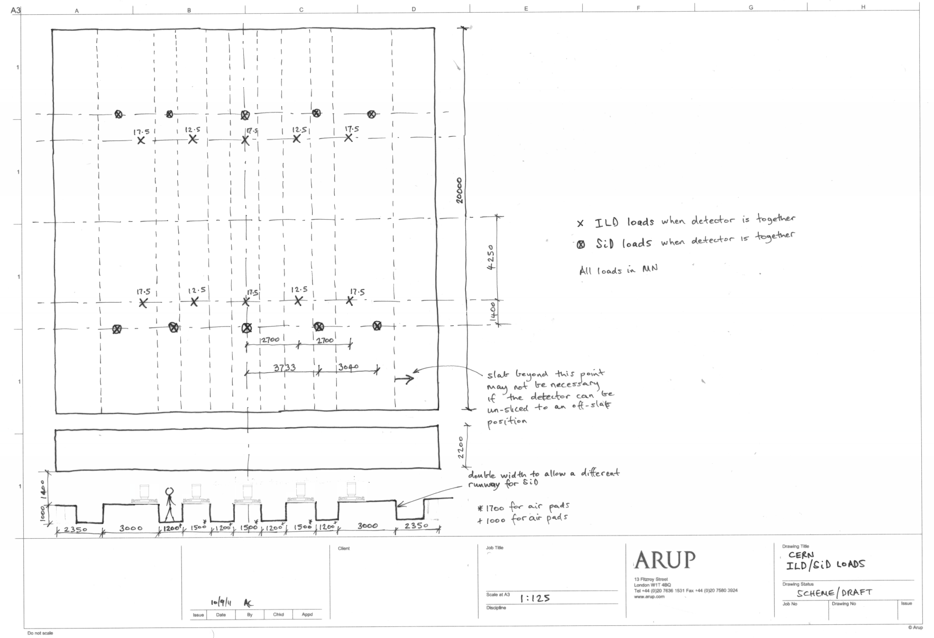
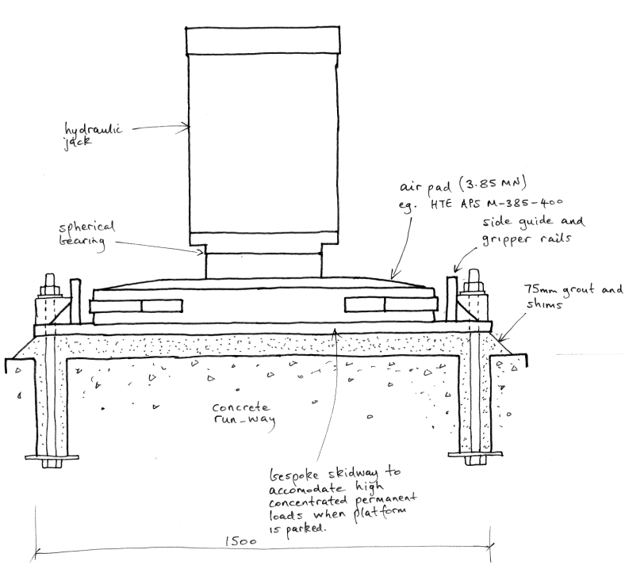
The movement support system – ILD, Airpads
Direction of travel
Permanent support (moves with slab)
Air pad

Slide 48
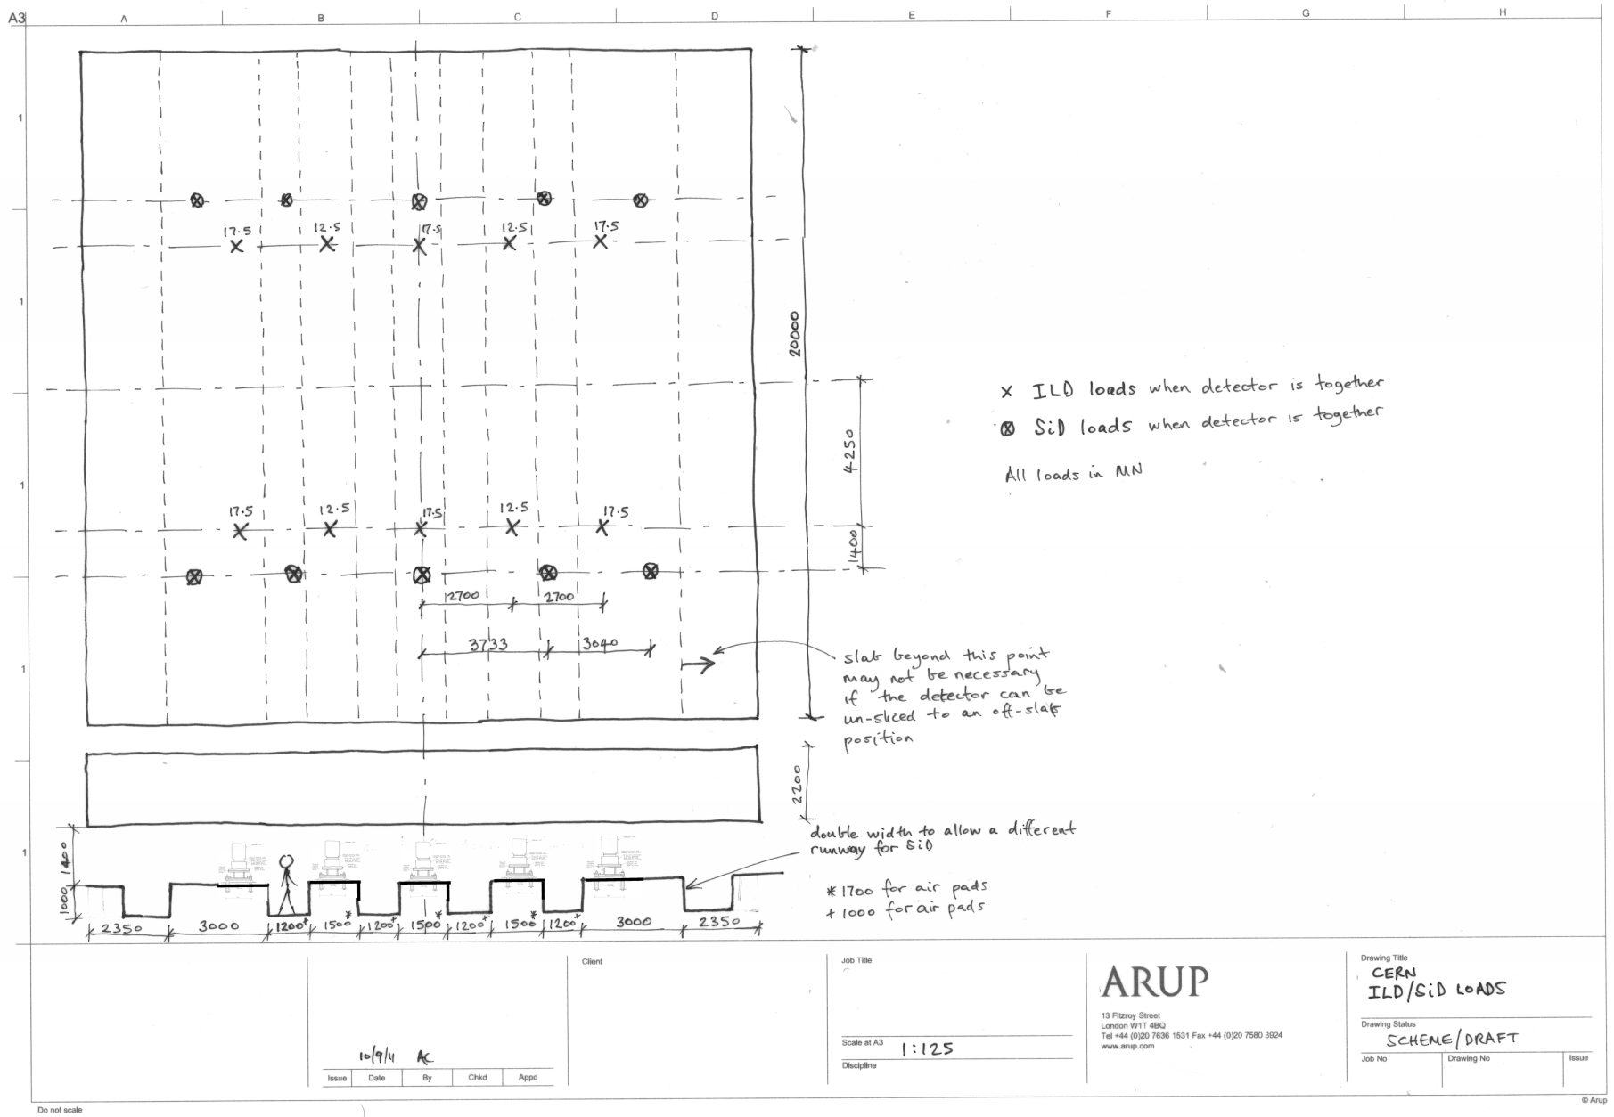
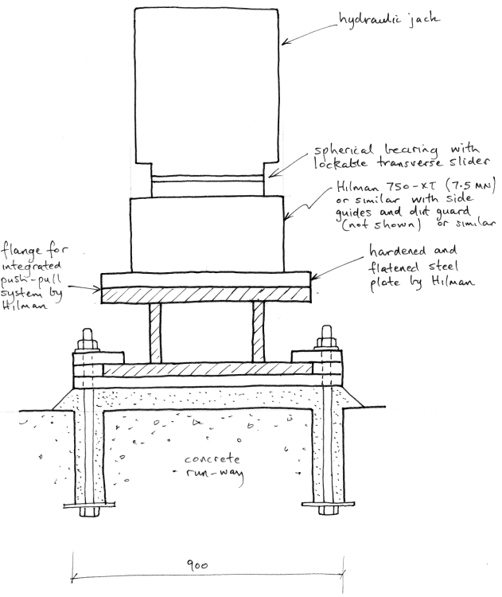
The movement support system – ILD, Rollers
Direction of travel
Permanent support (moves with slab)
Hilman roller

Slide 49
Slab Construction

Slide 50
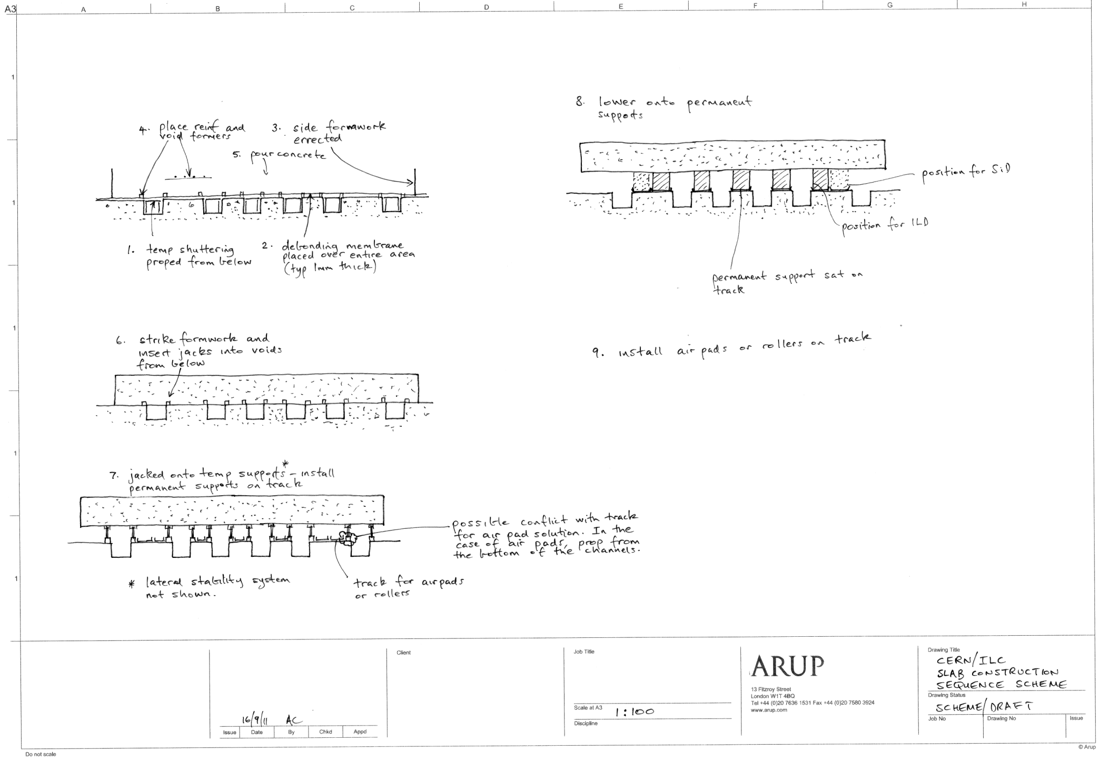

Slide 51
The Drive System

Slide 52
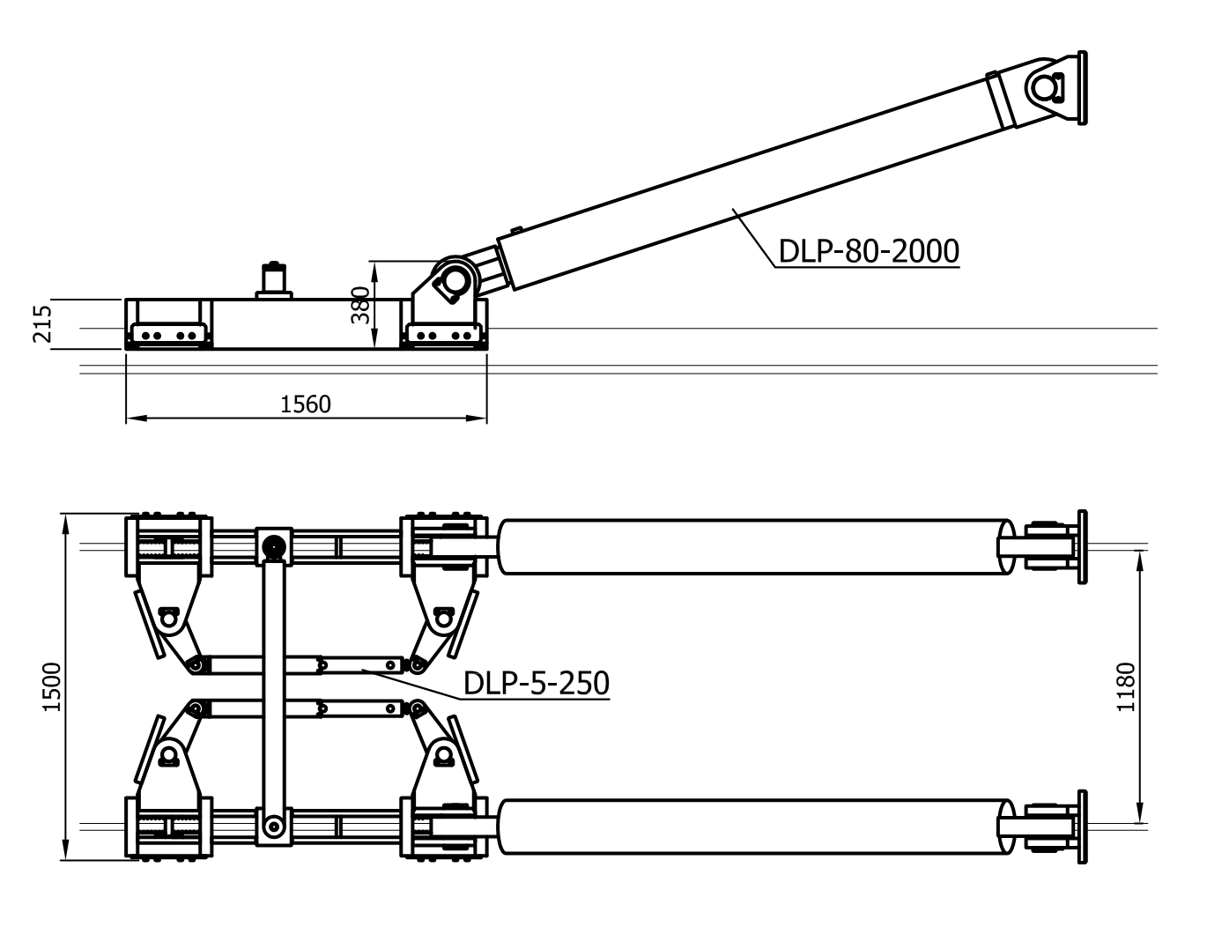
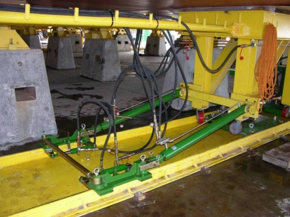
The movement drive system for pads
APS Grip jack 2No. PPU-160 (1.6MN capacity each) with air pads. Larger system required for Rollers.
Photo of smaller unit in use
Notes:
Air pressure systems CH

Slide 53
The movement drive systems for rollers
Awaiting response from Hilman following meeting with Hilman 15 Sept 2011
Two options being available:
  Hydraulic push-pull details similar to that for air pads;
  Self-driven Hilman rollers (awaiting confirmation on capacity)

Slide 54
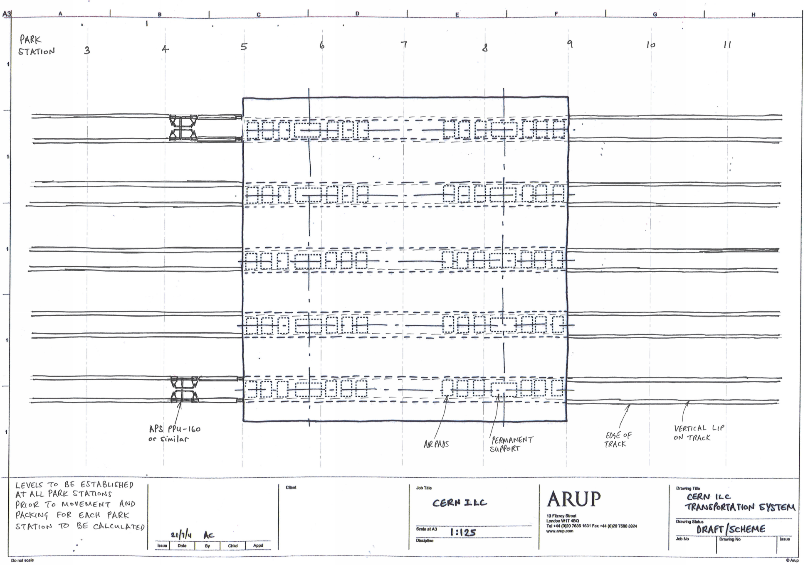
Movement Drive System
Note position of tracks is superseded by drawings on previous slides
NTS

Slide 55
Movement Drive System
Pair of hydraulic rams allow rotational correction
Control system to avoid on-plan rotation
Bar code encoder or laser to tell the control system how much each side of the slab has moved
Lateral guides to be investigated

Slide 56
The final positioning system

Slide 57
The final positioning system
Packs placed to push against with the flat jacks
Degree of freedom | Methodology
x, Rzz | Push pull system
z, Rxx, Ryy | Pack adjustment under slab
y (air-pads) illustrated | Lateral push with flat jacks whilst air pads are active
y (rollers) illustrated | Lateral push with flat jacks whilst the lateral slider (on the roller) is un-locked
y
z
x
Direction of travel
Note, Rxx is rotation about the x-axis, etc
Flat jacks push against the lateral packs to achieve precise position in y

Slide 58
Conclusions
ILD ok to jack and move on 2.2m slab with pads or rollers
ILD may exceed slab flex limits in long term due to concrete creep. A more optimal long-term support position may solve this (ongoing) but the likely outcome is that the slab would have to get smaller (on-plan) or deeper to solve this. +/- 2mm needs to be resolved.
SiD ok to jack and move on 3.8m slab with pads or rollers
BUT the scheme design on the table assumes that the cavern invert can easily meet the deflection criteria (since the slab sits it at many points). Latest soil studies suggest that this may not be guaranteed!
To mitigate this some ways forward are:
  Jacking and packing if the invert does flex (to keep the slab permanent supports plane)
Un-slicing scheme study to be undertaken. Un-slicing represents a challenge since the top loads move away from the permanent support points.
Need to confirm if deflection criteria apply when un-slicing. If they do there is a risk that the study will lead to the need for a deeper slab.

Slide 59
Work to be completed
Complete support optimisation to include un-slicing
Based upon these analyses, determine if necessary to make modifications to meet deflection & model criteria. These could be:
  Using props when un-slicing
  Making the slab smaller and un-slice off the slab
  Make the slab thicker
Establish more details on Hilman roller push-pull system and lateral slide system
Summarise risks which need further mitigation

Slide 60
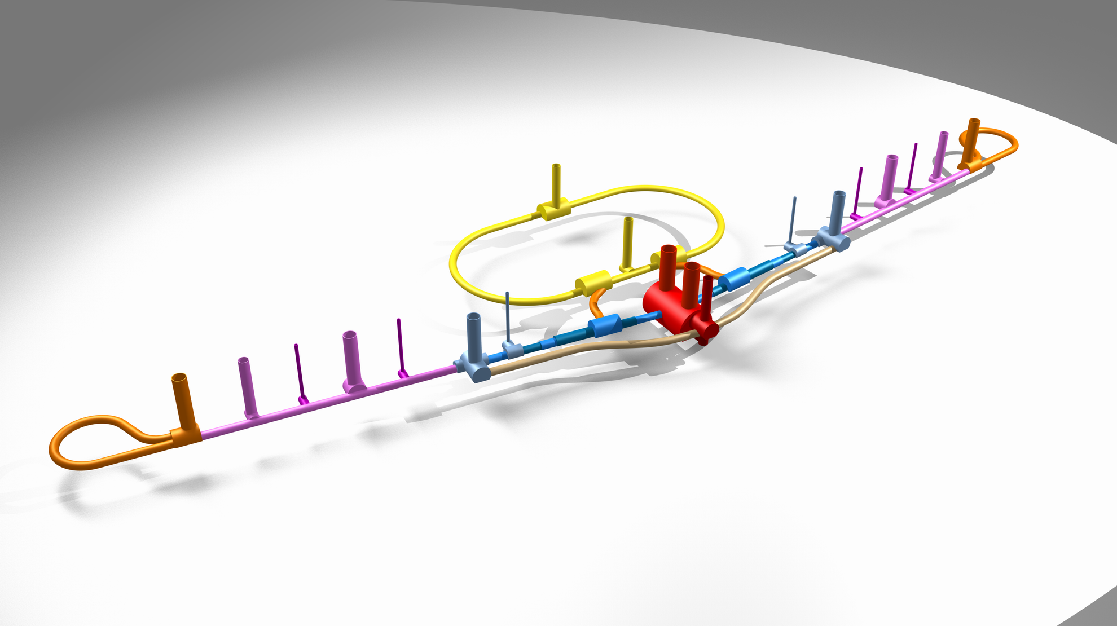
ILC Naming Convention
Slide 1 of 4 OBSOLETE

Slide 61
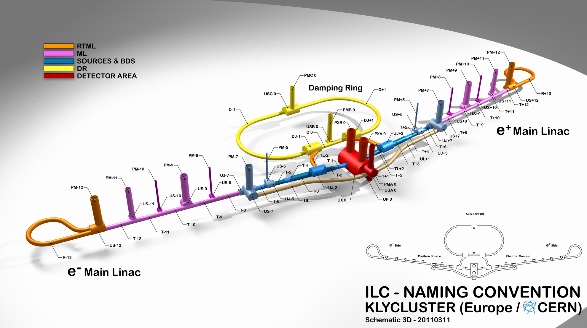
Slide 2 of 4 OBSOLETE

Slide 62
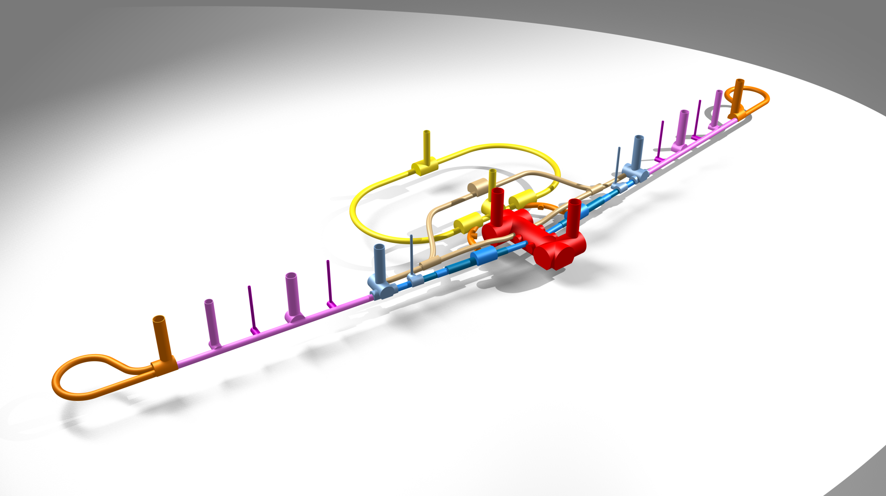

Slide 63
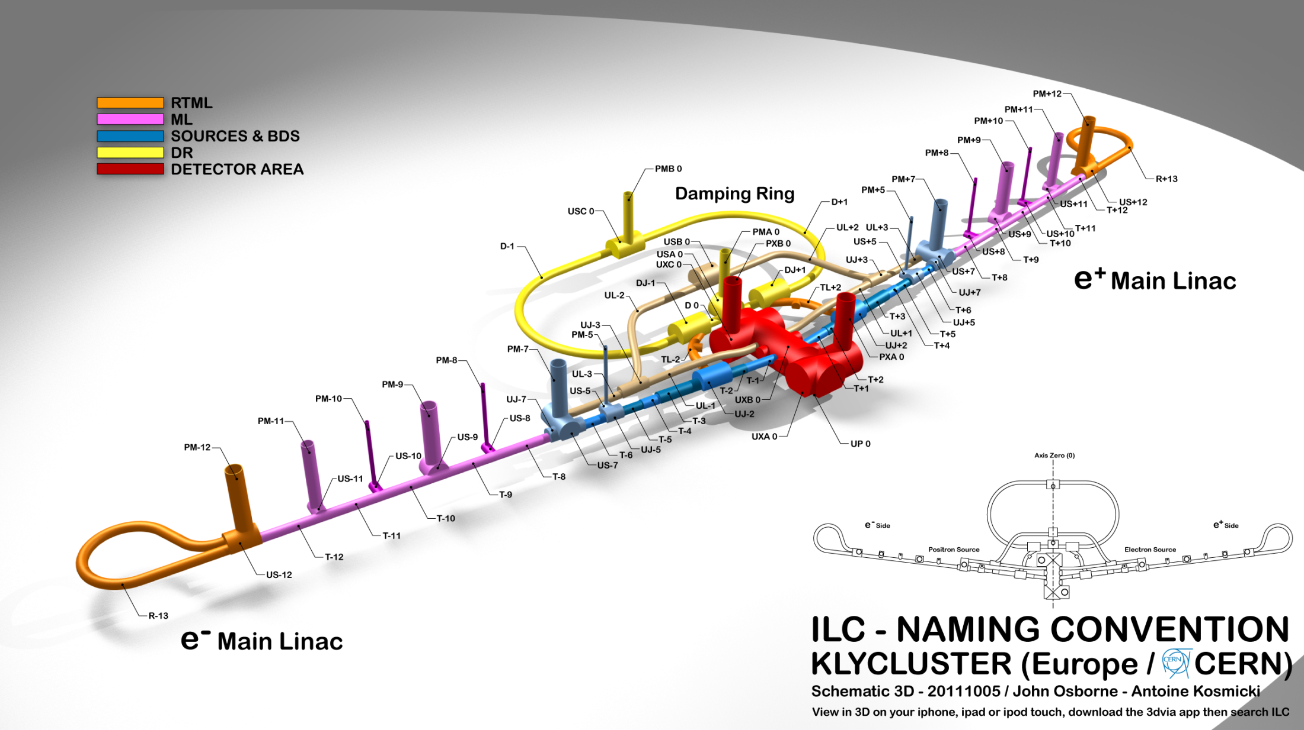

Slide 64
ILC Naming convention document is on ILC EDMS
Document Number : D00000000967235

