Slide 1
Preliminary Studies for future hanronic calorimeter
I. Vasilas , A.Para, P. Rubinov, H.Wenzel, F. Ptochos
University of Cyprus , Fermilab
IEEE Valencia, 2011

Slide 2
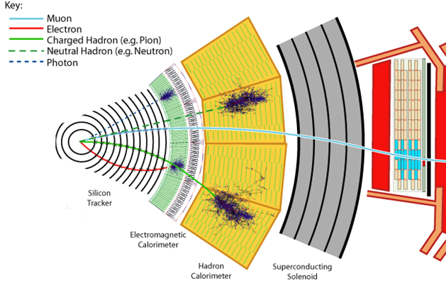
Introduction
the main disadvantage for presents hadronic calorimeter is the bad energy resolution ~60%/√E (ΔΕ/Ε)
^{e+}
γ
γ+γ
hadron
πº
^{e-}
γ
^{e-}
π⁻
p
γ
π⁺
n
γ
p+n
- nuclei binding energy
Nuclei binding energy lost = bad energy resolution in hadrons calorimeters
future hadronic calorimeters require energy resolution below 10%/√E (ΔΕ/Ε)
  Dual Readout techniques are plausible to achieve this kind of resolution.

Slide 3
Motivation
Dual Readout techniques : are based on the connected relationship of EM showers created by charged and neutral pions ~ 1. Measuring Cherenkov and Scintillation radiation light (depocit by neutral pions) , an event by event precise energy correction is possible.
  require an excellent Cherenkov light collection,
  using data from 120 GeV proton beam we evaluate the performance of
  different size SiPM ‘s
  different Geometries of BGO and PbF2 crystal samples
  to optimize the collection of Cherenkov and Scintillation light components for application of the Dual Readout technique
  compare the results with light production in crystals simulations

Slide 4
motivation
future hadronic calorimeter requires energy resolution below 20%/√E (ΔΕ/Ε)
  Dual Readout techniques are plausible to achieve this kind of resolution.
  require an excellent Cherenkov light collection, so you can be able to correct the nuclei energy lost in hadronic calorimeter volume
  using data from 120 GeV proton beam we evaluate the performance of
  different size SiPM ‘s
  different Geometries of BGO and PbF2 crystal samples
  to optimize the collection of Cherenkov and Scintillation light components for application of the Dual Readout technique
  compare the results with GEANT 4 light production simulations in crystals

Slide 5
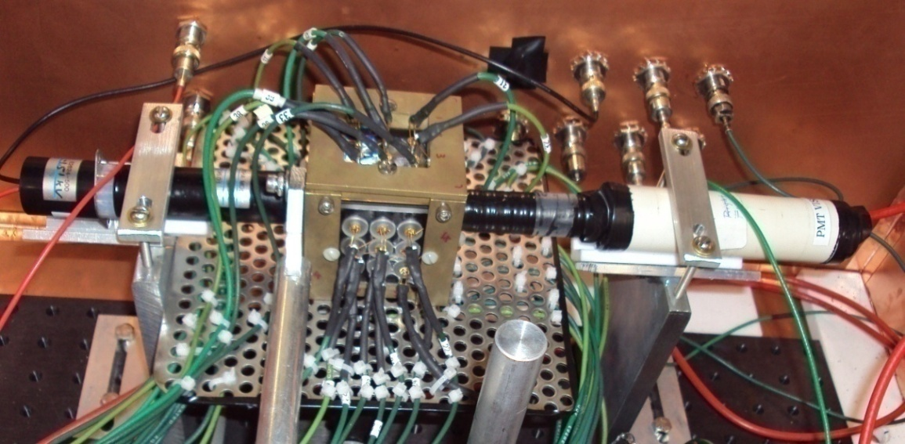
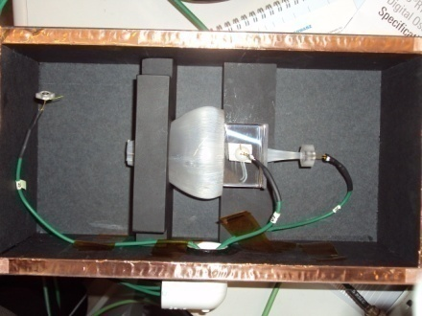
Test beam setup
Setup 1
BGO crystal 5x5x5 cm
all sides equipped with visible or UV filters
two opposite sides, one with UV and one with visible filter viewed by conventional PMT’s
4 sides viewed by 9 SiPM’s 1mm² Hamamatsu 25, 50 and 100 microns size pixels
Beam
Setup 2
BGO and PbF2 crystals 4x4x5, 3x3x5, and 2x2x5 cm
all equipped with a 3 mm² Hamamatsu SiPM (on the side of the beam)
crystals wrapped using black and white Tyvek
crystals with different surface finish
Beam
all exposure to a 120GeV proton beam

Slide 6
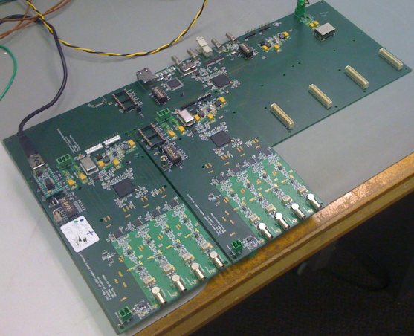
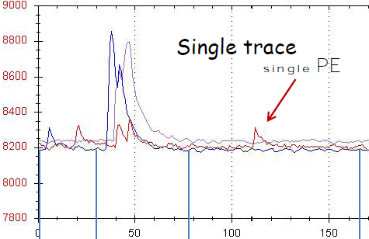
Data readout
For data readout we use TB4 readout boards build at Fermilab (Paul Rubinov).
Each board has 4 individual readout channels
gain 40db
bandwidth 100Mhz
50ohm input
pedestal is around 8200 counts
Support with USB 100 mbit Ethernet
Works on Win(XP,Vista,2000) using Ms .net
with C# express edition (free software)
Each channel can provide bias voltage to SiPM’s (until 100 Volts)
we took data for 11 different operating bias voltage (+/-) 1 volt from nominal bias voltage with step of 25 mvolts)
the gate window for each waveform was 2 μsec = 400 time slots *5 ns

Slide 7
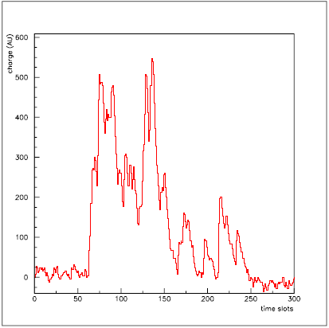
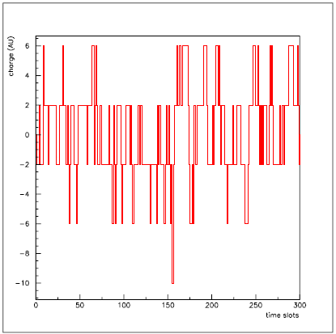
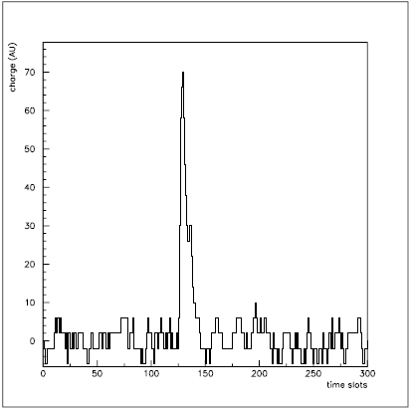
SiPM’s calibration
Determination of optimal operating bias voltage
From data without beam
For all detectors, we observe events waveforms for all operating bias voltages steps
Event Waveform
Event Waveform
Event Waveform
High Bias Voltage
Low Bias Voltage
Optimal Bias Voltage
Clean single pulse shapes indicates the optimal bias voltage

Slide 8
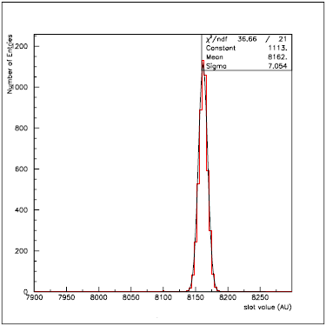
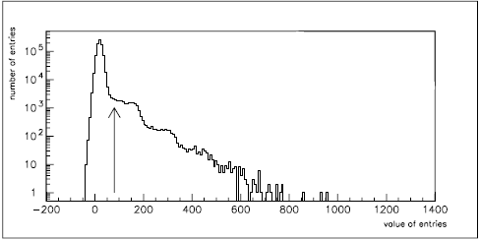
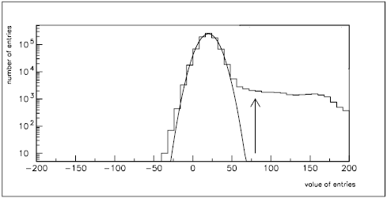
SiPM’s calibration
Determination of Electronic Noise And Threshold
Slot Values Distribution
Waveforms are assembled from 400 time slots. For each channel, we construct the Gaussian distribution from for each time slots value using all the events.
mean value of the fit correspond to electronic noise
noise
1pe
2pe
for every channel we subtract the electronic noise from every events time slot
Wfm Values Distribution
constructed the distribution of events waveforms values
first peak corresponds to noise, second step to 1 pe, third step to 2 pe etc
Any value between first peak and first step is a suitable for threshold
Wfm Values Distribution

Slide 9
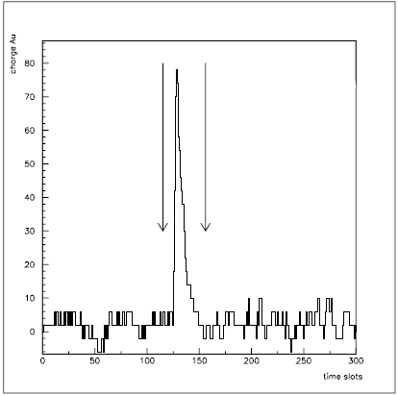
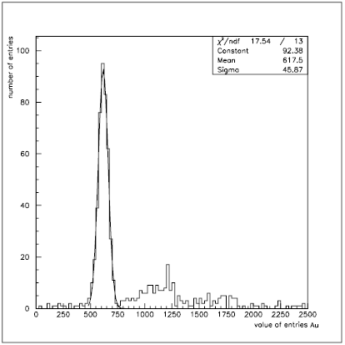
Sipm’s Calibration
Determination of a Single Avalanche Charge
We want to calculate the charge corresponds to a single avalanche.
Signal Wfm
for every event, we found the maximum value of the waveform above threshold.
isolate the pulse shape using a 100 ns window (25ns before and 75 ns after maximum peak) and we integrate to find single pe charge.
with the same time window we isolate sidebands regions to find charge causes from noise.
Single pe Charge Distribution
we compare the values of the sidebands
if were significantly different we rejected the event from further analysis.
if were not different we subtract their average value from single pe charge
for each channel we constructed the distribution of single pe charge for all the events and fit a Gaussian function.
charge = 617.5

Slide 10
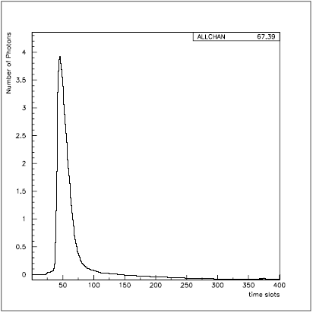
Test - Beam Data Analysis
Setup 2 ( small crystals)
average number of photons
for each channel we found the average waveforms with and without beam conditions.
we subtract them and integrate to find total charge.
Average Number of Photons Detected
we divide total charge with the value corresponds to 1 pe charge to find the average number of photons detected.
An example of Cherenkov light detected (67,4 photons) from PbF2 crystal. This is the first Cherenkov photons reported measurement with SiPM’s .

Slide 11
Test - Beam Results
Geometry Dependence
BGO
Geometry (cm) | Numbers of Photons
4x4 | 650,58
3x3 | 1121,35
2x2 | 1503,88
2x2 | 1595,22
PbF2
4x4 | 52,74
3x3 | 61,36
2x2 | 68,36
2x2 | 67,38
From our results, on average, we detect more photons by using smaller crystal.

Slide 12
Test - Beam Results
Surface Finish Dependence
We use 2x2x5 cm BGO crystals, with polished and no polished surface
BGO
Surface | Geometry (cm) | Numbers of Photons
no polish | 2x2 | 1503,88
polish | 2x2 | 1595,22
We detected small difference ~6 % in the average number of photons detected between polished crystals and crystals without surface finish

Slide 13
Test - Beam Results
Wrapping Dependence
BGO crystals wrapped with white and black Tyvec
material | BGO
 | Geometry (cm) | Numbers of Photons
Black | 4x4 | 650,58
 | 3x3 | 1121,35
White | 4x4 | 793,37
 | 3x3 | 1453,59
the average number of photons detected are consistently bigger in crystals wrapped in white paper, than in black Tyvec
(22 % for 4x4 and 30 % for 3x3 crystals)

Slide 14
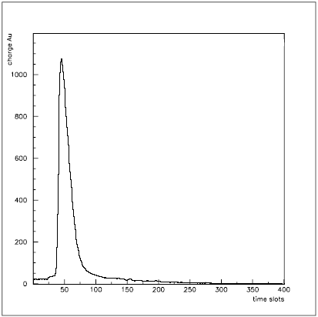
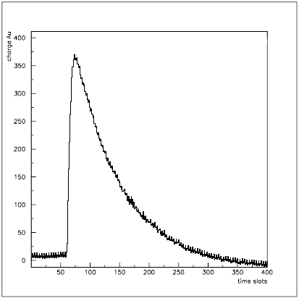
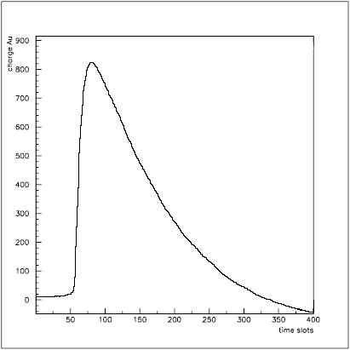
c/s Separation
Setup 1 5x5x5 cm BGO crystal
we compare the average signal light waveform coming from PbF2 crystal (only Cherenkov) and the average signal light waveform coming from the BGO crystal thru UV filter
Average Wfm
Average Wfm
PbF2
BGO UV filter
we can see an extended tail not consisted with Cherenkov light signal
Average Wfm
BGO visible filter
From the average signal light waveform coming form BGO crystal thru visible filter we see that scintillation light is passing through UV filters and we collect it as Cherenkov light
The presence of a filter is not enough to collect pure Cherenkov light so we have to find a way separate Cherenkov from scintillation light

Slide 15
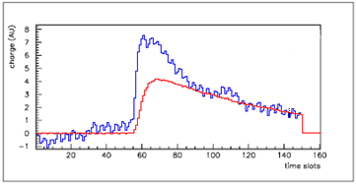
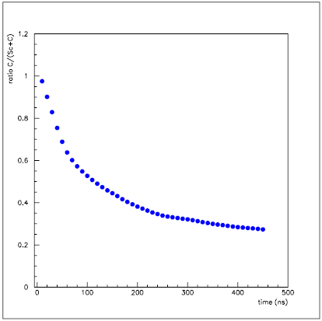
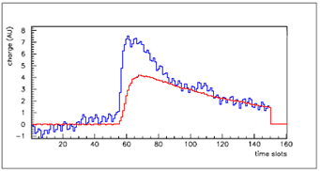
C/S Separation
We choose symmetrically placed detectors (behind visible and UV filter)
We integrate the waveforms using a window (150 ns) free from Cherenkov light and we divide them to find a scale factor.
We multiply the Scintillation shape with the scale factor.
We integrate the new waveforms, we subtract them and divide by the UV signal waveforms integral .
C/S Separation
With this curve we can determine the fraction of pure Cherenkov light detected from BGO crystal with this particular filter (UV-11) with this particular detectors(SiPM 3 mm² 50 microns)

Slide 16
FUTURE PLANS
Much to be done
Data analysis is still in progress
we need to polish our results
we will continue with data not analyzed yet, for example we need to analyze data taken by scanning, with the beam, the 5x5x5 BGO crystal in various places
Simulations are on the way, we are going to simulate crystals light yield and compare with our results
Once we finish analysis and understand the results, we are planning to proceed to a second test beam experiment using several other kind of crystals, and SiPM’s.
a new setup (telescope) is almost ready to take data by exposure BGO and PbF2 crystals of various shapes, Geometries and surface into Cosmic Rays beam

Slide 17
Back up

