Slide 1
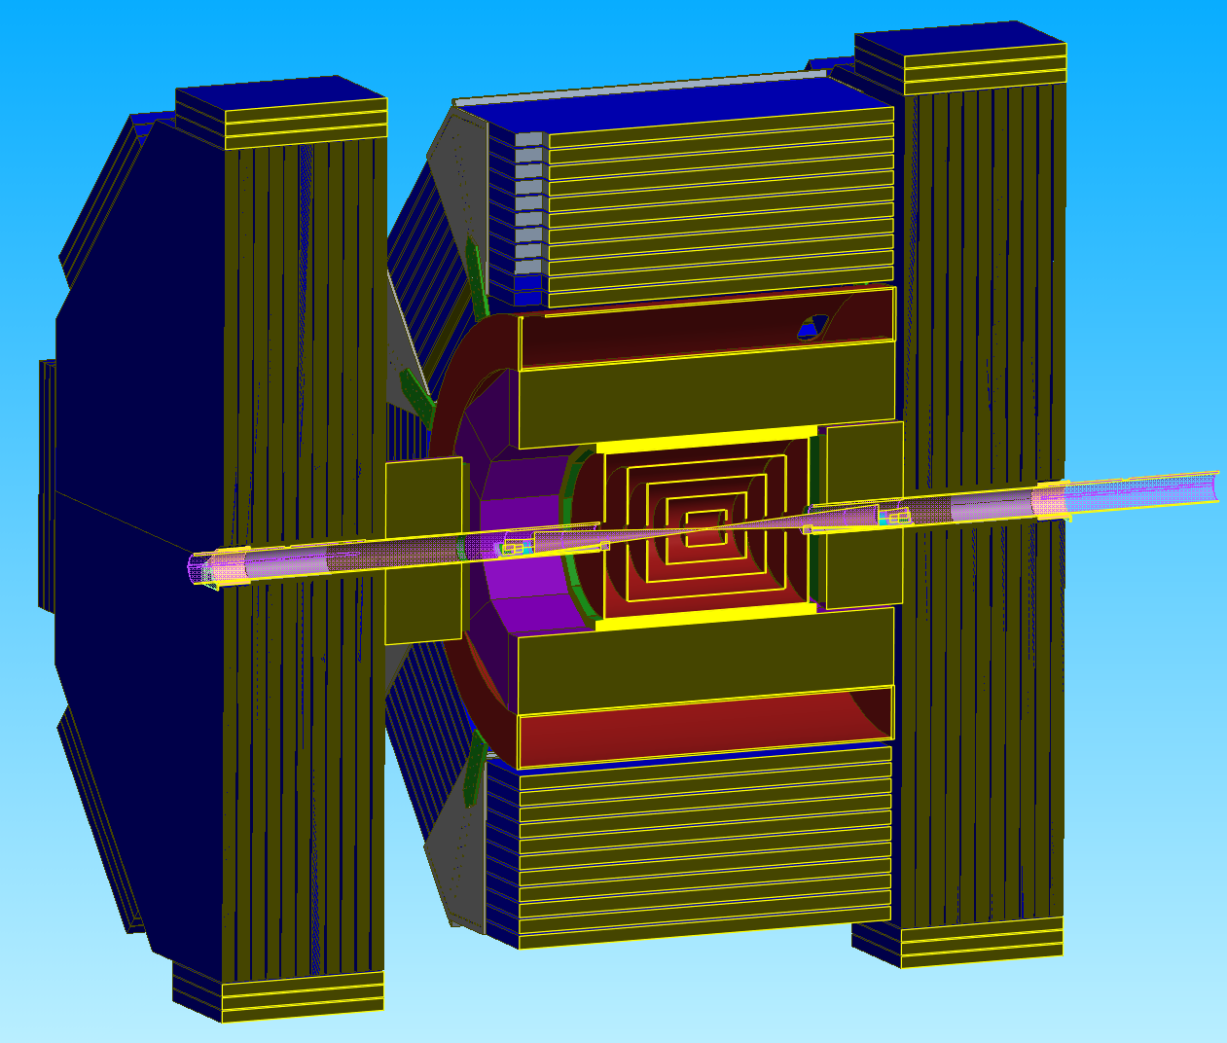
Precision Magnet Mover’s Cam Positions for QD0

Slide 2
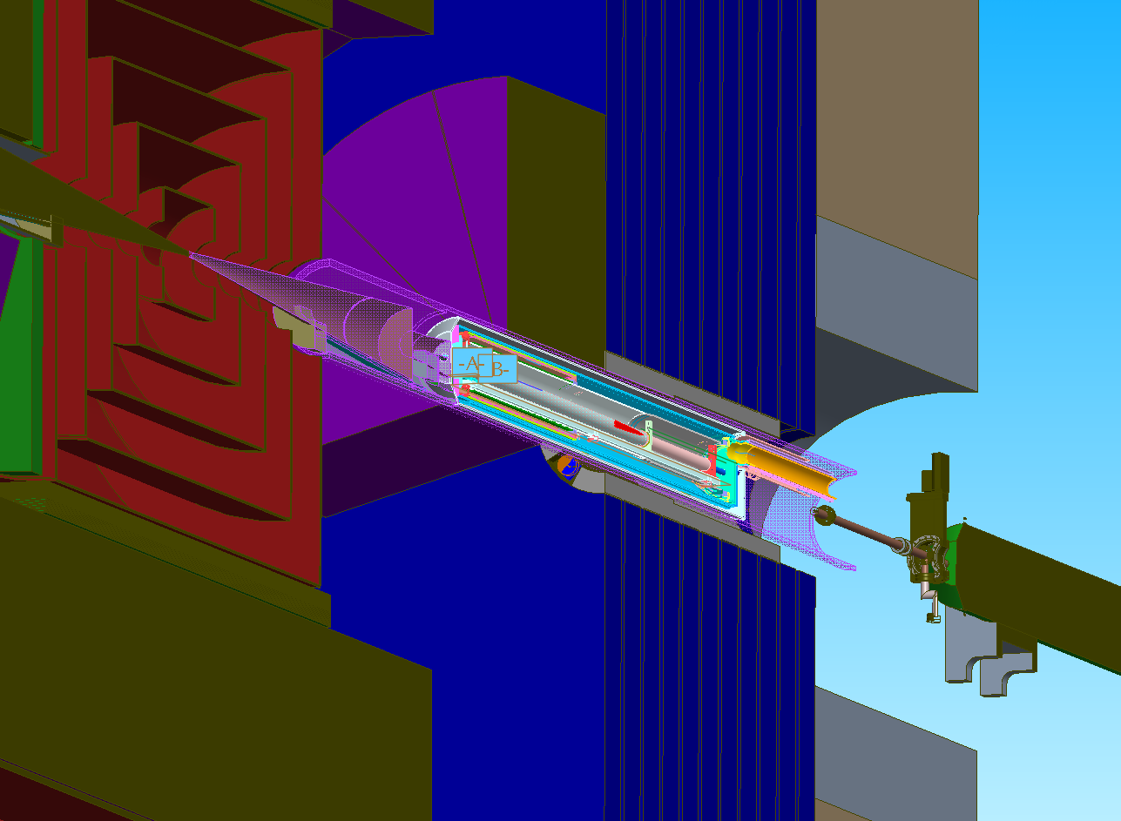
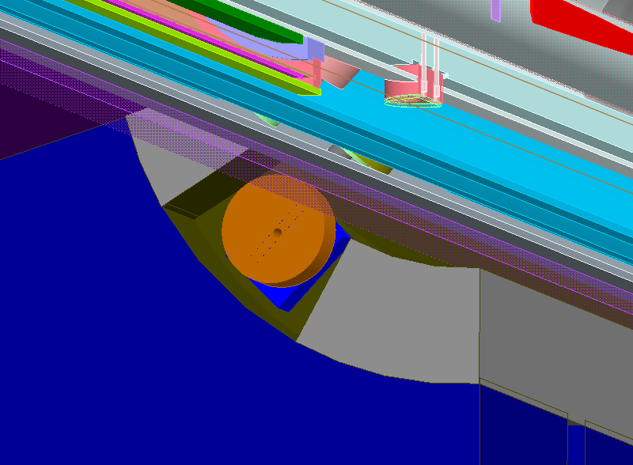
QD0 Cam Positioning for Front of Door
Note: Forward calorimeter is partially hidden to show cam position in door.
Cam
Gear Box
* Door in Open Position

Slide 3
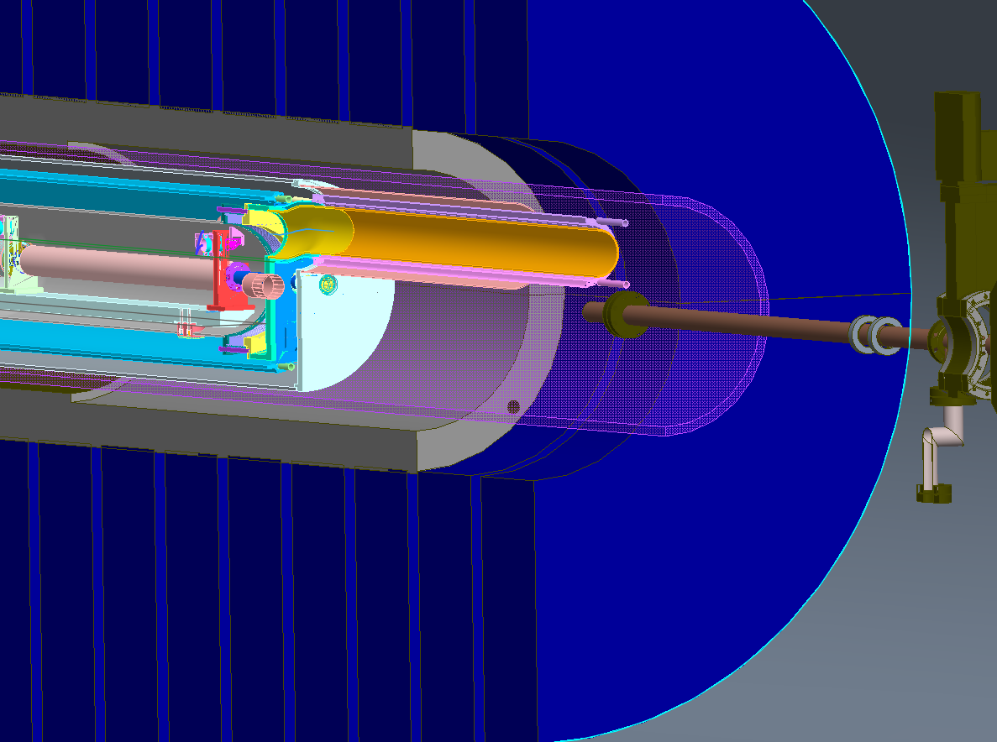
QD0 Cam Positioning for Front of Door
Doorinnertube.prt
Support Tube
Through Hole for Cam Shaft’s positioned at the front of door.
Note: Picture looking at back off QD0.
* Door in Open Position

Slide 4
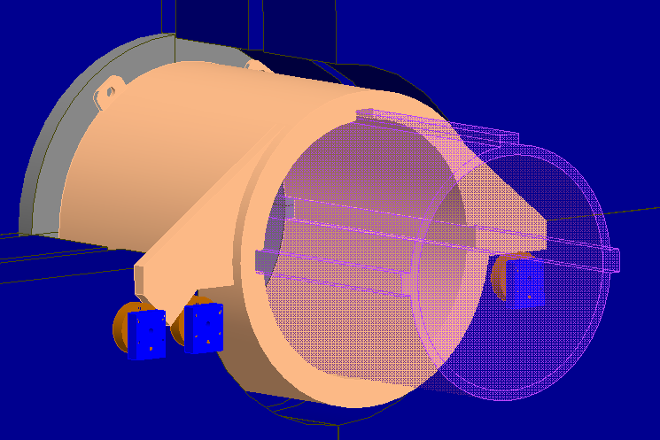
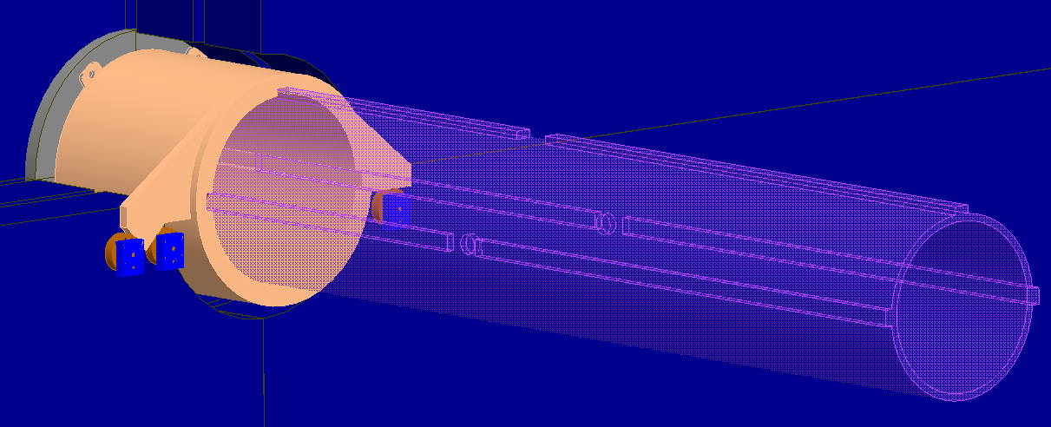
Support Tube Slide Tube Design
Slide Tube
Support Tube
Guides are added on the support tube that slide into cut-outs in the slide tube.
* Door in Open Position
The purpose of the slide tube is to allow the cams to remain engaged to the tube as the door opens and closes. QD0 will remain stationary as the slide tube moves with the door and the cam system attached to the back of the door.
* Door in Closed Position

Slide 5
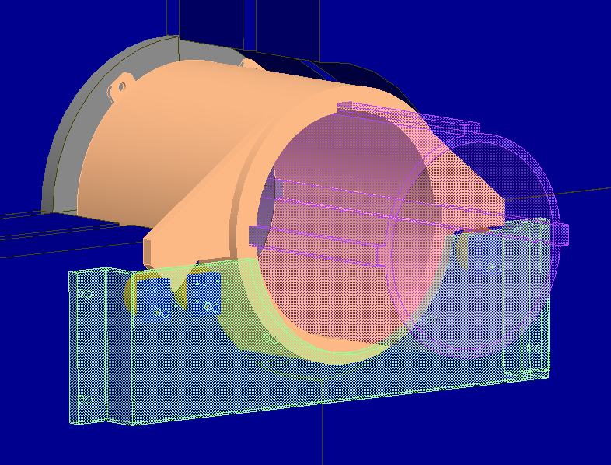
QD0 Cam/Motor Positioning
Support Tube
Slide Tube
QD0 has the ability to slide within the slide tube.
Cams for rear positioning as well as motors for all cams in the system will be mounted to this mounting plate.
Mounting Plate for Cams and motors.
* Door in Open Position

