Slide 1
Experimental hall design in mountain site
2011/11/17
Yasuhiro Sugimoto
@ILD MDI/Integ WG meeting

Slide 2
Recent events
Oct. 12-13: GDE CFS face-to-face meeting at KEK
  http://ilcagenda.linearcollider.org/conferenceDisplay.py?confId=5369
  CFS members and PMs visited both sites after the meeting
Nov. 8: GDE CFS webex meeting
  Discussion on the Japanese mountain sites
  I got a homework to report at the CFS meeting on Nov.30 on
    Size, length, and slope of access tunnel of each site
    Safety issues of the access tunnel
    Procedure of detector assembly
Nov.9: Meeting with people from each site
  Scientists (HEP, geology), civil engineering company, and local governments
  New information on the configuration of the experimental hall and access tunnels
  Discussion on the cavern design → modification of the design
Nov.11: Meeting with J-Power

Slide 3
Recent modification
Two access tunnels are connected on the same side of the cavern
Two alcoves (garages) are connected on the same side of the cavern
Access tunnel to SiD is enlarged to 9m
Access tunnels and the cavern have the same floor level in the central region (No down and up for SiD under the beam tunnel)
New access tunnels to the garages
Sub cavern for Helium compressor and liquifier
Detector services are placed at the both ends of the cavern (on the walls)
Small vertical shaft may be used for ventilation, if necessary (depends on the detail of the site)

Slide 4
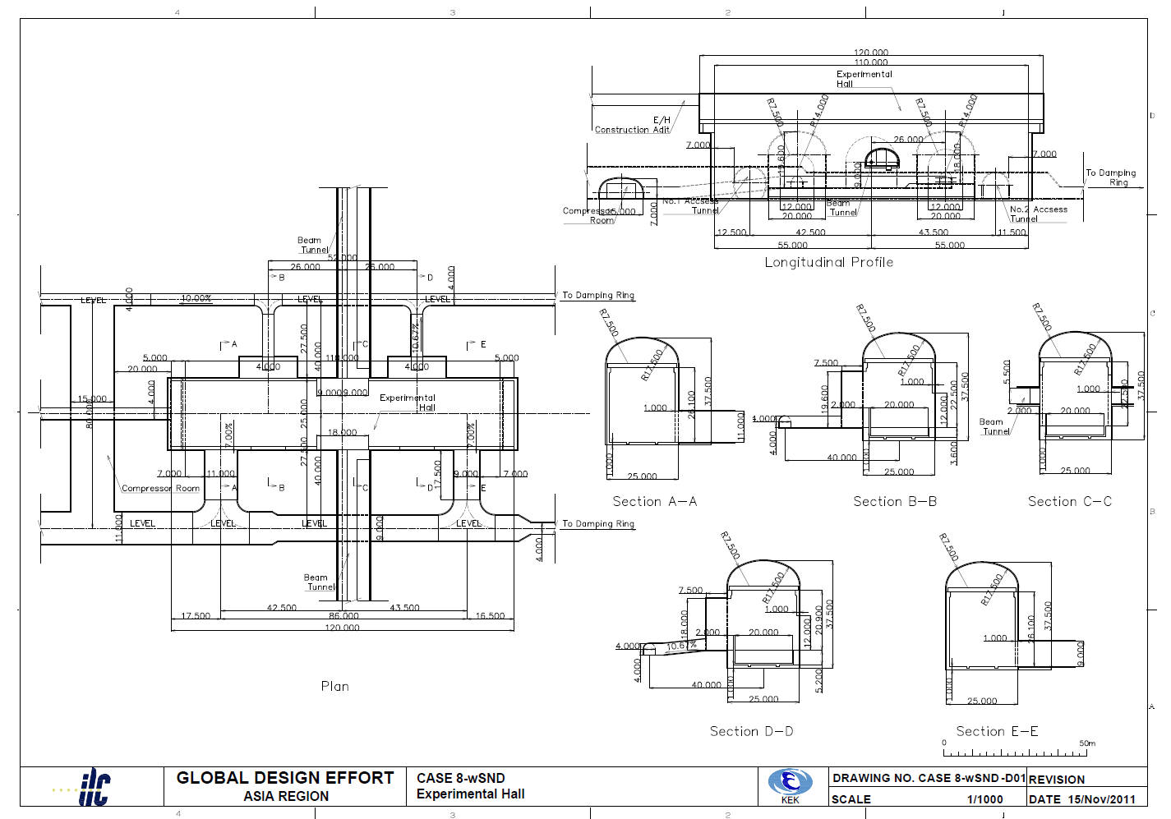
Design as of Nov.15
Helium compressor / cryogenics
Loading area
Detector services
Main access tunnel

Slide 5
Access tunnel
ILD
SiD
A trailer with lower deck height
would reduce the tunnel size

Slide 6
Solenoid transport
- 225t/5axles → 450t with 2-trailers
- Capable of ~7% slope

Slide 7
Tunnel crossing
Main access tunnel

Slide 8
Tunnel crossing
Sub access tunnel

Slide 9
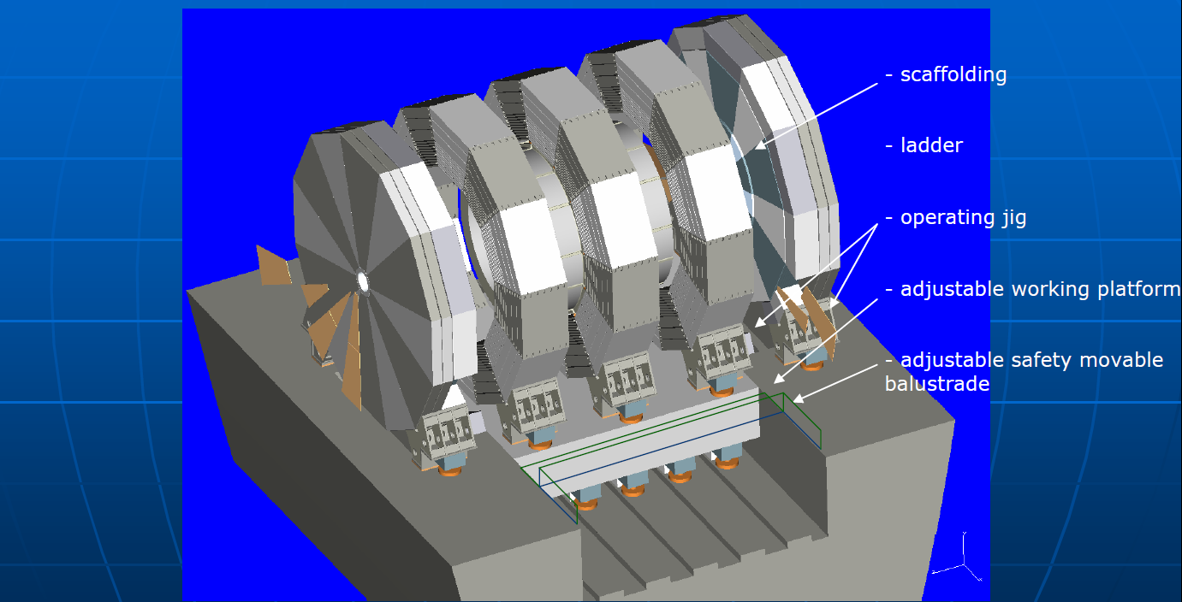
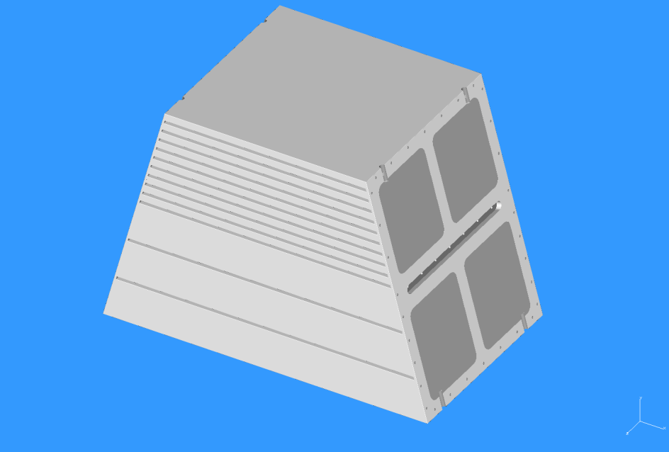
Detector assembly
ILD baseline using vertical shaft
  One ring is made of 12 blocks: ~200 ton/block
ILD assembly using access tunnel
  Each ~200 ton block is carried into the cavern one by one and assembled into one barrel
  No gap in the barrel yoke → Less leakage field

Slide 10
Detector assembly
1
2
Barrel assembly
Endcap (+) assembly
Endcap (-) assembly
Solenoid installation
QD0 support tube (-) assembly
QD0 support tube (+) assembly
Sub-detector installation
3
4
5
6

Slide 11
Safety issues
Ventilation
  Smoke and Helium gas will go out through the construction adit connected at the top of the cavern, and will not flow into the access tunnel (different tunnel entrances or a small vertical shaft for ventilation before joining the access tunnel) → More study will be done by a civil engineering company
  Amount of Helium gas ~ 5000m³ (CMS: 2x250m³x20bar =5000m³ at 1bar) =25mx100mx2m → No problem
Emergency egress
  Enough number of electric cars equipped with oxygen masks will effectively take people to the surface
  It should be forbidden to go to the cavern on foot

Slide 12
Schedule
~Nov.21: 3D drawing (step file)
  To be sent to SiD and ILD
11/30: GDE CFS webex meeting
  Report on the experimental hall in Japanese mountain site
12/12-13 CFS meeting at SLAC
  Finalize the basic design
  Start detailed design with cost estimate
Mar.22-23: CFS BTR meeting at CERN
  Finish the detailed design by this meeting

