Slide 1
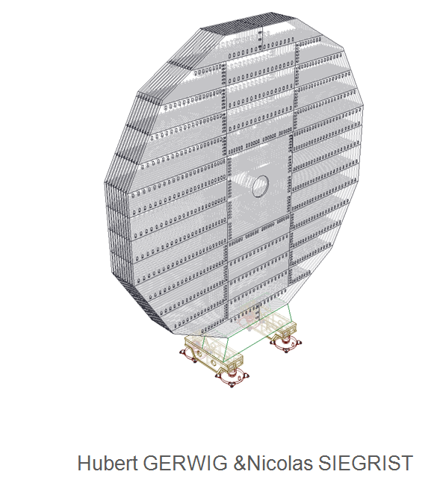
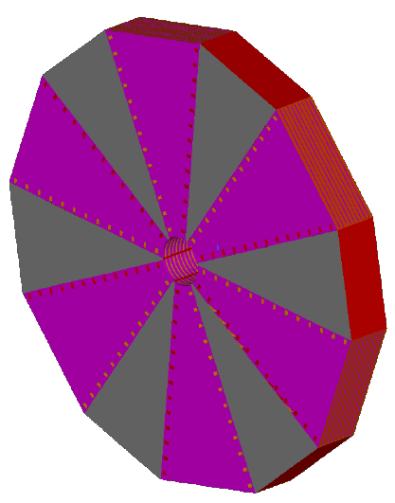
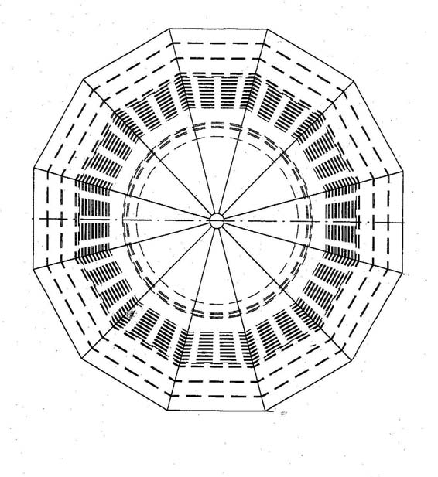
Yoke and Magnet
Yoke and stray field:
Decision made on no compensating coil :
  reduction of the store energy ( 2.7GJ> ≈ ?GJ)
  Might change the stray field = possible reduction of the return yoke
    reduction of the beam height, length of ILD ( i.e. opening access)
    Reduction of the cost
  Stress forces on the FSP and 1St layers of the Hcal endcap ( distortion)
Simulation ( magnetic field and Mechanical )needed
Return yoke design
still 2 designs
R.Stromhagen

Slide 2
Yoke and Magnet
Yoke and stray field:
Decision made on no compensating coil :
  reduction of the store energy ( 2.7GJ> ≈ 1.8 GJ)
  Might change the stray field = possible reduction of the return yoke
    reduction of the beam height, length of ILD ( i.e. opening access)
    Reduction of the cost
  Stress forces on the FSP and 1St layers of the Hcal endcap ( distortion)
Simulation ( magnetic field and Mechanical )needed
Return yoke design
After discussion with F.Kircher :
NO reduction …
still 2 designs
R.Stromhagen

Slide 3
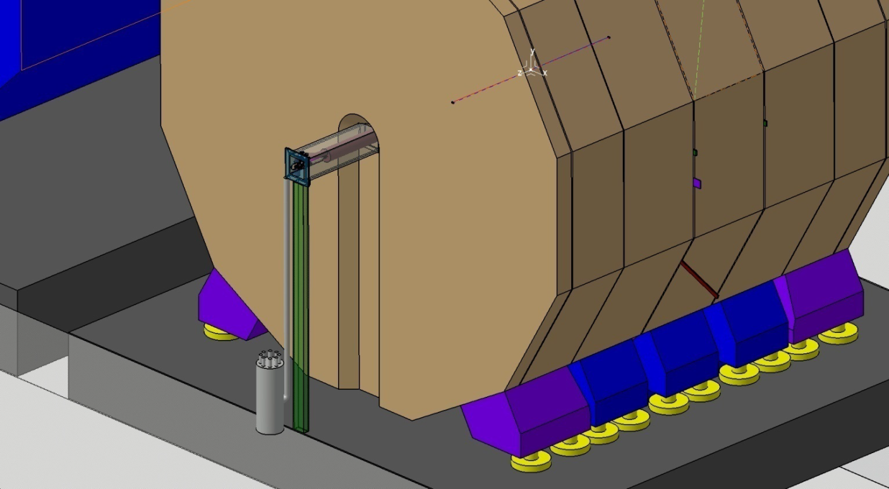
Return Yoke : split
Split or no split
cf presentation M.Jore in Orsay, June 2011
Possible by
Reducing the pillar +
trench in Return Yoke
Mathieu comments in June :
“Non split end cap seems feasible with 915mm for access on beam “
•To be studied :
  Detail design of the pillar and the trench
  Detail opening scenario
  Impact on the fringe fields
  Pacman compatible with SiD and our pillar
  Tooling
•For discussion …. Do we really need the last 560mm yoke ring?
Acted..
Still to be studied..

Slide 4
Return Yoke : split
Split or no split
cf presentation M.Jore in Orsay, June 2011
Possible by
Reducing the pillar +
trench in Return Yoke
Mathieu comments in June :
“Non split end cap seems feasible with 915mm for access on beam “
•To be studied :
  Detail design of the pillar and the trench
  Detail opening scenario
  Impact on the fringe fields
  Pacman compatible with SiD and our pillar
  Tooling
•For discussion …. Do we really need the last 560mm yoke ring?
Acted..
Still to be studied..

Slide 5
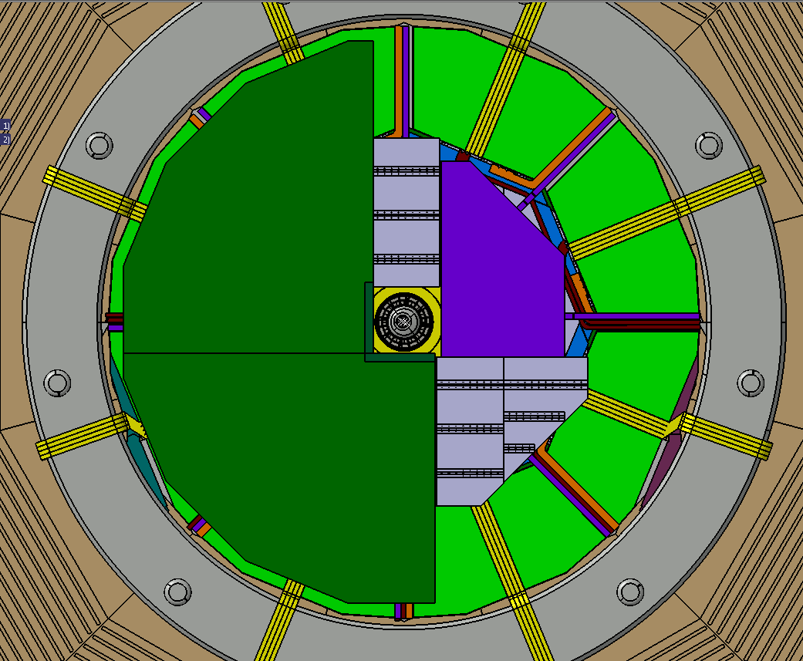
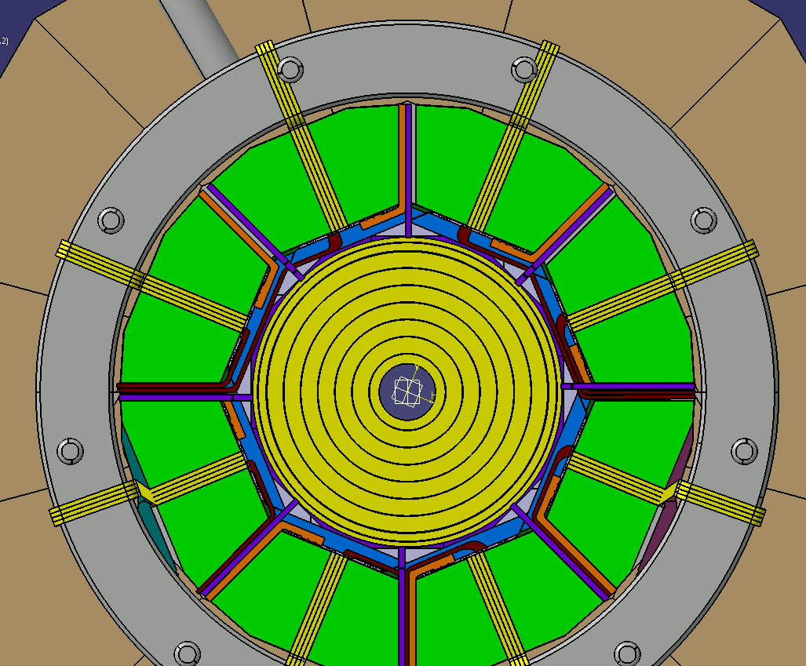
Ahcal tilt
Tilt of the Ahcal ( 22.5 °)
(because of self load deformation)
Problem with actual shape and construction of Ecal endcaps ( + ETD?)
No tilt in simulation but not crucial

Slide 6
Ahcal tilt
Tilt of the Ahcal ( 22.5 °)
(because of self load deformation)
Studies needed of the redesign of the Ecal endcap to check the incidence of this tilt on the segmentation of the endcap/slabs
In contact with LPSC , webex meeting foreseen

Slide 7
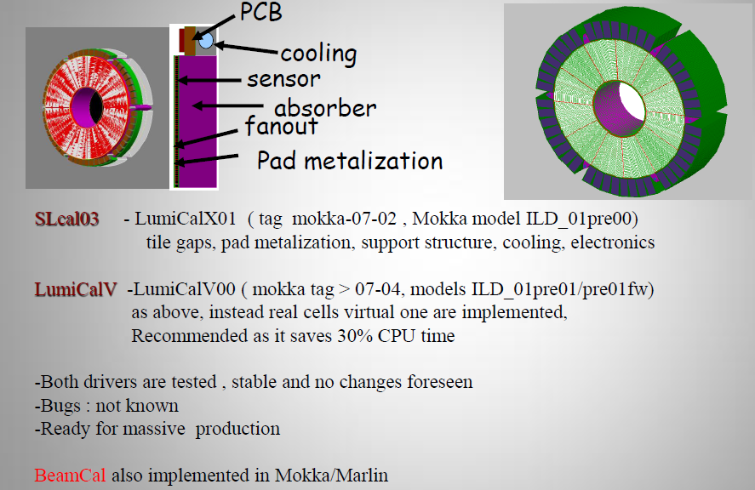
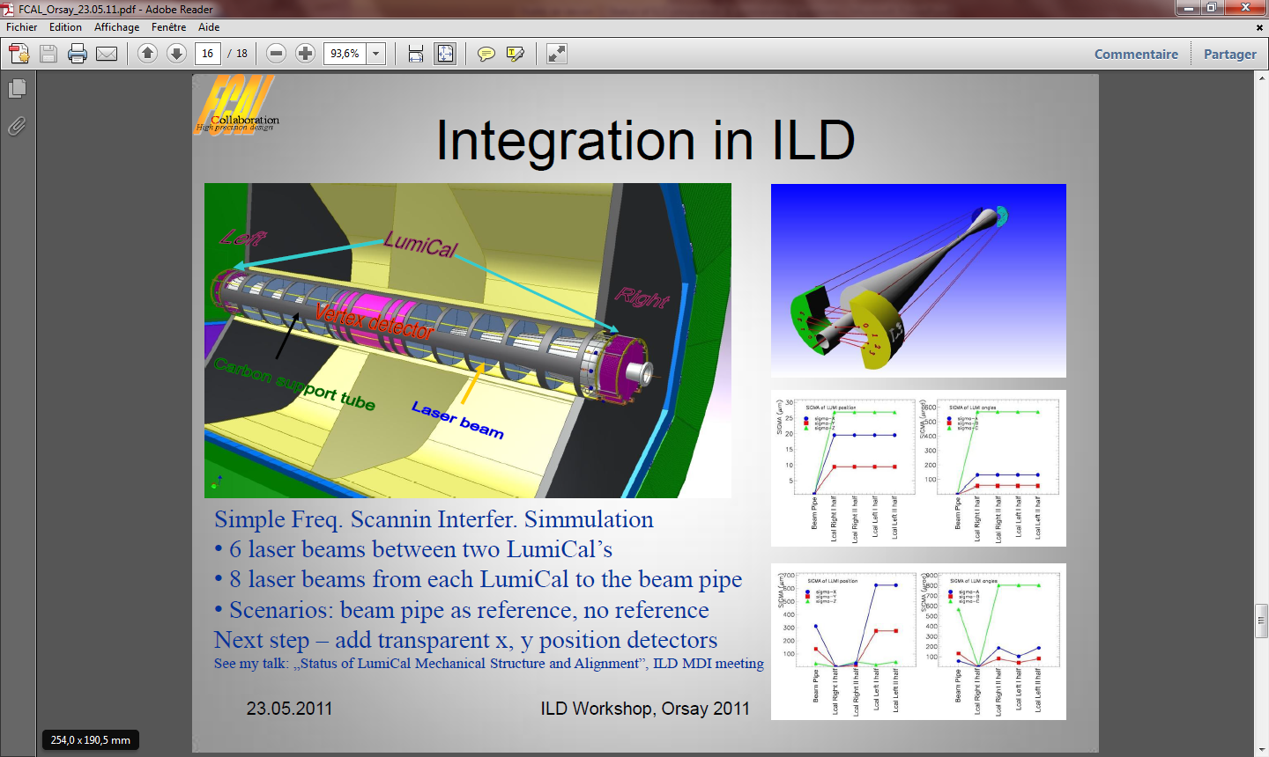
Forward region
Lumical & Beamcal in simulation model
Mechanical design well advanced, certainly need to be updated in CAD model and dimensions checked
Power pulsing & power needs are known
But :
from W. Wierba
ILD Workshop, Orsay may2011
Alignment system : 6 laser beams along the beam pipe ( through FTD)
Certainly not the only one :
impact?
See Szymon Kulis presentation, LCWS11

Slide 8
Forward region
Lumical & Beamcal in simulation model
Mechanical design well advanced, certainly need to be updated in CAD model and dimensions checked
Power pulsing & power needs are known
But :
from W. Wierba
ILD Workshop, Orsay may2011
Alignment system : 6 laser beams along the beam pipe ( through FTD)
Certainly not the only one :
impact?
Go through all the subdetectors ( inner and forward) hardware alignment system.
“ The ILD tracker alignment task force” ( 2009)
See Szymon Kulis presentation, LCWS11

Slide 9
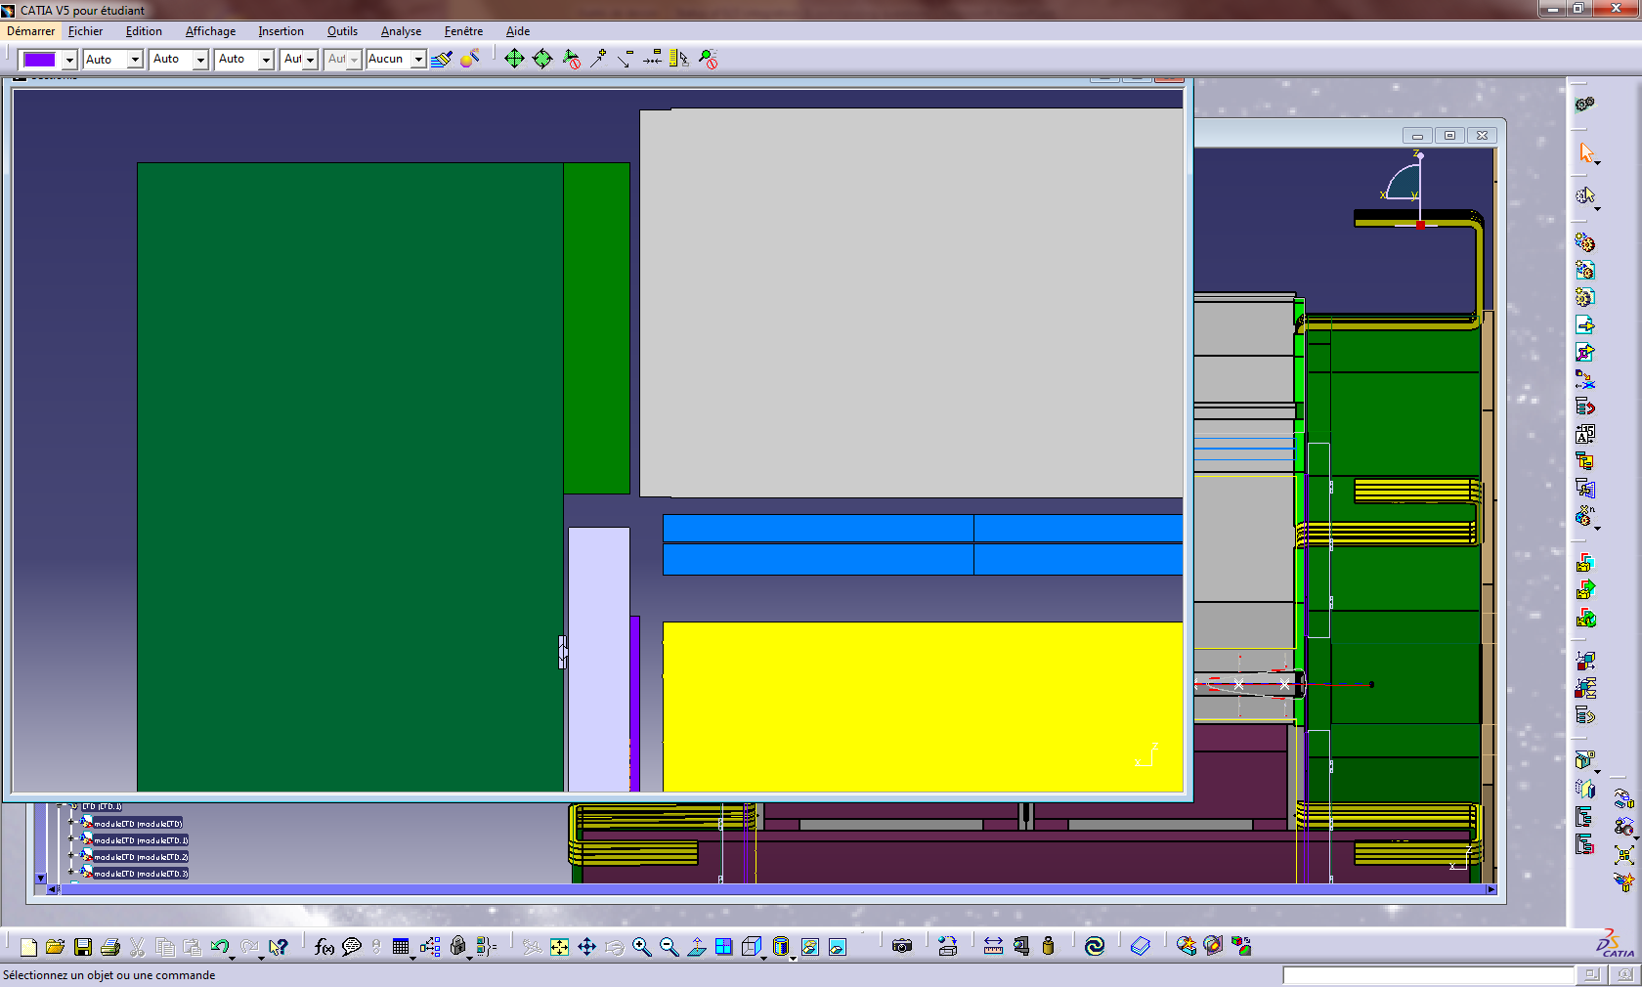
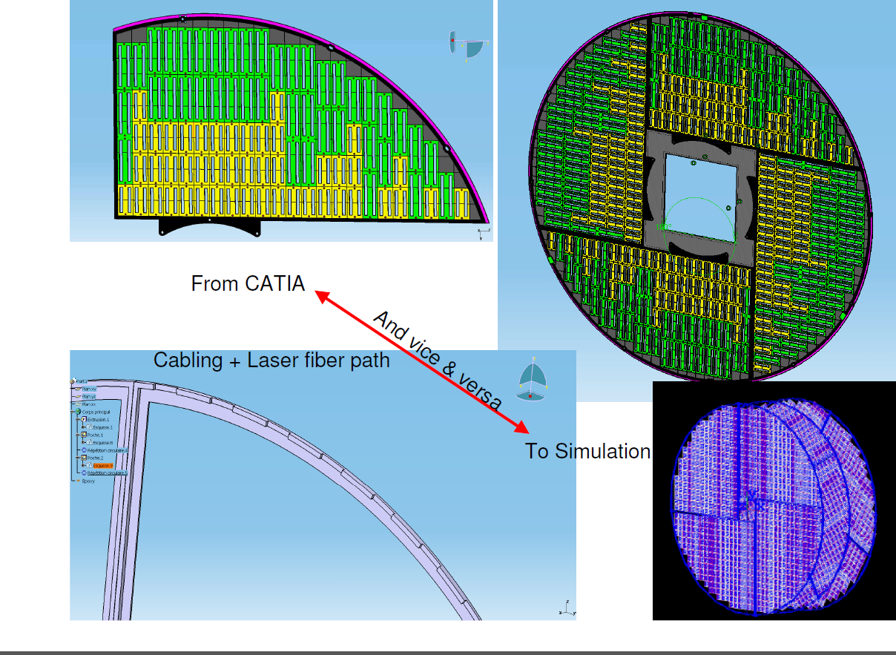
ETD
Ahcal Barrel
Its mounting system ( very preliminary on Rout ) and services, might limited its thickness , because: in the paths of the services.
Segmentation of mechanical submodules to be studied
AHCal Endcap
ring
Ahcal elec.
AHCal Endcap
30
95
100
Ecal Barrel
70
30
Ecal Endcap
ETD
TPC
Nbre of layers :
Thickness: actually still 30 mm in CAD model ( i.e.) 2 layers
but in simulation 3 layers XUV
Latest news of mechanical studies ( July 2010 ) : still considering 3 layers i.e. 45 mm total thickness,
Are 2 layers XY enough?
LPNHE by P. Ghislain &D. Imbault
in collaboration with
LPSC (D. Grondin), LAL (M. Jore),
LLR (P. Anduze). July 6-8, 2010,

Slide 10
ETD
Ahcal Barrel
Its mounting system ( very preliminary on Rout ) and services, might limited its thickness , because: in the paths of the services.
Segmentation of mechanical submodules to be studied
AHCal Endcap
ring
Ahcal elec.
AHCal Endcap
30
95
100
Ecal Barrel
70
30
Ecal Endcap
ETD
TPC
Nbre of layers :
Thickness: actually still 30 mm in CAD model ( i.e.) 2 layers
but in simulation 3 layers XUV
Latest news of mechanical studies ( July 2010 ) : still considering 3 layers i.e. 45 mm total thickness,
Are 2 layers XY enough?
LPNHE by P. Ghislain &D. Imbault
in collaboration with
LPSC (D. Grondin), LAL (M. Jore),
LLR (P. Anduze). July 6-8, 2010,

Slide 11
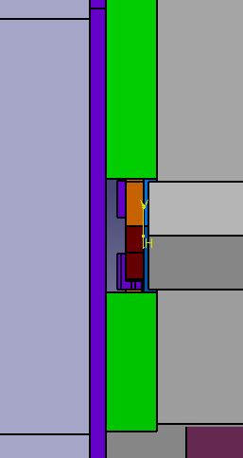
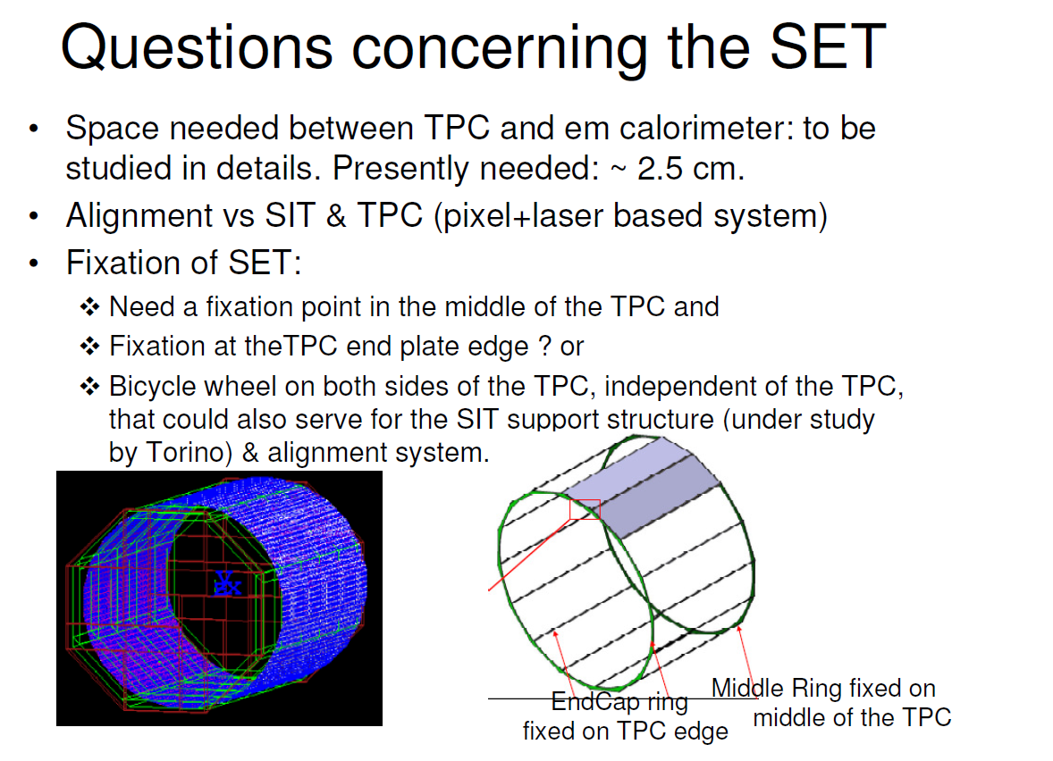
SET
Definition of the SET :
Still not in the CAD model .
+ its services have to share the same ways-out than ETD/Ecal/Ecal endcaps/TPC/ TPC support…. At least in case of AHCAL
Critical space between TPC and Calo actually 35 mm available, is it enough ?
In simulation 2 layers with total thickness 30mm
Study on the SET performed by Paolo MEREU
July 6-8, 2010,

Slide 12
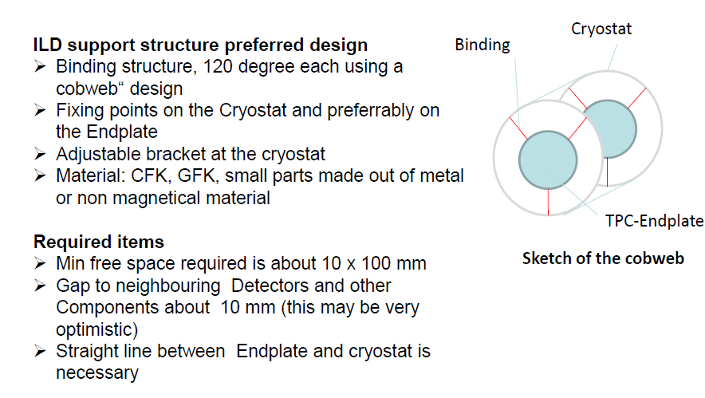
TPC support
Is it necessary to go up to cryostat ?
with SDHcal : fixation on Hcal endplate (20 mm thick)
with AHCAL
tension rods sharing the spaces with services in 2/3 ways out
Fixed on structural skin of the “ way out “ 2 cm thick SS?
Neither in CAD model, nor in Simulation
No decision made on the hanging system only conceptual
FEA calculations?
Placeholder ?
V. Prahl

Slide 13
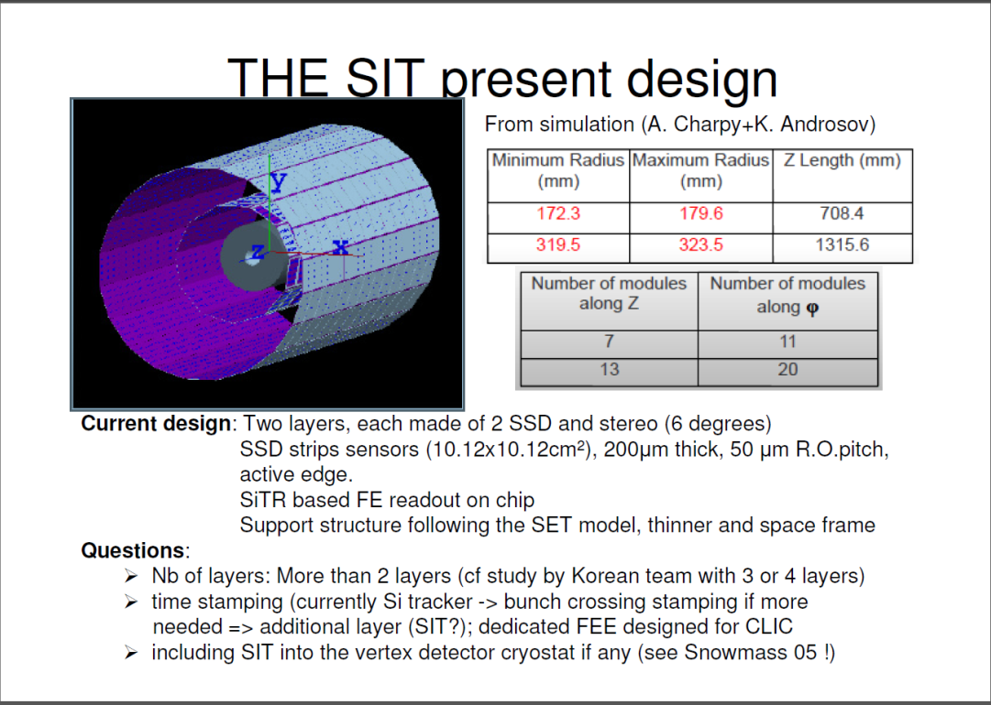
Inner detectors (2) : SIT/FTD & al
SIT : present design for simulation well advanced but structure/support/services ?
FTD1/FTD2 : same questions + do they have to be in the cryostat or at least a field cage
Path of the cables :
first assumption, along the forward detectors, seems no more valid due to the congestion around the Ecal ring and the needed space for connections box => inner services in the gap barrel-endcap with first patch-panel close to /on the TPC endcap.

Slide 14
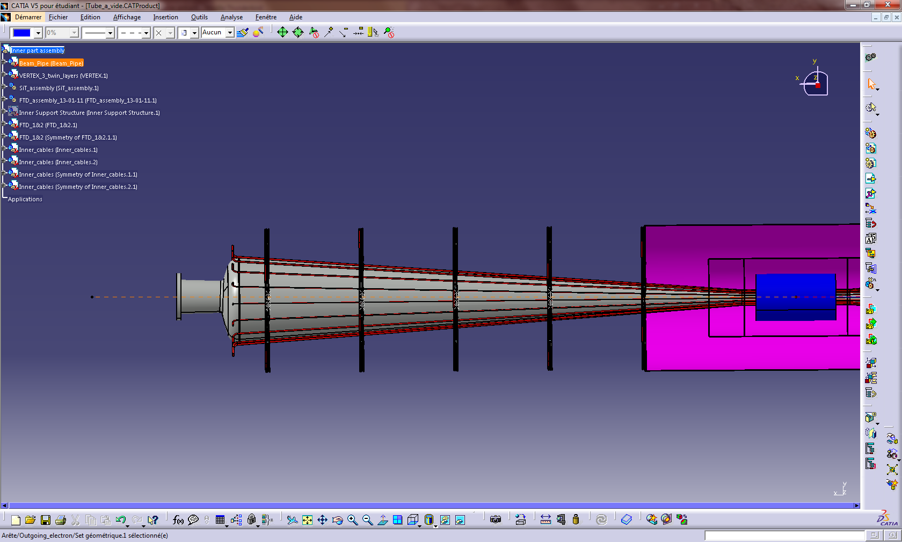
Inner detectors (6) : X0 along the beam pipe
FTD7
FTD6
FTD5
FTD4
FTD3
FTD2
FTD1
Cryostat
Beam Pipe φ
BP circumf
38 cm 31 cm 24 cm 18 cm 12 cm 4.8 cm
119 cm 97 cm 75 cm 56 cm 38 cm 15 cm
5 FTD + VXD
4 FTD + VXD
3 FTD + VXD
2FTD + VXD
1FTD + VXD
VTX :
CMOS 85 mm²
or FPCCD : 65mm²
875 mm²
Cu eq to 0,73mm 5.1% X0
717 mm²
Cu eq to 0,74 mm 5.2% X0
559 mm²
Cu eq to 0,74 mm 5.2% X0
401 mm²
Cu eq to 0,71mm 5.% X0
243 mm²
Cu eq to 0,64mm Cu
4,5% X0
in order to optimise the volume of cables : possible gain of factor 2 ( serialisation & optimisation of section)
CMOS:4% X0
FPCCD:2.9% X0
Conductor ( Cu >>> Al ?)
+
Optimisation of the power distribution
Study of the heating of the beam pipe
BUT ( again):
SIT = 6,9 m² versus FTD ( µstrips)= 4,8 m²
FTD 1&2 =0,67 m² per side versus VTX = 0,17 m² per side

Slide 15
( Al)/ρ(Cu) = 1.625 and λ(Al)/λ(Cu)= 6.22
so Gain of 3.74 on X0
The space occupancy of cables should not be too different( mostly due to insulator )
But quality of the Al alloy ?
Work on the references of the cables : actually sections of insulator/conductor≈10.
Huge for low voltage : has to be optimised ( special development)
Optimisation of cables occupancy and X0 insulator

Slide 16
Summary :
Coil :
no compensating coil lead to 2.7 GJ> 1.8GJ but no reduction of neither the stray field nor the thickness of the return yoke .
Still to be studied : stress forces on the FSP
Return yoke :
  decision on the 2 design
  Design of trench in yoke endcap + pillar ( no split)
Studies on the consequences of the tilt of Ahcal on the design of the Ecal endcaps
Compatibility of the alignment system for all the inner and forward subdtetectors, consequences on the inner part design
ETD :
Mounting system + services
XUV or XY enough
SET :
Design request in Cad model + fixation studies on TPC
TPC :
Fixing system ( case Sdhcal & Ahcal),
Free spaces on endcaps for connecting boxes ( either TPC or inner services)
SIT & FTD1-2 :
Crucial need of input for cabling/cooling(in cryostat? )
Inner part : support tube structure, integration steps and consequences on the way out of services/ inner patch panels position is ongoing with C.Bourgeois and A.Gonnin from LAL

