Slide 1
SCRF: Monthly WebEx Meeting
November 16, 2011
Report from PMs (20 min.)
  GDE activity/meeting plan
  Report of ILC-PAC, Nov. 14-15, (MR)
  Preparation for the Technical Design Report (NW)
  Status of SCRF industrialization study (AY)
  Preparation for TTC meeting and a post-TTC meeting: GDE-SCRF meeting at IHEP, Dec. 5 - 9 (AY)
  Preparation for the SCRF Technical Baseline Review (TBR) at KEK, Jan. 19-20, (AY, MR)
Report from TA Group Leaders (20 min.)
  Cavity Gradient R&D: R. Geng
  Cavity Integration: H. Hayano
  Cryomodule: P. Pierini
  Cryogenics: T. Peterson
  HLRF: S. Fukuda & C. Nantista
  ML Integration: C. Adolphsen
Special Discussions (20 min.)
  TTC-WG1: Plan for Cryomodule (S1-Global) test results and analysis (AY, HH, JK).
  SCRF meeting (as post-TTC) : Discussion on technical baseline for ILC-TDR and the cost estimate (AY, JK).
  SCRF-BTR: Baseline Technical Review: Focusing points for the BTR meeting at KEK, Jan. 19-20 (AY, MR, NW).

Slide 2
PM’s Action/Meeting Plan (2011-2012)
Month | Day | Place | Meeting
Nov. | 11 14-15 16 16 22 30 | Munchen Prague CEA-Saclay Web Web | Visit SST (EBW machine company) ILC-PAC Visit CEA/Saclay to discuss cryomodule assembly work Monthly SCRF meeting Visit RI (Cavity industrialization study) HLRF meeting
Dec. | 5-8 8-9 (14) | Beijing Beijing (Web) | TTC meeting ILC-GDE SCRF meeting (as a post TTC meeting) (Monthly meeting: be merged to the above meeting)
2012, Jan. | 11 18 19-20 21 | Web KEK KEK KEK | Monthly meeting Industrial study meeting with AS/Japanese Industry SCRF TDR Preparation Review & WS Costing meeting
Feb. | 8 | Web | Monthly meeting
March | 21 22-23 | CERN CERN | CFS-Ams, EU review CFS TBR
April | 23-26 | Korea | ACFA-LCWG

Slide 3
ILC-PAC, Prague, Nov. 14-15
GDE SCRF related Reports:
  R&Ds including System Test: M. Ross
  Industrialization Planning: A. Yamamoto
  TDR preparation: N. Walker
  Costing: G. Dugan
Reports are uploaded at:
  http://ilcagenda.linearcollider.org/conferenceDisplay.py?confId=5394

Slide 4

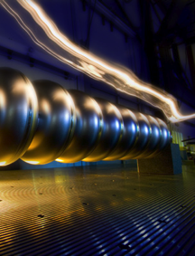
Technical Volumes
2007
2011
2013*
TDR Part I:
R&D
~250 pages
Deliverable 2
ILC Technical Progress Report
(“interim report”)
AD&I
TDR Part II:
Baseline
Reference
Report
~300 pages
Deliverables 1,3 and 4
Technical Design Report
Reference Design Report
* end of 2012 – formal publication early 2013

Slide 5
RDR vs TDR Part II
RDR was divided into
  Accelerator Systems (sources, DR, BDS etc.)
  Technical Groups (cryomodule, RF, magnets vacuum etc.)
TDR Part II is Accelerator System orientated
  Each sub-system will cover its own technical systems
  Better suited to TD Phase project structure
  Acknowledge lack of RDR-like tech. groups

Slide 6
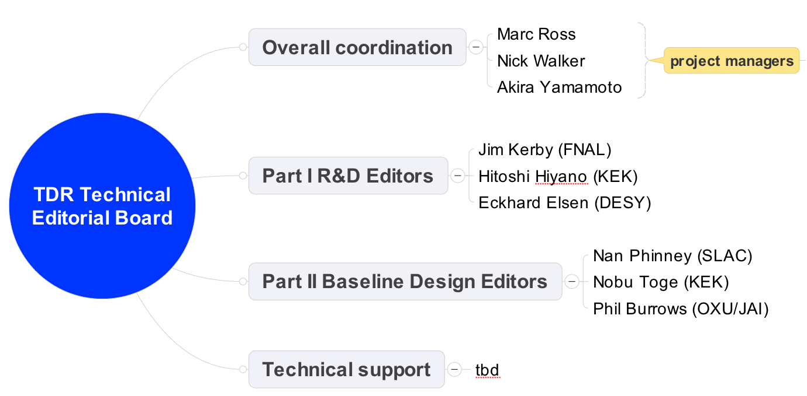
Technical Design Report (TDR)
Technical Editorial Board
Chief Editor: tbd
Hayano (KEK)

Slide 7
Part I: R&D - Outline
Introduction 5 pages
Superconducting RF Technology 75 pages
Beam Test Facilities 75 pages
Accelerator Systems R&D 50 pages
Post-TDR R&D 20 pages
Conclusions 10 pages

Slide 8
Part I: Tech. Design Phase R&D
Comprehensive report on TDP R&D programmes
  where and how we spent the money
Similar in scope to R&D sections in interim report
  more technically detailed
  more conclusive
Report R&D results should support baseline (decisions) in Part II
  But scope can be broader, i.e. R&D on alternative concepts

Slide 9
Part I: R&D - Outline
Introduction 5 pages
Superconducting RF Technology 75 pages
Beam Test Facilities 75 pages
Accelerator Systems R&D 50 pages
Post-TDR R&D 10 pages
Conclusions 10 pages
Key persons
Expected
2.1 A. Yamamoto
2.2 R. Geng
2.3 H. Hayano
2.4 P. Perini*/
T. Peterson
2.5 S. Fukuda*/
C. Nantista
2.6 C. Adolphsen
2.7 J. Kerby
2.8 H. Hayano
2.1 Overview
2.2 Gradient R&D and yield evaluation
2.3 Cavity integration and S1-Global cryomodule R&D
2.4 Cryomodule, cryogenics (incl. S1-Gobal)
2.5 High power RF generation and distribution
2.6 ML integration including quadrupole R&D
2.7 Industrialisation technology and R&D
2.8 Infrastructure for R&D and tests

Slide 10
Part II: ILC Baseline Design Report
Introduction and overview 5 pages
General parameters and layout 15 pages
SCRF Main Linacs 40 pages
Polarised electron source 15 pages
Positron source 20 pages
Damping Rings 30 pages
Ring to Main Linac (RTML) 20 pages
Beam Delivery System & MDI 30 pages
CFS and global systems 30 pages
.. see later
Detailed section outline available here

Slide 11
Special Cases: SCRF
3 SCRF Main Linacs
  3.1 Main linac layout and parameters
  3.2 Cavity performance and production specification
  3.3 Cavity integration (coupler, tuners,…)
  3.4 Cryomodule design (including quad package)
  3.5 Cryogenics
  3.6 RF power and distribution systems
    KCS
    DRFS
    RDR solution (back-up)
  3.7 Low-level RF control
Key persons
Expected
3.1 C. Adolphsen
3.2 A. Yamamoto
3.3 H. Hayano
3.4 P. Perini
3.5 T. Peterson
2.5 S. Fukuda*/
C. Nantista
2.7. J. Cardawine*/
S. Michizono
Description of regional baseline variants

Slide 12
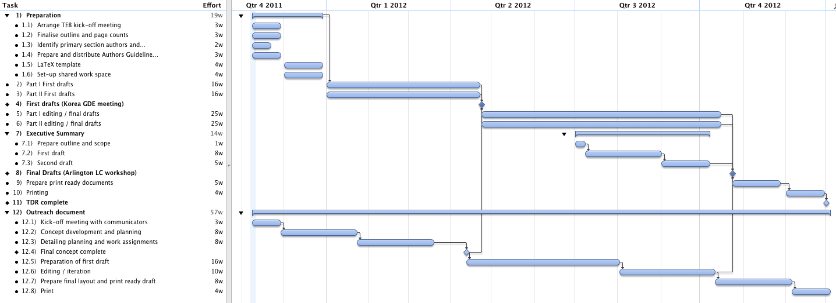
Tentative Schedule
2011 2012
Korea GDE meeting
24.04 – Parts I & II first drafts
16 weeks
25 weeks
Executive Summary
Companion outreach document
US LC meeting (Arlington)
24.10 – final Drafts
preparation
Very aggressive schedule!
In parallel:
cost estimation
TDD for EDMS
We like a challenge ☺

Slide 13
Status of Industrial Studies in Contracts with experienced companies
Objectives:
  Further reliable cost estimate and understanding mass production effect, based on the previous cost-study for a level of 20 %, (with no contracts)
EU:
  DESY-RI: Cavity industrialization study (50 , 100 %) including facility,
  CERN-BN (under discussion): Cryomodule assembly study (33 – 100%)
Ams:
  Fermilab-AES: Cavity industrialization including facility
AS/Japan (under discussion):
  KEK-MHI: -Hitachi: Cavity indust. study (50 ~ 100 %) including facility,
  KEK-Hitachi: Cryomodule assembly study
  KEK-Toshiba: Conduction cooled SC quadrupole industrialization study

Slide 14
Further Plans to prepare TDR
Cost-estimate work for TDR (by April, 2012)
  Communication with industry under contract
    Cavity: RI (w/ DESY), AES (w/ Fermilab), MHI (w/ KEK),
    Cryomodule Assembly: BN (w/ CERN), Hitachi (w/ KEK),
    Quadrupole: Toshiba (Q, w/KEK)
    HLRF (SLAC, KEK)
  Communication with laboratories
    Fermilab, JLab, CERN, DESY, Saclay, INFN, KEK, …
Technical specification to be fixed for TDR cost
  SCRF meeting at IHEP, Dec. 8-9, 2011
  SCRF-TBR, Jan. 19-20, 2011
  GDE meeting, 23-26, April

Slide 15
TTC Meeting at IHEP, Dec. 5-8
General agenda:
  WG1:
    Cryomodule tests and analysis
      focusing on the S1-Global test results and analysis
  WG2:
    Cavity material, fabrication, treatment and testing: new concepts and new benefits
  WG3:
    Cryogenics and cryostats: savings in cooling power

Slide 16
Technical Discussions on S1-Global Test Results at TTC, Dec. 5-8
Working Group 1: Cryomodule Test Results and Analysis
Date: Dec. 7, (the third, full day)
Sessions; 1 (2 hrs), 2 (1.5 hrs), 3 (1.5 hrs), 4 (1.5 hrs)
Focusing on cryomodule RF tests and problems observed
  Cavity: Degradation of field gradient after cavity-string assembly
  Input coupler: discharge and excessive heat-load
  Tuner: LFD and control, and failure modes in operation
  Cavity-string: alignment process and monitoring/control
  (LHe jacket, magnetic shield and others)
Notes and Request from TTC:
  Wider applications/projects to be covered
  ILC, FLASH/XFEL, NML, Cebaf, Spiral-2, …

Slide 17
TTC-WG1: agenda proposed
Cryomodule test results and analysis as of Nov. 16, after SCRF meeting
Session | Subject | Speakers
December 7: Wednesday: 1: 8:30 – 10:30 | Tuners: - LFD control with tuners Discussion and Comments on tuner performances: | Yuriy Pischalnikov (Fermiab), Shin-ichiro Michizono (KEK) C Pagani (INFN), and S. Noguchi (KEK)
2: 10:45 – 12:30 | Input couplers, associated work for the installation :and the RF and thermal performance and discussions: | Wolf-Dietrich Moeller (DESY), Eiji Kako (KEK, and Tug Arkan (Fermilab) (discussion by all)
3: 13:45 – 15:15 | Cryomodule Assembly: alignment, magnetic shield, radiation shield, tuner access, thermal balance .... | Axel Matheisen (DESY)* Michel Fontaine (Saclay)* Eiji Kako / or somebody else
4: 16:00 – 17:20 (discussion to be extended to the next morning session) | Gradient degradation in CM/cavity-string and recent results from CM gradient tests | Elvin Harms (Fermilab), Yasuchika Yamamoto (KEK)* Detlef Reschke (DESY)* Bob Rimme / R. Geng (Jlab)

Slide 18
GDE-SCRF Meeting as a post-TTC meeting, Dec. 8-9
Based on the S1-Global test results, to;
  Discuss baseline technology for the ILC Technical Design Report and cost estimate
    Project-oriented
    Technology choice for costing base
    Introduction and guideline proposed by PMs (Dec. 8, pm)
    Each Group Leader to lead individual discussions (Dec. 8 pm)
    General discussion and S1-Global report (Dec. 9)
Subjects to be discussed (more details in next pages):
  Plug-compatibility: boundaries to be established
  Tuner design for the TDR cost-estimate baseline
  Input coupler design for the TDR cost-estimate
  Cavity structure for alignment, and for adapting high-pressure code,
  S1-Global Report: to be finalized

Slide 19
Our Direction for TDR-SCRF
Operational cavity gradient :
  31.5 MV/m +/-20 %, with sorting /grouping
  Prepare for cavity gradient degradation after cavity-string/cryomodule assembly,
      With assuming 10 % cryomodule to be degraded with a level of 20 %
Cavity plug-compativility condition to be simplified
  Discussion to be necessary specially for beam flange, tuners and couplers
Cryomodule configuration:
  8 + (4+Q+4) + 8 cavity-string assembly as a baseline
  Further study required for
    periodicity of quadrupoles and
    cost effective assembly technology

Slide 20
Technical Issues toward TDR
Cavity gradient : (discussion led by R. Geng)
  Update and fix the cavity production and process recipe.
  Update and fix the successful production yield definition in production stage,
    including new parameters such as radiation, and the process w/ tumbling
  Gradient spread of 31.5 MV/m +/-20 %, with sorting method,
  Gradient degradation after assembly into the cryomodule (see: HLRF/DRFS w/ circulator)
Cavity Integration (discussion led by H. Hayano)
  A baseline design chosen for the TDR cost-estimate base,
    Including selection of tuner, coupler, beam-flange, magnetic shield, and LHe tank
  Plug-compatible design to be allowed in case of cost equivalent or more cost effective.
  Cavity delivery condition with LHe-tank, and cold-test sequence/monitor,
Cryomodule and Cavity-string Assembly (discussion led by P. Perini)
  Cryomodule string configuration with 8 + (4+Q+4) + 8 cavity-string assembly
  Simplification of 5K radiation-shield: simplification of bottom, and removal at inter-connect.
  Split-yoke, conduction-cooled quadrupoles
  Efficient alignment
Cavity and Cryomodule Test (discussion led by H. Hayano)
  Warm conditioning of Input Coupler: before or after installation into the tunnel
  Cold performance test: How much fraction to be cold tested? Subjects to be tested?

Slide 21
Continued
Cryogenics (discussion led by T. Peterson)
  Location and the options (reducing the number of station) of cryogenic systems,
  Capacity optimization and heat balance with cryomodule heat-load
HLRF (discussed led by S. Fukuda and C. Nantista)
  KCS/DRFS/RDR-unit HLRF system configuration including backup power supply and utilities with the single tunnel design
  Marx generator to be a baseline modulator,
  AC power capacity optimization with gradient spreads,
  Adaptability against cavity degradation after installation into cryomodule, by using circulator and power distribution system,
  Optimizations for low-power and high-power option.
  Tunable power distbribution system
ML Integration (discussion led C. Adolphsen)
  Beam dynamics
    Quadrupole/BPM periodicity, locations, alignment, and beam tunability,
    Bunch spacing limit specially on KCS (requirement of DR beam dynamics)
  Availability, reliability, and backup of cryomodules to be required

Slide 22
How to prepare for TDR?
Discussion during LCWS
Further technical discussion in TTC, Dec. 5 - 8
ILC Specific discussion in post-TTC, Dec. 8-9,
Consensus for TDR writing, BTR at KEK, Jan. 19 – 20, 2012

Slide 23
General Guideline for SCRF-BTR
Jan.19-20, 2012
For each Subject, we must have
  1) a presentation of the proposal with a description of what is to be changed and why,
  2) a summary of the R&D in support of the change,
  3) a summary of the interfaces and the impact on related systems and components, especially CFS, and
  4) a thorough explanation of the cost impact.
This format was followed with the previous Reviews.
While the first two items are to be presented by the appropriate group leader, number 3) and 4) must also have comment from the CFS team and the cost engineers. In some cases there is no impact on CFS. But in all cases there must be a cost impact evaluation.
Most of the topics have more than one interface with technical area groups within SRF technology and many have an impact on beam dynamics.
The BTR agenda should therefore include, in addition to the comprehensive presentations by the group leaders, presentations by the CFS team, the cost engineers and the beam dynamics group.

