Slide 1
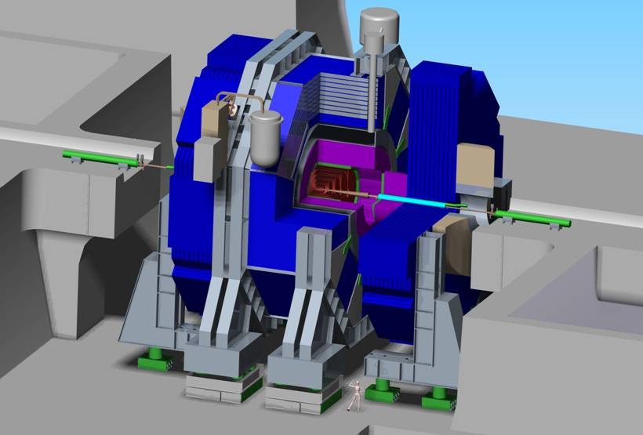



KILC’12, Daegu - April 2012
MDI Status
SID Assembly for Vertical Shafts & Japanese Site
Marco Oriunno, SLAC

Slide 2
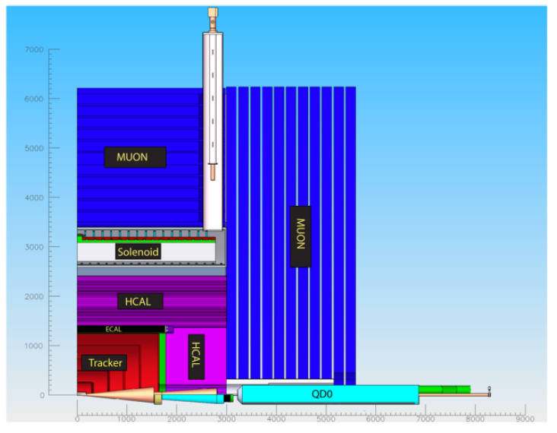
The assembly procedure of SID is driven by the its specific design features
Compact design with 5 T Solenoid
Single Ring Barrel
Self Shielded: Stray Fields & Radiation
Short L* with FFS QD0’s supported from the doors
Weight breakdown
Barrel Ecal | 60
Barrel Hcal | 450
Coil | 192
Barrel Iron | 3287
Total Barrel | 3990
Endcap Ecal | 10
Endcap Hcal | 38
Endcap Iron | 2100
Pacman | 100
Feet | 60
BDS | 5
Total Door (x1) | 2313
Total SiD | 8615

Slide 3
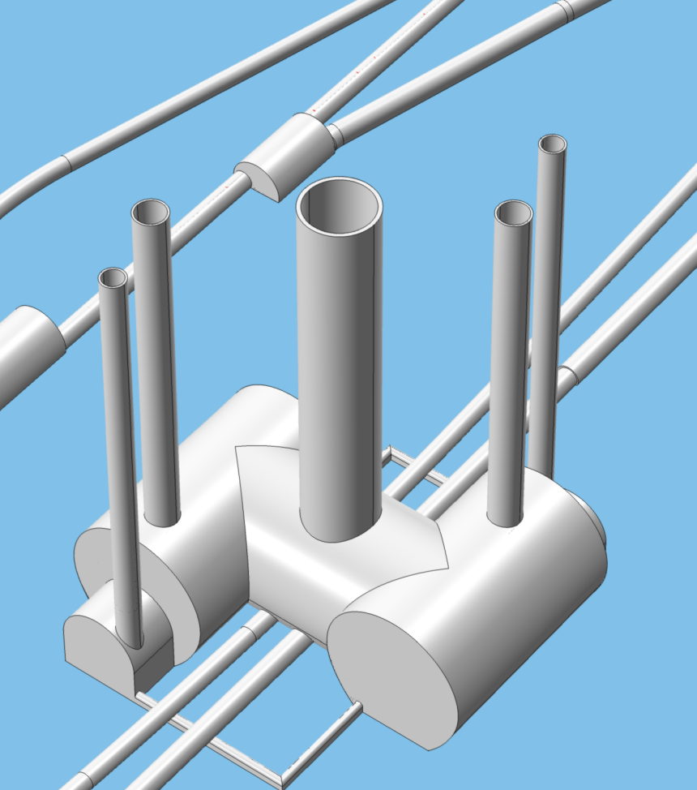
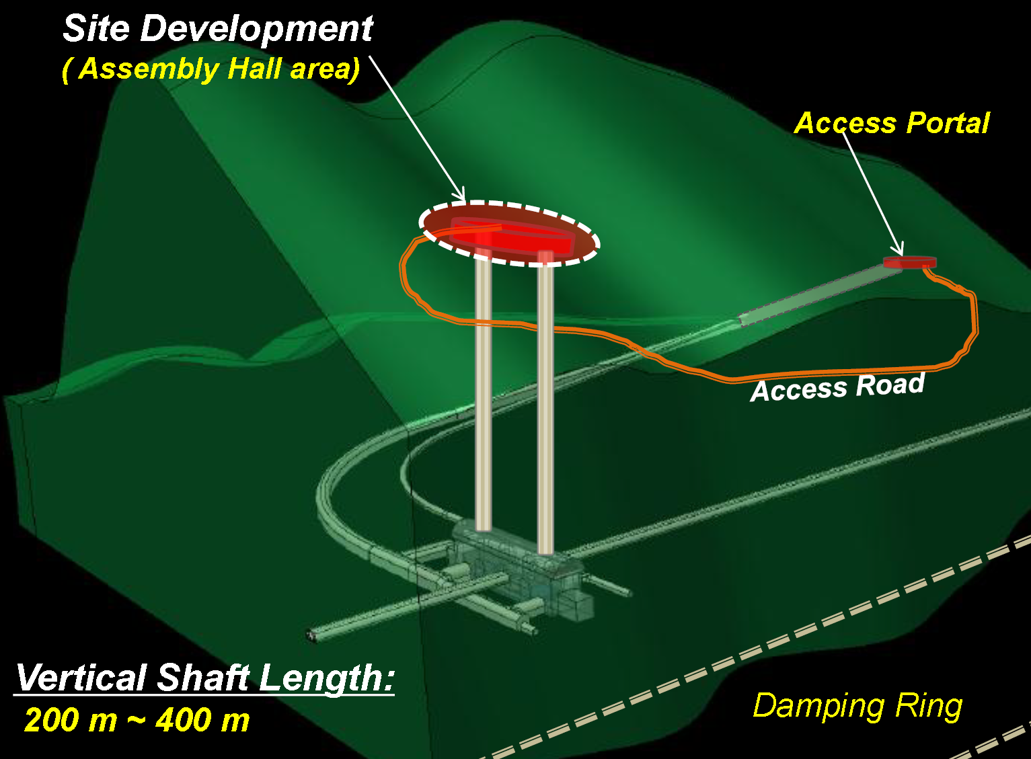
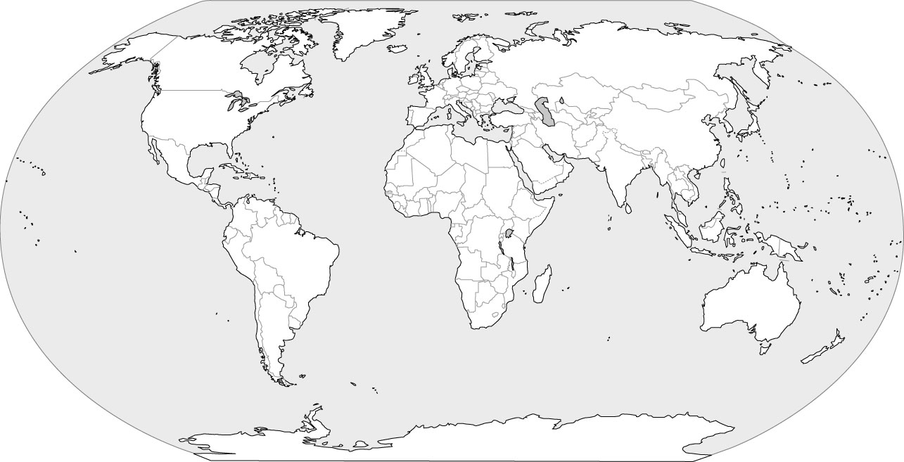
Two basic layouts of the experimental areas are considered, the main difference being the geometry of access tunnels :
Vertical shafts (Europe, Americas)
Horizontal shafts (Japan)
The assembly procedure will be different for the two sites
Both layouts must satisfy push-pull requirements
The detector hall must be optimized for costs: benefits vs. features

Slide 4
Vertical Shaft Sites
Europe, Americas, Asia

Slide 5
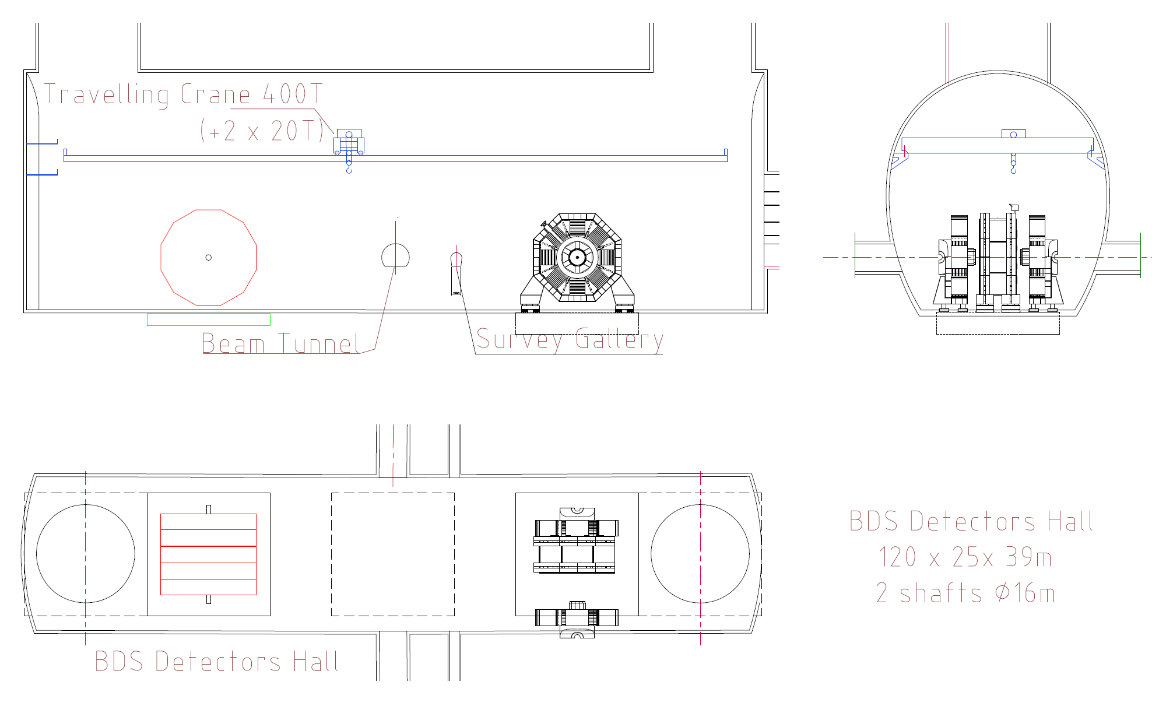
Detector Hall Optimization
Agreed at ALCPG11 (Eugene) that both detectors move on platforms
Common effort MDI-CFS moved to the implementation of the push-pull req’s on the RDR 2007 IR Hall.
Found several inconsistencies, i.e. small shaft, narrow cavern, floor depth. Inadequacy of layout to the surface assembly and expected maintenance scenarios
!
!
IR Hall 2007
!

Slide 6
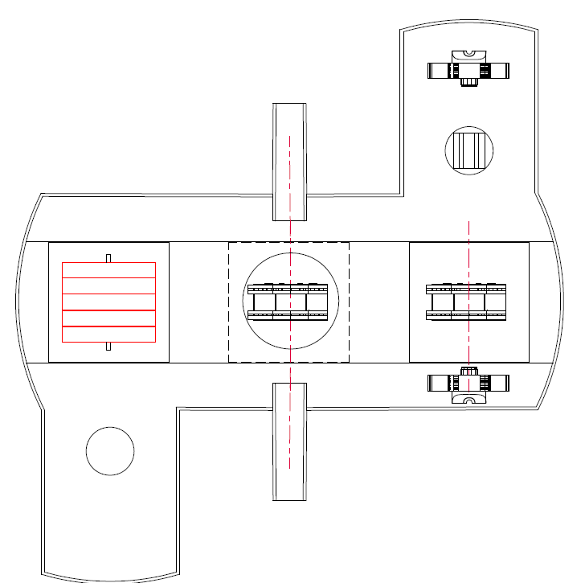
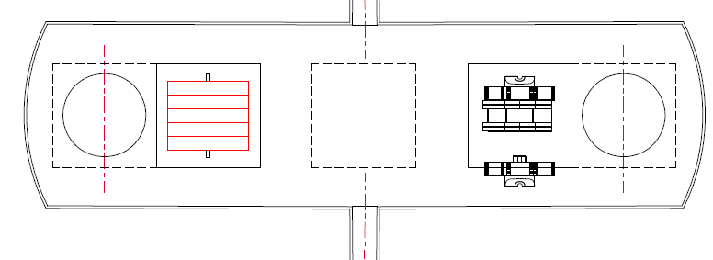
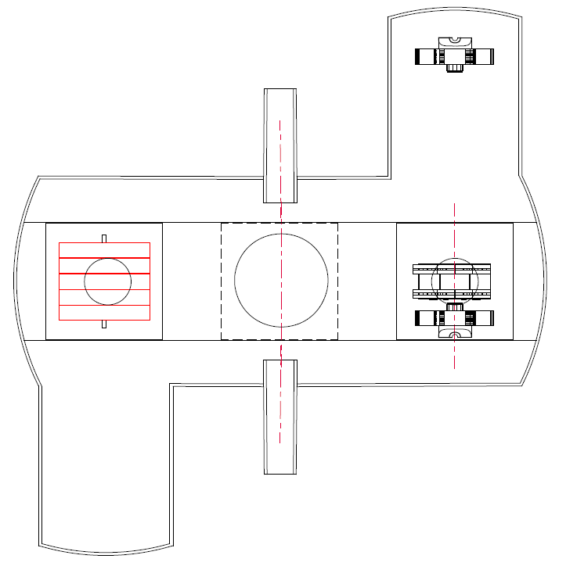
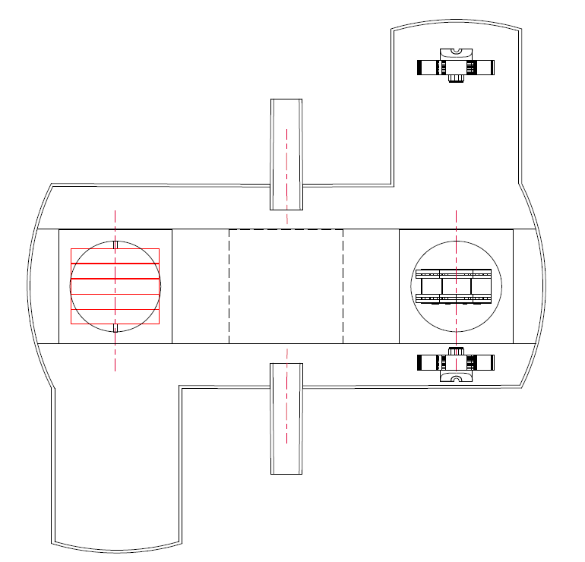
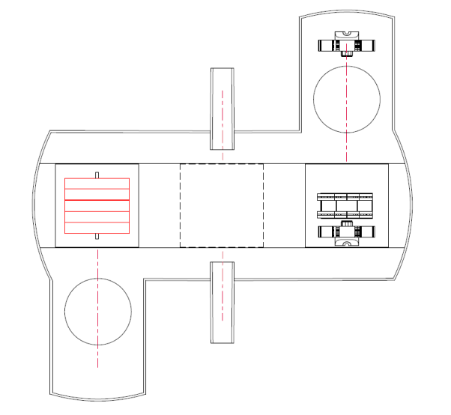
Layout 1
London, July 2011
Layout 5
Rating Scale 1÷5 : 1=Low, 5=High
# | Requirement | Layout 1 | Layout 2 | Layout 3 | Layout 4 | Layout 5
1 | Surface assembly of Magnet | 1 | 4 | 3 | 3 | 4
2 | Underground installation of Tracker, Calorimeters and Forwards | 1 | 4 | 2 | 2 | 4
3 | Number and Size of Cranes | 3 | 3 | 3 | 2 | 4
4 | Costs: Shafts and Halls size | 4 | 2 | 2 | 2 | 3
5 | Infrastructures | NA | NA | NA | NA | NA
6 | Easy Maintenance, Smooth Operation | 2 | 4 | 3 | 2 | 4
7 | Beam Comissioning | 1 | 1 | 1 | 4 | 4
8 | Safety | 2 | 4 | 2 | 2 | 4
 | Final Score | 14 | 22 | 16 | 17 | 27
Layout 4
Layout 3
Layout 2

Slide 7
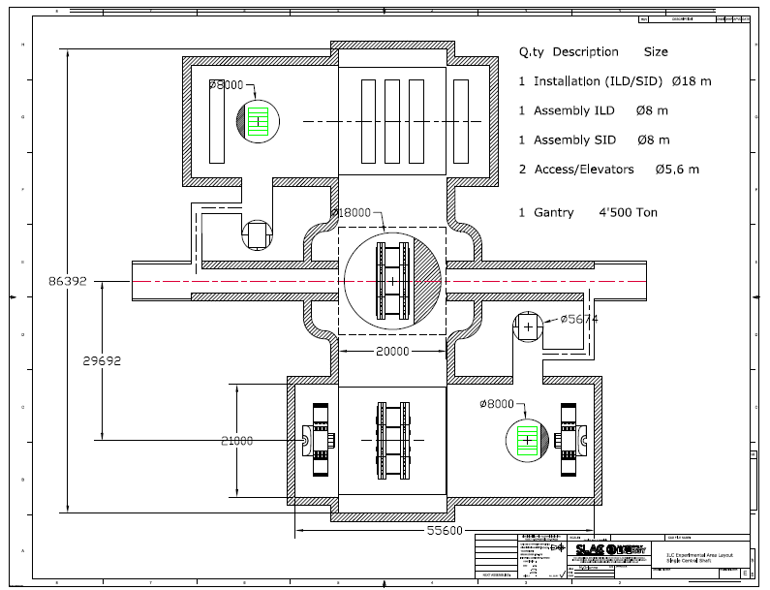
ILC IR layout (LCWS11,Granada)

Slide 8
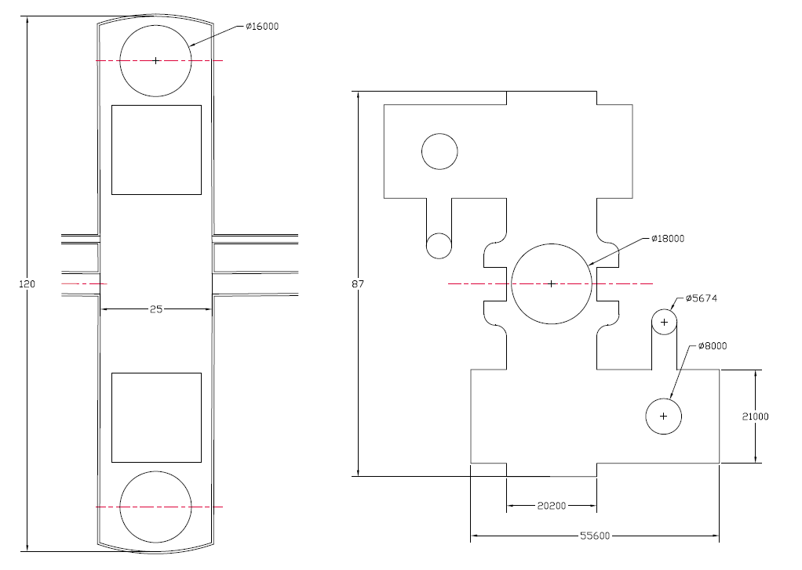
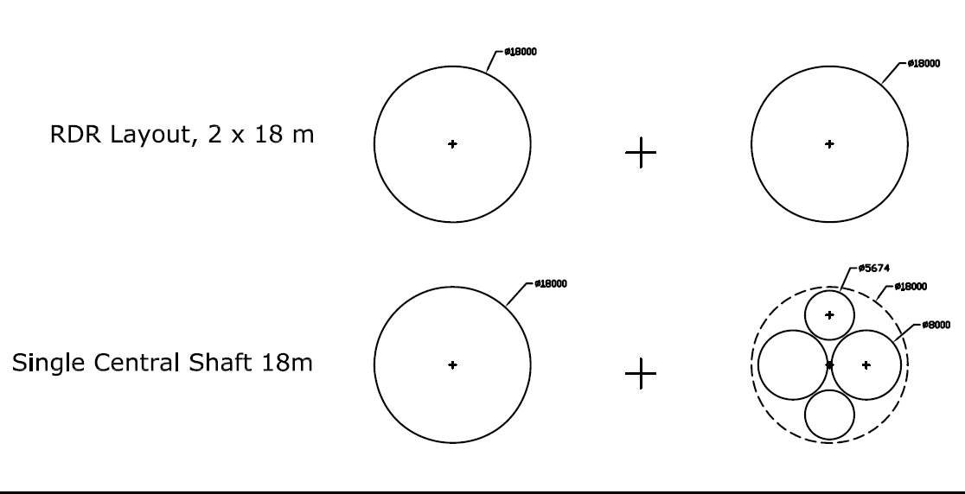
RDR 2007 vs. Granada layout
5 Shafts
Developed Area
3’340 m2
RDR 2007
Developed Area
3’000 m2

Slide 9
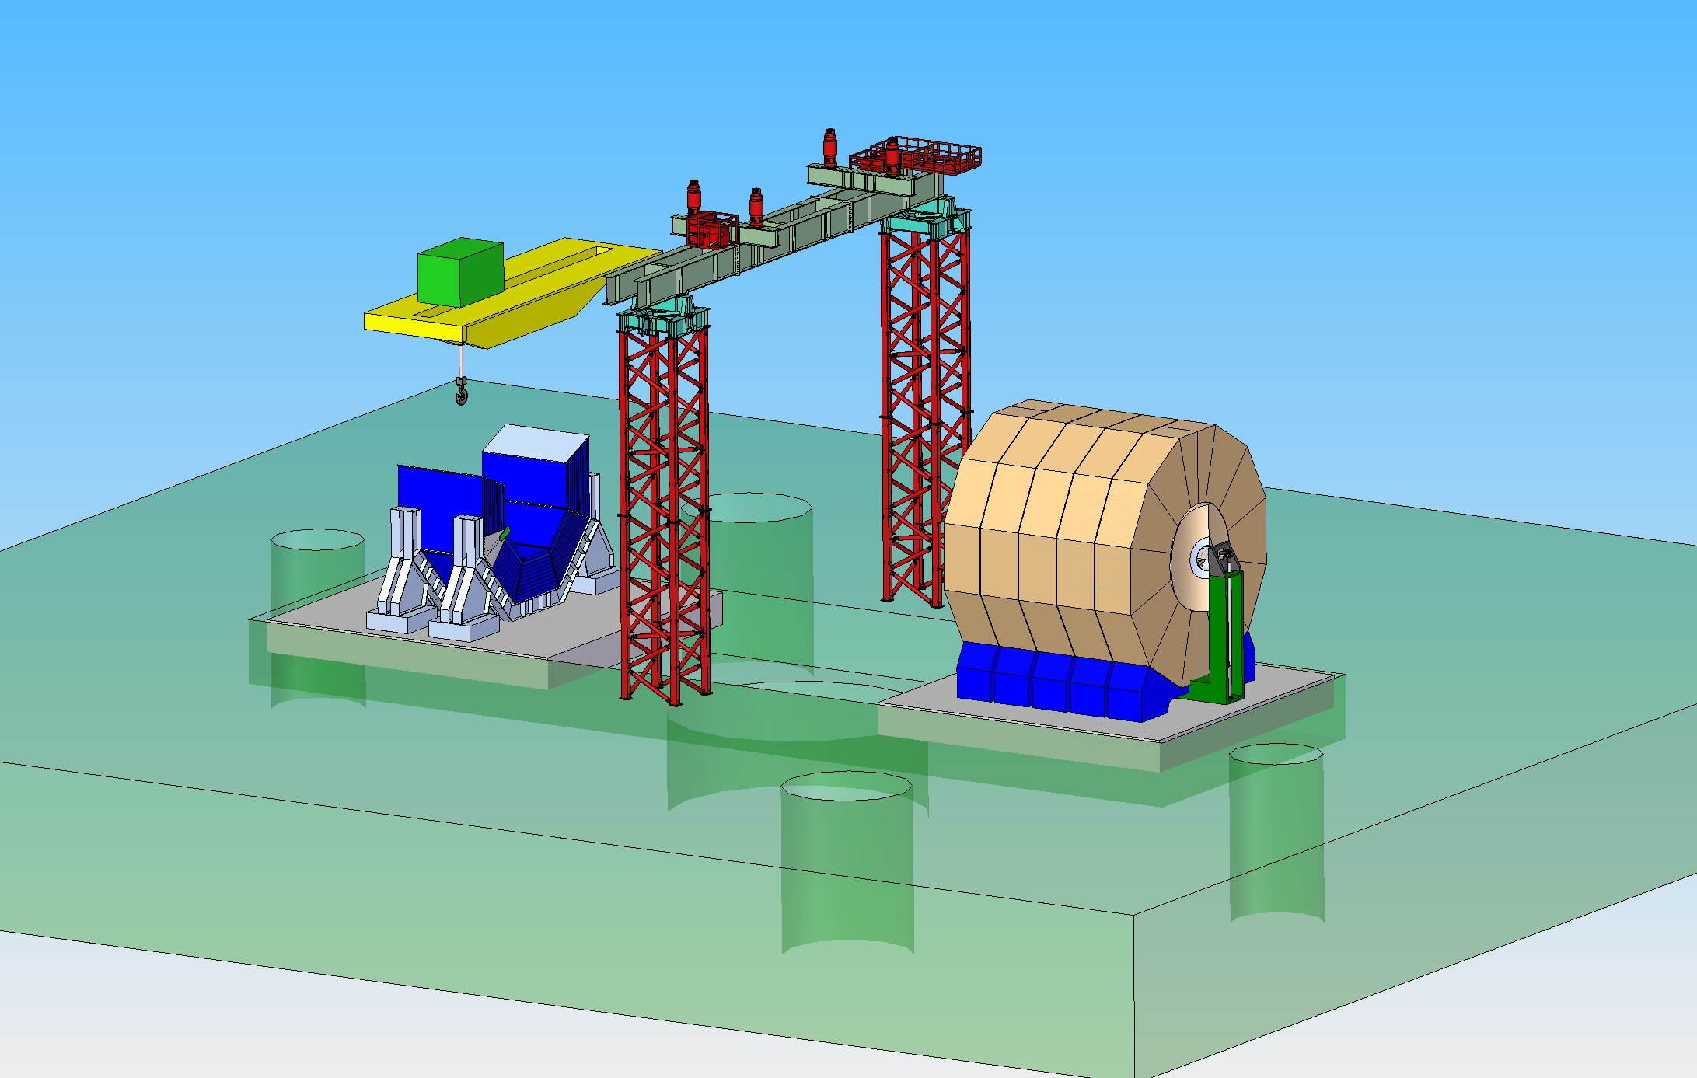
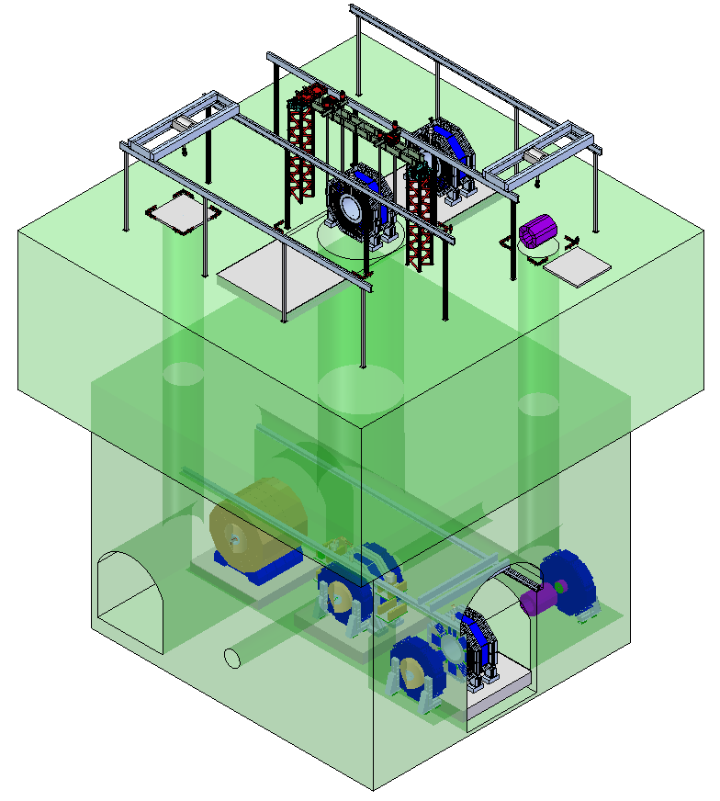
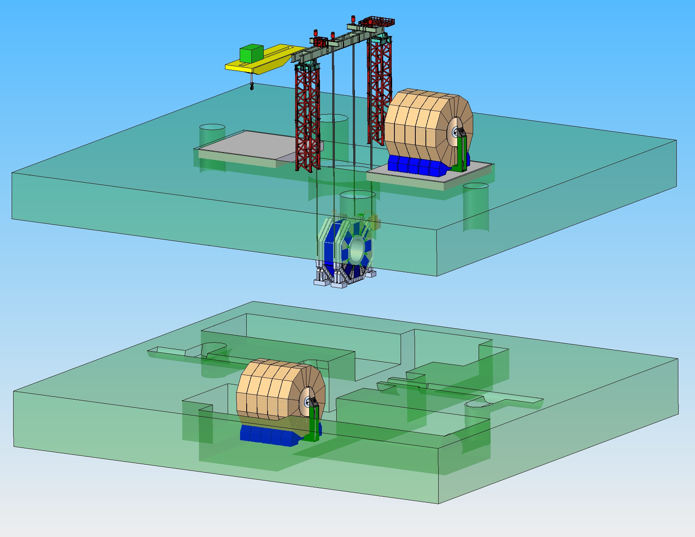
Surface assembly
200 t+20t Crane
4’000 t Gantry
Assembly of Iron Doors+Barrel on surface
Commissioning of the magnet on surface
Large capacity gantry

Slide 10
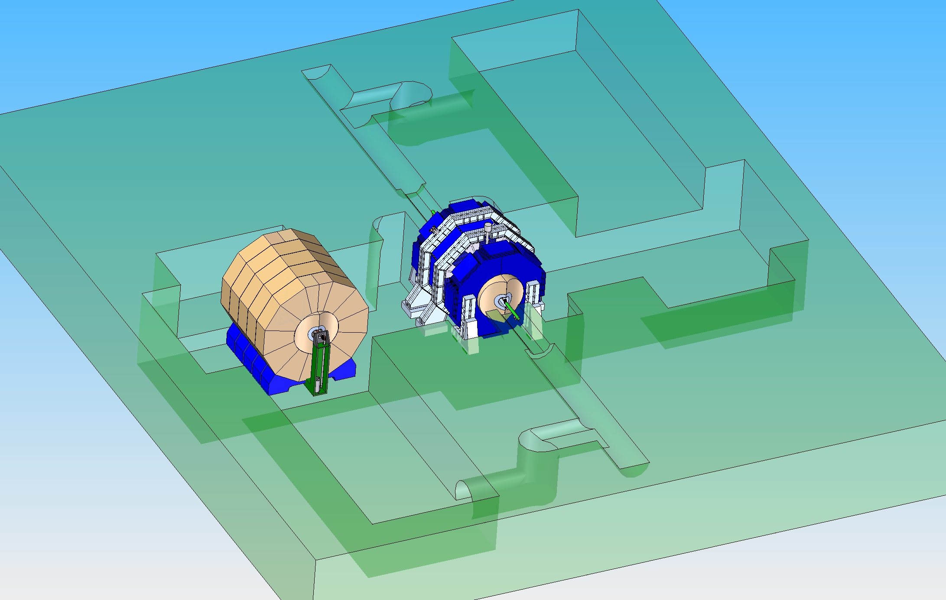
Underground Area
Sub-Detector installation
ID 8m
Elevator
Central Shaft
ID 18m
ID 5.6m
Elevator
ID 8m

Slide 11
Japanese Site
Horizontal access Tunnels

Slide 12
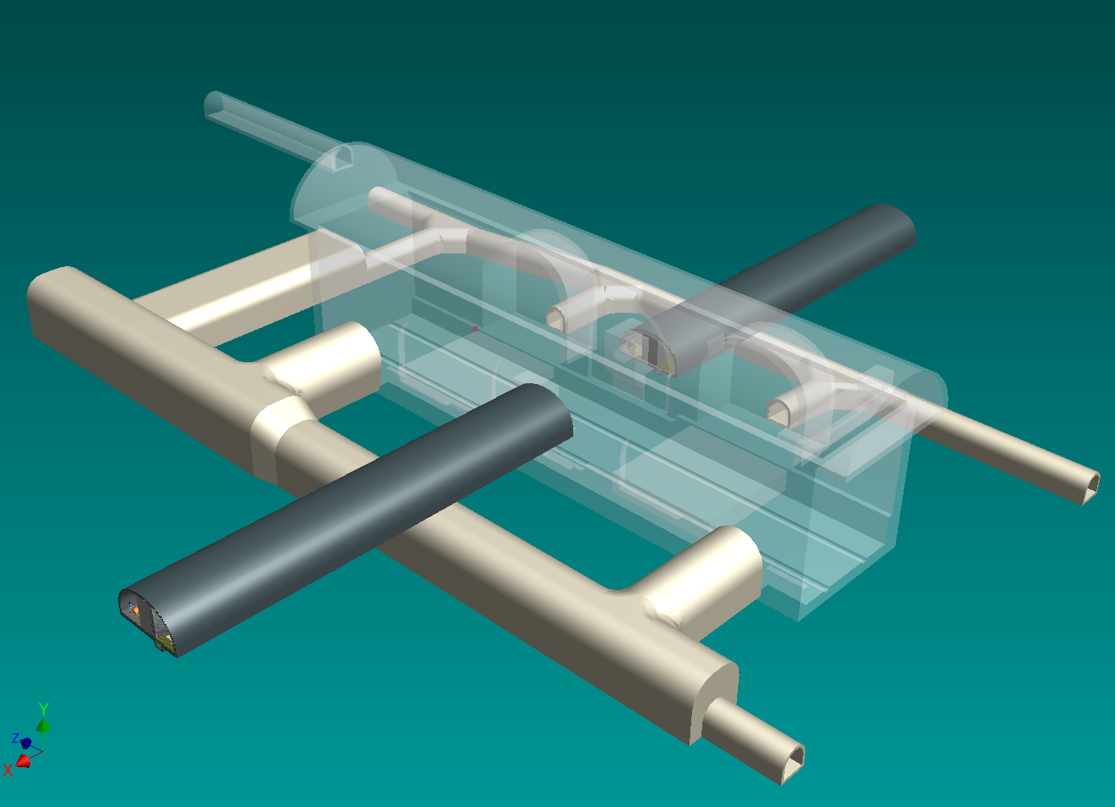
Detector Hall, Japanese Mountain Site
SLAC, Dec.2011
Surface
Storage caverns
are not shown
Damping
Ring
Transfer tunnel now increased to 11m

Slide 13
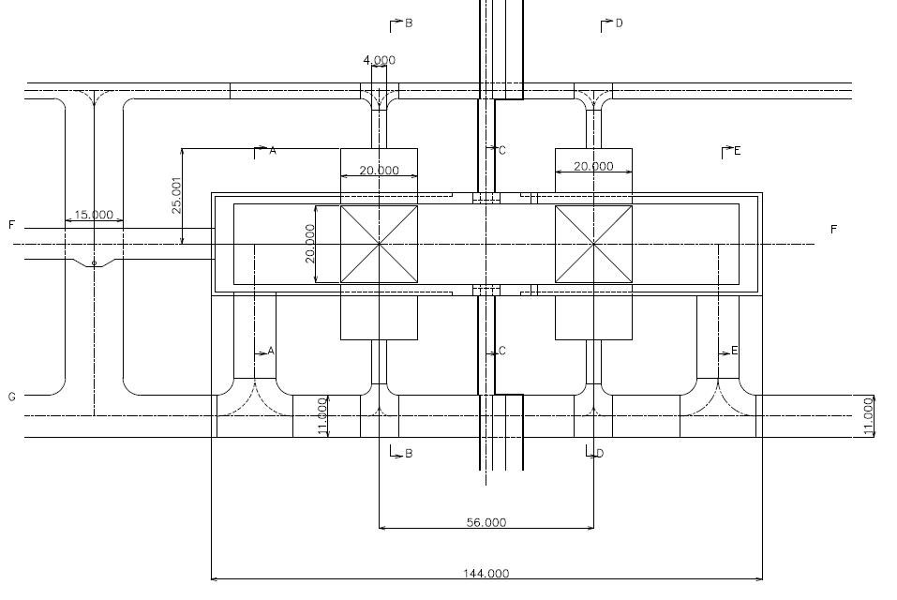
Current Layout, Apr.2012
Max . Assembly Region
Loading Area
IP
Cryogenics
Assembly Area

Slide 14
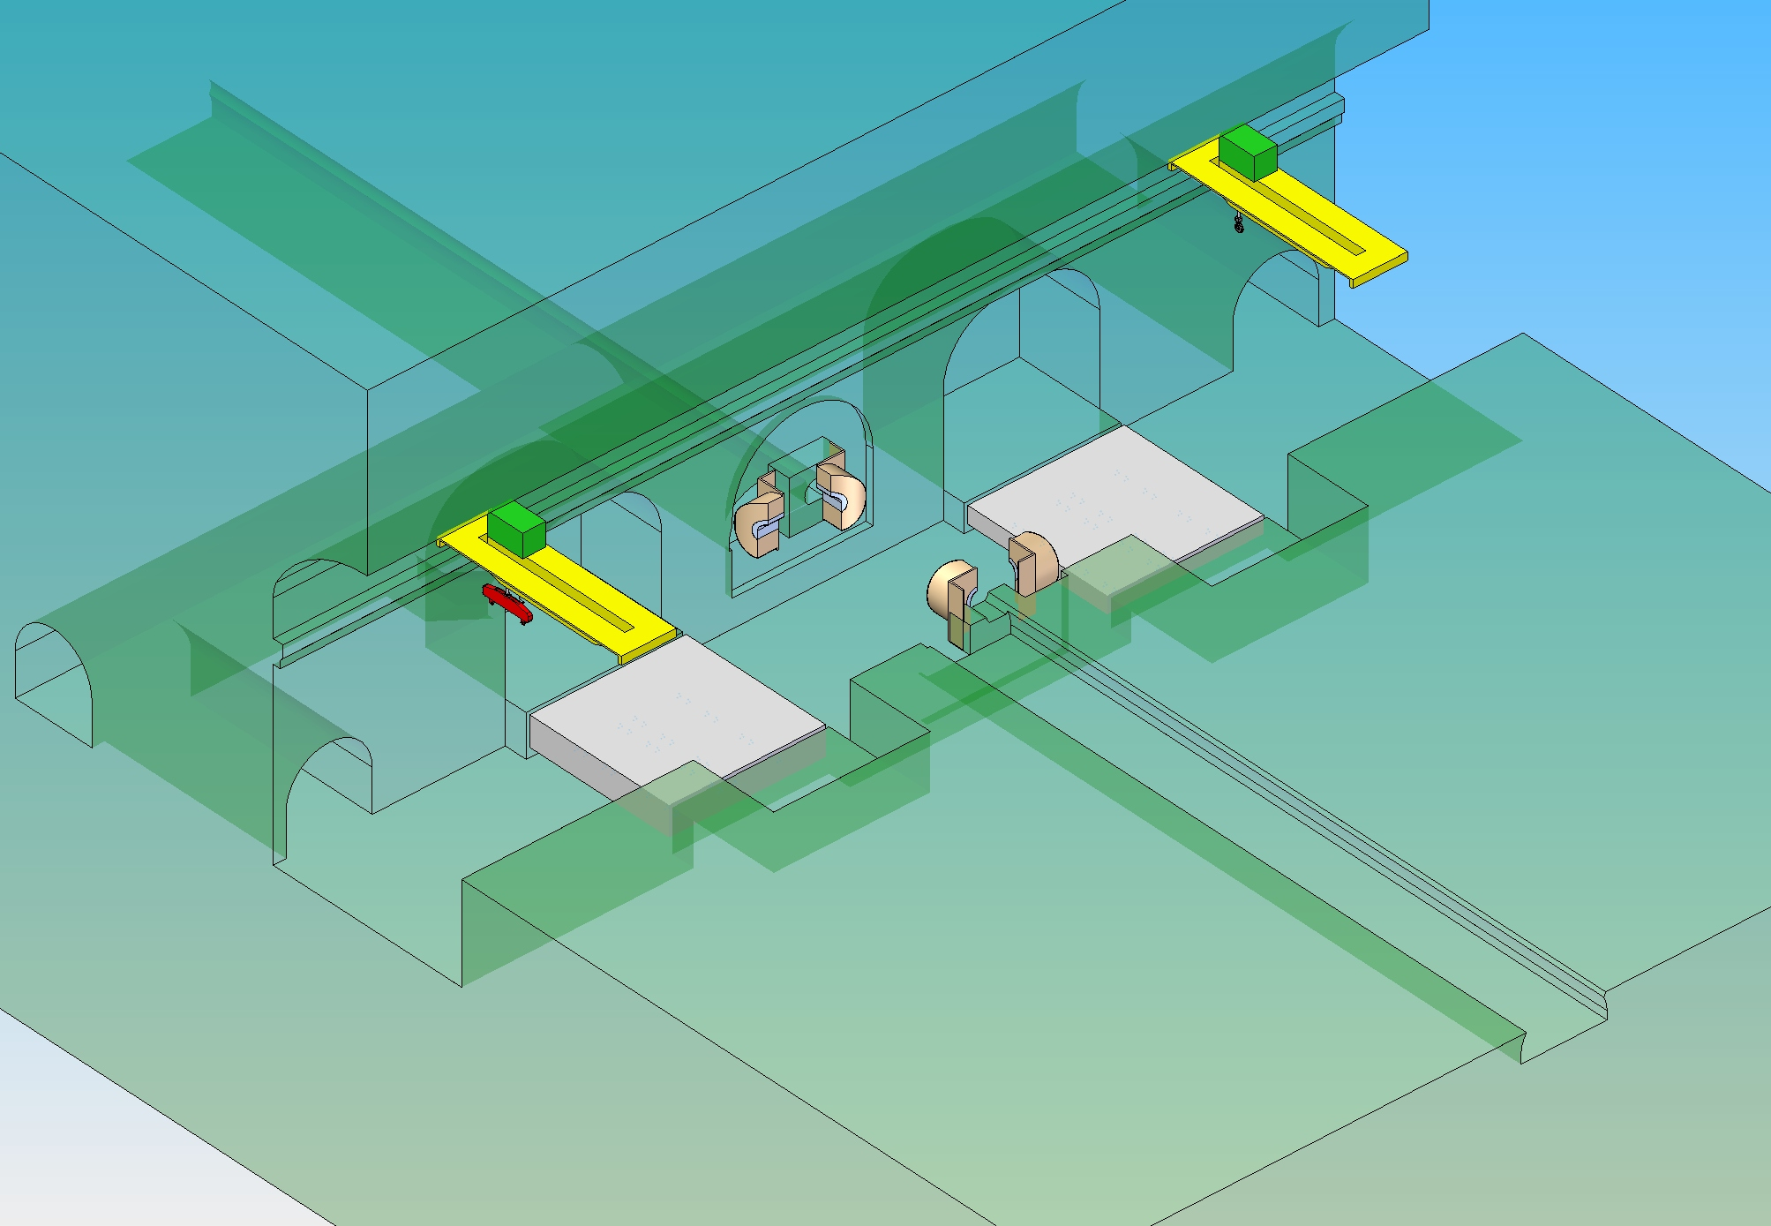
Site Delivery prior the start of the Detector Assembly
Two Cranes 215 tons,
Platforms
Minimum set of infrastructures (Power, Compr. Air, etc.)
Pacmen can wait until detectors are ready

Slide 15
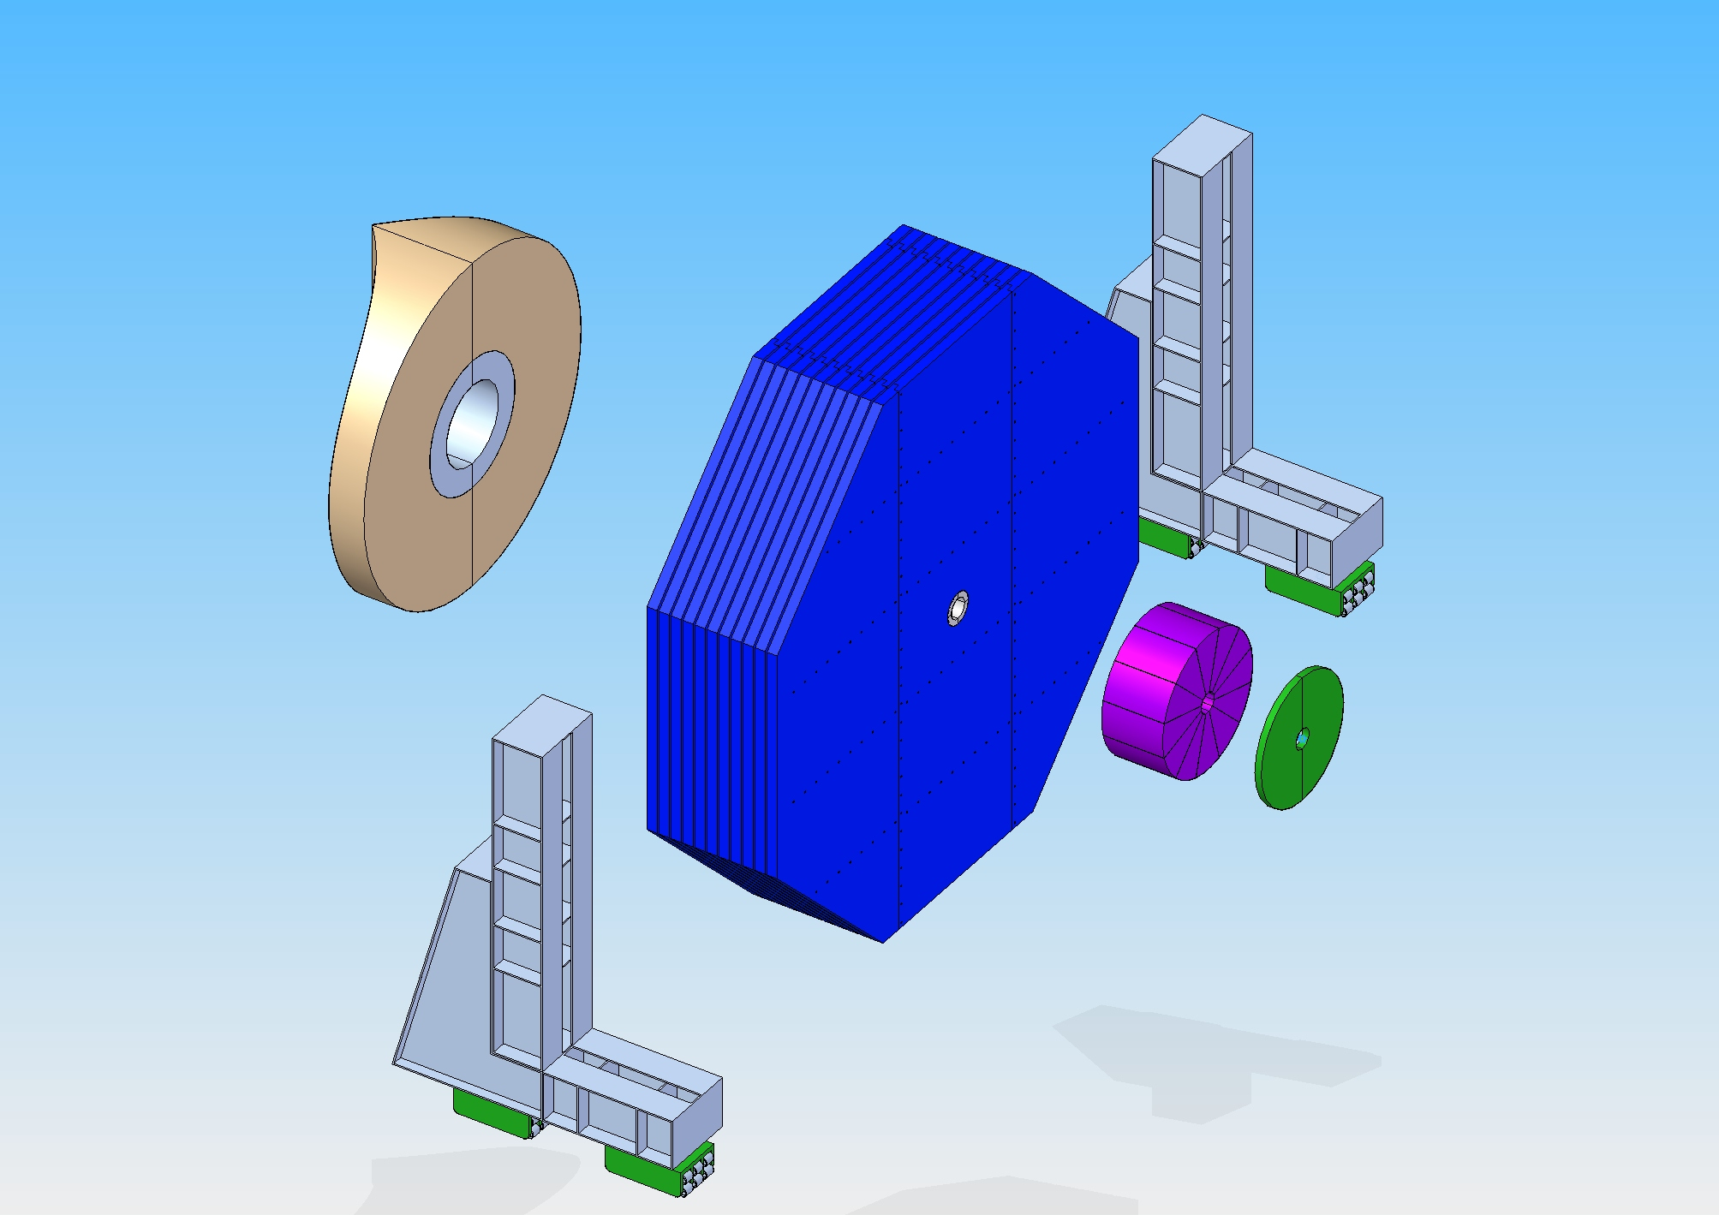
End Door
Pacman
on the door
11 x 200mm Iron plates
40mm gap
Total Mass ~ 2’300 Tons

Slide 16
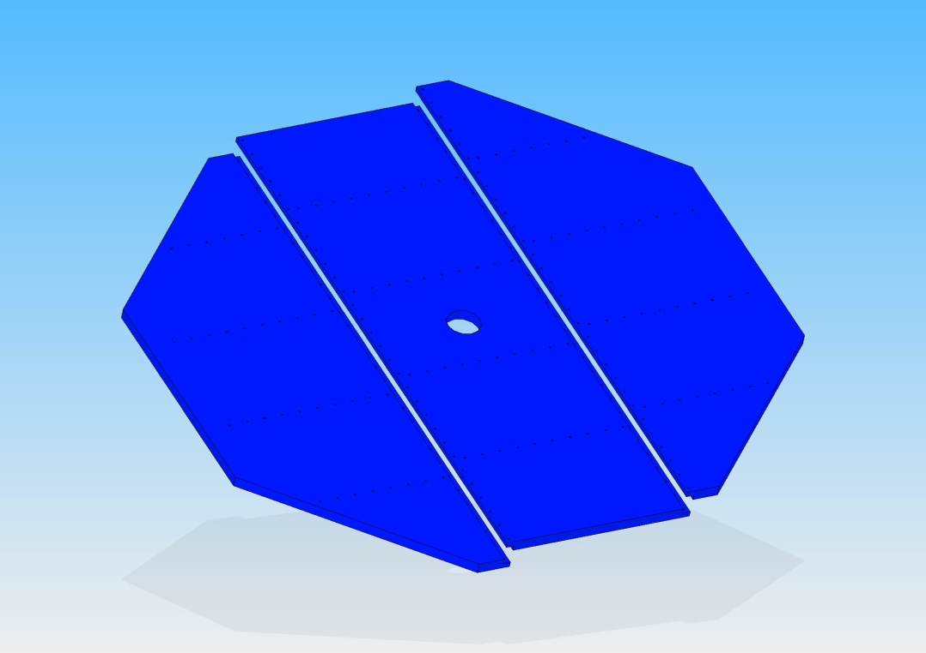
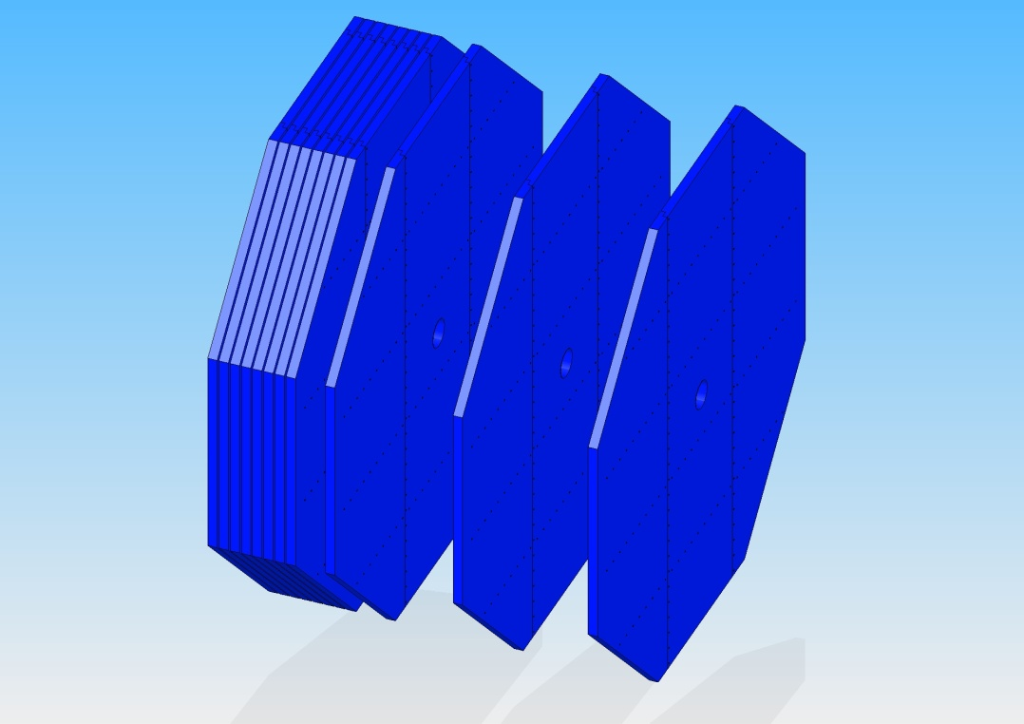
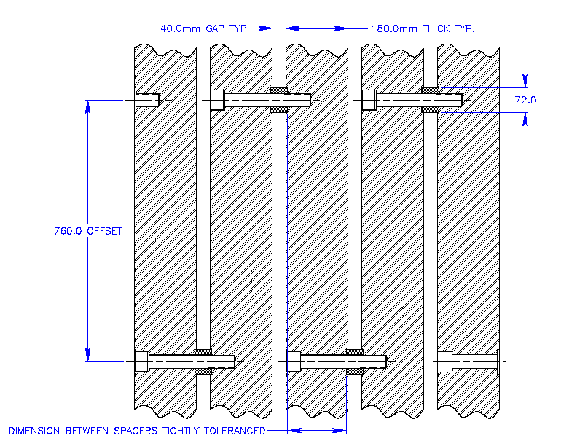
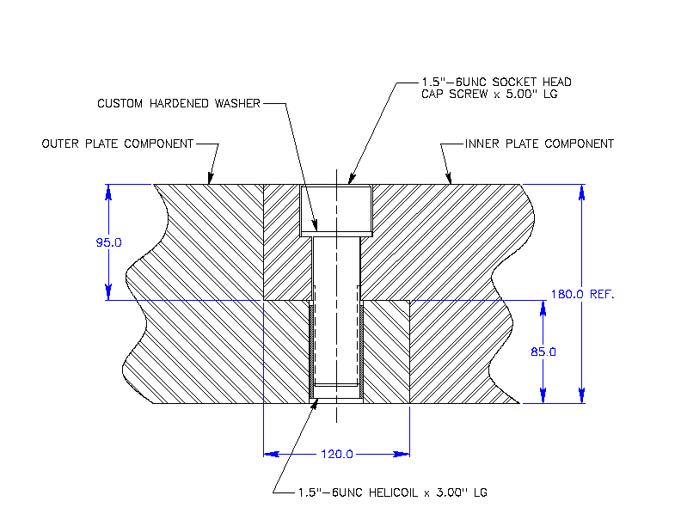
Intraplate connections
Spacer Offset

Slide 17
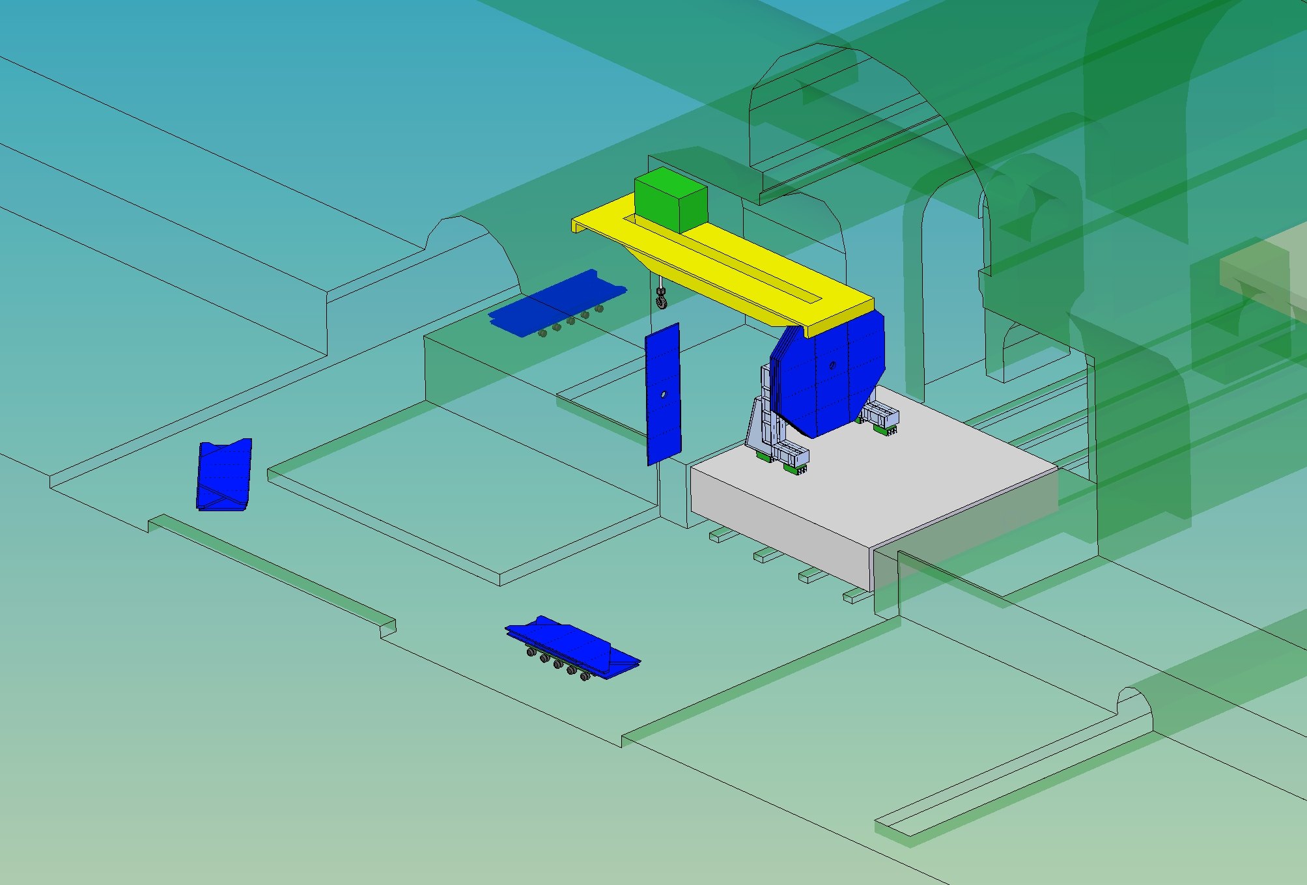
Door Assembly on the platform
66 Tons
11 trips from Surface /Door
1 heavy lift / day

Slide 18
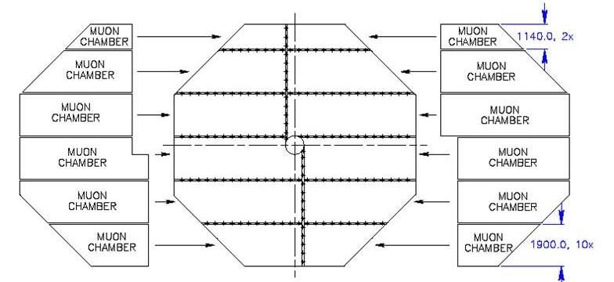
Muon Chamber Installation

Slide 19
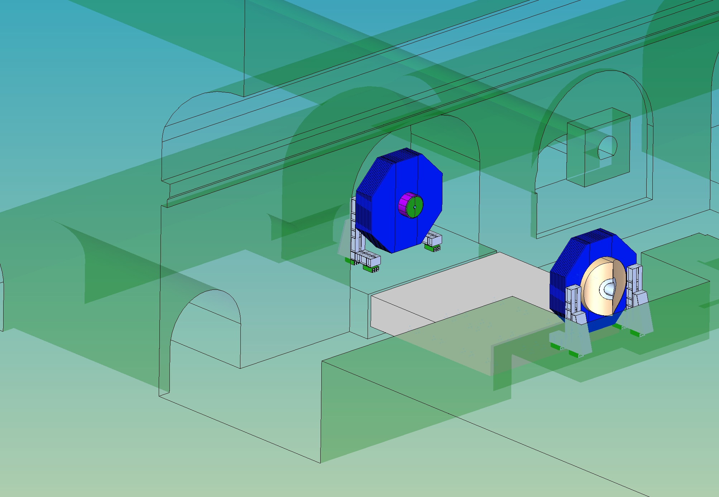
Doors completed – Moved in the alcoves
Total Elapsed time
~ 2 months / door ( with contingency)

Slide 20
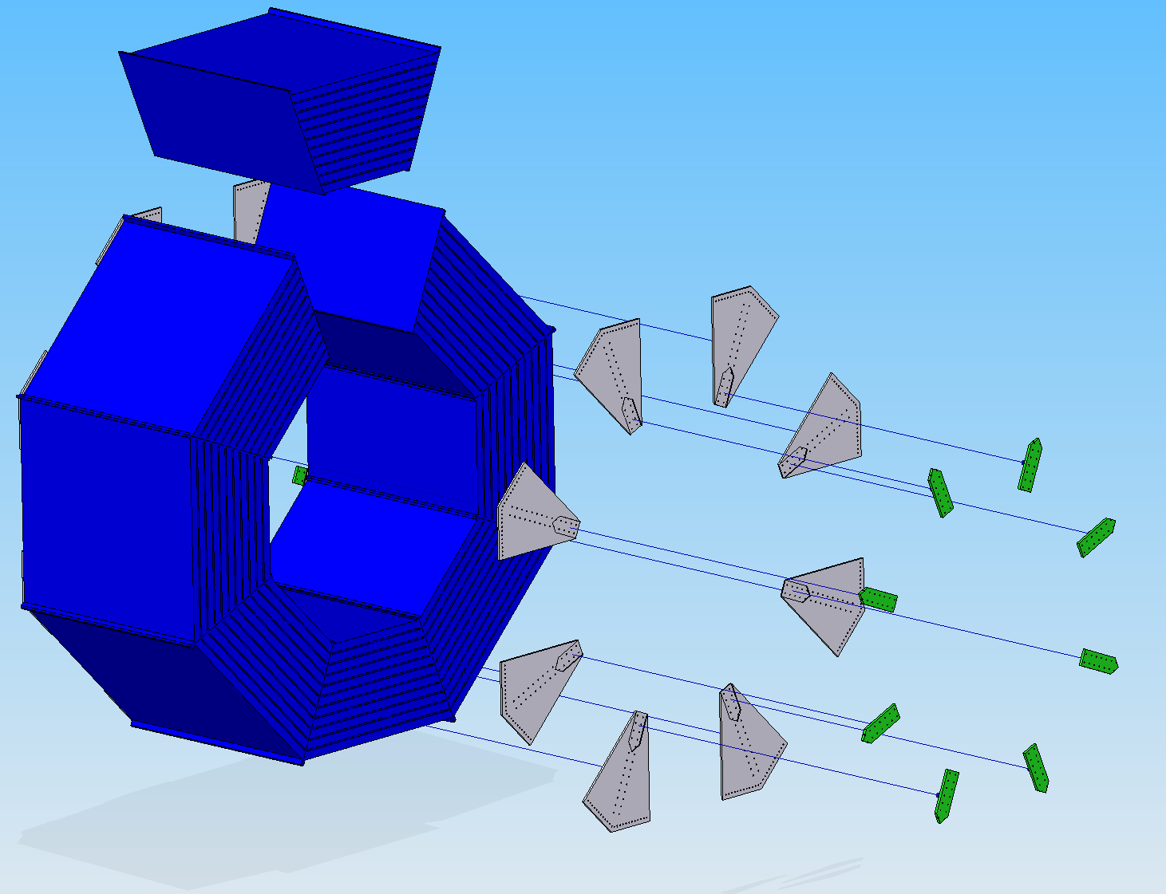
Iron Barrel Yoke layout
Bolted assembly, 144 plates 200 mm thick, 40mm gap
Opportunity to make blank assembly at the factory before shipping
Preliminary Contacts with Kawasaki Heavy Industries
  Plate thickness tolerance for each: 0.1mm
  Plate flatness: 4mm (in a plate)
  Fabrication (assembling & welding) tolerance: 2mm
  Full trial assembly: capable (but need to study)
3990 tons
Max. Crane capacity 215 Tons

Slide 21
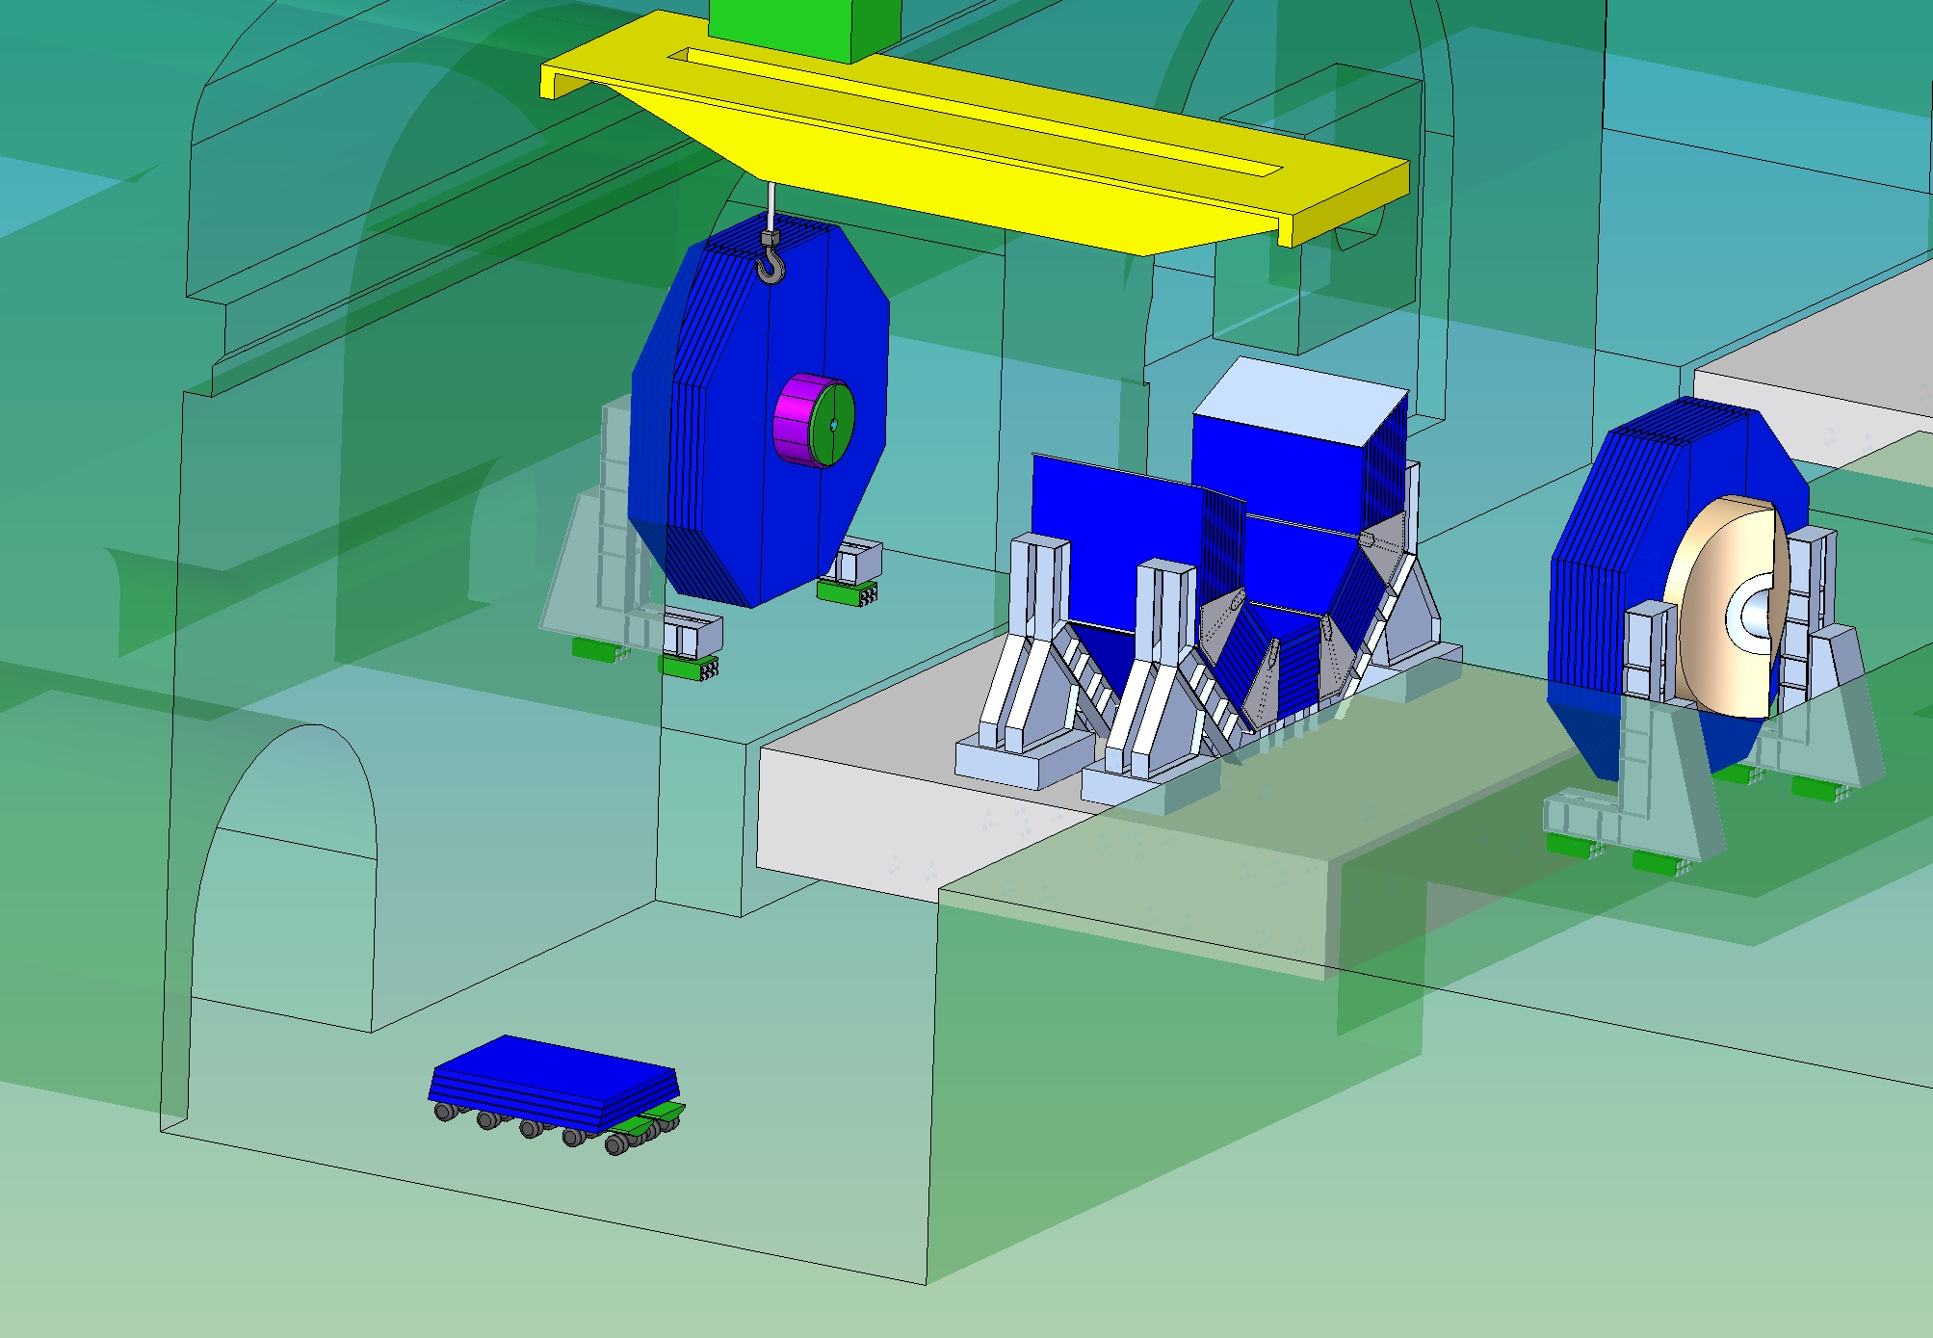
16 trips from Surface
1 heavy lift / day

Slide 22
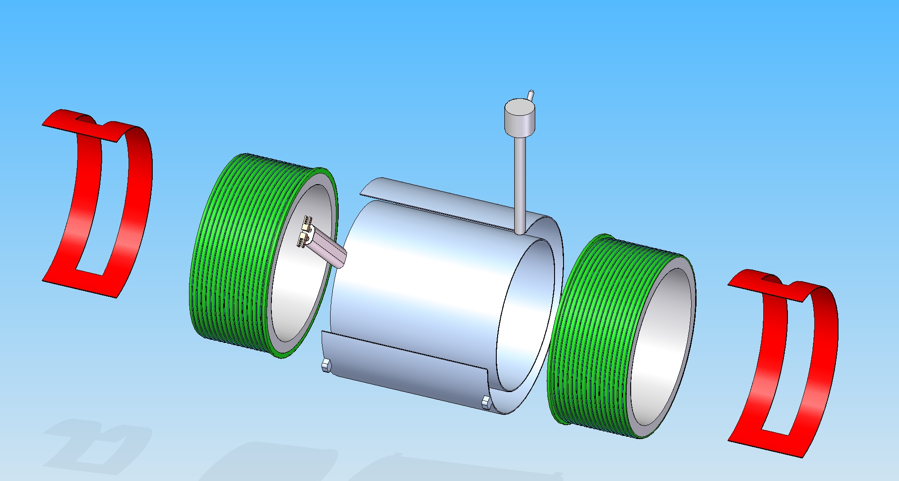
Assembly on Site (surface)
Test with low current
Total Mass = 180 Tons
Ring 2
Ring 1
DID
Solenoid Cross section

Slide 23
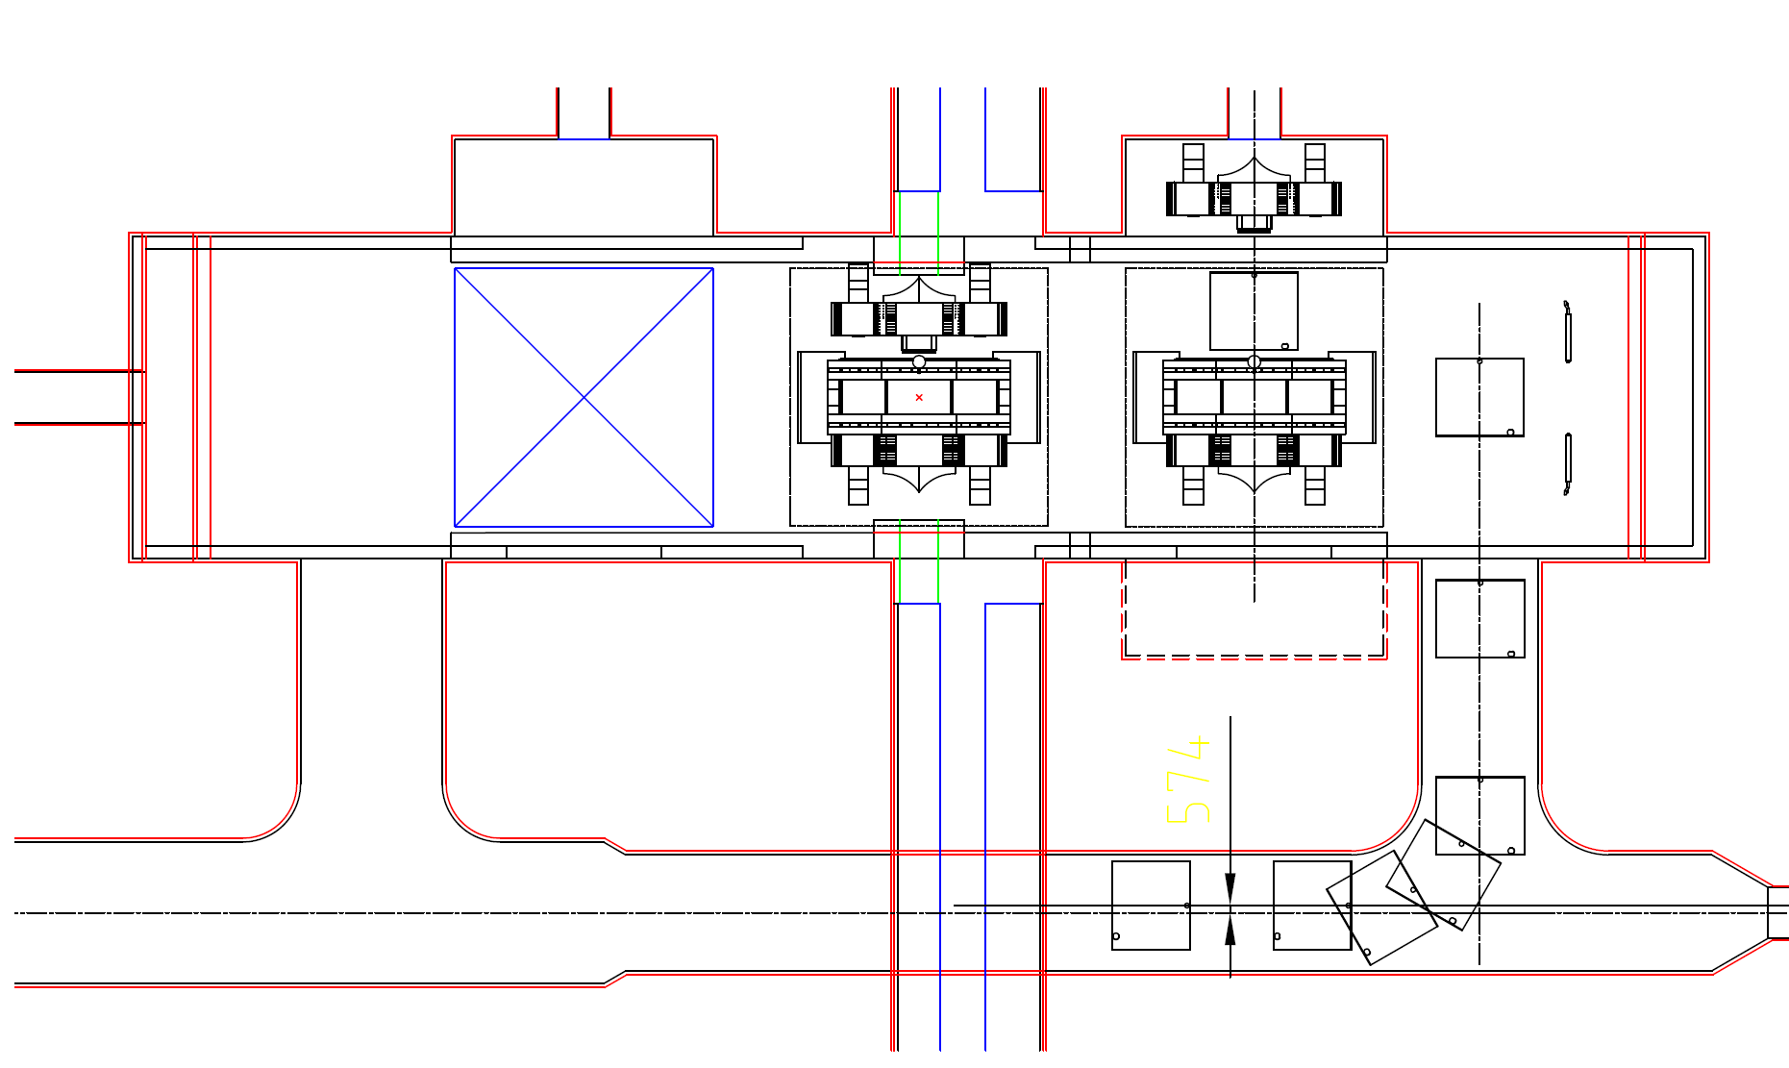
Access Tunnel, Coil
Solenoid on truck,

Slide 24
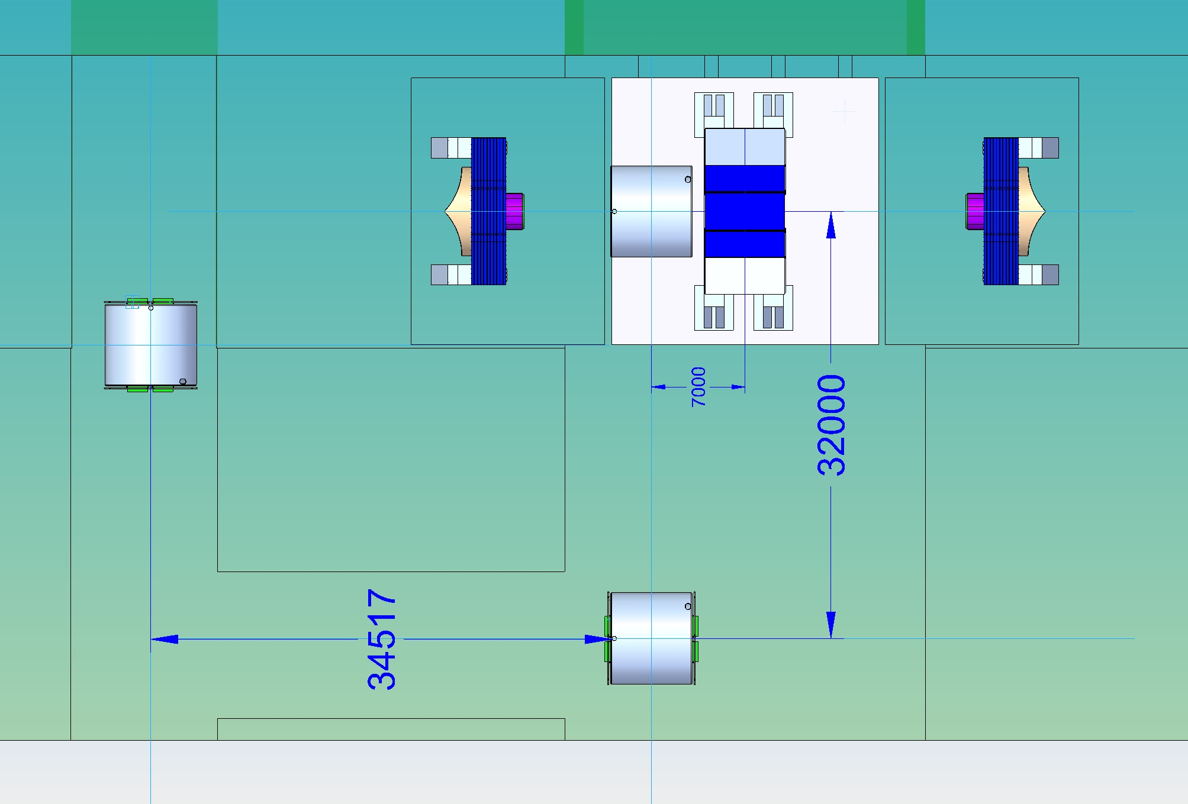
Solenoid Installation path (view from the top)
11 m
Z
X

Slide 25
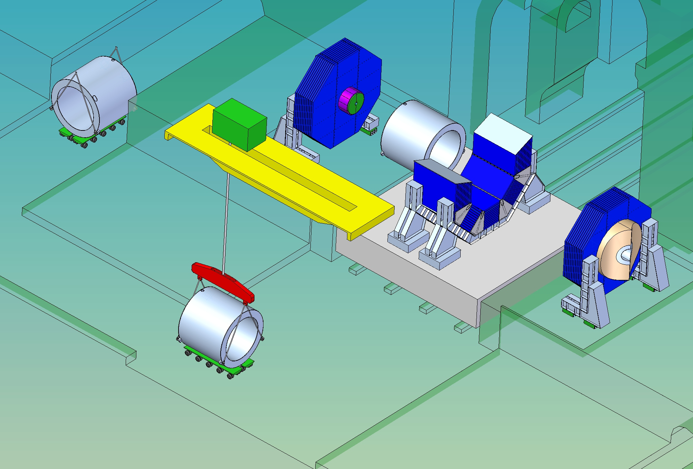
Solenoid Installation
215 tons Crane

Slide 26
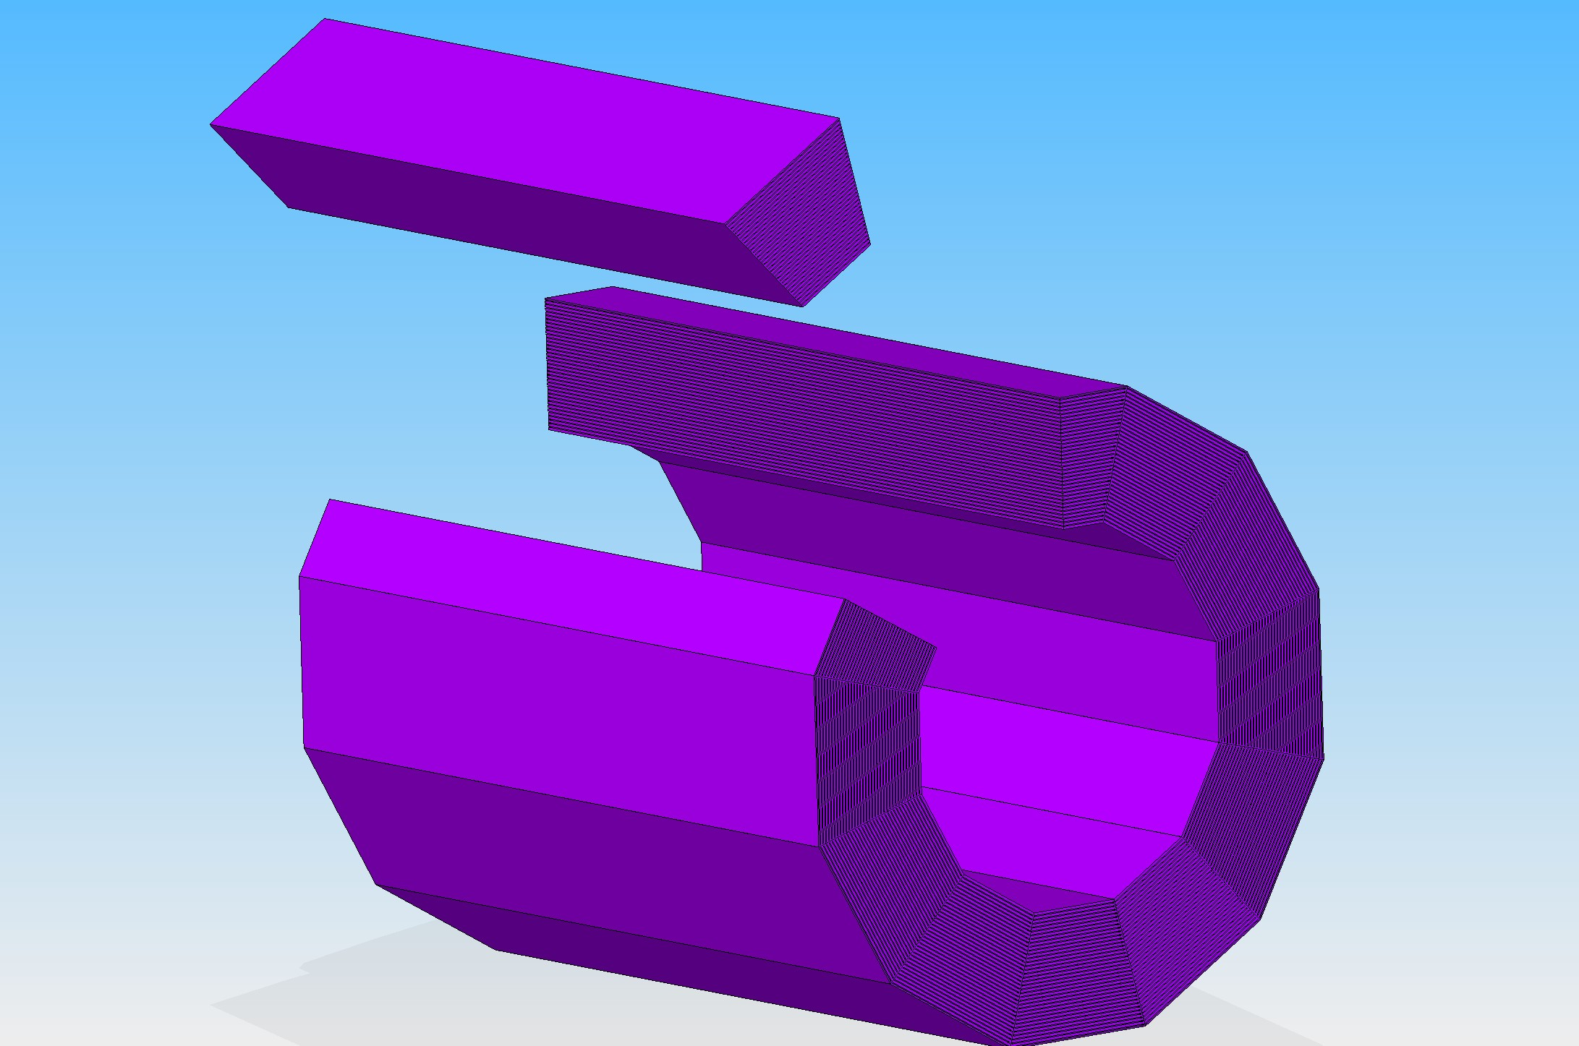
HCAL Barrel, 12 wedges x 38 tons
3 m

Slide 27
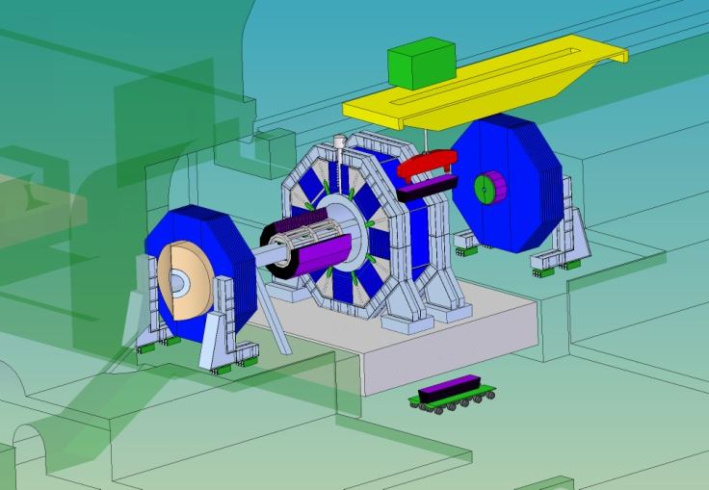
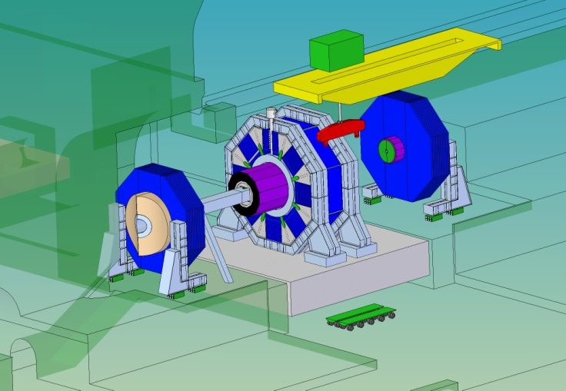
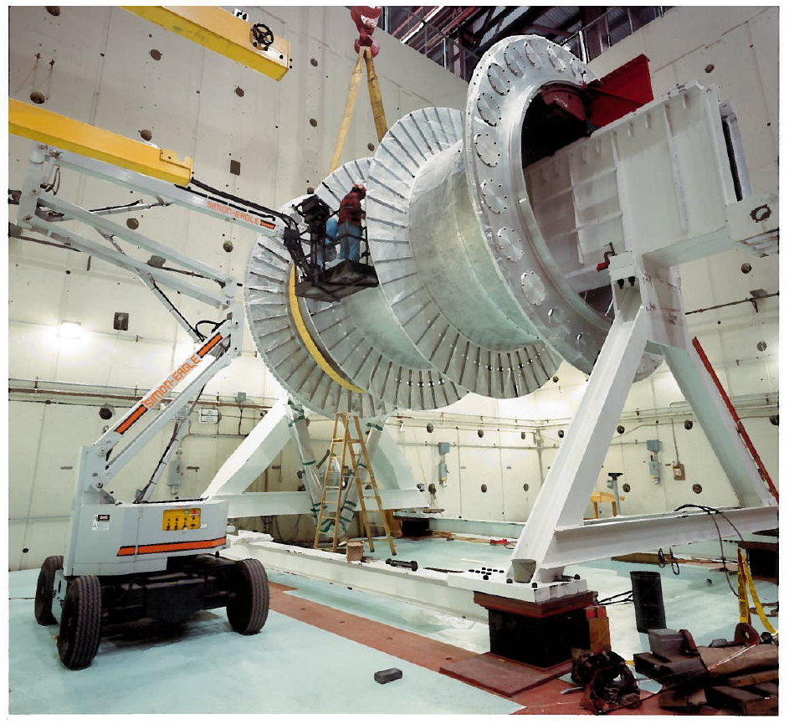

HCAL Barrel Assembly
Assembly beam
Assembly Spider
Insertion beam
Truck with HCAL Module
Insertion of HCAL
SLD, Liquid Argon Calorimeter
Assembly Beam

Slide 28
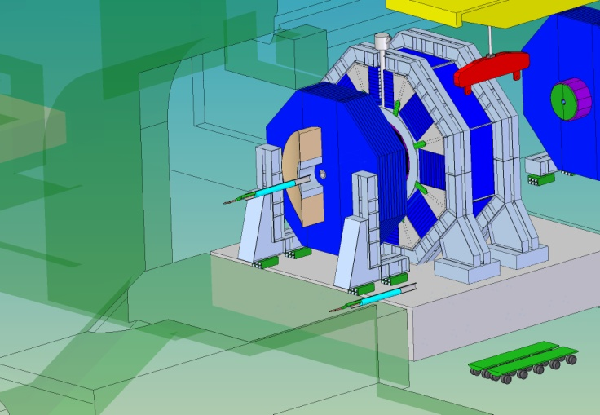
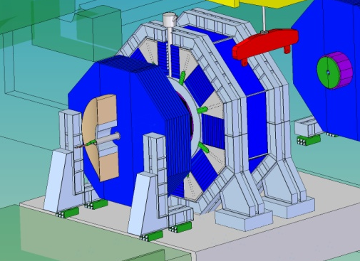
QD0 Assembly
It can be done in the alcove with the door moved on the platform
Need of a small crane ~3-5 tons in the alcove

Slide 29
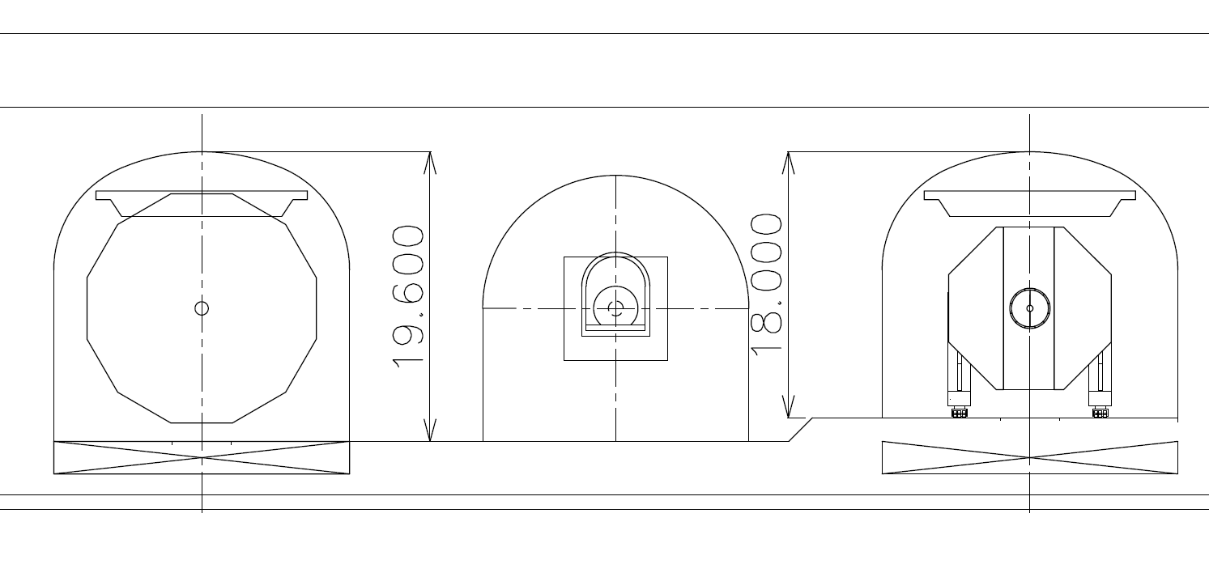
Alcoves only used for cabling and Door maintenance
Only Low capacity cranes (monorail ~2-5 tons)
ILD
SID

Slide 30
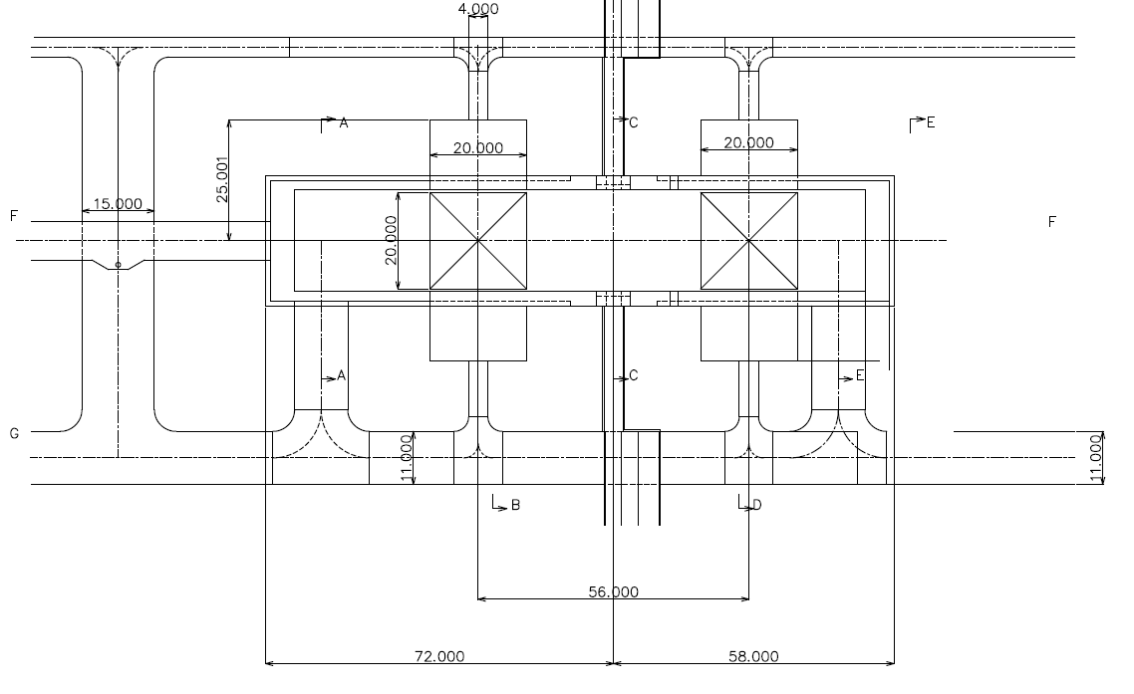
Possible Optimizations
Length reduction of the Loading Area
Total length 2 x 56 m vs. 2 x 72 m
Space around IP as temporary storage for tooling
IP
Cryogenics
Baseline
Reduced

Slide 31
Cryogenics layout
Cryogenic Service Cavern
Detector Hall

Slide 32
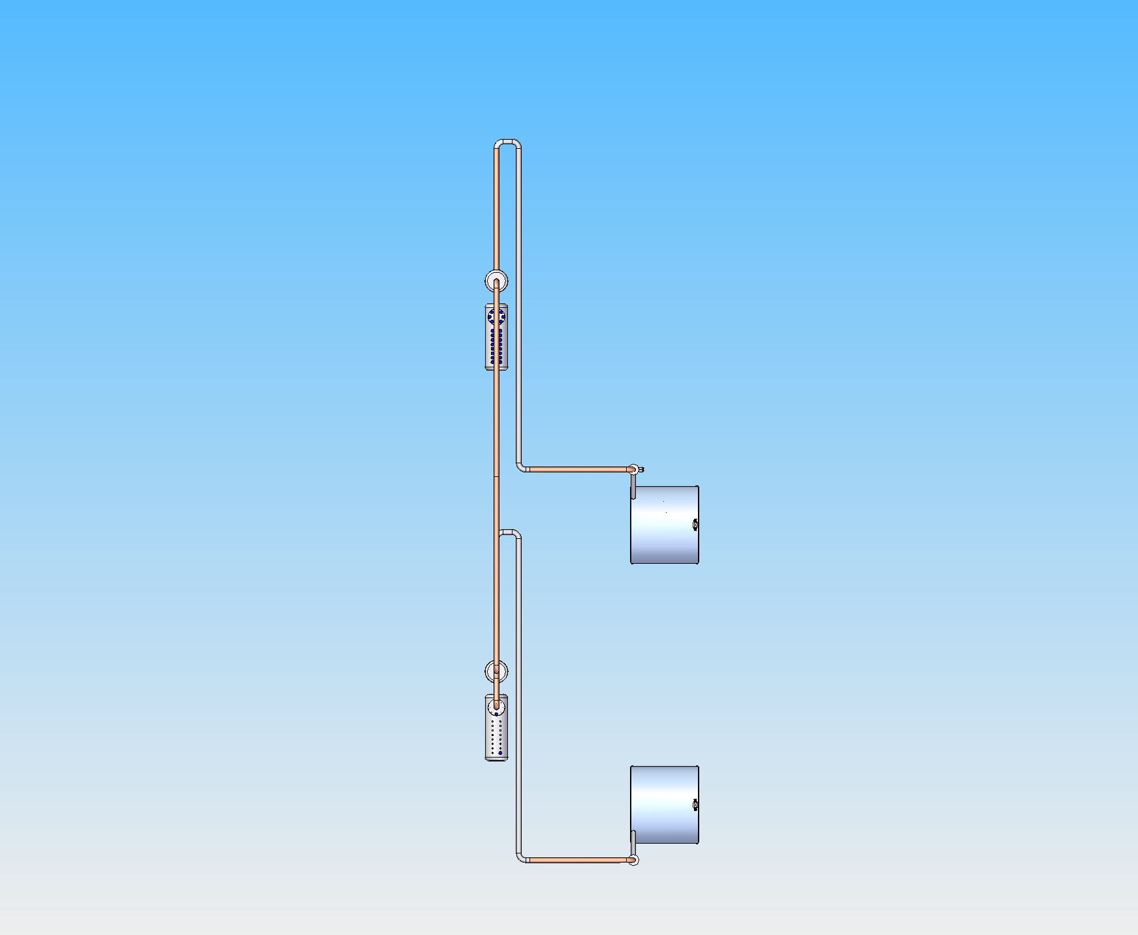
Flexible Cryo-line A
Cold box A
Solenoid Detector A
Interconnection
Beam Line
Cold box B
30 m
Solenoid Detector B
Garage

Slide 33
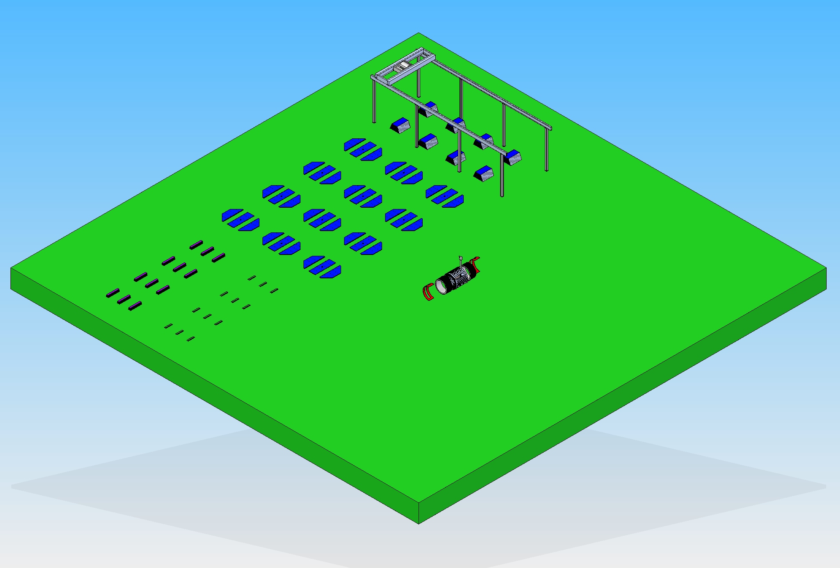
Surface Area, Very preliminary study
Iron Barrel Plates
Door Plates
HCAL Modules
Solenoid
ECAL Modules
200 m
200 m

Slide 34
Summary
SID has developed assembly scenarios for both the Vertical and Horizontal access shaft.
The Detector Hall with vertical shafts has been redesigned and optimized for the push-pull, in a common effort with ILD.
The Japanese Mountain site with horizontal shafts is preferred by SID, being closer to the original assembly procedure considered for the design of the detector.
With the present baseline we believe that there is still a margin to optimize cost and procedure.
More work is needed to define the layout of the cryogenic distribution and services
The logistic and procedures of the site on surface for the preassembly of the detector is at an early stage.

Slide 35
Spare Sides

Slide 36
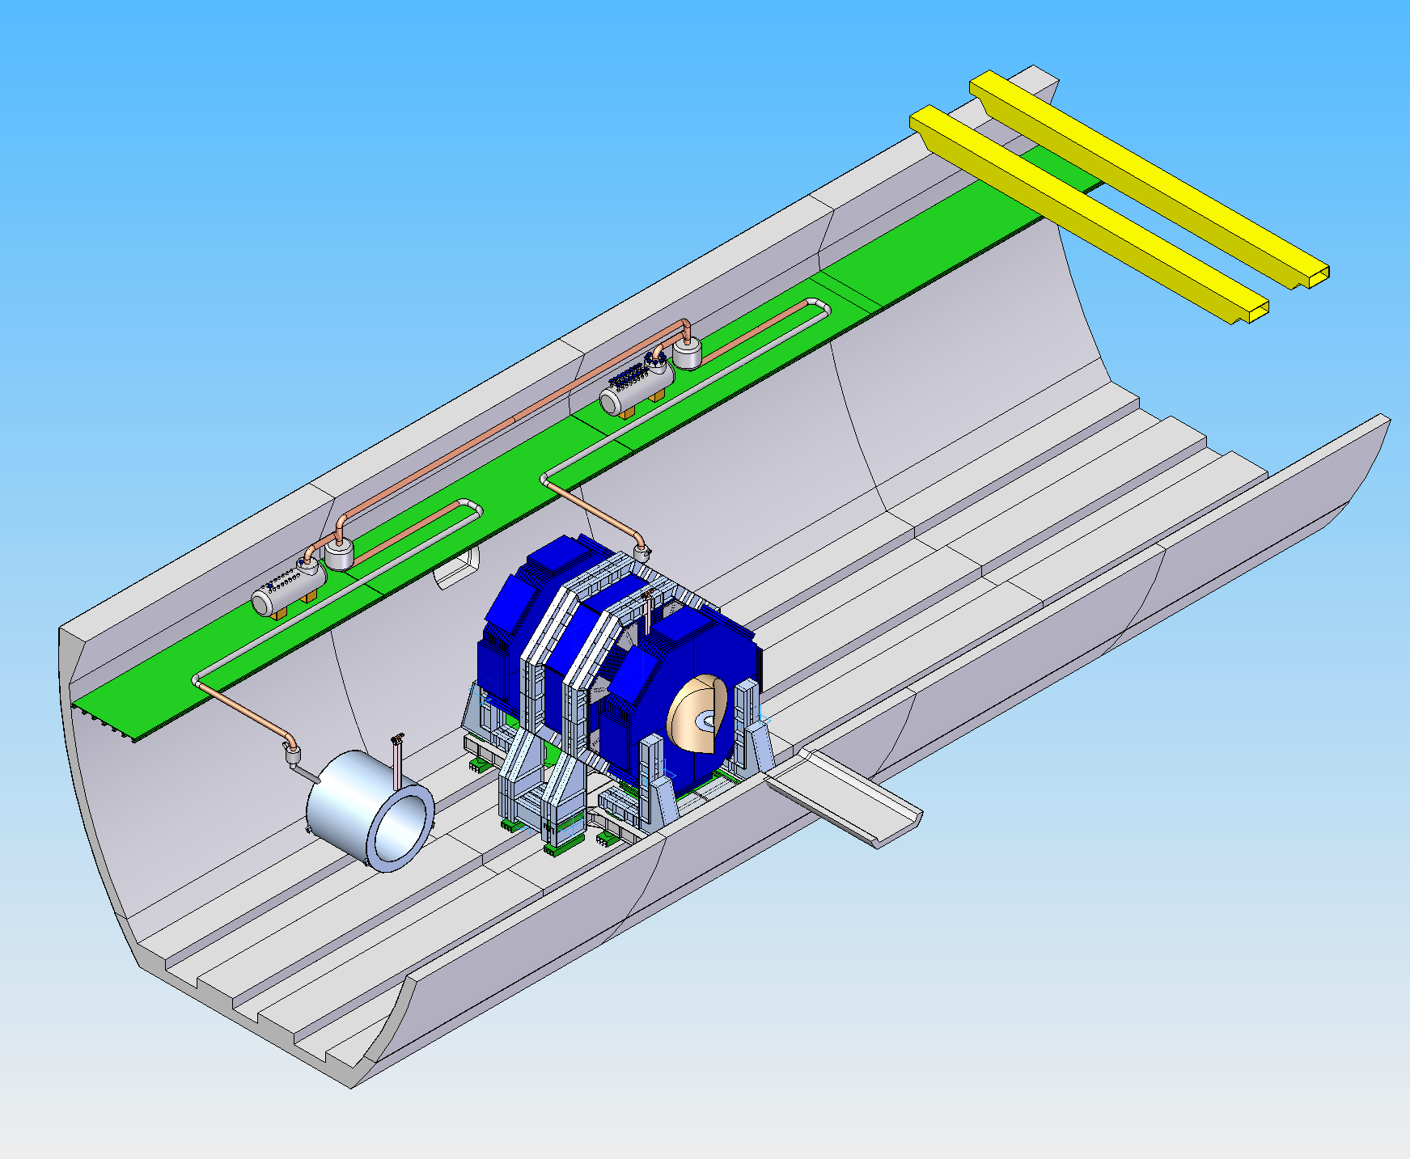
Cryogenics system design for push-pull
Stationary cold box with flexible cryo-transfer line
Minimize risks vs. a moving cold box with high pressure He flexible line
Cold boxes interconnection with redundancy feature for temporary unavailability
Interconnection
Cold box A
Cold box B
Flexible cryo-line
Detector B
Detector A

Slide 37
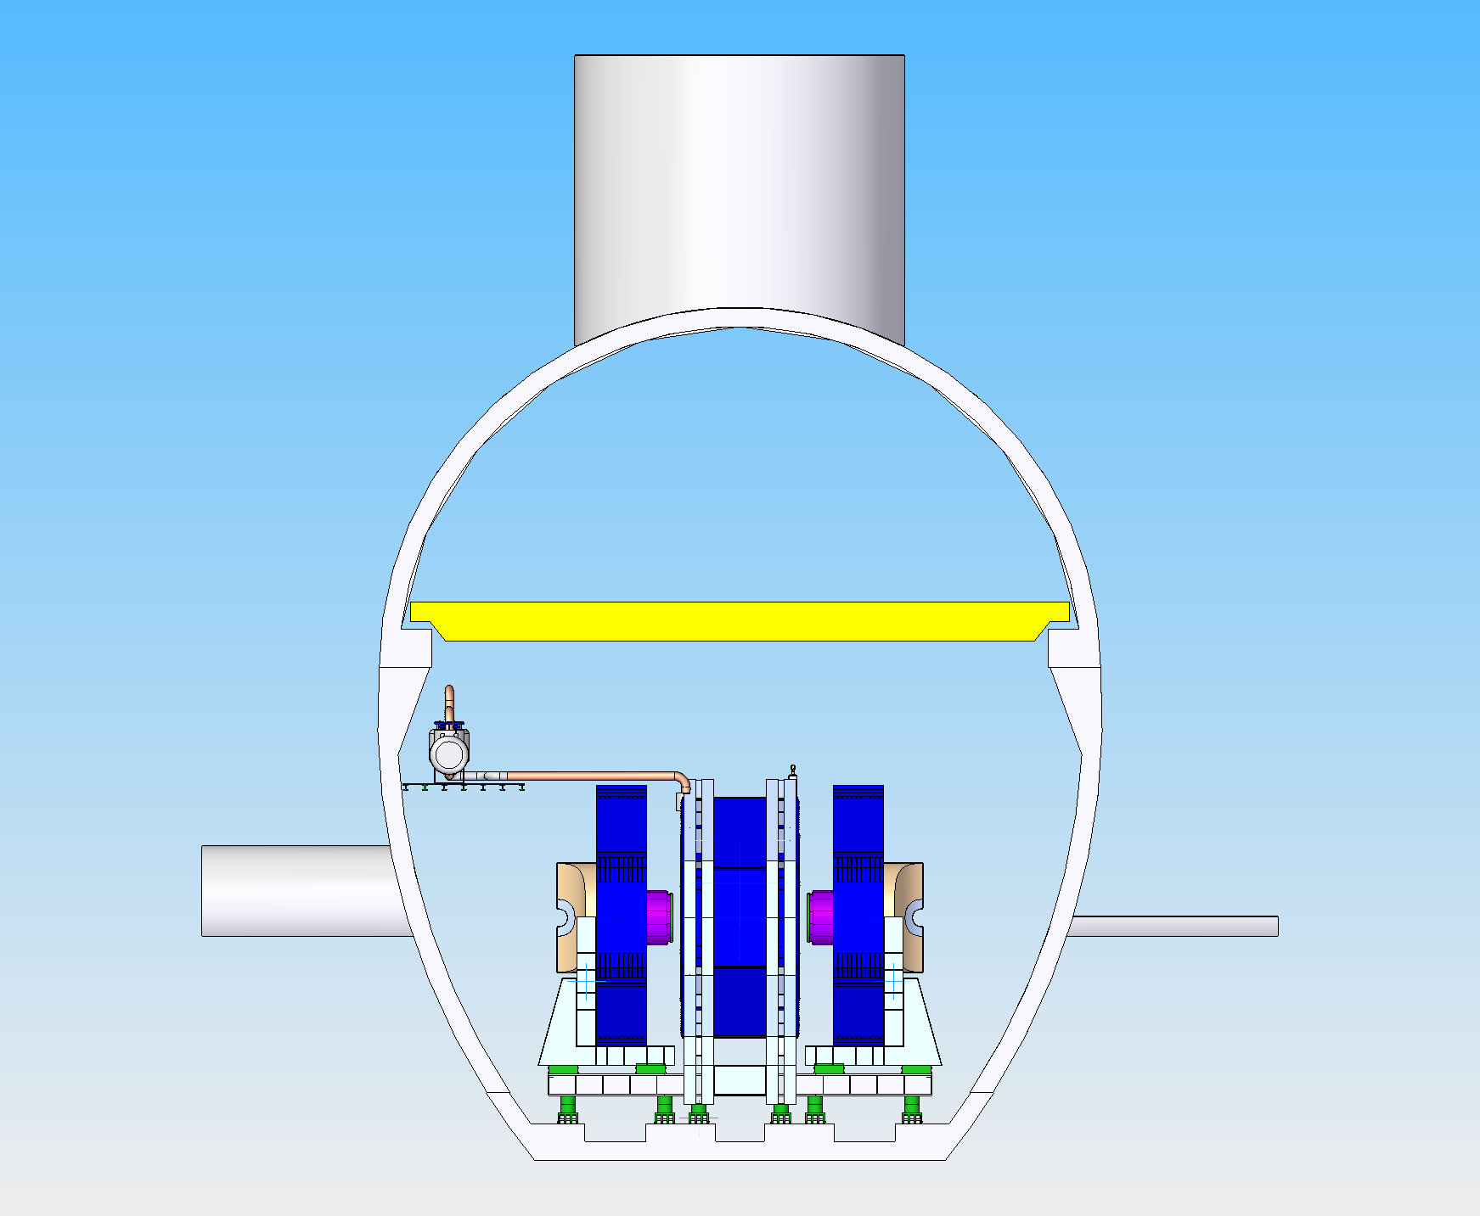
Cold box A
Cryo-line
Detector open on the beam line

Slide 38
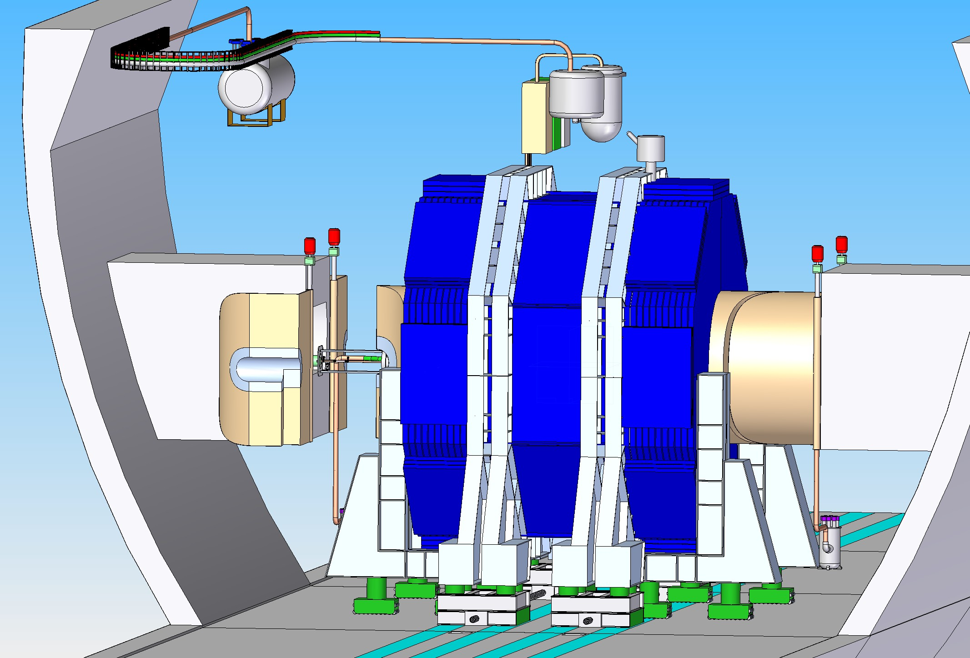
Rotating Pacmen
Electrical motor, low friction hinges

Slide 39
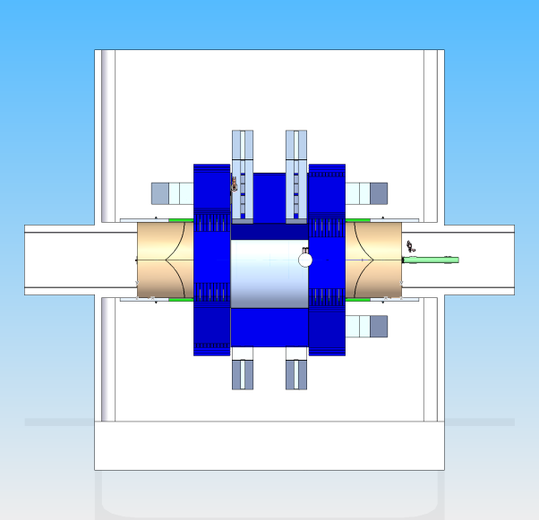
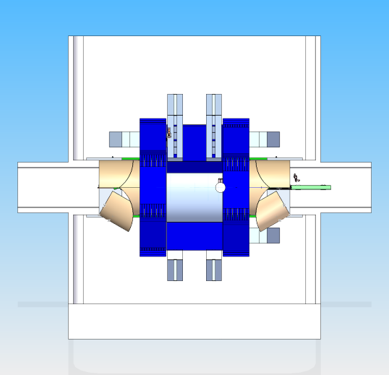






Detector opening on the beam
1
2
3
5
6
4
7
8

Slide 40
Pacmen closed: Modified to allow ILD opening
19 m
ILD
SiD
Interface pieces born by each experiment

Slide 41
Pacmen open
ILD
SiD
Increased to nominal!

Slide 42




LHC IR layouts
3 shafts
4 shafts
ATLAS, IP1
CMS, IP5
3 shafts
3 shafts
ALICE, IP2
LHCb, IP8

