Slide 1
Measuring very light gravitino with stau NLSP at the ILC
Ryo Katayama^{*1}
T. Suehara^{*2}, T. Tanabe^{*2},
S. Yamashita^{*2}, S. Matsumoto^{*3},
T. Moroi^{*1}, K. Fujii^{*4}
*1: The University of Tokyo, *2: ICEPP
*3: Kavli IPMU, *4: KEK

Slide 2
Introduction
H
λΛ
H
H
Standard Model: Radiative correction due to the Higgs is too large to be natural (hierarchy problem)
example : at GUT scale , correction becomes O(10¹⁹ GeV) for Higgs mass O(10² GeV)
→Expected to be solved by constructing a new model
Super symmetry model (SUSY): One of the most promising new models
In case of gauge mediated SUSY breaking (GMSB),
the gravitino appear as the lightest SUSY particle (LSP)
GMSB doesn’t have SUSY Flavor problem

Slide 3
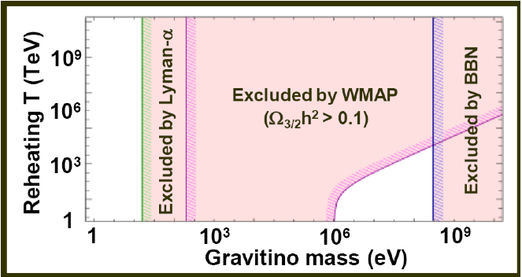
Low Scale GMSB Model
< Cosmological Constraints >
Cosmological measurements constrain
gravitino mass into two regions
The constraint against reheating temperature doesn’t exist for low scale GMSB which has O( 1 eV ) Gravitino
< Thermal Leptogenesis >
Baryogenesis is realized by assuming
right handed neutrino was generated in the early universe and the sphaleron process which conserves B – L
(B: baryon number L: lepton number)
Needs high reheating temperature
to generate heavy right handed neutrino
The object of study is low scale GMSB which has very light Gravitino
√3×10¹⁰ GeV
*Low Scale GMSB can not be cold dark matter candidate because it is too light.
Expect its problem be solved by another model,
for example: axion and so on.
T.Moroi: hep-ph/9503210
S.Shirai: arXiv/1003.3155

Slide 4
The Purpose and Significance of study
＜ Purpose ＞
Low Scale GMSB is attractive because it can solve both hierarchy problem and baryon asymmetry problem
In this study, we evaluate precision of gravitino mass determination at the ILC experiment
＜ Significance ＞
High precision determination of gravitino mass
  The mass of sparticles that appear in GMSB is
  a function of SUSY Breaking Scale
  By combining results of other study,
  we can constrain the messenger mass

Slide 5


Stau NLSP properties in Low Scale GMSB
Assume NLSP is the stau
Stau lifetime typically short
Excluded
by
Constraint
Gravitino mass can be determined from
the stau mass and lifetime:
sample point
In this study, we analyze
the case of stau mass of
120 GeV and lifetime of 100 μm
[arXiv:1104.3624]

Slide 6






Stau pair event topology
Decay lifetime of tau is 87μm
→Observe only the decay products
Tau decay mode:
  We limit to only the 1-prong mode in this study
  →Influence the stau lifetime determination method
  Indirect lifetime measurement from the impact parameter distribution
  Future plan:
  we will include the 3-prong decay
＜Signal at the ILC＞
τ⁻
e⁻
~
τ⁻
Z＊, γ*
~
τ⁺
e⁺
τ⁺
<Branching ratio of tau 1-prong decay>
[PDG]

Slide 7
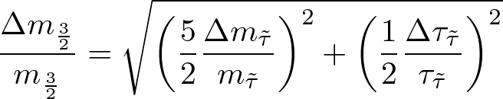
Analysis strategy
Determine the stau mass by using the following two methods
  From the track energy distribution: √s = 500 GeV
  From the threshold scan : √s ≈ 250 GeV
Determine the stau lifetime by using below
  From the impact parameter distribution: √s = 500 GeV
Determine Gravitino mass precision by putting both stau mass and lifetime precision into the formula below

Slide 8
Simulation framework
Event Generator
  Signal : Physsim
  Background : Whizard Ver.1.95
Beam condition
  Energy spectrum: include effects of Beamstrahlung
  Beam polarization
    Signal and background samples are generated with
    pure beam polarizations, then weighted to realistic polarizations
Software tools
  Mokka with ILD_00 for the detector simulation
  LOI digitizer, tracking, PFA for event reconstruction

Slide 9



Signal and Background Processes
＜ Assumed E_{CM} and Luminosity ＞
＜Choice in this analysis＞
Signal: Only right handed stau
Polarization: (P_{e-}, P_{e+})=(+0.8, −0.3)
→To suppress WW background
 | √s (GeV) | Luminosity (fb⁻¹)
nominal analysis | 500 | 500
threshold scan | 250 ∼ 261 | 100 /point
＜ Process and generated event number ＞
Process | Num event (nominal analysis) | Num event (threshold scan)
 | 68078 | 969
 | 634295 | 811753
 | 207952 | 37081
 | ∼ Ο(10⁸) | 3.5∗10⁹
 | ∼ Ο(10⁹) | /

Slide 10
Overview of event selection
＜ Main selection ＞
Number of tracks = 2
high P_{T} and energy
→ Suppress γγ background
Tight cut on |cos(θ)| → Suppress bhabha
Acoplanarity cut → Suppress ττ background
Analysis specific cut
  |d0|/σ(d0) (track energy, Threshold Scan)
  require at least1 hadron track (track energy, lifetime)
 | Nominal analysis | Threshold Scan
Evis ( GeV ) | > 30 | 30 ∼ 150
|cos(θ)| | < 0.8 | < 0.85
Acoplanarity | > −0.93 | > −0.9
＜ Weighted event counts after all cuts ＞
Signal
Background
 | stau-stau | ττ | γγ BG, Bhabha | WW, ZZ -> lνlν
Track energy fit (only 180 ~ 250 GeV) | 219.5 | 1.1 | 0 | 6.1
Threshold scan (261 GeV) | 467.5 | 49.7 | 20.0 | 211.8
Lifetime analysis | 14565 | 563 | 1047 | 1859

Slide 11
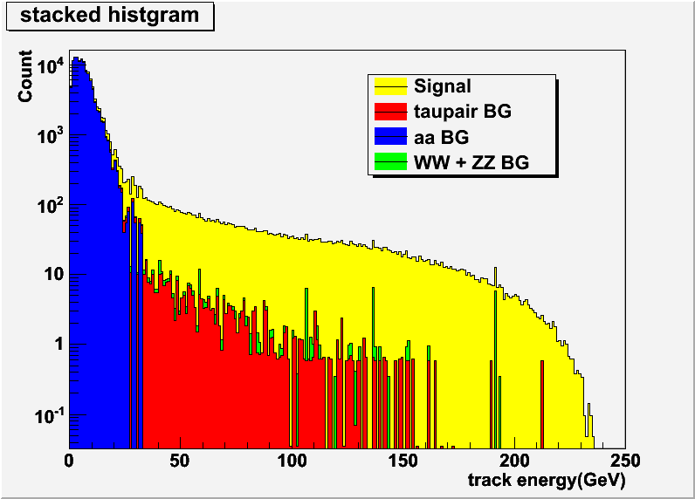
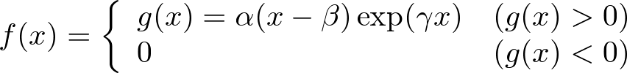

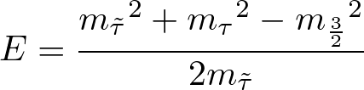

Stau mass with track energy fit
Track Energy fit
The stau mass determines the maximum of the track energy
Procedure
Acquire the edge of track energy distribution by the following fitting function (refer to right figure)
Substitute the fitted value for the maximum energy in the kinematic formula (refer to right) to solve for
the stau mass
Repeat 1 − 2 above 10,000 times
to evaluate expected precision of stau mass
Tau energy is maximum
when the stau and the tau
are collinear
IP
decay

Slide 12
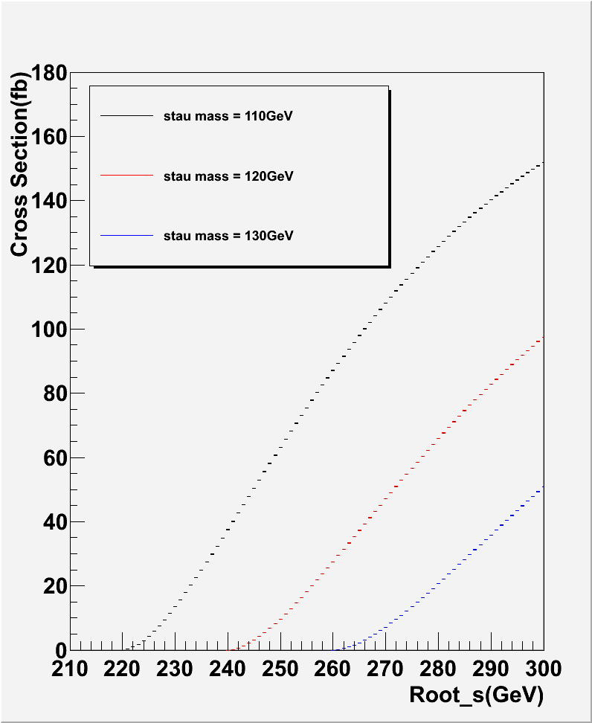
Stau mass with threshold scan
Threshold Scan
The stau mass can be also obtained from the rise of the cross section near the threshold
→ Acquire the cross sections at several E_{CM}s to be compared with template samples of various stau masses
Procedure
Perform full simulation of signal samples at √s =250,256,261 GeV
and background samples at √s =250 GeV, scaled to 256 and 261 GeV
Perform toy MC experiments on the signal yield to derive the cross sections considering S/N and cut efficiency
＜ The rise of the cross sections ＞
Stau mass 110 GeV
cc
Stau mass 120 GeV
Stau mass 130 GeV
Sample point 250 GeV
Sample point 256 GeV
Sample point 261 GeV
sample points

Slide 13
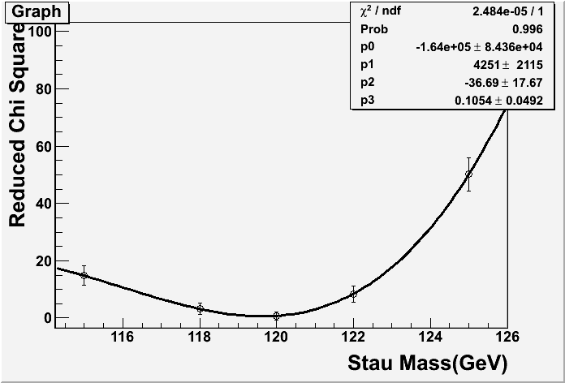
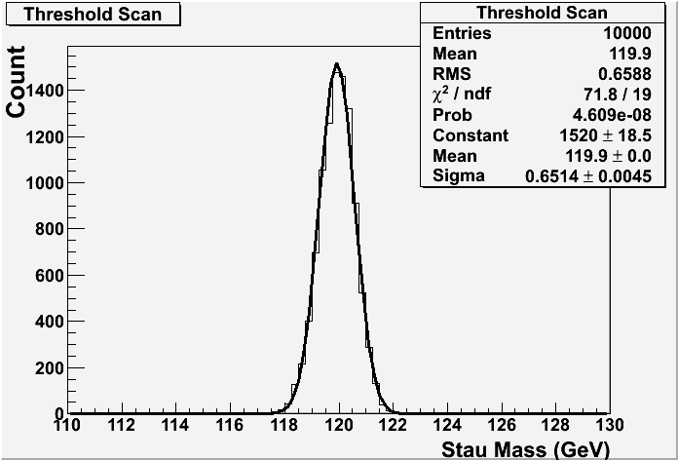

Stau mass with threshold scan
Compute the chi2 against the expected cross section at five points( 115 ,118 ,120 ,122, 125 GeV )
Compare the cross section with
stau mass by fitting with a third polynomial function
→ Regard the chi2 minimum as the measured stau mass
Repeat 2 − 4 above 10,000 times
to evaluate the expected precision of stau mass
(Preliminary)
(Preliminary)

Slide 14
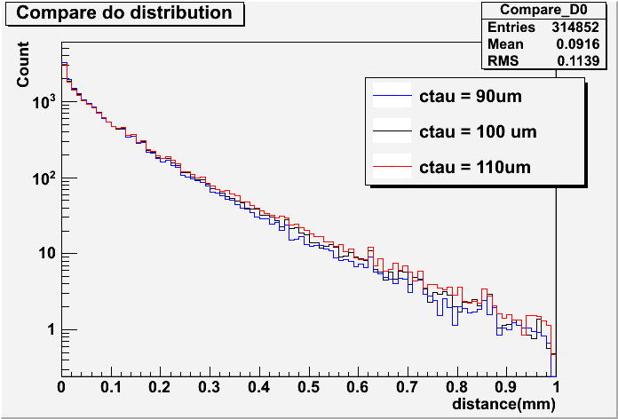

Stau lifetime determination
Impact parameter
Impact parameter distribution is sensitive to the stau lifetime
Use the d₀ component because its uncertain is small
Procedure
Perform toy MC experiments to compare d₀ distribution against the template samples at cτ = 90, 100, 110 μm
Fit the chi2 at the three points by a parabola and regard the minimum as lifetime
Repeat 1 − 2 above 10,000 times
to evaluate the expected precision of the stau lifetime
1-prong decay products
(π±, e±, etc.)
Impact
Parameter
τ
stau
16mm
Gravitino
Collision Point
Vertex detector
1st layer

Slide 15



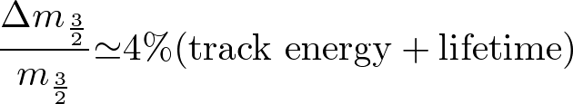
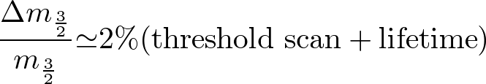
Determination of the gravitino mass
Substitute stau lifetime and mass precision into gravitino mass formula, we get the following result
Reminder: Prefactors 5/2 and 1/2 come from the power in the gravitino mass formula

Slide 16
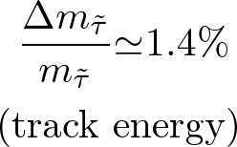
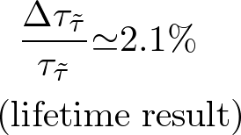
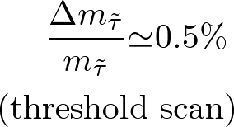
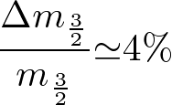
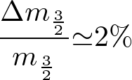
Summary
Assuming Low Scale GMSB and stau NLSP with 120 GeV mass and cτ = 100 μm lifetime, we obtain the following results
The lifetime precision should be evaluated including three prong tau decays in the future

Slide 17
Back Up

Slide 18
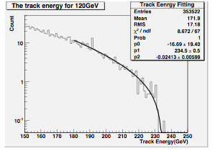


stauの質量決定法
実験結果のtrack energy分布のedgeを以下のFitting関数で取得(左上図参照)
1の値をstauから崩壊するtauの持つ最大エネルギーの解析式へ代入し(左式参照)、stau質量の解を持つ関数を作る
2で得られた関数の解を数値計算で求める
衝突点で生成されたstauと崩壊tauが同方向に 放出される場合に最大
衝突点
decay

Slide 19
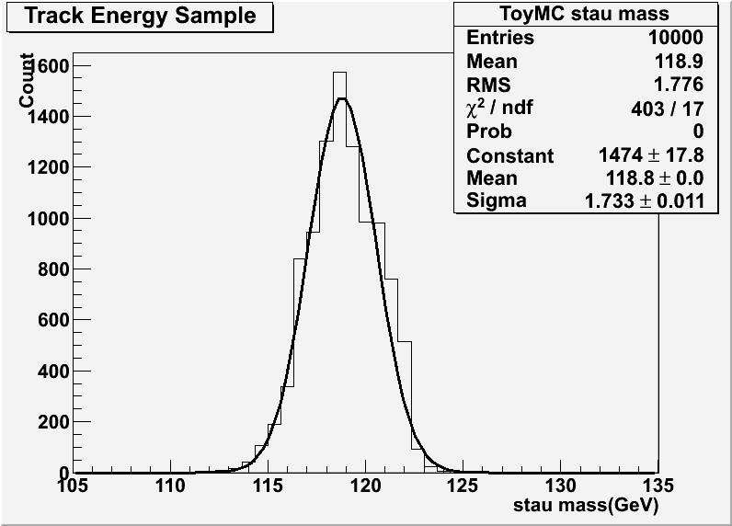
stau質量決定精度の評価
signalの高統計サンプルを使って作った実験結果のtrack energy分布から、各BinをPoisson統計で振った『1実験』を生成 (Toy MC)
Toy MCでmass fitを1万回試行し、得られた結果の分布を用いてmass決定の誤差を見積もり以下の値を得た

Slide 20
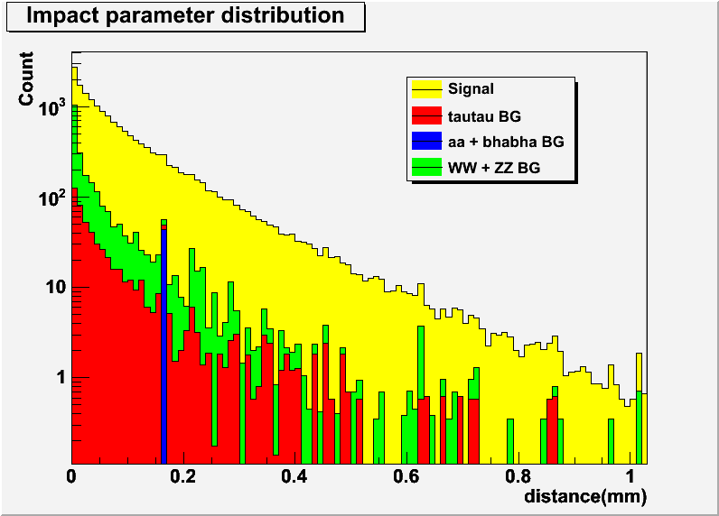
The signal and noise ratio for lifetime analysis

Slide 21
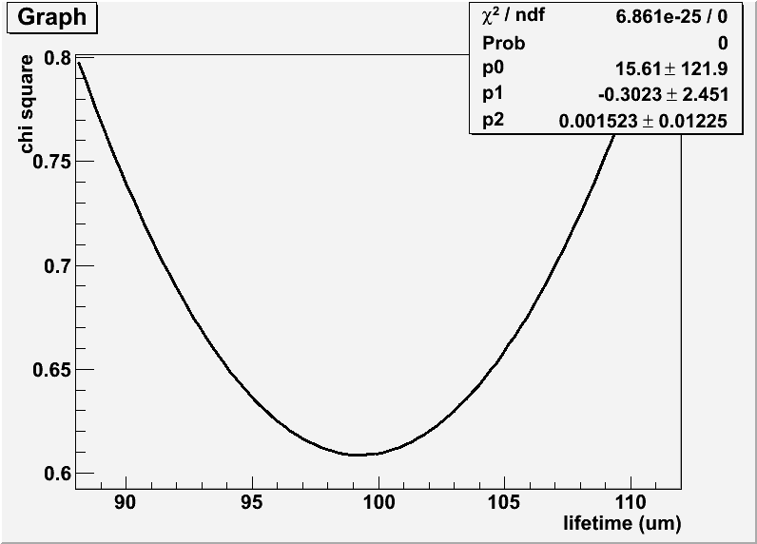
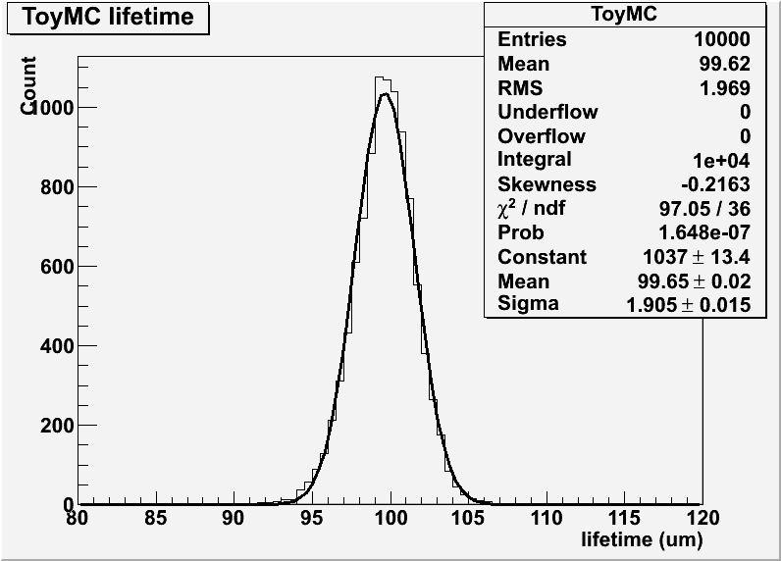

stauの崩壊寿命の決定精度の評価 1
cτ = 90 μm, 100 μm, 110 μmの高統計テンプレートサンプルとSignalの高統計サンプルを使って作ったd0分布から、各BinをPoisson統計で振った『1実験』を各々用意する
Toy MC試行と各テンプレートとのreduced χ²を縦軸に、テンプレートの崩壊寿命cτを横軸に取る
χ²の(Error)²をテンプレートの統計の総和と実験結果の統計の総和の二乗の平方和で定義する
上記reduced χ²の三点を放物線でフィットする
Toy MCで放物線フィットを1万回試行し、得られた最小値の分布を用いて寿命決定の誤差を見積もり以下の値を得た

Slide 22
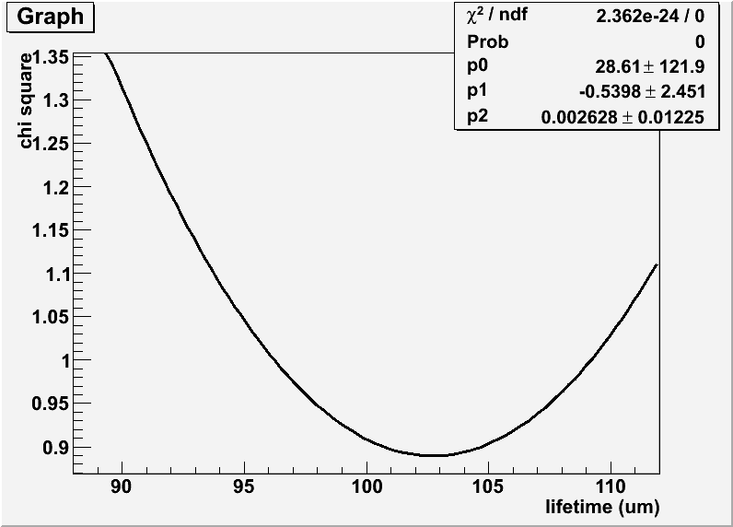
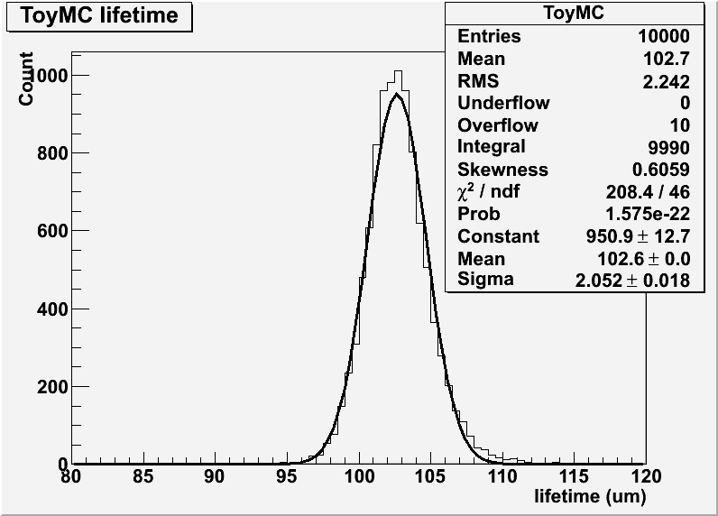
stauの崩壊寿命の決定精度の評価 2
cτ = 90 μm, 100 μm, 110 μmの高統計テンプレートサンプルとSignalの高統計サンプルを使って作ったd0分布から、各BinをPoisson統計で振った『1実験』を各々用意する
Toy MC試行と各テンプレートとのreduced χ²を縦軸に、テンプレートの崩壊寿命cτを横軸に取る
χ²の(Error)²をテンプレートの統計の総和で定義する
上記reduced χ²の三点を放物線でフィットする
Toy MCで放物線フィットを1万回試行し、得られた最小値の分布を用いて寿命決定の誤差を見積もり以下の値を得た

Slide 23




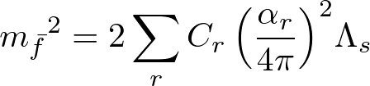
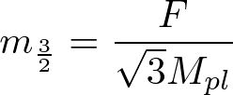

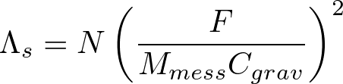

GMSB模型検証とgravitino質量の関係
見える超対称性粒子がメッセンジャー粒子のゲージ相互作用を介して超対称性ポテンシャルと相互作用し、超対称性の破れが伝わる模型
メッセンジャースケールで超対称性粒子の質量が決まり、ほかのエネルギースケールへは繰り込み群方程式を発展させて決める
超対称性粒子の質量はメッセンジャースケールで以下である。
M_{i} : ゲージーノ質量 m_{f} : sfermion質量 m_{3/2} : gravitino質量
参考文献(1,(2,(3
N : メッセンジャー粒子の数 M_{mess} : メッセンジャースケール Cgrav:無次元定数
F: SUSY Breaking のスケール M_{pl} :プランク質量 ＝ 2.44 × 10¹⁸ (GeV)
GMSBモデルはパラメータΛ、M_{mess}、N、C_{grav}で構築され、決定にgravitino質量取得によるSUSY BreakingのスケールFが必要
gravitino質量の取得精度はGMSB模型検証の根幹に関わる問題であり、高精度決定を目指す

Slide 24
前項の参考文献
実験屋さん向け超対称性入門 (著)野尻美保子 京都大学基礎物理学研究所
高エネルギー物理学の発展 (著)長島順清(版)朝倉書店
Study of GMSB models with photon final states using the ATLAS detector http://www-atlas.desy.de/theses/Terwort_phd.pdf

Slide 25
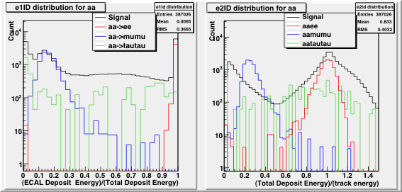
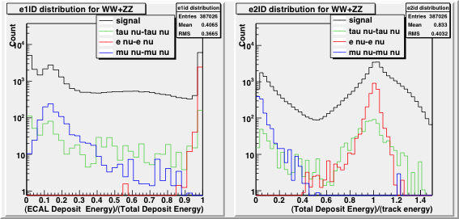
Lepton id distribution

Slide 26
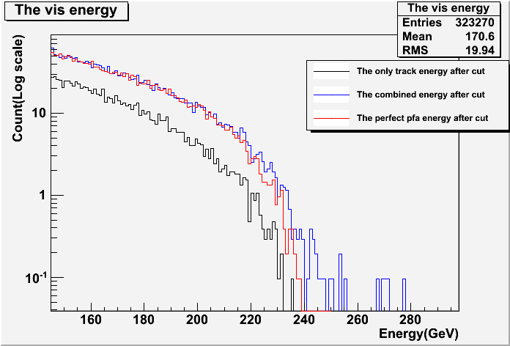
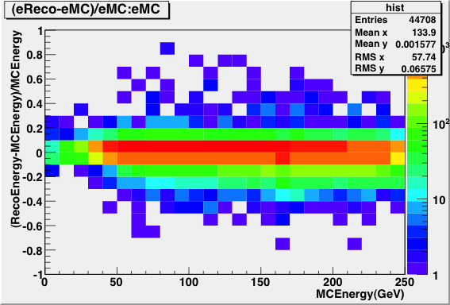
PFAの改善可能性
stau質量決定にtrack + neutral energyを用いればedge付近の統計が増大し結果も更に改善
  現在の再構成アルゴリズムにはedgeにexcessが存在しFittingが不可能
高エネルギーTau Jetに対するPFAの失敗が疑われる
重心系エネルギー500GeVでe⁺e⁻ ->τ⁺τ⁻ を用いて以下を解析
    τ⁻->ν + π⁻ + π⁰
    τ⁻->ν + π⁻ +2π⁰
エネルギー分解能が悪い結果は正負同程度存在
本研究では負の場合の補正に成功した

Slide 27
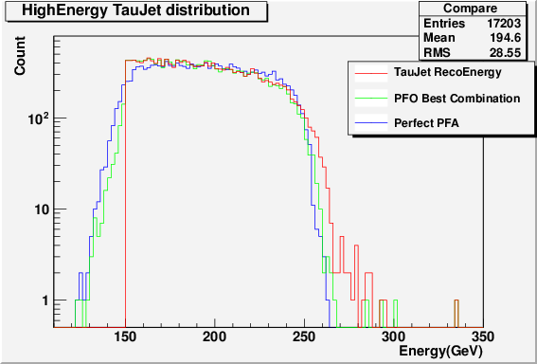
クラスター組み替えの試行
  仮説:クラスターの組み間違え
    エネルギー分解能の悪いイベントをEvent displayで確認した
MCでの確認
  MCの情報を見ながら、中性HCAL Clusterと荷電ECAL Clusterを組み替え、
    1.精度が改善した場合はそれを採用
    2.精度が悪化した場合はそれを採用しない
として新分布を生成
  結果はほぼ全てのexcessが消滅
    仮説を示唆する結果

Slide 28
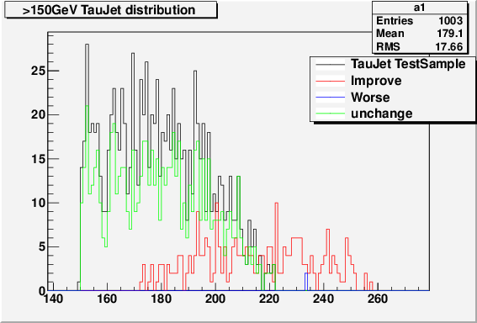
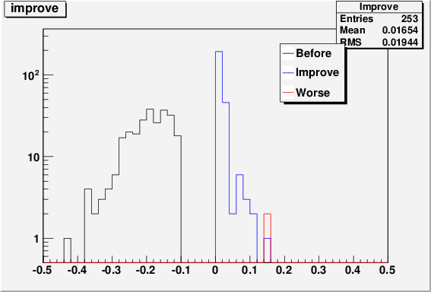
PFAの改善
以下のprocedureで150GeV以上のtau jetのPFAの改善を確認した
trackで測ったエネルギーより荷電パイオンクラスターのエネルギーが20%以上大きいものを選び出す
フォトンクラスターのエネルギーより荷電パイオンクラスターのエネルギーが40%以上あるイベントを選び出す
1,2を満たす場合に、ECALにあるエネルギー全てをpi0->2gammaの寄与と見なし、 不変質量を組んで、真の値 m ~ 770MeVと1GeV以内のイベントを選ぶ
3を満たすイベントに対してはECAL全てのエネルギーをフォトンクラスターの寄与と見なしてエネルギー再構成を行う
結果、150GeV以上のTau JetでReco EnergyがMC Truthより-10%より悪い サンプル数1003のうち、253のイベントを改善できた

Slide 29
Cut table( lifttime analysis)
 | stau-stau | ττ | γγ ->ll,qq | WW, ZZ -> lνlν
No cut | 68078 | 634295 | 4.6∗10⁺⁰⁷ | 207952
Track数=2 | 45636 | 307758 | 2.1∗10⁺⁰⁷ | 96712
p_{T}> 5 GeV for each track | 38698 | 271367 | 1.1∗10⁺⁰⁷ | 89460
|cos θ_{miss}| < 0.9 | 35685 | 152974 | 3.3∗10⁺⁰⁶ | 50282
E_{vis}> 30 GeV | 34824 | 152698 | 1.0∗10⁺⁰⁶ | 50146
|cos θ|< 0.8 for each track | 28606 | 118889 | 747386 | 18664
Acoplanarity > -0.93 | 18661 | 12151 | 566519 | 10716
θ₁₂ / E_{vis} > 3.0/400 | 18049 | 814 | 21799 | 6777
注）γγ->ll,qqはPreselection後のイベント数

Slide 30
最終サンプル(lifetime analysis)
 | stau-stau | ττ | γγ -> ll+bhabha | WW, ZZ -> lνlν
前ページCut + Lepton ID CUT (stau lifetime 解析用) | 14565 | 563 | 1047 | 1859
Lepton ID Cut：以下のelectron id Cutとmuon id Cutを少なくとも一本のトラックが満たす事を要求
  electron id cut:
    ECAL deposit energy/Total deposit energy<0.92
  muon id cut:
    Total deposit energy/Track energy>0.5

Slide 31
Cut table( track energy )
 | stau-stau | ττ | γγ ->ll,qq | WW, ZZ -> lνlν
No cut | 68078 | 634295 | 4.6∗10⁺⁰⁷ | 207952
Track数=2 | 45636 | 307758 | 2.11∗10⁺⁰⁷ | 96712
p_{T}> 5 GeV for each track | 38698 | 271367 | 1.1∗10⁺⁰⁷ | 89460
E_{vis}> 30 GeV | 37800 | 270948 | 6.4∗10⁺⁰⁶ | 89316
|cos θ|< 0.8 for each track | 30036 | 129937 | 4.5∗10⁺⁰⁶ | 25118
Acoplanarity > -0.93 | 18856 | 13243 | 2.9∗10⁺⁰⁶ | 11423
θ₁₂ / E_{vis} > 3.0/500 | 18506 | 2172 | 1.3∗10⁺⁰⁶ | 8613
|d0|/σ(d0) > 1 for each track | 17537 | 1538 | 382615 | 1319
注）γγ->ll,qqはPreselection後のイベント数

Slide 32
最終サンプル( track energy )
 | stau-stau | ττ | γγ -> ll+bhabha | WW, ZZ -> lνlν
前ページCut + Strong Lepton ID CUT (track fit解析用) | 8301 | 829 | 78473 | 166
Lepton ID Cut：以下のelectron id Cutとmuon id Cutを少なくとも一本のトラックが満たす
  electron id cut:
    ECAL deposit energy/Total deposit energy<0.92
  muon id cut:
    Total deposit energy/Track energy>0.5
Strong Lepton ID Cut：以下のstrong electron id Cutとstrong muon id Cutを一本のトラックが満たす
  electron id cut:
    ECAL deposit energy/Total deposit energy<0.95
  muon id cut:
    Total deposit energy/Track energy>0.2

Slide 33
Cut Table for Threshold Scan (Preliminaly)
 | Signal-1 (250 GeV) | Signal-2 (256 GeV) | Signal-3 (261 GeV) | ee->ττ | γγ->ll,qq eγ->ll,qq | WW,ZZ ->νllν
Before cut | 969.6 | 1995.0 | 2943.7 | 811753 | 3.5∗10+09 | 37081.6
track = 2 | 640.9 | 1342.3 | 1935.9 | 417522 | 1.8∗10+09 | 27236.9
Pt > 5 GeV for each track | 511.1 | 1078.5 | 1545.1 | 325647 | 9.5∗10+07 | 24362.6
|cos θ_{miss}| < 0.8 | 410.5 | 872.0 | 1245.0 | 109289 | 2.0∗10+06 | 16659.5
30< E_{vis} <150(GeV) | 392.4 | 834.0 | 1180.3 | 70297.5 | 321686.0 | 11505.6
|cos θ|< 0.85 for each track | 328.1 | 689.9 | 991.3 | 62562.5 | 246379.0 | 8074.9
Acoplanarity > -0.9 | 287.6 | 614.2 | 874.1 | 2100 | 6147.3 | 6265.9
|d₀|/σ(d₀) > 3.5 | 194.2 | 432.1 | 626.8 | 1003 | 183.1 | 319.3
Final cut | 150.5 | 314.6 | 467.5 | 49.7 | 20.0 | 211.8
Final Cut = (Missing mass)²/|cos θ_{miss}| > 300e³ GeV²

