Slide 1
Phenomenology of the
Higgs Triplet Model
Kei Yagyu (National Central U)
Collaborators:
Mayumi Aoki (Kanazawa U), Shinya Kanemura (U of Toyama), Mariko Kikuchi (U of Toyama)
S. Kanemura, K. Yagyu, arXiv: 1201.6287 [hep-ph]
M. Aoki, S. Kanemura, M. Kikuchi. K. Yagyu, arXiv: 1204.1951 [hep-ph]
KILC12, Daegu, Korea, 25th April 2012
1/16

Slide 2
Introduction
・ The Higgs sector is unknown.
- Minimal? or Non-minimal?
- The Higgs boson search is underway at the LHC.
The Higgs boson mass is constrained to be
115 GeV < mh < 127 GeV or mh > 600 GeV.
- By the combination with electroweak precision data at the LEP,
we may expect that a light Higgs boson exists.
・ There are phenomena which cannot be explained in the SM.
- Tiny neutrino masses
- Existence of dark matter
- Baryon asymmetry of the Universe
・ New physics may explain these phenomena above the TeV scale.
- Extended Higgs sectors are often introduced.
2/16

Slide 3
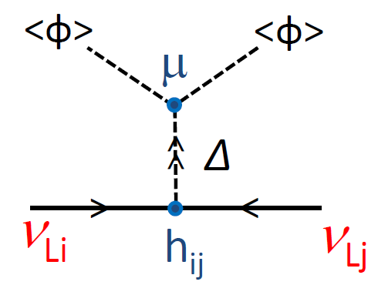
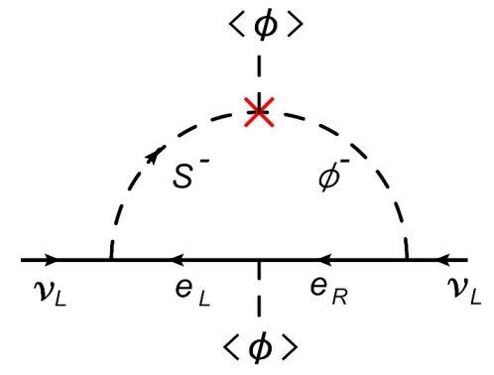
Explanation by extended Higgs sectors
Tiny neutrino masses
- The type II seesaw model
- Radiative seesaw models
(e.g. Zee model)
Dark matter
- Higgs sector with an unbroken discrete symmetry
Baryon asymmetry of the Universe
- Electroweak baryogenesis
Introduced extended Higgs sectors
SU(2) doublet Higgs + Singlet [U(1)_{B-L} model]
+ Doublet [Inert doublet model]
+ Triplet [Type II seesaw model], etc…
Studying extended Higgs sectors is important to understand
the phenomena beyond the SM.
3/16

Slide 4
How we can constrain various Higgs sectors?
An Extended Higgs Sector
Affects
Yukawa Interaction
・Flavor changing
neutral current
EW Parameters
・Rho parameter
・Gauge boson masses
Higgs Potential
・Higgs boson mass
・Higgs self coupling
Compare
Experimental Data
LEP, LHC, ILC, …
It is necessary to prepare precise calculations for observables
in the Higgs sector in order to distinguish various Higgs sectors.
4/16

Slide 5
How we can constrain various Higgs sectors?
An Extended Higgs Sector
Affects
Yukawa Interaction
・Flavor changing
neutral current
EW Parameters
・Rho parameter
・Gauge boson masses
Higgs Potential
・Higgs boson mass
・Higgs self coupling
Compare
Experimental Data
LEP, LHC, ILC, …
In this talk, we focus on the renormalization of
electroweak parameters and the Higgs potential.
4/16

Slide 6

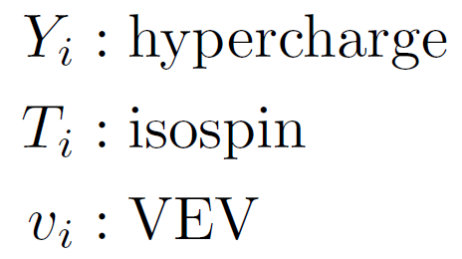
The electroweak rho parameter
★ The experimental value of the rho parameter is quite close to unity.
ρ_{exp} ~ 1
Tree-level expression for the rho parameter （Kinetic term of Higgs fields）
ρ_{tree} = 1
ρ_{tree} ≠ 1
・ Standard Model
・ Higgs Triplet Model
・Multi-doublet
(with singlet) model
・ Model with larger isospin
representaion fields.
There is the custodial SU(2) sym. in the kinetic term
The custodial SU(2) sym. is broken in the kinetic term.
These sector affects
the rho parameter by the
loop effects.
Higgs Potential
Yukawa interaction
5/16

Slide 7
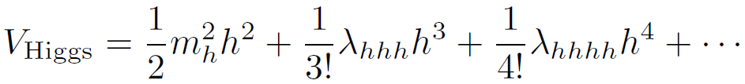
Higgs Potential
Non-minimal
Higgs sectors
Discovery of extra Higgs bosons; i.e., Charged Higgs bosons H±, …
Direct evidence
★Measuring the mass spectrum, decay branching ratios
of these extra Higgs bosons.
Deviation of (SM-like) Higgs couplings
(hVV, hff, hhh)
from those predicted values in the SM.
Indirect signature
★ Once “SM-like” Higgs boson (h) is discovered, precise measurements
for the Higgs mass and the triple Higgs coupling turns to be very important.
Precise calculation of these physics quantities is very important to discriminate various Higgs sectors.
6/16

Slide 8

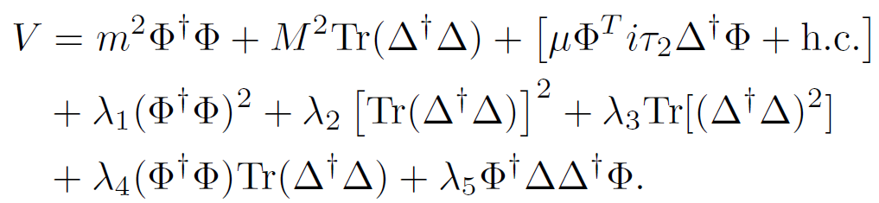
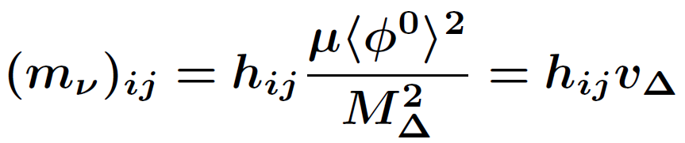
The Higgs Triplet Model
 | SU(2)I | U(1)Y | U(1)L
Φ | 2 | 1/2 | 0
Δ | 3 | 1 | -2
The Higgs triplet field Δ is added to the SM.
Cheng, Li (1980);
Schechter, Valle, (1980);
Magg, Wetterich, (1980);
Mohapatra, Senjanovic, (1981).
・Neutrino Yukawa interaction:
・Higgs Potential:
Lepton number breaking parameter
・Mass eigenstates: (SM-like) h, (Triplet-like) H±±, H±, H, A
・Neutrino mass matrix
M_{Δ} : Mass of triplet scalar boson.
v_{Δ} : VEV of the triplet Higgs
7/16

Slide 9
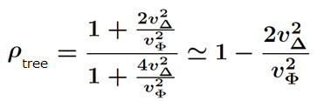

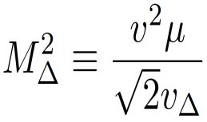
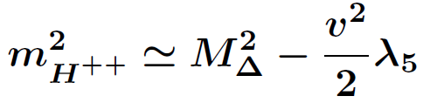
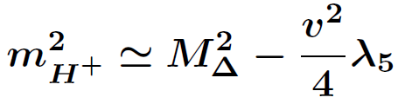

Important predictions (Tree-Level)
★ Rho parameter deviates from unity.
★ Characteristic mass relation is predicted.
m_{H++}² － m_{H+}² ≃ m_{H+}² － m_{A}²
Under v_{Δ} << v_{Φ} (From experimental data ρ_{exp} ~ 1)
Case I (λ₅ > 0)
Case II (λ₅ < 0)
Mass
Mass
A, H
H⁺⁺
_{Φ}
H⁺
H⁺
H⁺⁺
A, H
How these predictions are modified by the radiative corrections?
8/16

Slide 10
Important predictions (Tree-Level)
★ Rho parameter deviates from unity.
Renormalization of the electroweak parameters
★ Characteristic mass relation is predicted.
Renormalization of the Higgs potential
m_{H++}² － m_{H+}² ≃ m_{H+}² － m_{A}²
Under v_{Δ} << v_{Φ} (From experimental data ρ_{exp} ~ 1)
Case I (λ₅ > 0)
Case II (λ₅ < 0)
Mass
Mass
A, H
H⁺⁺
_{Φ}
H⁺
H⁺
H⁺⁺
A, H
We first discuss renormalization of the EW parameters.
8/16

Slide 11

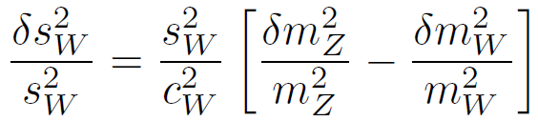
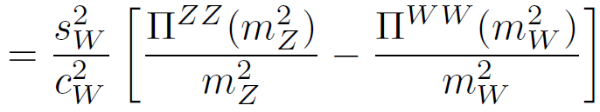
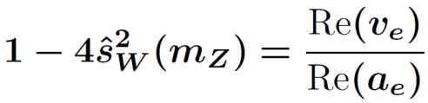
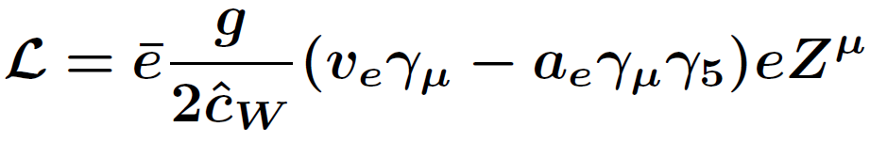
Model w/ ρ_{tree} = 1 and Model w/o ρ_{tree} = 1
Model w/
ρ_{tree} =1
EW parameters are described by 3 input parametes: α_{em}, G_{F} , m_{Z}
and the relation: c_{W}²=m_{W}²/m_{Z}².
Z
Z
W
W
Counter term δs_{W}² is determined as
~ ρ_{1-loop}
One-loop corrections to the rho parameter measures the custodial sym.
Model w/o
ρ_{tree} =1
EW parameters are described by 4 input parameters:
α_{em}, G_{F} , m_{Z} and s_{W}² .
^
Blank, Hollik (1997)
e
^
s_{W}² is defined by the Ze⁺e⁻ vertex:
Z
e
^
To determine the counter term δs_{W}² , additional renormalization condition is necessary.
→Effects of the custodial sym. is absorbed by the renormalization of δs_{W}² .
^
One-loop corrections to the rho parameter does not measure the custodial sym.
9/16

Slide 12
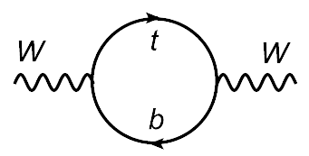
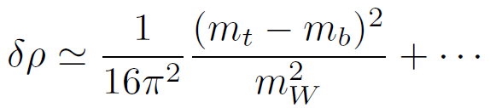
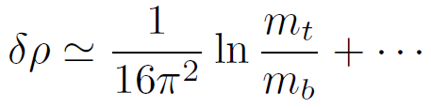
Radiative corrections to the rho parameter
Model w/
ρ_{tree} =1
Custodial sym. breaking in the
Yukawa sector
Quadratic dependence of the mass splitting appears as the effect of the custodial
symmetry breaking.
Peskin, Wells (2001);
Grimus, Lavoura, Ogreid, Osland (2008);
Kanemura, Okada, Taniguchi, Tsumura (2011).
Model w/o
ρ_{tree} =1
Quadratic dependence of the mass splitting disappears by the renormalization,
and only logarithmic dependence is remained.
10/16

Slide 13

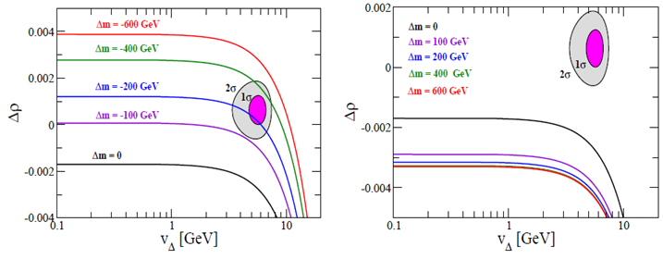
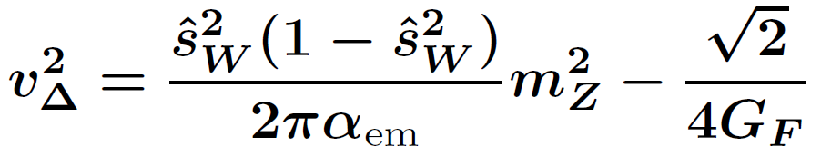
One-loop corrected rho parameter in the HTM
Kanemura, KY, arXiv: 1201.6287 [hep-ph]
m_{H++} = 150 GeV, mh = 125 GeV
m_{A}= 150 GeV, mh = 125 GeV
Case I
Case II
A, H
H⁺⁺
H⁺
H⁺
H⁺⁺
A, H
Δm = m_{H++} - m_{H+}
v_{Δ} is calculated by the tree level formula:
In Case I, mH⁺⁺ = 150 GeV, 100 GeV <|Δm| < 400 GeV , 3 GeV < vΔ < 8 GeV is favored, while
Case II is highly constrained by the data.
11/16

Slide 14


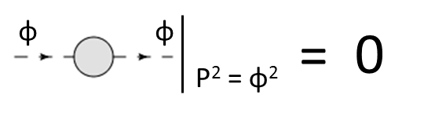

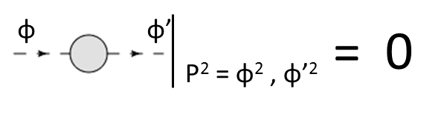

Renormalization of the Higgs potential
Aoki, Kanemura, Kikuchi, KY, arXiv: 1204.1951
8 parameters in the potential
8 physical parameters
μ , m , M , λ₁ , λ₂ , λ₃ , λ₄ , λ₅
v , v_{Δ} , m_{H++} , m_{H+} , m_{A} , m_{h} , m_{H} , α
δv , δv_{Δ} , δm_{H++}² , δm_{H+}² , δm_{A}², δm_{h}² , δm_{H}² , δα
Counter terms
Tadpole： δT_{φ ,} δT_{Δ ,}
Wave function renormalization：δZ_{H++,} δZ_{H+,} δZ_{A,} δZ_{H,} δZ_{h},…
^
δv , δv_{Δ}
Renormalization of G_{F} and s_{w}²
Vanishing 1-point function
δT_{φ ,} δT_{Δ}
On-shell condition
δm_{H++}² , δm_{H+}² , δm_{A}², δm_{h}² , δm_{H}²,
δZ_{H++,} δZ_{H+,} δZ_{A,} δZ_{H,} δZ_{h,…}
No-mixing condition
δα, …
where 2-point function is defined by
12/16

Slide 15
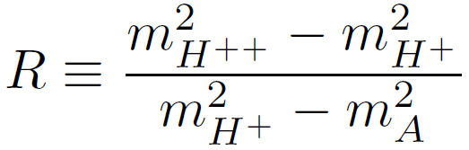
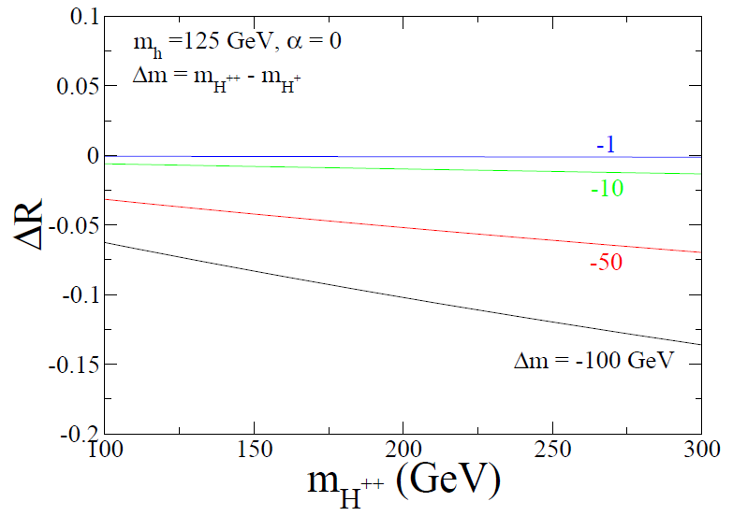
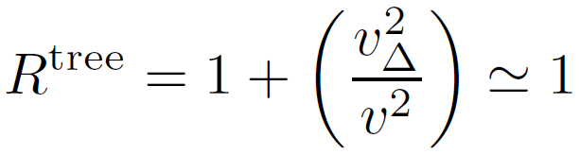
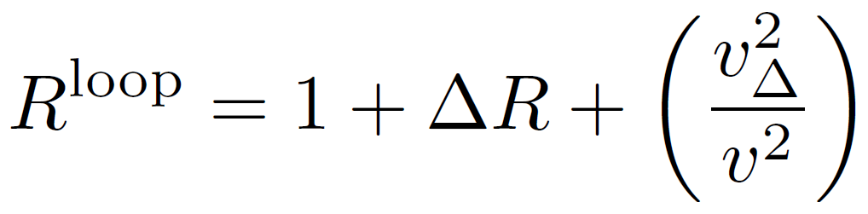
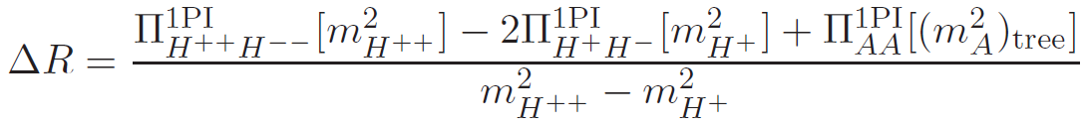
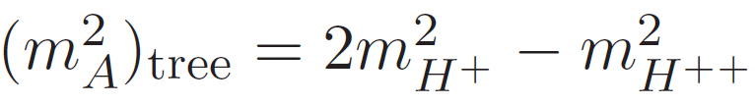
Radiative corrections to the mass spectrum
Aoki, Kanemura, Kikuchi, KY, arXiv: 1204.1951
Ratio of the squared mass difference R
Case I
Tree level:
Less than 10⁻³
Loop level:
Loop correction
(m_{A}²)_{tree}is determined by m_{H++}² and m_{H+}² :
In favored parameter sets by EW precision data: m_{H++} = O(100)GeV,
|Δm|～100GeV, ΔR can be as large as O(10)%.
13/16

Slide 16
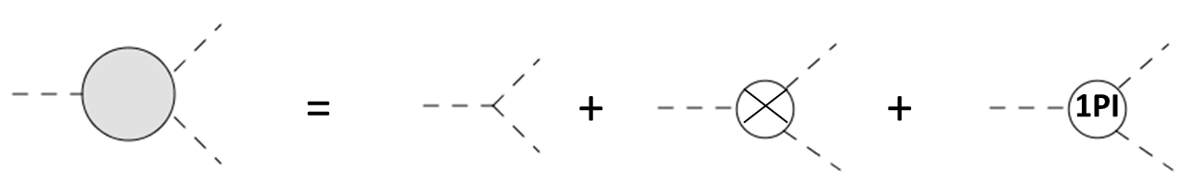

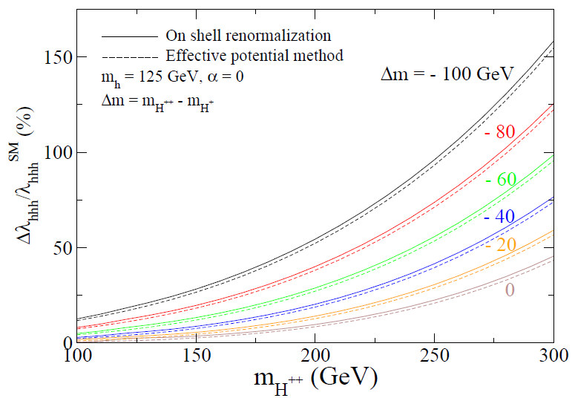
One-loop corrected hhh coupling
Aoki, Kanemura, Kikuchi, KY, arXiv: 1204.1951
On-shell renormalization of the hhh coupling:
For v_{Δ}² << v²
Quartic mass dependence of Δ-like Higgs bosons appears to the hhh coupling ⇒ Non-decoupling property of the Higgs sector.
Results for the renormalization of the EW parameter suggests m_{H++} = O(100)GeV, |Δm|～100GeV.
In this set, deviation of hhh is predicted
more than 25%
Case I
By measuring the mass spectrum
as well as the hhh coupling,
the HTM can be tested.
Unitarity is
broken
14/16

Slide 17
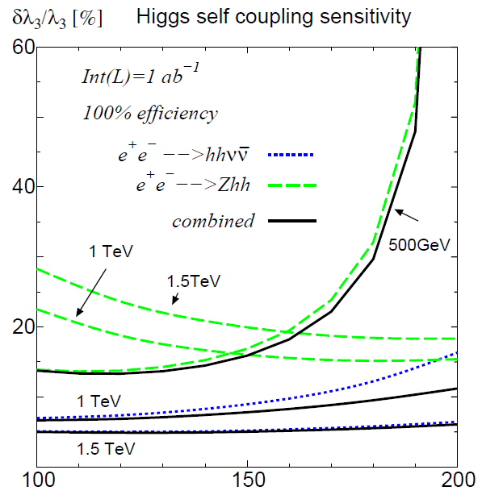
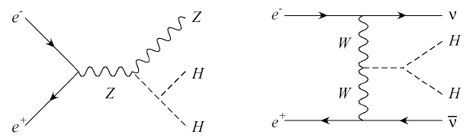
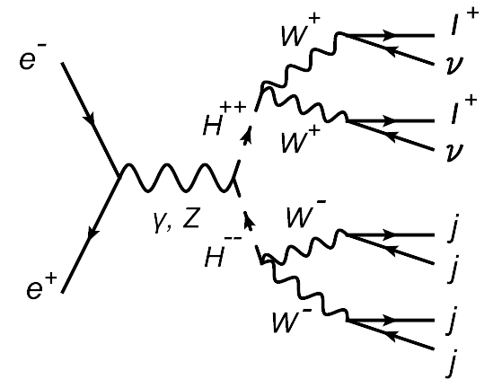
Measuring hhh and the mass spectrum at the ILC
Yasui, Kanemura, Kiyoura, Odagiri, Okada, Senaha, Yamashita, hep-ph/0211047
Measuring the hhh coupling
e⁺e⁻ → Zhh
e⁺e⁻ → hhνν
O(10)% precision may be expected.
Recent analysis was given by Suehara-san’s talk.
mh (GeV)
Measuring the mass spectrum
Case I
Transverse mass
Ex. e⁺e⁻ → H⁺⁺H⁻ ⁻ → W⁺ W⁺ W⁻ W⁻
→ l⁺ l⁺ 4jet + missing
m_{H++}
Invariant mass
15/16

Slide 18
Summary
Precise calculations of EW parameters as well as Higgs couplings (hhh, hVV, hff) are important to discriminate various Higgs sectors.
The important predictions in the Higgs Triplet Model:
Renormalization of the EW parameters
- 4 input parameters (not 3 as the SM) are necessary in to describe
the EW parameters.
⇒ mA > mH+ > mH++ with Δm=O(100) GeV is favored.
Renormalization of the Higgs potential
- One-loop corrected mass spectrum: ΔR = O(10)%
- One-loop corrected hhh coupling : deviation from the SM
prediction can be as large as O(100) %
These observables may be able to measured at the ILC.
m_{H++}² － m_{H+}² ≃ m_{H+}² － m_{A}²
16/16

Slide 19
Back up slides

Slide 20
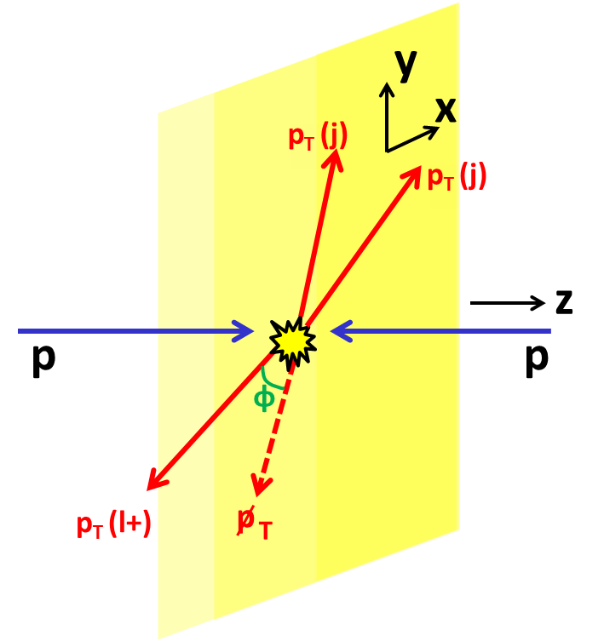
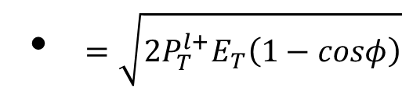
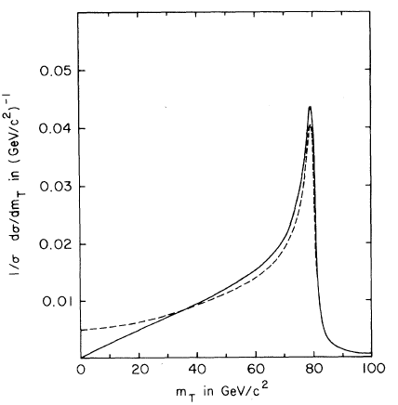


Transverse mass distribution
Ex.) Measurement for W boson mass Definition of the transverse mass
$M_{T}\left(l^{+}E_{T}\right)=\sqrt{{\left(P_{T}^{l+}+p_{T}\right)}^{2}}$
≃
Smith,Neerven,Vermaseren,PRL(1983)
$$m_{W}$$

Slide 21
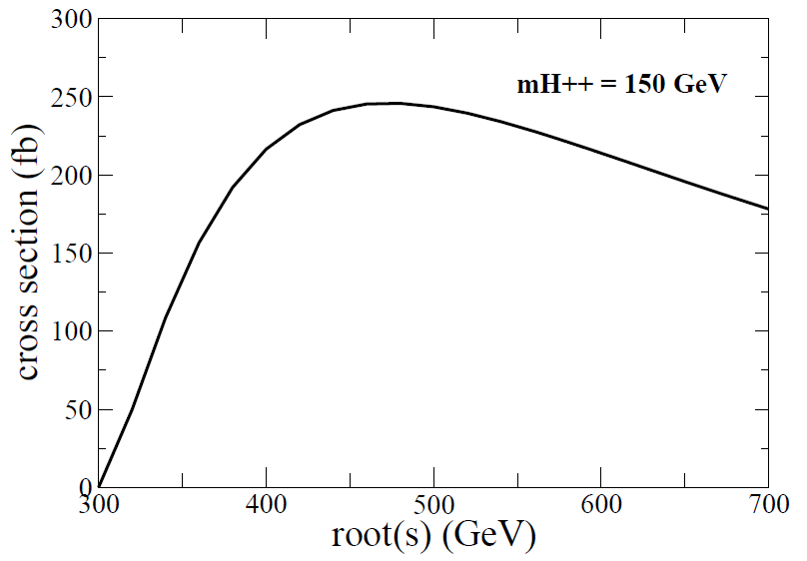
Cross section of e⁺e⁻ → H⁺⁺H⁻⁻

Slide 22
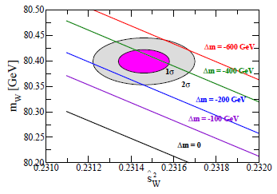
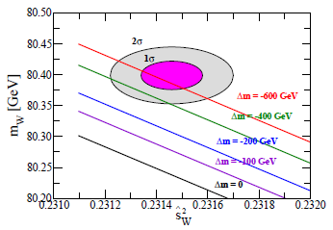
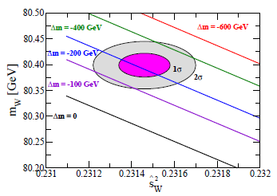
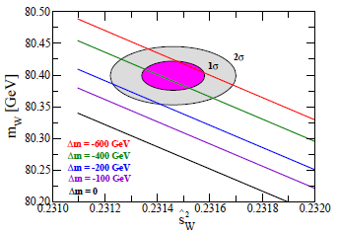
Large mh and mH⁺⁺ case (Case I)
m_{h} = 125 GeV and mH⁺⁺ = 150 GeV
m_{h} = 125 GeV and mH⁺⁺ = 300 GeV
m_{h} = 700 GeV and mH⁺⁺ = 150 GeV
m_{h} = 700 GeV and mH⁺⁺ = 300 GeV

Slide 23
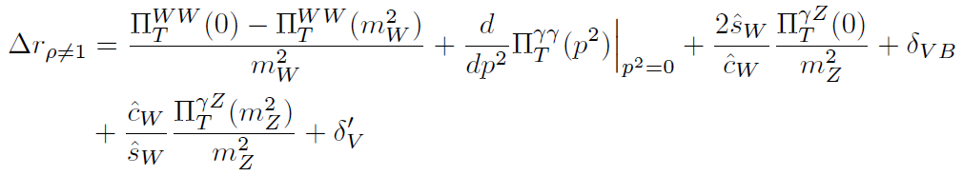
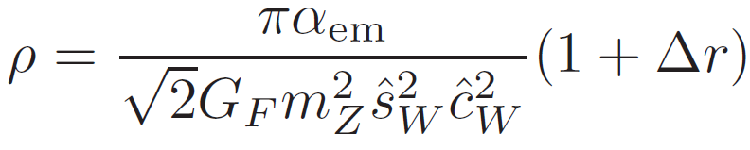
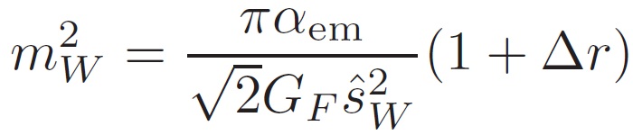
Renormalized ρ and m_{W}
One-loop corrected ρ and m_{W} are given by:
,

Slide 24
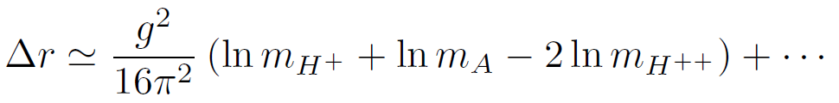
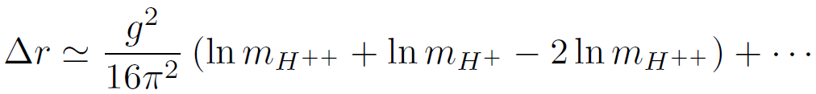

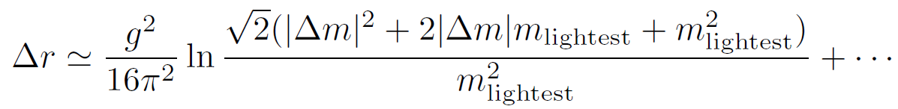
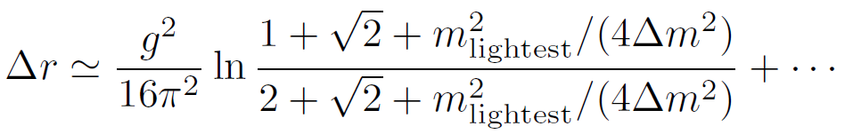
Approximately formulae of Δr
Case I:
mA > mH⁺ > mH⁺⁺
Case II:
mH⁺⁺ > mH⁺ > mA
By using
Case I:
with m_{lightest} = mH⁺⁺
Case II:
with m_{lightest} = mA

Slide 25
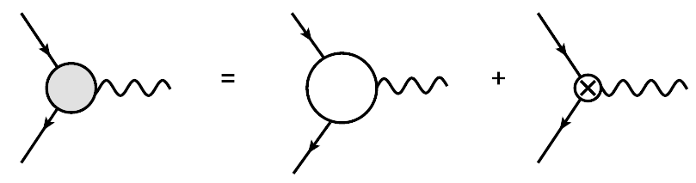

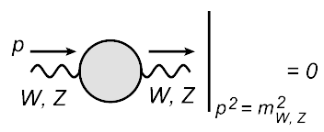




On-shell renormalization scheme
IPI diagram
Counter term
IPI diagram
Counter term
On-shell renormalization conditions
From these 5 conditions, 5 counter terms (δg, δg’, δv, δZ_{B}, δZ_{W}) are determined.

Slide 26








Radiative corrections to the EW parameters
The deviation form
can be parametrized as:
From the renormalization conditions;
In models with ρ = 1 at the tree level, s_{W}² is the dependent parameter.
Therefore, the counter term for δs_{W}² is given by the other conditions.
This part represents the violation of the custodial symmetry
by the sector which is running in the loop.

Slide 27







Y=1 Higgs Triplet Model:Kinetic term
Covariant
Derivative
VEVs
Masses for
Gauge bosons
ρ parameter

Slide 28








The Higgs Triplet Model (HTM)
The Higgs potential
There are 10 degrees of freedom of scalar states.
10 scalar states can be translated to 3 NG bosons, 1 SM-like scalar boson
and 6 Δ-like scalar bosons.
.
6 Δ-like scalar bosons → H±±, H±, A and H
Doubly-charged
Singly-charged
CP-odd
CP-even
Notes:
Next, we discuss the Higgs sector of the Higgs triplet model.
The most general Higgs potential is given by this.
There are 7 degrees of freedom of the physical scalar bosons.
Those are small h which is the SM like Higgs boson, and
Doubly-charged scalar bosons, singly-charged scalar bosons, neutral CP-even scalar boson and
The neutral CP-odd scalar boson which are the triplet like scalar bosons.
The mass formulae for these scalar bosons can be calculated as this.
The important point is that the characteristic mass spectrum: *** is predicted.
Thus, by measuring this spectrum, the model can be tested.
Same interval

Slide 29





Custrodial Symmetry
The Higgs doublet can be written by the 2×2 matrix form
In the limit of g’ → 0,
The kinetic term is invariant under SU(2)_{L}×SU(2)_{R}
After the Higgs field gets the VEV,
Only the symmetry of SU(2)_{L}＝SU(2)_{R} =SU(2)_{V} remain.
This SU(2)_{V} is called the custodial symmetry.

Slide 30


Prediction to the W boson mass at the 1-loop level
Kanemura, Yagyu, arXiv: 1201.6287 [hep-ph]
mH⁺⁺ = 150 GeV
mH⁺⁺ = 300 GeV
Δm = m_{H++} - m_{H+}
Case I
A, H
H⁺
H⁺⁺
Case II
H⁺⁺
H⁺
A, H
mA = 150 GeV
mA = 300 GeV
In Case I, by the effect of the mass splitting, there are allowed regions .
Case II is highly constrained by the data.

Slide 31



Heavy mass limit
Kanemura, Yagyu, arXiv: 1201.6287 [hep-ph]
ξ = m_{H++}² – m_{H+}²
Case I
Case II
SM
prediction
When we take heavy mass limit, loop effects of the triplet-like scalar bosons disappear.
Even in such a case, the prediction does not coincide with the SM prediction.

Slide 32

Decoupling property of the HTM
HTM with L# (μ ≠ 0)
・ ρ ≠ 1 at the tree level
(v_{Δ} ≠ 0)
・ 4 input parameters
(α_{em}, G_{F}, m_{Z} and s_{W}²)
HTM with L# (μ = 0)
・ ρ = 1 at the tree level (v_{Δ} = 0)
・ 3 input parameters (α_{em}, G_{F} and m_{Z} )
with s_{W}² = 1-m_{W}²/m_{Z}²
Heavy Δ-like fields limit
Heavy Δ-like fields limit
SM
・ L# is conserved.
・ ρ = 1 at the tree level
・ 3 input parameters (α_{em}, G_{F} and m_{Z} )
with s_{W}² = 1-m_{W}²/m_{Z}²

Slide 33








Higgs → two photon decay
Kanemura, Yagyu, arXiv: 1201.6287 [hep-ph]
+
SM contribution ＋
Triplet-like scalar loop contribution
mH⁺⁺ = 150 GeV, mh = 125 GeV
mH⁺⁺ = 300 GeV, mh = 125 GeV
Case I
A, H
H⁺
H⁺⁺
The decay rate of h → γγ is around half in the HTM compared with that in the SM.

Slide 34



Branching ratio of H⁺⁺
Δm = 0
Δm = 10 GeV
m_{H++} = 500 GeV
m_{H++} = 150 GeV
m_{H++} = 300 GeV
m_{H++} = 150 GeV
m_{H++} = 300 GeV
m_{H++} = 500 GeV
v_{Δ} = 0.1 MeV, m_{H++} = 200 GeV
Chakrabarti, Choudhury, Godbole, Mukhopadhyaya, (1998);
Chun, Lee, Park, (2003);
Perez, Han, Huang, Li, Wang, (2008);
Melfo, Nemevsek, Nesti, Senjanovic, (2011)
Phenomenology of Δm ≠ 0 is drastically different from that of Δm = 0.
Notes:
Here, I show the decay branching ratios of H++.
These upper two figures show the decay branching ratio of H++ as a function of the v delta.
The left figures shows the case of delta m = 0.
As you can see, H++ decays into the diboson when v delta is lager than 10-4 to 10-3.
The location of the cross points, where main decay mode is changing from l+l+ to W+W+
depends on the mass of the H++.
Heavier H++ tends to decay into W+W+ in smaller values of v delta.
The right figure shows the case of delta m = 10 GeV.
In this case, in the wide regions of the vdelta, H++ decays into H+W+.
The bottom figure shows the decay branching ratio of H++ as a function of the delta m.
Even when delta m is greater than one GeV, main decay mode of H++ becomes H+W+.
So, as mentioned by several authors,
phenomenology of delta m not = 0 is drastically different from that of delta m =0.

Slide 35



Branching ratios of H⁺, H and A
★ The H⁺ → φ⁰ W⁺ mode can be dominant
in the case of Δm ≠ 0.
★ The φ⁰ → bb mode can be dominant
when v_{Δ} > MeV.
Notes:
Next, we discuss the decay branching ratios of H+, H and A.
This figure shows the decay branching ratio of H+ as a function of the v delta.
Similarly to the case of the H++, the H+ to HW+ mode can be dominant in the case of delta m not = 0.
These two figures show the decay branching ratios of H and A as a function of the v delta.
When v delta is large, the mixing between the doublet Higgs and the triplet Higgs becomes strong,
So that the phi to bb mode can be dominant when vdelta greater than MeV.

Slide 36



Phenomenology of HTM with the mass splitting at the LHC
Aoki, Kanemura, Yagyu , Phys. Rev. D, in press (2011)
Case II
Cascade decays of the Δ-like scalar bosons become important.
Case I
H⁺⁺
A, H
H⁺ ⁺ → H⁺ W⁺ → A (H)W⁺ W⁺
H⁺ → A (H)W-
A (H) → νν or bb
(mA~100 GeV case)
A (H) → H⁺W⁻ → H⁺⁺W⁻W⁻
H⁺ → H⁺⁺W⁻
H⁺ ⁺ → l⁺l⁺ or W⁺W⁺
H⁺
H⁺
A, H
H⁺⁺
Transvers mass
M_{T}
By using the M_{T} distribution, we may reconstruct the mass spectrum of Δ-like scalar bosons.
→ We would test the Higgs potential in the HTM.

Slide 37


2HDM の hhh結合
Kanemura, Okada, Senaha, Yuan (2004)

