Slide 1
SuperKEKB Vacuum System
- for the positron ring -
Y. Suetsugu
KEKB Vacuum Group
Outline
Design and production status of key components
    Beam pipes for arc section
    Beam pipes for wiggler section
    Pumps
    Bellows chambers, Gate valves
Approximate costs
Summary

Slide 2

SuperKEKB
SuperKEKB is an electron-positron double ring collider in Tsukuba, Japan.
  Electron ring (HER; High Energy Ring): 7 GeV
  Positron ring (LER; Low Energy Ring): 4 GeV
  Circumference: 3016 m
Main features
  Goal luminosity:
  8×10³⁵ cm⁻²s⁻¹
  High beam current;
    LER: 3.6 A, HER: 2.6 A
  Short bunch length
    σ_{z} = 5-6 mm)
  Short bunch spacing
    4 ns, 2500 bunches
  Low beam emittances
    ε_{x}=3.2 – 2.4 nm
    ε_{y}=13 – 8.4 pm

Slide 3
SuperKEKB Vacuum System
These features make strenuous demand on the vacuum system
  Endurance for high power synchrotron radiation (SR) from the high beam currents
  Low beam impedance for beam pipes and the components to avoid single and multi-bunch instabilities
  Suppression of electron cloud instability in the positron ring
  Suppression of ion instability in the electron ring
Very similar issues for damping rings for the damping rings of ILC.
Here briefly reported are the designs of some key vacuum components for the SuperKEKB positron ring, and their approximate costs.

Slide 4
Design of SuperKEKB Vacuum System
The designs of most of key components have been finished, and the production of them have started in full swing since last year.
Beam pipes:
  Beam pipes with antechambers
    Aluminum part
    Groove surface (in bending magnets)
    Clearing electrode (beam pipes for arc section
    Copper beam pipes for wiggler section
  With countermeasures against electron cloud effects
    TiN coating for most in wiggler magnets)
    Solenoid (drift region)
Pumps
  Distributed pumping system using NEG strips
Bellows chambers and gate valves
  Comb-type RF shield: High HOM shielding property

Slide 5
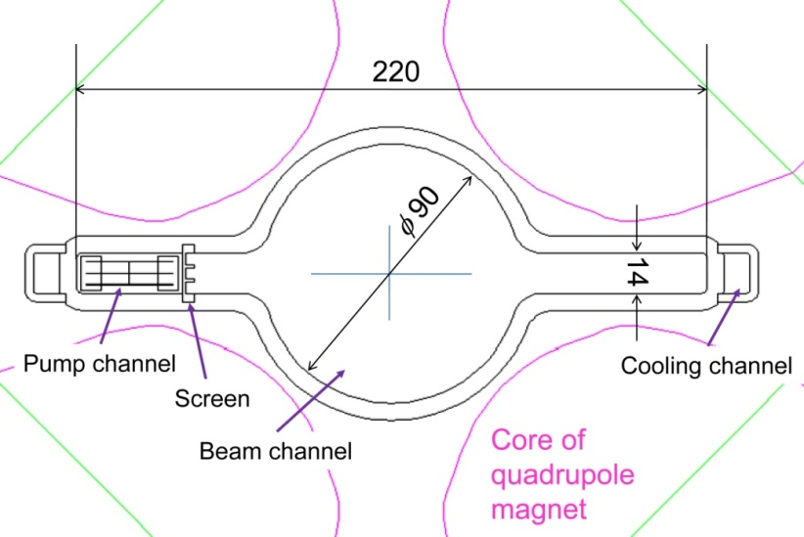
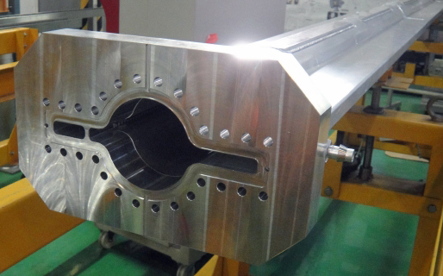
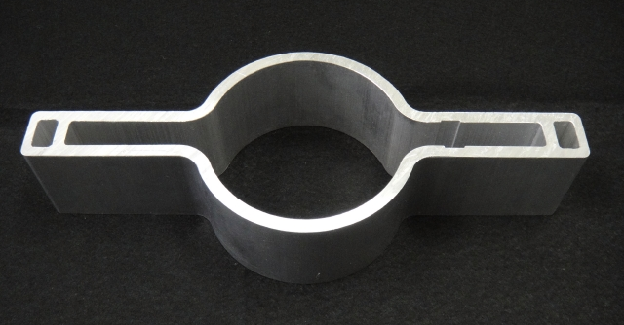
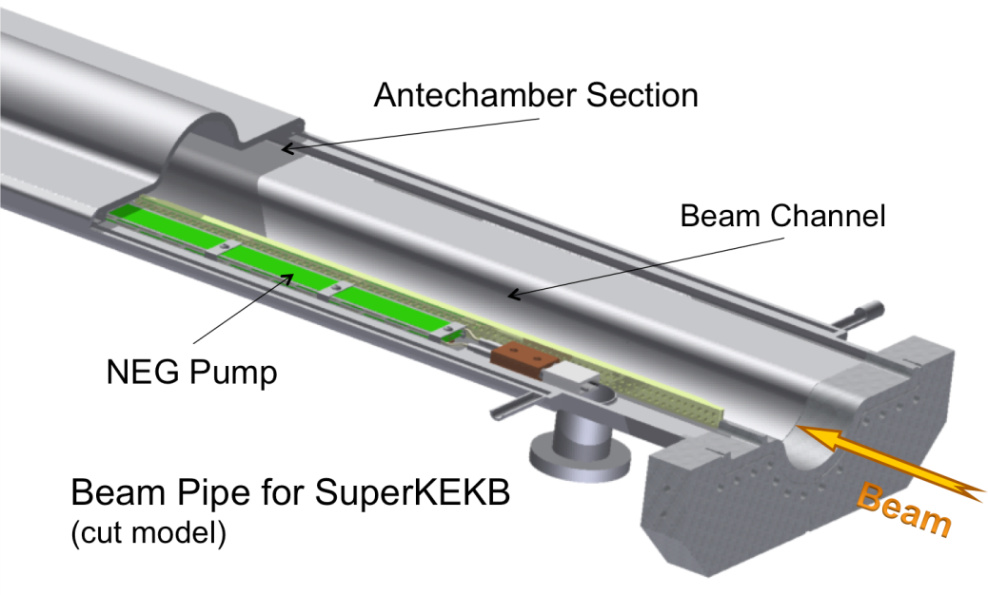
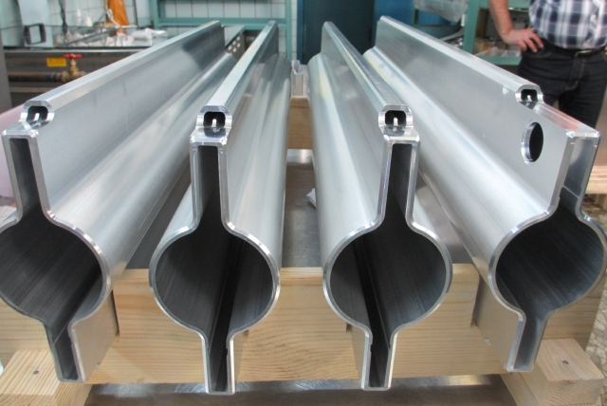
Beam pipes for arc section _1
Beam pipes with antechambers
  Small effect of photoelectrons, low beam impedance, low SR power density at side wall
  To be fit to the existing magnets.
  Same cross section for flanges.
Aluminum alloy is available for arc section
  Extrusion method
Aluminum (A6063)

Slide 6
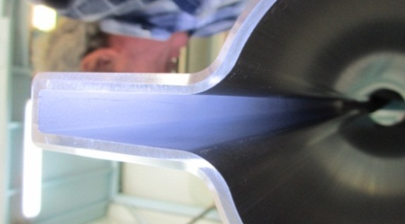
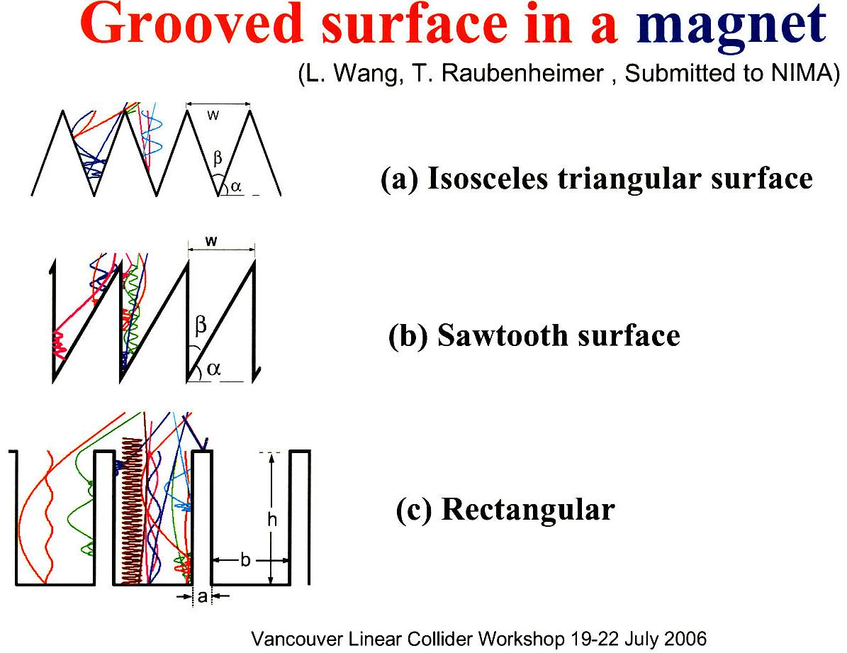
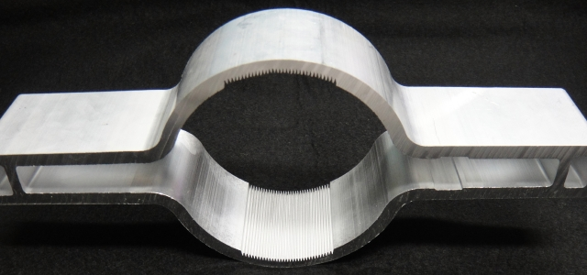
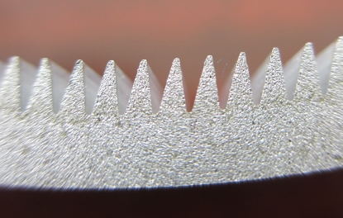
Beam pipes for arc section _2
Rough surface at the side wall
  Suppress the photon reflection
  Ra~20
Grooved surface in bending magnets
  Reduce effective SEY structurally
  Expected reduction of electron density by factors
  Formed by extrusion method
  With TiN coating
B
  (Depth)
Valley ：R0.1~0.12
Top ：R0.15
Angle：18~18.3°
  d
  by L. Wang et al.

Slide 7
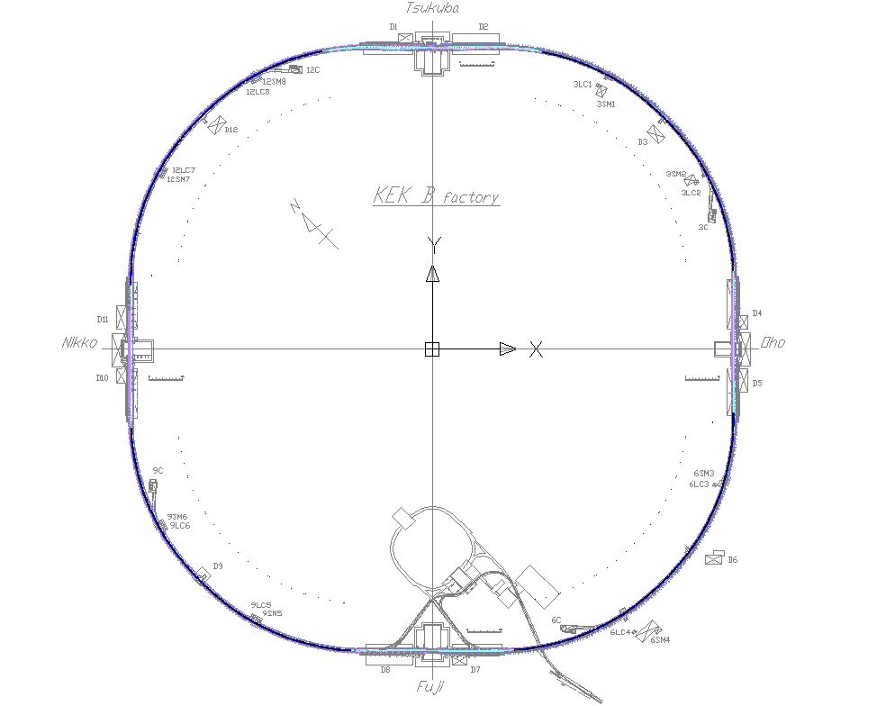
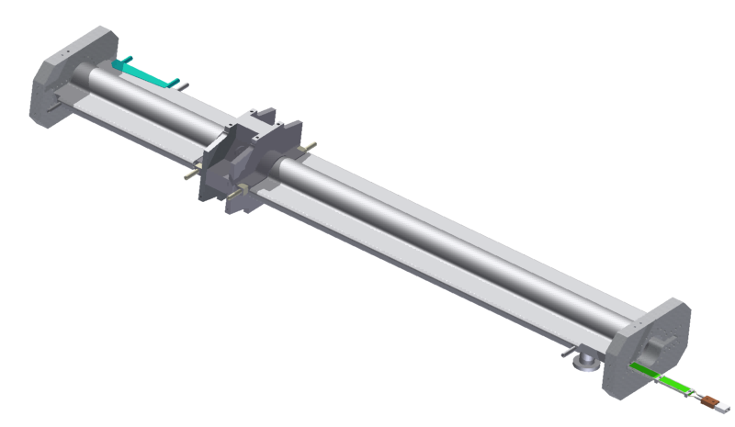
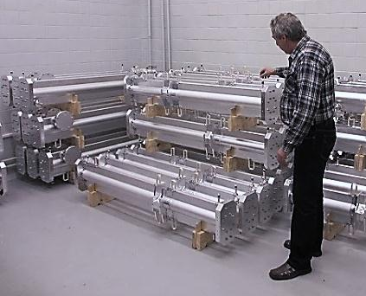
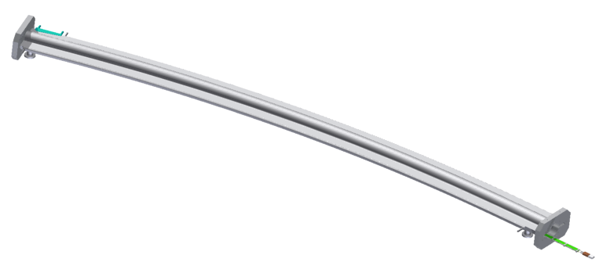
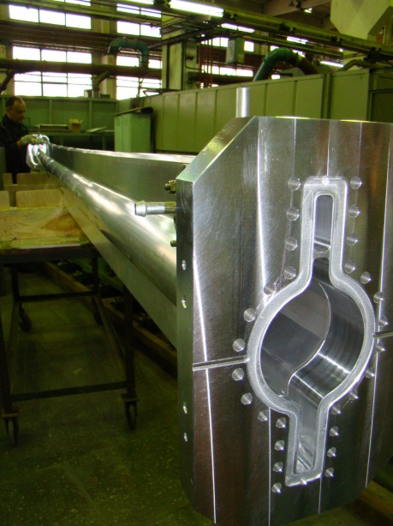
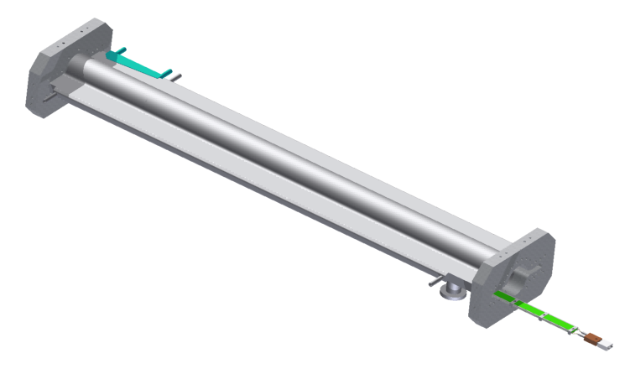
Beam pipes for arc section _3
Production
  Formed with an extrusion method (A6063)
    Aluminum-alloy flange (A2219)
  Type-S, Q and B: 1861 m
  Manufacturing is in progress.
BPM block
Type-Q
ＳＲ Mask
Type-B
Type-S

Slide 8
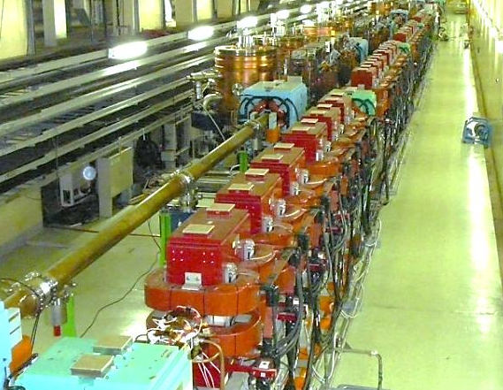
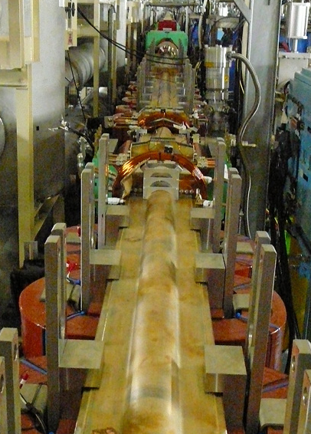
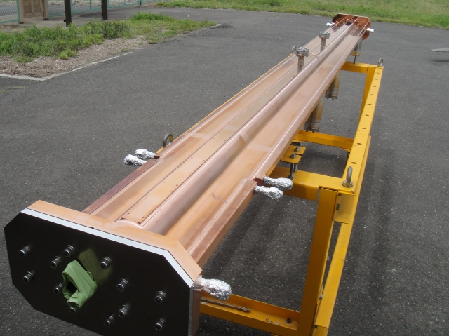
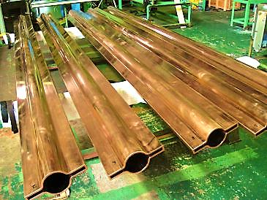
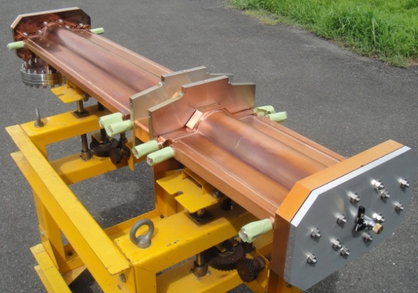
Beam pipes for wiggler section _1
Beam pipes with antechambers
Copper is required due to intense SR power
  Formed by cold drawing method
  Copper alloy flanges (CrCu)

Slide 9
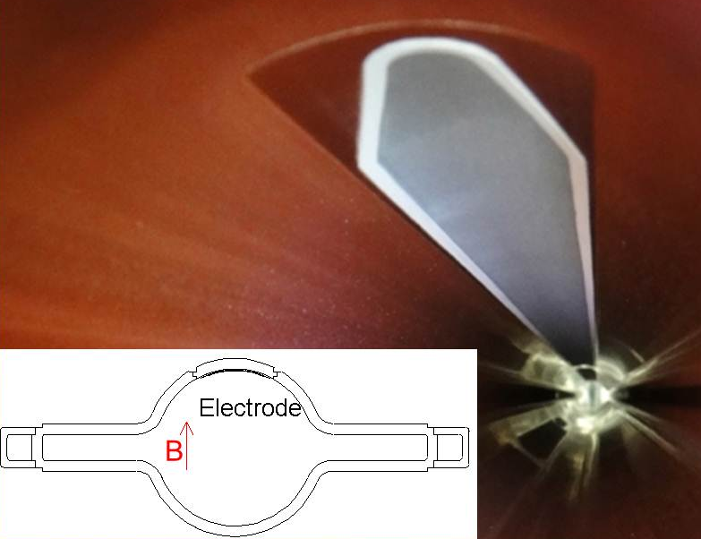
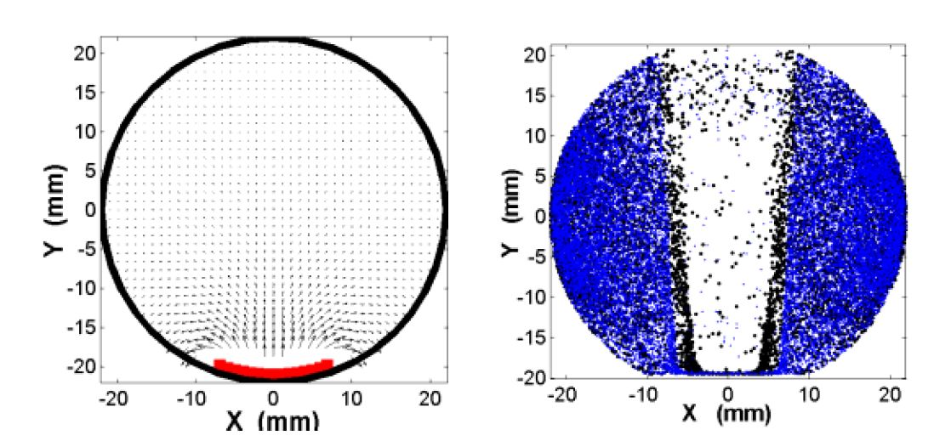
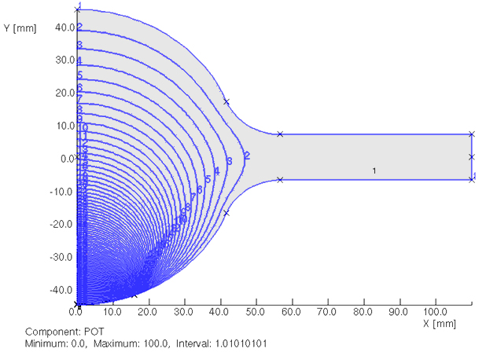
Beam pipes for wiggler section _2
Clearing electrode in wiggler magnets
  Attract electrons by electrostatic field
  Very thin electrode has been developed
  0.1 mm tungsten on 0.2 mm Al₂O₃
  Expected reduction in electron
  density around beam of ~1/100
Electron density
0 V
Beam channel
(φ 90mm)
+75 V
  ~3kV/m
Antechamber
Electrode (+)
L. Wang et al, EPAC2006, p.1489
+500 V

Slide 10
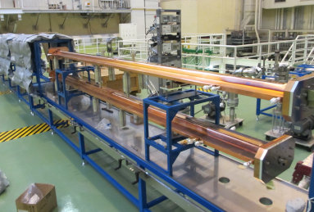
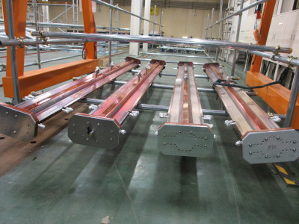
Beam pipes for wiggler section _3
Production
  Nikko and Oho straight section
  Type-S and Q 223 m
  Type-S has two clearing electrodes.
  Type-Q has TiN coating.
  Beam pipes at the downstream of wiggler
  should be also made of copper.

Slide 11
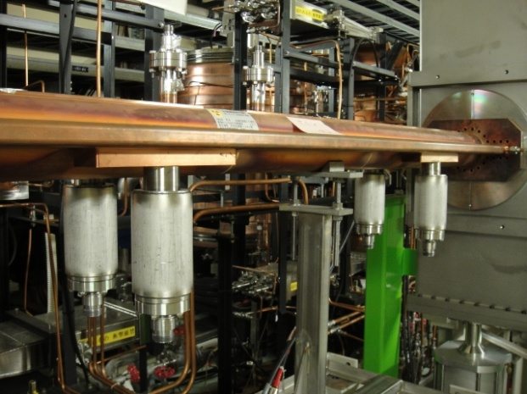
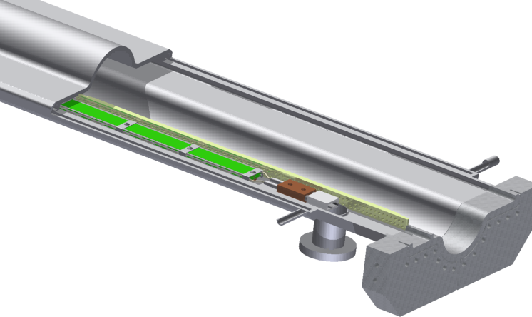
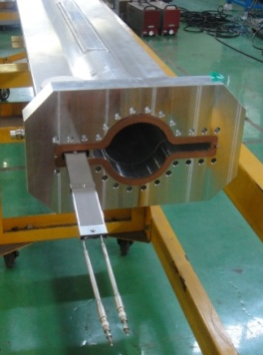
Pumps _1
Main Pump: NEG strips
Arc: Inserted in one of antechambers (inside of the ring)
  Distributed pumping system
  Effective pumping speed of ~ 80 l/s/m.
Straight: Lumped pump ports at both antechambers
Ion pumps: Placed every 10 m as an auxiliary pump
Straight Section (Wiggler)
NEG strip
Feed-through

Slide 12
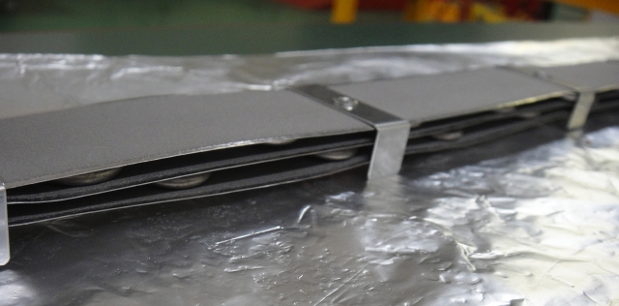
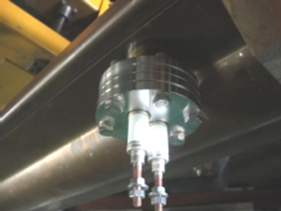
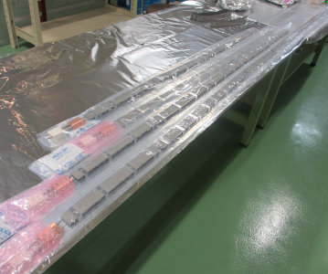
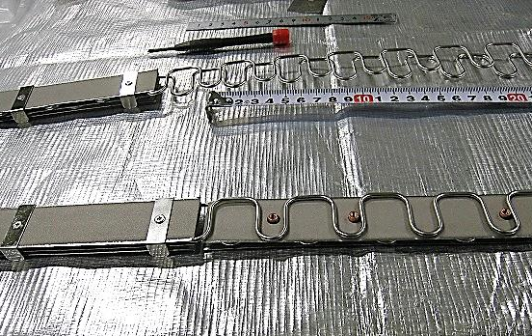
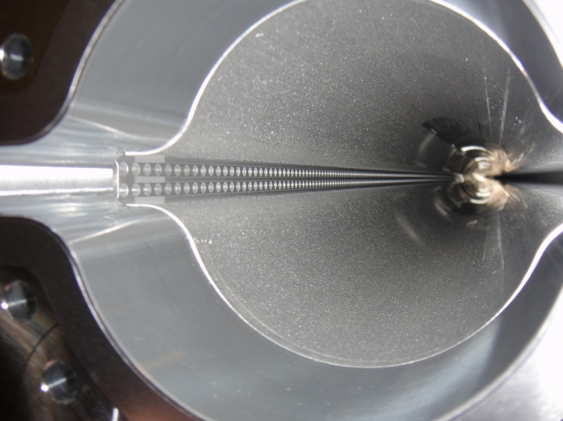
Pumps _2
Production
  Three layers of NEG strips “ST707 3D”
  Activated by micro-heaters (sheath heaters)
  Screens between pump and beam (φ 4 mm)
  NEG strips (3m x 2400 pcs.), Heaters (1070 pcs.), transformer (1105 pcs.), Feed-though (950 pcs.)
Arc Section

Slide 13
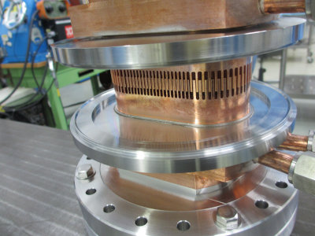
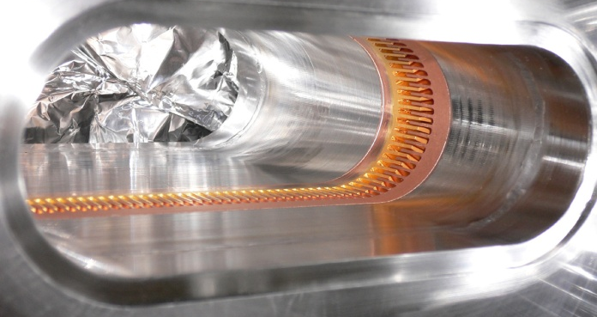
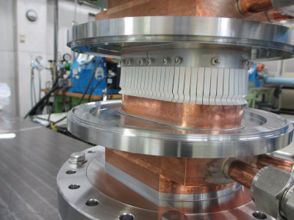
Bellows chambers and gate valves _1
Bellows and gate valves with comb-type RF-shield
  Sure RF shielding, thermally strong
  Applicable to antechamber scheme
  Finger-type for some cases, if flexibility is required.

Slide 14
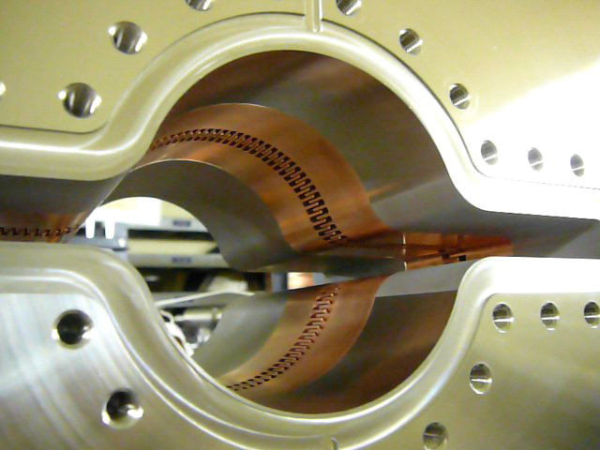
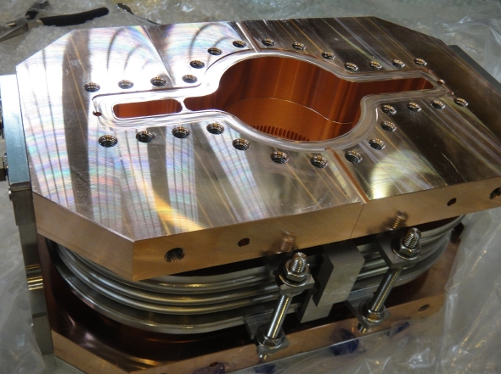
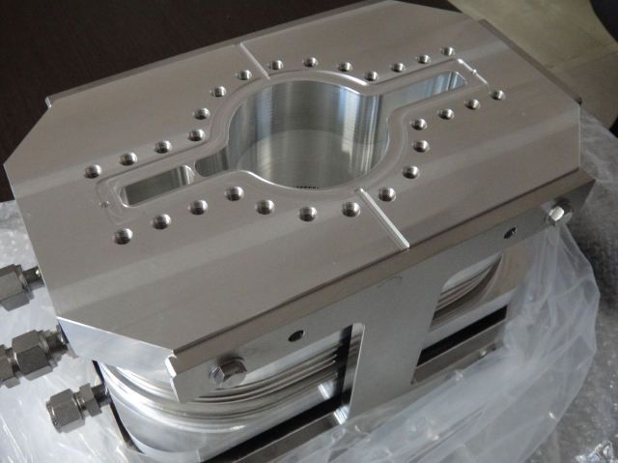
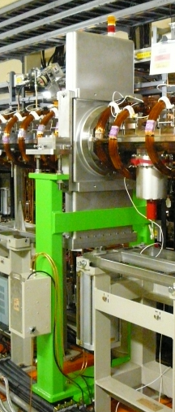
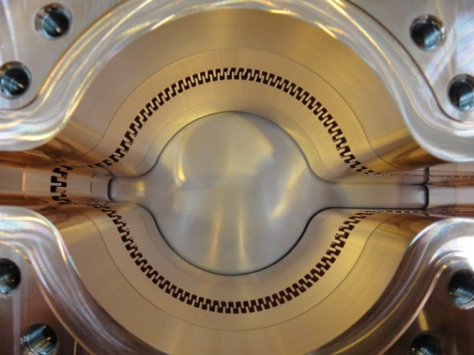
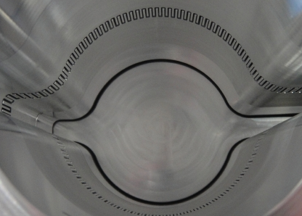
Bellows chambers and gate valves _2
Production
Bellows chambers
  Aluminum alloy for arc section (690)
  Copper for wiggler and straight section (125)
Gate valves 24
  Stainless steel (Ag coating)+ Comb shield (copper)
Copper bellows chamber
Aluminum alloy bellows chamber
Inside
Inside

Slide 15
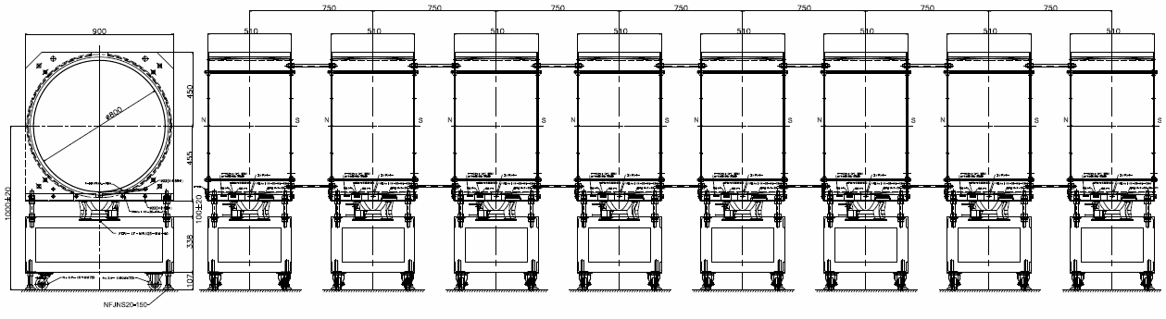
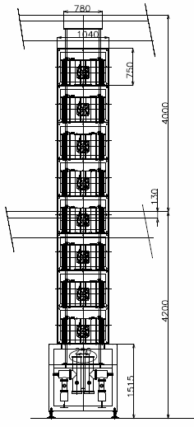
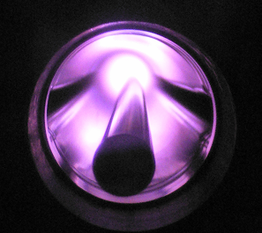
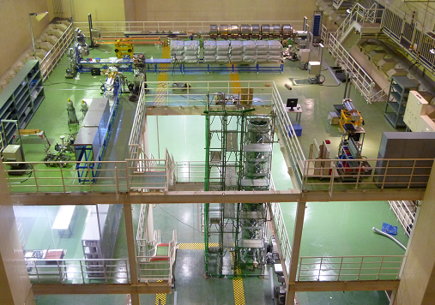
TiN coating system _1
TiN coating in KEK, followed by pre-baking
  Magnetron sputtering
  5 sets for Q and S-types, and 2 sets for B-types
Construction is in progress.

