Slide 1
Physics Summary at KILC 12
Shinya KANEMURA
University of TOYAMA
KILC12, Daegu, Korea, April 26, 2012

Slide 2
Thanks to all 22 speakers
14 Higgs (EWSB) or Higgs related:
H. Ono, J. Tian, C. Calancha, H. Tabassam,
T. Suehara, K. Tsumura, T. Shindou, M. Peskin,
M. Patra, E. Senaha, Y. Kikuta, K. Yagyu,
T. Nabeshima, O. Stal
6 Others:
R. Katayama, M. Berggren,
B. Vormwald, R. Poeschl & V. Marcel,
R Godbole, S. Choi
Tevatron: P. Grannis
CLIC: F. Simon
11 Experimentalists
11 Theorists

Slide 3
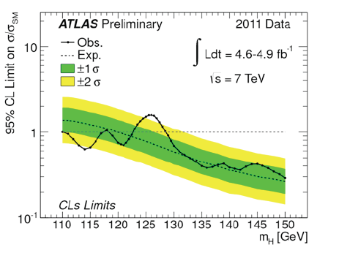
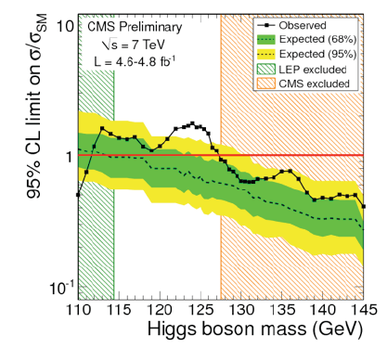
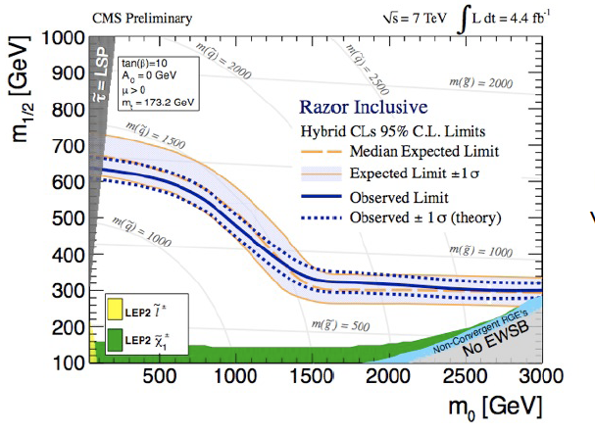
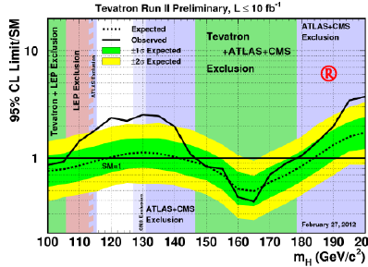
Current Status
Higgs mass is strongly constrained to be around 115-127 GeV
(Higgs around 125 GeV ?)
No new (colored) particles found below about 1 TeV
Data consistent with SM
[T.J. Kim]
[Grannis]
Victory of our Standard Model?

Slide 4
Why still new physics?
We all know the SM must be replaced by a model of new physics beyond the SM
Reasonable motivations for BSM
Theoretical
  Unification, Hierarchy, Flavor symmetry, …
Empirical
  Neutrino Mass & Mixing, Dark Matter, Baryon Asymmetry of the Universe, …
All of them cannot be explained in the SM

Slide 5
Beyond the SM?
???
Grand Unification
History tells us unification of low in the nature
Unification is GOAL
We are still on the way to the unification
It must be…
SM
EW theory
QCD
Electromagnetic Force
Weak force
Strong force
Electric
Force
Magnetic
Force
Light
Gravity

Slide 6
Beyond the SM?
Established
Phenomena
Beyond the SM
Baryon Asymmetry
DM
ν-Mass
……
Not connected
Standard Model

Slide 7
Beyond the SM?
SUSY
Little Higgs
Dynamical
Extra D
Extended-Higgs
Extra gauge
Vector like
……
Established
Phenomena
Beyond the SM
New physics
Baryon Asymmetry
DM
ν-Mass
……
Standard Model

Slide 8
SM must be replaced

Slide 9
Where is it ?
TeV scale? -------------------- Planck Scale?
Terascale?
Hierarchy Problem (Be just above the EWSB scale!)
  Λ = 1 TeV mild fine tuning
  10 TeV more fine tuning
  10¹⁶ GeV huge fine tuning
Dark Matter
  WIMP hypothesis: m_{DM} = 1GeV - 1 TeV
NP candidate
SUSY
Little Higgs
Dynamical
Extra D
……

Slide 10
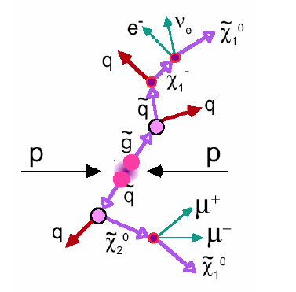
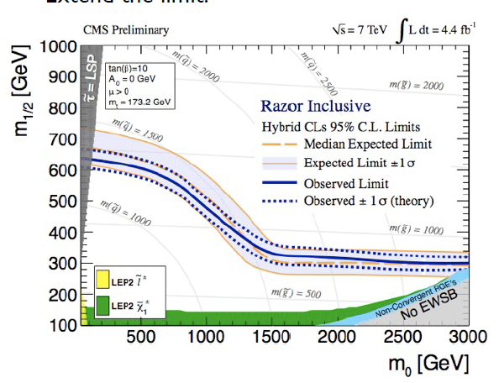

LHC tells us about SUSY
CMSSM
Produce via QCD process:
gluinos, squarks
Signal:
JETs+MET(+leptons)
No signal found up to now
[Tae Jeong Kim]
Excluded up to ~ 1.35 TeV for m(squark)= m(gluino)

Slide 11
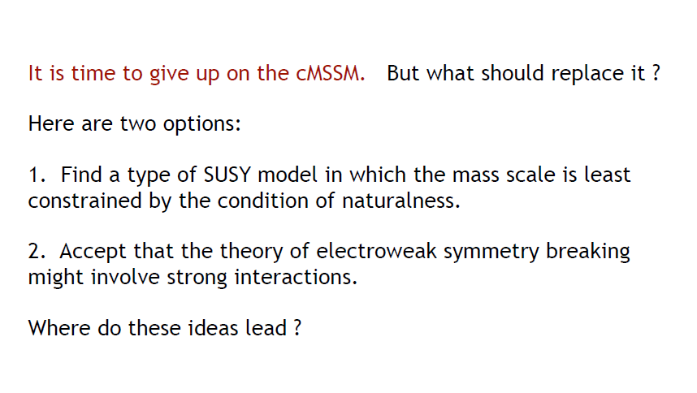
CMSSM (MSUGRA) is in trouble
Michael Peskin, Summary Talk at LP11, Aug 2011

Slide 12
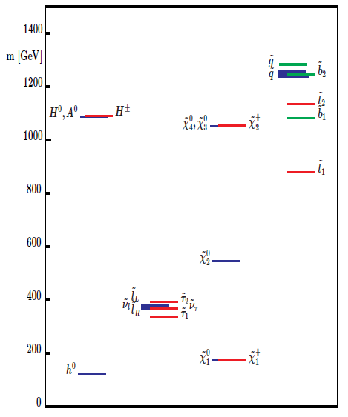
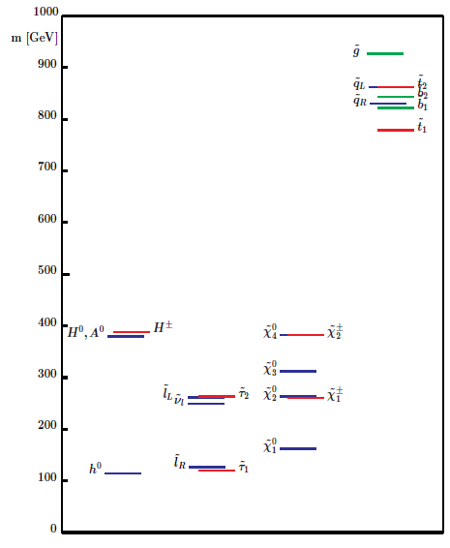
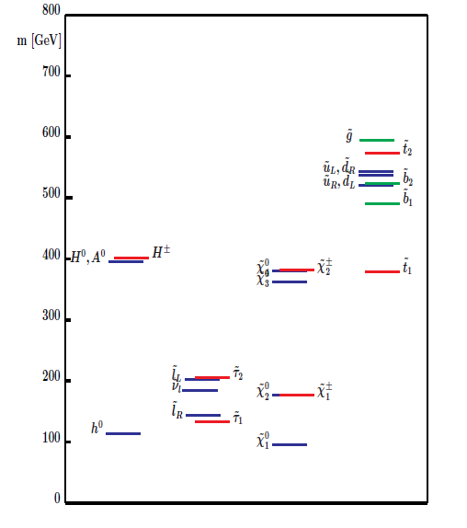
Colored sparticles are constrained from below by LHC
We need mass splitting between the colored sector and the uncolored sector
Typical AMSB
scenario
Colored
Typical GMSB
scenario
Typical CMSSM
scenario
Colored
Colored
ILC 1000
Sleptons
Sleptons
Sleptons
S. Heinemeyer

Slide 13
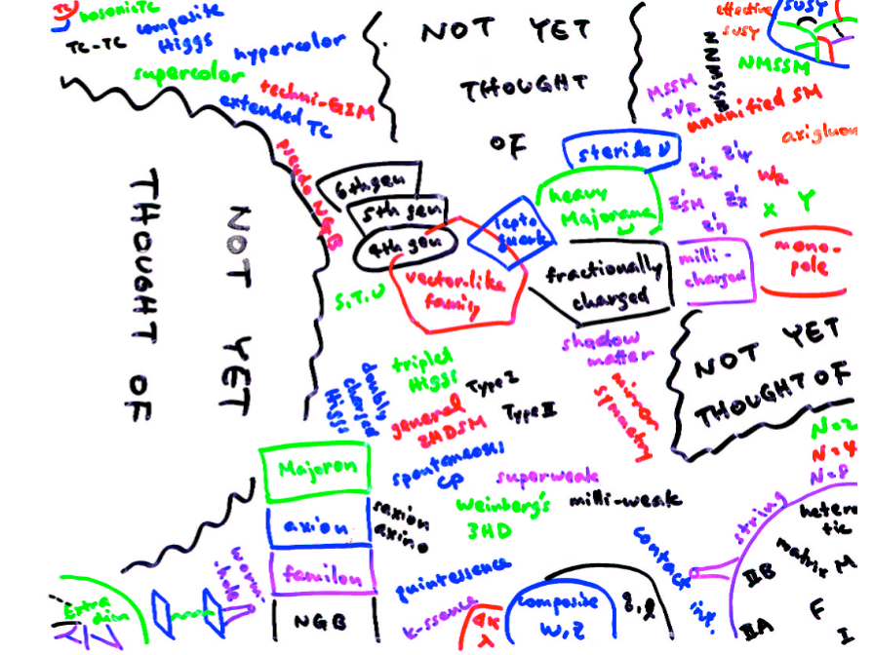
New Physics Paradigm
H. Murayama

Slide 14
What is the point?
It should be O(1) TeV, but …
Whether the mass of a new particle is 300 GeV, 500 GeV, 1 TeV, or even 3 TeV strongly depends on the model
This would be a serious situation from the experimental view point, especially in designing future colliders
Surely we need luck

Slide 15
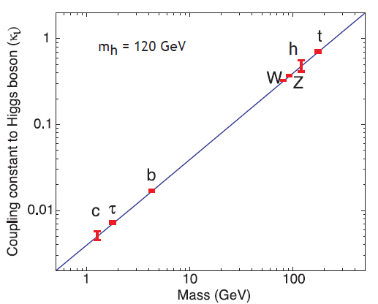
Solid target is the Higgs sector
“Higgs” is really the origin of mass?
Incomplete part in the SM
  Gauge interaction is beautiful, but
  The SM Higgs has no principle (ugly!)
  Just a guess [Peskin]
  Various possibility for (extended) Higgs sectors
Current data strongly suggest that the Higgs boson is a light (SM-like) Higgs boson
  Notice that SM-like ≠ SM !

Slide 16
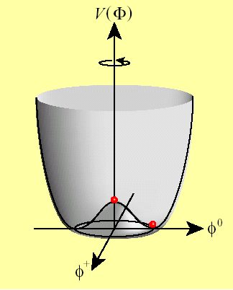
SM Higgs
SM Higgs
m_{h}: free parameter
Hint for the Higgs dynamics
  Light Higss ⇔ Weakly interacting
  Heavy Higgs ⇔ Strongly coupled
V(φ)=－μ²|φ|²＋λ|φ|⁴
m_{h}² = 2 λ v²
Higgs dynamics determines
the nature of EWSB
But the SM Higgs sector has no principle !!

Slide 17
Higgs and New Physics
What is the essence of the Higgs field?
  Elementary Scalar?
  Composite?
  Pseudo NG Boson?
  A gauge field in Extra D?
  ……
Higgs nature ⇔ New Physics scenario
Supersymmetry
Dynamical Symetry Breaking
Little Higgs
Gauge-Higgs unification
……
Each model has a specific Higgs sector
Higgs sector = Window to new physics

Slide 18
Extended Higgs sector
If the Higgs sector contains more than one scalar bosons, possibilities would be
  SM Higgs doublet + Extra singlet
  SM Higgs doublet + Extra doublet
  SM Higgs doublet + Extra triplet
  ….
Nabeshima
Tsumura
Yagyu

Slide 19
Higgs dynamics
There are possibilities
(1) Light (125GeV) Higgs
with weakly interacting
(2) Light (125GeV) Higgs
with strongly coupled
T. Shindou
Standard SUSY models,
Gauge-Higgs Unification
If there is the principle for m_{h}² ≠ λv² then
Higgs as pseudo scalar
(Little Higgs, Holographic Higgs, … )
SUSY with extra Chiral superfields
Electroweak Baryogenesis
How we distinguish ?
Precision measurement of h !!
M. Patra, Y. Kikuta、E. Senaha

Slide 20
Decoupling/Non-decoupling
Decoupling Theorem
Appelquist-Carazzone 1975
New phys. loop effect in observables
1/M^{n} → 0 (decouple for M→∞)
Violation of the decoupling theorem
  Chiral fermion loop (ex. Top, 4th gen. )
  m_{f} = y_{f} v
  Boson loop (ex. H⁺ in non-SUSY 2HDM)
  m_{φ}² = λ_{i} v² + M² (when λv² > M²)
TeV
New Particle
100GeV
h
Non-decoupling effect

Slide 21
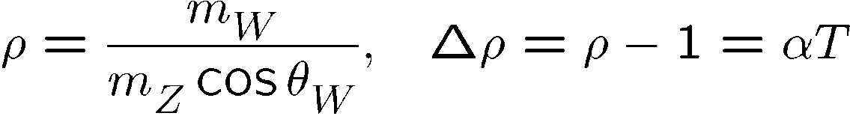
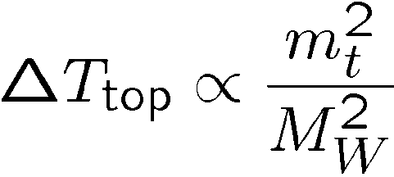
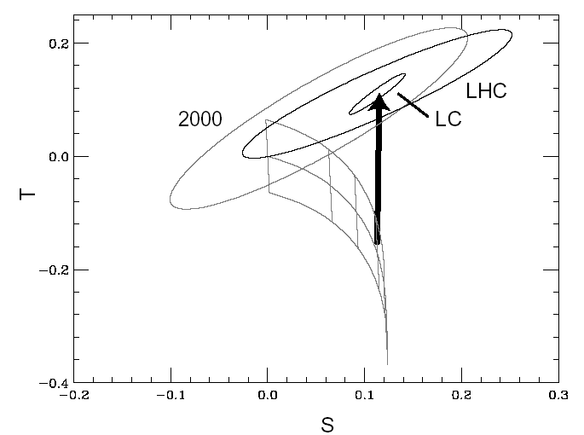
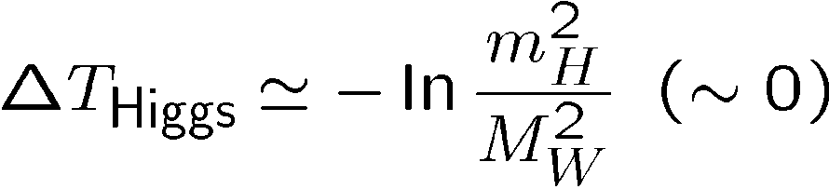
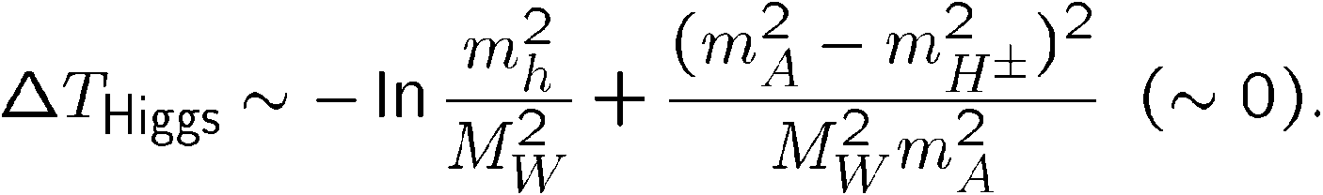
Non-decoupling effect
t
Example (Electroweak T parameter)
W, Z
t
W,Z
H
Data |T| < 0.1
W, Z
W, Z
W, Z
(SM )
Extra Higgs
Contribution
mh=100
300
(2HDM)
500
Quadratic mass contribution
(non-decoupling effect)

Slide 22
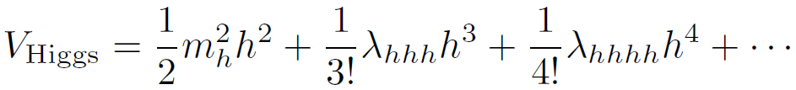
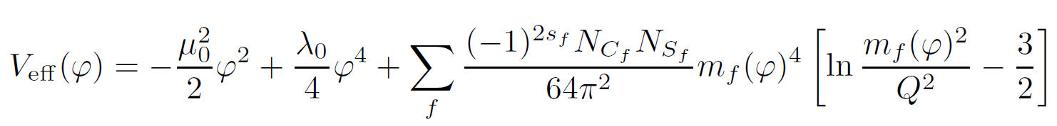
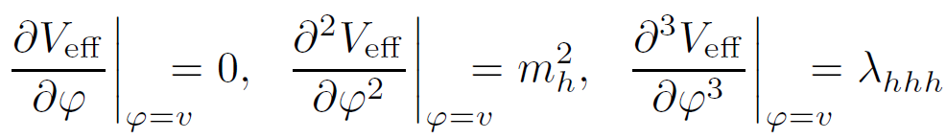
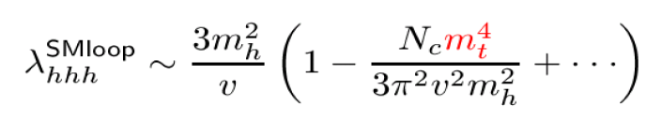
Higgs potential
To understand the essence of EWSB, we must know the self-coupling in addition to the mass independently
Effective potential
Renormalization
Conditions
SM Case
Non-decoupling effect

Slide 23
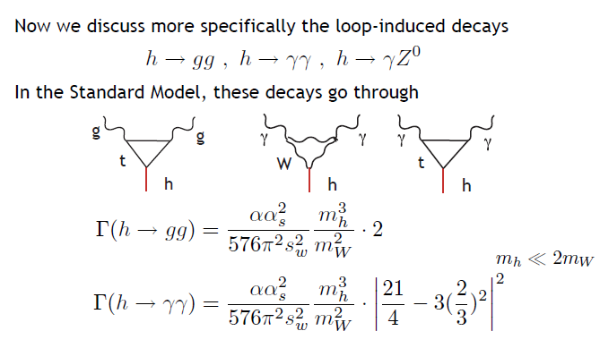
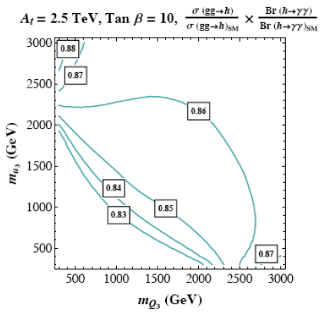

Non-decoupling effect
h → gg (loop induced)
h → γγ (loop induced)
Logarithmic non-decoupling effect can give O(10)% corrections (ex. Extra scalars)
In these vertices (esp. gg), the effect of vector-like particles can also be relatively large (5-10 % level)
These effect probably cannot be seen at the LHC but will be visible at the ILC
[Peskin]
MSSM

Slide 24
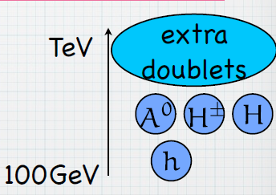
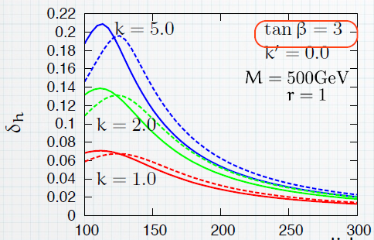

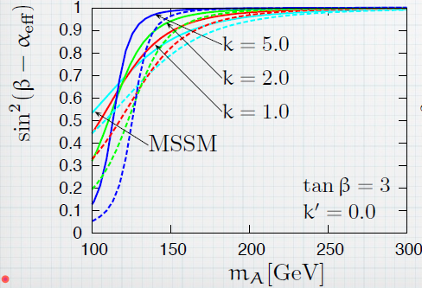
Extended Higgs sector
SUSY 4HDM (Shindou)
  Quasi-nondecoupling effect due to the B-term between the first two doublets and the rest two.
  Deviation from the MSSM predictions can be significant
  O(10) % deviation (mh, hVV)
Higgs Triplet model (Yagyu)
  Type Ⅱ Seesaw model
  At tree, ρ ≠ 1.
  Study of radiative correction
  Prediction on hγγ (-40%) and hhh (>20%)

Slide 25
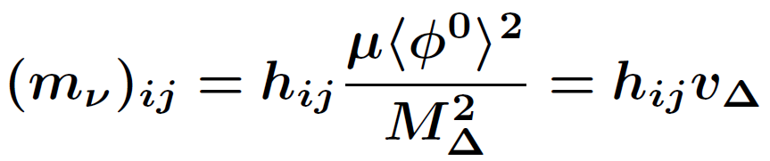
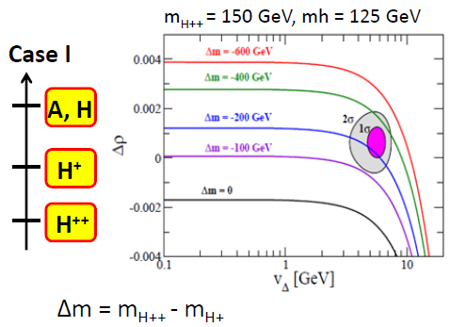
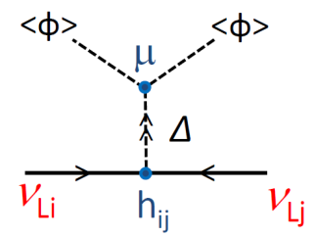
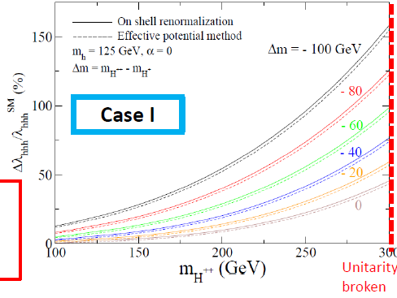
Extended Higgs sector
SUSY 4HDM (Shindou)
  Quasi-nondecoupling effect due to the B-term between the first 2 doublet and the rest 2.
  Deviation from the MSSM predictions can be significant
  O(10) % deviation
Higgs Triplet model (Yagyu)
  Type Ⅱ Seesaw model
  At tree, ρ ≠ 1.
  Study of radiative correction
  Deviation in hγγ (>10%) and hhh (>20%)

Slide 26
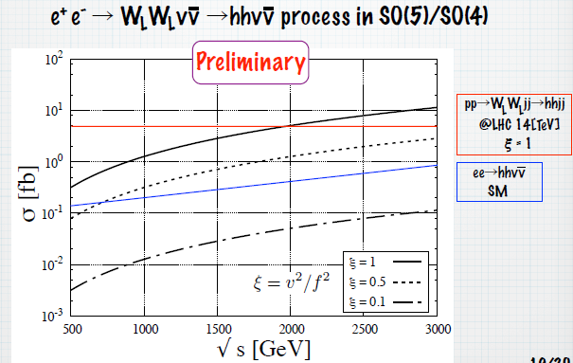
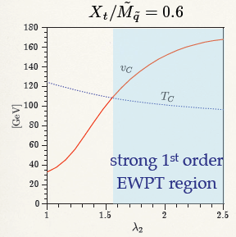
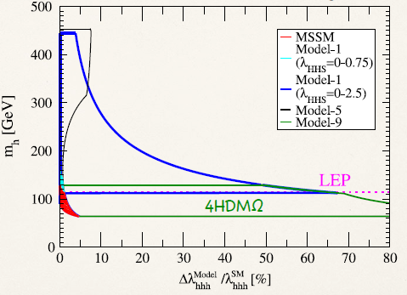
Extended Higgs sector
Strongly interacting light Higgs (pseudo NG) with N-doublets [Kikuta]
  Collider physics underway
New SUSY extended Higgs model for Electroweak Baryogenesis [Senaha] (4HDM+Ω(charged singlets))
  A 125 GeV Higgs with the strong coupling of the new F-term
  Strongly 1st Order Phase Transition realized by non-decoupling effect
  Prediction on hhh (>40% deviation from the SM prediction)
  Connection between Higgs physics and Cosmology!
  W_{L}W_{L} → W_{L}W_{L}, Z_{L}Z_{L}, hh, HH, AA, …

Slide 27
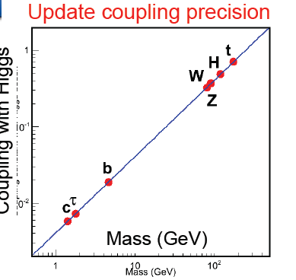
Higgs coupling measurement
For model descrimination, theorist requires
1 % level precision for
hWW, hZZ, hττ, hbb, hgg, hγγ
10 % level for hhh, htt
LHC cannot attain such accuracies…
We do hope that LC can reach

Slide 28
Higgs coupling measurement
Simulation Studies
Higgs branching ratio [Ono]
E_{cm}=250 GeV, L=250fb⁻¹
Higgsstrahlung (ZH)
WW*→4q, lνqq
HWW coupling (Tian)
E_{cm}=500GeV, L=500 fb⁻¹, W-fusion
Δg/g~1.4%, ΔΓ/Γ~5%
W polarization can also be measured
Hγγ coupling [Calancha]
Ecm = 250 GeV, L=250 fb-1
Challenging, Underway for DBD
ΔBr/Br~8%

Slide 29
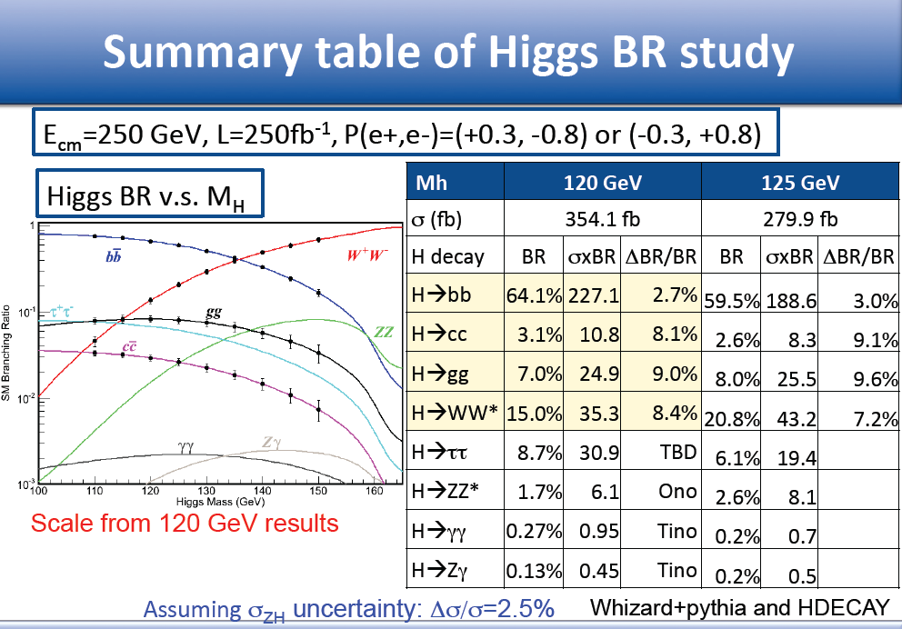
Slide by Ono

Slide 30
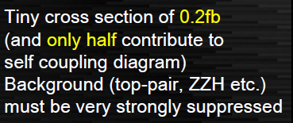
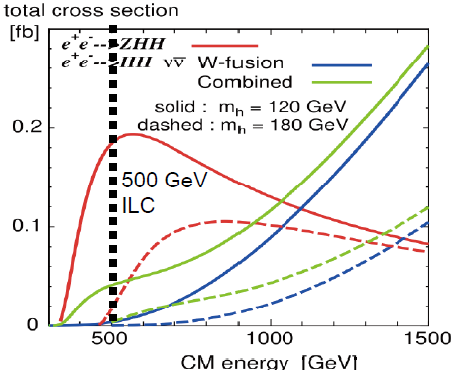
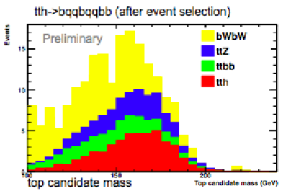


Higgs coupling measurement
Simulation Studies
Higgs self-coupling (hhh) [Suehara]
E_{cm} =500GeV, L=500fb⁻¹
HHZ coupling sensitivity 57% (2011)
Under Improvement by developing
jet clastering, vertex finder,… toward DBD
Top Yukawa coupling [Tabassam]
E_{cm} =500GeV (1 TeV), L=1 ab⁻¹
Full simulation undeway toward DBD

Slide 31
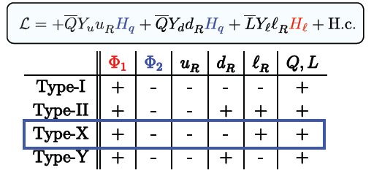
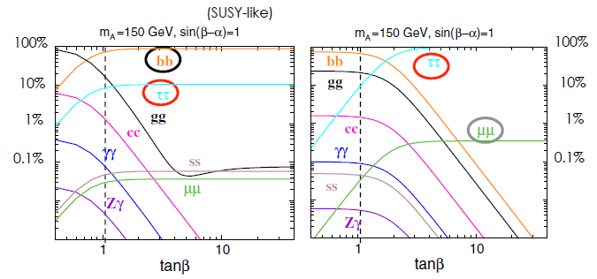
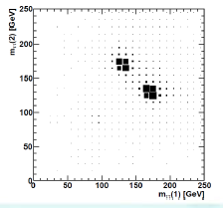
Direct searches of additional scalars
Leptophilic (type X) 2HDM [Tsumura]
For neutrino mass, dark matter, …
Discussed difference from MSSM-like (type II) 2HDM
HA production at LHC vs ILC
HA → 4 tau signal
Simulation study
  At LHC endpoint analysis
  At ILC invariant mass analysis with colinear approx.
  Direct probe of the pair production

Slide 32
Outlook
A light Higgs boson seems suggested from current data
No new particle has been found yet
(We do not know the scale where new particle appears)
Where we go?
  SM Higgs has no principle, but nature seem to suggest “SM-like” Higgs boson (SM-like ≠ SM)
  various possibilities for extended Higgs
Higgs sector can be reached at the LHC
But precision measurement of the Higgs sector will be possible only at LC Higgs factory (0.25-0.5 TeV)
Energy extension to 1 or muliti-TeV (hhh, htt)
Higgs as a probe of new physics

Slide 33
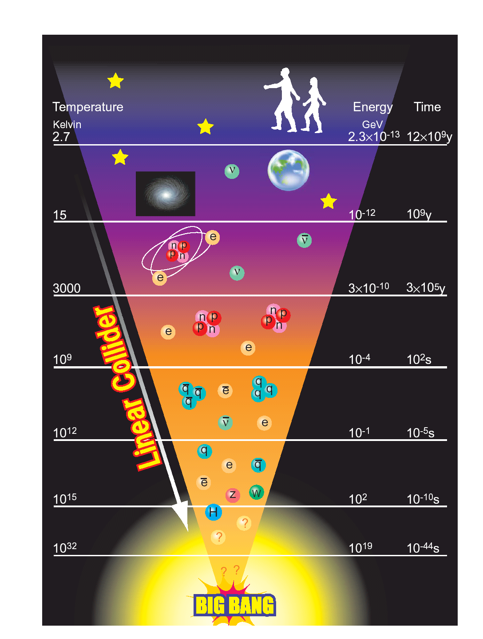
Thank you for all the speakers again!
S. Choi, P. Grannis, F. Simon, H. Ono, J. Tian, C. Calancha, H. Tabassam, T. Suehara,
K. Tsumura, T. Shindou, M. Peskin, M. Patra,
E. Senaha, Y. Kikuta, K. Yagyu, T. Nabeshima, O. Stal, R. Katayama, M. Berggren,
B. Vormwald, R. Poeschl & V. Marcel,
R. Godbole
We need LC
Thank you very much

