Slide 1

Progress of SiD Towards the DBD
Tim Barklow
SLAC
for the SiD Concept

Slide 2
Overview
Introduction - Detector design
- Design Study Organization
Areas of SiD to be included in DBD
Area-by-area summary for detector components
Simulation/reconstruction, PFA
Benchmarking
Costs
DBD Editors
Collaboration with CLIC on DBD

Slide 3
The SiD Design
A compact, cost-constrained detector designed to make precision measurements and be sensitive to a wide range of new phenomena.
-> Compact design with 5T field.
-> Robust silicon vertexing and tracking system – excellent momentum resolution, live for single bunch crossings.
-> Calorimetry optimized for jet energy resolution, based on a Particle Flow approach, “tracking calorimeters”, compact showers in ECal, highly segmented (longitudinally and transversely) ECal and HCal.
-> Iron flux return/muon identifier – component of SiD self-shielding.
-> Detector is designed for rapid push-pull operation.

Slide 4
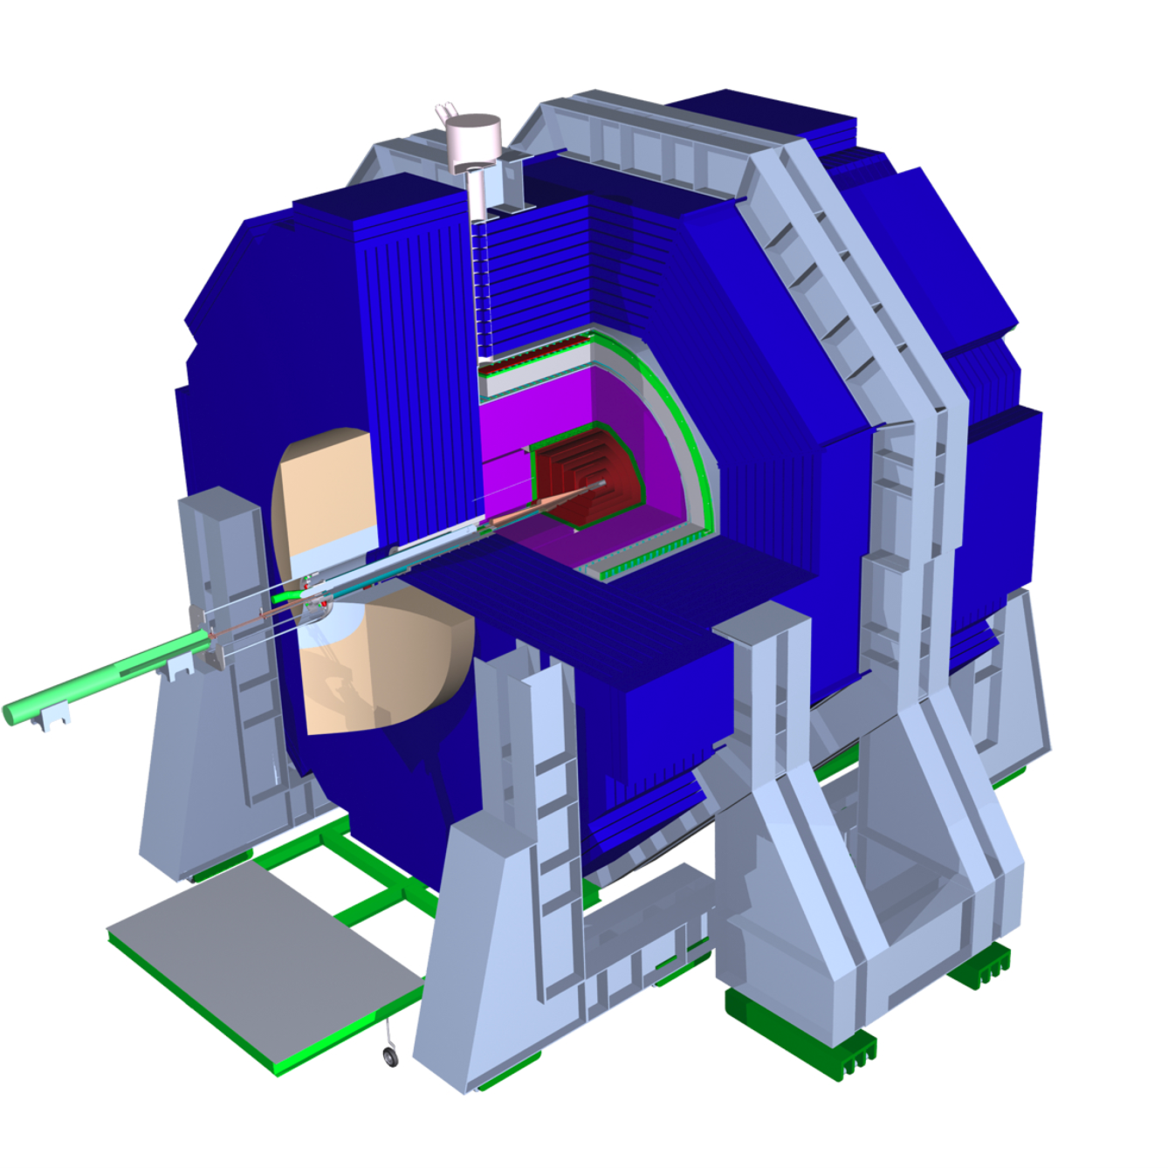
The Silicon Detector Concept

Slide 5
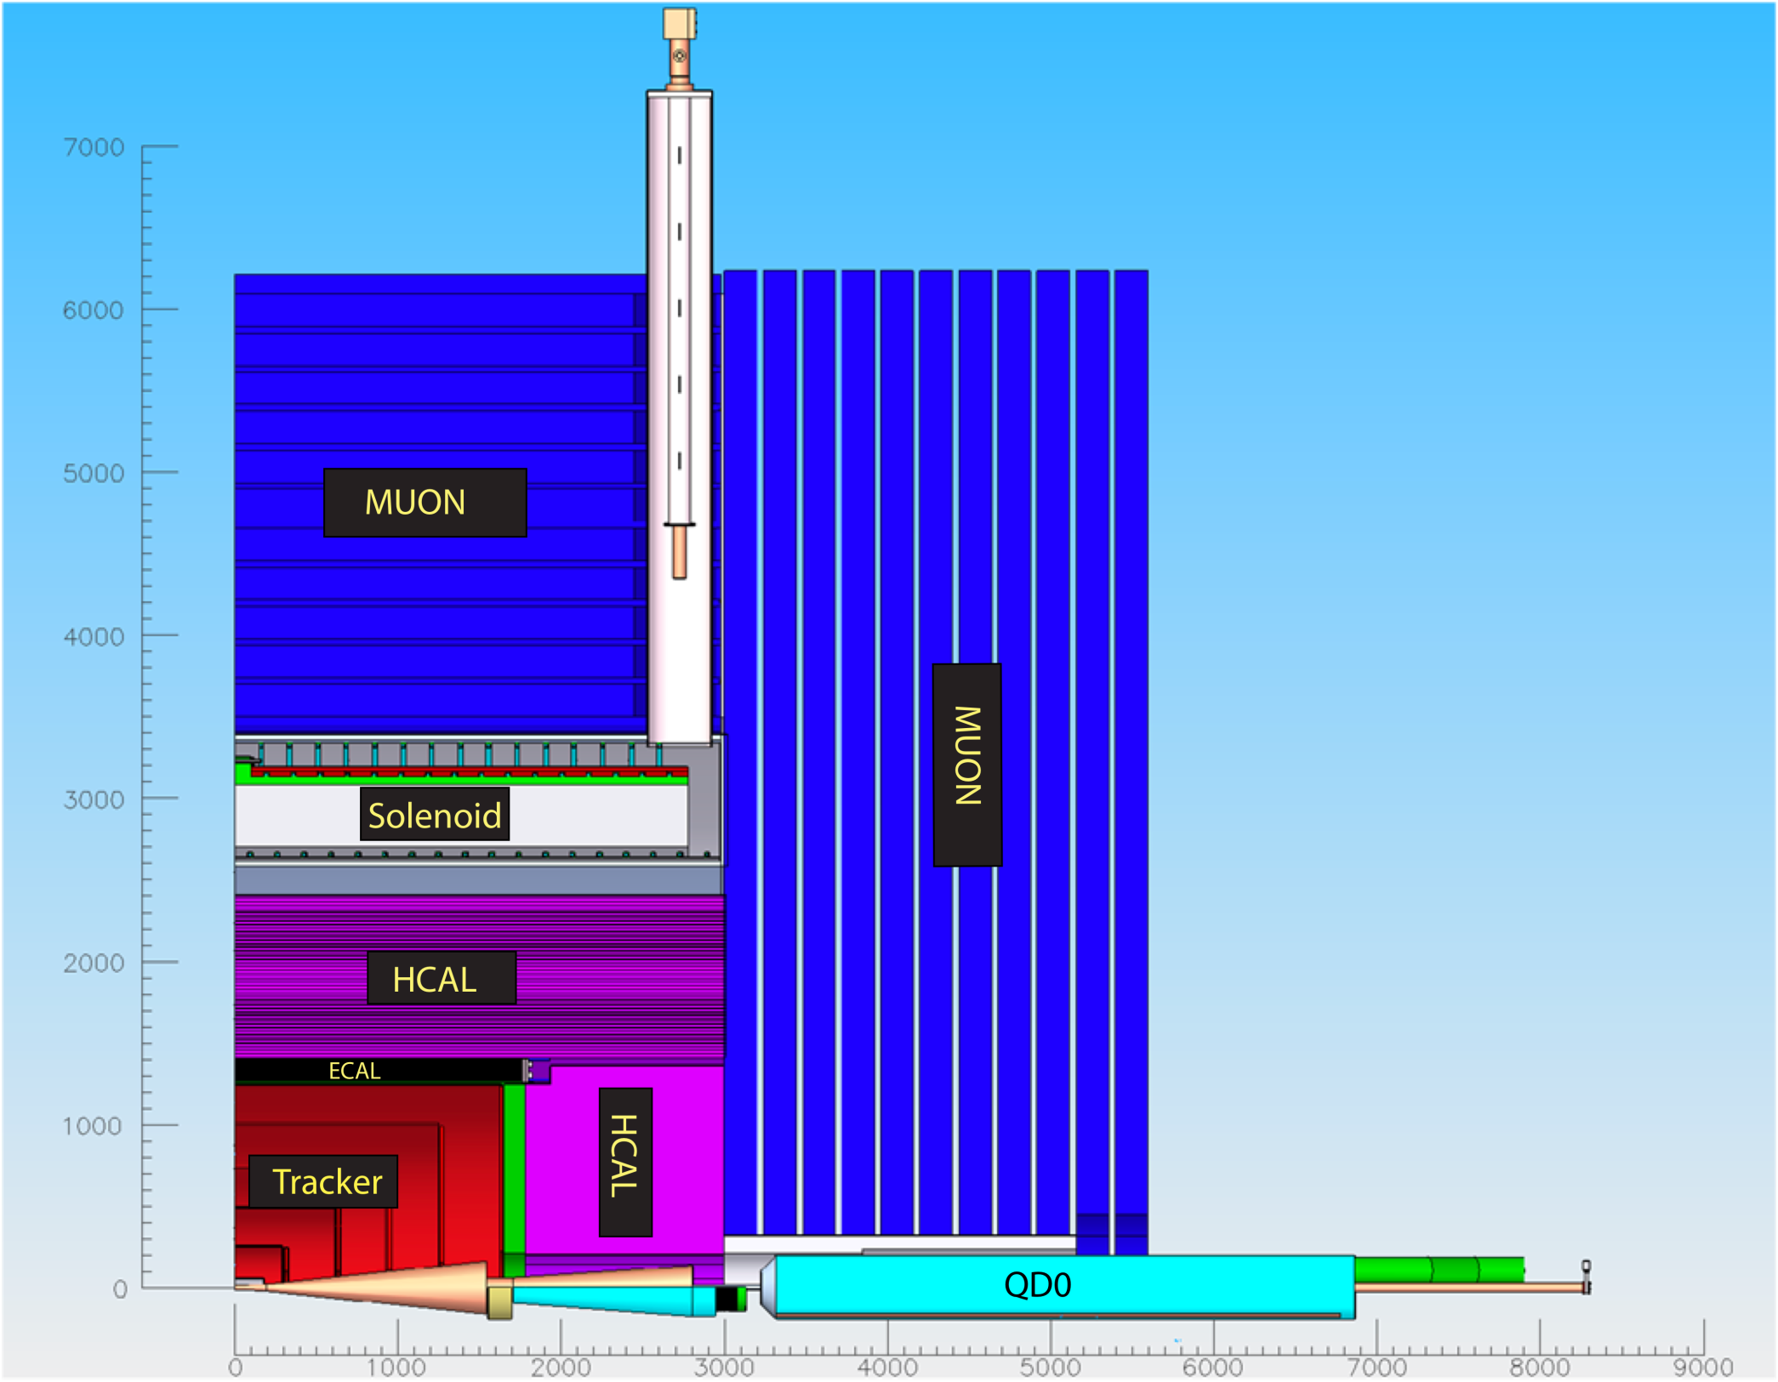
The SiD Detector

Slide 6
SiD Global Parameters

Slide 7
SiD Design Study Organization
SiD DESIGN STUDY COORDINATORS
J. Jaros, H. Weerts, A. White
EXECUTIVE COMMITTEE
H. Aihara, J. Brau, M. Breidenbach, P. Burrows, M. Demarteau,
J. Jaros, J. Karyotakis, H. Weerts, A. White
ADVISORY COMMITTEE
All names on this chart
DBD EDITORS
H.Aihara, P. Burrows, L. Linssen, M. Oreglia,
M. Stanitski,
R&D
A.White, Coordinator
J. Brau, M. Demarteau, co-PIs
VERTEXING
Su Dong
R. Lipton
Mech: W. Cooper
CALORIMETERS
A. White
ECal: R. Frey/M. Stanitzki
HCal: A. White/H. Weerts
PFA: N. Graf/S. Magill
MUON
H. Band
E. Fisk
BENCHMARKING
T. Barklow
A. Nomerotski
COST
M. Breidenbach
ELECTRONICS
G. Haller
SILICON TRACKER
M. Demarteau
R. Partridge
Mech: W. Cooper
SOLENOID
FLUX RETURN
K. Krempetz
W. Craddock
VERY
FORWARD
T. Maruyama
MDI
P. Burrows
T. Markiewicz
M. Oriunno
ENGINEERING
K. Krempetz
M. Oriunno
SIMULATION
N. Graf
-> Current focus on preparation/organization/writing for DBD .
-> Next SiD Workshop: August 21-23@SLAC

Slide 8
DBD - Areas of SiD
Introduction and Philosophy of the SiD Detector Concept
Vertex detector
Tracking detector
E.M. calorimeter
Hadron calorimeter
Muon system
Forward calorimeters
Solenoid
MDI
Simulation/reconstruction/PFA
Benchmarking
Costs

Slide 9
DBD – Summary by Area
Groups/collaborators
System description
Critical R&D and Goals
Key R&D results to date
(not an exhaustive R&D report)
Timeline for R&D
Results anticipated for DBD
Issues and concerns

Slide 10
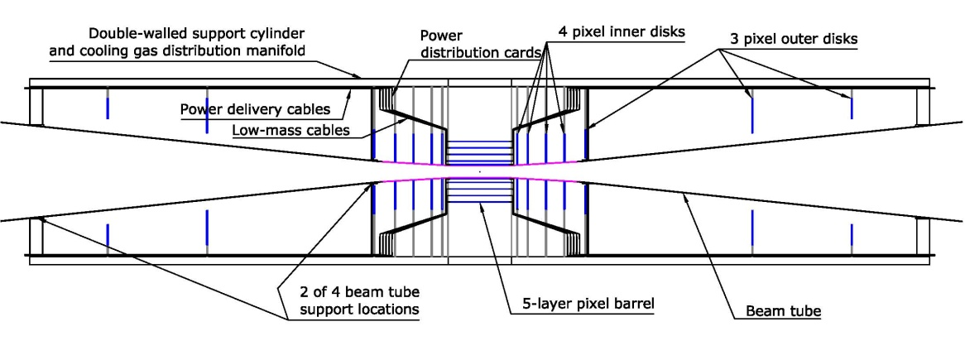







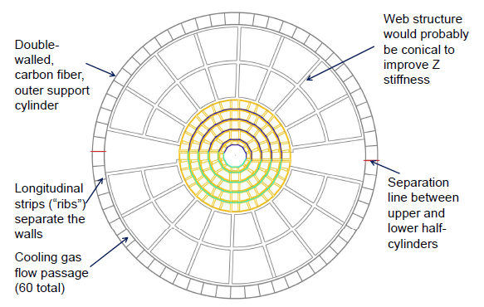
Vertex Detector
Vertex Detector Side Elevation
Participating Institutions:
PLUME, SiLC, Fermilab, SLAC, Cornell U., U. of New Mexico, U. of Oregon, Yale U.
Baseline: Silicon pixels, all-silicon barrel, carbon fiber end rings & support cylinder
Option 1: Silicon on foam sensor support
Option 2: Silicon on carbon fiber sensor support
Option 3: Silicon micro-strip outer disks (vs. pixels)
End view
Bill Cooper (FNAL)
Area of critical R&D/goals
Sensor technology R&D: Incorporate latest developments
Low-mass structures: Demonstrate all-silicon, silicon on carbon fiber, & silicon on foam structures
Power delivery: Develop DC-DC conversion & serial power
Cooling/cabling/vibrations: Fabricate & test R&D structures for vibrations due to air cooling & pulsed power

Slide 11
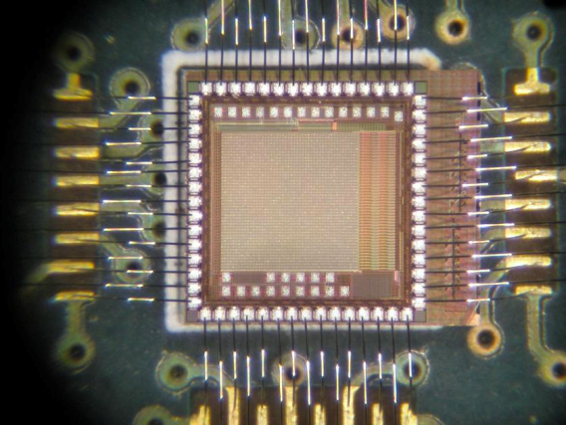
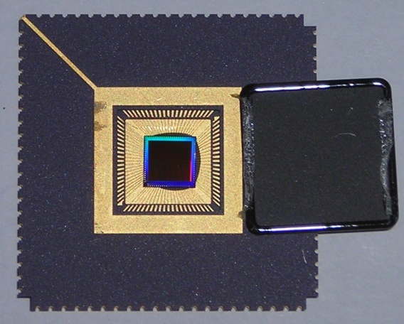
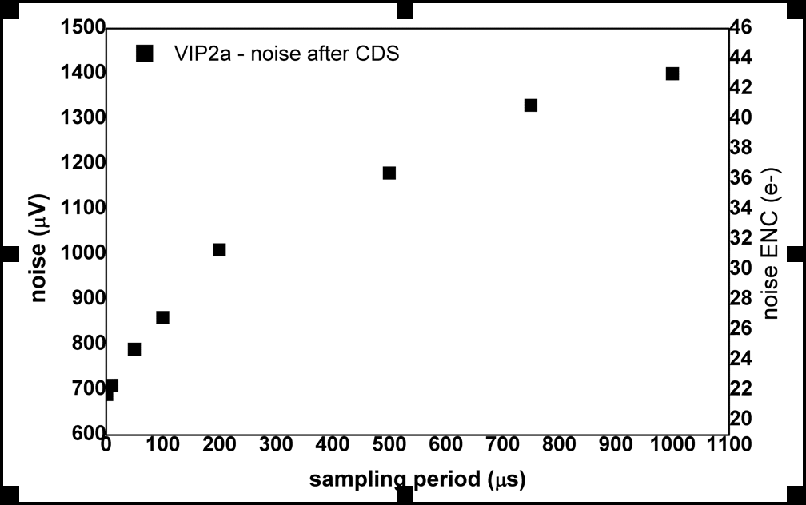
Vertex Detector
Sensor R&D and results to date for 3D and Chronopixel
VIP 2a – 3 tier MIT-LL
VIP 3D chip
VIP
VIP2a (3-tier MIT-LL chip) is produced and tested
Both analog and digital sections work well, solving problems found in VIP1
VIP2b (2-Tier Tezzaron/Global foundries) is in process.
Initial tests of 2D test devices shows good analog performance.
noise = 8e + 0.5 e/ fF
Sensors for 3D integration of VIP2b produced and tested.
18 fF
Chronopixel V1
Chronopixel
Measured noise of 24 e, specification is 25 e.
Sensitivity measured to be 35.7μV/e, exceeding design spec of 10μV/e.
Comparator accuracy 3 times worse then spec, need to improve this in prototype 2.
Sensors leakage currents (1.8·10⁻⁸A/cm²) is not a problem.
Readout time satisfactory
Prototype 2 late 2011, 65nm TSMC
VIP 2b noise.

Slide 12
Vertex Detector
Timeline for R&D
Sensor technology R&D: On-going Chronopixel, 3D prototypes produced
Low-mass structures: Silicon structures of each type have been made; R&D is paused on all structures except silicon on foam, which is progressing well.
Power delivery: R&D is expected to resume in FY2012.
Cooling/cabling/vibrations: R&D awaits power delivery results. B field studies? (Yale)
Results expected for inclusion in DBD
- Conceptual VTX+beam pipe design
Plume low mass ladder results
3D sensor integration with readout (VIP2b chip), Chronopixel tests v2.
CMOS MAPS and DepFET experience in STAR and BELLE
Benefit from parallel work on e.g. CMS Track Trigger Upgrade
Issues/concerns for DBD and beyond
No funding to proceed on support R&D. Expertise, mandrels,…available
Limited ability to consider system aspects of designs
No ability to demonstrate low mass ladder/sensor concepts outside of PLUME work

Slide 13
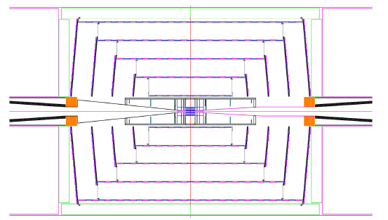
Silicon Tracker
Participating Institutions:
ANL, FNAL, Michigan, New Mexico, Oregon, UC Davis, UCSC
Baseline: silicon tracking; no alternatives considered
First priority R&D:
Development of KPIX chips and associated sensors
Studies of signal to noise and crosstalk
Development of sensors, modules and overall support structures for the barrels and disks
Studies of pulsed power, power delivery, and associated vibrations
Studies of heat removal, particularly from the disks
Studies of alignment precision and monitoring
Second priority R&D:
Studies of alternative sensors and readout to provide z information
Development of cabling
Development of module fabrication techniques

Slide 14
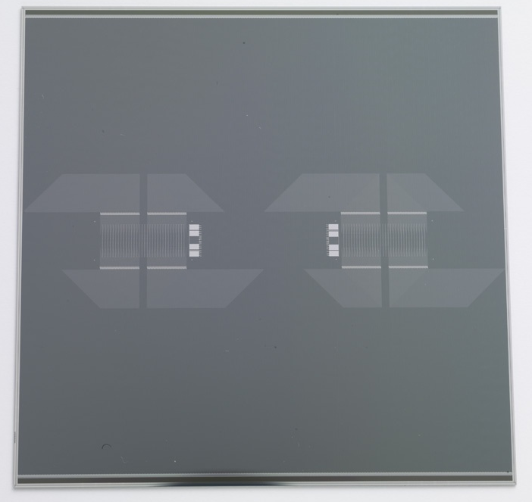
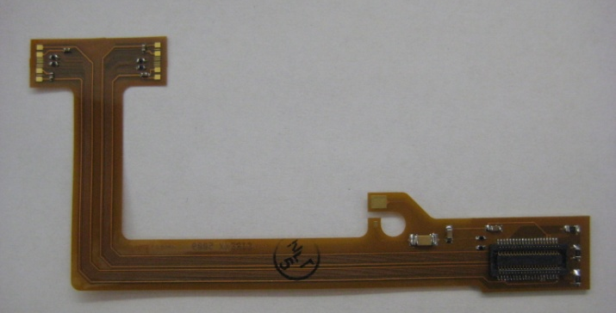
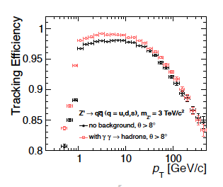
Silicon Tracker: Status
Module
All components in hand
  1024 channel KPiX chip
  Sensor
  Cable
Had difficulties in past bump bonding KPiX to sensors; IZM vendor appears to have solved the problem
Software
Optimized tracking algorithms for
CLIC_SiD and studies at 3 TeV
  Silicon tracking performs very
  well under severe conditions:
  Z’ → qqbar @ 3 TeV

Slide 15
Silicon Tracker: Timeline
Modules:
Complete full Si module this year
Bench test (noise, crosstalk, …) and, if time permits, beam tests at SLAC in 2012
Alignment:
Resume laser scanned interferometry (U. Michigan/K. Riles) 2012
Reconstruction:
A robust system has been tested for CDR – fine for DBD
⇒ Study tracking algorithms and optimize the layout and segmentation if effort available
Concerns:
Personnel to construct/test Si module
People to study pulse powering and associated vibration tests

Slide 16
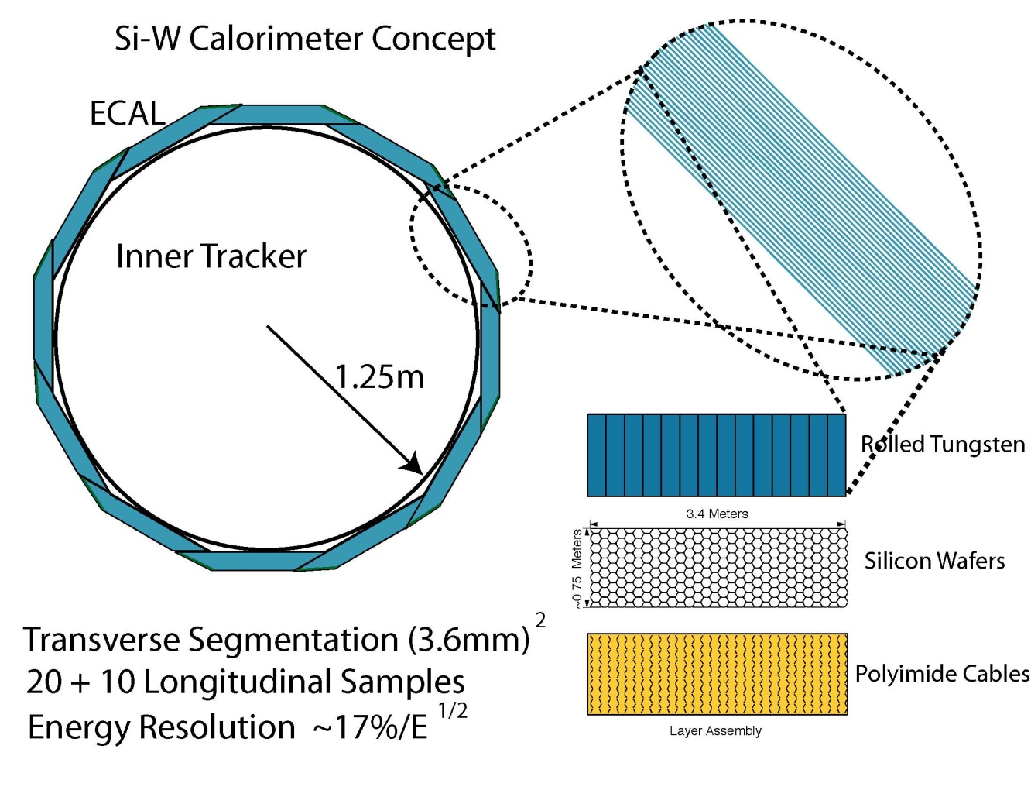
ECal
SLAC National Accelerator Lab
UC Davis
University of Oregon
Brookhaven National Lab
Baseline: Silicon-tungsten (13 mm² pixels) with highly integrated readout (KPiX chip)
Option: MAPS – uses same tungsten and mechanical structure
Critical R&D: Build test beam prototype module using components of final SiD ECal:
1024-channel integrated readout chip (KPiX)
1024-pixel silicon sensors
interconnects
Notes:
Note: SiD Ecal is octagonal, not a dodecahedron as depicted in drawing

Slide 17
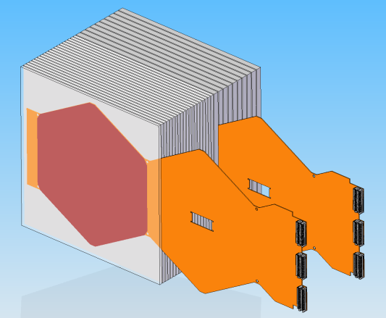
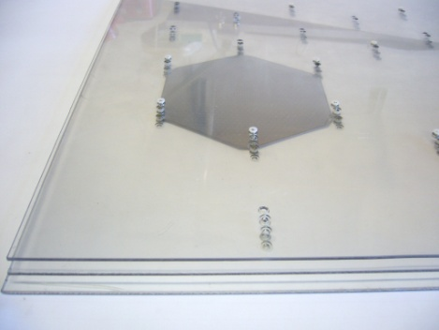
ECal (contd)
Silicon sensors: Meet specs. for SiD ECal
Hamamatsu
low leakage current; DC coupled
sufficient number for prototype (30 layers)
Prototype module
Integrated readout chip (KPiX): prototypes meet SiD specs.:
low noise (10% of MIP)
large dynamic range: ~10⁴
full digitization and muliplexed output
passive cooling (power pulsing)
Development of ECal mechanics
Interconnects:
Flex cable R&D ok so far – successful attachment to dummy sensors
Main focus of recent R&D is the KPIX – sensor interconnect. Problem recently solved using IZM:

Slide 18
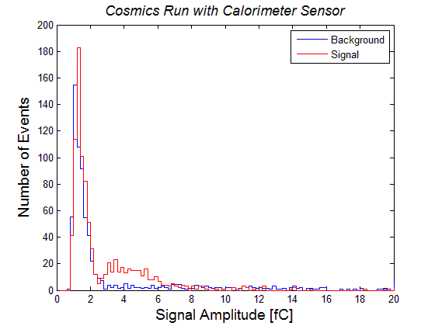
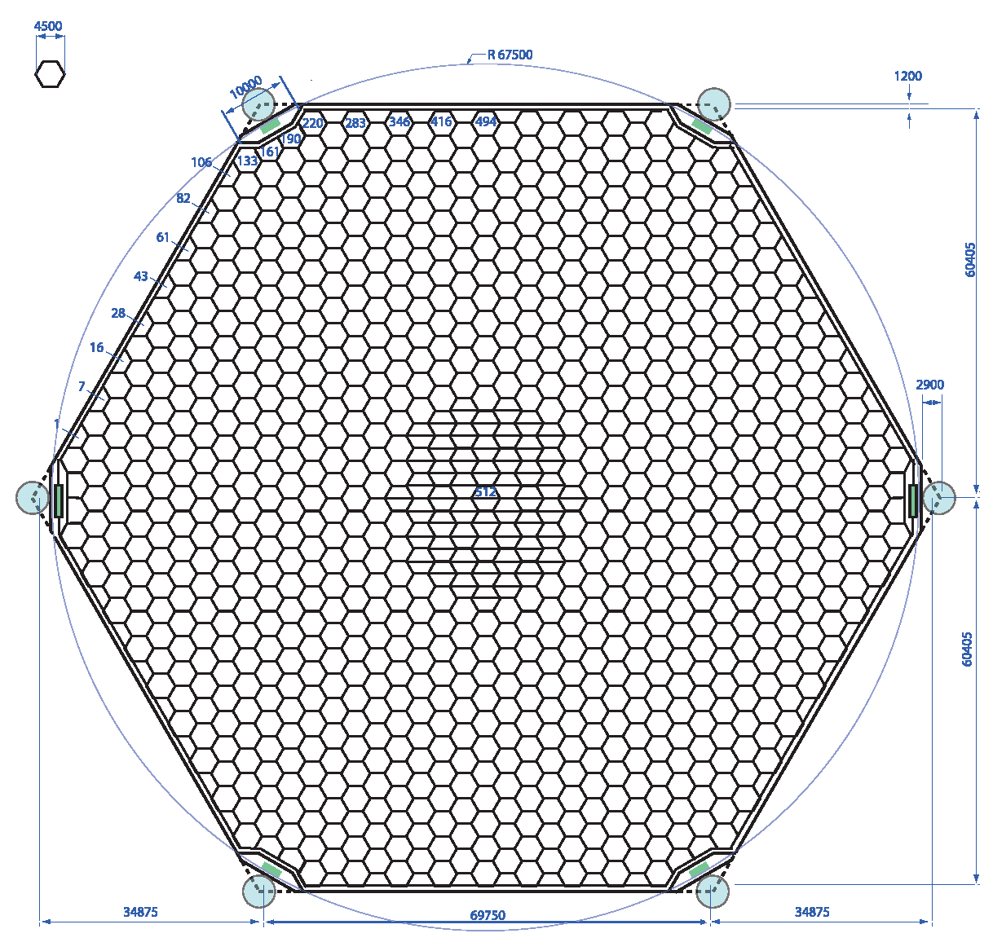
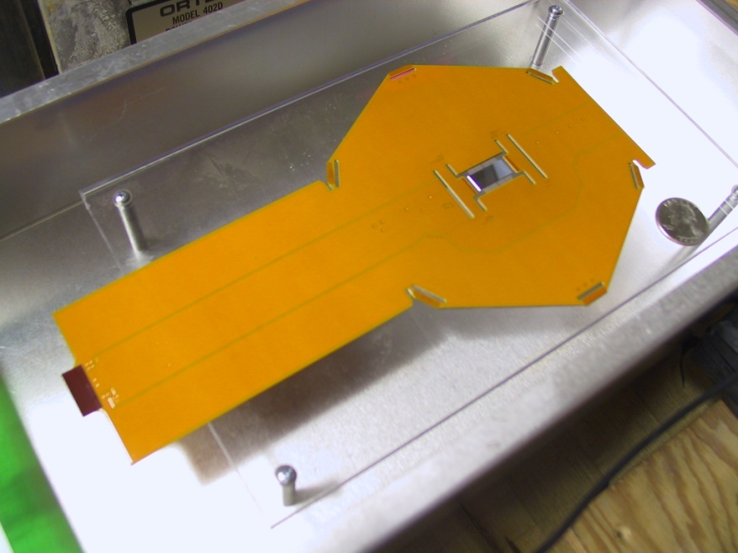
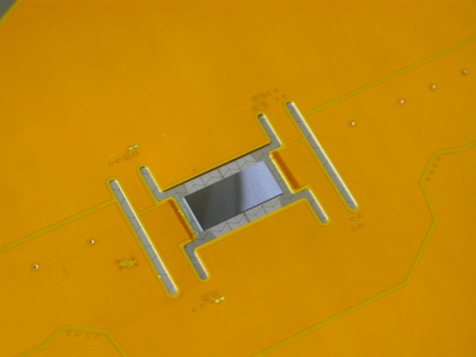
SiD EmCal Sensors
ECal (contd)
1024 Pixel Si Sensor
12 cm across flats
KPiX bump bonded by IZM to sensor
Cable bump bonded to sensor
Assembly 1 mm high

Slide 19
ECal (contd)
Timeline for R&D
Assemble test module now that bonding problem has been solved
Target is revived End Station test beam at SLAC sometime in 2012
Results expected for inclusion in DBD
Technical results on components – updates to LOI
Successful assembly of fully functional prototype will demonstrate feasibility of the design
First test beam results, if available in time
Issues/concerns for DBD and beyond
Personnel also engaged in other experiments
The MAPS option (UK based) needs resources to continue

Slide 20

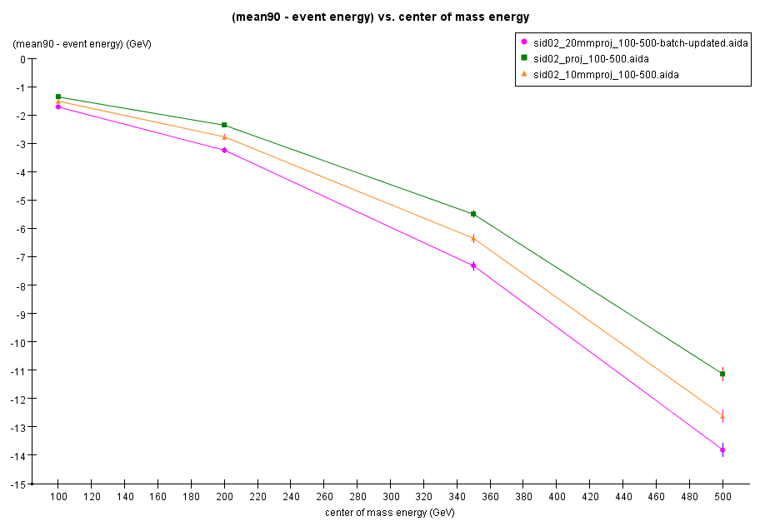
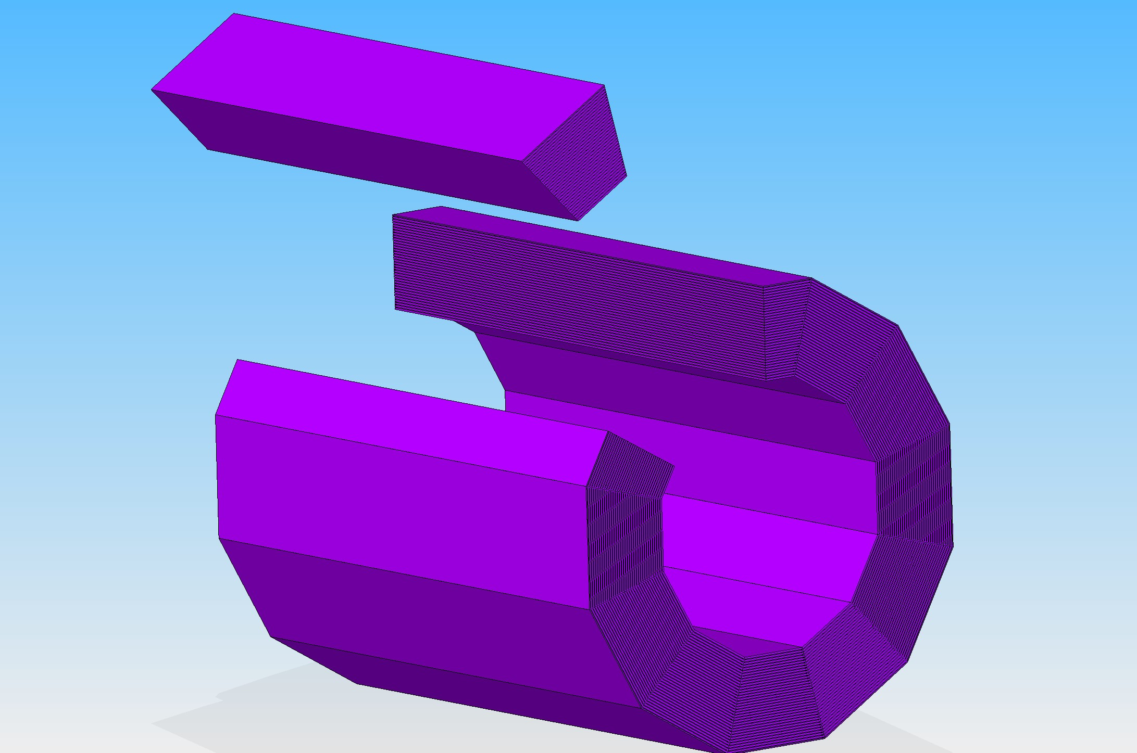
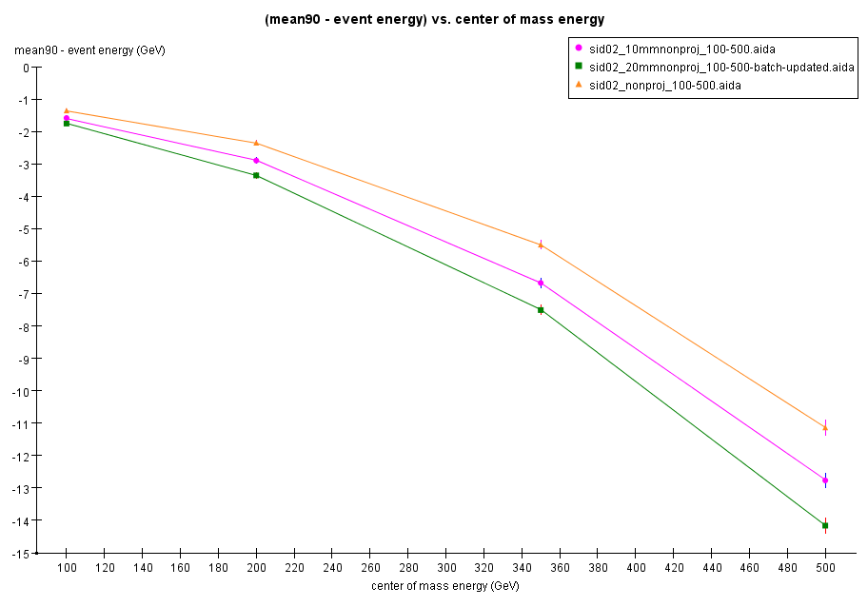
Hadron Calorimeter
Proj.
Argonne National Laboratory
Boston University
Fermi National Accelerator Laboratory
IHEP Beijing
Illinois Institute of Technology
University of Iowa
McGill University
Northwestern University
University of Texas at Arlington
NIU
SLAC
Non-proj.
Areas of critical R&D/goals - baseline
Large area glass chambers
Module design (projective/non-projective)
Gas (re-)circulation/routing
Improved readout boards
HV/LV distribution
Data transmission
Baseline – 4.5 λ RPC/Steel
Option 1 – GEM/μmegas/Steel
Option 2 – Scint/Steel

Slide 21
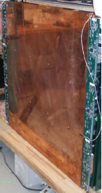
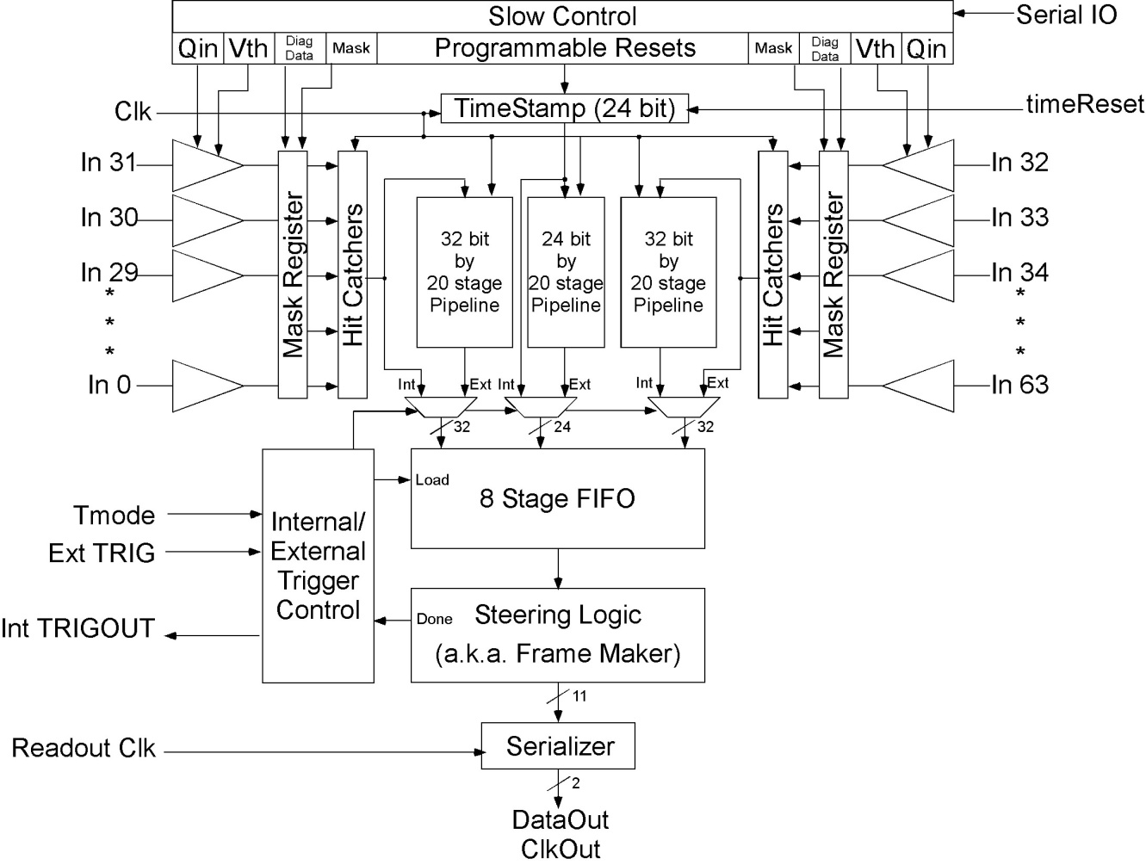
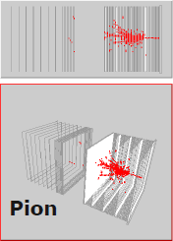
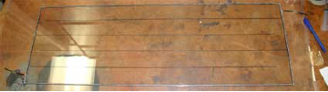
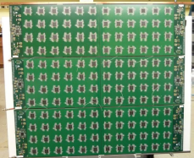
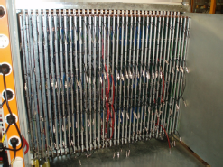
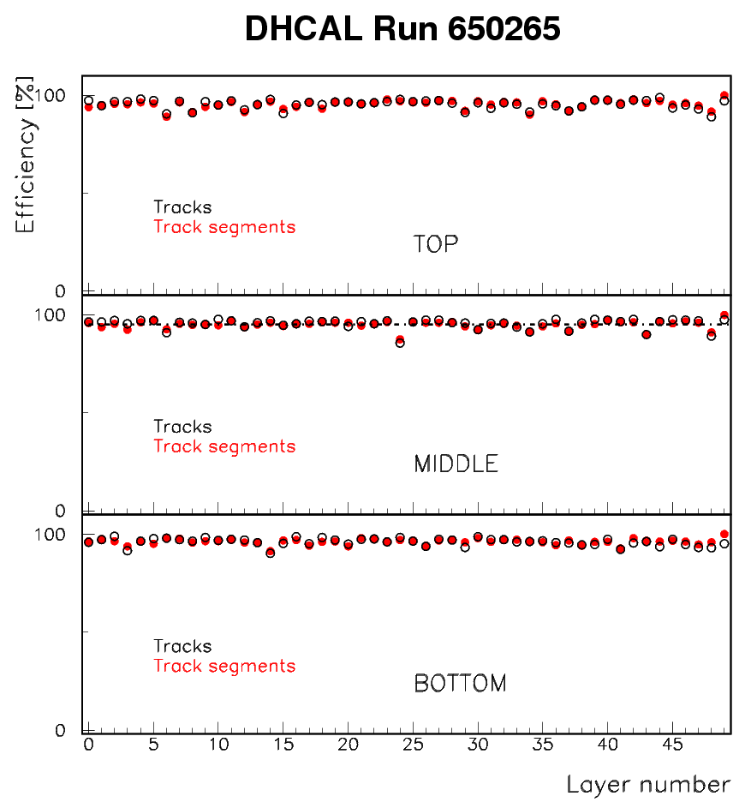
Hadron Calorimeter
R&D and results to date
Had 5 test beam runs so far
- 10/2010: 38 layers
- 1/2011: completed 38+14 during run
- 4/2011: SiW ECAL + RPC DHCAL
- 6/2011: RPC DHCAL (high energies)
- 11/2011: Minimal absorber: 50 layers
- 2012: Tests with W absorbers at CERN
Readout – DCAL chip
Detector layer w/ Front-end boards
DHCAL:
480,000 readout channels
World record
in calorimetry

Slide 22
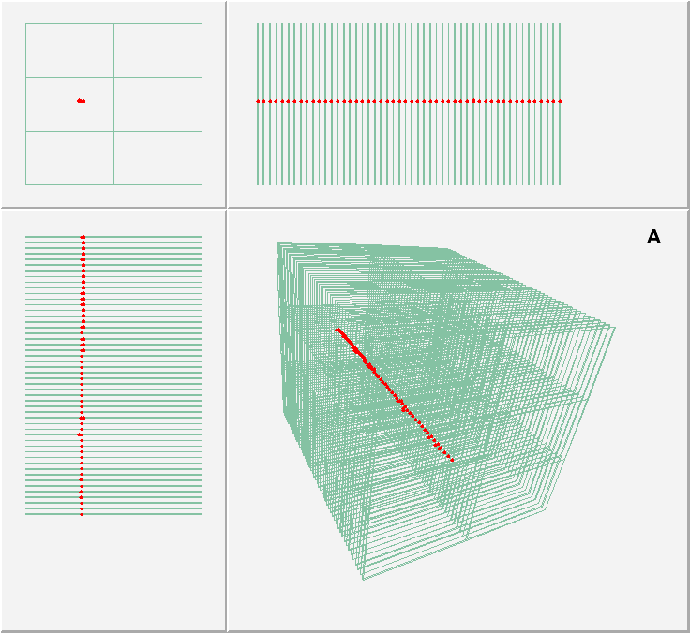
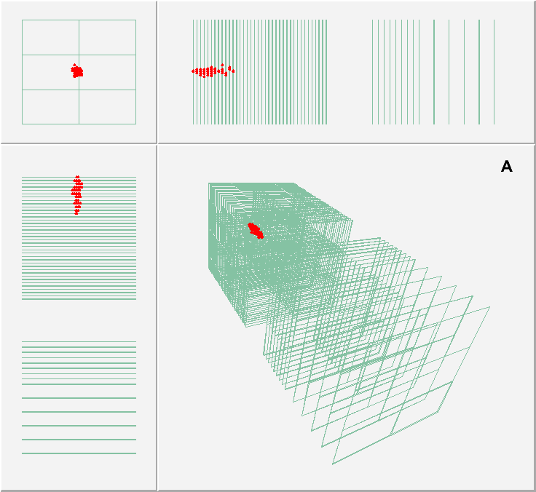
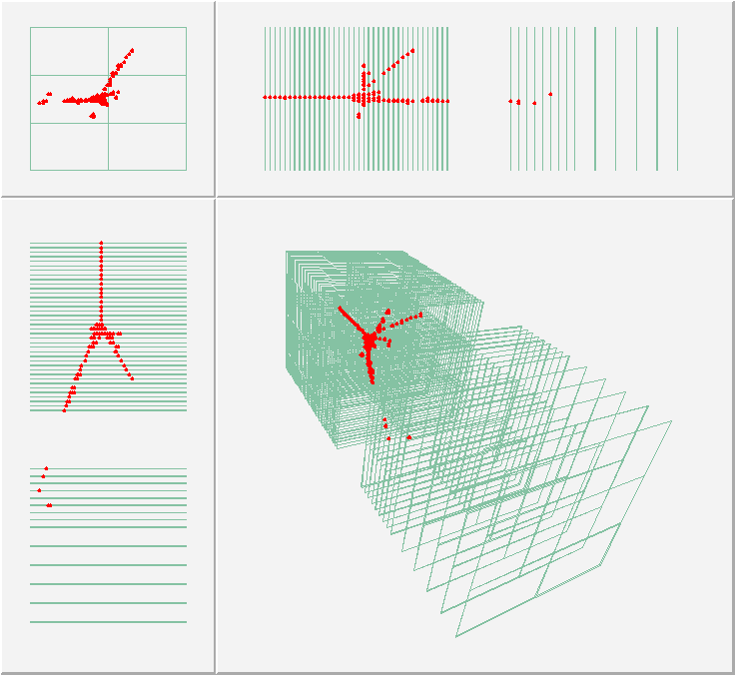
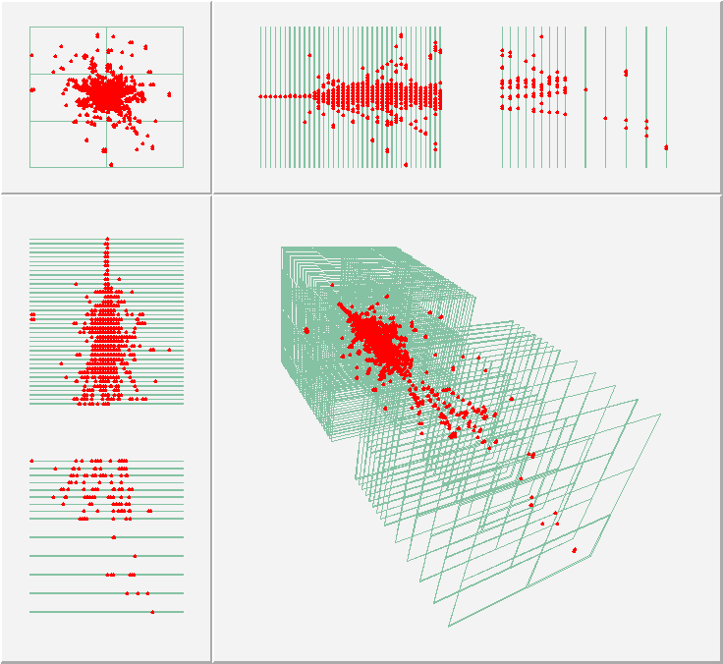
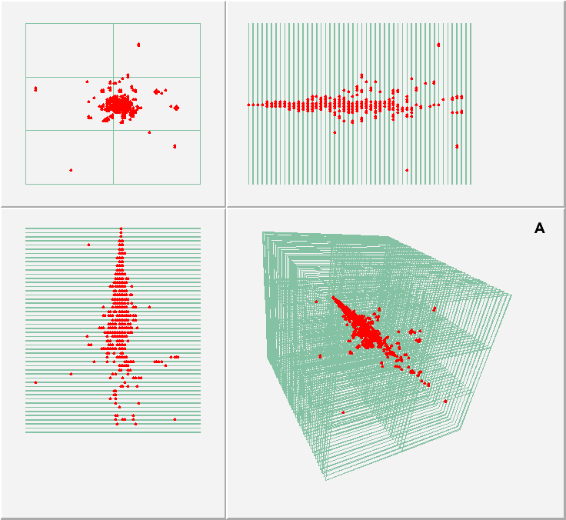
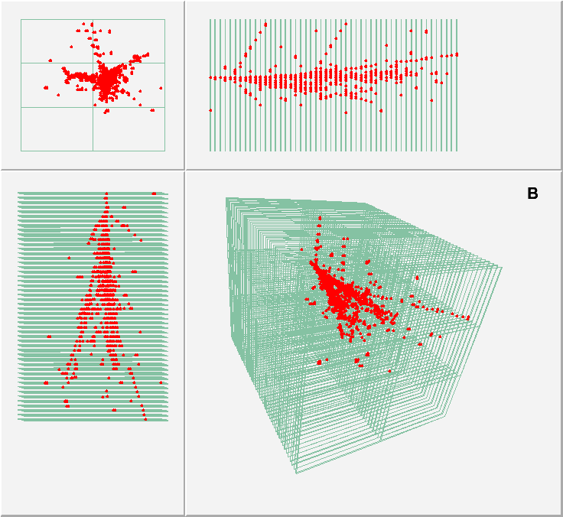
Hadron Calorimeter
Selection of nice events from the test beam
Muon in the minimal absorber structure
8 GeV e⁺ in the DHCAL
8 GeV/c π⁺ in the DHCAL and TCMT
120 GeV/c p in the DHCAL and TCMT
10 GeV e⁺ in the minimal absorber structure
10 GeV π⁺ in the minimal absorber structure

Slide 23
Hadron Calorimeter
Timeline for R&D
Completed prototype construction in Dec 2010
5 successful test beam campaigns at FNAL in 2010/2011
Beam tests at CERN in 2012 (DHCAL with Tungsten absorber)
R&D on HV distribution system, high-rate RPCs, 1-glass RPCs, gas … ongoing
Gas re-circulation systems being developed and tested at CERN
Results expected for inclusion in DBD
Description of DHCAL/RPCs/Readout system (instrumentation paper)
Detailed measurement of noise in the DHCAL (noise paper)
Calibration of the DHCAL with Muons
DHCAL response to positrons and pions
Measurements with large 1-glass RPCs (viability of design)
- Conceptual engineering design (if resources permit)
DHCAL concept
will be
validated
Issues/concerns for DBD and beyond
Conceptual engineered design
Analysis of DHCAL data not yet complete

Slide 24
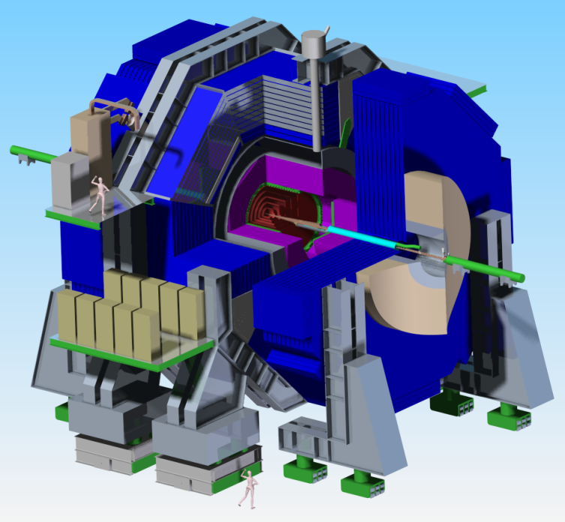
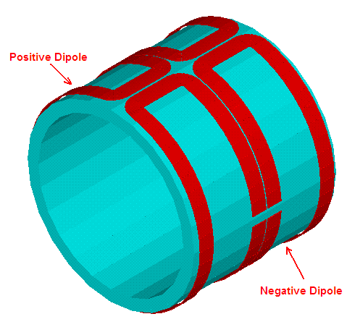
SOLENOID/DID
Participating Institutions
SLAC (Wes Craddock)
FNAL
BNL
LLNL
(CERN & KEK informal)
Baseline
Modified CMS Conductor
Option 1
Al-0.1% Ni (ATLAS)
Stabilizer
Option 2
Advanced Next Generation Stabilizer
Note: The only significant option choices based on technological advancements are with the conductor.
Areas of Critical R&D / Goals
3 D Magnet Field FEM Analysis
Integration of DID Coil into Cryostat
Assembly and Installation Procedures
Structural and Thermal Design (real world)
Cryogenic Systems Integration with QD0

Slide 25
SOLENOID/DID
RESULTS TO DATE
Magnetic Field Calculations
2D to minimize stray fields – Sufficient for DBD
Iron Barrel HCAL option – Completed: Complexity not worth improved uniformity
3D (with DID): ANSYS modeling at least ½ completed. Need to solve and study.
BNL Opera 3D simplified solenoid/DID analysis. Need ANSYS/Opera comparison
Structural and Thermal Design
Vacuum shell analysis completed. Need attachment integration with Fe and detector.
Need coil support, thermal shield and current lead design.
Practical but not detailed DID winding and solenoid attachment schemes.
Conductor: CMS conductor with 40 strand Rutherford cable. Need DID conductor.
Electrical: Sufficient for DBD except for DID coil and instrumentation list.
Cryogenics: Detector layout completed but needs integration with QDO
Conductor R&D: Identified many potential paths for higher strength high conductivity aluminum such as carbon nanotubes reinforcement and scandium.

Slide 26
SOLENOID/DID
Results expected for inclusion in DBD
3 D Magnetic Field, Force & Stress including DID Coil and Vacuum Shell
Structural and Thermal Design including Integration with Iron and Detector
Assembly and Construction Procedure
Size and Tolerances for Major Components
Cryogenic Scheme integrated with QD0
Power Supply/Dump Circuit/Grounding/Instrumentation
Issues/concerns for DBD and beyond
The main concern is SLAC manpower committed to other projects.
Potential cost savings exist using advanced high purity Al stabilizers and conductor fabrication techniques. There will be negligible time to pursue this before the DBD.

Slide 27
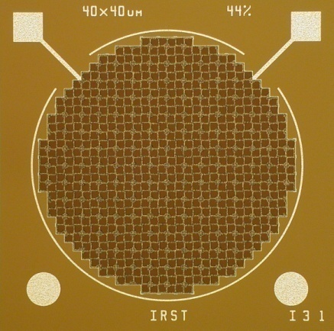
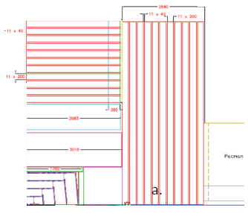
Strip-scintillator/Si avalanche photo-diode Muon System
APD’s
1.2 mm φ
660 pix
40μ²
Fermilab Test beam + Inst
INFN Udine APDs
Notre Dame Scint /WLS
Baseline:
Strip-scintillator/WLS fiber & Avalanche Photo-Diodes
(replaces old baseline of double layer
resistive plate chambers)
Areas of critical R&D/goals
Need to build and test strips with robust techniques.
We need enough tests to validate the technology.
We need HEP Laboratories to back an LC.

Slide 28
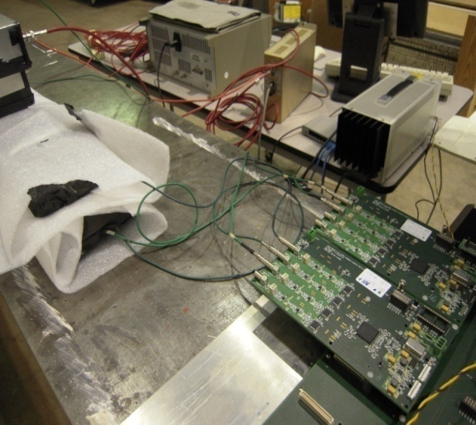
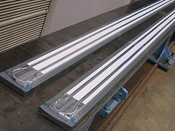
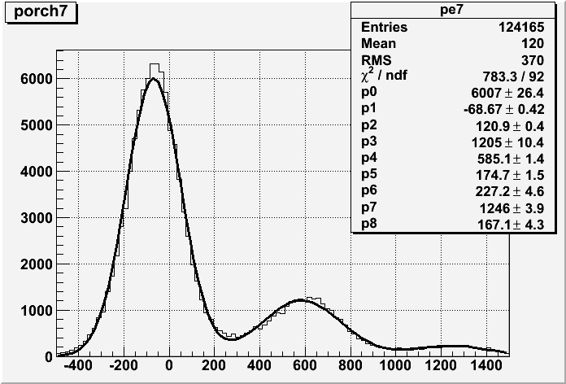
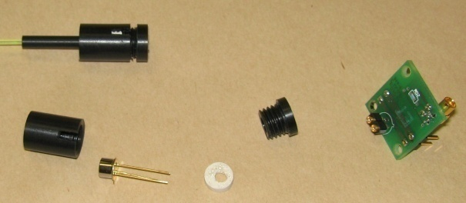
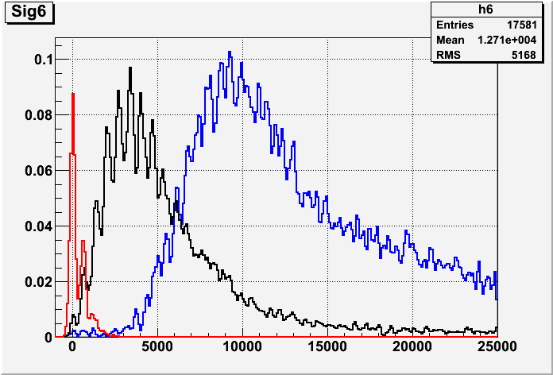
Strip-scintillator/Si avalanche photo-diode Muon System
R&D and results to date
Prototype construction
Test Setup
Results: FTBF beam
Calibration w/Noise
Resolution: Single p.e.s
Strip-
Scint.
TB4 Boards:
8 channels
180 digitizations *
4.708ns = 847ns
212 MHz
SiAPD
Pre-amp

Slide 29
Strip-scintillator/Si APD Muon System
Timeline for R&D
New design of mechanical /optical coupling scheme using tooling.
Jan 31, 2012. Try with short strips. Feb. 2012
Refine drawings of coupling scheme with specifications. March 2012
Start work on new test stand. Manpower needed.
Set-up tests with 4 strips and new optical/mechanical coupling. June 2012
Results expected for inclusion in DBD
First results from cosmic ray tests of new coupling scheme.
Write a paper if there is sufficient data.
…
Issues/concerns for DBD and beyond
No money; Need a few km of WLS fiber at a cost of $2 or $3 per foot.
No people; Universities have dropped out.
Funds are needed and does anyone think we will get them?
Need Lab directors and DOE HQ to help us. Universities too.

Slide 30
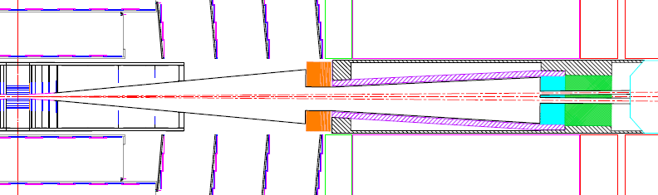
Forward Detector
SiD Forward Region
Participating Institutions:
UC Santa Cruz (SCIPP), Pontificia Universidad Catslica de Chile, U. of Colorado, SLAC
Baseline:
Silicon-Tungsten sampling calorimeter
LumiCal
BeamCal
Areas of critical R&D/goals
Radiation hard Silicon sensor R&D
FCAL chip development
Simulation study of BeamCal tagging

Slide 31
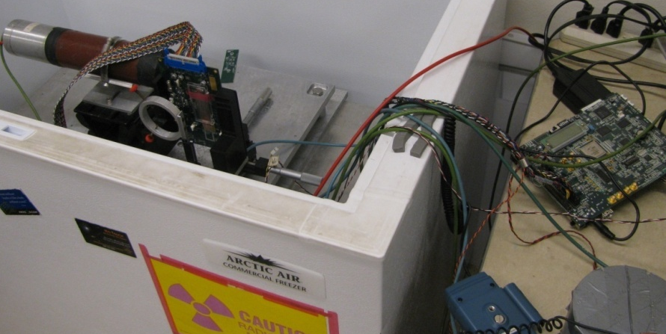
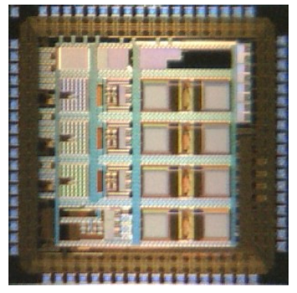
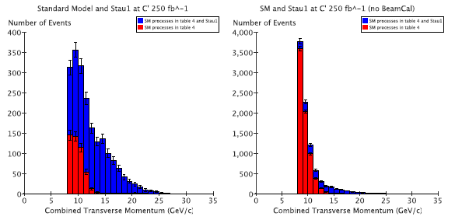
Forward Detector
Radiation hard sensor R&D (SCIPP/SLAC)
• Micron sensors from ATLAS R&D
• Runs of up to 100 Mrad (Spring 2012)
• Will assess the bulk damage effects and charge
collection efficiency degradation.
Charge collection apparatus being upgraded at
SCIPP to process many samples quickly.
Sensor +
FE ASIC
DAQ FPGA
with Ethernet
FCAL chip development (Santiago/SCIPP)
• 180 nm TSMC process
• 72 pads, 2.4 mm × 2.4 mm
• 7306 nodes, 35789 circuit elements
• 3 channels
No digital memory
Bean v1.0
prototype
Study of stau production (Colorado)
• Stau production in co-annihilation points: M. Battaglia et al hep-ph/0306219 σ ∼ 10 fb
• Background
  γγ →ττ, σ∼10⁶ fb
  BeamCal veto is essential.
Veto
No Veto

Slide 32
Forward Detector
Timeline for R&D
Summer 2012: Initial (100 MRad) study completed
Summer 2012: Submission of second BEAN prototype
BeamCal simulation study has been completed.
Results expected for inclusion in DBD
100 MRad study with Czochralski/FloatZone n-on-p/p-on-n sensors
Submission of second prototype BEAN readout chip
BeamCal simulation study.
Issues/concerns for DBD and beyond
Availability of SLAC 13.6 GeV test beam
Chilean support for BEAN chip development (and continue US support for digital components)

Slide 33
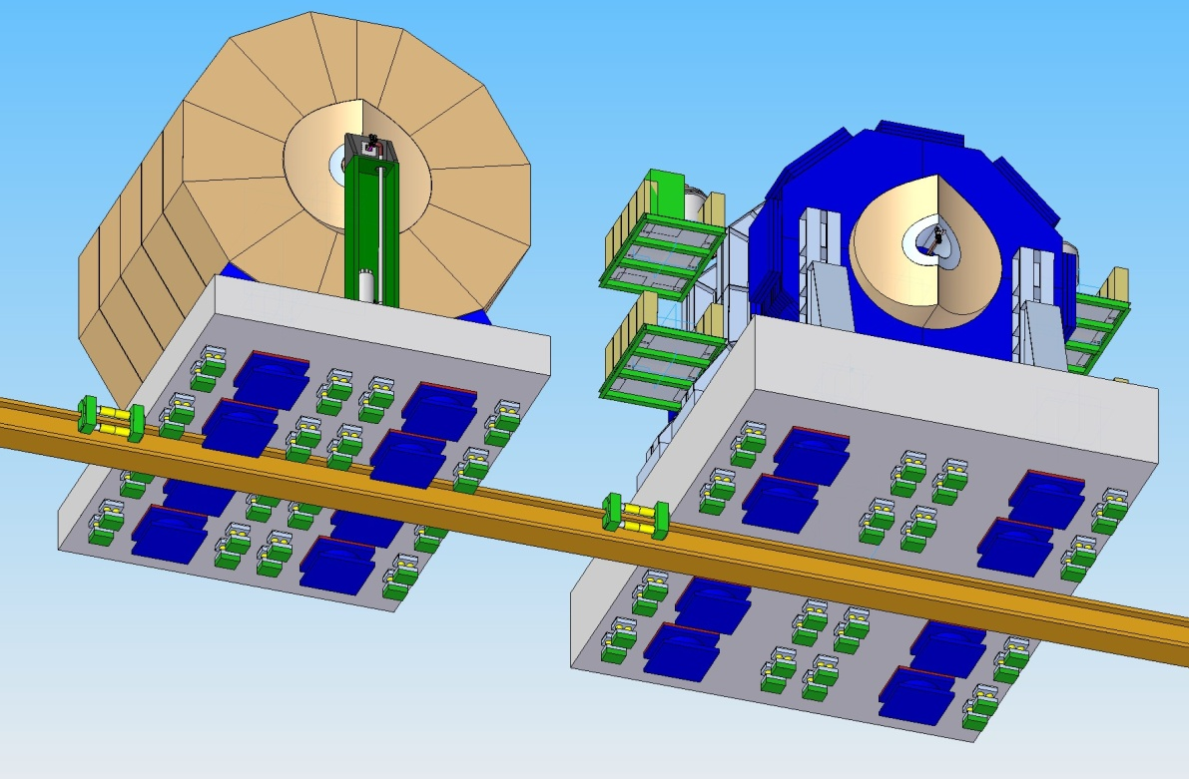
Machine Detector Interface
Participating Institutions
SLAC
Fermilab
BNL
Oxford U.
U. Of Michigan
ILC CFS
ILC MDI CTG
Push-Pull Baseline : Platform on rollers with gripper jacks
Ex. Area Baseline: 3 Shafts access with single Gantry
Areas of critical R&D/goals
Motion System for Push-Pull
Platform & QD0/FCAL Alignment
QD0 Adjustment System
Intra-train Fast Feedback System
Beam Pipe Design
IR Hall Design
QD0 Prototype

Slide 34
Machine Detector Interface
Timeline for R&D
 | Options Review | Final Design
Motion System for Push-Pull | Apr. 2012 | Sept.2012
Platform @ QD0/FCAL Alignment | Apr. 2012 | Sept.2012
QD0 Adjustement | Apr. 2012 | Sept.2012
Intratrain Fast feedback System | Mar. 2012 | Mar.2012
Beam Pipe & Forward Cal | Mar 2012 | Jun.2012
IR Hall Design | Apr. 2012 | July.2012
QD0 Prototype | Apr. 2012 | Nov.2012
Results expected for inclusion in DBD
Motion System for Push-Pull
IR Hall Design
Beam Pipe & Forward Cal
Results from QD0 Prototype
Performance of FONT prototypes of Intra-train Feedback System at ATF2
Issues/concerns for DBD and beyond
- Timeline for QD0 Prototype Completion very tight given scope of work
Keep or increase Manpower available after DBD
M&S for prototype construction

Slide 35
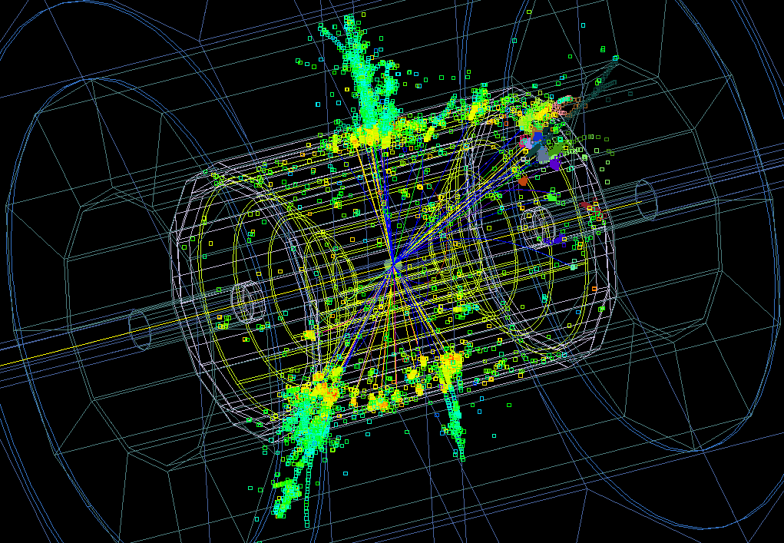
Simulation and Reconstruction
SLAC: slic
org.lcsim
Baseline:
sid_dbd : LOI geometry with more realistic detector descriptions.
Option 1:
sid_dbdopt: Detector optimized for 1TeV operations.
Option 2
sid_dbdspt: Silicon Pixel Tracker option.
Option 3
sid_dbdsci: Analog scintillator HCal
Areas of critical R&D/goals
Finalize global system design via detector performance optimization using physics analyses.
Incorporate latest detector R&D results
Improve tracking and PFA reconstruction
Automate & streamline production sim/reco

Slide 36
Simulation and Reconstruction
R&D and results to date
CLiC CDR provided stress test of the DBD simulation, reconstruction and analysis exercise.
Required improvements to the functionality such as event overlay, track-finding in dense environments and use of PandoraPFA.
DBD will benefit from these improvements.
Most significant difference wrt LOI will be the use of Grid resources (CPU & SE).
Dirac tried and proved in CLiC CDR. Will coordinate with ILD on common solution.
Event overlay to be incorporated into the reconstruction.
Effect of detector noise and electronic inefficiency will be studied
Full detector response simulation will use slic, plus detailed SiD design.
Reconstruction will use detailed silicon strip and pixel response, RPC response, plus track finding and fitting using org.lcsim.
slicPandora and LCFI for individual particle reconstruction and jet flavor tagging.

Slide 37
Simulation and Reconstruction
Timeline
Learn from and preserve functionality developed for CLiC CDR
Adapt tracking code to LCIO2.0 event data model
Implement Kalman fitting for final track states
Develop full digital HCal response simulation
Upgrade to latest PandoraPFA & LCFIPlus
Results expected for inclusion in DBD
Full simulation of realistic detector design including support structures
Full tracker hit digitization and ab initio track finding and fitting.
Digital RPC signal simulation, including cross-talk , noise & inefficiencies
Full reconstruction using slicPandora & LCFIPlus
Issues/concerns for DBD and beyond
Loss of key individuals in reconstruction efforts.
Lack of manpower to conduct detector optimization studies.
Aging software infrastructure.

Slide 38
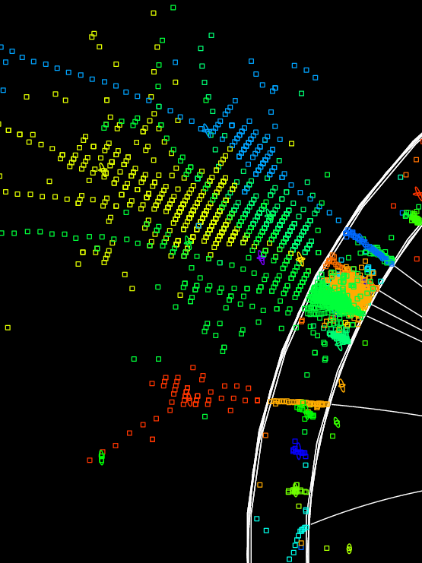

Iowa Particle Flow Algorithm
Pandora/PFA already used with CLIC_SiD for CDR.
This section describes work on alternative Iowa PFA.
Participating Institutions
The University of Iowa
and
SLAC National Laboratory
Confusion
Simulation
Reconstruction
Areas of critical R&D/goals
The ILC physics goals require a jet-jet reconstructed mass resolution at most 3%.
The current implementation, a work in progress, now achieves 3.1% for
When ideal photon detection is used, this improves to 2.6%.
Work is ongoing in the area of pattern recognition to improve the shower reconstruction as well as the neutral hadron identification.

Slide 39


Iowa Particle Flow Algorithm
Iowa PFA R&D and results to date
Improvements achieved in:
- photon/hadron confusion
- purity of subclusters
- track-seed matching
- likelihood for link scoring
Current status:
- Improved resolution
3.5% (LOI) → 3.1%
- 2.6% with perfect photon reconstruction
In progress rewriting shower building:
- First iteration : charged shower cores (Done)
- Second iteration : primary and secondary neutral showers (Done)
- Third iteration : overall event E/p balance (Ongoing)
RMS 90 / Mean 90: 3.1% (ΔE/E)
RMS 90 / Mean 90: 2.6% (cheat γ)

Slide 40


slicPandora
N. Graf & J. McCormick (SLAC)
It provides an interface between events reconstructed using org.lcsim (Java) and pandoraPFA (C++), demonstrating the interregional cooperation and collaboration enabled by the use of a common event data model and file format (LCIO). Successfully used to simulate the response of SiD’ (clic_sid_cdr) at 3TeV for the CLiC CDR. Performs well at 1TeV using a digital RPC HCal. Number of improvements have been made recently to provide more flexibility in defining input LCIO collections and to accommodate changes to pandoraPFA itself.

Slide 41


slicPandora
1x1
Recent comparison of Z→qq
energy resolution using slicPandora with different
detectors ( Jan Strube)

Slide 42
Benchmarking
DBD Benchmark Event Generation (ILC Common Generation)
  2-4-6-8 fermion SM Background: MC event generation is complete. ee→2f and ee→4f were generated at DESY; ee→6f, high pT γγ→2f, γγ→4f, eγ→e+2f, eγ→e+4f were generated at SLAC; ee→ttbb & ttZ 8f backgrounds were generated at KEK.
  low pT, high cross section γγ→hadrons have been generated at SLAC
  γγ mini-jet events (high pT subprocesses involving quark&gluon constituents of photons) will be generated at SLAC for the DBD -- they slipped through the cracks in the LOI generation.
  vvH and ttH signals: DBD generation was completed at SLAC and KEK, respectively. The WW signal was generated when the ee→4f background was generated at DESY; alternate initial state polarizations and anomalous TGC’s will be simulated through reweighting.
  All MC event generation stdhep files are stored on the grid with an ftp accessible copy on SLAC NFS.

Slide 43
Benchmarking
SiD Full Simulation and Reconstruction
  The MC event generation stdhep files - each of which are generated with 100% initial state e-/e+ polarization and contain thousands of events - are mixed together at SLAC to produce smaller stdhep files with 500 events each and 80% /20% e-/e+ polarization. These smaller files serve as input to the SiD full simulation and reconstruction software which can be run either on the SLAC linux batch farm or on the grid.
  2-4-6-8 fermion SM Background: a little bit of everything is being fully simulated – just as was done for the LOI; more fully simulated background events can be produced at the request of the benchmarking group
  low pT, high cross section γγ→hadrons will be overlaid on all fully simulated events
  SiD will use the LOI MC event generation stdhep files for the ttbar signal and background when it reanalyzes this benchmark with the DBD detector.

Slide 44
Benchmarking
ttH Benchmark
  Jan Strube (CERN) and Philipp Roloff (CERN) are doing the SiD ttH DBD benchmark and providing support for full simulation and reconstruction.
vvH Benchmark
  Homer Neal (SLAC) will analyze this benchmark. Homer is also doing validation of the particle flow object output from the SiD reconstruction software.
WW Benchmark
  SiD will do a simultaneous measurement of the initial state e-/e+ polarization and several triple gauge couplings. Tim Barklow will be responsible for this analysis.
Reanalysis of ttbar at Ecm=500 GeV
  Have yet to identify someone for this analysis.

Slide 45
Costs
SiD participates in the PEB Costing Working Group:
Study of solenoid cost with CLIC
- In-house (assume risk) vs. Industry contract
Agreement of unit costs of common items:
- Iron, stainless steel, tungsten, silicon
- A costing spreadsheet system exists (M. Breidenbach/SLAC) for SiD…will update with common costs/further output from Costing Group

Slide 46

Costs

Slide 47
SiD DBD Editors
Overall editors:
P. Burrows, M. Stanitzki, L. Linssen, M. Oreglia, H. Aihara
Section editors:
SiD Area | Section editors
VTX | R. Lipton, W. Cooper,
TRK | M. Demarteau, T. Nelson, W. Cooper
ECal | R. Frey, M. Stanitzki
HCal | A. White, L. Xia
Muon | G. Fisk, H. Band
FWD | B. Schumm, T. Maruyama
Magnet | W. Craddock, M. Oriunno
MDI | P. Burrows, T. Markiewicz
Sim/Reco/PFA/Perf. | N. Graf, J. Strube
Benchmarking | T. Barklow, P. Roloff
Cost | M. Breidenbach, K. Krempetz
CLIC contributions

Slide 48


Interworking with CLIC on DBD
Beneficial interworking with CLIC detector and physics group:
- Many SiD contributors/contributions to CDR
- Areas of contributions to DBD identified
- SiD simulation/reconstruction critically exercised during CDR work
CDR tools (svn, job submission,…) will be used for DBD work

Slide 49
Areas of interworking with CLIC/DBD
Participation in engineering and integration studies, in particular in the domain of:
  Contribution to engineering studies on moveable service lines and on general infrastructure aspects for the experiment in the underground cavern
  Vibration measurements
Engineering calculations and design parameters of the SiD solenoid and its return yoke. Extrusion tests of a candidate reinforced conductor for the SiD solenoid
Studies of tail catching and muon identification and layout proposal for the SiD yoke instrumentation at 500 GeV and at 1 TeV.
Studies of the dependence of jet energy resolution and HCAL leakage as a function of HCAL depth at 1 TeV centre-of-mass (using SLiCPandora).
Studies of particle identification for photons electrons and muons using particle flow objects at 1 TeV (using PFO’s in SLiCPandora)
Studies of occupancies and radiation levels in the vertex and tracking detectors due to beam-induced background at 1 TeV. This study includes a layout optimization of the forward region and beam-pipe liner.
Participation in GRID production for the DBD using ILCDIRAC (within ILC common data sample subgroup)
Participation in 1 or 2 detector benchmark studies at 1 TeV
Participation in DBD editing tasks
Setting up and hosting an SVN repository for the editing process of the SiD DBD document
…and more …

Slide 50
Summary
The SiD Concept remains a key element of future ILC/CLIC plans.
R&D progress made as resources have allowed.
Simulation/reconstruction well tested/robust for CDR – now being applied to DBD.
Cooperation with CLIC colleagues worked well for CDR and continues to work well now on DBD
DBD editors, outline in place; plans developing towards SiD Workshop at SLAC, August 21-23, 2012

