Slide 1


HLRF
Power Distribution System (PDS)
.…………………….
Christopher Nantista
SLAC
KILC, Daegu, Korea
April 23-27, 2012

Slide 2
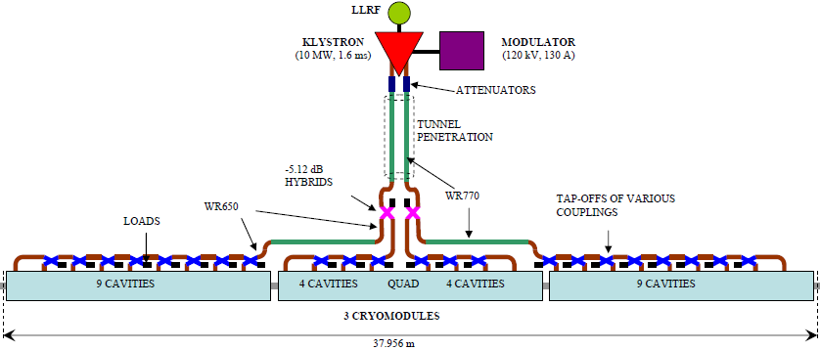
Old RDR Power Distribution System

Slide 3
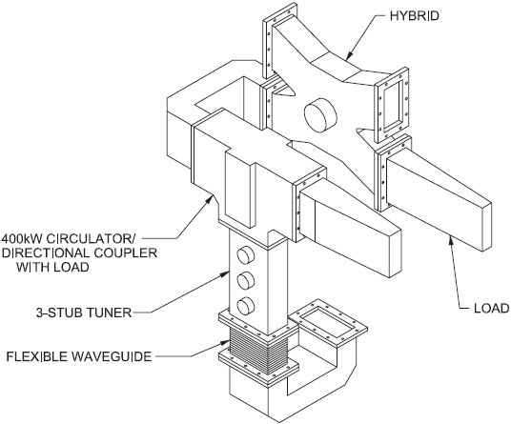
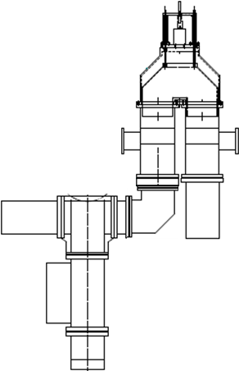
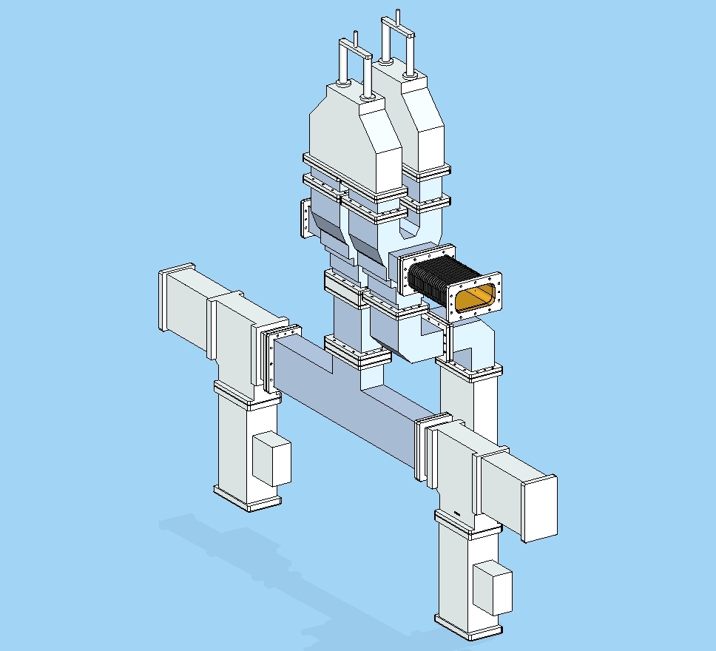
Main Changes to Local Power Distribution System (LPDS)
FIXED-COUPLING
RDR
TDR
“RF power is equally distributed among the cavities… hybrid-style 4-port tap-offs… couple the appropriate sequential fraction…
The three-stub tuner allows fine adjustment of both cavity phase and external coupling. …
With three degrees of freedom, the three-stub tuner is a complicated tool to use. It is, however, compact and well tested in TTF. It may be desirable to replace it with an alternate phase shifter, with the movable coupler antenna providing Q_{ext} adjustment. …
The entire waveguide system, from the klystron window to the outer coupler window, is pressurized with dry nitrogen to a pressure of 3 bar absolute.”
IMPROVEMENTS:
individual cavity power adjustability
more, easier cavity phase control
accomodates unpressurizable couplers
base cost quantity reduction
2×(folded magic-T + U-bend φ-shifter) + window + φ-shifter:
fixed “slot” or ferrite-based hybrid + 3-stub tuner:
Also, the 5 MW variable attenuators shown in RDR for 13-cavity power tweeking may not have been costed (or even exist).

Slide 4
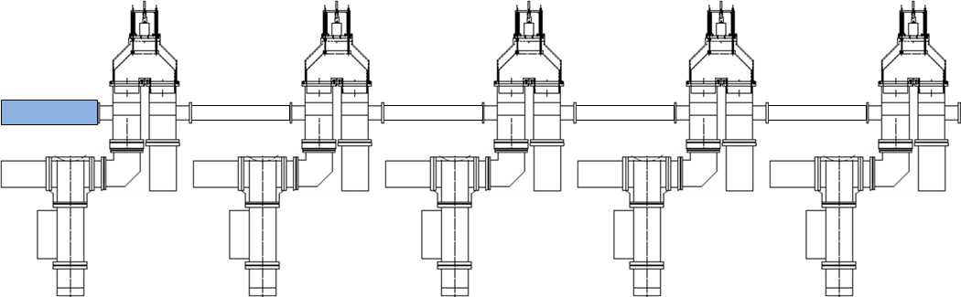
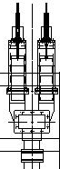

Local PDS Circuit
presented at BTR in January 2012
− too expensive
Use circulators and r.c. switches
(as in combining circuit) respectively to shield KCS from reflections and,
if necessary, to depower 1½ CM’s.
KCS waveguide
CTO
9
4 Q 4
9
By splitting CTO outputs through asymmetric (-5.12 dB) “hybrids”, as in the RDR, we can physically decouple cryomodules and limit variable coupler cascading.

Slide 5
PDS Cost Reduction
After the costing exercise performed for the BTR meeting, the cost estimate for the PDS was considered too high, requiring efforts to find a more economical solution. Options considered have included:
  Returning to cavity pairing
  Removing remote control of relative power couplings to cavities
  branching distribution to minimize number of windows
  substituting limited range for unnecessary full range power dividers
?
✔
?

Slide 6
Branched PDS Layouts
average # of var. cplrs. rf passes through
my initial layout
4.2308 + hyb.
26 windows
1 cav./window
+ 2 asym. hybrids + 4 extra loads
4.6923
14 windows
≤ 2 cav./window
4.2308
10 windows
(assuming ~1MW capability)
≤ 3 cav./window
4.538
6 windows
≤ 5 cav./window

Slide 7
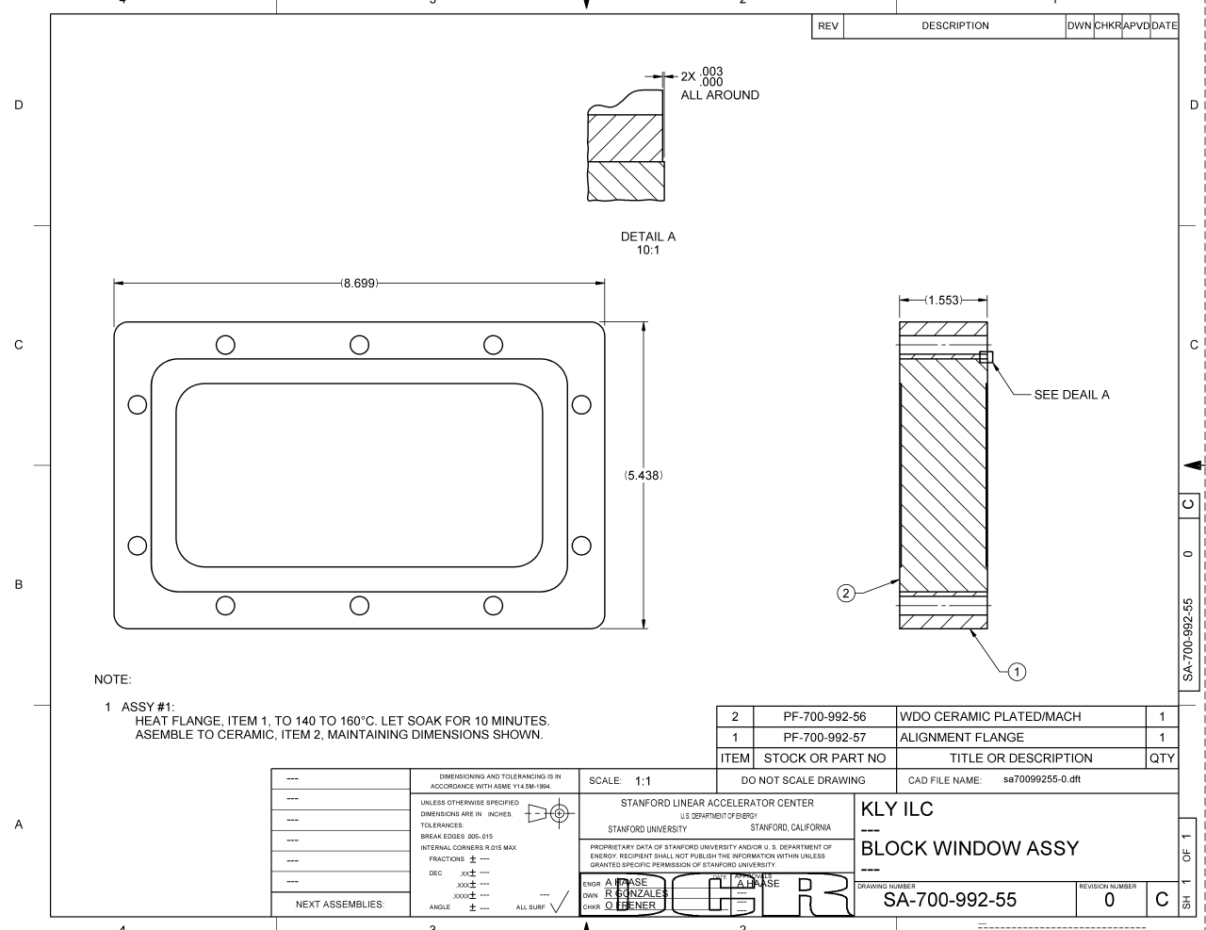
Window Power Handling
Maximum Power Needed per Cavity Fed:
287.2 kW (nominal for high power)
× 1.06 (timing)
× 1.04 (local losses)
× 1.20 (max gradient - all unlikely)
380 kW
→ 1 cav.: 380 kW
2 cav.: 760 kW
3 cav.: 1.14 MW
4 cav.: 1.52 MW
5 cav.: 1.90 MW
9 cav.: 3.42 MW
13 cav.: 4.94 MW
SLAC
Nantista & Neubauer
High power tested up to 3 MW, 1 ms.
Ceramic Plug Pressure Window

Slide 8
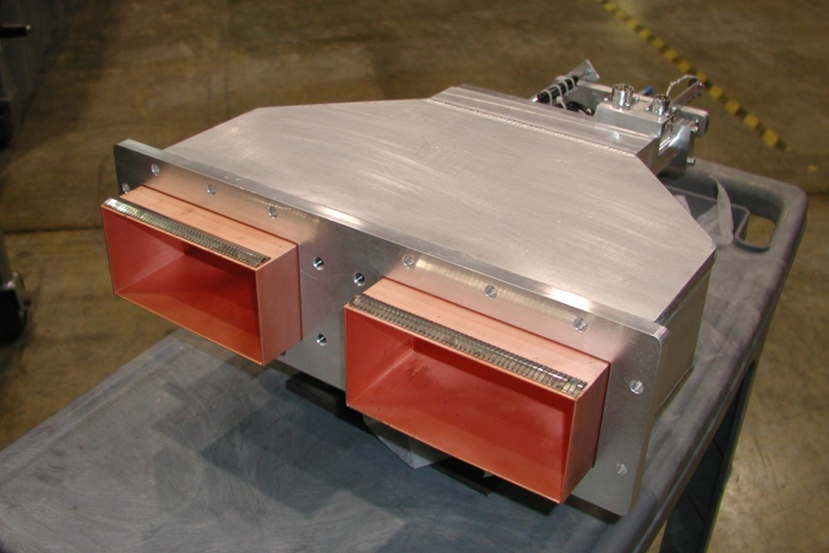
U-bend Phase Shifter
SLAC
Nantista
Tested to 2 MW
No significant field enhancement or mismatch.
Rate of phase change with mechanical position independent of position
mean loss: ~0.51% (-.0221 dB)
max reflection: ~0.025% (-36 dB)

Slide 9
Simplify Most Power Dividers
FULL RANGE
LIMITED RANGE
moving inner waveguide
outer box
back to load
E-plane bend into feed
For unpressurized, limited range
variable power dividers, use:
  non-pressurizable waveguide (after windows)
  ordinary (not folded) magic-T’s
  a single trombone + a U-bend (need phase shifters)
port lengths center range
nominal coupling | Δφ range | coupling range (cos²Δφ/2)
20% | 81.9°−171.9° | 0.5−57.0%
25% | 75°−165° | 1.7−62.9%
33% | 64.5°−154.5° | 4.9−71.5%
50% | 45°−135° | 14.6−85.4%
Set cavity phases right for nominal couplings by input waveguide length (spacers on E-plane U-bend).
Each divider can introduce a phase change of up to ±22.5°.
Phase shifters have a range of ~130° (± 65°), so it’s possible, but unlikely to get out of range by the 5th cavity in a group of 5.

Slide 10
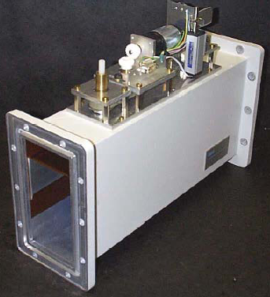
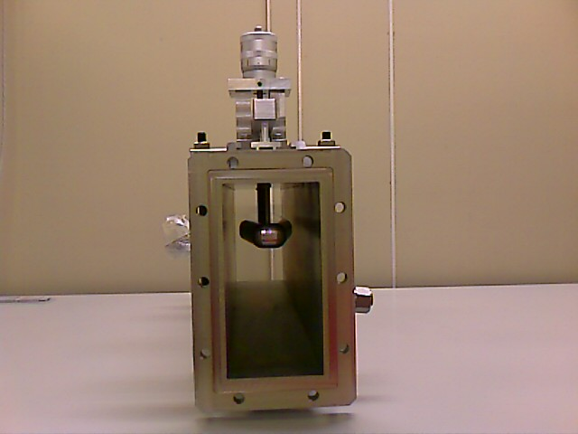
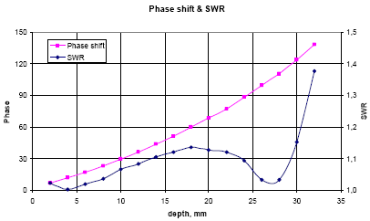
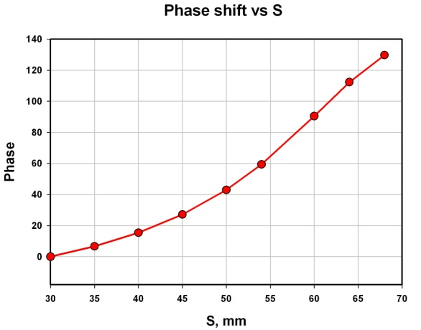
Phase Shifters
DESY/SPA Ferrite
KEK/Toshiba
Katalev & Choroba
Kazakov

Slide 11
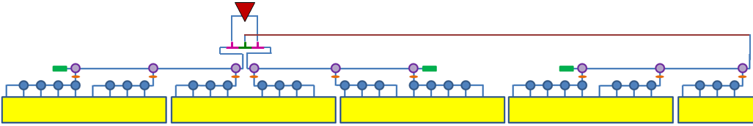
Streamlined PDS
pressurizable, 0-100%, phase stable
non-press., limited range
pressure window
5 MW load
Unused power can be dumped to the loads
Power to ½ CM’s fully adjustable without affecting phases.
from CTO
9 cavities
4 cavities quad 4 cavities
9 cavities
phase shifter on each feed, as well as isolator, bi-directional coupler, and flex guide.
RF UNIT: 3 cryomodules (26 cavities)
WR770
For low power Kamaboko Tunnel option, one klystron powers 1 ½ rf units or 4 ½ cryomodules (39 cavities).

Slide 12
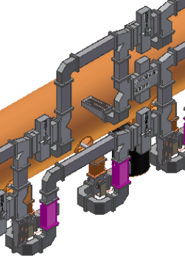
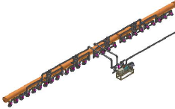
Shigeki’s Tree-Like Layout
w/ Kazakov hybrids
+ phase shifters
to neighboring ½ rf unit for low power
plus 2 var. cplr’s & 2 loads if excess power dumped near klystron.
4.8462
(incl. 1 near kly.)
6 windows
≤ 5 cav./window
Double branching used to avoid small coupling ratios, where Kazakov variable hybrid becomes highly sensitive.

Slide 13
4.231
8 windows
≤ 4 cav./window

Slide 14
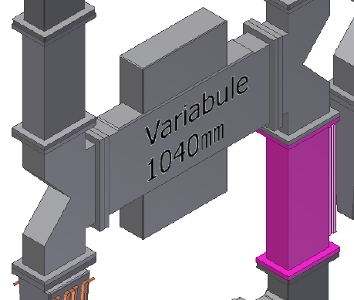
Options for PDS Power Splitting
VTO (mode rotator) – too long w/out pairing, not motorizable.
folded magic-T’s and U-bend phase shifters
magic-T’s,
U-bend phase shifter, and U-bend
magic-T’s,
U-bends, and customized spacers
Variable H-hybrid
motorizable
needs phase shifters
small coupling limited
motorizable
motorizable
needs phase shifters
custom machining?*
*stacked shims?

Slide 15
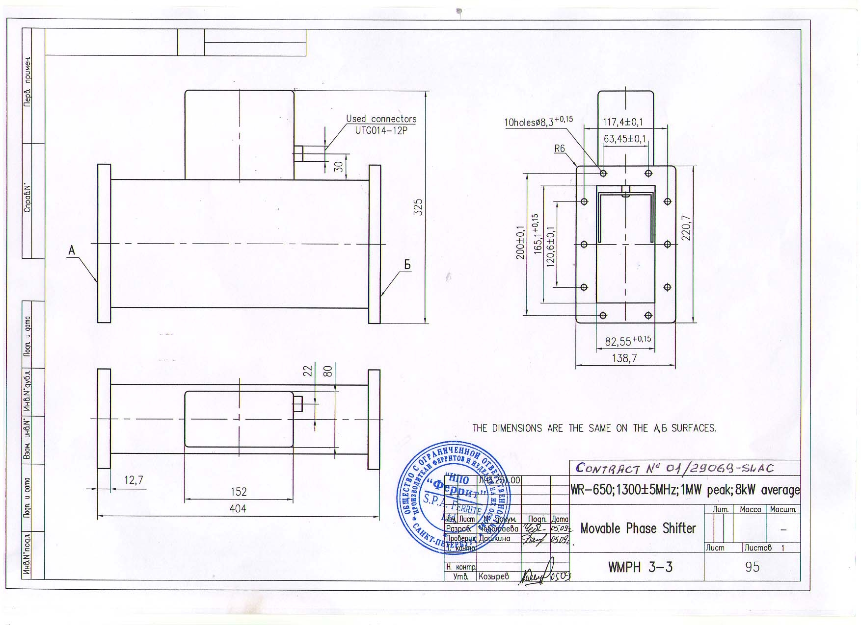


Slide 16
Klystron Cluster System (KCS) Layout
.…………………….
Christopher Nantista
SLAC
KILC, Daegu, Korea
April 23-27, 2012

Slide 17
Power Needed per Cavity
(low power)
For optimal coupling of power to beam:
Main Linacs are run at φ = 5° off-crest.
E_{acc} = 31.5 MV/m, L = 1.038 m, I_{b} = 5.7857 mA, R/Q₀ = 1,036 Ω
V_{eff} = E_{acc} cosφ L = 32.5726 MV
In-phase power: P_{0,i} = I_{b}V_{eff} = 188.4546 kW into beam
Q_{L} = 5.434×10⁶, t_{i} = 922.3 μs
Out-of-phase power: P_{0,o}(t<t_{i}) = P_{0,i} tan² 5° = 1.4425 kW
P₀(t<t_{i}) = 189.897 kW
P₀(t<t_{i}) = 188.815 kW
360.6 W
Drop out-of-phase component to steady state value at beam injection.

Slide 18
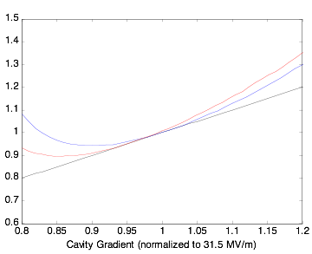
Achieving Flat Gradient w/ Common Timing
With control of P_{k}, Q_{e}, and t_{i}, can achieve flat acceleration at desired cavity gradient, with no power reflected during the beam pulse.
With 39—676 cavities locked to a common source timing,* flat acceleration over a range of gradients is still achievable by adjusting P_{k} and Q_{e}, albeit with some level of power reflected into isolator loads.
For a flat distribution
0.8 ≤ V/V₀ ≤ 1.2,
w/ common timing
~5.35% extra power is needed on average
(5.08% added loss reflected into isolators)
For a given distribution of gradients, the timing can be set so as to minimize the average reflected power.
Q_{L}/Q_{L0}
P/P₀
~4.26% extra power
* For upstream(downstream) KCS feeding, the effective spread in fill time is ~7.64(0.40) μs, roughly 1.28%(.07%) of the nominal fill time and has little effect on efficiency.

Slide 19
Peak RF Power Required from Klystron for RDR-Like feeding of 1.5 26-Cavity RF Units
(Low Current)
189.9 kW (nominal to beam per cavity)
× 39 (cavities fed) ~7.406 MW
÷ 0.965 (big circulator and WR650 losses)
÷ 0.94 (6% local distribution losses) ~8.164 MW
÷ 0.983 (WR770 run to other ½ rf unit)
× 1.054 (for flat gradient w/ cavity gradient spread and common timing)
× 1.062 (for statistical spread in feed/rf unit requirements)
÷ 0.933 (cos² 15˚, counter-phasing to give 7% (5% usable) overhead for LLRF
9.965 MW from klystron

Slide 20
Eliminate KCS Backup Klystrons
Power needed per 26(25) rf unit KCS KCS: ~193.26 MW (~185.19 MW)
With backups for a single failure per KCS:
(21/22)² × 22 × 10 MW = 200.45 MW
(20/21)² × 21 × 10 MW = 190.48 MW
→ 22 klystrons (21 on) for 26 rf units
→ 21 klystrons (20 on) for 25 rf units
3.7% extra
2.9% extra
If we eliminate backup spares, we can drop to:
→ 20 klystrons for 26 rf units
→ 19 klystrons for 25 rf units
3.5% extra
2.6% extra
Then if one klystron fails in a KCS:
(19/20)² × 20 × 10 MW = 180.5 MW 9.75% drop
(18/19)² × 19 × 10 MW = 170.53 MW 10.25% drop
6.6% low
7.9% low
Squeeze overhead power out of remaining klystrons (~3%).
Detune one cavity in each set of 13 (7.7%) fed by a CTO port.
Adjust PDS power division to reestablish operating conditions in other cavities.
Regain energy by bringing into play 2 of 4.5 available overhead rf units.
Then one loses 26 rf units × 2 cavities/rf unit = 52 cavities
→ 52 cav. × ~32.58 MeV/cav. = ~1.69 GeV (0.68%)
For Kamaboko option, one klystron loss costs 39 cavities
→ 39 cav. × ~32.58 MeV/cav. = ~1.27 GeV (0.51%)
TOTAL ML KLYSTRONS
RDR-Like (Kamaboko): 188 + 190 = 378 (374 on)
KCS (no backup): 17×20 + 5×19 = 435 (15% more)
KCS (backup): 17×20 + 5×19 = 479 (457 on) (27% more)
Overhead allows for 3 failed klystrons per main linac for Kamaboko and 2 for KCS (as long as not in the same KCS).

Slide 21
Copper Plate KCS Circular Waveguide?
σ = 2.459 ×10⁷ Ω⁻¹m⁻¹ (6061-T6 Al)
f = 1.3 GHz (k₀ = 27.246 m⁻¹)
δ_{s} = (μ₀πfσ)^{-1/2}
R_{s} = 1/(σδ_{s}) = √μ₀πf/σ = 0.0144
k₀ = 27.246 m⁻¹
R_{s} = 0.0144
χ_{0,1} = 3.8317
TE₀₁:
= 6.771×10⁻⁵ m⁻¹
, a = 0.24 m
= 2.404×10⁻⁴ m⁻¹
, a = 0.1746 m
→ σ = 5.8 ×10⁷ Ω⁻¹m⁻¹ (Cu)
R_{s} = 1/(σδ_{s}) = √μ₀πf/σ = 0.00941
TE₀₁:
α = 4.41×10⁻⁵ m⁻¹
, a = 0.24 m
α = 1.57×10⁻⁴ m⁻¹
, a = 0.1746 m
a=0.24m: L₁=37.039m
a=0.1746m: L₂=1.75m
Power attenuation per rf unit (6061 Al): e^{-2αL} → exp(-2α₁L₁) exp(-2α₂L₂)=.9967385× .9994507= 0.996191
=.9967385× .9991590= 0.995900
Tunnel pipe loss goes from 7.15% to 4.70% (or ~5.05% if WC13.75 not plated). Gain 2.6%.
Combining, bends, & shaft loss ~2.77% → ~1.82%. Gain 0.98%.
Overall, copper plating gains ~3.64%.
9.72% loss → 6.43% loss

Slide 22
Peak RF Power Required from Klystrons per KCS feeding 26(25) 26-Cavity RF Units
(Low Power)
Sort CM’s for installation to accommodate power requirements to measured relative installed CTO power couplings.
189.9 kW (nominal to cavity)
× 26 (cavities/rf unit) 4.937 MW
× 26 (25) (rf units) 128.37 MW
÷ 0.933 (cos² 15˚, counter-phasing for 7% LLRF overhead, 5% usable)
÷ 0.950 (input circulator and WR650 loss)
÷ 0.990 (0.9904) (1.00%(0.96%) combining CTO circular waveguide ohmic losses)
÷ 0.982 (klystron combining CTO ±0.2dB errors)
÷ 0.9821 (1.79% shaft and big bends loss)
÷ 0.953 (.9548) (4.70%(4.52%) main KCS waveguide loss)
÷ 0.96 (tunnel CTO ±0.2dB errors)
× 1.062 (for statistical spread in feed/rf unit requirements)
× 1.059 (for flat gradient w/ cav. gradient spread and common timing)
÷ 0.94 (6% local distribution losses)
188.3 MW (180.6 MW) from klystrons
~0.8539
×~1.05?
~0.7984
19 (20?) klystrons for 26 rf units
18 (19?) klystrons for 25 rf units
TOTAL KLYSTRONS: 17×19 + 5×18 = 413
RDR-Like (Kamaboko): 188 + 190 = 378

Slide 23
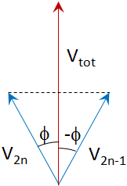
Klystrons Needed per KCS (Low Current)
The calculation/estimate suggests we need generate ~185 MW worth of klystron power for a 26 rf unit KCS at I_{b} = 5.79 mA.
However, we need 7% (5% usable) overhead for LLRF to be harnessed via phase control of the rf drives, oppositely dephased in pairs, such that the combined power is reduced as P = P_{max} cos² φ, with φ nominally 15˚.
The maximum power requirement rises to 185 MW/0.933 = ~198.3 MW.
We also want to be robust against a single klystron failure per system.
With N sources combined in a passive network, failure of one source leaves combined the equivalent of (N-1)²/N sources.
With 21 klystrons and 20 on, we have 190.5 MW available (~4% short).
With 22 klystrons and one off, we have 200.45 MW (~1% to spare).
21 klystrons for the 25 unit KCS (need ~190.7 MW)
13 klystrons for the 16 unit KCS @ 27.6° (need ~108.6 MW)
TOTAL: 17×22 + 5×21 + 2×13 = 505 klystrons installed (481 on)

Slide 24
KCS Shafts and RF Units per KCS
1/30/12
Latest Changes:
Back to 9-8-9 (26 cavity) rf units.
2nd stage bunch compression at 15 GeV → 10 GeV accel. moved from each main linac to RTML2.
Since the latter are in-line w/ the main linacs, we can power them with upstream KCS’s running
past the BC’s from the first shaft at the start of each main linac.
Add 3 rf units (~1%) to each linac for overhead.
presented at BTR in January 2012
RTML2’s: 10 GeV ÷ (27.1 MeV/m*×cos27.6°×1.038 m/cav.) = ~401 cav.
401 cav. ÷ 26 cav./rf unit = 15.42 rf units → RTML2: 16 rf units
Main Linacs: (250 GeV–15 GeV) ÷ (31.5 MeV/m(avg.)×cos5°×1.038 m/cav.) = 7,215 cav.’s
7,215 cav. ÷ 26 cav./rf unit = 277.5 rf units + 1.5 = 279 rf units (186 RDR-like units)
→ e⁺ ML: 282 rf units (4×25 + 7×26)
e⁻ ML: 285 rf units** (1×25 + 10×26)
Add 3 rf units per ML for ~1.5%overhead
-- main facilities shaft
-- additional KCS shaft
undulator
26
26
26
26
26
26
26
26
26
26
25
16
I.P.
BC2
e⁻ beam
16
26
25
25
25
25
26
26
26
26
26
26
I.P.
BC2
e⁺ beam
NOTE: Feasibility of feeding RTML w/ KCS must be confirmed.
total: 599 rf units (567 ML + 32 RTML)
1,797 cryomodules
15,574 cavities
* all cavities same gradient for off-crest common rf control.
** 3 more to restore up to 2.54 GeV loss in undulator.

Slide 25
KCS Final Layout
3/20/12
-- main facilities shaft
-- additional KCS shaft
-- cryogenic systems
## -- 3-CM rf units
# -- 4-rf unit cryostrings
# -- 3-rf unit cryostrings
e⁻ beam
I.P.
undulator
25
26
26
26
26
26
26
26
26
26
26
12+1
13
13
13
13
5+2
e⁺ beam
26
26
26
26
26
26
26
25
25
25
25
I.P.
5+2
13
13
13
11+2
11+2
main linac totals: 12 shafts
22 KCS’s
567 rf units (285+282)
1,701 cryomodules
14,742 cavities

Slide 26
Evolving KCS Parameters
separate RTML
add 1.5% overhead
eliminate spare klys.
Cu plate main wg
10 GeV → RTML but included,
8-8-8→9-8-9
rf units added from RTML
half bunches
9-8-9→8-8-8
 | 9/2010 BAW1 | 3/2011 ALCPG11 | 9/2011 LCWS11 | TDR LCWS11 | 1/2012 BTR | 4/2012 KILC
# of shafts / main linac | 5 | 6 | 6 | 6 | 6 | 6
# KCS systems /ML | 10 | 11 | 11 | 12 | 11 + 1(RTML) | 11
# of rf units /ML (e⁺/e⁻) | 280/284 | 290/294 | 314/319 | 314/319 | 278+15 / 282+15 | 282/285
# of rf units (CTO’s) / KCS | 28 | 27 | 29 | 27 (22) | 25−26, 15 | 25−26
linac length fed / KCS (km) | 1.064 | 1.026 | 1.024 | 0.994 | 0.965−1.003, 0.58 | 0.965−1.003
# of cryomodules / KCS | 84 | 81 | 87 | 81 | 75−78, 45 | 75−78
# of cavities / KCS | 728 | 702 | 696 | 648 | 650−676, 390 | 650−676
# of klystrons&mod.’s / KCS | 34 | 33 | 33 | 22 (18) | 21−22, 14 | 18−19
peak rf power /system (MW) | 340 inst. 330 gen. 320 into | 330 inst. 320 gen. 310 in | 330 inst. 320 gen. 310 in | 220 inst. 210 gen. 200.5 in | 220 installed 210 generated 200.5 into syst. | 190 inst. 190 gen. 190 in

Slide 27
AC Power and Heat Loads (KCS)
(Low Power)
For both main linacs, excluding second RTML stage
Average rf power: 413 klystrons × 10 MW × 1.65 ms × 5Hz = 34.1 MW
Average beam power: 5.79 mA × 472.54 GV × 727μs × 5Hz = 9.945 MW (26.4%)
wall plug–modulator pulse efficiency: ~87%
modulator pulse–HPRF efficiency: ~65% ➔ wall plug – HPRF: ~57%
34.1 MW / 0.57 = 59.8 MW AC
59.8 MW(AC) – 9.95 MW(beam) = 49.9 MW ML cooling
.57 AC to rf
.854 comb. into shaft
.798 shaft to cav.
.437 cav. to beam
.1698
~16.6% efficient
0.487 → 51.3% lost above ground: ~30.7 MW
0.349 → 31.7% lost below ground ~19.0 MW
~17% into beam/beam dumps ~10.1 MW

