Slide 1
Cornell Updates
Commissioning of T-map for ILC single cell starts.
3-cell re-entrant is under prep. for VT.
Flatness tuning done, VT is planed at end of this month.
New VT insert w/ T-map for multi-cell is under assembly, commissioning will start next month.

Slide 2
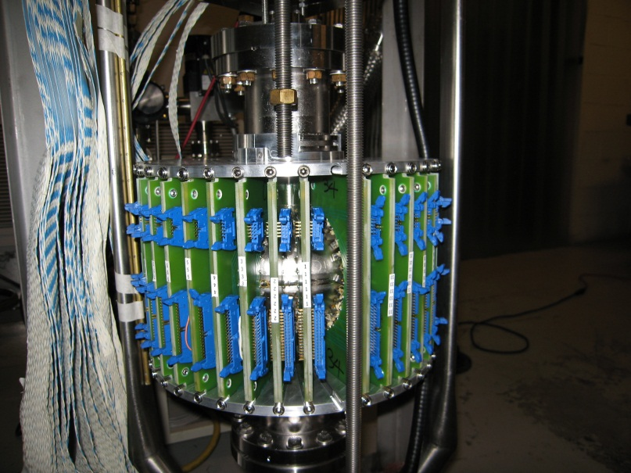
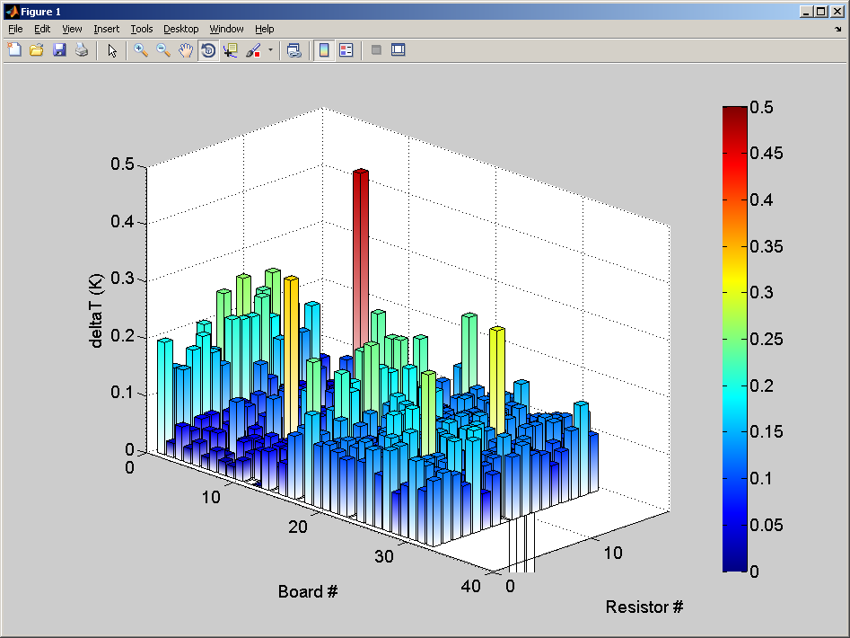
Cornell Updates
Initial test of T-map for ILC single by Sam
One of the data analysis for two bords.
iris
equator
iris
*preliminary T-map data, not yet calibrated well.
T-map system works well.
Data calibration and analysis is on going.
Additional test is planed for system commissioning.

Slide 3
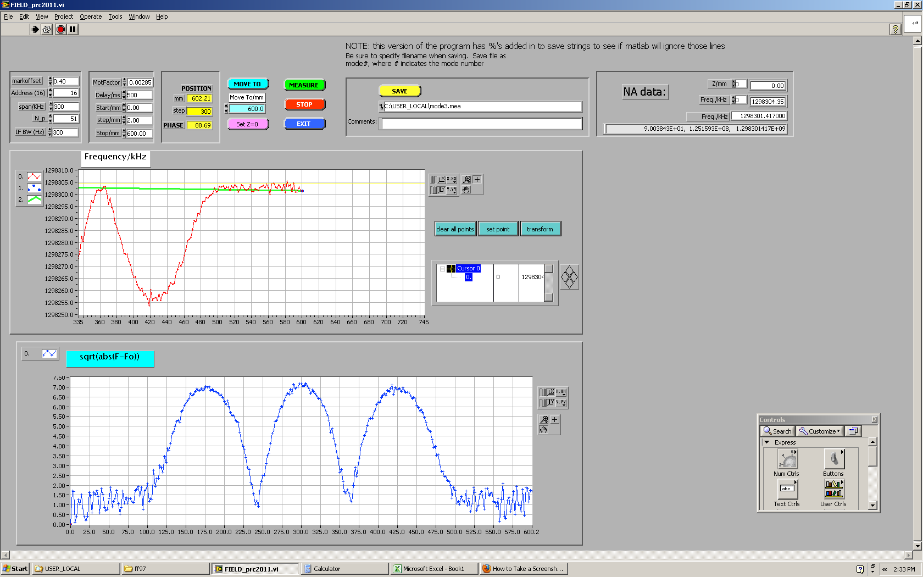
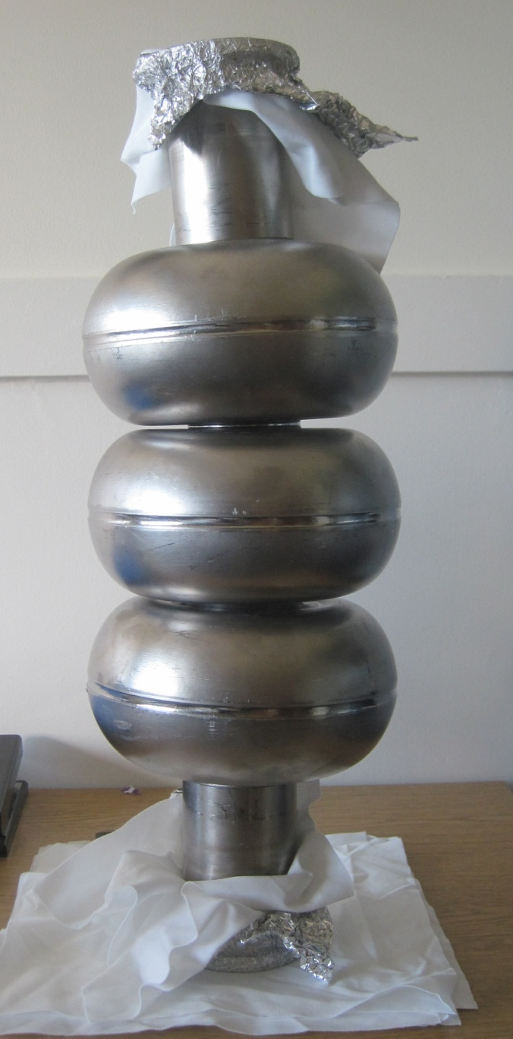
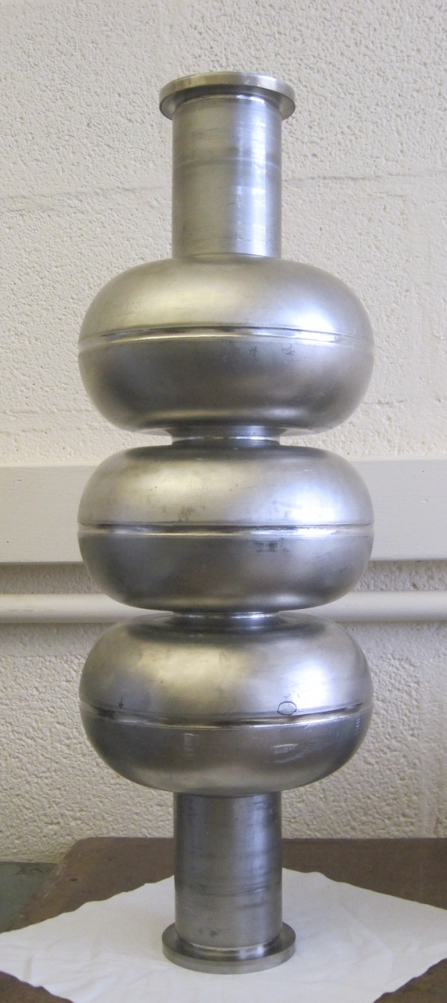
Cornell Updates
3-cell re-entrant by Fumio
Previous VT results of LR3-1, 14April2009
History
Oct-Dec2008 Tumbling,
29Jan2009 VEP(200um),HT(800C x 2h),
Micro-VEP, USC, HPR, 120C Bake,
15Apr2009 VT, Q-disease,
20May2009 HT (800C x 2h) again,
cavity stuck with furnace
and deformed when took out.
Eacc=25.3MV/m
Qo=2.0E+09
Plan
> straighten cavity, done.
> inspection, done.
> Flatness tuning , done.
> HPR + VT are planed to check the status.
> additional process + VT.
Flatness = 96%

Slide 4
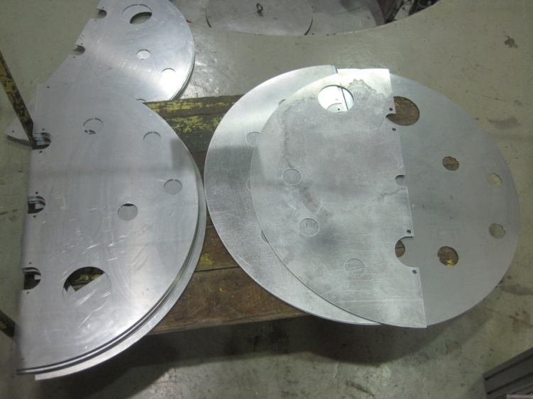
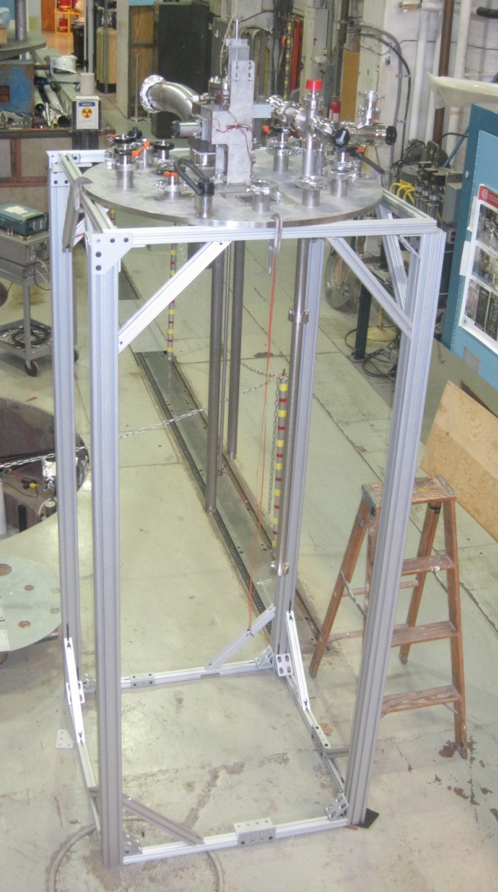
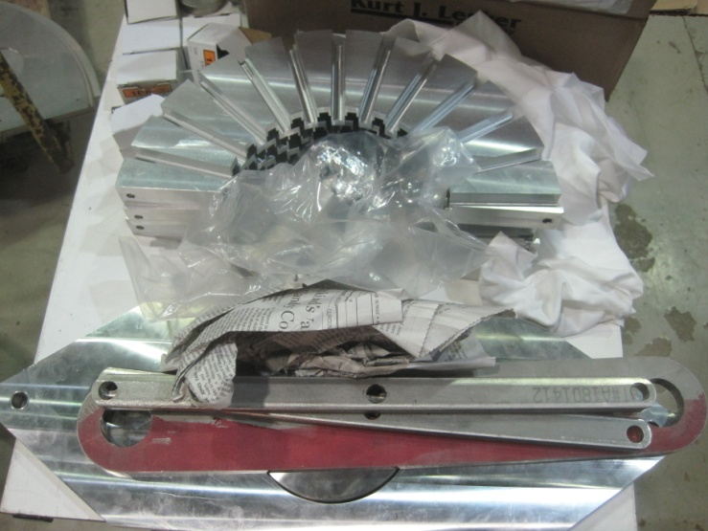
Cornell Updates
New VT insert w/ T-map for multi-cell by Mingqi.
New insert
Temp. shields
T-map boards support

Slide 5
Fermilab S0 News
TB9ACC015
  Limiting pit was tumbled away, ~18 MV/m -> ~35 MV/m
  Test Oct.27: 35 MV/m with Q0=1E10
    Reaches ILC spec in gradient and Q0, but still high field emission
    Cavity was tested with add’l FE instrumentation (Faraday cup) as part of instrumentation development
TB9NR004
  First test after standard EP at FNAL/ANL facility
  Test Nov.1: 30 MV/m with Q0=1.2E10, also had significant FE present
One1-cell for R&D, and one JLab beta=0.61 1-cell for PrX were tested
No more 9-cell vertical tests until mid-January
  VTS upgrades and cryogenic system downtime started
  Limited 1-cell tests will be available at the A0 facility
  Processing continues to prepare (stack up) cavities for when VTS is back up
Next cavities
  8 ARRA Niowave-Roark 9-cells arrived late Oct; not through inspection yet
    Remaining 2 had equator weld blow-throughs which have to be repaired – plan underway

Slide 6
JLab Status: 9-Cell Cavities
  DESY seamless 9cell#1 RF test following Ethanol rinsing and additional HPR
    Pi-mode quench limit 21 MV/m due to probably one defect in cell#4
    7 out of 9 cell reached Pi-mode equivalent gradient in range of 33-42 MV/m
    Thermometry test next week
  JLAB LG#1 Medium Pressure Rinse (MPR) completed following local grinding at quench-causing defect in cell#6 (done in August at JLab by K. Watanabe and H. Hayano)
    Light EP next week
  ICHIRO 9-cell cavities
    ICHIRO8 vertical bead pull completed, tune for flatness is next, light EP before Christmas, vertical test in January 2012
  MHI#8 and ICHIRO#7 are returned to KEK
  New 9-cell cavity fabrication (SLAC LSF shape) under way

Slide 7
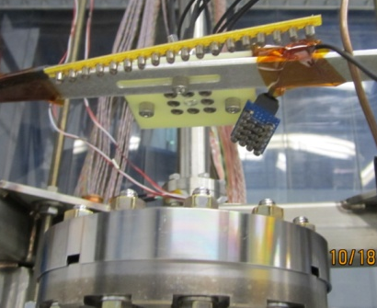
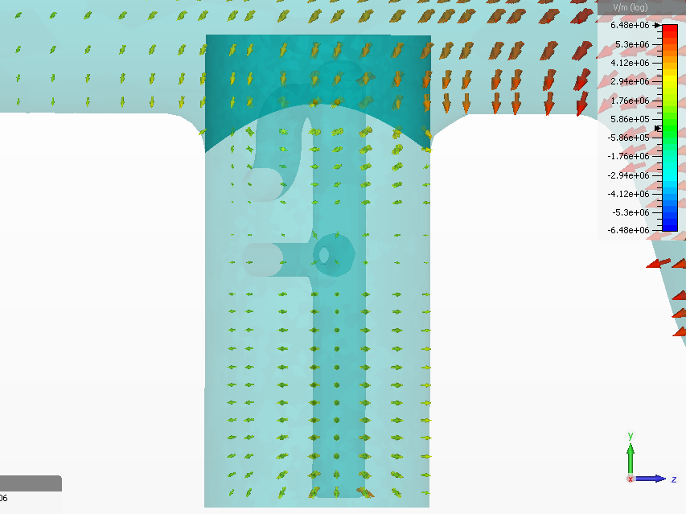
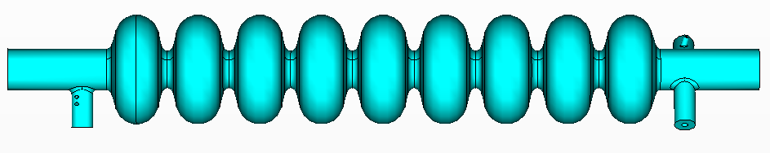
JLab Status:
Cryogenic Radiation Instrumentation & Dark Current Simulations
Cryogenic radiation instrumentation
  KEK Si diodes validated and checked for sensor variability and sensitivity (with respect to the standard JLab VTA radiation detector)
Dark current Simulations
  TESLA 9-cell models being looked at using Omega-3P and CST MWS
    Looking at peak electric field at HOM coupler tip among other things
  Track-3P to be used for simulation of field emitted electrons
A. Palczewski
Y.M. Li

