Slide 1
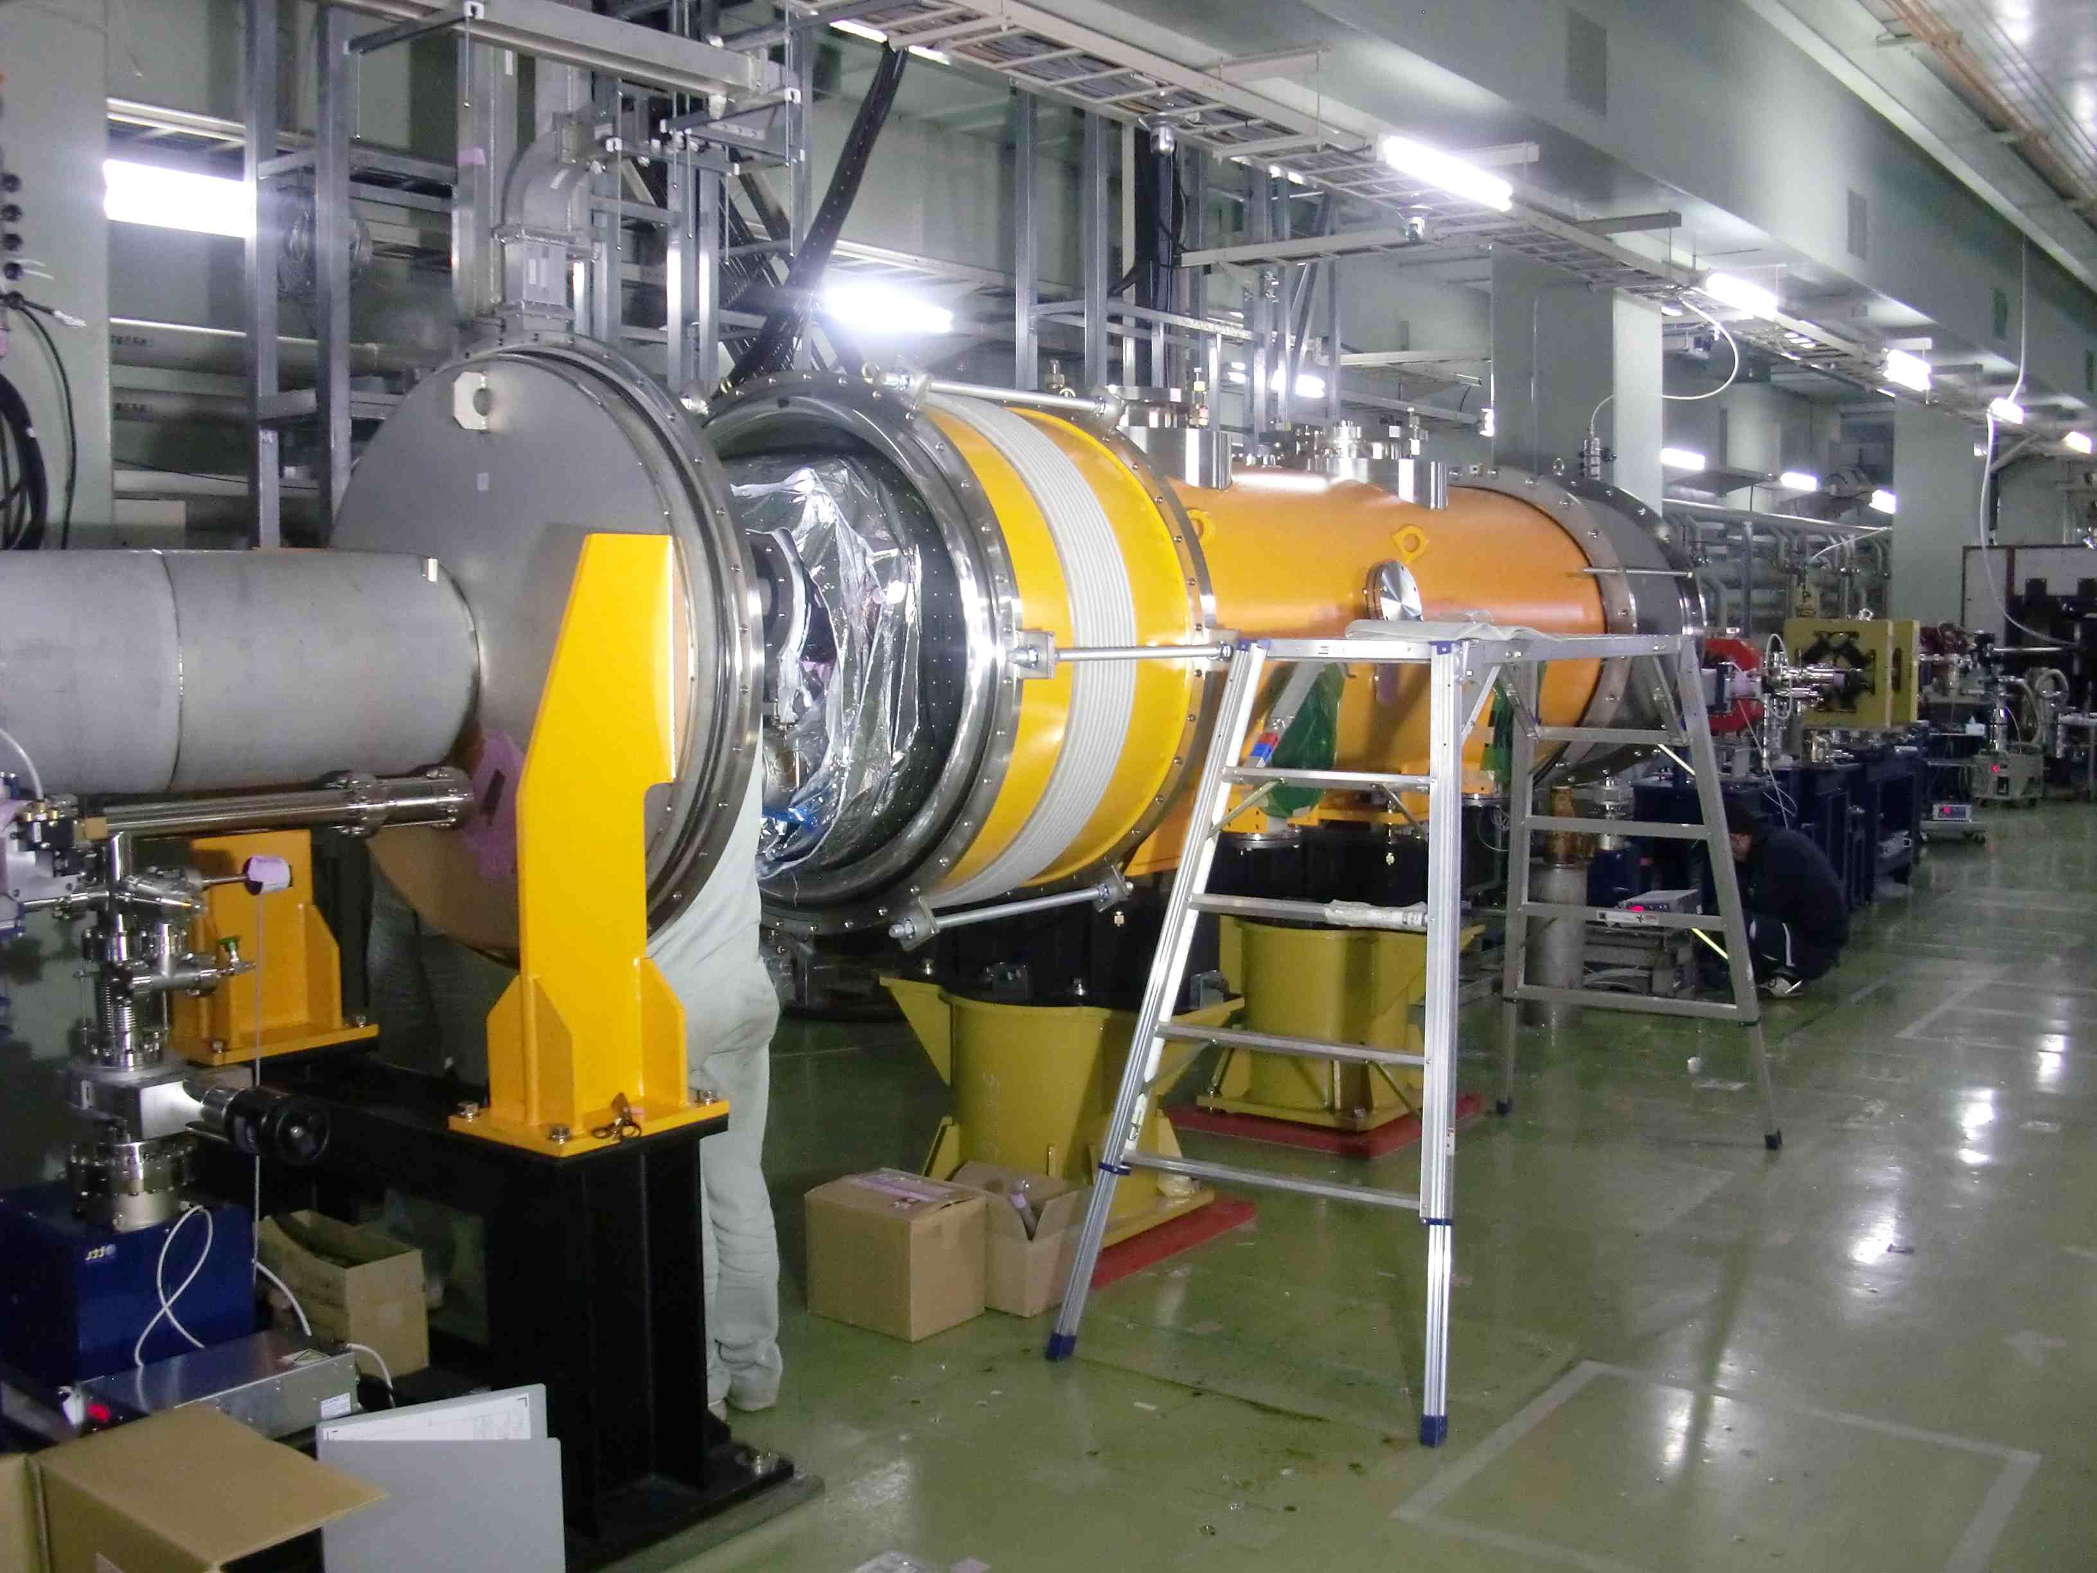
2011.11.22: Hayano
Cavity status; recent KEK activities
(1) MHI-012, MHI-013 cavities were installed into capture cryomodule,
and now placed in the tunnel.
(2) STF CM-1 cavities are;
MHI-014: finished with 36MV/m
MHI-015: local grinding repaired, waiting for final-EP and VT
MHI-016: local grinding repaired, waiting for bulk-EP
MHI-017: finished with 38MV/m
MHI-018: Bulk-EP, then optical inspection
MHI-019: Bulk-EP, then optical inspection
MHI-020: Bulk-EP, then optical inspection
MHI-021: waiting for bulk-EP
MHI-022: waiting for bulk-EP
* Vertical test priority is now in ERL 9-cell and ERL 2-cell cavities.
In parallel, capture cryomodule installation in beam-line is under way.
S1-Global disassembly started.

Slide 2
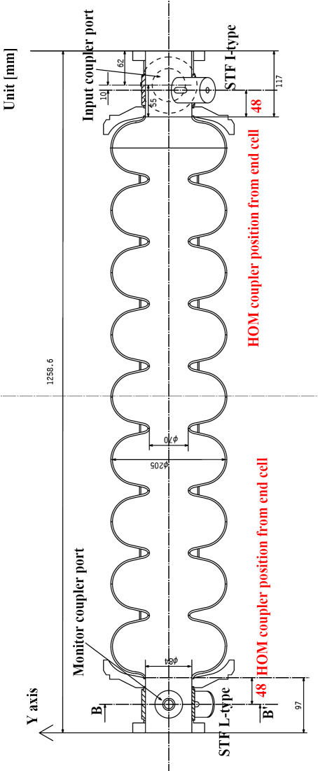
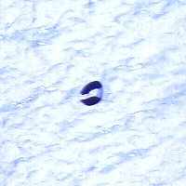
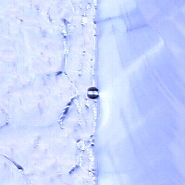
空洞名 | 内面検査前の空洞の状態 | 検査日 | 測定者
MHI #18 | EP1後の検査 | 2011/9/5 | 今田 信一
7cell equator, t=235 deg
downstream.
5cell equator, t=236 deg
MHI-018
Kirk

Slide 3
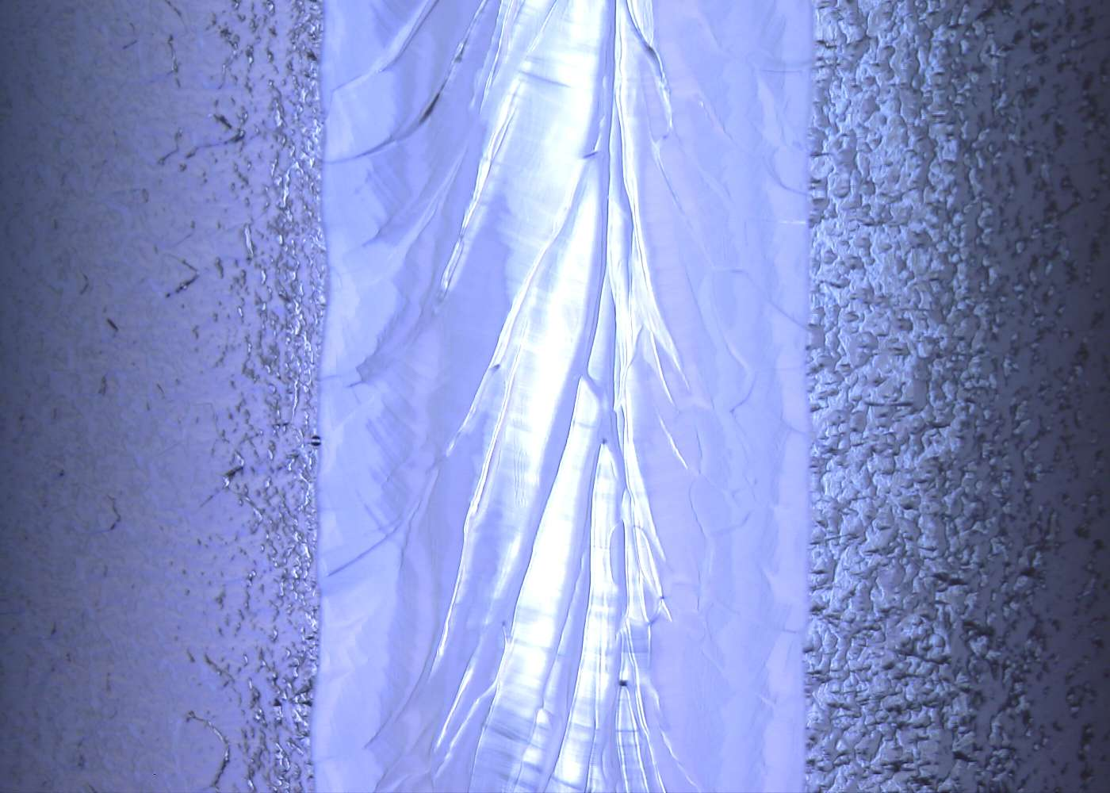
MHI-18 5cell eq , t=236 deg.
Air
Nb
MHI-018
Kirk

Slide 4
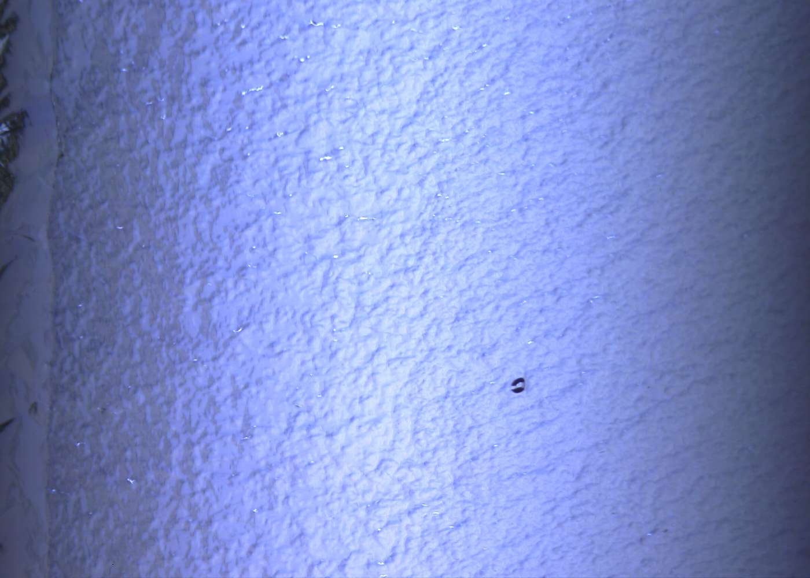
MHI-18 7cell eq-down , t=235 deg.
Air
Nb
MHI-018
Kirk

Slide 5
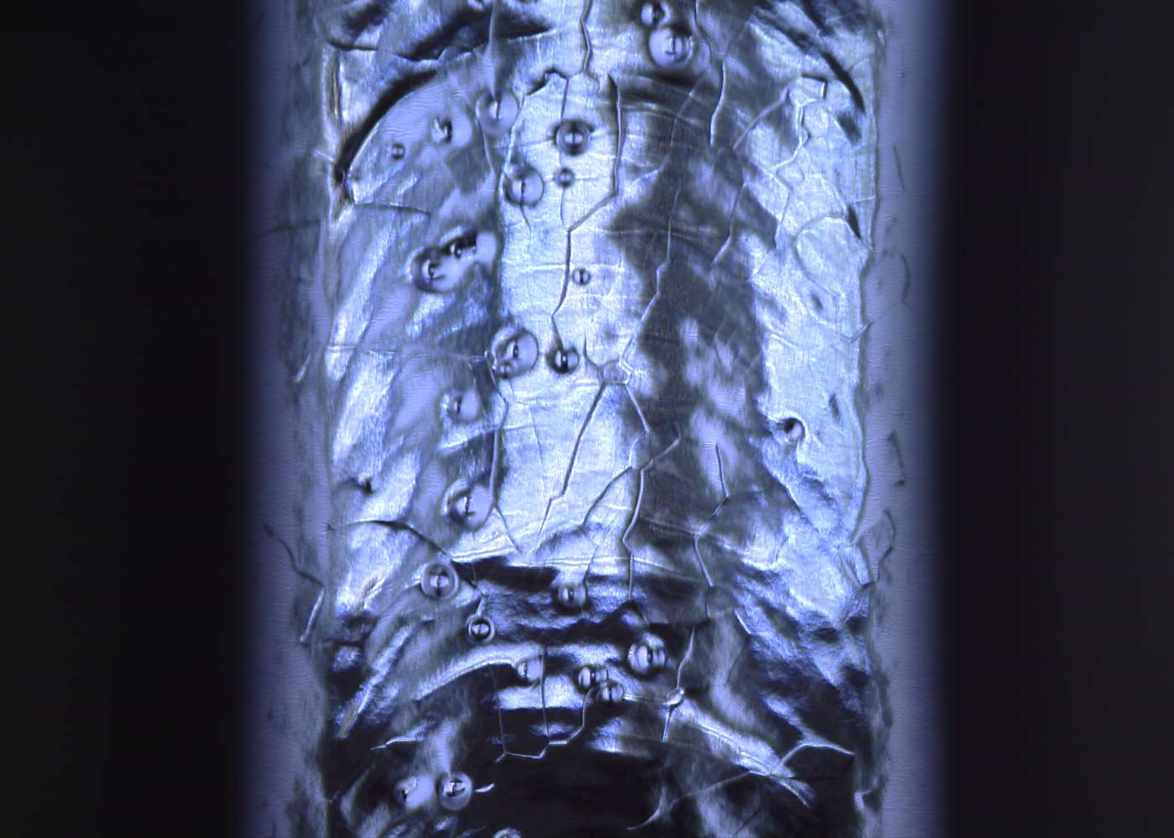
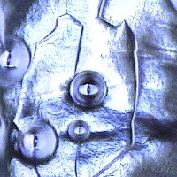
MHI-18 bp-top-cell , t=79 deg.
many pits on beam-pipe weld seam
MHI-018
Kirk

Slide 6
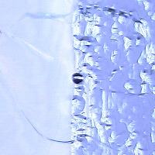
空洞名 | 内面検査前の空洞の状態 | 検査日 | 測定者
MHI #19 | EP1後の検査 | 2011/9/9 | 今田 信一
5cell equator, t=324 deg
MHI-019
Kirk

Slide 7
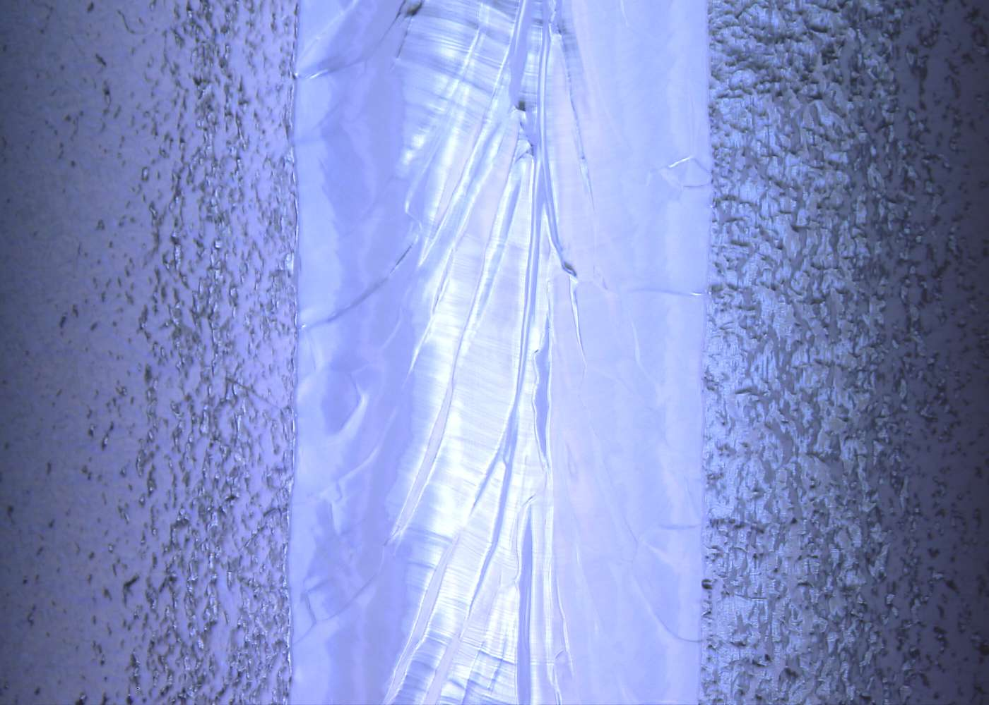
MHI-19 5cell eq , t=324 deg.
Air
Nb
MHI-019
Kirk

Slide 8
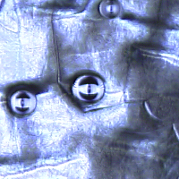
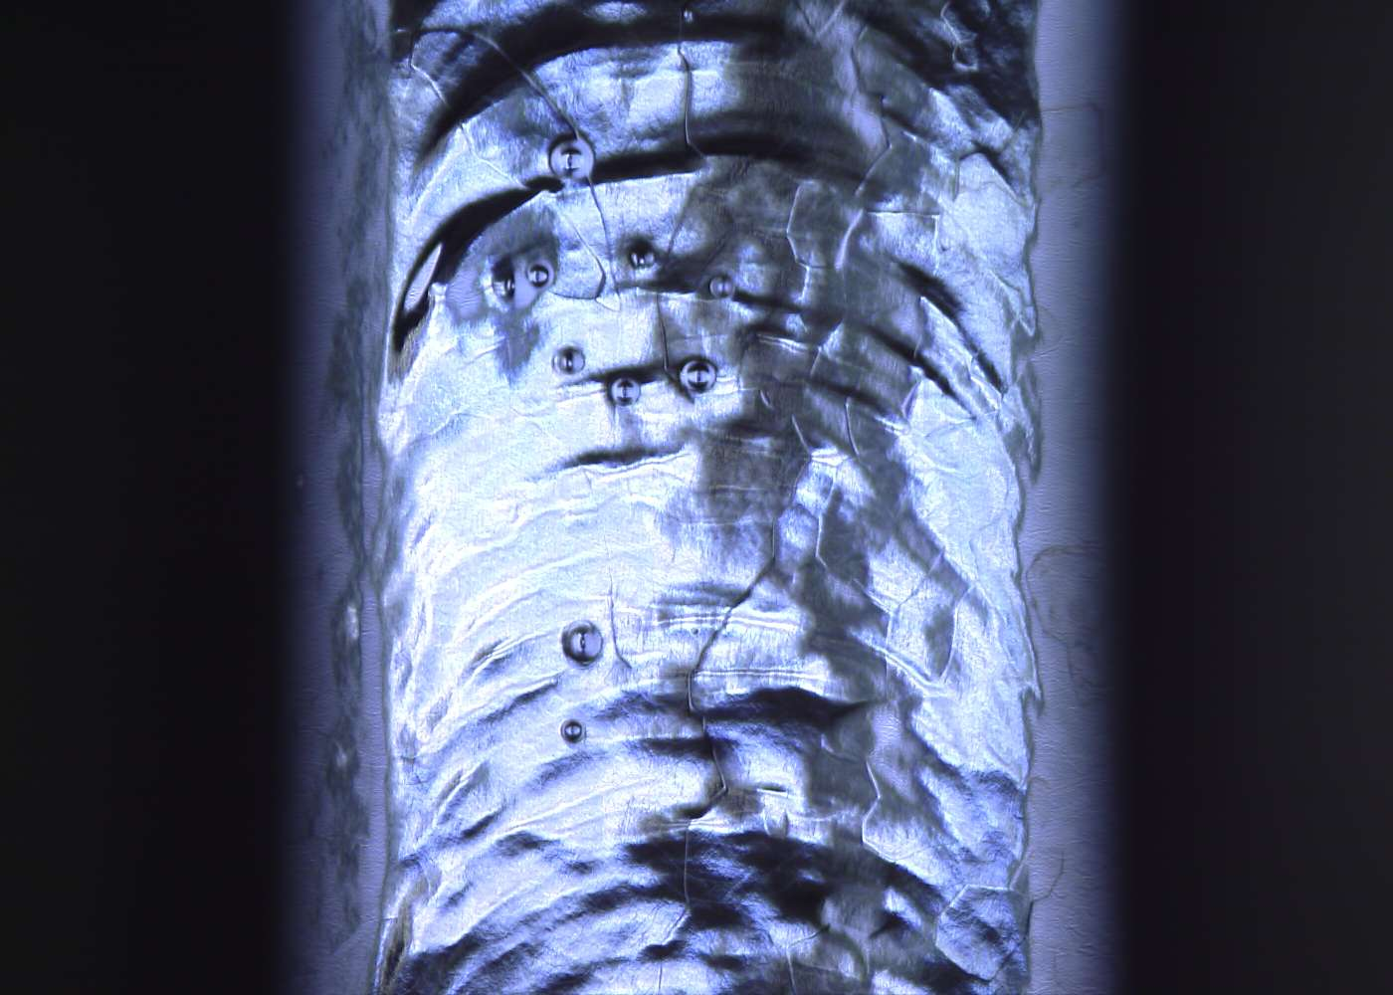
MHI-19 bp-top-cell , t=66 deg.
many pits on beam-pipe weld seam
MHI-019
Kirk

