Slide 1
Experimental hall in Japanese mountain site
2011/11/30
Yasuhiro Sugimoto
@GDE CFS Webex meeting

Slide 2
Outline
Experimental hall
Access tunnel
Detector assembly
Safety issues

Slide 3
Experimental hall
Recent modifications:
  Two access tunnels are connected on the same side of the cavern
  Two alcoves (garages) are connected on the same side of the cavern
  Access tunnel to SiD is enlarged to 9m
  Access tunnels and the cavern have the same floor level in the central region (No down-and-up for SiD under the beam tunnel)
  New small access tunnels to the garages
  Sub cavern for Helium compressor and liquefier
  Detector services are placed at the both ends of the cavern (on the walls)

Slide 4
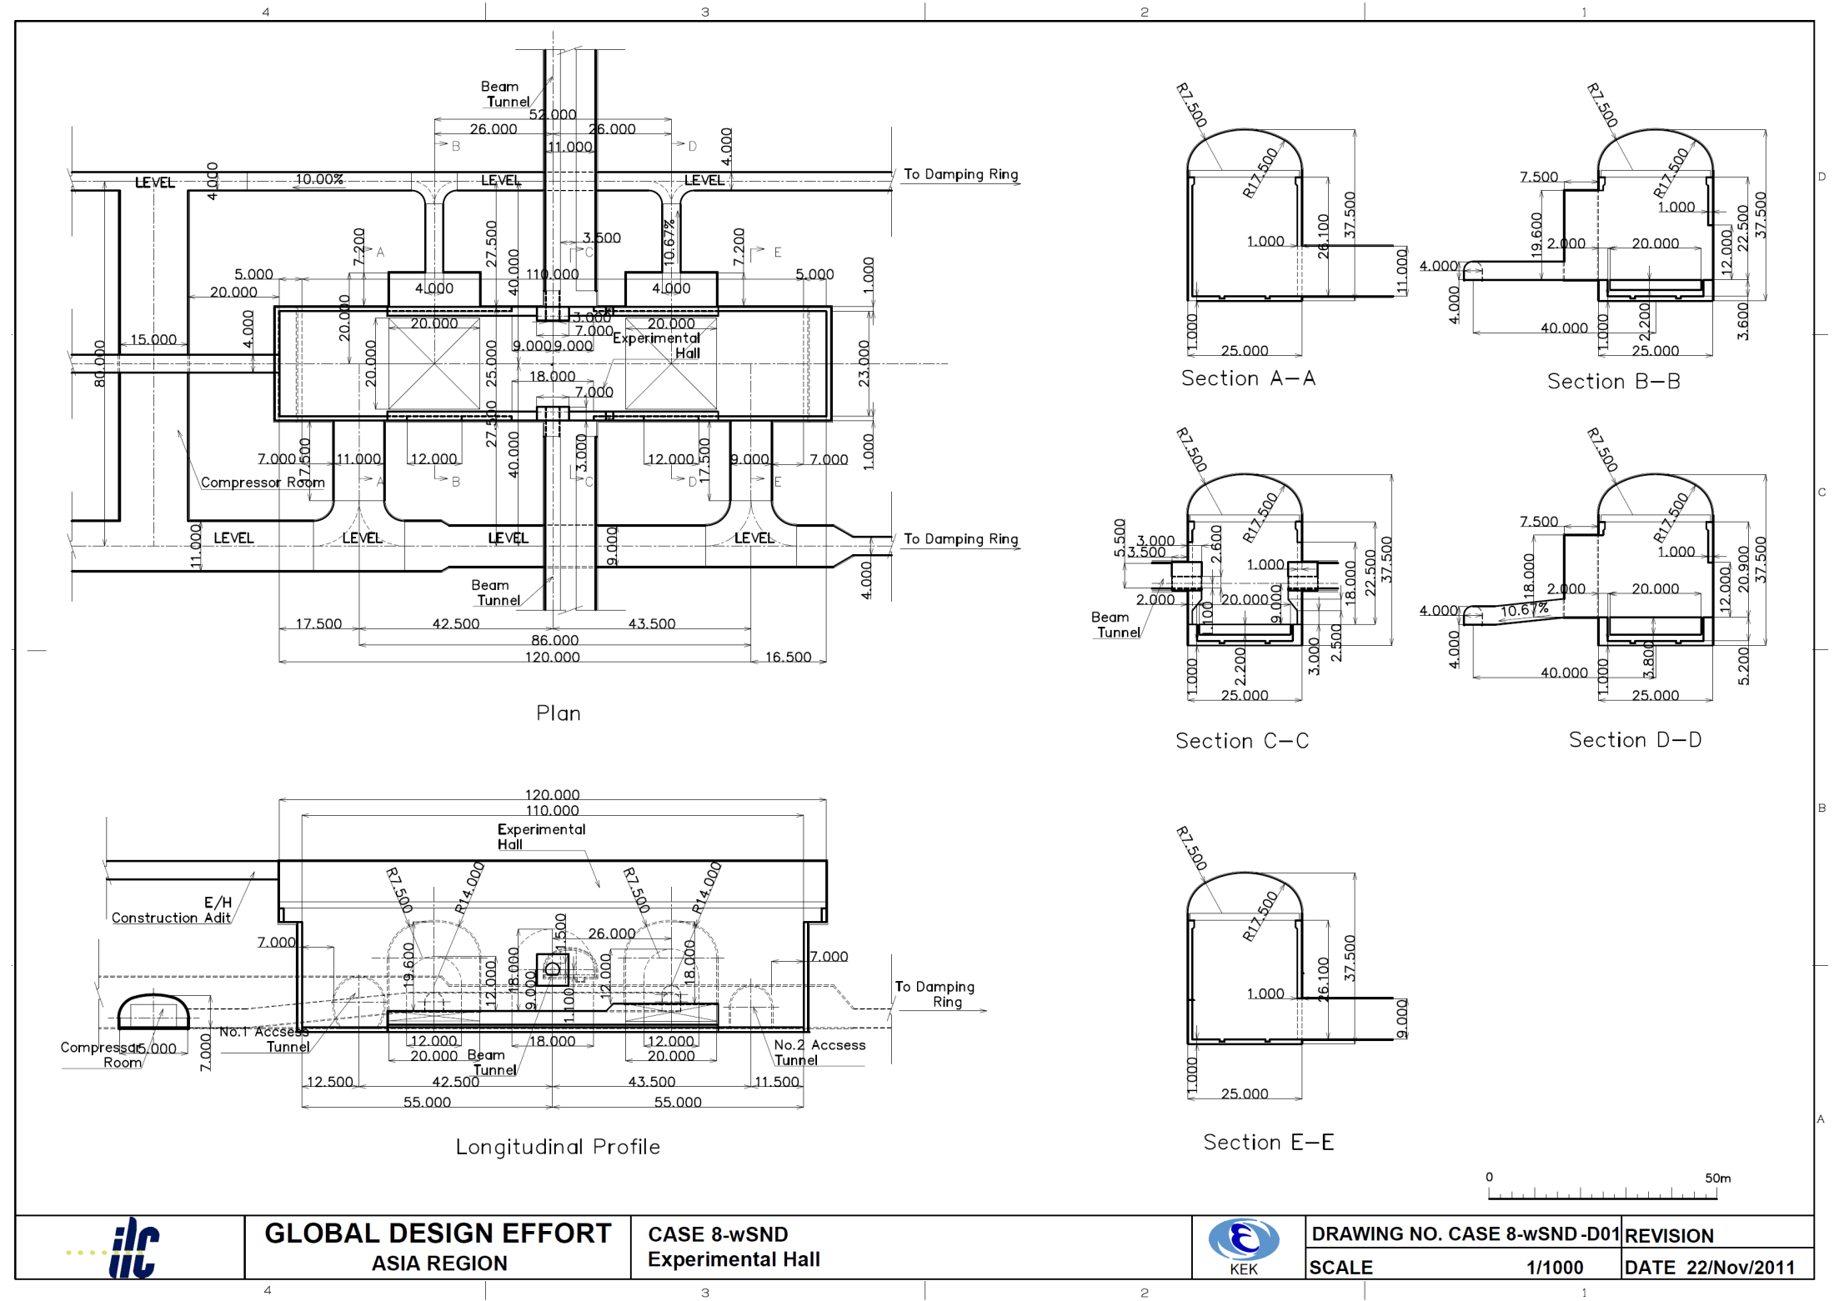
Detector services
Helium compressor / cryogenics
Loading area
Main access tunnel

Slide 5
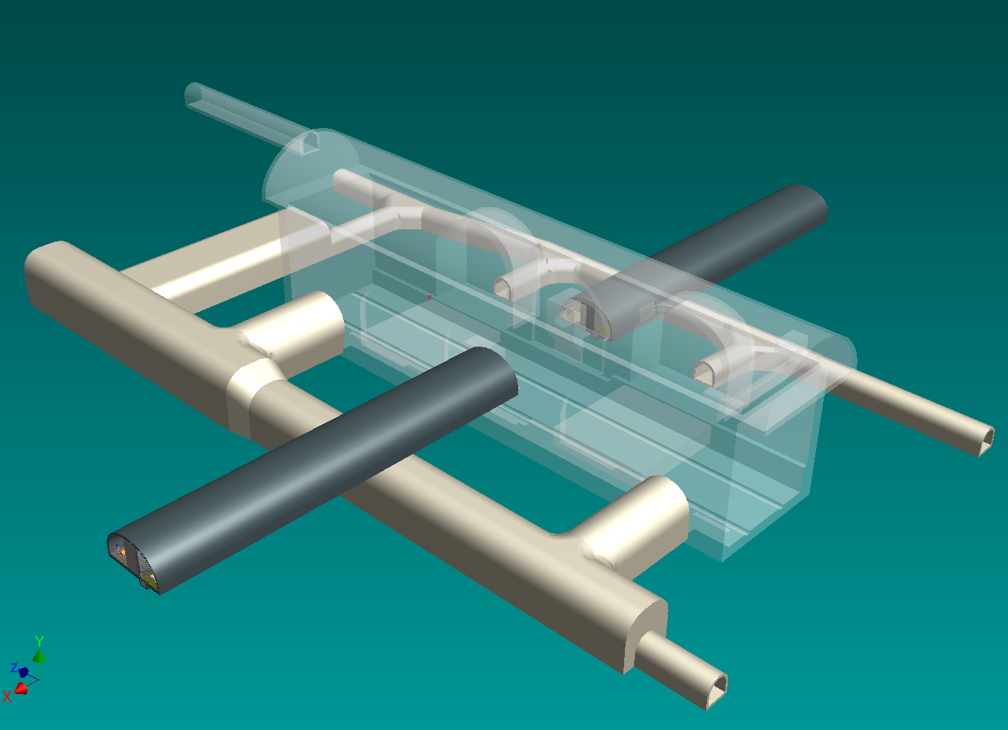
Surface
Dampimg
Ring

Slide 6
Access tunnel
ILD
SiD
A trailer with lower deck height
would reduce the tunnel size

Slide 7
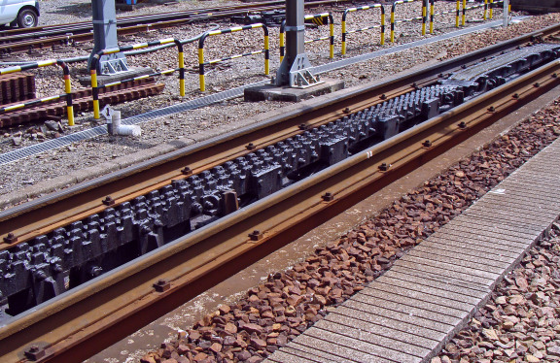
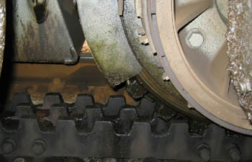
Solenoid transport
Trailer truck
  225t/5axles→450t with 2 trailers
  Capability of ~7% slope
Gear track (Abt system) is also suggested

Slide 8
Tunnel crossing
Main access tunnel

Slide 9
Tunnel crossing
Sub access tunnel

Slide 10
Access tunnel parameters
There are several options for the ILC route and the location of the IP, and the optimization is not done yet
Parameters listed below are just for some examples of the access tunnel to the experimental hall
Site | Option | Length | Slope | Earth covering* | Beam line elevation
A | 1 | 1700 m | 6.3% | ~300 m | 110 m
 | 2 | 900 m | 6.4% | ~200 m | 110 m
B | 1 | 1420 m | 7% | ~550 m | -30 m
 | 2** | 1470 m | 7% | ~400 m | -21 m
(*) Vertical distance between the cavern ceiling and the surface
These values changes largely with the IP location
(**) Main linac is inclined by 0.03%

Slide 11
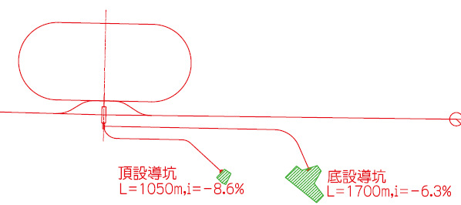
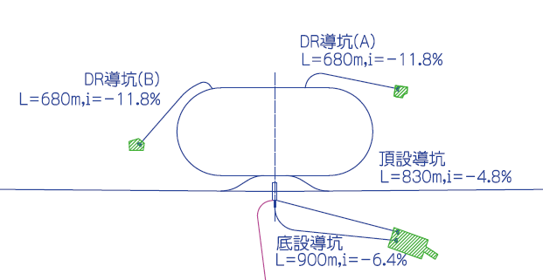
Tunnel layout examples
A 1
=Construction adit
=Access tunnel
A 2
=Construction adit
=Access tunnel

Slide 12
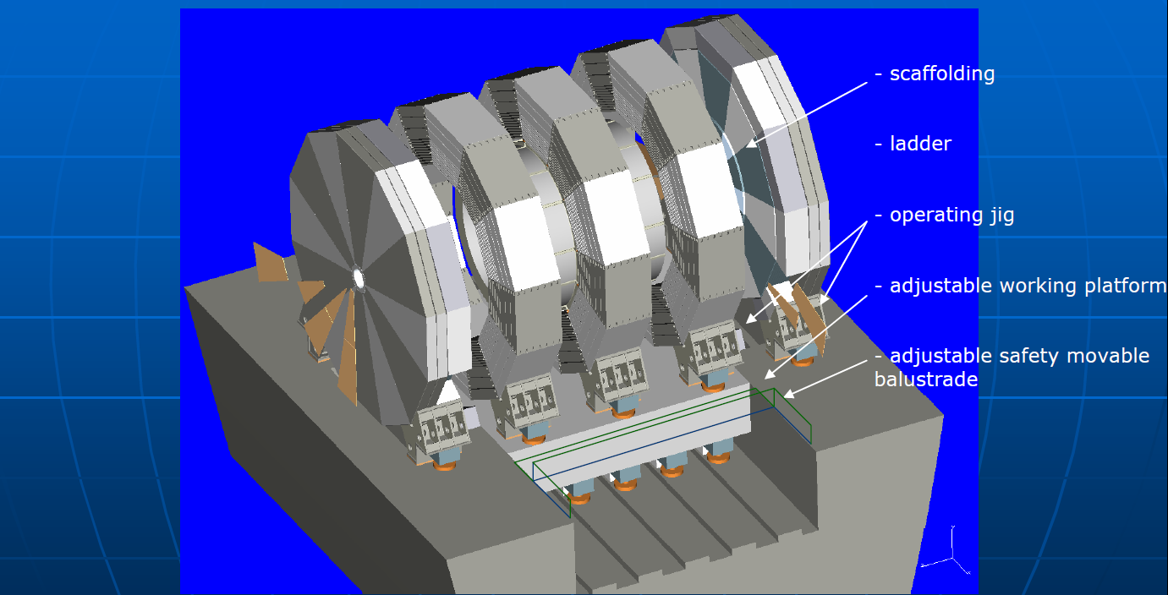
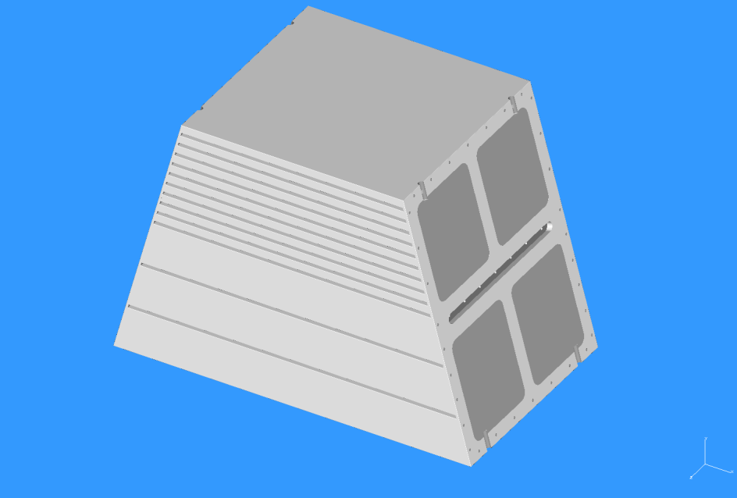
ILD Detector assembly
Solenoid
  Wound, assembled, and tested on surface
  Carried into the cavern as a whole
Return yoke
  Pre-assembled on surface as relatively small blocks ~200 tons
  Each ~200 ton block is carried into the cavern one by one and assembled into one barrel
  No gap in the barrel yoke → Less leakage field
Large assembly hall on surface is necessary

Slide 13
Detector assembly
1
2
Barrel assembly
Endcap (+) assembly
Endcap (-) assembly
Solenoid installation
QD0 support tube (-) assembly
QD0 support tube (+) assembly
Sub-detector installation
3
4
5
6

Slide 14
Safety issues
Ventilation
  Smoke and Helium gas will go out through the construction adit connected at the top of the cavern, and will not flow into the access tunnel (different tunnel entrances or a small vertical shaft for ventilation before joining the access tunnel) → More study will be done by a civil engineering company
  Amount of Helium gas ~ 20000m³ (CMS: 2x250m³x20bar =10000m³ at 1bar, x2 for SiD+ILD) =25mx100mx8m → No problem
Emergency egress
  Enough number of electric cars equipped with oxygen masks will effectively take people to the surface
  It should be forbidden to go to the cavern on foot

Slide 15
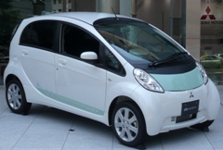
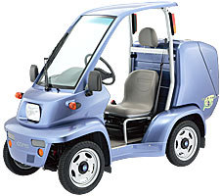
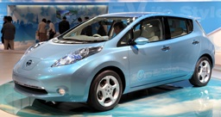
Electric cars
Mitsubishi
TOYOTA
Nissan

Slide 16
Outlook
Additional caverns/tunnels to be considered
  Parking area (~50 cars?)
  Meeting rooms
  Rest room
  Storage cavern
    Detector pieces before installation
    Tooling for detector assembly/installation
  Small vertical shaft may be used for ventilation, if necessary (depends on the detail of the site)
  Pressurized blockhouse for refuge (?)
Estimations to be made;
  Cooling water, air conditioning (temperature/dew-point should be defined), and electric power consumption
  Ventilation speed (simulation of gas/smoke flow)
  Deformation of the cavern due to heavy detector movement (p.p.)

