Slide 1
TDR of RDR-like Solution of HLRF in Mountain Region.
S. Fukuda
KEK

Slide 2
Scheme Change in Mountain-region ILC
DRFS->RDR Type
RDR fits to Kamaboko Tunnel and has cost advantage.
  In the site of mountain region, DRFS was favored but in recently proposed Kamaboko Tunnel, RDR is superior to DRFS from the view point of cost. We needed to have a suitable cost estimation for the various schemes, and for the RDR using Marx modulator has the cost advantage.
Costing and TDR are required in a few months.
  Old RDR cost was based on bouncer type modulator, and comparison among that and Marx modulator is required.
  Marx modulator cost was studied by SLAC since KCS also uses Marx Modulator.
  Cost for Modulator of KEK’s SC Test station
    If RDR is employed in TDR model, KEK wants to use Marx Modulator for STF-II and proto-type cost information is required.

Slide 3
Different Points from Old RDR
We studied new RDR type HLRF in Kamaboko tunnel.
Need to establish the SB2009 model as standard “Low power baseline” and suitable pass to upgrade to “High power option”.
Recent requirement of cavities variation and degradation problems possibly introduces PDS change and CFS reassignment.

Slide 4
HLRF Technical change items in
Mountain-region ILC
Confirmation of specifications since new RDR differs from previous RDR
  Cavity performance including the yield, gradient spread and degradation should be considered
  Common consensus for Energy overhead should be taken (related with Availability)
  Understanding of Power overhead in digital feedback of LLRF
  Details of Technical different points from previous RDR
  CFS Issues especially for the effects including variety of cavity performance
  Low power baseline scheme

Slide 5
Technical Change Guideline Re-Proposed
See Red parts (Further details with EXCEL sheets by Marc Ross )
Tech. Area | Main Subjects | Description
ML Integration | Parameters and layout | Confirmed including alignment tolerance CM and Q periodicity: → 8+4Q4+8 requiring additional ML length ( ~ 100 m) >> back to 9+4Q4+9 How we shall keep additional backup 400 m w/o or w/ utility ? >> need more precise discussions for purpose New request from CFS: 0.5 ~ 1 % tunnel tilting
Cavity performance | Yield Gradient spread Degradation | For example: 1st pass: 60% and 2nd pass: 70% 31.5 +/- 20 % confirmed (Assume 1/10 cavities to degrade dG => 20 % ) >> Adopt a statistical approach to cavity degradation; <> and rms
Cavity integration | Envelope | Tuner type, coupler warm-flange, beam pipe flange, magnetic shield (inside/outside), LHe tank etc.
Cryomodule | Envelope/interface Unit 5 K radiation shield | Piping interface with flange?, inter-connect condition, etc, 8+4Q4+8 (or original 9 +4Q4+9) Simplification
Cryogenics | Unit capacity | 5 → 4 units / linac or not? Stay at 5 units
RF power | Configuration | DRFS/RDR in mountain site, >> back to RDR-RF unit KCS/RDR in flat land
Cost | (Conversion) | (PPP)

Slide 6
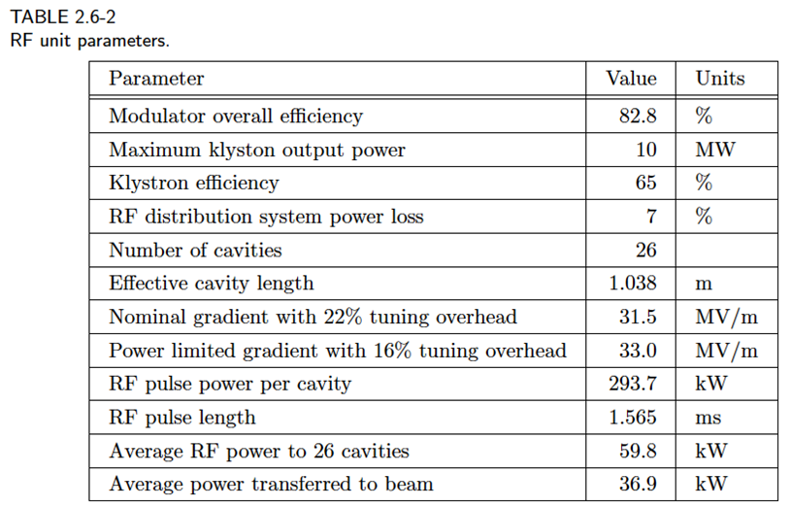
HLRF Parameter in full power option

Slide 7
Description of HLRF in Mountain-region ILC
Components of HLRF in Mountain-region ILC
  All components in Kamaboko tunnel
  Klystron ; 10 MW MBK
  Modulator; Marx modulator
    Cost benefit comparing with bouncer-type modulator
    No pulse transformer, Direct connection to MBK
  Power distribution system to cryomodule with 9+8(Q)+9
    Based on linear poser distribution with variable power divider
    PkQl system is employed
    Pressurizing and guard window
  System accepts the variety of cavity gradient variation and tries to achieve optimization of power feeding
  CFS Issues especially for the effects including variety of cavity performance
  Minimum layout change from low power baseline scheme to full power option.

Slide 8
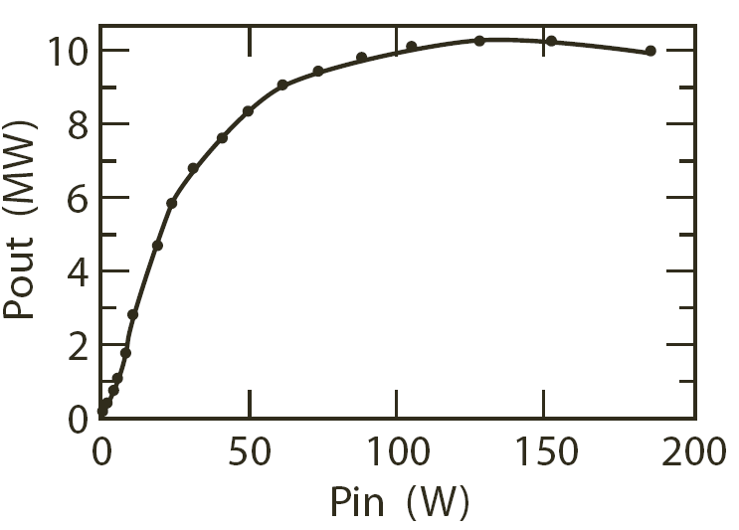
Overhead of klystron output power and PkQl
Assuming cavity gradient variation, how much the overhead of klystron output varies under the PkQl control and 10MW output power to drive 39 cavities.
No cavity variation
  7.65MW and 17.35 % (*16%) overhead
Cavity variation from 25 to 38 MV/m with constant distribution
  7.9MW and 17.7% (*16.7%) overhead @ <31.5MV/m>
  Optimized timing; 8.4MWmax and 10.7% (*9.7%) overhead @<33.3MV/m>max
Cavity variation from 25 to 38 MV/m with Gaussian distribution
  7.8MW and 19% (*18%) overhead @ <31.5MV/m>
    Optimized timing; 8.1MW max and 15% (*14%) overhead @<32.7MV/m>max
*33m extra PDS for 1/3 cavity numbers is included
10MW Output from MBK has overhead more than 10%
LLRF overhead issues (By Shin)
Llrf overhead
operation
(~8.6 MW @33 MV/m)
Note: 10;1 change in the klystron gain slope!

Slide 9
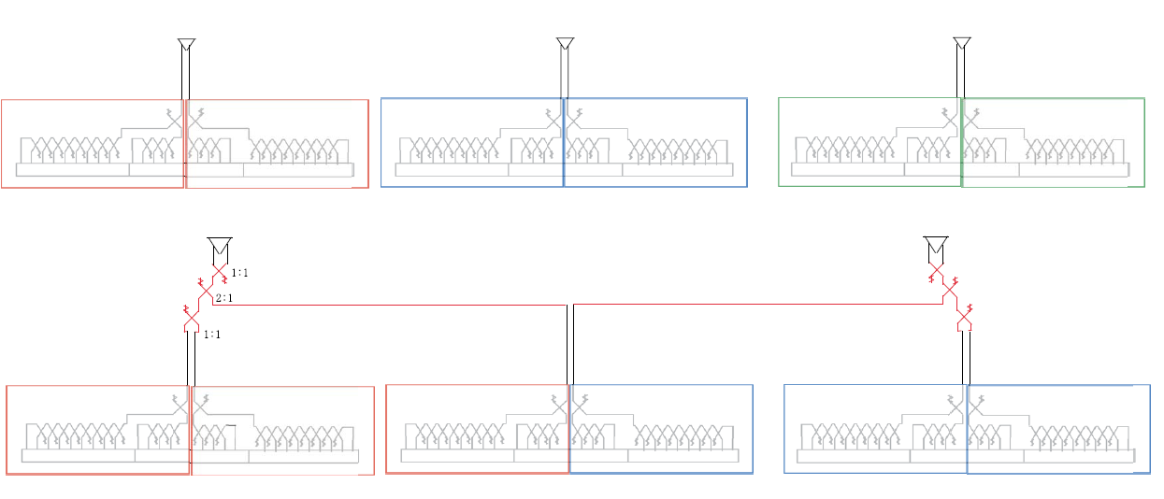
Numbers of Klystrons in low power baseline and high power option
Assume 989 system
In full power option, each
RDR unit (3 cryomodule=26
cavities) has 3 modulators.
In low power baseline, or in
reduced bunch scheme, each
three RDR units have 2
cryomodules, namely total
number is reduced to
2/3 of full current scheme.
Considering the simple PDS

Slide 10
RF Units in low power baseline
From the consideration of overhead of klystron output power, 10 MW output power is enough and the same as the RDR specification.
Total amount of RF units in ILC plan
  Configuration of previous slide, total RF units of 650 (=560 + 90) in the high power option
  Low power baseline; 464 (=374 + 90)
  *Need to check final numbers
Discussion and understanding of energy overhead will be desired

Slide 11
ILC Main Linac TD Parameters:
From Marc’s slide PAC20111114
Number of cavities | 14,560
Repetition rate | 5 Hz
Gradient | <31.5> MV/m (25 to 38 max. range)
2 K Cryogenic load | 1.3 W / cavity average
Final Energy Stability / energy spread | 0.1% (~1% per RF unit)
250 GeV/beam | # of bunches | bunch spacing | beam current | beam duration | rf peak power | fill time, t_{i} | rf pulse duration
full beam RDR | 2625 | 369.2 ns | 9 mA | 0.969 ms | 294.2 kW | 0.595 ms | 1.564 ms
DRFS | 1313 | 738.5 ns | 4.5 mA | 0.969 ms | 147.1 kW | 1.190 ms | 2.159 ms (up 38%)
KCS | 1313 | 535.1 ns | 6.21 mA | 0.702 ms | 203.0 kW | 0.862 ms | 1.564 ms
RDR – HLRF (backup) | 1313 | 553.8 ns | 6 mA | 0.727 ms | 196.1 kW | 0.893 ms | 1.619 ms (up 3.5%)

Slide 12
Low power baseline and full power option
At the beginning of ILC, the operation will start with low beam current. The 39 cavities will be operated at average 31.5 MV/m. The operational parameter list is as bellow.
Owing to the low beam current Ql values will becomes x1.5 times higher (~5e6).
Center of Mass energy | current | Gradient | #cav./kly. | beam width | fill time | rep. e- | rep. e+ | klystron power
500GeV | 9mA | 31.5MV/m | 26 | 1 ms | .6ms | 5Hz | 5Hz | 10MW
500GeV | 6mA | 31.5MV/m | 39 | 0.7ms | 0.9ms | 5Hz | 5Hz | 10MW
Pulse duration time of RF in both schemes are almost the same as 1.6ms
Is energy overhead of 3% at CoE 500 GeV included? Related with 400m extra length area. Guide-line is required.

Slide 13
Marx modulator
Marx modulator is the candidate of modulator in mountain-region ILC from the following reason
  Cost benefit comparing with the RDR bouncer modulator
  It is possible to eliminate the big heavy pulse transformer with large volume of insulation oil
  Easy adjustment of the flat top (or sag compensation) of voltage waveform
  Easy handling of overcurrent protection
Comparing with RDR bouncer modulator, it is necessary to show the reliable operation by the future R&D. DESY XFEL and KCS in ILC have experience of operating it.
Several companies have technical ability to manufacture it.

Slide 14
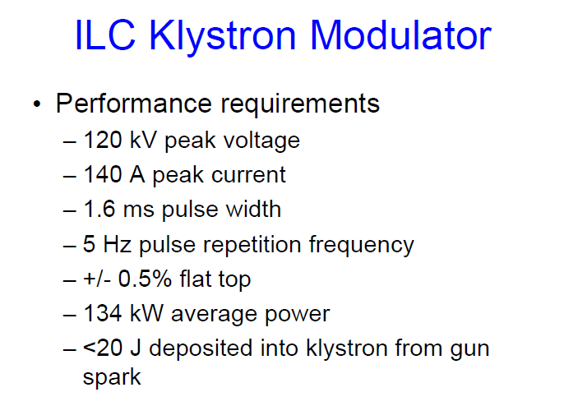
For Marx modulator, Chris Adolphson will have a presentation

Slide 15
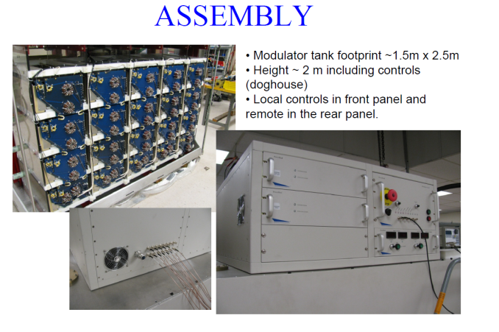
Cost Estimation of Marx Modulator
WebEx Meeting with DTI in Dec. 21, 2011.
  Change the cost estimation from DRFS type to RDR, and discussed about the cost
  Depend on the condition of quotation
  How to set the learning curve values
  They will offer us the cost estimation
Collaboration with SLAC for Marx Modulator

Slide 16
Cost of Marx Modulator assuming the same as DRFS Marx
Mail from DTI
  First product $600k
  Mass product $370k @650 for LC=95%
                $224k for LC=90%
                $130k for LC=85%
      Dependence of numbers of unit and numbers of vendor?
      What is reasonable LC?
      Relative cost to RDR Marx?

Slide 17
Layout of PDS
Simple linear power distribution with variable power divider is baseline. What is the relation with KCS PDS ?
In low power baseline, 10 MW power feed to 4.5 RDR-units. PDS to feed to 1.5 RDR units are performed through service area of Kamaboko tunnel.
Pressurizing with dry air requires the WG window which is different type of the window in the coupler.
  How about the SLAC’s experience? Since WG window is not required in DRFS, we employ ether SLAC type or DESY type.
Concerning about variable power divider, Kazakov type one is the candidate device, and it was used successfully used in STF-I in KEK .
Two type of circulators connecting to coupler are used in STF-I, Japanese one and Russian one. For 5MW circulator, Russian type 4-port circulator is employed and the same type as RDR.

Slide 18
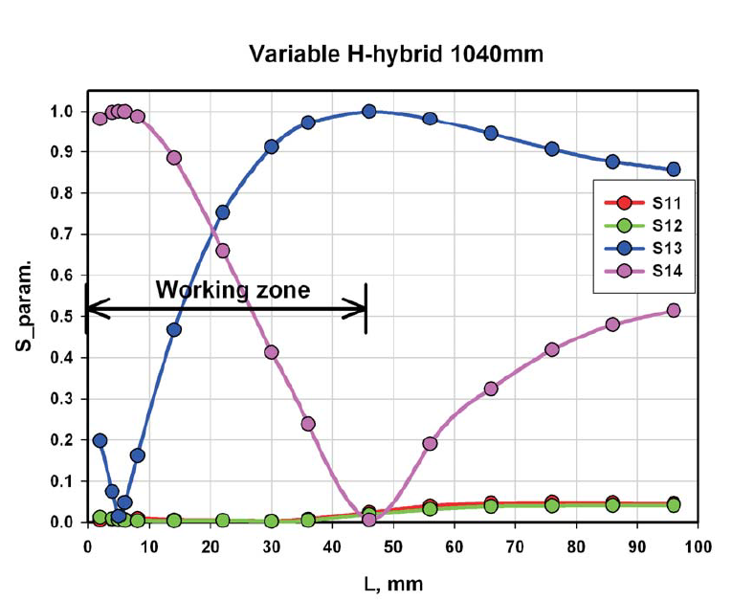
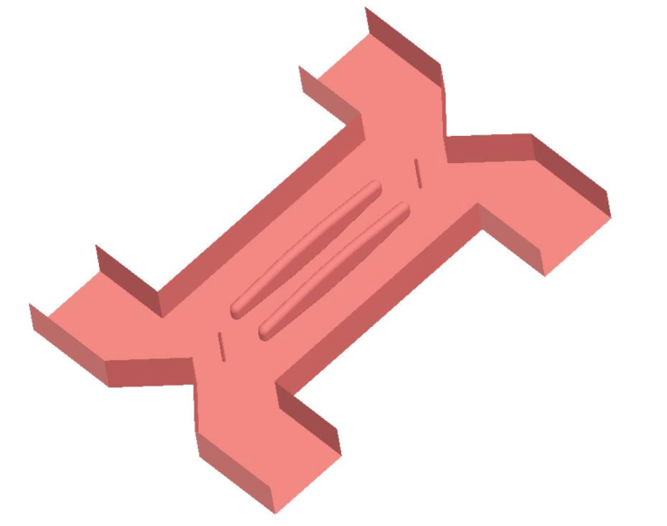
Variable Power Divider
Variable power divider developed by kazakov.
High power capability
By changing the length of interaction region, variable range is changed.
Interaction region of 1040mm, 0-100 % variable range is achieved.
This type was used in S1-global test sucessfully.

Slide 19
PDS layout in low power baseline
For the regulation of RF, once two rf are combined and divided into two, and 1/3
Of power is transported for 33m PDS.
Attenuation increases and
Overhead of LLRF decrease.
In upgrade to high power option, layout of the accelerator room remains same and only service room layout is reformed.
Highest power capability required in rectangular waveguide is 10MW.
Pressurizing is inevitable and extra rf window is desired.

Slide 20
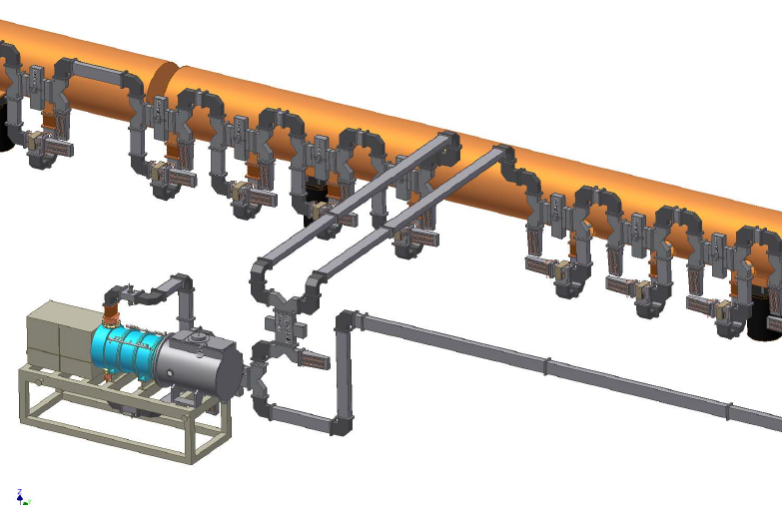
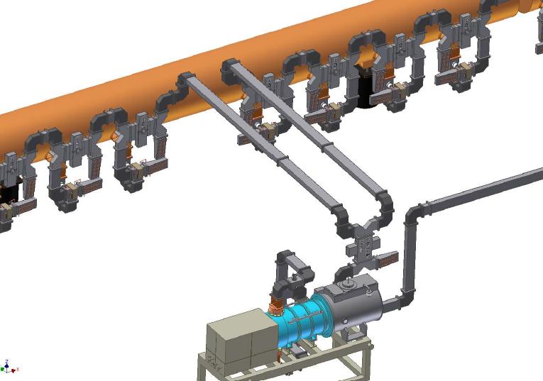
Layout Example
Low-power baseline layout
Complete linear power distribution with all variable hybrids is shown
Need enough passage space and
Ｗorking space near cryomodule.

Slide 21
R&D Plan for RDR-like Scheme in KEK
Due to the RF technology change, STF-II experiment will be performed based on the RDR-like scheme comprised of 10MW MBK, Marx modulator and associated PDS.
We have a plan to procure a Marx modulator in Japanese FY 2012.Marx modulator has the same specification as using 10-MW MBK.
International bid: One of candidate company is DTI.
Back-up MBK is also being procured.
Demonstration will be scheduled in FY2013.

Slide 22
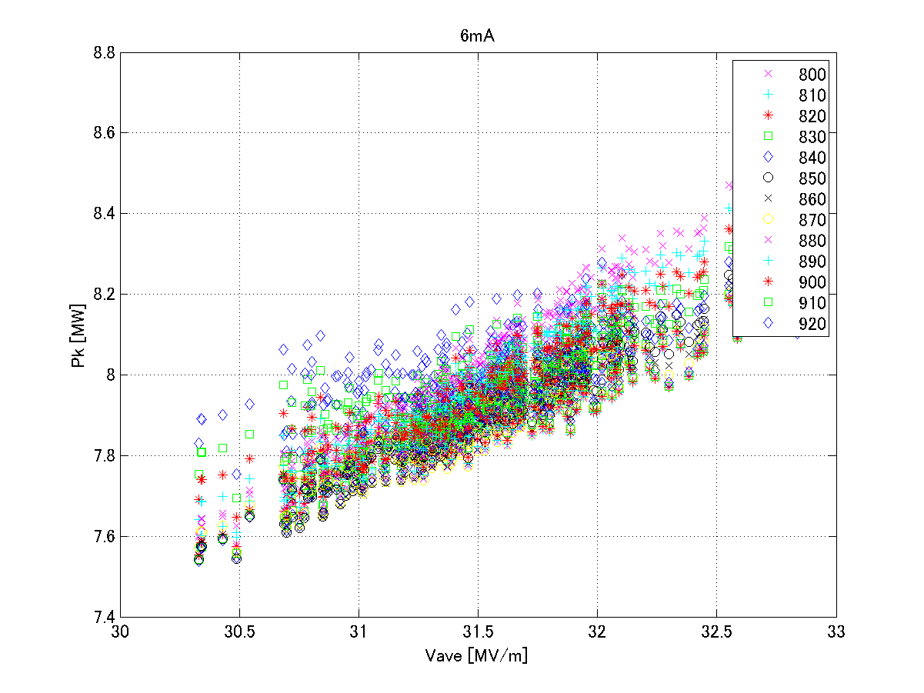
CFS related issues - effect of cavity variation
Effect of cavity’s variation to CFS capability (From Sin’s simulation)
  Assume that 10MW MBK is always
  operated at 10MW or less than 10MW
  output. Cavity’s gradient variation
  changes the overhead of LLRF.
  For 39 cavities, output power variations
  are shown in right graph.
  (Assume Gaussian variation from 25 to
  38MV/m)
  For 39 cavities (one rf unit for low power baseline), variations are averaged out and even when optimizing the injection timing, Nominal RF power increased to 7.8 MW and individual RF power required varies from 7.55 to 8.1 MW.
  If CFS units of electricity and water cooling plant are controlled by more large number groups, these variation are expected to be furthermore averaged out.
  For CFS control, average operation of output power of 7.8 MW is very likely number. This results in 2% more higher than ideal case (no cavity variation)

Slide 23
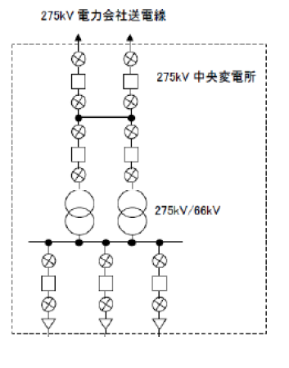
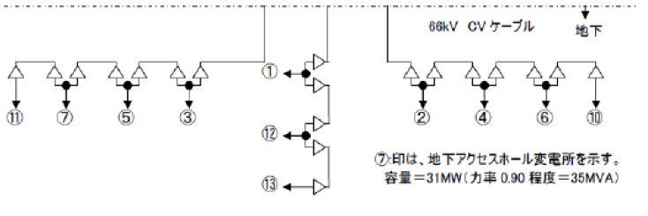
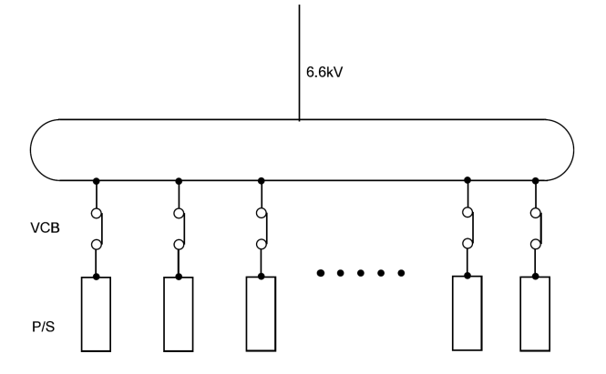
Electricity Distribution
Electricity distribution in RDR-like configuration is the same as the DRFS case, which was presented in CRS- Tsukuba 2011
Comparing with RDR layout, in new scheme the alcoves of CFS electricity are eliminated after the discussion with Atsushi and CFS group to save the cost. (KEK: CFS Review June 10, 2010)
  6.6 kV line is directly introduced to each VCB of rf unit for low-energy baseline. Numbers of VCB reduce to 2/3. How about the total capacity of ILC electricity center? So electrical interface points is sub-electric center which has the transformers of 66kV to 6.6 kV in every 4.5km distance.
  Variation of each rf unit is expected to be averaged out.
  In every front end of the electricity of P/S makes a low voltage line such as AC100V and AC200 V for the control and low voltage electricity.
Center:275kV
275kV->66kV
66kV->6.6kV in each 4.5km apart

Slide 24
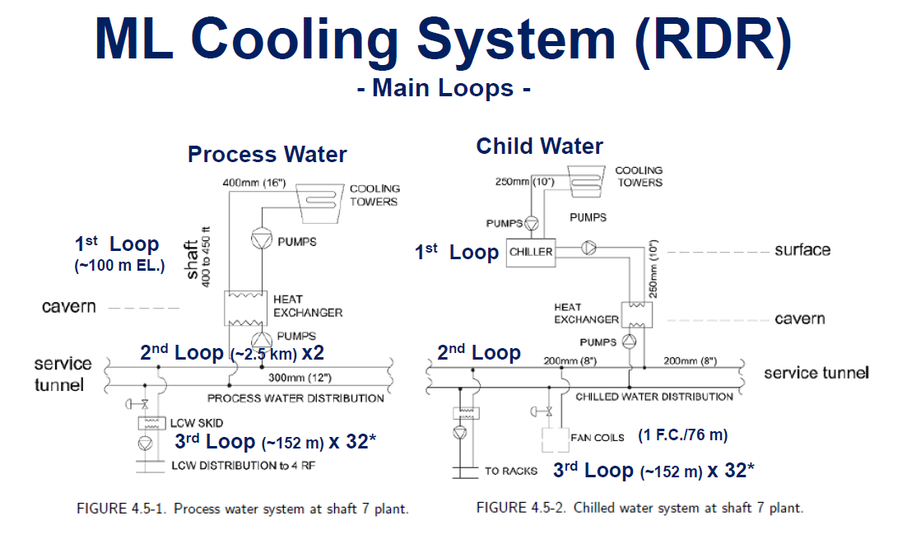
ML Cooling System
Even klystron output powers are almost constant, due to the cavity gradient variation and PkQl control, power to every cavity varies and then power dissipation in PDS varies.
RDR has a plant structure comprised of 3 loops and lowest loop distributes in each 152m. CFS like to introduce more simple structure comprised of 2 loops without LCW SKID to save the cost.
Then lowest loop distributes in each 2.5 km and control 4*32*2/3 units in low power baseline. This structure likely averages out the individual variation of heat dissipation to average value (2% higher value)

Slide 25
CFS related issues - effect of cavity variation (II)
7.6MW
For No cavity variation
7.8MW medium
For Gaussian Cavity variation
Output power of 2% increase
7.55MW
8.1MW
For 300 RDR unit
  For cooling scheme, 2.5km system control roughly 55 RDR unit in low power baseline (2.5km/33m/1.5) and how to change the above distribution? Upper line determines the maximum CFS capacity required.

Slide 26
CFS related issues
HLRF Parameter and Heat Load
Parameter Comparison with RDR and RDR-LPBL(Low Power BaseLine)
 |  |  | RDR | RDR-LPBL
 | Pulse rep | pps | 5 | 5
 | Pulse width | ms | 1.565 | 1.619
 | Rise time of pulse | ms | 0.595 | 0.893
 | Pout | MW | 10 | 10
 | K-eff | % | 65 | 65
 | M-eff | % | 83 | 83
 | Beam | mA | 9 | 6
 | Cavity number |  | 26 | 39
 | Wall Plug Power for HLRF | kW | 145 | 156
 | Total Power | kW | 160 | 170
Heat Load |  |  | Max Heat Load | Max Heat Load
 | Modulator (80% all) | kW | 25 | 31
 | Klystron (Coll. Body Window) | kW | 58.9 | 63.2
 | Waveguide | kW | 3.9 | 4.1
 | Circulator , Attanuattor Load | kW | 43.4 | 47.6
 | Klystron Solenoid | kW | 4 | 4
 | Klystyron Gun | kW | 1 | 1
 | Rack | kW | 10 | 10
RDR-LPBL Is the value of 4.5 unit
of cryomodule.
Assuming all klystron’s outputs are
10 MW and LLRF operation point is
Varied with the averaged cavity
gradient. This changes the collector
Loss of klystron. 2% higher RF power
Increase resulted in loss increase in
PDS, but not yet evaluated in detail.
Go back to the estimation by Chris A of 071020 and comparison is made.

Slide 27
TDR Write-up Plan (I)
RF related descriptions are written in various chapter and general term are described in common section
  Energy overhead and number of rf units should be described in “2. parameters and layout” of Part-II with the consistent manner with availability description.
  Upgrade path from low power baseline to high power option should be also described in common section.
TDR Part-I R&D
  In “2.5 The S1-global experiment”, based on S1-global report, RF test results using old RDR and DRFS are described. Results of circulator-less test are also included.
  In “2.7 RF power generation and distribution”, sharing the volume with KCS description, R&D results are described including PDS. How to treat DRFS R&D? How to include STF-II plan? To future R&D plan?

Slide 28
TDR Write-up Plan (II)
TDR Part-I I ILC Baseline Reference
  In 3.6 “RF power and distribution system”, though common components such as 10-MW klystrons and Marx modulator, so far independent description of RDR-like and KCS are planed. Necessary to discuss how to chaptalize and summarize the description.
  In 9 “CFS and global system”, RDR-like scheme and KCS describe electricity and cooling system including the heat dissipation table.
  LLRF system are described in “3.7 Low-level RF control” and so far independent description of RDR-like and KCS.
Upgrade path from low energy baseline to high energy option are described in “chapter of upgrade” . Basically RDR-like scheme has describe the PDS reformation and introduction of 1/3 of rf sources with the reformation schedule.

Slide 29
Summary
HLRF system in mountain region was changed from DRFS to RDR like scheme in Kamaboko tunnel due to the cost comparison.
Basic consideration of low power baseline for RDR like scheme was made
  Effect of cavity gradient variation and degradation effect
  RF overhead considering cavity variation
Description of rf main component including Marx modulator
R&D plan for RDR-like scheme in KEK
CFS issues considering cavity performance variation
TDR writing-up plan

Slide 30
Agenda from Yamamoto
KCS/RDR-unit HLRF system configuration including backup PS and utilities with the single tunnel design
LLRF overhead w/ gradient spread , and w/ (989 or 888) cavity-strings
Marx generator
AC power and cooing w/gradient spreads
Adaptability against cavity degradation after installation into cryomodule by using circulator & power distribution system
Low-power and high-power option review
Tunable power distribution system
Comments from CFS and Cost Group

