Slide 1
ILC MAIN LINAC & SCRF
BASELINE TECHNICAL REVIEW
Progress and Status of ML CFS Design
And Requests for ML and SCRF
Conventional Facilities and Siting
V. Kuchler, A. Enomoto, T. Lackowski

Slide 2
CFS Progress and Status
Asian Region
  Single Tunnel w/Center Shielding Wall can be Optimized Using the RDR Type HLRF System
  DRFS will not be Pursued at this Time
  Detailed Mechanical and Electrical Design will be Based on RDR RF
Americas Region
  KCS and DRFS RF Systems have been the Basis of Work to Date
  Complete Mechanical and Electrical Designs have been Developed
  Extent of Design for RDR RF System is the Development of a Preliminary ML Cross Section
  Limited Time and Resources will Impact the Detail of Mechanical and Electrical Design for RDR RF
European Region
  Civil Design will be Developed Using KCS RF System

Slide 3
Questions for Final ML Design
Several Aspects of ML Design Remain
  General Overhead for Cryomodule (or Cavity) Failure
  Undulator Energy Loss
  Accommodation for Warm Cryo Gap Sections
  9-8-9 vs 8-8-8 Cavity Configuration (probably N/A)
  Overall Timing Requirements
Final Main Linac Length
  400 m was Included in the Original RDR Estimate
  Adjustments to ML at this Scale do not Pose a Large Potential for CFS Cost Increases
CFS TDR
  RF Developments have a Direct Impact on CFS
  These Developments Need to be Described in the TDR

Slide 4
Request from Asian CFS Team
  The Asian CFS Team (ASCT) will design the electrical and mechanical systems based on the RDR-type HLRF scheme with “Kamaboko”-shape Tunnel.
  However, the ILC configuration has been advanced since 2007. We need to confirm the difference between 2007 and the current scheme

Slide 5
The number of RF units
The RDR table 3.3.2 and 3.4.2 defined the rf units by area:
What is the difference from these?

Slide 6
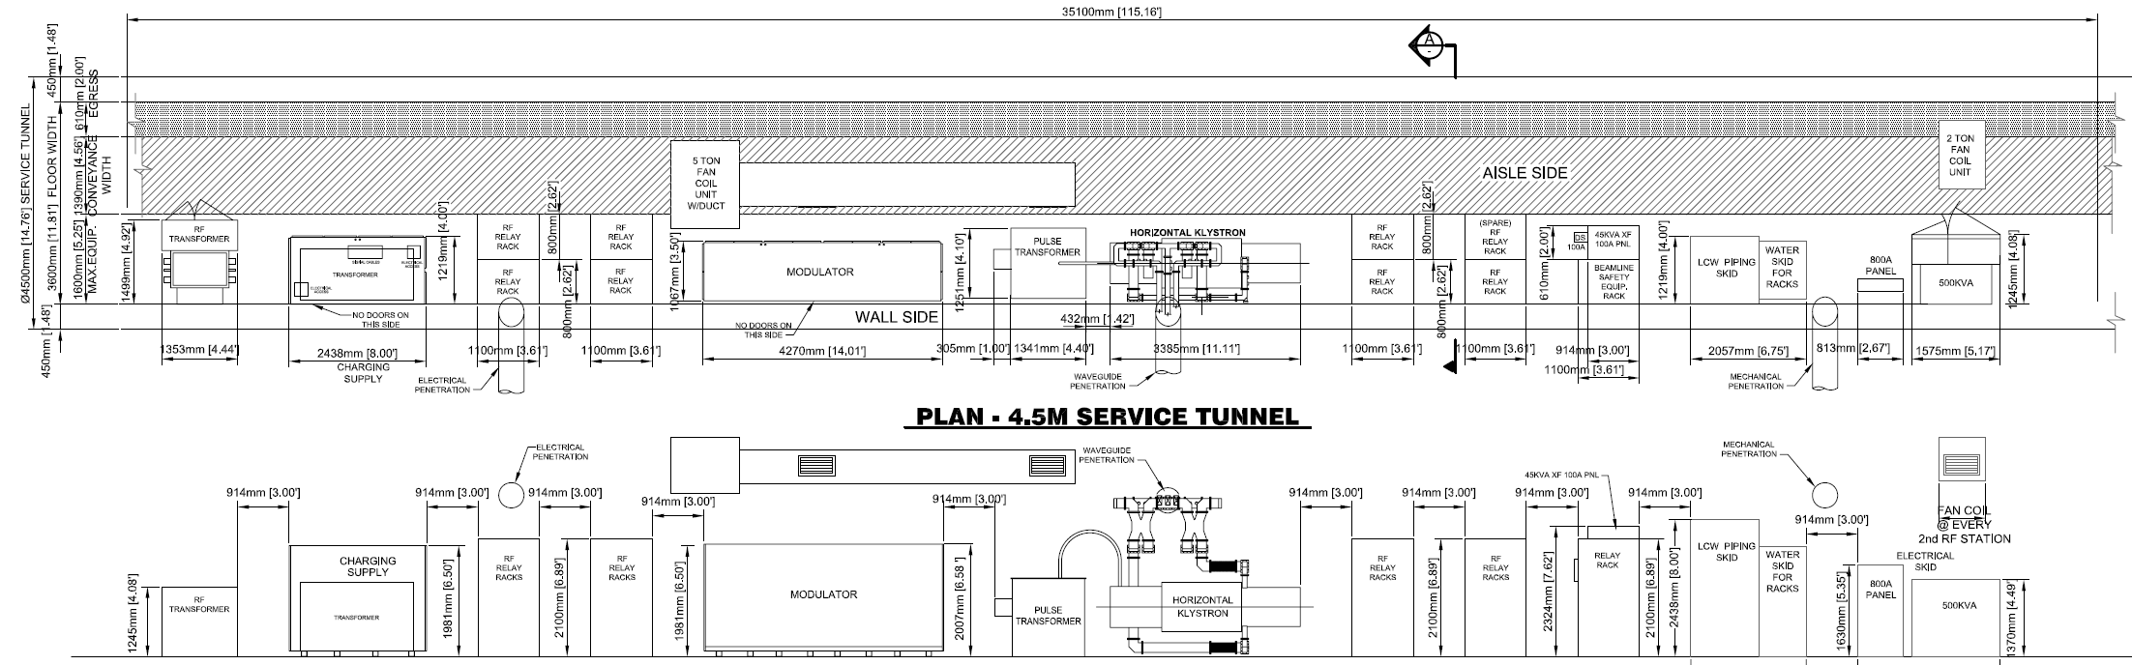
Specifications of HLRF
Equipment Size
Electrical spec
Heat loads
For both 1300 and 650 MHz
140.1
98.5
10.1

Slide 7
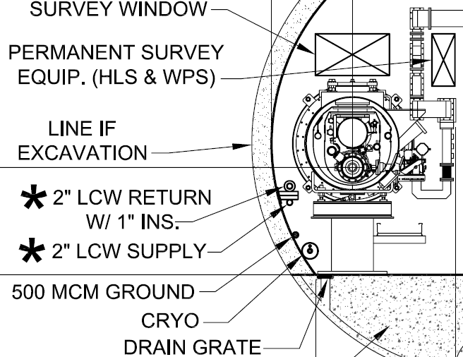
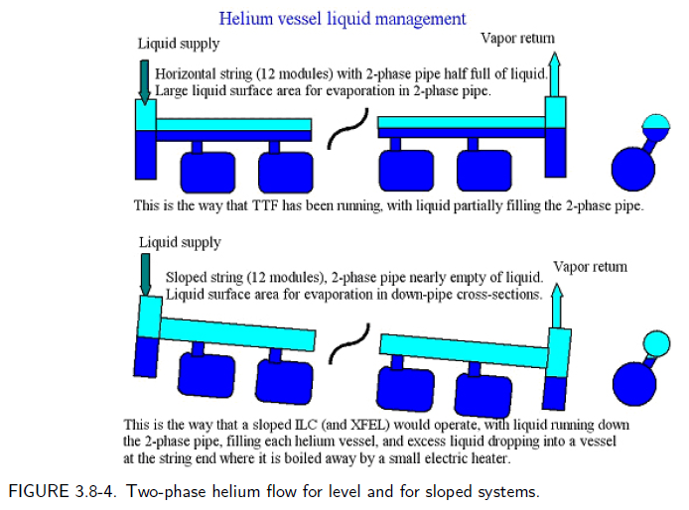
Acceptable Angle for sloped attitude
Specifications of Cryomodule
Equipment Size
for sloped

Slide 8
Americas Civil Construction Status
SB2009 Main Linac Cost Breakdown
Developed KCS Main Linac Tunnel Cross Section for TBM
Advanced Site and Building programing with functional layouts
Studied tunnel rock support methods, tunnel lining and slab alternatives
Approach to Life Safety developed
Timing

Slide 9
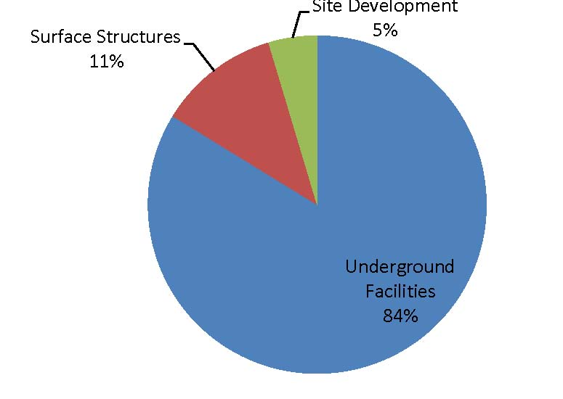
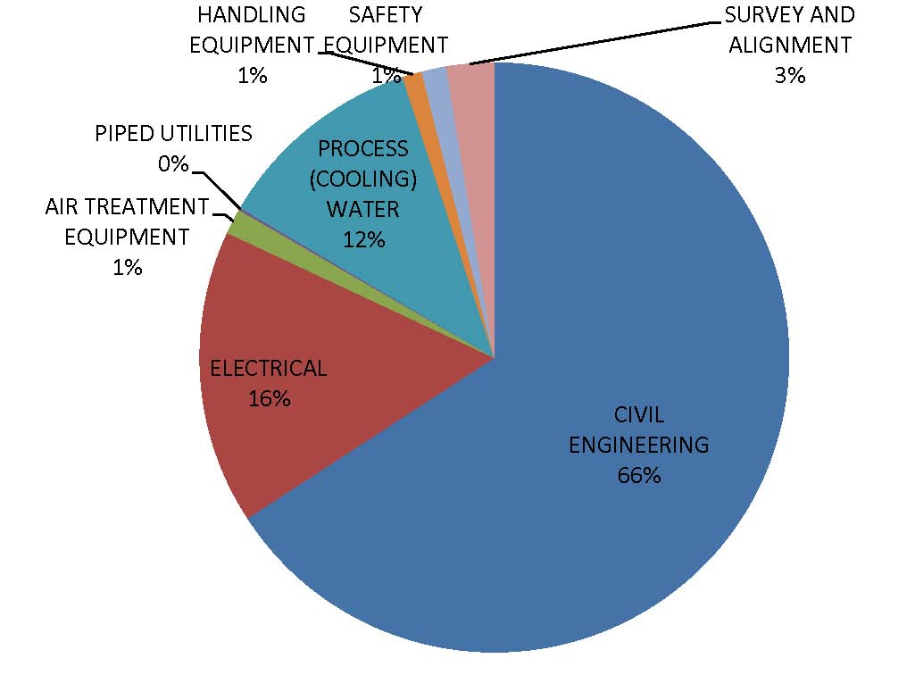
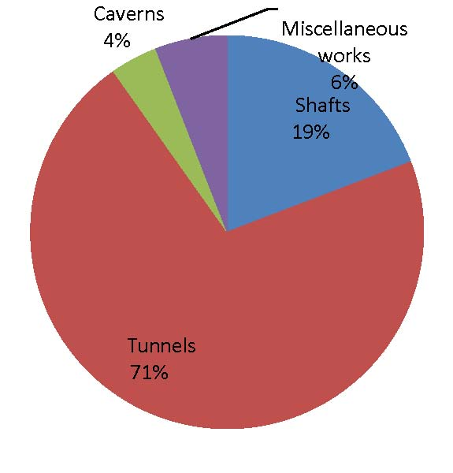
2009 Breakdown of Main Linac Costs
Civil Engineering
Level 2 CFS Breakdown
Underground Facilities

Slide 10
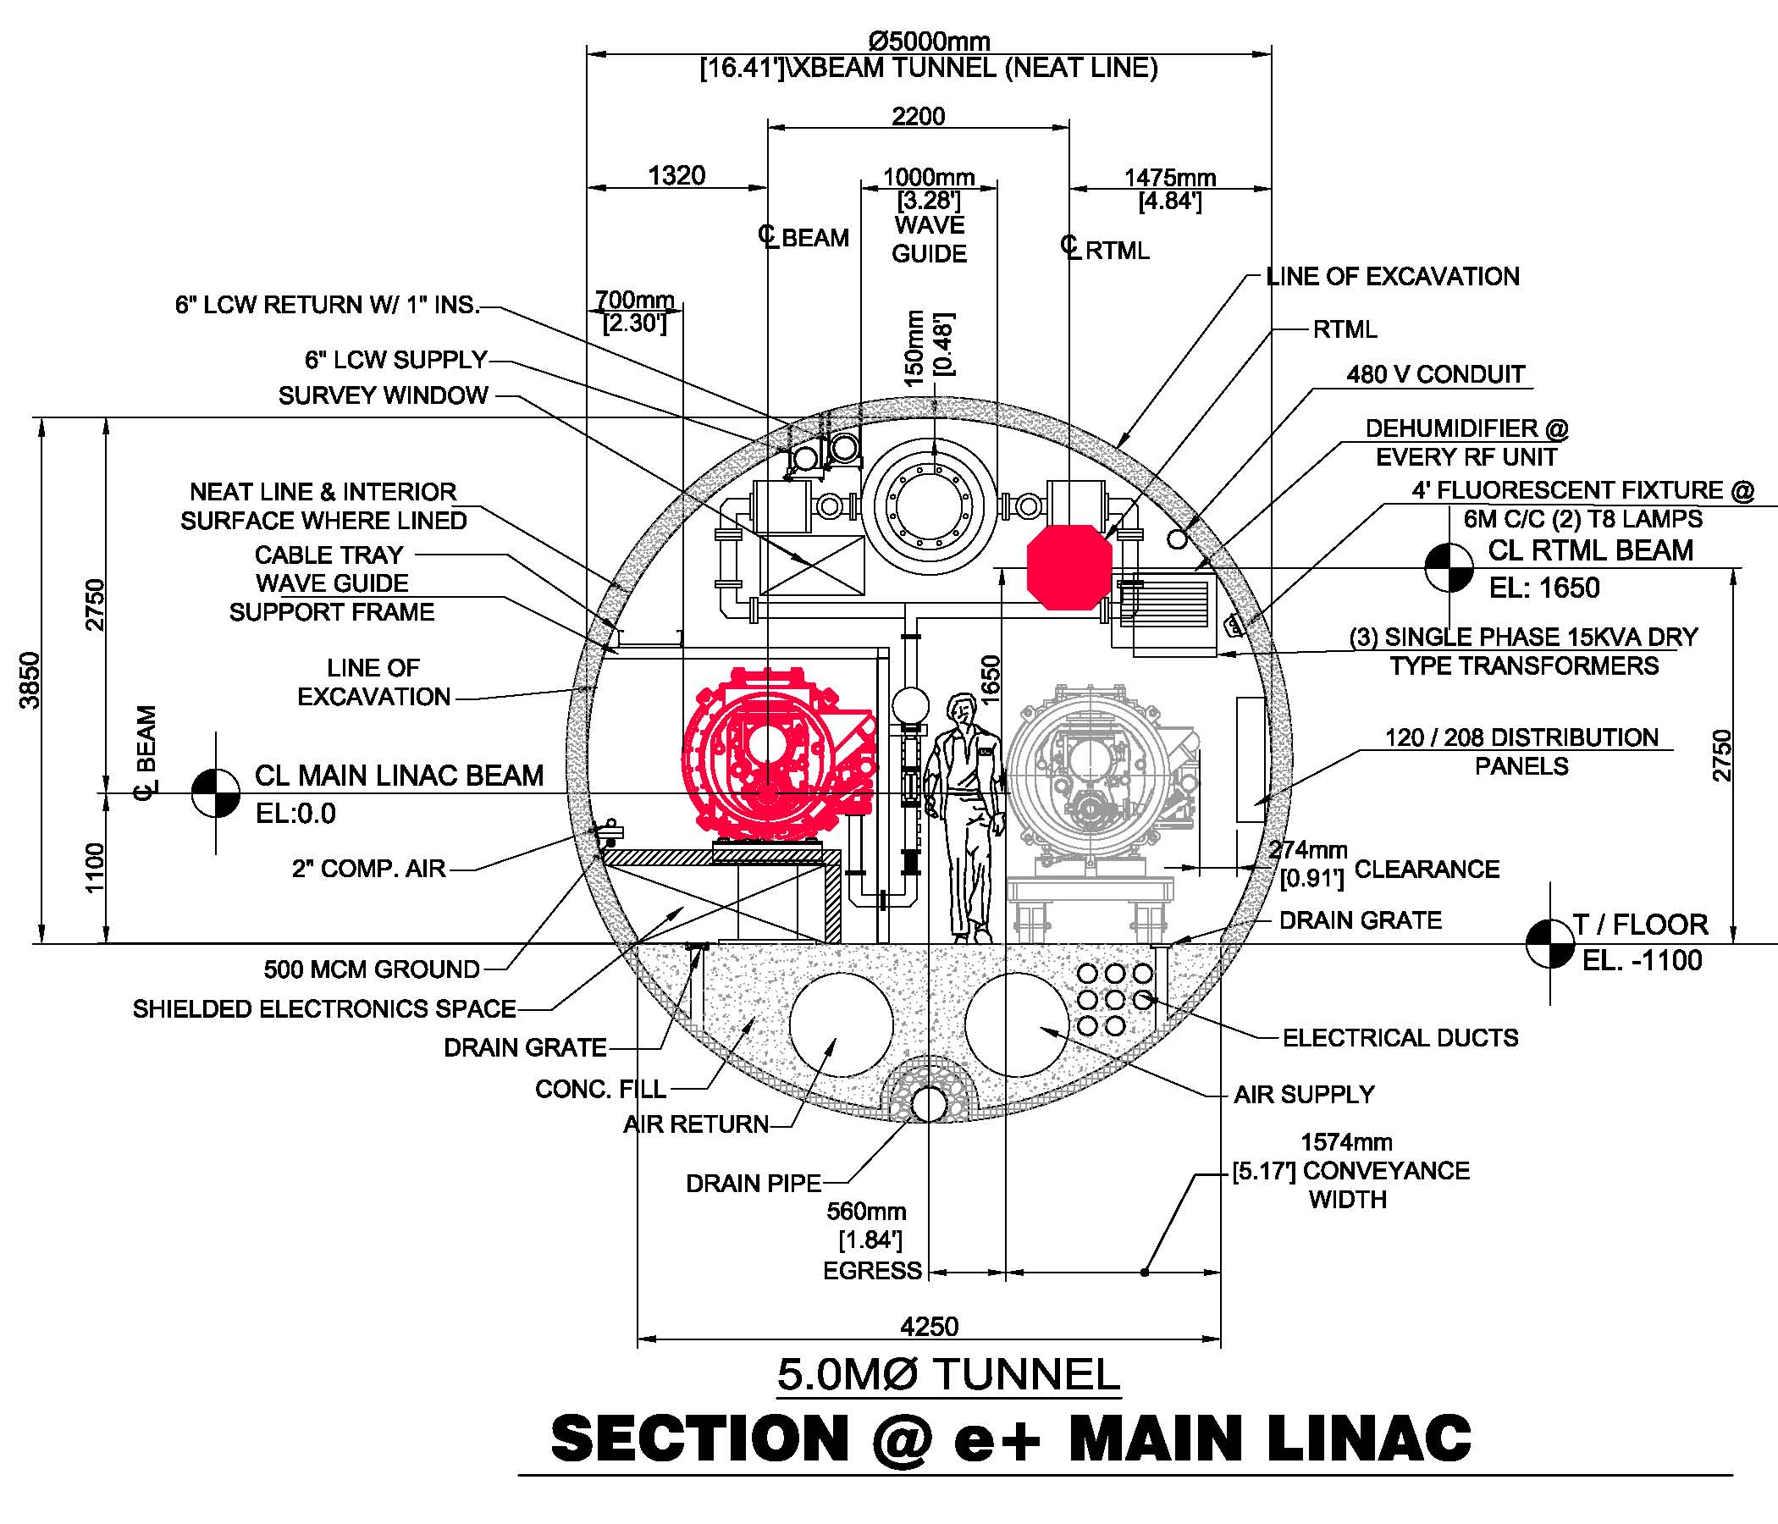
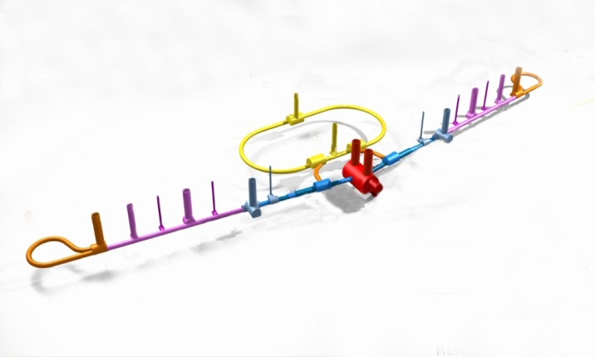
5 M Dia. KCS Tunnel Cross Section

Slide 11
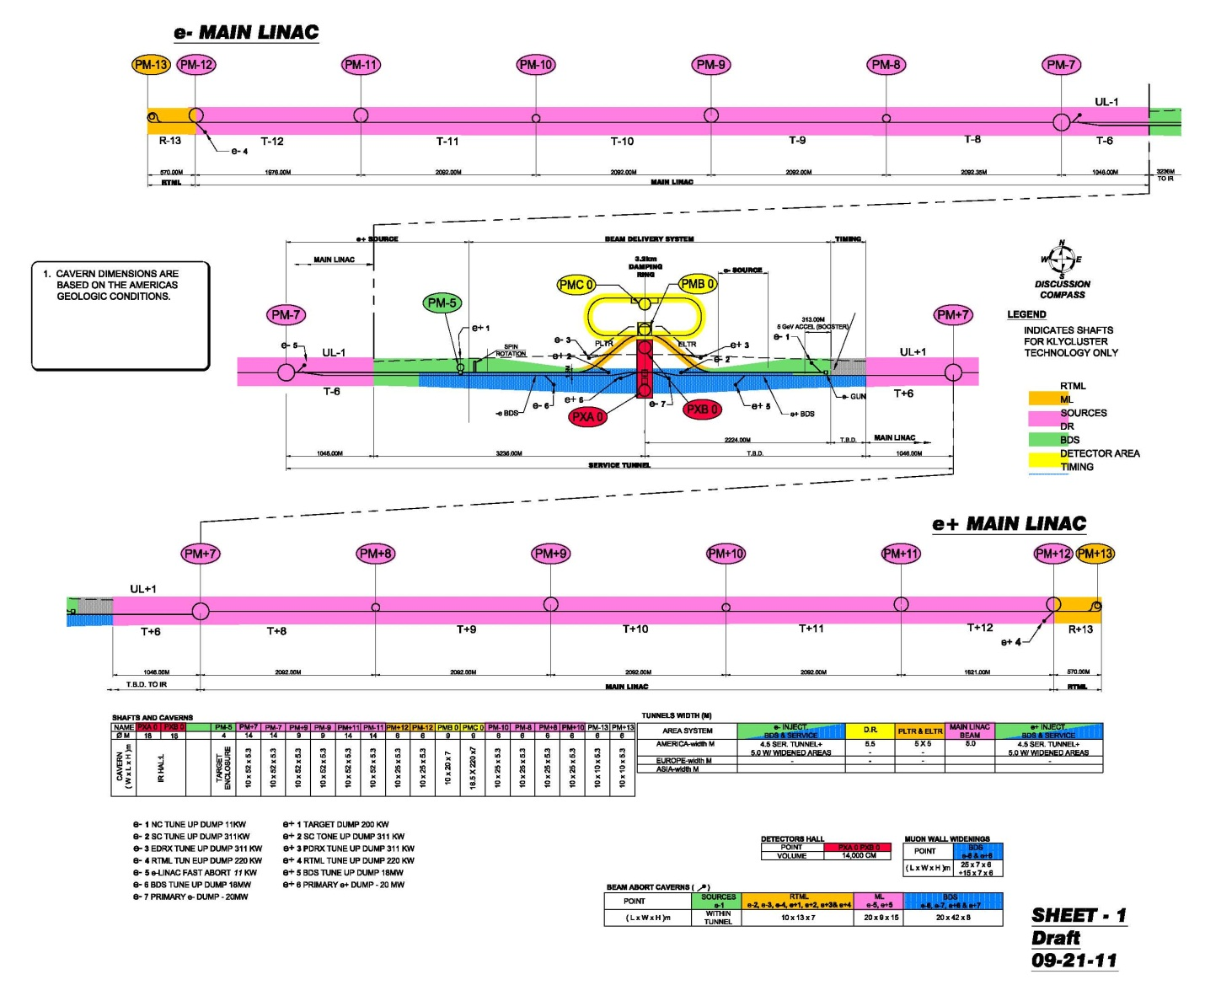
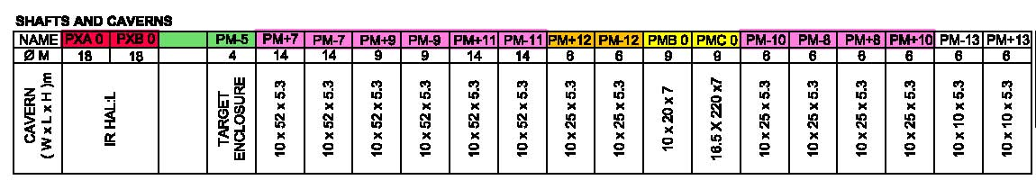

Slide 12

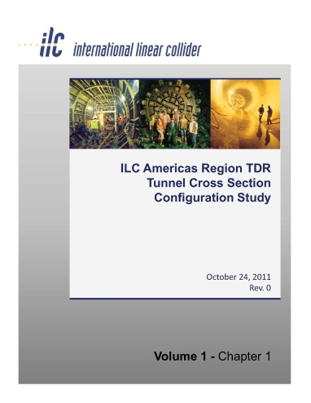
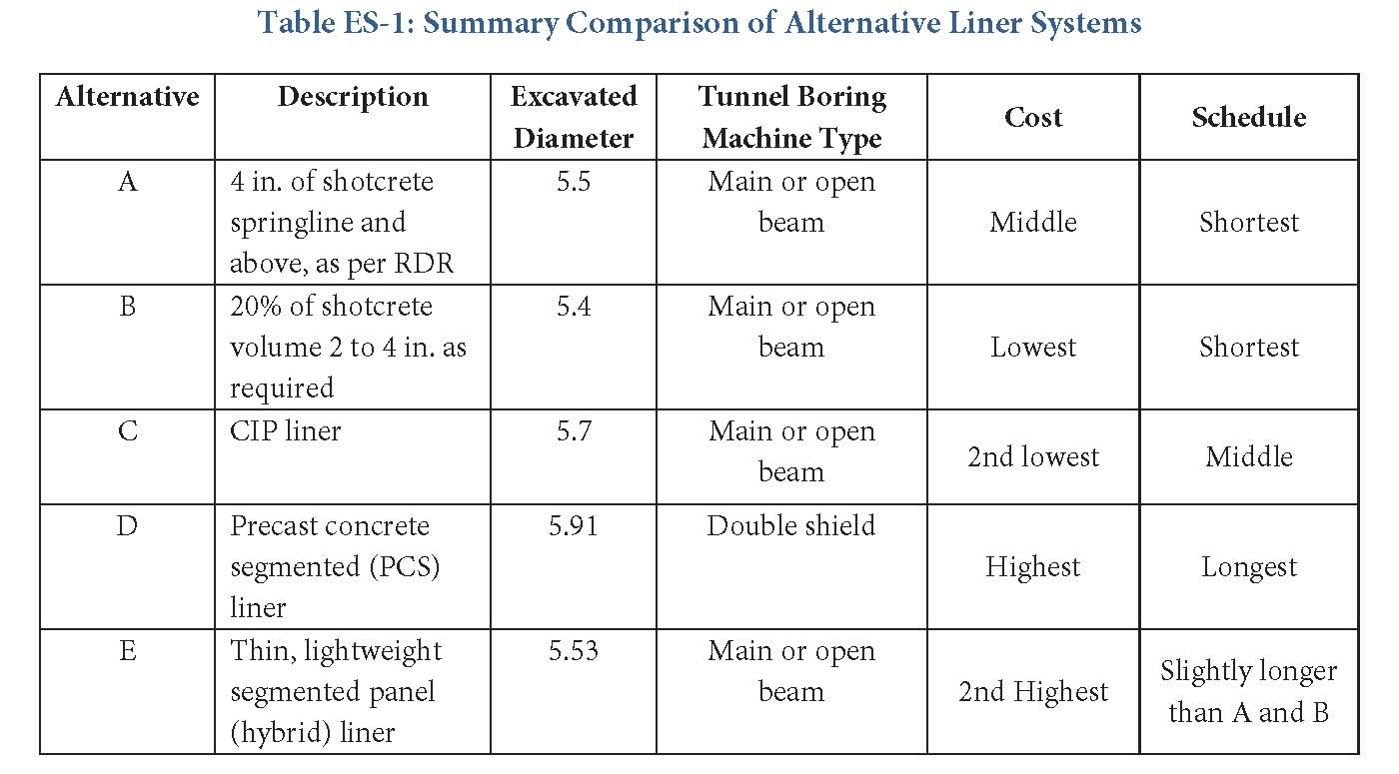
Investigated Shotcrete Liner, CIP Liner, and Segmental Precast Liner
Investigated CIP and Precast Base slab
Cost and Schedule
Constructability
Attachments
Services installation
Life Cycle Costs
Groundwater
Lighting and Luminosity

Slide 13
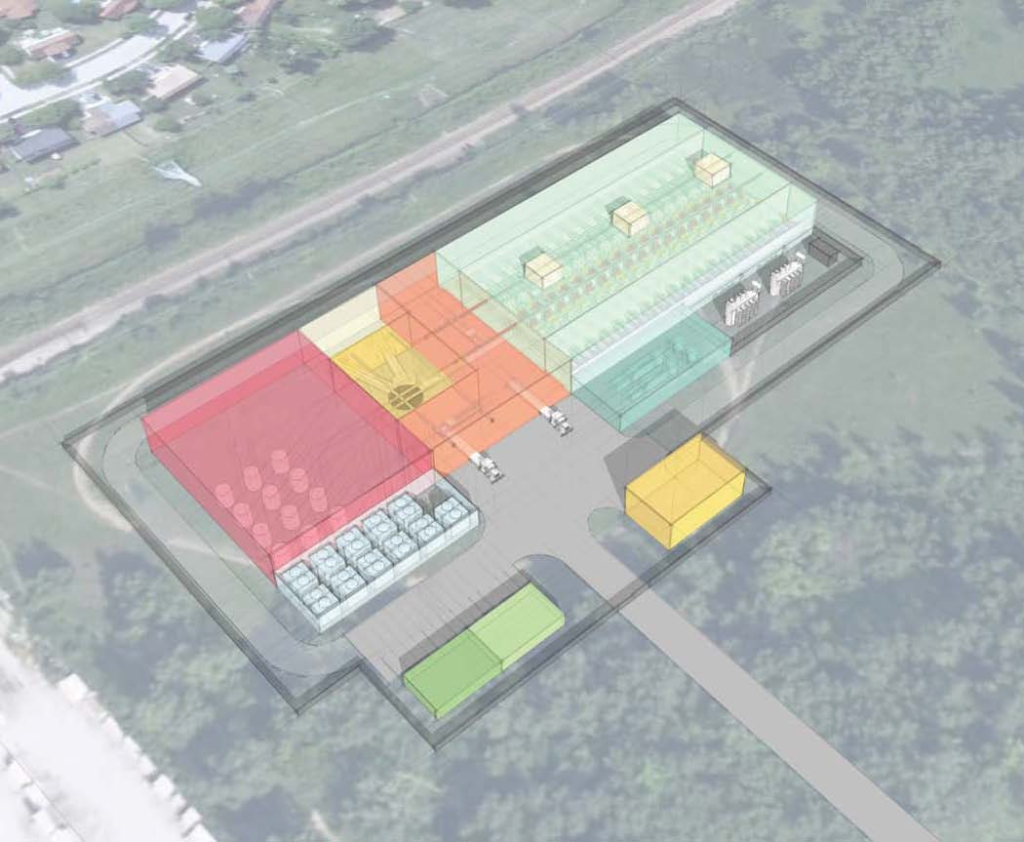
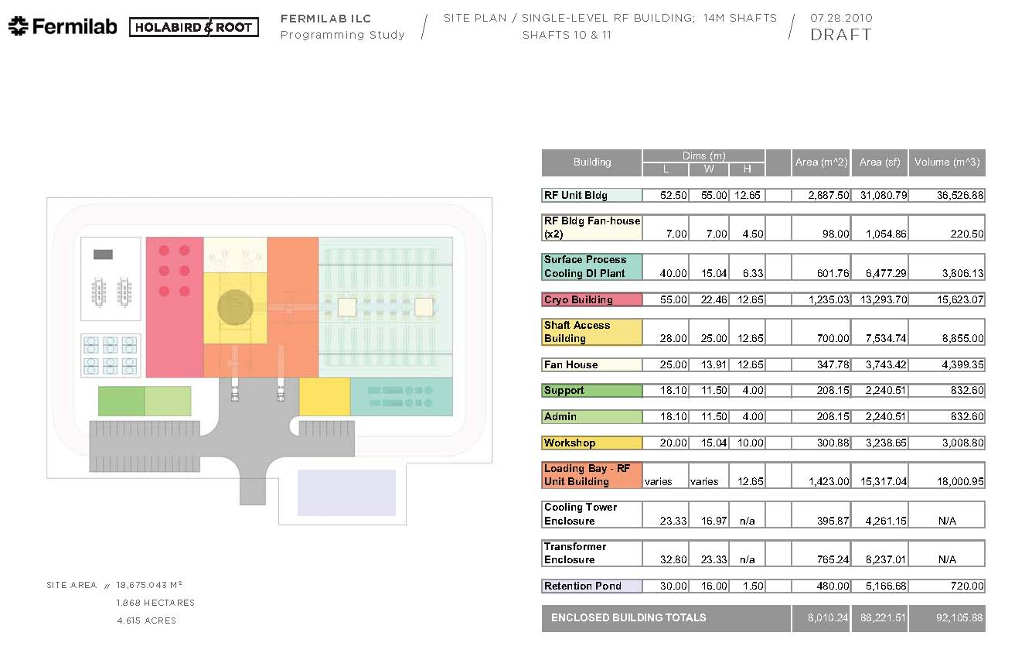

Sites and Buildings
Program developed from KCS Requirements
Building layouts for Cryo Major Shaft and Minor Shafts

Slide 14
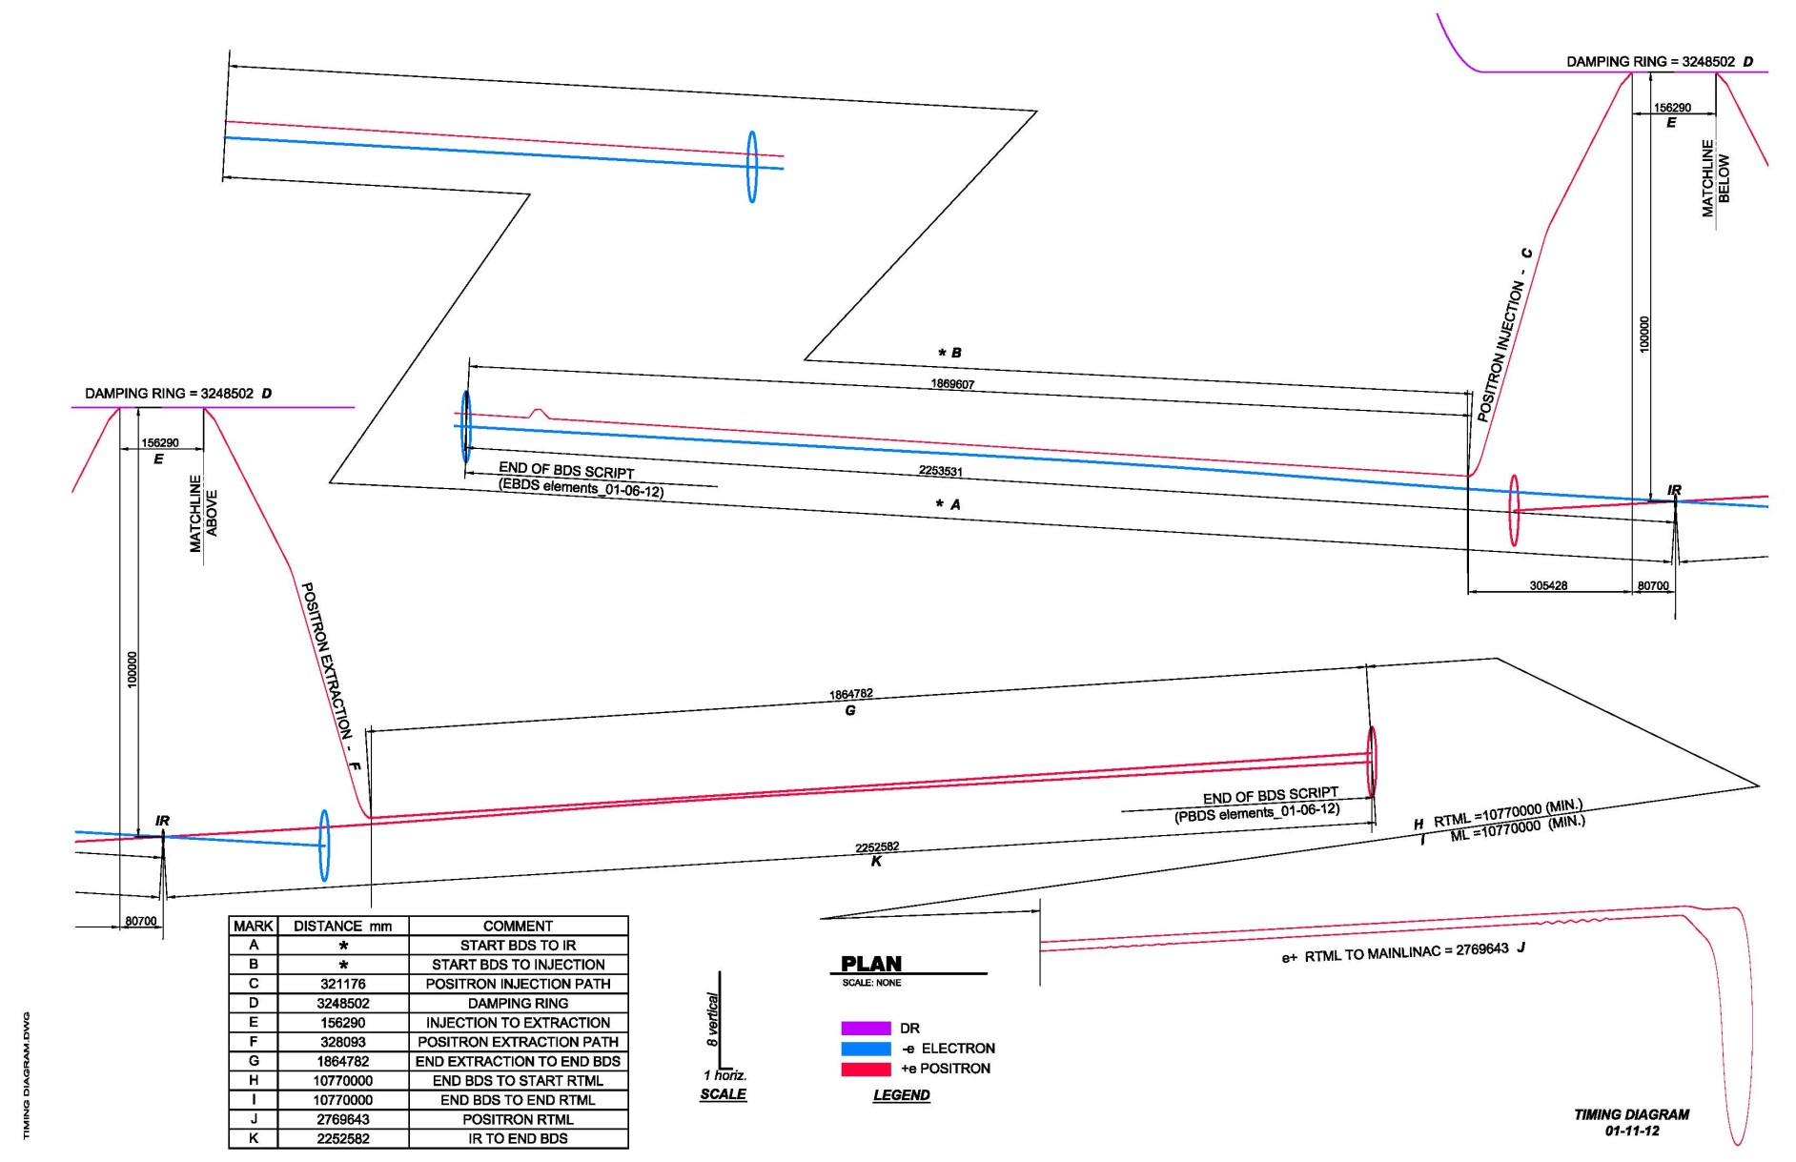
Timing Diagram

Slide 15
Fire and Egress Simulated Computational Fluid Dynamics Model
The Objective of the analysis was to confirm the feasibility and appropriateness of the single tunnel life safety based on the life safety requirements as delineated in NFPA 520.
The tunnel diameters of 4.5M, 5.0M, 5.5M and 6.5M were considered in the analysis.
Area of Refuge (AOR) will be located between each vertical egress shaft to limit maximum travel distance of 610M.
The computational model indicated for every tunnel type and tunnel diameter, there is a limiting fire size that will allow occupants in a single portions of the tunnel to evacuate before conditions become untenable. Reference the following table.

Slide 16
    Area oor Reufyrexxxx

Slide 17
Conclusions
    As smoke travels down the tunnel away from the fire it cools and eventually approaches the ambient temperature of the tunnel at a distance away from the fire, when this occurs, the cool smoke looses buoyancy and begins to be drawn back towards the fire by air being entrained into the fire near the floor of the tunnel (back-layering).
    The analysis has demonstrated that fires are small enough to allow occupants to walk faster than the rate at which back-layering occurs. Once back-layering occurs, occupants would remain in clear conditions if they continue to walk away from the leading edge of the smoke as it propagates down the tunnel.

Slide 18
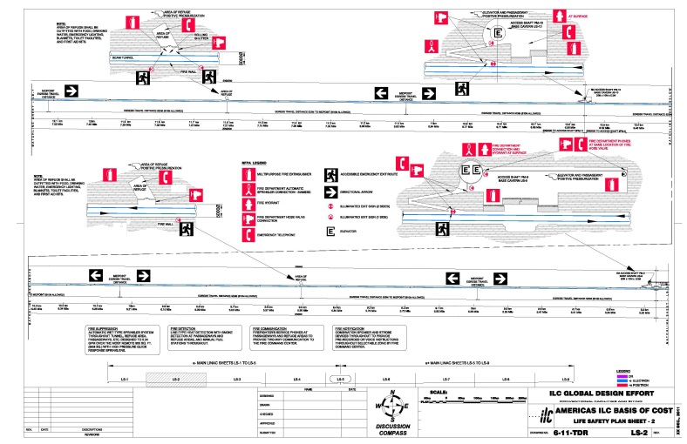

Slide 19
Utilities
  TIMELINE
  CFS-MECHANICAL
  CFS-ELECTRICAL
  WORK THAT WE STILL HAVE TO DO
  LOW POWER – our understanding
  QUESTIONS - we need answers

Slide 20

Conventional Mechanical – ML/Rtml only
For KCS, there are total of 12 process water plant located above the 6 major shafts and 6 minor shafts in ML. The sizes are about 5MW each for the minor plants, and 17-21 MW each for the major plants.
The minor plants provide cooling for the surface RF equipment only, while the major shaft plants provide cooling for the tunnel RF components, cryo plants, RTML at extreme ends, as well as the surface RF equipment.
For DRFS, the plant location is roughly same as RDR, 3 on each side, with sizes from 20 to 33MW each.

Slide 21
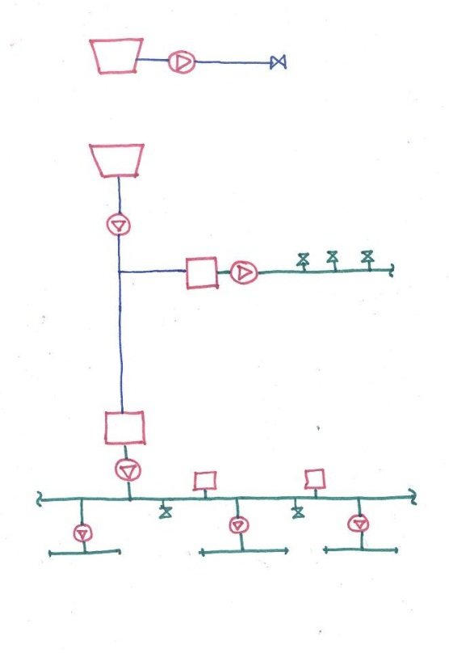
..Continuation Conventional Mechanical
Process water cooling system for Main Linac utilizes cooling towers for heat rejection. Scheme is similar to the DRFS and RDR concept except there’s no chilled water system.
For KCS, the surface RF equipment is located in a ventilated (not conditioned) space. For DRFS, the RF equipment is located in the tunnel and the heat load to air is picked up by DX(compressorized)-fancoils rejecting to the process water system.
Cooling tower for CRYO
TOWER FOR CRYO
Cooling tower
83/98F
(15 DT)
85/100F
(15 DT)
LCW Heat Exchanger
PLANT in MINOR SHAFT
LCW
85/107F
(22 DT)
LCW Heat Exchanger
FCU
85/95F
(10 DT)
LCW
104F Space

Slide 22
..Continuation Conventional Mechanical
For the KCS, the rack heat loads are roughly 62% at the surface and 38% in the tunnel. Racks in the surface are cooled using CRAC (computer room air-conditioning DX unit). For the racks in the tunnel we are just providing taps from the LCW header. For DRFS, all the racks are in the tunnel, and the concept is to locate them in same area per RF to be cooled by a rack chiller that will reject its compressor load to the process water
For the KCS, the RF heat load is roughly 65% in the surface and 35% in the tunnel. For the DRFS, all the loads are in the tunnel.
The design was done based on Full-Power ML with the 24RF from RTML. The equipment was selected based on industry standard n+1 redundancy (for example, 3 pumps installed, with 2 running and one standby)

Slide 23
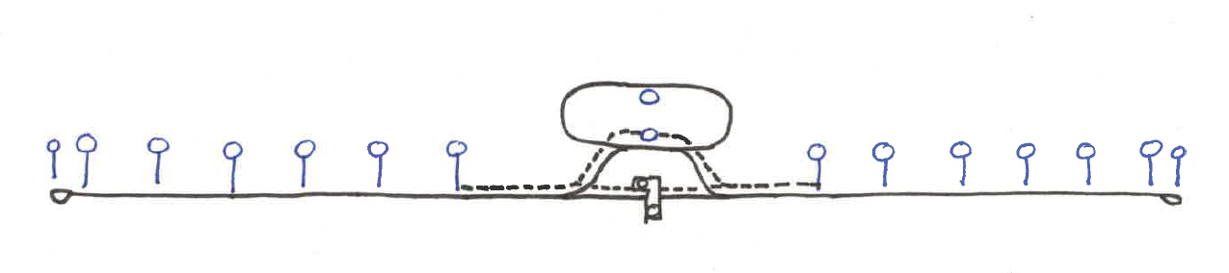
..Continuation Conventional Mechanical
Ventilation plants are located at each shaft providing the required outside air volume and they are configured such that 100% outside air is provided during purge condition. Normal conditions provide neutral temperature dehumidified air.
The design provides for dedicated 100% outside air supplied to the areas of refuge through separate ductwork.
Ducted supply air to each “Refuge Area Alcove”

Slide 24
Conventional Electrical – ML & RTML only
Loading tables were developed for both the KCS and DRFS systems based on the Full & Low Power Options.
Electrical system conceptual design was done using the load tables and standard electrical design practices.
    Substations were designed with N+1 power transformers and loop feeds.
    Dedicated service transformers were designed as single units with radial electrical power feeds.

Slide 25
Electrical Distribution System
345 kV power source to central main substation.
69 kV loop power distribution installed through the tunnel to substations at shafts.
34.5 kV power distribution loops fed at each shaft from the substations to serve building and tunnel loads
Separate electrical feeds are provided by the 34.5 kV looped system to Cryogenics, RF Buildings, Conventional Facilities and the Tunnel.
Transformers provide 480 V local power and is delivered to the experimental and conventional loads using standard panelboard and conduit systems.

Slide 26
Tunnel Power Distribution System
34.5 kV tunnel power feed is brought down the shaft to the base cavern 480 V transformer. Power is distributed with radial feed from this transformer through the tunnel at 480 V.
Distribution panelboards and low voltage transformers are attached to the tunnel wall and located every 230 meters.
Emergency Power Distribution System
4,160 V diesel generators at each shaft
480 V transformers and Automatic Transfer Switches on the surface and in the shaft base cavern

Slide 27
KCS Distribution System
Klystron RF units are fed from MCC power centers
  Feeds to klystrons - 480 V and 300 amps
  Power Center serves up to 14 RF units each
  Typically 5 power centers are located at each shaft
DRFS Distribution System
12.47 kV substation transformers
    Located on the surface
    Dedicated to powering the RF units in the tunnel
    No CF&S transformers are located underground to serve RF equipment
Klystron power feed
    12.47 kV loops in the tunnel
    Each loop feeds approximately 10 RF units

Slide 28
WORK THAT WE STILL HAVE TO DO (ML-related)
Design and costing are ~90% done, based on full power & previous criteria. The following are examples of adjustments that we still have to do ( this doesn’t include any changes from this meeting )
  add fire protection cost, engineering consultancy, and other sub wbs from RDR that was not costed by Parson
  add laser room HVACs cost based on NML (no design)
  adjustment based on impact of RTML 2BC (using ratio/proportion of cost)
  adjustment to low power /reduced bunch ( using ratio/proportion of cost)

Slide 29
OUR UNDERSTANDING OF LOW POWER ADJUSTMENT
The main pipe and electrical distribution are sized for full power. Low power adjustment will be made on sub wbs such as pipe taps, tower cell, pumps, transformers.
Only the DR and ML cost will be adjusted for low power
The rough % low power reduction for ML cost adjustment is about 20%

Slide 30
QUESTIONS
need confirmation if the ~20%? we’re using for ‘proportioning’ our cost for low power is correct
need get a updated RTML load (high level), otherwise we’ll just use the one that we currently have.
Updated KCS info (number in the surface, cryoplant updates,etc)
What’s our direction towards TDR (DRFS vs. RDR fallback?)

Slide 31
BACK UP SLIDES
CFS UTILITIES

Slide 32
TIMELINE
TIMELINE (PARSONS)
JAN 2011-MAR 2011 FINALIZE CRITERIA / SENT TO PARSONS
SEP 2011 DESIGN FINISHED BASED ON FULL POWER
OCT 2011 PRELIMINARY COST ESTIMATE
JAN 2012 FINALIZE COST FOR FINAL REVIEW
TIMELINE (IN-HOUSE)
JAN-FEB 2012 ADD MISC SUB-WBS COST
JAN-FEB 2012 IDENTIFY / UNDERSTAND CHANGES SINCE SEP2011
FEB 2012 UPDATE COST FOR ANY CHANGES
FEB 2012 UPDATE COST FOR LOW POWER
MAR 2012 CFS REVIEW

Slide 33
MAIN LINAC KCS
Mar 23 2011
Backup Slides

Slide 34
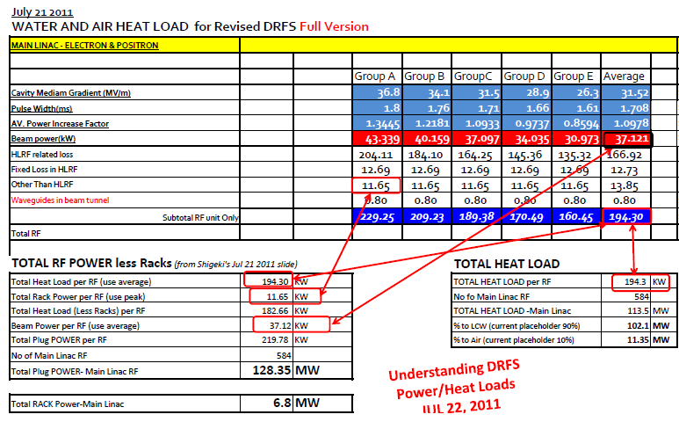
DRFS
Backup Slides

Slide 35
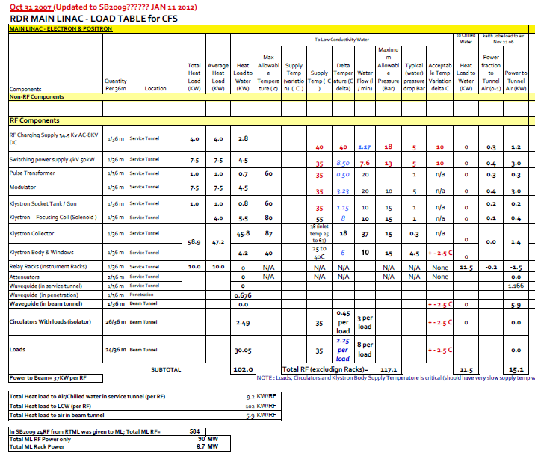


Slide 36
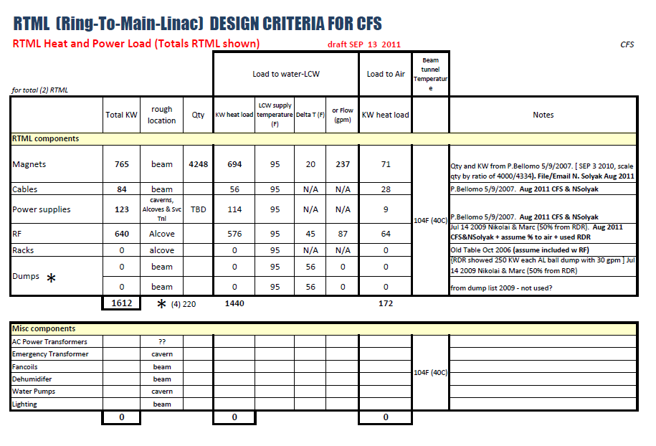

Slide 38
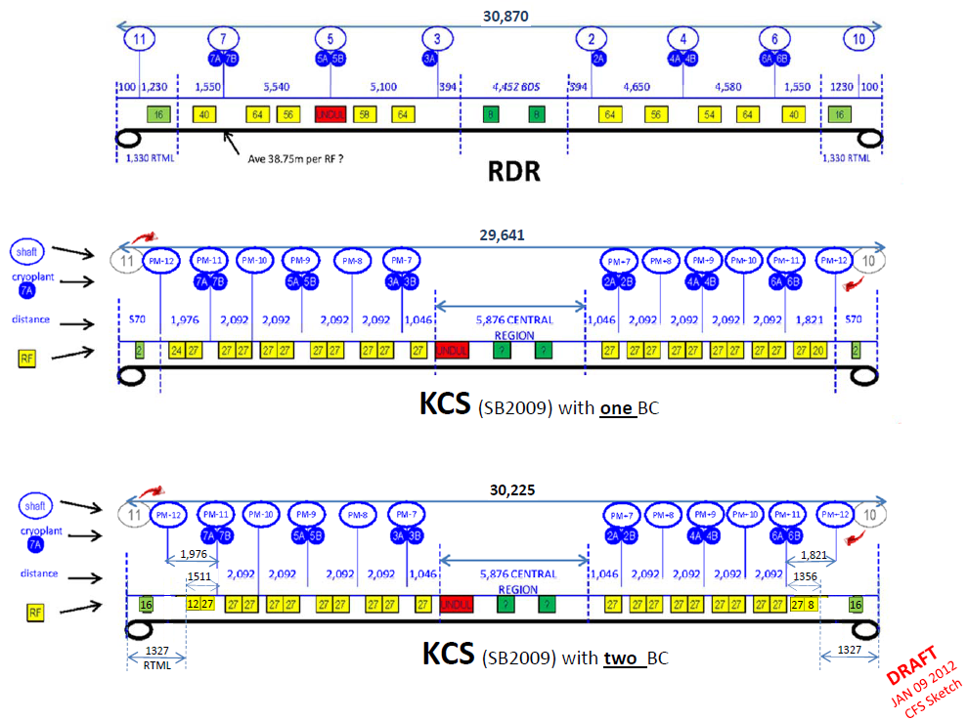

Slide 39
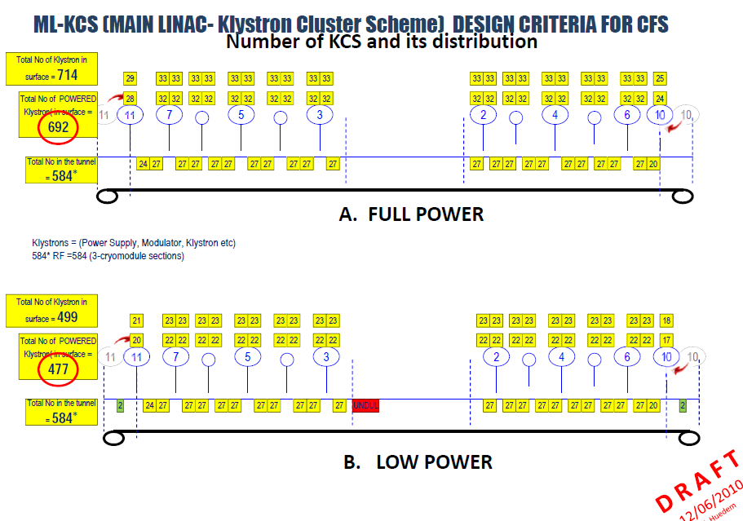

Slide 40
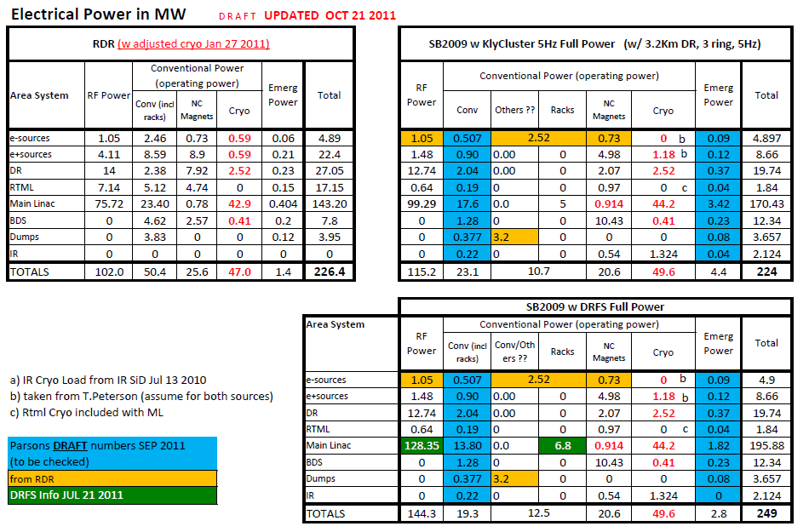

Slide 41
Load Table progress –
Basis for current Concept design

Slide 42
CFS
MECHANICAL
BACKUP
SLIDES

Slide 43
SCOPE:
Conventional Mechanical scope includes Air Treatment (Ventilations), Sumps systems (part of pipe utilities wbs), and Process Cooling Water system
Follows the RDR WBS system
1.7.3 AIR TREATMENT (HVAC)
1.7.4 PIPED UTILITIES
1.7.5 PROCESS COOLING WATER
Notes:
The scope of the conventional mechanical includes Air Treatment (or ventilations), Sump systems (which is a portion of the piped utilities wbs), and process cooling system
This follows same WBS as was used in the RDR, which is 1.7.3 for air treatment, 1.7.4 for piped utilities, and 1.7.5 for process water.
with some minor additions/revision, further down in next level the wbs (shown in the right column)

Slide 44

PROCESS WATER PLANT LOCATIONS
*
PM+10
PM+11
PM+9
*
*
PMC-0
PM+7
PM+8
PM+12
PMB-0
PM-7
PM-9
*
*
PM-8
PM-11
PM-10
*
PXB 0
PM-12
*
=used in KCS only (serves only surface KCS RF loads)
Background drawing taken from John Osborne presentation
Notes:
The effort is being done by our consultant, Parson and started around Mar 2011 (using whatever Loads we have)
This slide gives us an graphical overview of where the process water plant would be in relation to the whole machine.
It pretty much follows the shaft locations. The one shown here is for KCS. The one noted in asterisk are true for the KCS only
The loads we gave our consultant is based on full load tables
Started with KCS. DRFS information were only available early August 2011

Slide 45
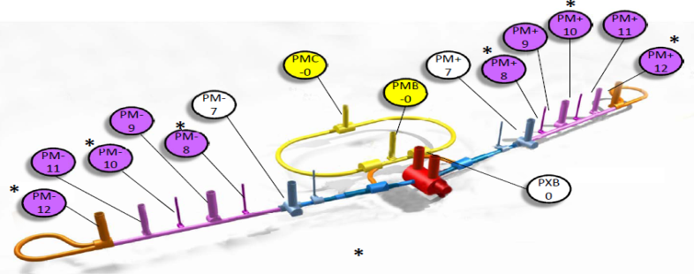
PROCESS WATER PLANT LOADS-KCS (Technical components only shown)
D R A F T
7/19/2011
E. Huedem
Notes:
This summarized the various load tables from area systems and associate those with the plants.
About 38% of the technical load is from Main Linac
Plants in Major shaft serves all the remaining tunnel loads, while the minor shaft only serves the surface RF loads.
Heat load to air in the surface are just ventilated

Slide 46
PROCESS WATER PLANT LOADS-DRFS (Technical components only shown)
D R A F T
08/09/2011
E. Huedem
Notes:
For the drfs, the only thing change is the main linac loads and distribution, and basically the loads that was on the surface are back in the tunnel similar to the rdr.
The DRFS loads came in around early August.

Slide 47
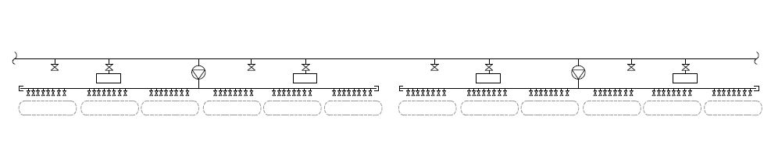
INTERFACE (KCS) (ONLY THE SUPPLY PIPE ARE SHOWN FOR CLARITY)
ONE 1” VALVE TAP FOR RACKS PER RF
(5 KW PER RF) @ 10 F dt
3.4 GPM
1-1/4” (4.5 GPM)
TO FANCOILS
1qty/RF
LCW BOOSTER PUMP
(1 PER 2 RF)
24 GPM, 1 BHP, 1-1/2”PIPE
12” LCW MAIN SUPPLY PIPE
1 RF ( 3 CRYOMODULES)
1-1/4” PIPE HEADERS AFTER BOOSTER PUMPS INCLUDED
(BUT NOT THE VARIOUS VALVE TAPS?)
~ 38.75 m
Notes:
For the KCS, The load in the tunnel are small since most of the loads are in the surface.
For our termination in the tunnel we’re considering various valve taps as shown
We’re including booster pumps which are small enough to install in line with the little bit of space.
We’re including the header but not the various taps (unknown numbers)

Slide 48
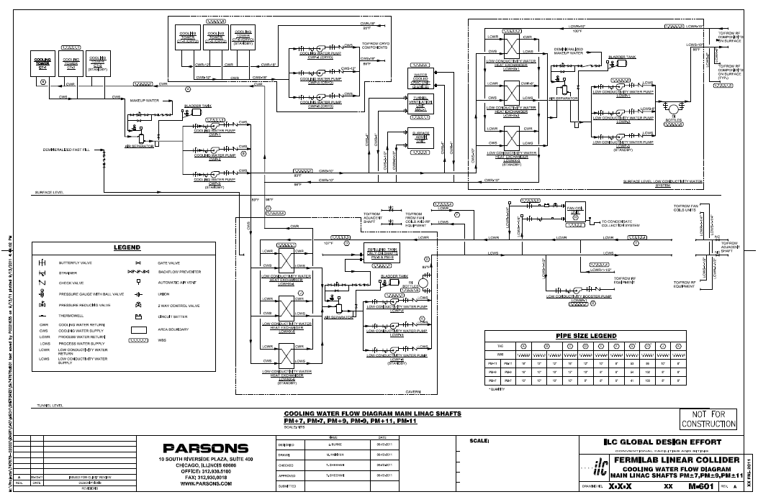
ML-KCS Process water System
Notes:
This is a schematic for Major ML shaft at PM +- 7,9,11 Cooling water flow diagram.
This include cooling towers for the cryo system, (shown separate) and cooling towers, pumps HX in the surface.
The intermediate shafts PM + - 12, 10, 8 is similar except they don’t have the cryo load in the surface and RF load in the tunnel
Heat load to air from RF loads in the surface are just ventilated. RF racks in the surface used CRAC unit (DX unit watercooled)
The scheme for Main Linac use just cooling towers, no chillers.

Slide 49
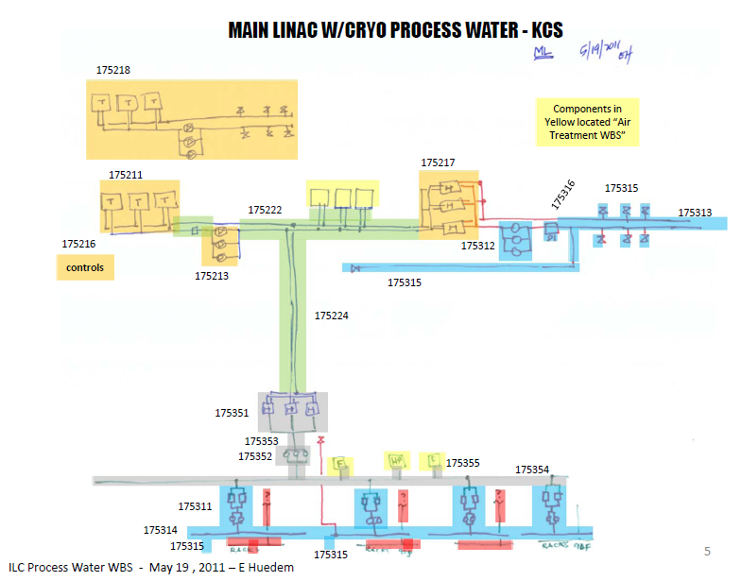
ML-KCS Process water System (simplified)
83/98F
(15 DT)
85/100F
(15 DT)
FCU
85/95F
(10 DT)
LCW
85/107F
(22 DT)
104F Space
Notes:
Simplified version showing wbs and temperatures
LCW starts at the cavern heat exchanger and there’s multiple booster pumps along the way

Slide 50
CFS
ELECTRICAL
BACKUP
SLIDES

Slide 51
Electrical Substation Equipment
345 kV
Open air bus with SF6 gas insulated circuit breakers and oil filled power transformers
69 kV
SF6 gas insulated switchgear, installed outdoors
34.5 kV
Insulated bus with vacuum circuit breakers

Slide 52
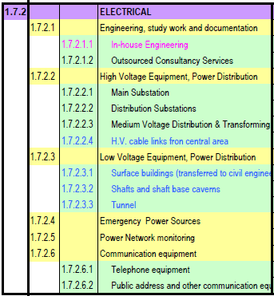
SCOPE:
Conventional Electrical scope includes ………………..
Follows the RDR WBS system
*

Slide 53
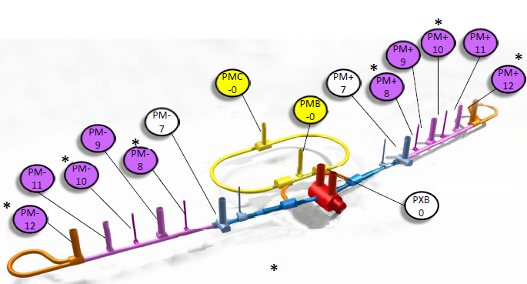
Electrical Power Distribution
Central Region Tunnel
MW AREA SHAFT
15.0 IR ,BDS,DMP PXA
PXB
8.61 RTML PM+/-12
PMB-0
4.0 e- PM+7
6.25 e+ PM-7
14.81 DR PMB-0
PMC-0

Slide 54
KCS POWER LOAD TABLE (Technical Equipment only)

Slide 55
DRFS POWER LOAD TABLE (Technical Equipment only)

Slide 56
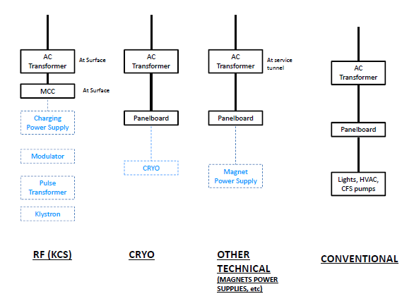
INTERFACE – Electrical

Slide 57
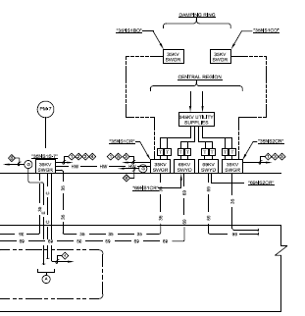
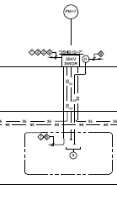
Electrical Power Single Line Diagram
Central Region
Damping Ring
PMB0
PMC0
PM-7
PM+7
Central Campus

Slide 58
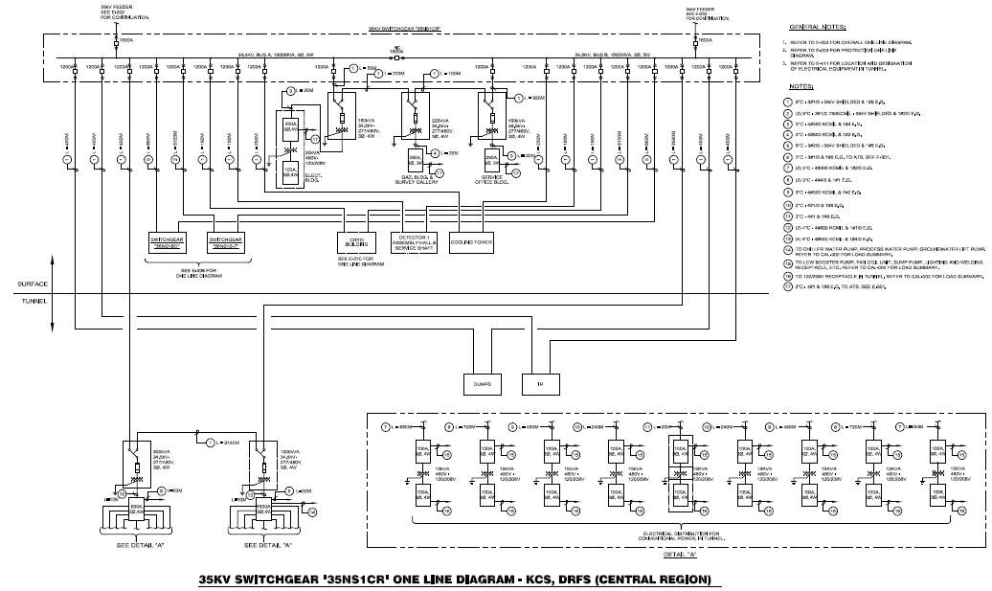
34.5 kV Power Distribution
Surface Facilities
Detector Hall & Shaft
Tunnel Facilities

Slide 59
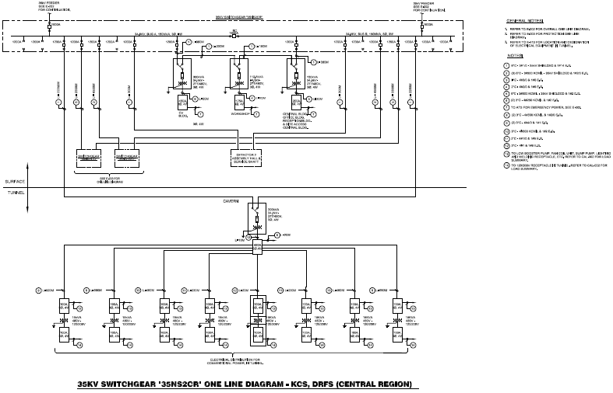
34.5 kV Power Distribution
Detector Hall
& Shaft
Transformer in Cavern
480 V Power
Distribution
In Tunnel

Slide 60
Electrical System Diagram
345 kV
Supply
345 – 34.5 kV
Transformers
T
T
345 – 69 kV
Transformers
34.5 kV Switchgear
69 kV Switchgear
34.5 kV Switchgear
Distribution
T
69 – 34.5 kV
Transformers
T
69 – 34.5 kV
Transformers
Distribution
34.5 kV Switchgear
34.5 kV Switchgear
34.5 kV Switchgear
Distribution
Distribution
34.5 kV Switchgear
Distribution
Distribution

Slide 61
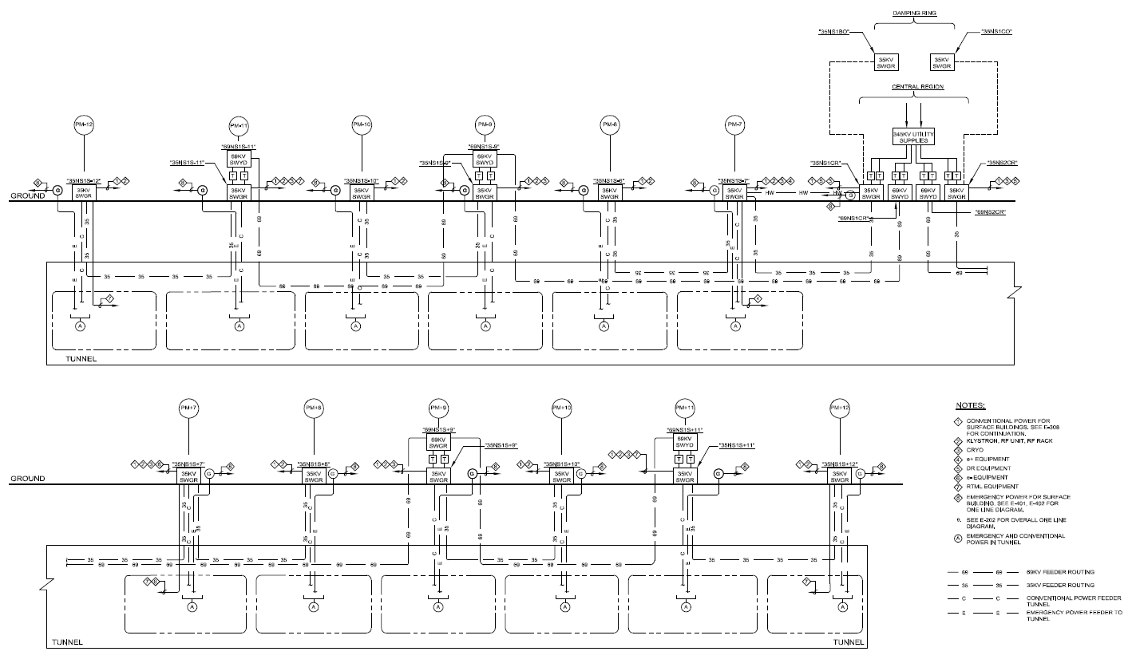
PMB0
PMC0
PM-12
PM-11
PM-10
PM-9
PM-8
PM-7
PM+7
PM+8
PM+9
PM+10
PM+11
PM+12
Power System Configuration

Slide 62
Power System Configuration - KCS
PM-7
PMB0
PM+7
PM-9
PMC0
PM+9
PM-8
PM+8
PM-10
PM+10
PM-11
PM+11
PM-12
PM+12
Notes:
345kV/69kV/34.5kV One Line Diagram

Slide 63
High Voltage Power Distribution
PM-7
PMB0
PM+7
PM-9
PMC0
PM+9
PM-8
PM+8
PM-10
PM+10
PM-11
PM+11
PM-12
PM+12
Notes:
Dual HV at 345kV circuits from utility power grid, for redundancy
Each circuit shall have adequate capacity to support the total load
Main electrical switchyard located in Central Region

Slide 64
High Voltage Power Distribution
PM-7
PMB0
PM+7
PM-9
PMC0
PM+9
PM-8
PM+8
PM-10
PM+10
PM-11
PM+11
PM-12
PM+12
Notes:
(4) 345kV to 69kV 80MVA transformers connect to (2) 69kV switchyards (69NS1CR, 69NS2CR) at Main Electrical Station.
(4) 345kV to 34.5kV 80MVA transformers connect to (2) 35kV switchgears (35NS1CR, 35NS2CR) at Main Electrical Room, next to main electrical station.

Slide 65
Medium Voltage Power Distribution
PM-7
PMB0
PM+7
PM-9
PMC0
PM+9
PM-8
PM+8
PM-10
PM+10
PM-11
PM+11
PM-12
PM+12
Notes:
The (2) 69kV switchyards in Central Region will provide power for the electrical loads in remote shafts #8, 9, 10, 11, 12 (+ve and –ve).

Slide 66
Medium Voltage Power Distribution
PM-7
PMB0
PM+7
PM-9
PMC0
PM+9
PM-8
PM+8
PM-10
PM+10
PM-11
PM+11
PM-12
PM+12
Notes:
The (2) 35kV switchgears in Central Region will provide power for the electrical loads in Central Region, Damping Ring and nearby shaft #7 (+ve and –ve).
The Damping Ring tunnel is supplied by (2) 34.5kV loops, feeding switchgear 35NS1B0 and 35NS1C0 located on the surface at shafts PMB-0 and PMC-0 respectively. Cryo and mechanical equipment are fed directly from these switchgears.
34.5kV dual circuits will provide power to the step down transformer at the cavern in the base of the shaft. 480V power panel in the tunnel will provide power to the electrical load in the tunnel.
Similarly for shafts #7, RF and Cryo will be fed directly from the 35kV switchgears and the electrical loads in tunnel will be fed via a step-down transformer in the cavern.

Slide 67
Medium Voltage Power Distribution
PM-7
PMB0
PM+7
PM-9
PMC0
PM+9
PM-8
PM+8
PM-10
PM+10
PM-11
PM+11
PM-12
PM+12
Notes:
In Main Linac, 69kV switchyards at shafts #9 (69NS1S-9, 69NS1S+9) are sub-fed from the 69kV switchyards in Central Region.
(2) 69kV to 34.5kV, 40MVA transformers (dual feed for redundancy) in shaft #9 will provide to power to the 35kV switchgears at shafts #9 & 10.
Another (2) 69kV to 34.5kV, 40MVA transformers are provided in shafts #11 to provide power for the 35kV switchgears at shafts #11 & 12.

Slide 68
Emergency Power Distribution
Notes:
4160V, 600kVA stand-by diesel generator is provided at each shaft.
To protect critical, Life and Safety Loads (e.g. fire detection and protection control, life support system, emergency lighting and egress lights, ventilation fans, etc.)

Slide 69
Emergency Power Distribution
Notes:
Unit substation / Transformer are provided to backup the critical load in surface buildings.

Slide 70
Emergency Power Distribution
Notes:
A 4160V to 480V step down transformer fed by a 4160V loop will provide power to backup the critical load in the tunnel.

Slide 71
Power Distribution for RF
Notes:
A double-end 35kV switchgear with dual circuits for redundancy will be provided in the RF Building.
A 500kVA 34.5kV to 480V transformer is provided for the conventional building load in the RF Building.

Slide 72
Power Distribution for RF
Notes:
(5) double-end MCCs are provided to provide power for the RF units.

Slide 73
Power Distribution for RF
Notes:
Step down transformers to 480V are used to power the RF units. Each RF unit is individually protected.

Slide 74
Power Distribution for Cryo
Notes:
1. Power distribution for Cryo is similar to the power distribution for RF.

Slide 75
Power System Configuration - DRFS
PM-7
PM+7
PM-9
PMB0
PMC0
PM+9
PM-11
PM+11
PM-12
PM+12
Notes:
Alternative Scheme.
Estimated load at 310.67kVA.
Shafts #8 and 10 are eliminated

Slide 76
Power Distribution for RF - DRFS
SHAFT BASE CAVERN
MAIN LINAC RF
MAIN LINAC RF
Notes:
RFs are located in tunnel.
A 15kV switchgear is located in the surface, RFs are fed by 12.47kV circuit loops in the tunnel.

