Slide 1
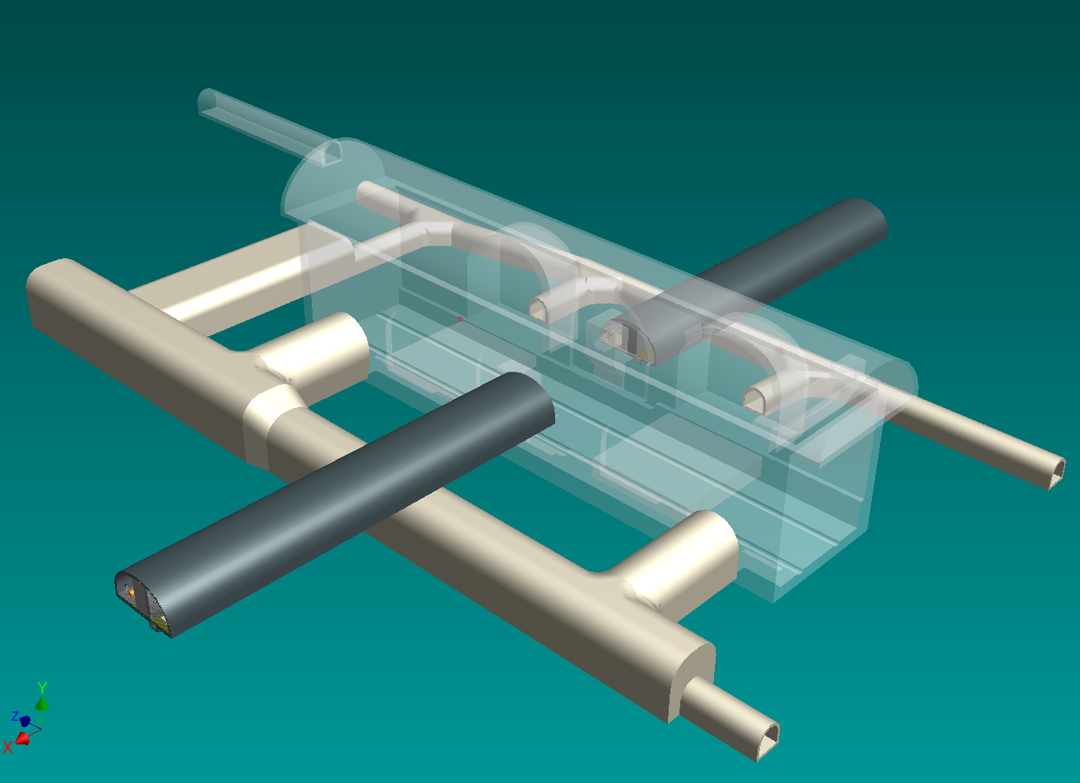
Surface
Dampimg
Ring

Slide 2
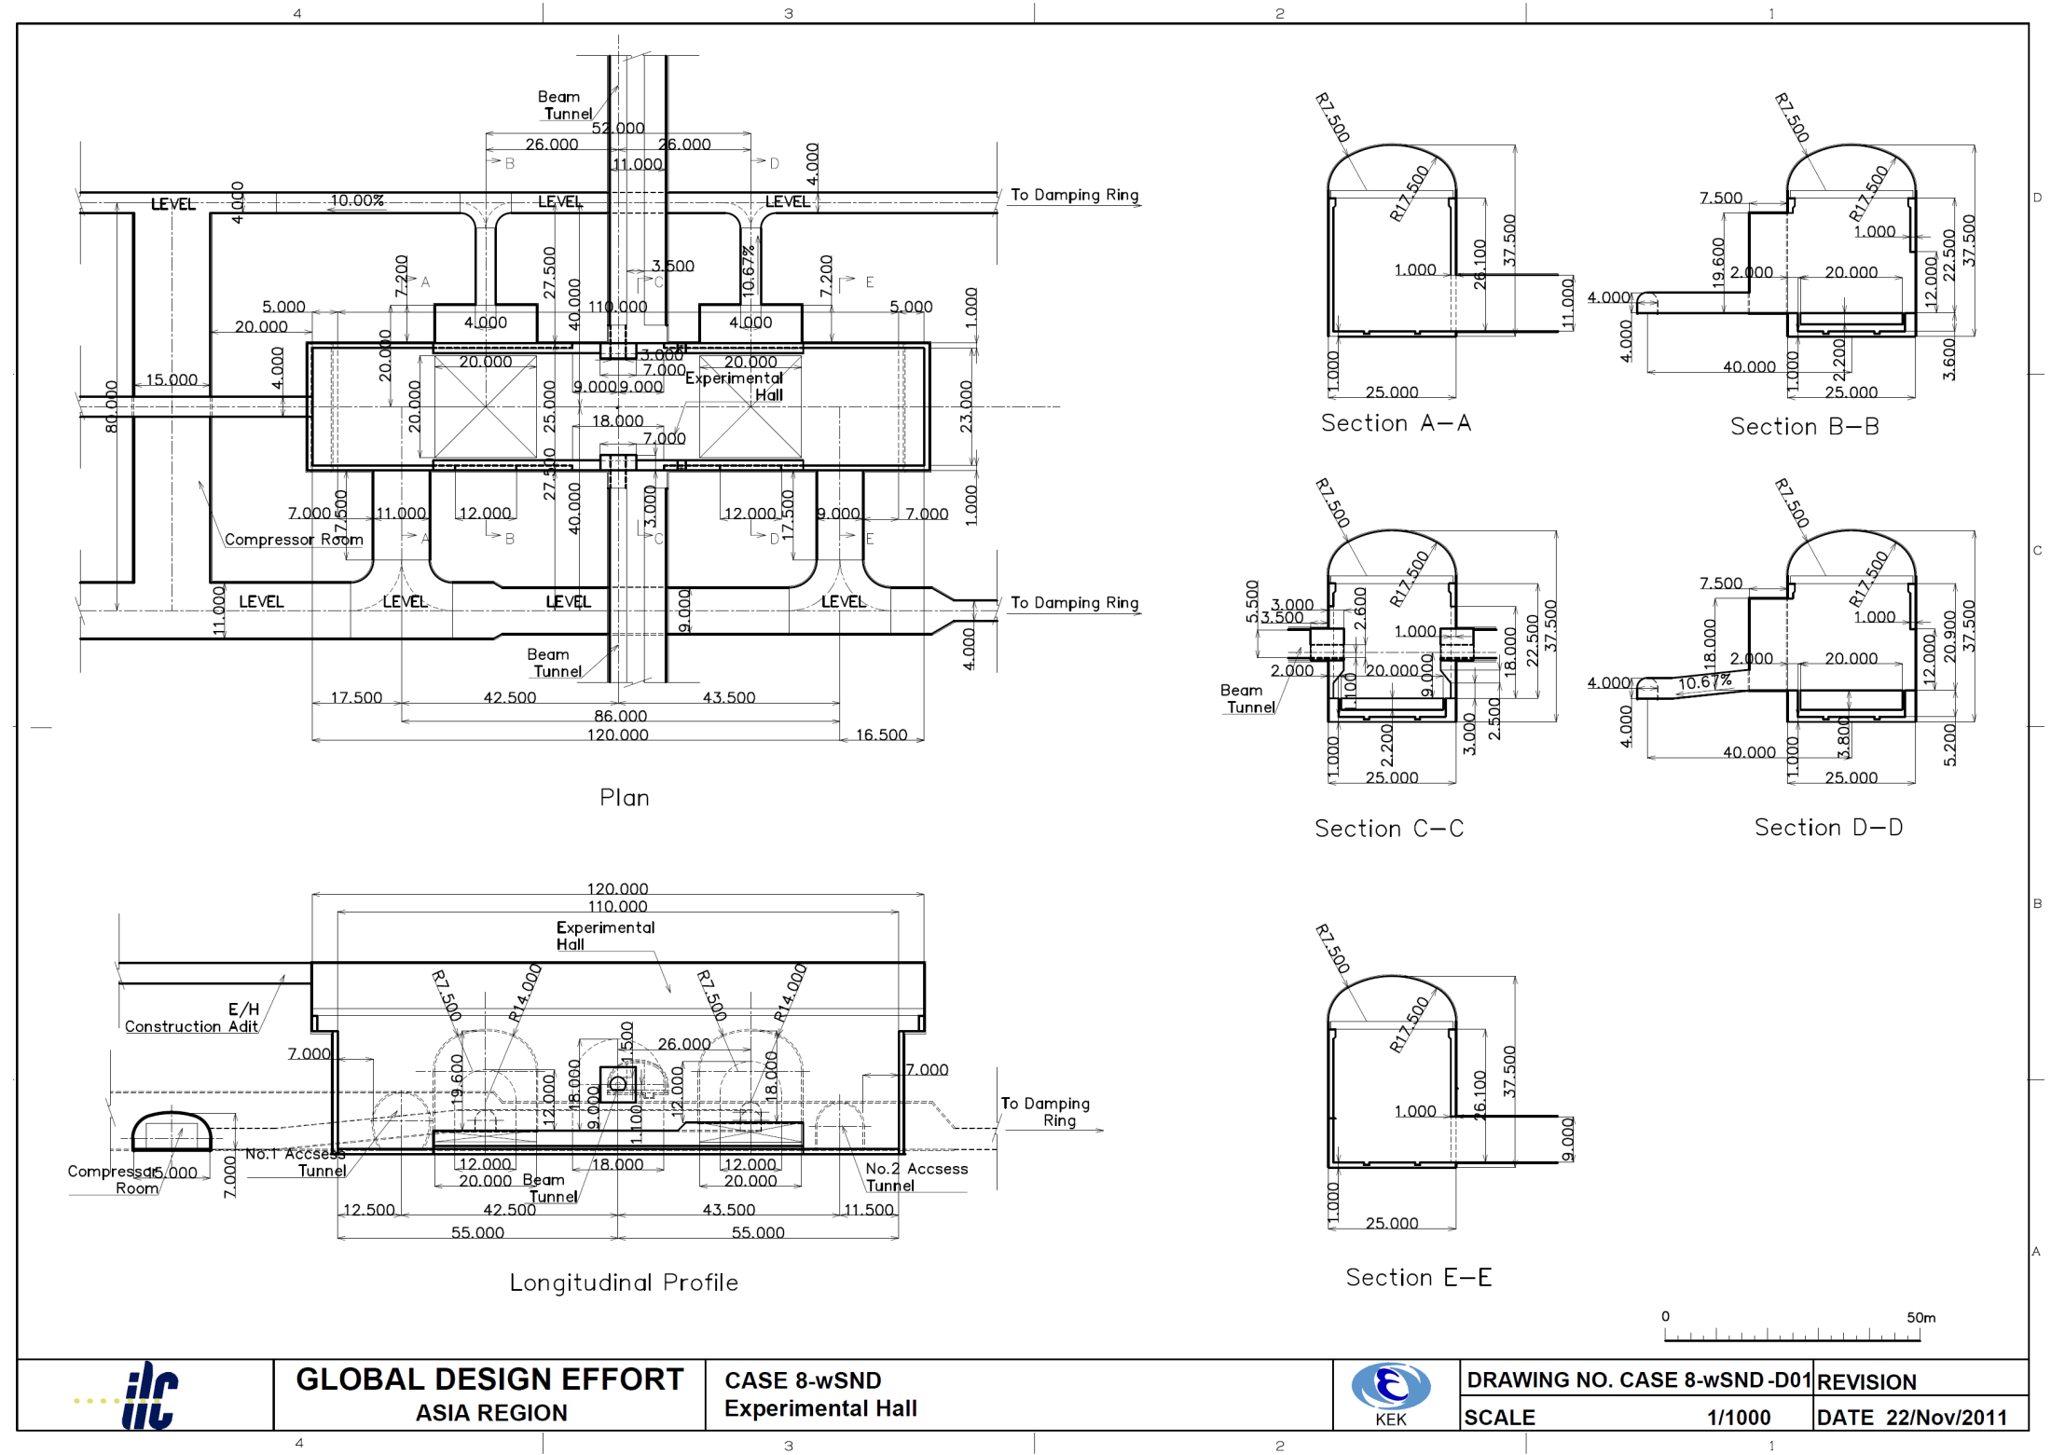
Detector services
Helium compressor / cryogenics
Loading area
Main access tunnel

Slide 3
Access tunnel
ILD
SiD
A trailer with lower deck height
would reduce the tunnel size

Slide 4
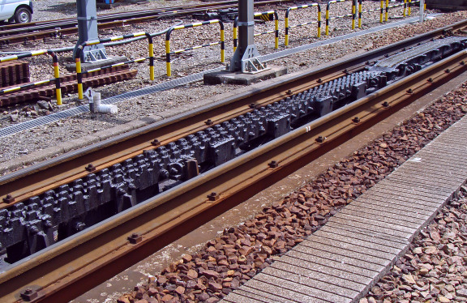
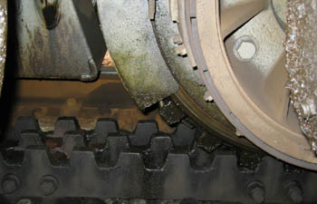
Solenoid transport
Trailer truck
  225t/5axles→450t with 2 trailers
  Capability of ~7% slope
Gear track (Abt system) is also suggested

Slide 5
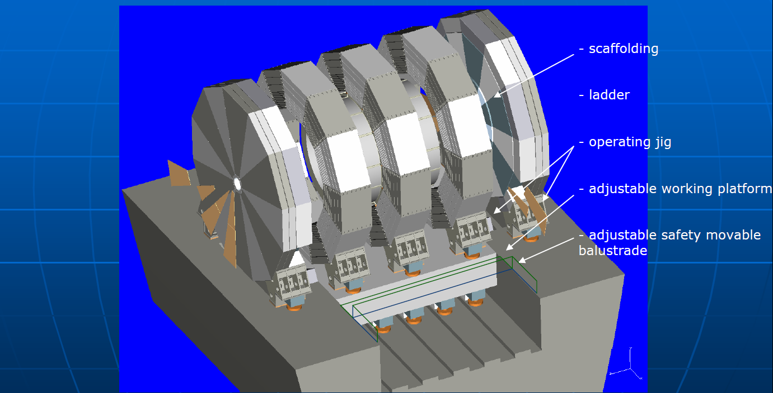
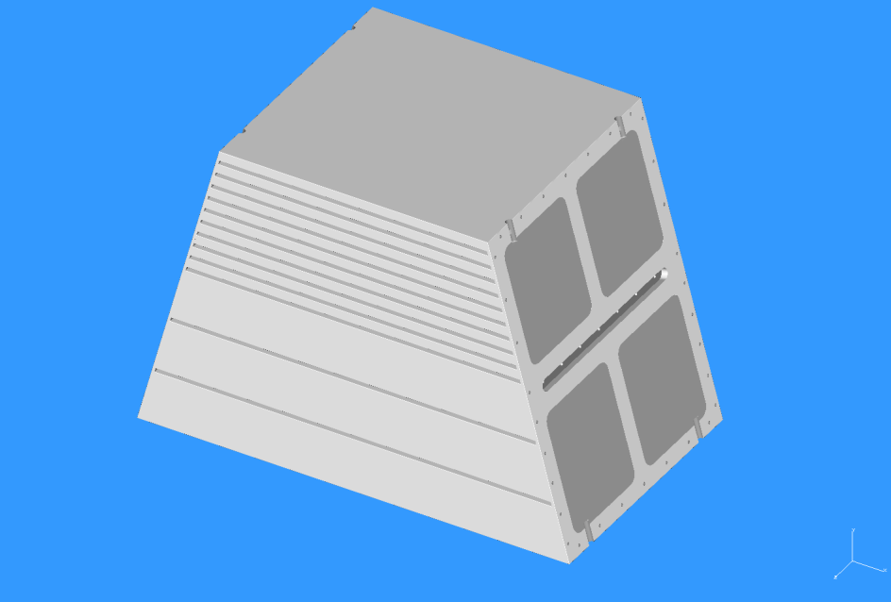
ILD Detector assembly
Solenoid
  Wound, assembled, and tested on surface
  Carried into the cavern as a whole
Return yoke
  Pre-assembled on surface as relatively small blocks ~200 tons
  Each ~200 ton block is carried into the cavern one by one and assembled into one barrel
  No gap in the barrel yoke → Less leakage field
Large assembly hall on surface is necessary

Slide 6
Detector assembly
1
2
Barrel assembly
Endcap (+) assembly
Endcap (-) assembly
Solenoid installation
QD0 support tube (-) assembly
QD0 support tube (+) assembly
Sub-detector installation
3
4
5
6

Slide 7
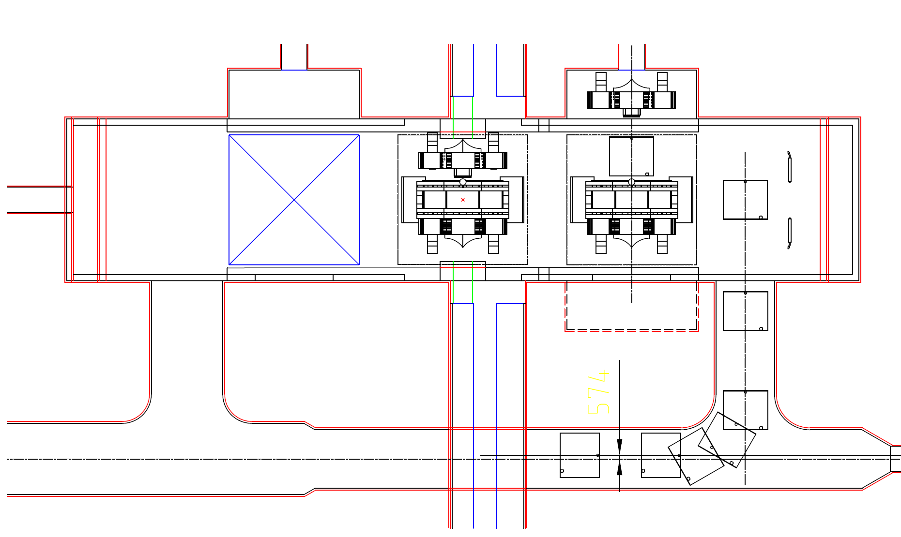

Slide 8
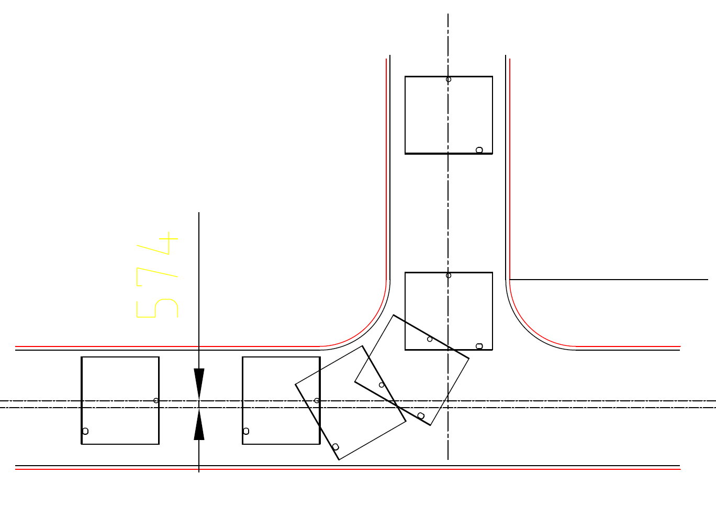

Slide 9
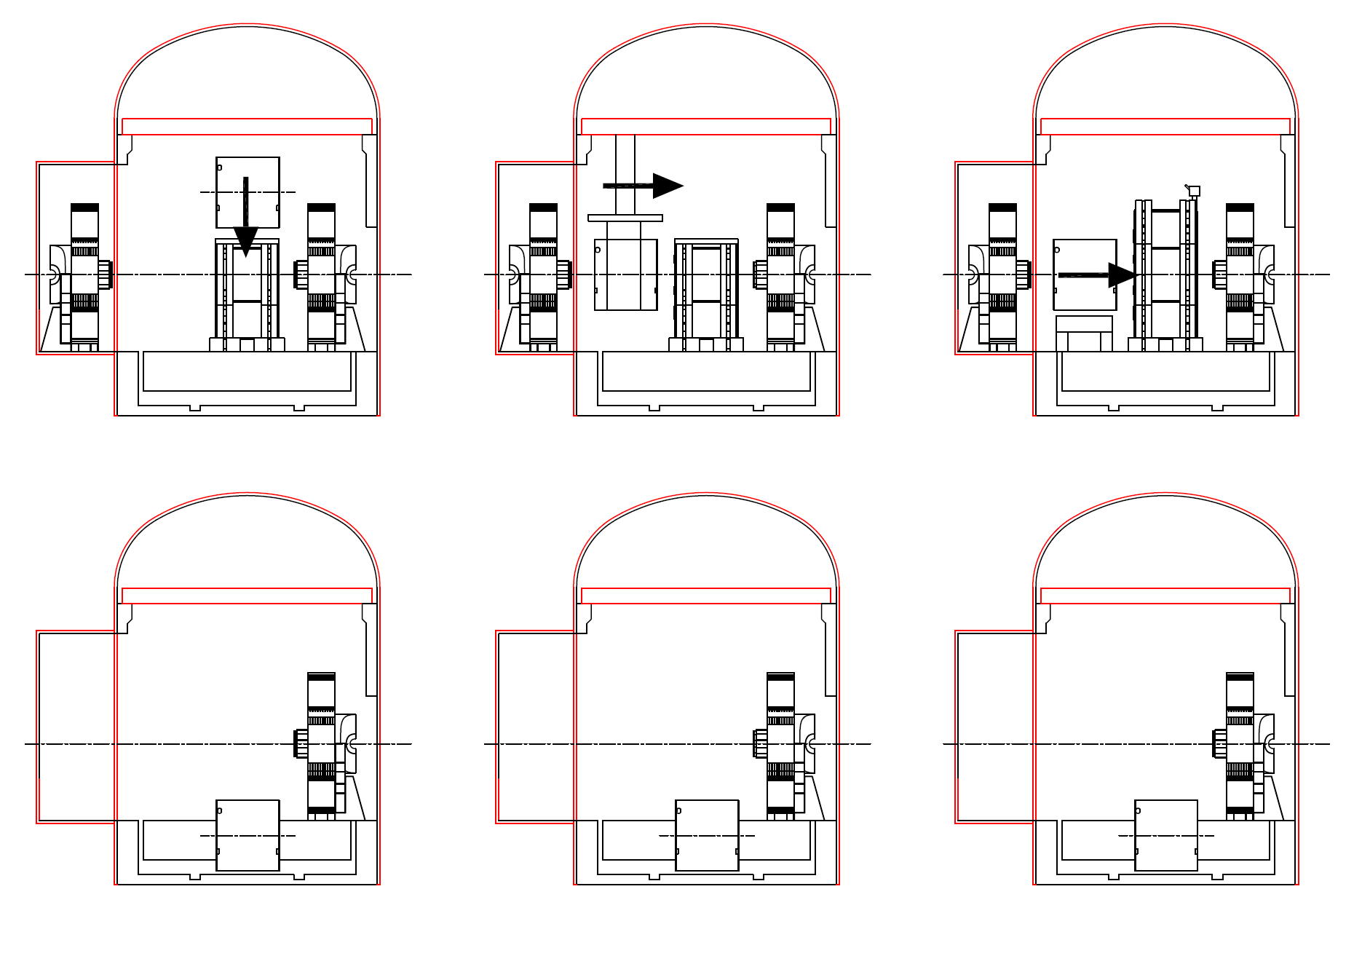

Slide 10
