Slide 1
MICROMEGAS data analysis with MarlinTPC
D. Attié, P. Colas, W. Wang
Saclay
G. De Lentdecker
Université Libre de Bruxelles
P. Hayman
Carleton
With the kind help of K. Fujii
KEK

Slide 2
MarlinTPC installation
MarlinTPC installation:
  Use version v01-13-01 of ILCSOFT
  + HEAD version of MarlinTPC
  + HEAD version of CEDViewer
  Installation succeeded on different machines (Saclay, Carleton, CERN) and different OS (SL5, Ubuntu 11.10).
KalTest and KalDet
  The code needed to use the Kalman Filter (written by K. Fuji)
  Now installed with MarlinTPC
  Straightforward to use it with MICROMEGAS data

Slide 3
Status
Current status
  Run on 2010 data
  Able to reconstruct Pulses, Hits (without PRF)
  Able to reconstruct tracks with the KalmanFilter:
  See tracks with CEDViewer:

Slide 4
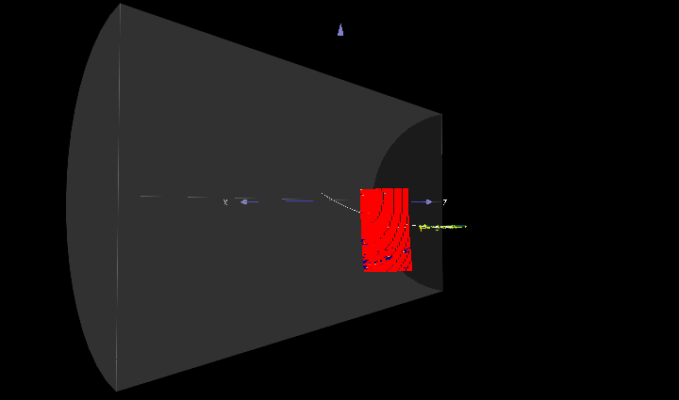
CEDViewer

Slide 5
Ongoing developments:
Add “PRF Processor” to reconstruct correctly hit position
Produce correct channel mapping in LCIO format for 2011 and future data
And repeat the analysis performed in the past with FTPC with MarlinTPC

