Slide 1
STATUS of E+/- GLOBAL TIMING, V4
UPDATED FOR AD&I MEETING
DEC 21 2011
JMP

Slide 2
QUICK SUMMARY OF ISSUES AND RECOMMENDATIONS
A Statement of the Issue of Optimum Timing which maintains a constant bunch pattern in DR (any pattern)
E+ bunch goes from Tgt to DR and spends ~ 200msec in DR then goes down linac around turnaround , through compressors ,E+ linac, and FF to IR.
The Matching E- bunch goes past target in step with next cycle E+ bunch and straight through FF to IR
THE DIFFERENCE IN E+/- PATHLENGTHS FROM TARGET TO THE IR MUST BE AN INTEGER NUMBER OF DR TURNS (3.2 km)
ACHIEVED by
1) Adjust machine layout with variable being the distance from the
end of E+ Linac to beginning of E+ Final Focus
2) Survey to ≤ +/- 10 mm and insert in design a chicane with that
range.
3) Measure relative beam timings and adjust with small changes in
chicane setting or DR RF phasing. (or combination)

Slide 3
STATUS of LAYOUT ADJUSTMENT
Path Lengths Central Region New Layout-done.
Linac Decision Jan 2012?
Turn-around Done 2-stage compressor
Last Estimate of needed correction before LINAC BTR is 350 meters
Therefore a simple shortening of the E+ linac side of the central region by 175 meters is required. Needs update!
We should update the lengths from the latest info before the January BTR meeting, so that we understand the impact of any proposed changes in the length of the linac!
Suggest Benno does this from latest lattices and Tomski from CFS drawings. This would find differences in assumptions.

Slide 4
Working Decision
Final layout correction will be shortening of E+ linac to BDS length (compared to e+ source side) where there is ≤ 500 m possible. (This is equivalent to undulator plus photon drift length) This should be enough unless linac gets much longer with increased overhead!
We need to start discussions on expected final path length accuracy after installation, during operation and methods of adjustment.

Slide 5
How accurately can we measure before we have both beams in the IR area?
What can be achieved during construction and installation, before beam is available. 10*-6 or 20 mm??
Metrology experts using modern techniques ( a geodetic network using access to multi-satellite GPS every ≈ km and long period averaging) say we should get +/-10 mm in the horizontal plane and an update on this network should take one week. Limits will be errors in transferring to an in-tunnel network.
(Straight horizontal or vertical alignment shafts will help.)
Over long distances (km’s) GPS is superior to optical techniques which are limited by systematic errors related to temperature, pressure and humidity.
However laser optical stations WILL be used for transverse offset measurement and correction. Final alignment will require stable tunnel conditions, e.g. temperature! During installation?

Slide 6
How accurately can we measure and adjust path-lengths during operation?
When 2 beams are available relative timing measurements close to the IR can measure to an accuracy equivalent to the bunch length
What techniques are available for corrections during operation?
a) Variation of Path Length in the Installed Chicane ( 1% ≈ 100 μ )
b) RF phase adjustments in DR during inter-pulse period OR some combination. Needs further study.

Slide 7
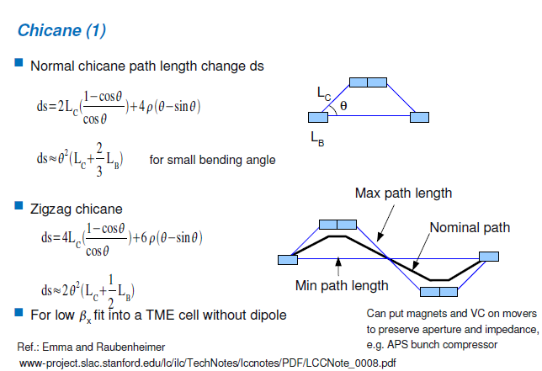
AN EXAMPLE SINGLE PASS CHICANE
A 5 GeV, 4 magnet chicane with an angle of 40 mrad and a total length of 2 X 15 meters gives a maximum trajectory offset of 60 cms. With a nominal setting this can give a variation in path length of +/- 12 mm with manual change in offset.
This can be installed in E+ LTR after spin rotator (but large energy spread) or in E+ RTML almost anywhere (but small emittance.)

Slide 8
NEXT STEPS
Get estimate of maximum possible linac length and verify that there is adequate drift space at the end of the E+ linac to correct timing.
Examine the impact of timing changes using the above correction schemes (Chicane or DR Adjustment) on other collider systems.
Design a Geodetic Network and installation survey and alignment scheme that gets the global E+/- timing or pathlength error to ≤ +/- 10 mm. Site dependent
May need some additional alignment shafts? Will need some write-up on overall Metrology for TDR!

Slide 9
ADDITIONAL SLIDES

Slide 10
CHICANES

Slide 11
DR Circumference Changing Chicane
58 x 1 meter long dipoles with 2.68 kg field over 150 m length required to give +/- 3.3 mm path length change with < 10% ? emittance growth.

