Slide 1
Comments on Damping Ring Acceptance
DR Interface to Positron Source
The DR acceptance parameter treaty values are now:
Ax+Ay < 0.07m (previously was 0.09m)
dp/p now +/-1% (previously was +/-0.5%)

Slide 2
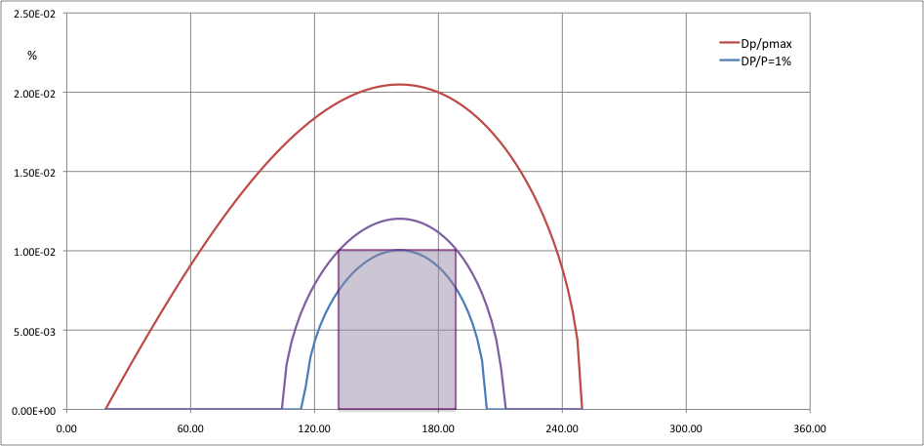
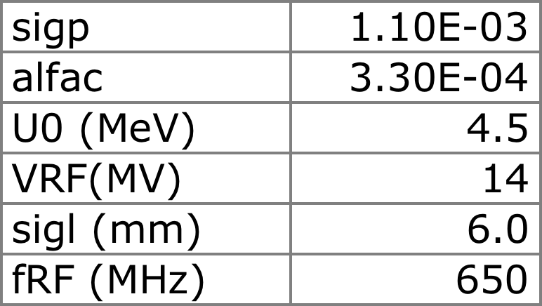
DR RF Acceptance
δ_{max} = ± 1.2%
Injected e⁺ beam:
δ_{max} = ± 1%
Δl_{max} = ± mm
DR acceptance:
δ_{max} = ± 1.2%
DR RF Bucket:
δ_{max} = ± 2.1%
Δl_{max} = - 46 mm, +38 mm

Slide 3
DR Acceptance
DR energy acceptance needs to be somewhat larger than injected positron beam size
Longitudinal (z or t) acceptance, including bunch length and jitter, depends on momentum compaction and RF voltage
In the Baseline nominal configuration it is:
Δl_{max} = ± 35mm
or Δt_{max} = ±118 ps

