Slide 1
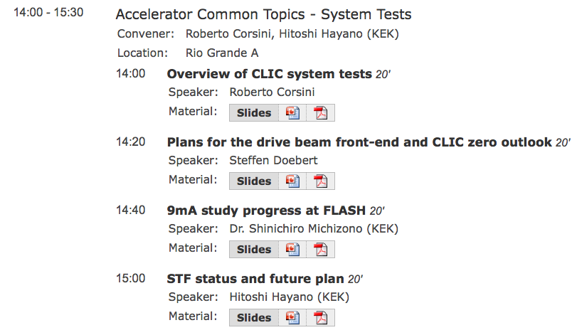
Summary of system tests
R. Corsini, H. Hayano

Slide 2
9 mA study at FLASH on Sep., 2012
Shin MICHIZONO (KEK)
Outline
Achievement before Sep.2012
Study items for ILC
III. Study plan
IV. Study results
Gradient study for near quench limit operation
Klystron output linearization
RF operation near klystron saturation
V. Summary and future plan
S. Michizono - 9 mA study at FLASH

Slide 3
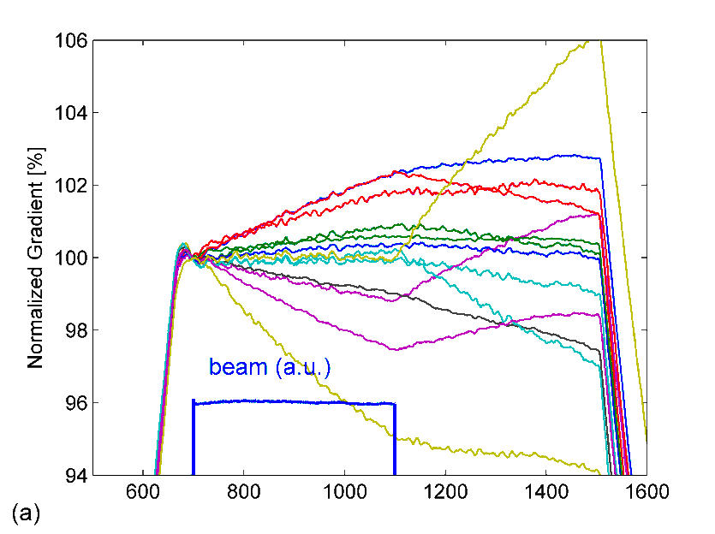
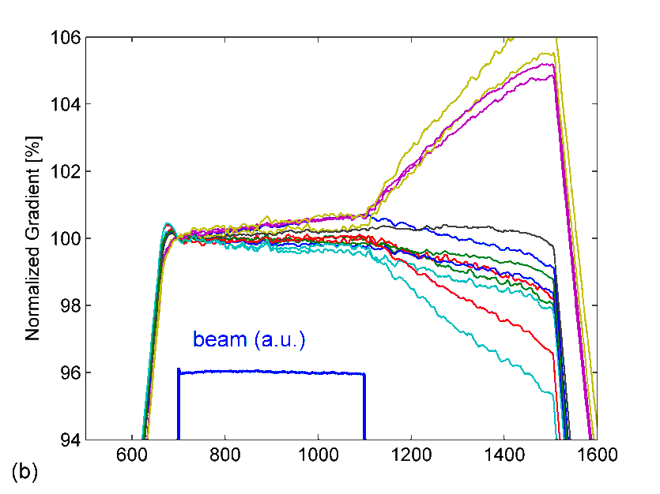
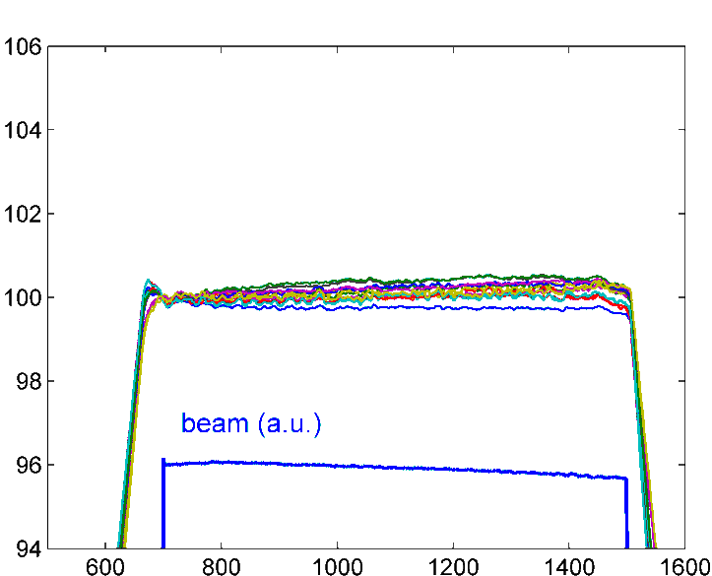
P_{k}Q_{L} control demonstration with 4.5mA beam loading
ILC: 9mA @ FLASH: Gradient Study
Results from FLASH 9mA study (Feb. 2012): I_{beam} = 4.5 mA
Results from FLASH 9mA study (Sep. 2012):
QL optimization algorithm now includes exception handling (Piezo, Ql,…)
Still not fully understood about optimization procedure (next study):
A
B
C
400 usec
400 usec
800 usec
A
Time [usec]
B
Time [usec]
C
Time [usec]
short bunch train
default Q_{L} = 3x10⁶
short bunch train
optimized Q_{L}
long bunch train
optimized Q_{L}
S. Michizono - 9 mA study at FLASH

Slide 4
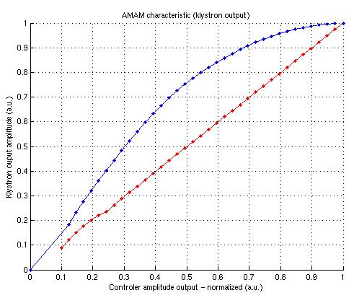
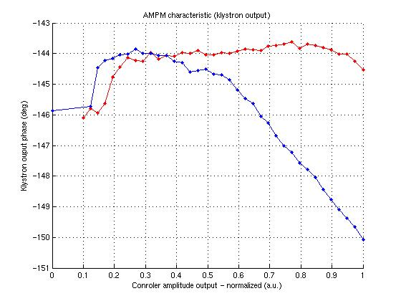
Linearization results
Linearization of Klystron characteristics
for FB control at saturation region
The results of linearization achieved during last high beam current studies at FLASH (RF station for accelerating modules ACC67 – 10 MW klystron) (red characteristics).
Proposed and implemented method allowed for klystron behavior linearization. Although some system weak points can be recognize (eq. poor phase detection for low signal levels) amplitude and phase characteristic correction can be considered as satisfactory.
The main benefit of constant gain maintenance can be clearly noticed especially for operation with wide working point range (eq. high feedback gain control).
S. Michizono - 9 mA study at FLASH

Slide 5
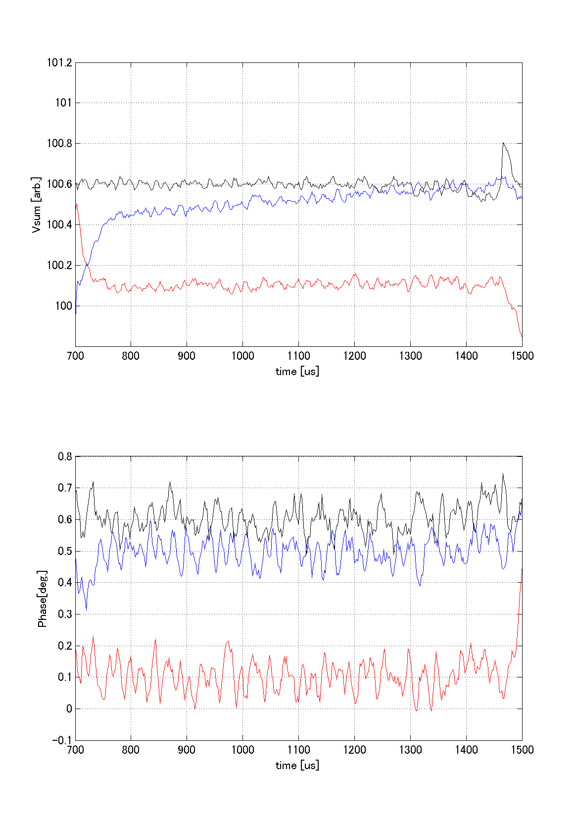
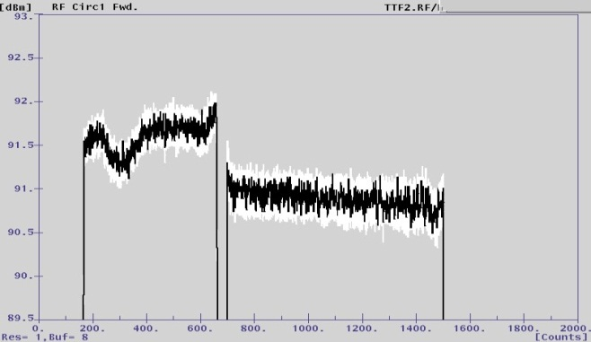
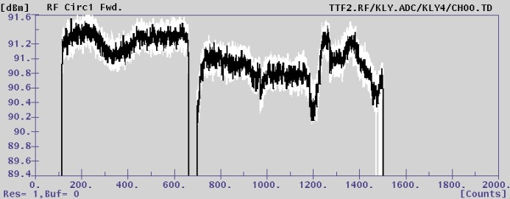
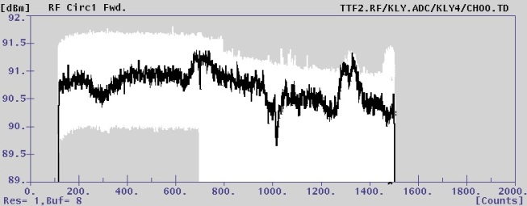
FB control at klystron saturation region
with intentional reduction of klystron HV, artificial RF amplitude steps
Measured stability
Vector sum amplitude [arb.]
beam
nominal
RF output with artificial step
-0.3dB
-0.3dB
operation
Vector sum phase [deg.]
beam
-0.2dB
operation
-0.2dB
beam
S. Michizono - 9 mA study at FLASH

Slide 6
Summary and future plan
Several studies have been carried out at FLASH for technical demonstration of ILC specification.
  PkQl control (Ql adjustment) for near quench limit operation
  Klystron linearization and rf operation near saturation
  High current beam loading with long bunch train.
For the engineering phase (post TDR), we need to accumulate more experience for stable operation.
XFEL and ILC have many common study items because of the similar beam parameters.
Further studies will be necessary.
  -> strategy for automation (reach near quench limit without exceeding etc.)
  -> Beam energy stability, long term stability with flat beam current
  -> High beam, high gradient, near klystron saturation study
FLASH
(10% of XFEL)
 | EU-XFEL | ILC (250GeV)
Gradient | 23.6 MV/m | 31.5 MV/m +-20%
Bunch charge | 1 nC | 3.2 nC
Beam current | 5 mA | 5.8 mA
Energy stability | 2.5MeVrms/20GeV (0.013%) | 0.1% rms
Operate FLASH as if it were XFEL
EU-XFEL
(10% of ILC)
Operate EU-XFEL as if it were ILC
ILC
S. Michizono - 9 mA study at FLASH

Slide 7
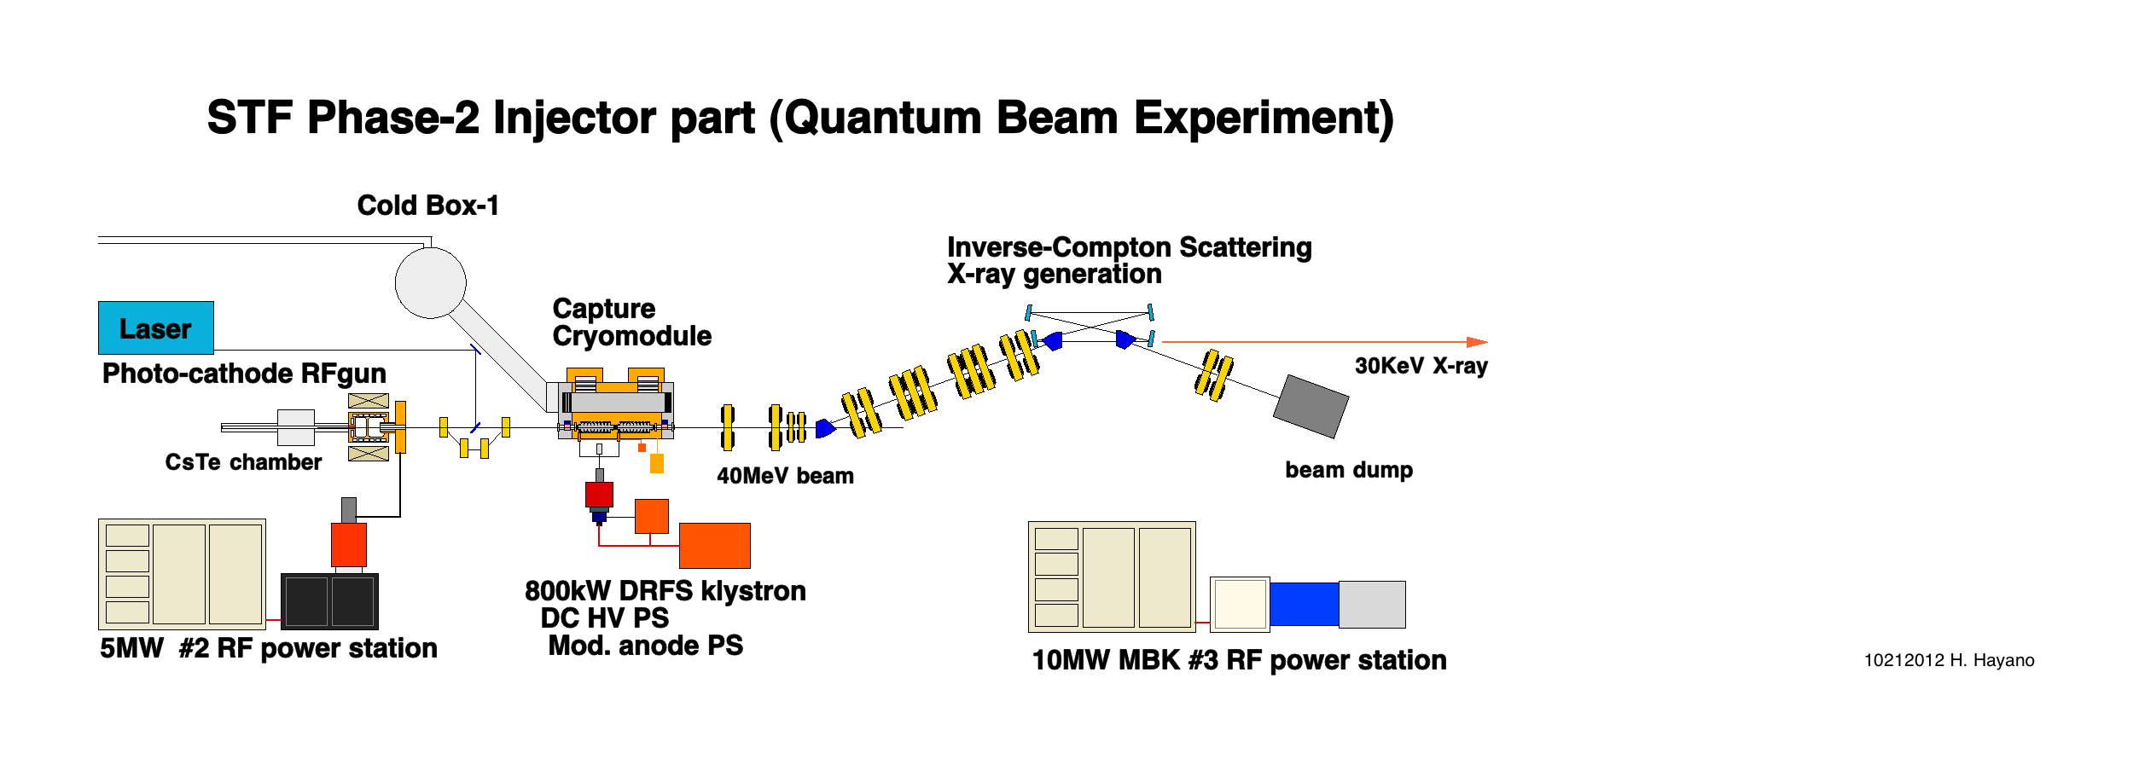
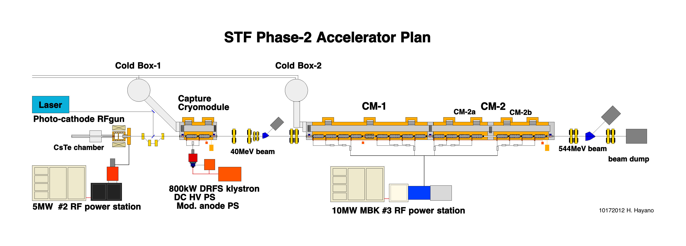
Injector part as Quantum-beam-experiment is under operation in 2012,
and then series of ILC cryomodules will be placed at downstream.
STF Accelerator Plan (2012- 2015)
Quantum-Beam
ILC Cryomodules
H. Hayano - STF Status and Future plan

Slide 8
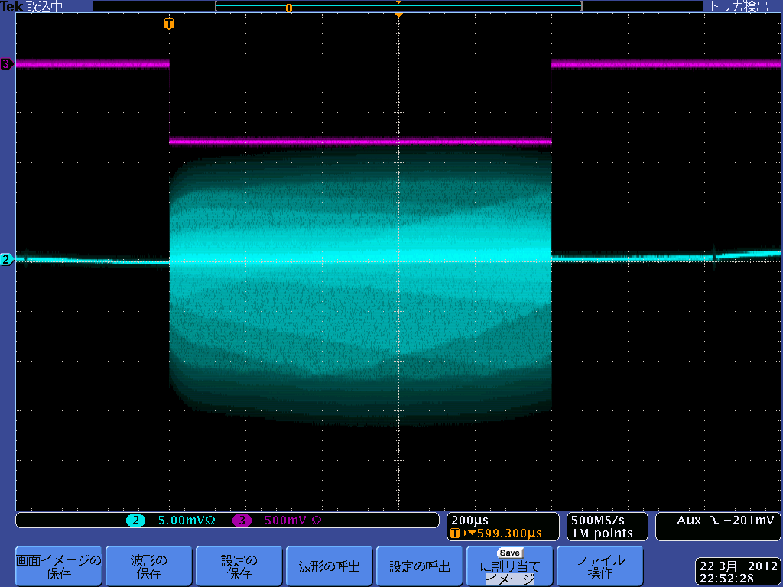
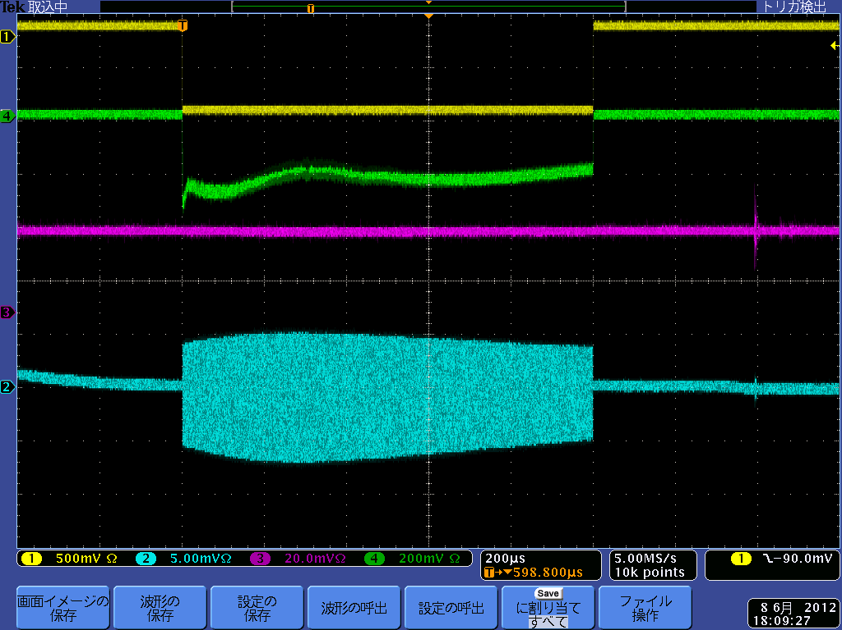
1ms bunch train with 2.5mA beam are successfully accelerated to 40MeV in Injector operation, 4 mirror laser accumulator is ready for X-ray generation experiment.
Achieved Long bunch train generation and acceleration
1ms bunch train extraction from RF-gun
Beam acceleration by Capture Cryomodule
Beam on gate
Beam on gate
Beam loss monitor
BPM signal
BPM signal
1ms flat Beam extraction from RF-gun 1ms
(RF feedback ON) 03.22.2012
Beam acceleration with 1ms train (15pC/bunch)
(Gun/SCRF RF feedback ON) 06.08.2012
2.5mA
* ILC(TDR) : 5.8mA beam current, 0.727ms train length
H. Hayano - STF Status and Future plan

Slide 9
ILC-type Cryomodule has started its construction. Cavities are all TDR qualification clear performance. It will be installed into STF accelerator in 2013. Series of cryomodules will come later, year by year.
ILC design cryomodule : CM-1
The fabrication started in this month.
Will be completed till June, 2013.
Will be installed in tunnel till December, 2013.
Will be beam operation on February, 2014.
8 Cavities + dummy quad
4 cavities : slide-jack tuner in center
4 cavities : slide-jack tuner in end
H. Hayano - STF Status and Future plan

Slide 10
STF future Plans
CY2011
CY2012
CY2013
CY2014
CY2015
CY2016
Beam operation
Construction of
STF phase2 injector
Phase2 Injector part
(Quantum-Beam)
operation
Cryomodule construction
Phase2 CM-1 construction
operation
1st Cryomodule
Cryomodule construction
Phase2 CM-2a construction
operation
2nd Cryomodule
STF phase-2
Cryomodule construction
3rd Cryomodule
Phase2 CM-2b construction
operation
CM-3a
CM-3b
Cavity Fabrication Facility
CFF ready for cavity production
Startup of facility
Cavity Fabrication operation
KEK EBW in operation
1st cavity
2nd cavity
3rd, 4th, ….

Slide 11
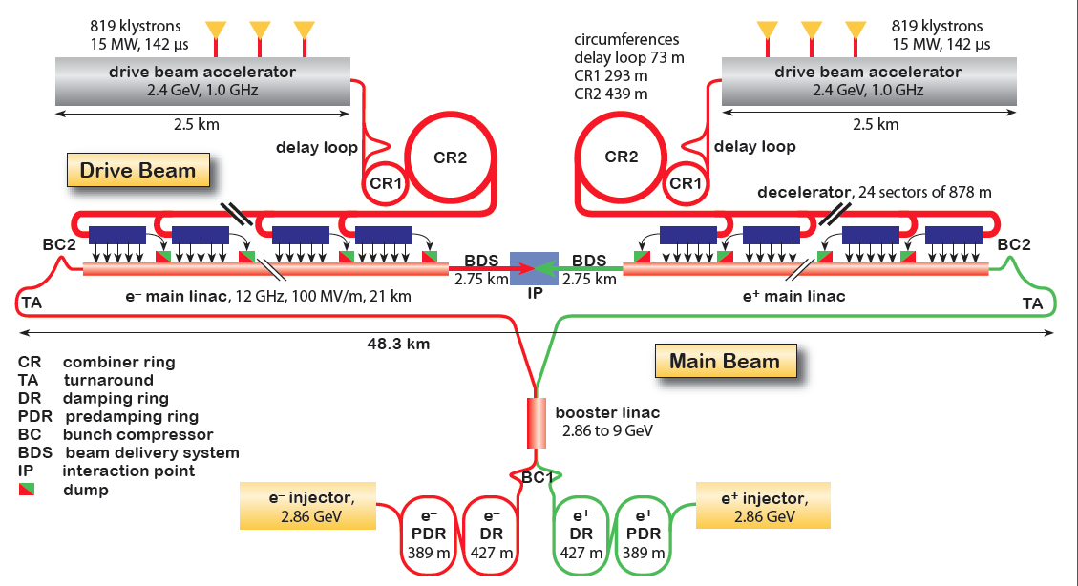
CLIC Layout at 3 TeV
The ultimate CLIC system test
Drive beam time structure - initial
Drive Beam Generation Complex
Drive beam time structure - final
240 ns
240 ns
5.8 ms
140 ms train length - 24 × 24 sub-pulses
4.2 A - 2.4 GeV – 60 cm between bunches
24 pulses – 101 A – 2.5 cm between bunches
Main Beam Generation Complex
R. Corsini - Overview of CLIC system tests

Slide 12
What do we learn in CTF3, relevant for the CLIC RF power source ?
A non-exhaustive list ☺ easier ☹ more difficult
System quantity/issue CTF3 CLIC
Injector/linac bunch charge 2-3 nC 6.7 nC
current 3.5 - 4.5 A 4.2 A
pulse length 1.4 μs 140 μs
phase coding same
frequency 3 GHz 1 GHz
transverse stability about the same - CTF3 ``too stable ´´
Delay loop/ring final current 28 A 100 A
beam energy 125 MeV 2.4 GeV
combination 2 - 4 2 - 3, 4
CSR, wakes worse in CTF3 (lower energy)
Deflector instability about the same
Power production (PETS) Aperture 23 mm 23 mm
Length ≈ 1 m 23 cm
Power > 135 MW 135 MW
Pulse length 140 ns (260 ns with recirculation) 240 ns
Decelerator Fractional loss 50 % 90%
Final energy 60 MeV 240 MeV
wakes, stability somehow ``masked´´ in CTF3
beam envelope much larger in CTF3
In general, most of detrimental effects are equivalent or worse in CTF3 because of the low energy, however in CLIC the beam power is much larger (heating, activation, machine protection)
Needed tolerances on the final drive beam parameters (phase, current, energy stability...) are more stringent in CLIC – some could be are being demonstrated in CTF3 as well
R. Corsini - Overview of CLIC system tests

Slide 13
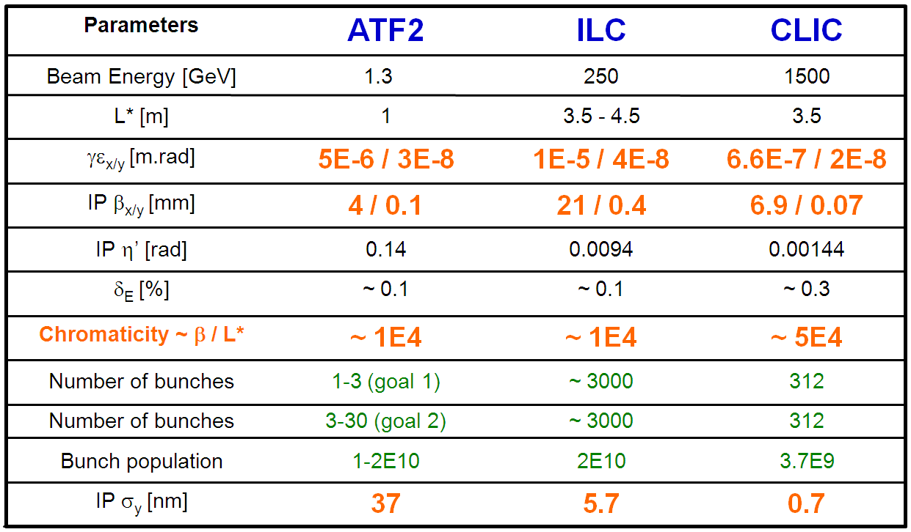
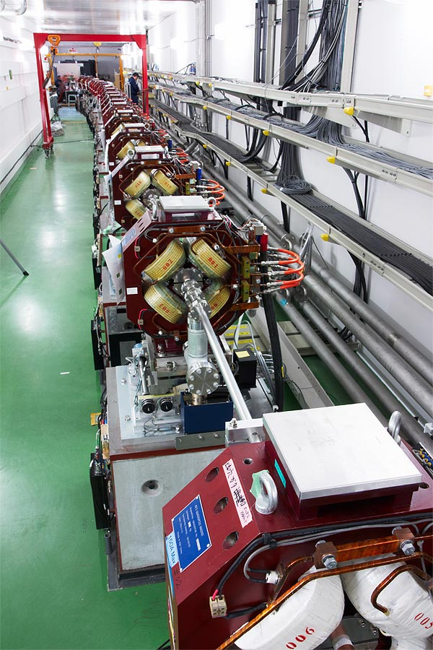
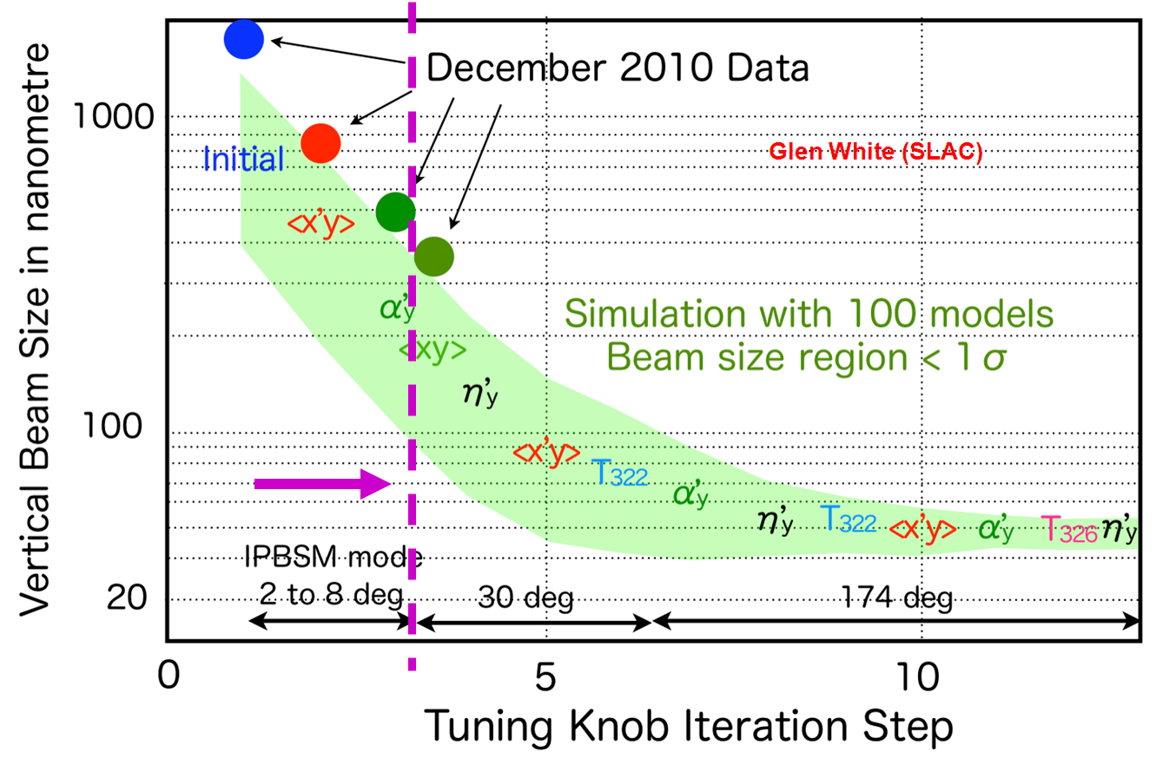
Beam Delivery System (ATF 2)
Philippe Bambade, CLIC Collaboration Workshop, May 2012
Shintake Monitor
R. Corsini - Overview of CLIC system tests

Slide 14
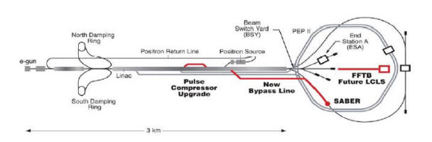
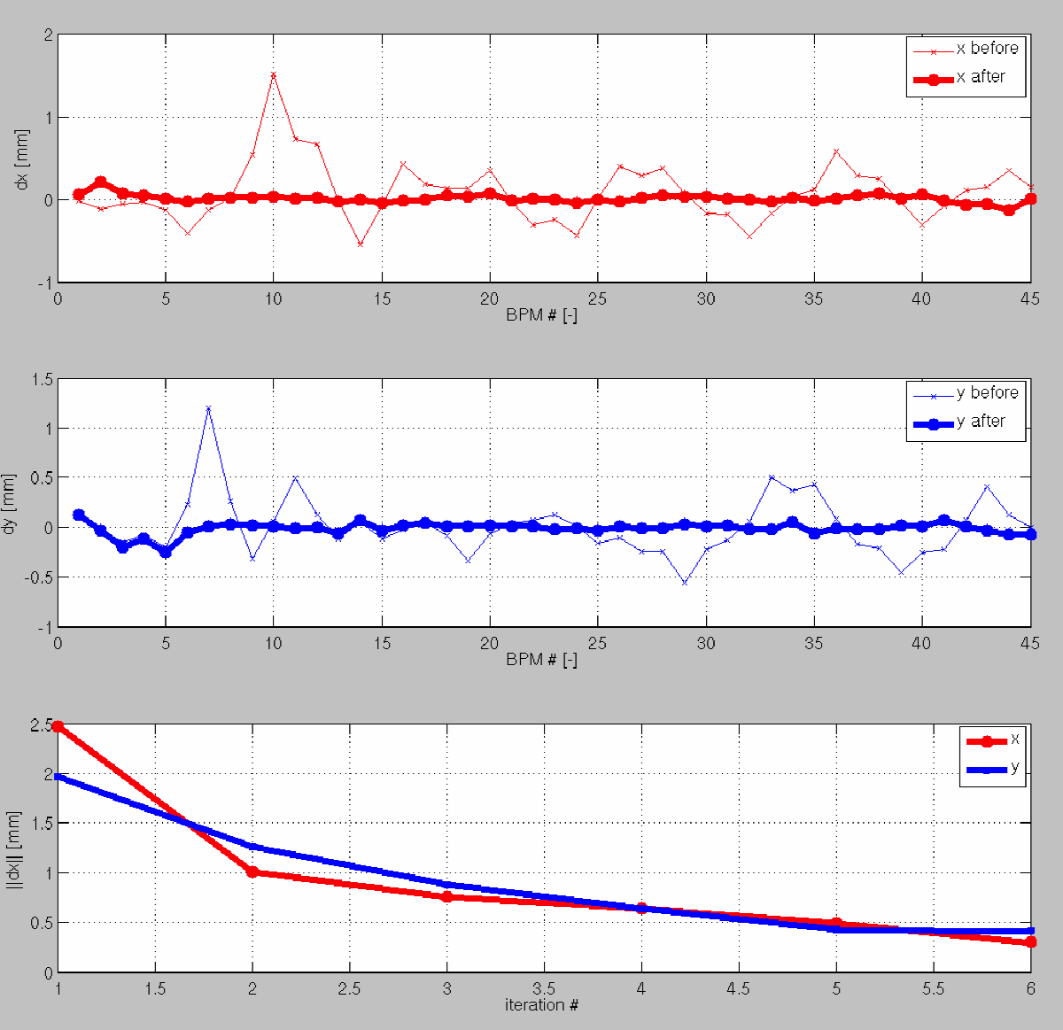
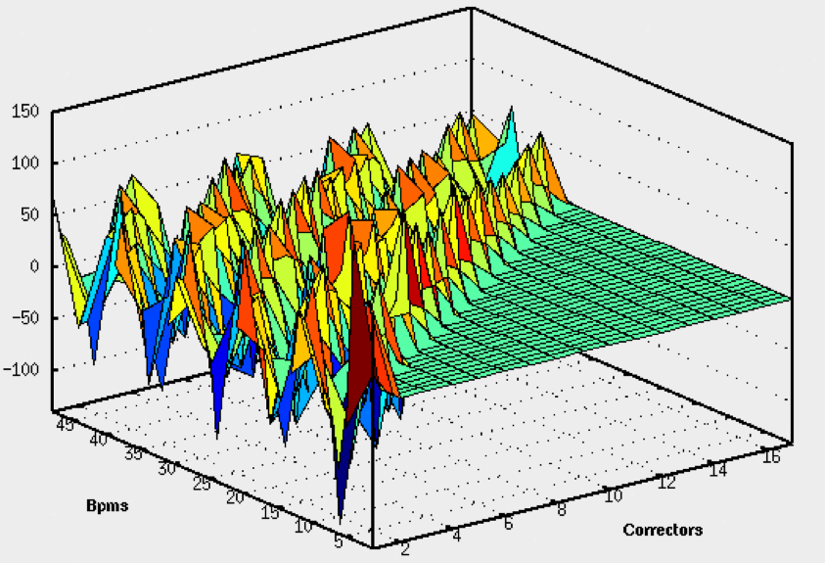
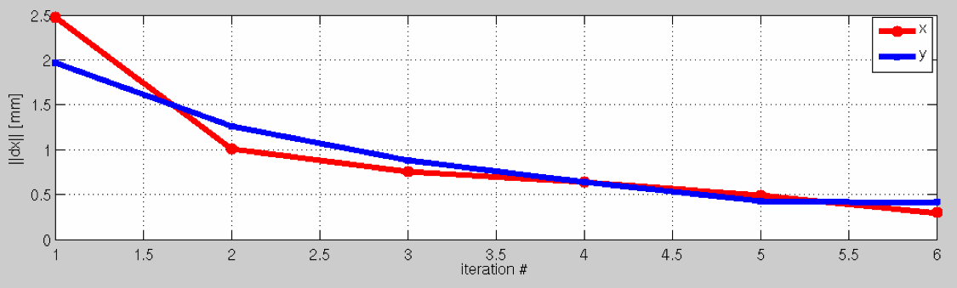
Emittance Preservation – Main linac Beam-Based Alignment
T501: FACET test-beam proposal to study advanced global correction schemes for future linear colliders.
CERN-SLAC collaboration where algorithms developed at CERN are tested on the SLAC linac.
The study includes linac system identification, global orbit correction and global dispersion correction.
Successful system identification and global orbit correction has been demonstrated on a test-section of 500 m of the linac.
The section of the SLAC beamlines we work on
RESULT: Example of global orbit correction of a test-section of the SLC linac:
(above) Horizontal and Vertical trajectories before and after orbit correction
(Above) Measured Rx response matrix for the test-section of the linac (17 correctors, 48 BPMs)
(above) Iterations of orbit correction: convergence of the algorithm
R. Corsini - Overview of CLIC system tests

Slide 15
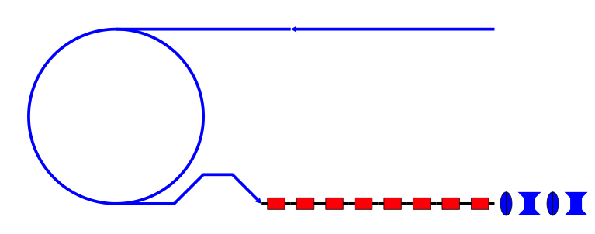
Dream test facility – emittance generation/preservation/beam delivery
Daniel Schulte, CLIC Collaboration Workshop, May 2012
Injector
Note: FFTB has been similar
But with ε_{y}= O(1μm)
Reached σ_{y}=70nm
(design 50nm)
Low emittance ring,
e.g. 3rd generation light source,
damping ring test facility
Main linac with bunch compressor
Powered with drive beam or X-band
klystrons
BDS test facility
Example options: SPS as damping ring (combined with CLIC0?),
FACET with improved damping ring? ATF, PEP-II, ESRF, SLS, SPRING-8, …
Bypassing the damping ring, one can use the linac as a 4th generation light source
Maybe some benefit in using ring and linac together as light source or for other experiments, e.g. ATF3
R. Corsini - Overview of CLIC system tests

Slide 16
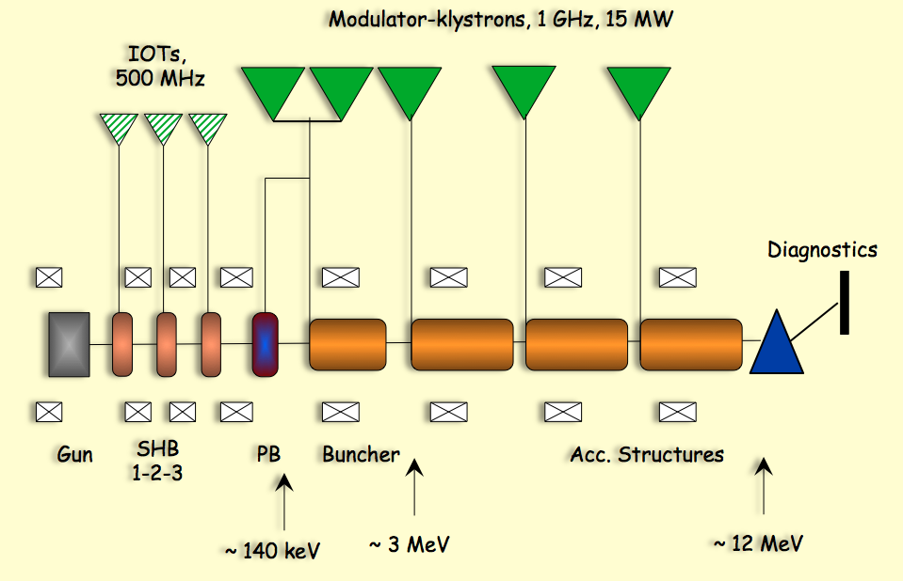
CLIC DB front end,
Post CDR Project
Gun, sub-harmonic bunching, bunching, three accelerating structures,
5 long pulse klystrons and modulators, diagnostics
S. Doebert - Plans for the drive beam front-end and CLIC zero outlook

Slide 17
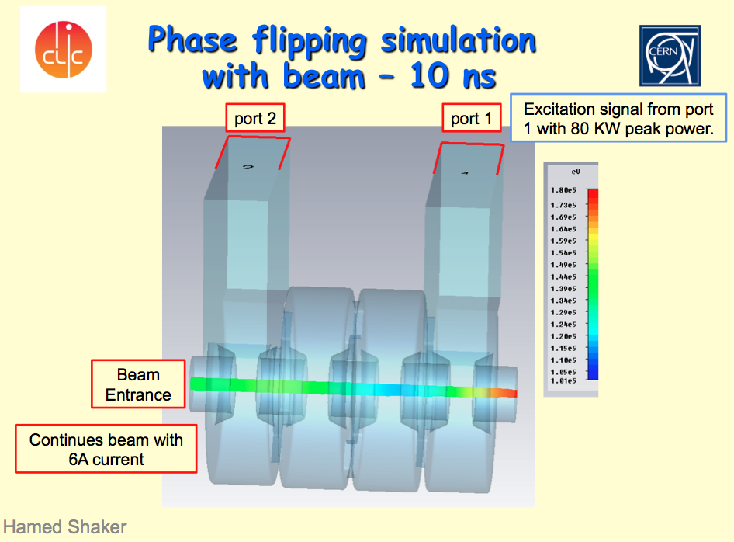
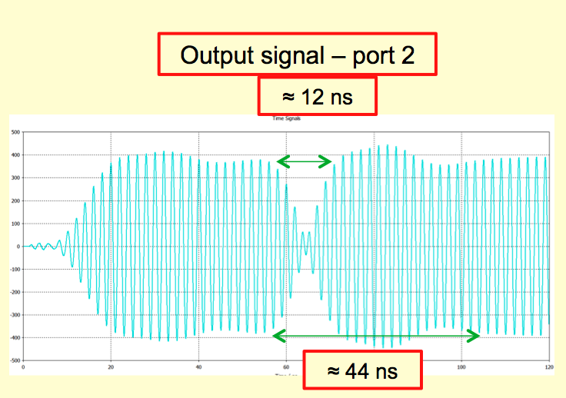
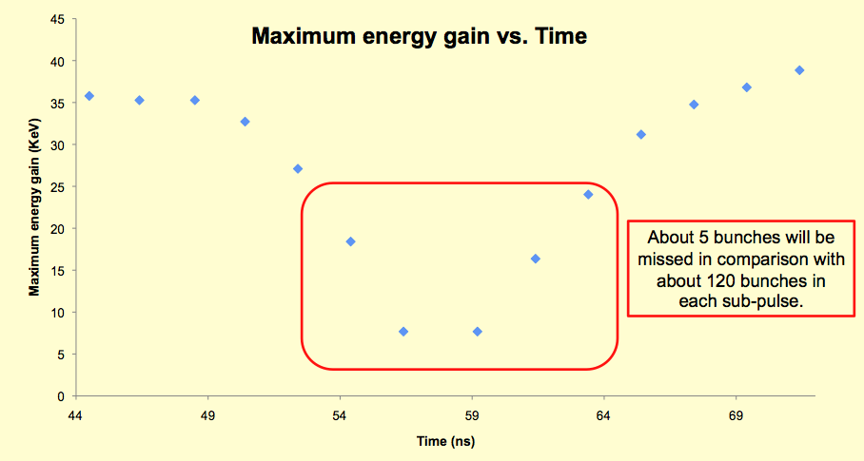
Sub-harmonic bunching system
S. Doebert - Plans for the drive beam front-end and CLIC zero outlook

Slide 18
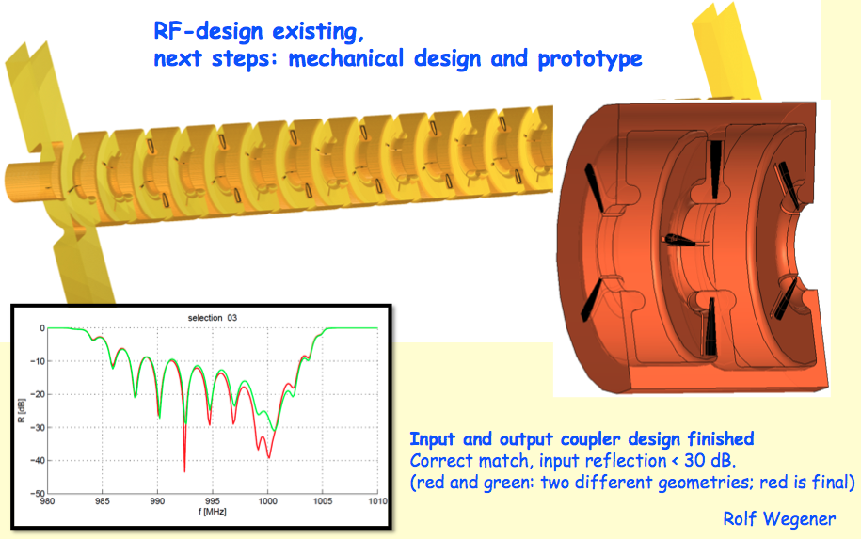
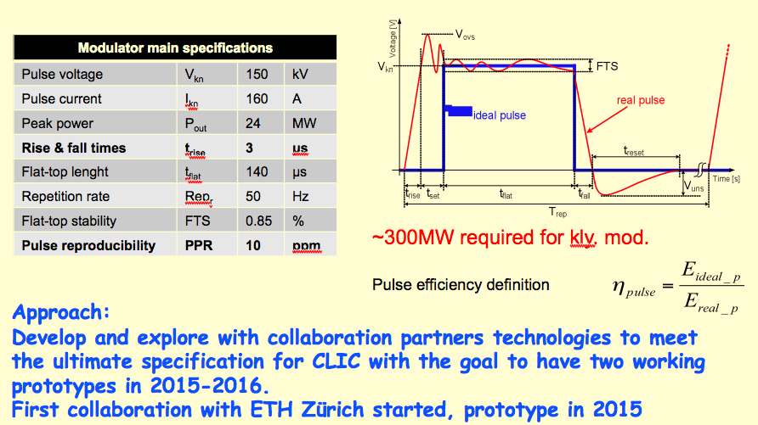
DB-accelerator structure
modulator specs
S. Doebert - Plans for the drive beam front-end and CLIC zero outlook

Slide 19
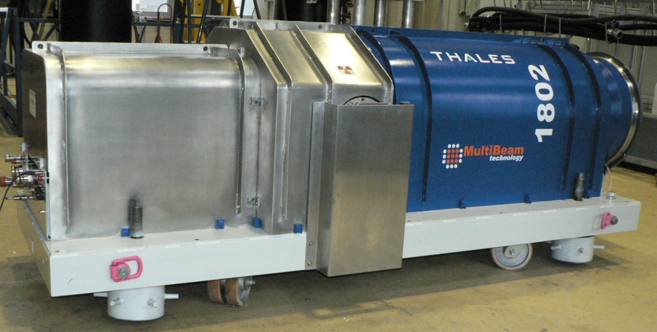
Klystron specifications
FREQ | Vklystron | Iklystron | V pulse width | RF pulse width | Peak RF Power | Repetition rate | Average Power | Gain | Efficiency | Waveguide
MHz | kV | A | µs | µs | MW | Hz | kW | dB | %
1300 | 115 | 132 | 1700 | 1500 | 10 | 10 | 150 | 47 | 65 | WR 650
TH1802, ILC MBK klystron
FREQ | Vklystron | Iklystron | V pulse width | RF pulse width | Peak RF Power | Repetition rate | Average Power | Gain | Efficiency | Waveguide
MHz | kV | A | µs | µs | MW | Hz | kW | dB | %
999.52 |  |  |  | 150 | 15-20 | 50 | 113 |  | 70
S. Doebert - Plans for the drive beam front-end and CLIC zero outlook

Slide 20
What do we plan to do until 2016
Optimistic and rough planning
Create a gun test facility to test the source
and a high power test stand to test the klystron, modulator and rf structures
S. Doebert - Plans for the drive beam front-end and CLIC zero outlook

Slide 21
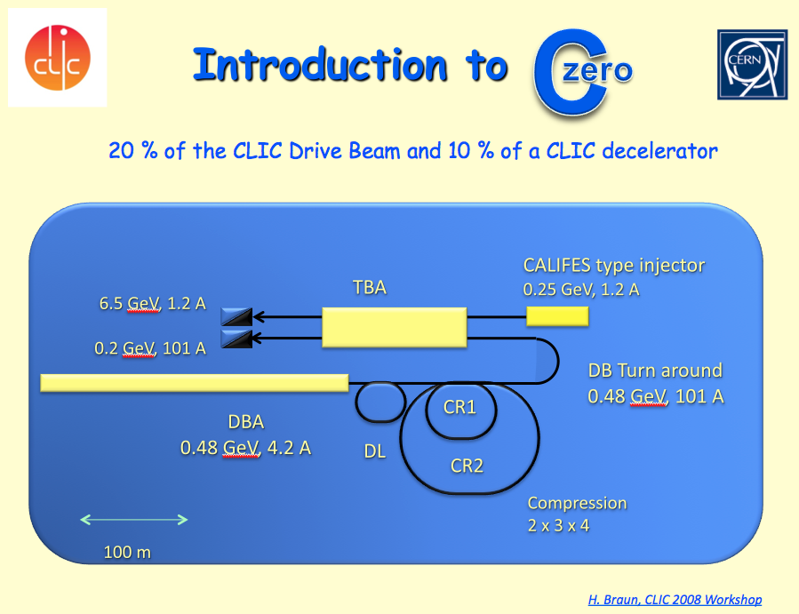
S. Doebert - Plans for the drive beam front-end and CLIC zero outlook

Slide 22
Conclusions
ILC now concentrating on SC linac operation.
Good results with “ILC-like” beams reported from Flash and STF.
EU-XFEL will provide a lot of operational experience.
CTF3 has completed its initial program. Future program centered on Two-Beam modules tests.
R&D on high average power drive beam generation to prepare technology and complement CTF3 results – drive beam front-end facility in preparation.
Importance of system tests beyond main linac, for critical sub-system: BDS (ATF), damping ring, main beam generation.
Integrated tests > “dream facilities”…

