Slide 1
2 K cryogenic plant turn-down
Two slides from a talk by Laurent Tavian (CERN)
Presented at Fermilab (27 Sep 2012)
With introduction from Tom Peterson (Fermilab)
To be presented at LCWS-12, Oct. 23, 2012, by Akira Yamaoto (KEK)
(with some additional slides)

Slide 2
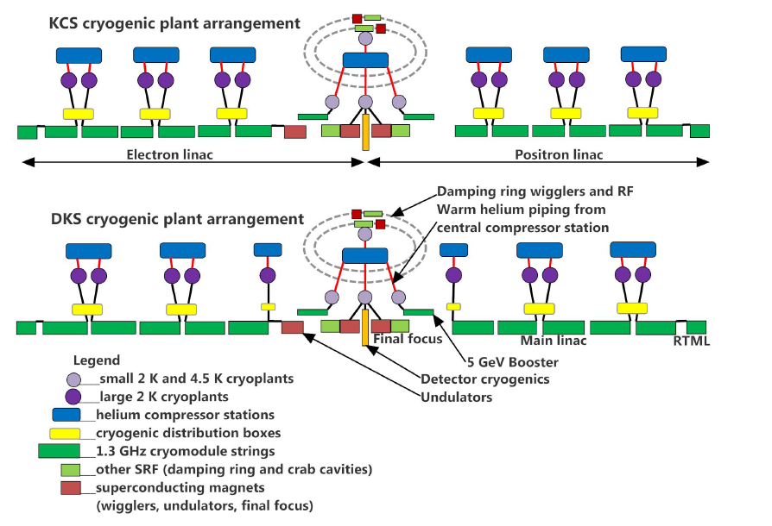
ILC Cryogenics Configuration

Slide 3
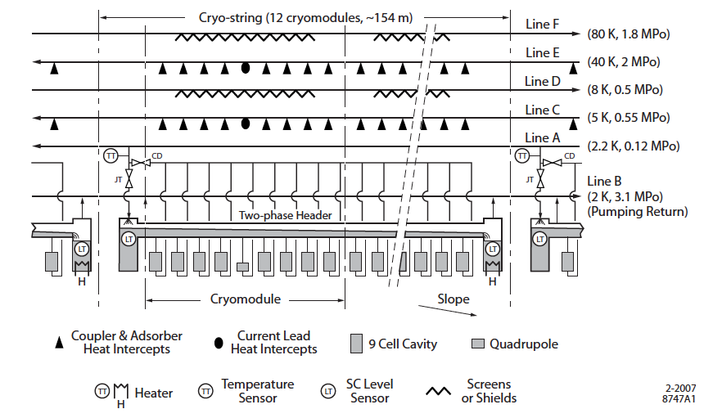
Cooling Scheme of a Cryo-String

Slide 4
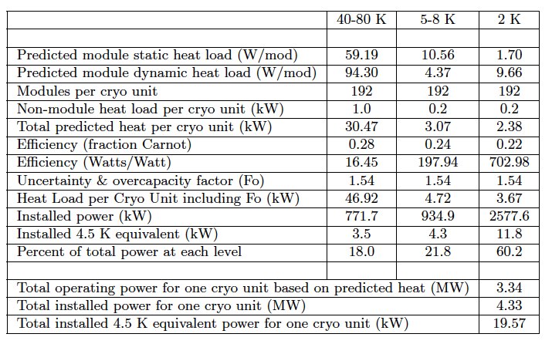
ILC ML Thermal Load

Slide 5
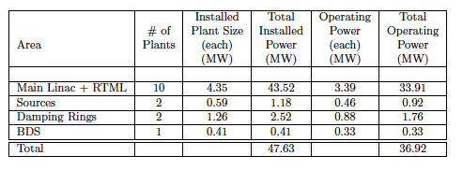
Cryogenics Plant Power Consumption
How much fraction need to be adjusted ?

Slide 6
Comments from Tom Peterson about cryogenic capacity and efficiency
Cryogenic plant efficiency is optimal when the plant capacity is matched to the load.
Due to various factors such as uncertainties in final as-installed heat loads, overcapacity required for control, and variability or absence of large dynamic heating, ILC may experience varying levels of mismatch between cryogenic plant capacity and loads.
This mismatch results not only in inefficiency but control difficulties for the 2 Kelvin system due to the dynamic nature of the cold compressors.

Slide 7
Matching load to capacity
Two mechanisms (among other features in the cryogenic plant) would provide matching of cryogenic capacity to the load in an ILC
1. Electric heaters in cryomodules will be required to compensate dynamic loads from variations in RF power.
  These will also operate continuously at some low level for control
2. Slow changes in required capacity can be accommodated by the cryogenic plant at the 2 Kelvin level using a mixed compression cycle as described by Laurent Tavian in the following slides.

Slide 8
Cycles for refrigeration below 2 K
P. Lebrun
~ 2 kPa
Sub-cooling
heat exchanger
“Warm”
Compression
“Integral Cold”
Compression
“Mixed”
Compression

Slide 9
Condition
need to be fixed

Slide 11
Summary
Cryogenics power can be adjusted by using two approaches
  Heater power adjustment for quick feedback and actions, as the most reliable and safest operation.
  Cold and warm compressor power adjustment for slow and long-term response to mazimize power-saving and overall efficiency.

