Slide 1




CLIC DR EXTRACTION KICKER DESIGN, MANUFACTURING AND EXPERIMENTAL PROGRAM
C. Belver-Aguilar (IFIC)
On behalf of:
A. Faus-Golfe (IFIC), F. Toral (CIEMAT), M.J. Barnes (CERN), D. Gutiérrez (TRINOS V.P.), I. Podadera (CIEMAT)
25 October 2012 LCWS12 International Workshop on Future Linear Colliders Arlington, USA

Slide 2
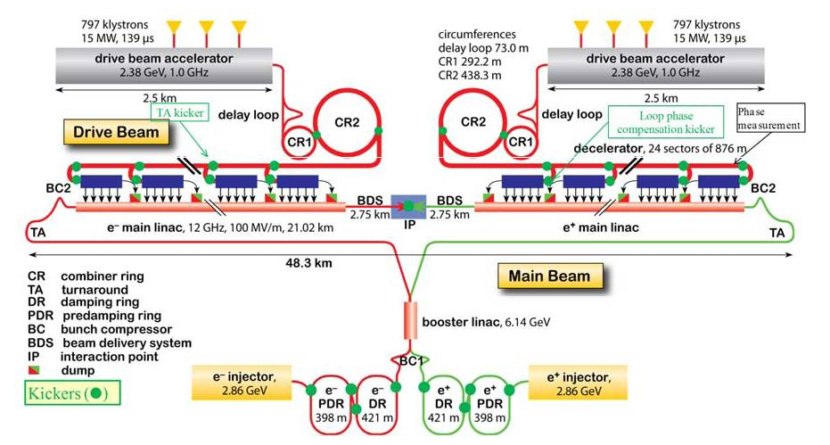
INTRODUCTION
The CLIC design relies on the presence of PDRs and DRs to reduce the beam emittance and, therefore, to achieve the lumonisity requirements for the CLIC main linac.
 | Extraction kicker CLIC Damping Ring (DR)
 | 1 GHz | 2 GHz
Beam energy (GeV) | 2.86
Total kick deflection angle (mrad) | 1.5
Aperture (mm) | 20
Effective length (m) | 1.7
Field rise time (ns) | 560 | 1000
Field fall time (ns) | 560 | 1000
Pulse flattop duration (ns) | 900 | 160
Field inhomogeneity (%) [CLIC: 1mm radius] | ± 0.01
Repetition rate (Hz) | 50
Pulse voltage per stripline electrode (kV) | ± 12.5
Stripline pulse current [50 Ω load] (A) | ± 250
Beam current (A) | 110 | 120
Buch length (ps) | 6 | 5.3
Bunch spacing (ns) | 1 | 0.5
Longitudinal beam coupling impedance (Ω per turn) | < 0.05
Transverse beam coupling impedance (kΩ/m) | < 200
Kickers are required to inject beam into and extract beam from the PDRs and DRs for both the main beam of CLIC.
to achieve low beam coupling impedance and reasonable broad band impedance matching to the electrical circuit, striplines have been chosen for the kicker element;
a set of prototype extraction striplines will be built under the CDTI program, and tested:
  without beam at CERN
  with beam at ALBA
  with beam and with the inductive adder at ATF2

Slide 3
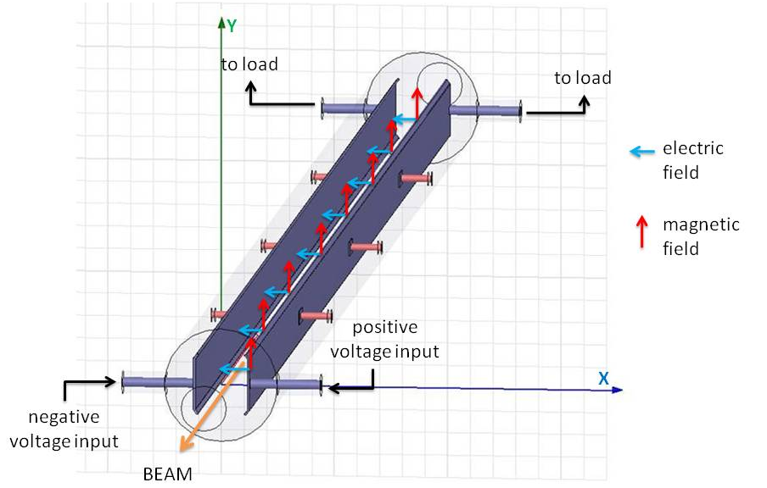
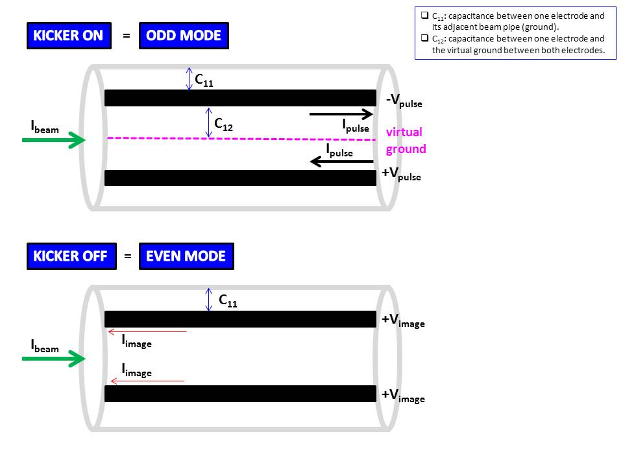
STRIPLINE KICKER OPERATION
The stripline kicker proposed for the extraction kicker of the CLIC DRs consists of two parallel electrodes, each of 1.7 m length, inside a cylindrical vacuum pipe.
  Each electrode is powered by an inductive adder.
The two electrodes are charged to opposite polarity.
The striplines will be powered, via coaxial feedthroughs, from the beam exit end: the upstream feedthroughs will be connected to resistive loads.
COUPLED TRANSMISSION LINES
The stripline kicker operates as two coupled transmission lines, each of which should ideally have a characteristic impedance matched to 50 Ω.
Coupled transmission line theory shows two operating modes for the stripline kicker, since three conductors are involved in the signal transmission, i.e. both electrodes and the vacuum beam pipe: even mode and odd mode.
When the electrodes are excited with opposite polarity voltages, the current flow is in opposite directions in each stripline electrode and an electromagnetic field is created betweeen the electrodes, giving a transverse kick to the beam: this is the odd mode.
When unkicked circulating beam passes through the aperture of the striplines, it induces image currents in the electrodes: the direction of the current flow is the same in both electrodes. This is the even mode. This generates an electromagnetic field, which gives a longitudinal kick to the beam and can produce beam instabilities.

Slide 4
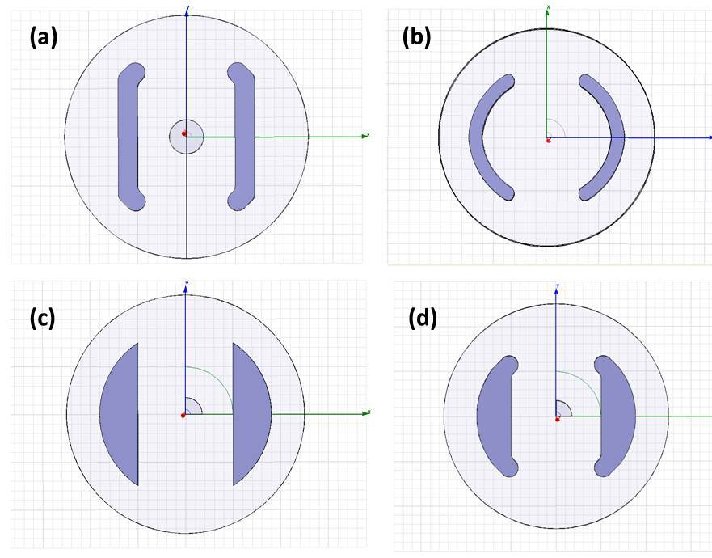
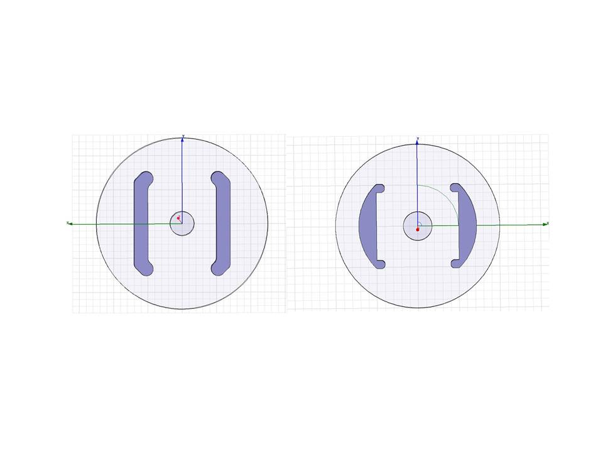
STRIPLINE DESIGN: CROSS SECTION STUDY
The striplines cross section determines their characteristic impedance and the field homogeneity inside the aperture.
  The stripline aperture corresponds to the inner diameter of the beam pipe in the accelerator ring adjacent to the striplines.
The cross section is optimized by simulating a slice, orthogonal to the length of the striplines, and applying the appropriate boundary conditions, by using HFSS.
Three possible electrode cross sections have been considered for the design of the striplines: all of them have a cylindrical stripline beam pipe, since it is the easiest shape for manufacturing from a commercial pipe.
Flat an curved electrodes ((a) and (b)) are the most common electrodes used for stripline kickers.
With flat electrodes it is possible to achieve very good field homogeneity in the aperture.
By using curved electrodes it is possible to decrease the stripline beam pipe radius, which results in a better matching between both the odd and even mode characteristic impedances; however, the field homogeneity is worse than in the case of flat electrodes.
Different half-moon electrode shapes ((c), (d) and (e)) have been studied because with them we could keep the good field homogeneity of the flat electrodes, as well as trying to decrease the stripline beam pipe radius.
(e)

Slide 5
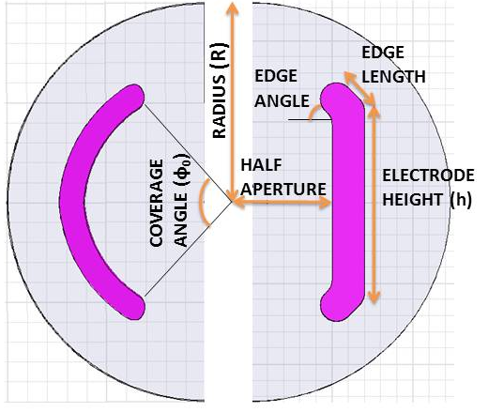
STRIPLINE DESIGN: CROSS SECTION STUDY
The variables of the optimization process are the geometric dimensions of the cross section:
the ratio between the electrode height and the aperture;
  in the case of curved electrodes, the equivalent parameter is the coverage angle, which is defined as the angle that each electrode forms with the beam pipe.
the shape of the edges
the electrode thickness
the stripline beam pipe radius
The minimum stripline beam pipe radius analyzed is 20 mm since this is the minimum radius to avoid potential problems of electric breakdown (Kilpatrick limit).
In the optimization process, we must try to reduce the capacitance between both striplines in order to achieve odd and even mode characteristic impedance close to 50 Ω. We can find three different situations:
If coupling is zero → Z_{odd} = Z_{even} = 50 Ω. This is the ideal case.
If coupling is different to zero:
  Z_{odd} = 50 Ω and Z_{even} > 50 Ω. The beam coupling impedance will increase in direct proportion to the value of the even mode characteristic impedance.
  Z_{even} = 50 Ω and Z_{odd} < 50 Ω. The characteristic impedance of the striplines, seen by the pulse generator and the loads, is mismatched. As a result of the impedance mismatch, multiple reflections from the inductive adder can be expected.

Slide 6
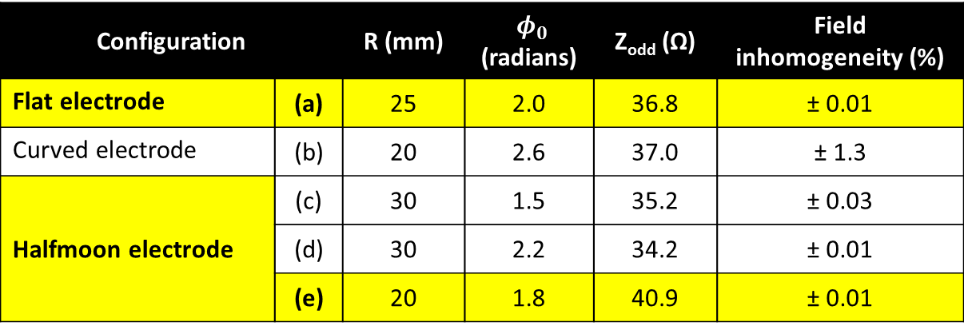
STRIPLINE DESIGN: CROSS SECTION OPTIMIZATION
FOR A 50 Ω EVEN MODE CHARACTERISTIC IMPEDANCE
Configuration |  | R (mm) | $φ_{0}$ (radians) | Z_{odd} (Ω) | Field inhomogeneity (%)
Flat electrode | (a) | 25 | 2.0 | 36.8 | ± 0.01
Curved electrode | (b) | 20 | 2.6 | 37.0 | ± 1.3
Halfmoon electrode | (c) | 30 | 1.5 | 35.2 | ± 0.03
 | (d) | 30 | 2.2 | 34.2 | ± 0.01
 | (e) | 20 | 1.8 | 40.9 | ± 0.01
Flat electrodes allow for 50 Ω even mode characteristic impedance and a field homogeneity of ± 0.01 % with a stripline beam pipe radius of 25 mm. However the odd mode impedance is not ideal.
Halfmoon electrodes, with a reduced coverage angle, allow for better optimization of the odd mode characteristic impedance, with a stripline beam pipe radius of 20 mm, while achieving 50 Ω even mode impedance.
A small stripline beam pipe radius results in closer values of even and odd mode characteristic impedances.
In the following, some features of the halfmoon and flat electrodes are compared, which will allow the final geometric design of the striplines to be chosen.

Slide 7
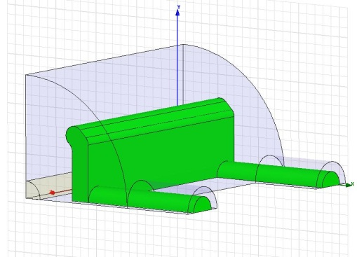
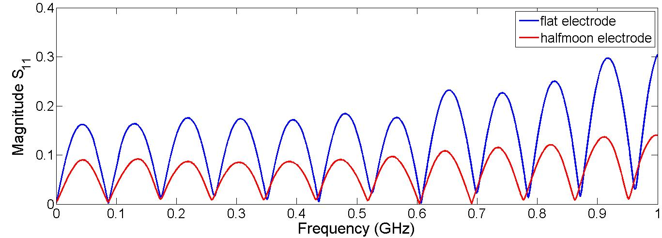
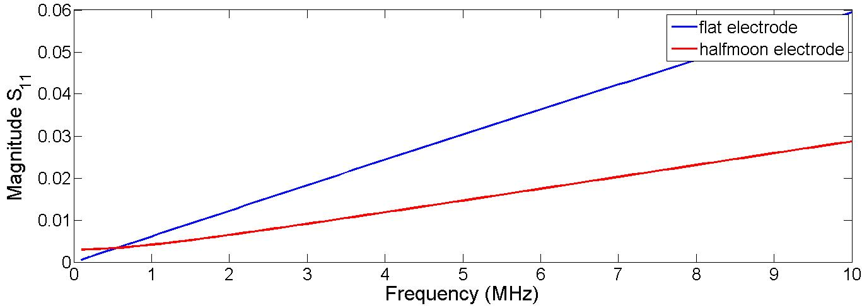
REFLECTION STUDIES DUE TO IMPEDANCE MISMATCHING
A total of four coaxial feedthroughs, with 50 Ω characteristic impedance, are required to transfer power:
from the inductive adders to the two electrodes,
from the electrodes to the two loads.
Multiple reflections could be expected due to, basically, two mismatching problems:
The feedthroughs are coaxial outside of the stripline beam pipe but the connection from a feedthrough to an electrode cannot be coaxial: the characteristic impedance of the connection to the electrode is not 50 Ω.
During the kicker operation, the stripline characteristic impedance is lower than 50 Ω.
HFSS has been used to calculate the reflection parameter S₁₁ looking into an input port when the corresponding output port is resistively terminated at 50 Ω.
For CLIC the S₁₁ parameter must be below 0.1 up to 10 MHz.
For flat electrode, S₁₁ parameter is lower than 0.1 up to 18 MHz, while for halfmoon electrode shape the excellent transmission stays up to 636 MHz.
Therefore, both geometries are suitable from the signal transmission point of view, although halfmoon electrode shape shows a better transmission in a wider frequency range.
However, a reflection parameter as low as possible is better from the pulse rise time point of view: halfmoon electrode would be the better choice.

Slide 8
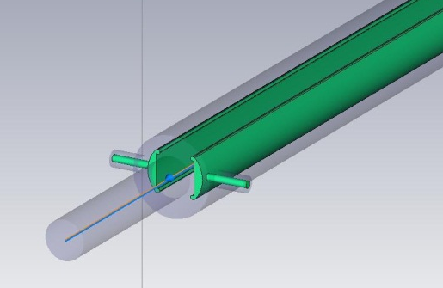
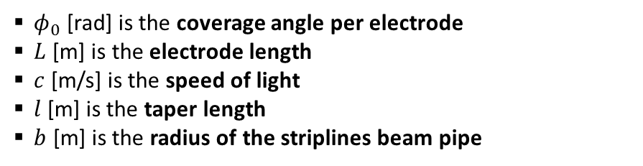
ONGOING BEAM COUPLING IMPEDANCE OPTIMIZATION
Since the DRs are periodic, it is important to reduce as much as possible the effect of the field produced by the beam itself, in the striplines, when the kicker is not operating, in order to diminish the wake field effects in the unkicked circulating beam.
From beam dynamics, the allowable broad band impedance, per kicker system is:
  0.05 Ω per turn longitudinal beam coupling impedance,
  200 kΩ/m transverse beam coupling impedance.
Longitudinal beam coupling impedance
Transverse beam coupling impedance
$φ_{0}$ [rad] is the coverage angle per electrode
$L$[m] is the electrode length
$c$ [m/s] is the speed of light
$l$ [m] is the taper length
$b$ [m] is the radius of the striplines beam pipe

Slide 9
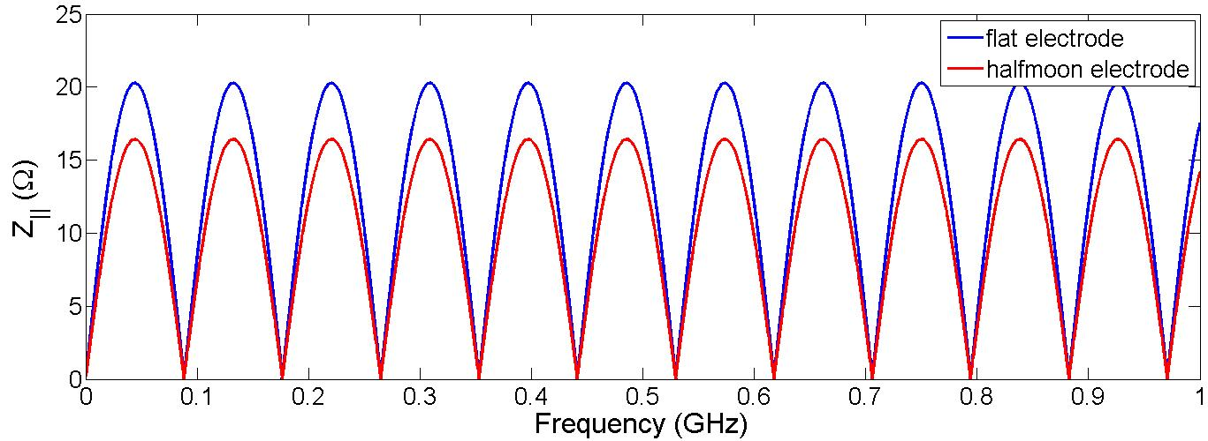
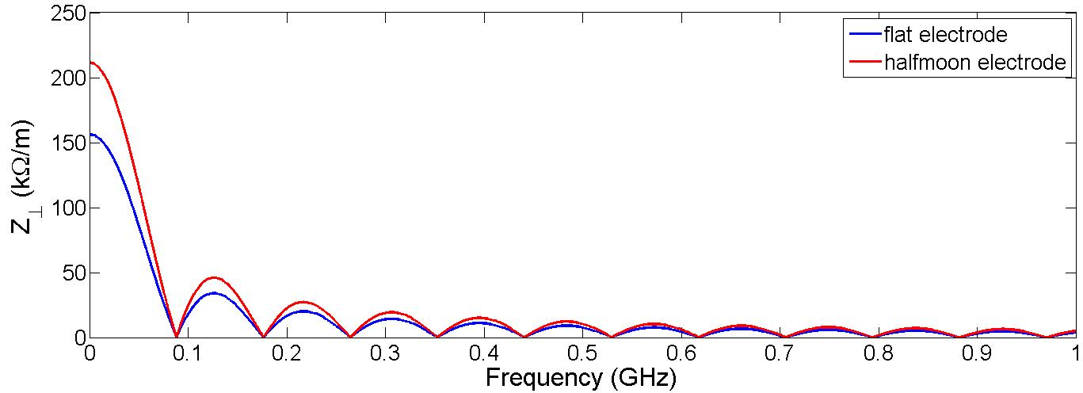
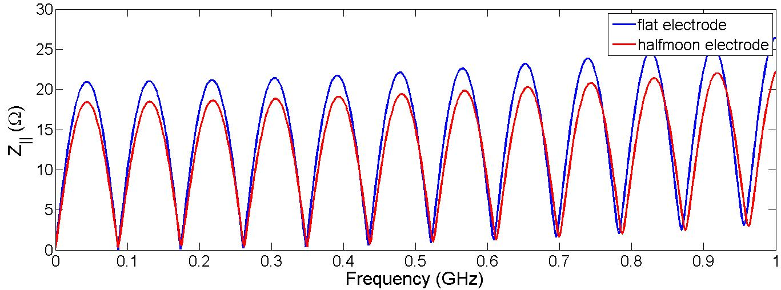
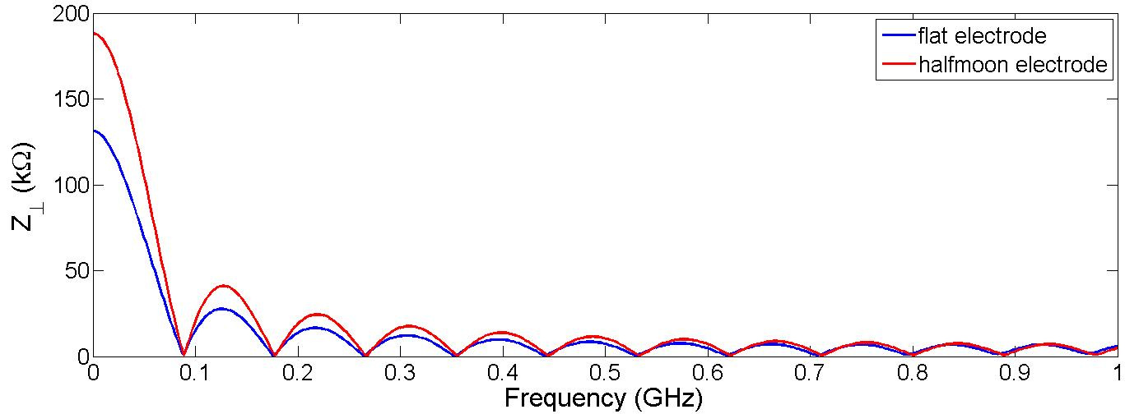
ONGOING BEAM COUPLING IMPEDANCE STUDIES: untapered beam pipe
ANALYTICAL EQUATIONS
SIMULATIONS
Simulations and analytical equations agree reasonably well for both geometries.
The longitudinal beam coupling impedance for the halfmoon striplines is lower than in the case of flat striplines, since for the halfmoon electrode the coverage angle is reduced from 2 radians to 1.8 radians.
The transverse beam coupling impedance is better in the case of flat striplines. Although halfmoon electrode allows for a better matching of both modes (odd and even), it is achieved with a 20 mm radius, wich produces a higher transverse impedance.

Slide 10

SUMMARY OF THE DESIGN RESULTS
A prototype of the extraction stripline kicker for CLIC Damping Rings is being designed and will be built in the next months.
The two operation mode of a coupled striplines have been taken into account when optimizing the design: the odd mode and the even mode.
Two cross-section shapes have been selected: flat electrode shape and halfmoon electrode shape, both inside a cylindrical beam pipe.
Although transverse coupling impedance for halfmoon electrode is in the limit of the allowable value, it would be the most suitable geometry for the extraction kicker of CLIC DR from the pulse rise time point of view.
 | FLAT ELECTRODE | HALFMOON ELECTRODE
Odd characteristic impedance
Signal transmission
Untapered longitudinal beam coupling impedance
Untapered transverse beam coupling impedance
FUTURE DESIGN STUDIES
Beam coupling impedance study for a tapered stripline beam pipe.
Optimization study of the stand-offs.
Calculation of the fabrication tolerances.
Analysis of the higher order modes.

Slide 11
EXPERIMENTAL TESTS
A set of prototype striplines will be built under the Spanish Industry Program “Science for Industry”.
Tests in the laboratory: IFIC, CIEMAT, CERN
Verification of the stripline dimensions.
Vacuum compatibility.
High voltage performance.
Longitudinal and transverse beam coupling impedance measurements.
Field homogeneity.
Others…

Slide 12
EXPERIMENTAL TESTS
Tests in a Test Facility
ALBA:
Using DC power supplies instead of the inductive adder
Transverse beam coupling impedance
Longitudinal beam coupling impedance (if possible)
Field homogeneity measurements with the DC power supplies and a closed bump.
ATF2:
Using the inductive adder, presently being designed
The kicker will be installed in a straight section in the Final Focus System, where many cavity BPMs with high resolution can be used to measure the stability and jitter of the beam deflection.

