Slide 1
Contents
Progress and future of ATF experimental program
Junji Urakawa, KEK
LCWS2012 at Arlington, Texas
Introduction
R&D Progress
    Beam Size Monitors (Laser Wire, IP-BSM,…)
    Beam Position Monitors (Cavity BPMs,…)
    Orbit feedback (FONT)
    R&D for Polarized Positron (Cavity Compton)
Future R&D Proposals

Slide 2
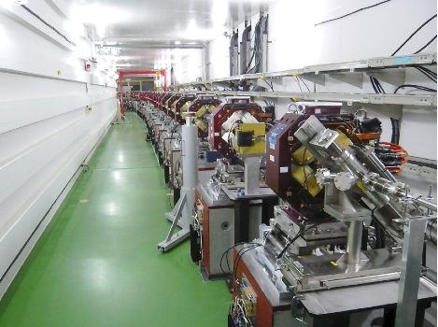
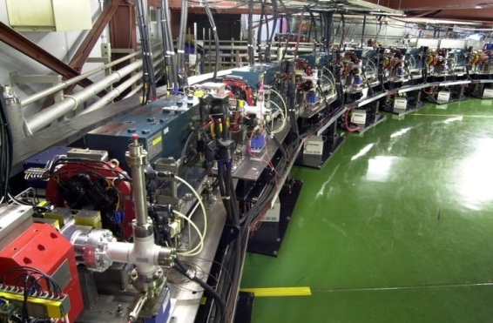
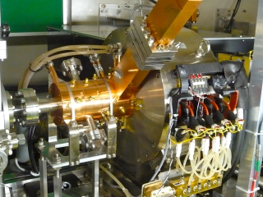
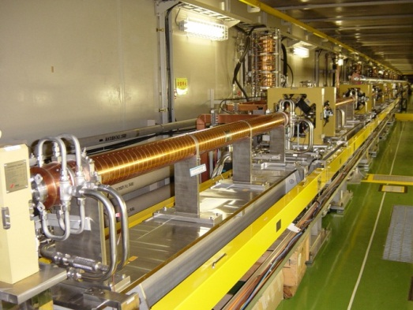
KEK Accelerator Test Facility (1.3 GeV)
R&D for the advanced accelerator technologies using the Low emittance multi-bunch beam; for ILC,…
Global collaboration
Education of the young researches
ATF2 beamline
Nano-meter beam studies;
Advanced beam instruments R&D
Damping Ring
Low emittance beam studies
Photo-cathode RF gun
Multi-bunch electron source
S-band Linac
Multi-bunch beam acceleration, 1.3 GeV

Slide 3
Challenging goals for ATF/ATF2
An important technical challenge of ILC is the collision of extremely small beams of a few nanometers in vertical size.
ATF/ATF2 will address the development of the techniques for following issues:
achieve the small vertical emittance
    ATF DR 4 pm(achieved)→ 2 pm or less
achieve the design vertical beam size at the IP; 37 nm
stabilize the the beam position in a few nanometer level at the IP.
The ATF international collaboration is strongly promoting these activities.

Slide 4
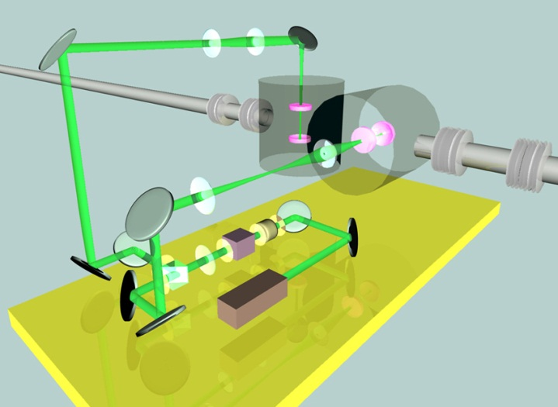
Development of the Beam Size Monitor for ILC
Non-destructive beam profile measurement
Survive against the high intensity multi-bunch beam
      → The Laser Wire Scanner
Two types of laser wires have been developed at ATF.
based on the Optical Cavity → in DR
based on the Pulsed Laser → in EXT-line/ATF2-FF

Slide 5
Development of the Pulsed Laser Wire
- Beam Size Monitor for BDS -
ILC design requirement:
  < 1 um laser wire scanner
Relocated in the matching section of ATF2 beam line.
Virtual IP of ATF2 IP
  e- beam ~1.4um (by OTR meas.)
Results at ATF extraction line (2008)
  σ_{lw} = 2.2 μm
Results at ATF2 FF line (2012 June)
  σ_{lw} = 0.9 ~ 1.4 μm
  Almost achieved the goal.
JAI(RHUL,Oxford) / KEK

Slide 6
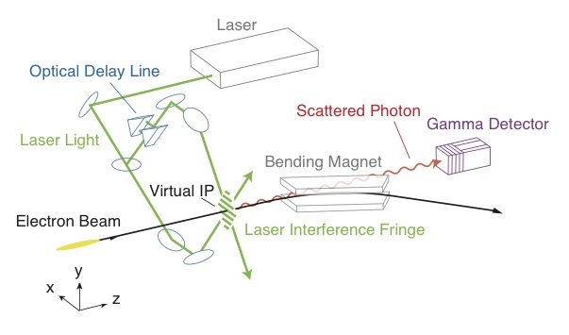
Nano-meter Beam Size Monitor
Univ. Tokyo / KEK
Beam Size Measurements at ATF2-IP
Solid (W,C) wire Scanners (meas. for 2um or more)
Laser interference fringe monitor (meas. for 20nm~6um)
FFTB ~70nm(measured) -> ATF2 37nm(goal)
    Laser wavelength
    (1064 → 532 nm)

Slide 7
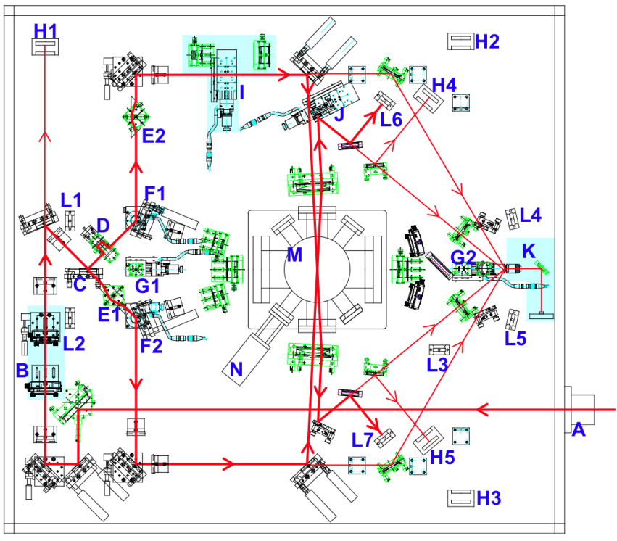
Laser Interference Fringe Monitor for ATF2
Measureable beam size
174°
 | 174° | 30° | 8° | 2°
Fringe pitch | 266 nm | 1.03μm | 3.81μm | 15.2μm
Minimum | 25 nm | 100 nm | 360 nm | -
Maximum | 100 nm | 360 nm | - | 6 μm
2~8°
30°

Slide 8
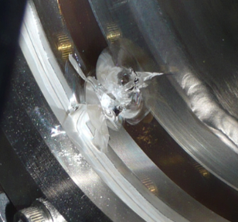
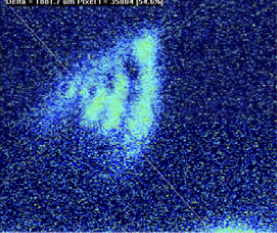
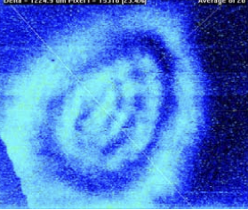
Laser Interference Fringe Monitor for ATF2
2-8° mode
  Spend most beam time in 2010~2011.
  beam tuning down to 300 nm
  commissioning of the fringe monitor
  beam size ~ 300 nm
30° mode
  First modulation was detected in February 2012.
  beam size ~165 nm
174° mode
  Modulation is not yet detected.
  Need improvement on the split laser handling (crossing angle control) in summer. Almost done.
Improvements on the fringe monitor
Damage → laser spot size optimization vs Compton Signal
pointing stabilization → Beam Lok device
profile improvement → laser cavity exchange
Laser crossing angle control
Hot Spot

Slide 9
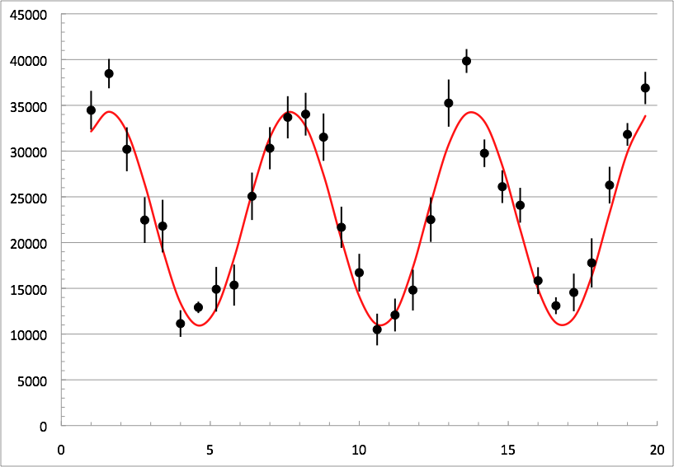
2012.2.23 data, 30 degree mode, 10points/phase
Signal Energy / ICT intensity [ arb. unit ]
ave. ICT/10⁻⁹= 5.70
M=0.517 ± 0.022
166.2±6.7nm
Phase [ rad ]
Notes:
meas120223_133534, 10 data points/phase, 30 degree mode
ave. ICT/10⁻⁹= 5.70 C_stat= 29.0, C_stat/SQRT(E), E in MeV
N_0=22609.4329
M=0.51689777 ± 0.022
phi0=1.646673838
Cphi=1.031352918
166.2±6.7nm

Slide 10
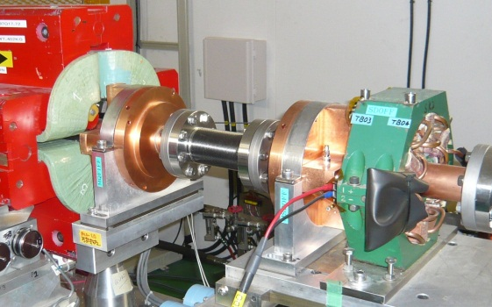
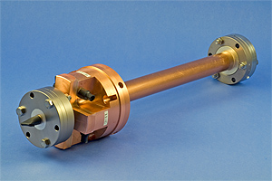
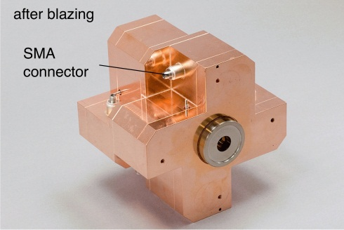
Nano-meter Beam Position Monitors
KNU / PAL / KEK / RHUL / SLAC
S-band BPM system
BPM cavity: 4 units
Ref. cavity: 1 unit
Target : 100 nm
Aperture: φ40 mm
C-band BPM system
BPM cavity: 34 units
Reference cavity: 4 units
Target resolution: 100 nm
Aperture: φ20 mm
IP BPM system
(BPM + Ref) Cavity
1 unit
Target : 2 nm
Aperture: 6 mm(V)
Achieved resolution at ATF
  8.72 +-0.28(stat) +-0.35(sys) nm
@ 0.7×10¹⁰ electrons/bunch,
@ 5 μm dynamic range
[Y. Inoue et al., Phys. Rev. ST-AB 11, 62801 (2008)]
Proto-type
Achieved resolution
  15.6 nm
  @dymamic range ±20μm

Slide 11
Operational status of the ATF2 Cavity BPMs
C-band BPM
  It is in the steady operation for ATF2.
  Achieved Resolutions:
      200 nm for typical BPMs with 20 dB attenuator to realize the wider dynamic range (~10 mm) for ATF2 tuning.
      50 nm for BPMs w/o attenuator
      27 nm was confirmed when BPMs are carefully tuned and a beam is well centered.
        The Cavity BPM on ATF2 demonstrates well the target resolution of ILC, 100 nm.
S-band BPM
  It needed only for the ATF2 large aperture final doublet. Not for ILC.
  Present resolution ~ 1 μm
IP-BPMs
  Trial installation: ~several 100 nm
BPM number

Slide 12
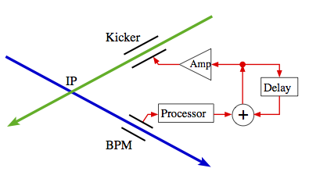
Nano-meter Beam Position Stabilization
Oxford / KNU / RHUL / KEK
One of the challenging goals for ATF2
  achieving of the 37 nm vertical beam size
  Stabilize a beam in a few nanometer level at the IP.
FONT (Feedback On Nano-Second Timescales) has been developed
  as a prototype of a beam-based intra-train feedback system for IP of LCs.
  Correct the impact of fast jitter sources such as the vibration of magnets.
FONT1~FONT3
Analogue feedback system for very short bunch-train LCs.
  Latency FONT3(ATF) 23 ns.
  FONT4 & FONT5 (ATF2)
Digital feedback system for long bunch-train ILC.
allow the implementation of more sophisticated algorithms

Slide 13
FONT-5 Digital feedback system at ATF
Analog Front-end
BPM processor
FPGA based
digital processor
Kicker drive Amplifier
Multi-bunch beam
Strip-line kicker
Beam Position detection

Slide 14
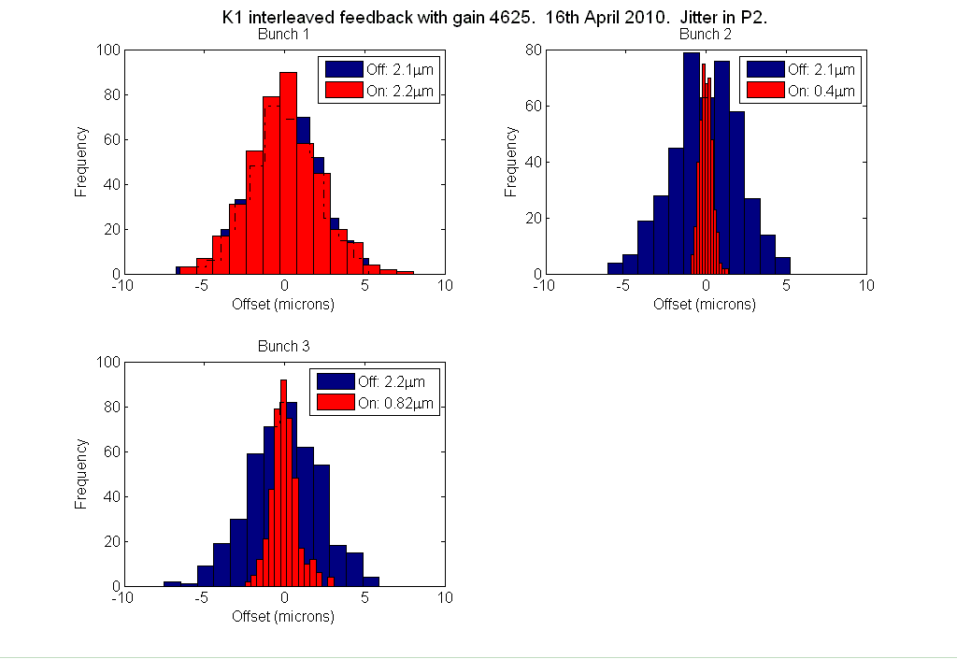
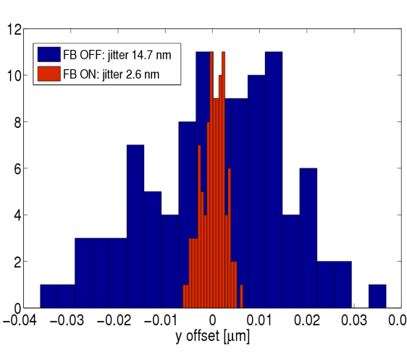
Results of the fast feedback
Results at ATF EXT-line feedback
Bunch 1 Bunch 2 Bunch 3
Jitter comparison at ATF2-IP (simulation)
Counts
2.1 um → 0.4 um → 0.8 um
Assuming perfect lattice,
no further imperfections (!)
Simulation
FB OFF: jitter 14.7 nm
FB ON: jitter 2.6 nm
FONT + IP-BPM
“for ATF2 Goal 2”

Slide 15
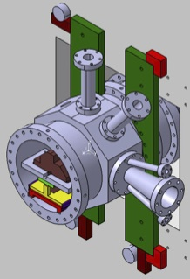
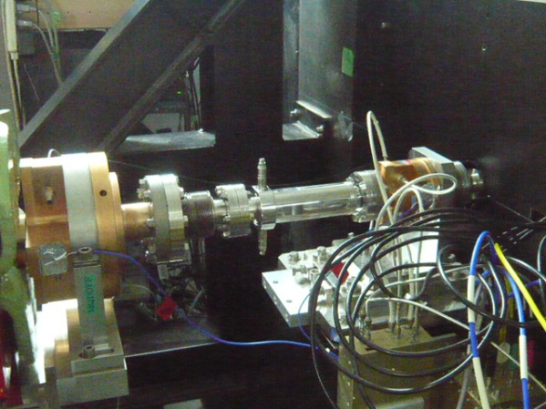
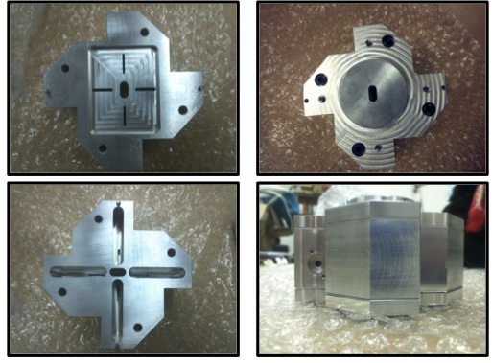
Preparation for the nm-beam position stabilization
IPBPM+FONT
New vacuum chamber
Store the triplet of IPBPM.
Under fabrication at LAL.
FONT-kicker
Installed near the ATF2-IP.
Tested in June 2012.
Full setup will be assembled at IP in early 2013.
IP
Beam
IPBPM
Triplet of the Low-Q cavity BPM. Fabricated by KNU. Sensitivity was tested at ATF LINAC.
Readout electronics has been tested at ATF2.

Slide 16
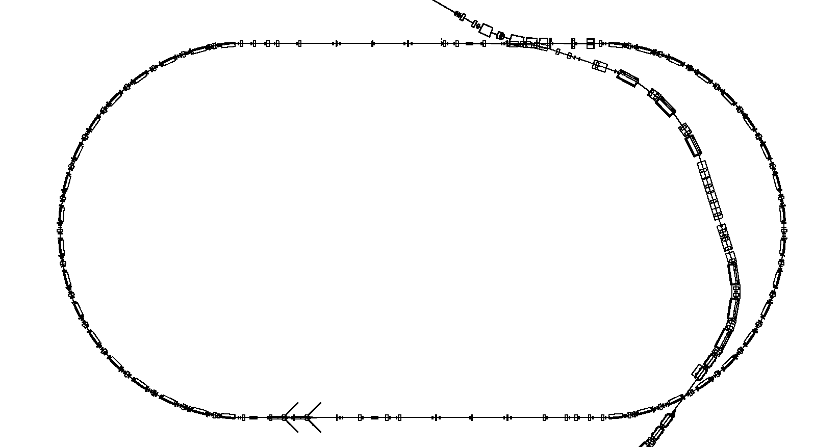
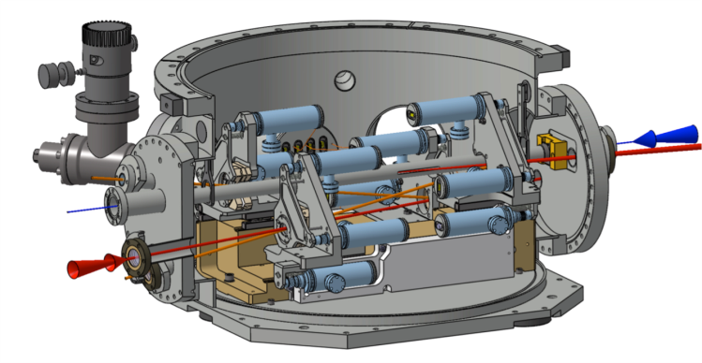
Polarized Positron Source R&D
Compton γ-ray
Detector
Hiroshima/KEK
2-mirror cavity
→ 4-mirror cavity system
Installed in 2011 Nov.
LAL
4-mirror cavity system
Installed in 2010 Aug.
High-intense laser by Optical cavity
2-mirror system → 4-mirror system
          Higher tolerance
          Higher number of Compton γ-ray
        → Polarized positron source
        → Future γ-γ collider technique

Slide 17
4-mirror Optical Cavities
Hiroshima/KEK System
Improvement by 2→4-mirror
  σ~30um → 15um
  finesse 2000 → 5000
~100 photons/train was observed. Stored power 2.6kW
More improvements in JFY2013
  finesse 5000 → 28000 or more (R>99.996%)
  Digital feedback
LAL System
Detect the first Compton signal on October 2010.
Laser trouble was happened.
Checkout of the Improved system with new laser is carried out at LAL.
It is planning to install in ATF again in early 2013.

Slide 18
Application of 4-mirror cavity
- Upgrade of the DR Laser Wire -
Emittance measurement by direct collision of a laser and an electron beam.
2-mirror LW system → 4-mirror system
  expect 100 times increase of the Compton signal
  reliable and faster measurement
  for vertical, horizontal and longitudinal beam size measurement.
manufacturing has been started.
the system will be installed in DR by the end of this year.

Slide 19
ATF Future Plan
ATF長期計画(案)
GDE
Next KEK Roadmap
CY
2011
2012
2013
2014
2015
2016
2017
2018
Not yet approved,
waiting discussion of the next KEK roadmap
by end of this year
ILC
others
Delay by fire and earthquake
Nano beam orbit control
Develop.(2nmBPM, Fast FB)
Nano beam orbit control (FONT extension)
Beam study
2nm stab. R&D
2nm steady op.
35nm
Steady op.
Challenging R&D of the Very high chromaticity optics
Ultra small beam ~ 20 nm
Small beam
Beam study
Gamma-gamma collider R&D
Develop. / beam study
4-mirror optical cavity (LAL/KEK)
Gamma-gamma laser system R&D
Application
High Field Physics
General R&D
Ex) for KEKB; CSR, RF gun,
Instrument develop.,
Low emittance,…
Test beamline for detector?

Slide 20
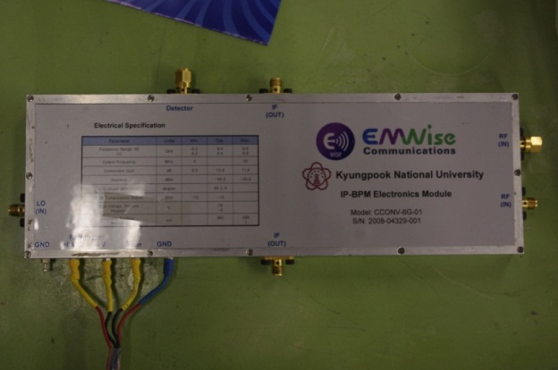
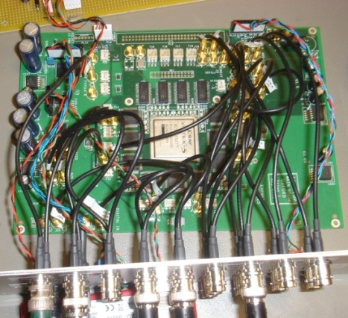
Proposal：nm beam orbit control
The nm-level beam stabilization is one of the key for ILC and Goal-2 on the ATF2 project. It is so challenging then will not be completed at the end of FY2013. Extension of this program will be necessary.
Full setup at IP will be assembled in early 2013.
Beam test
Upgrade of 2 nm readout
Upgrade of FONT feedback system
nm Stability R&D

Slide 21
Proposal：nm small beam
Explore the small beam after the 37 nm at ATF2
Collaborated R&D for CLIC
Demonstration of the final focus with the Very high chromaticity optics and establish the beam tuning method → 20 nm beam
Critical Developments
Beam Size Monitor (Highly stable Laser Interference Fringe Monitor at ATF2); Modulation 0.8 (37nm) → 0.9 (20nm)
Beam Stabilization (IP-BPM + FONT)
Renew the Final Doublet Quadrupole (QF1) at ATF2; CERN proposed In-kind Contribution

Slide 22
Proposal from CERN
12 January 2012, KEK,14th ATF TB/SGC Meeting

Slide 23
Proposal from CERN
12 January 2012, KEK,14th ATF TB/SGC Meeting

Slide 24
Grand Motion Sensors prepared by LAPP
Proposal from CERN
12 January 2012, KEK,14th ATF TB/SGC Meeting

Slide 25
Proposal from CERN
12 January 2012, KEK,14th ATF TB/SGC Meeting

Slide 26
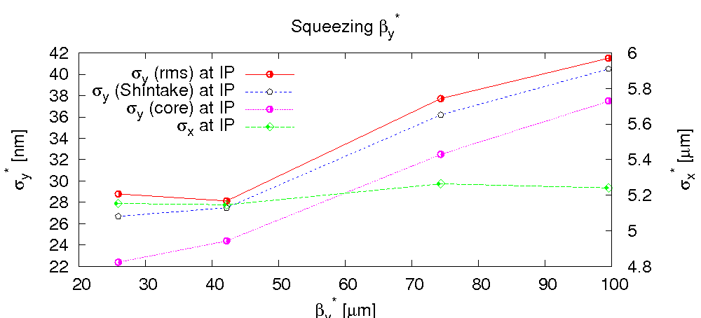
Proposal from CERN
  Ultra-low beta-function
R. Tomas
motivation
To prove CLIC chromaticity levels in ATF2 requires a factor 4 lower IP beta function. The main obstacle is the field quality (already issue for ATF2 nominal)
project | L*[m] | β_{y}* [μm] | ξ_{y}
ATF2 nominal | 1.0 | 100 | ~19000
ILC design | 3.5 | 400 | ~15000
ATF2 ultra-low | 1 | 25 | ~76000
CLIC 3 TeV | 3.5 | 90 | ~63000
limitation from multipoles: σ_{y}* vs β_{y}*
with measured magnetic multipoles; optimization with MAPCLASS; no further reduction when decreasing β_{y}* below 40 μm
β_{x}*=10 mm

Slide 27
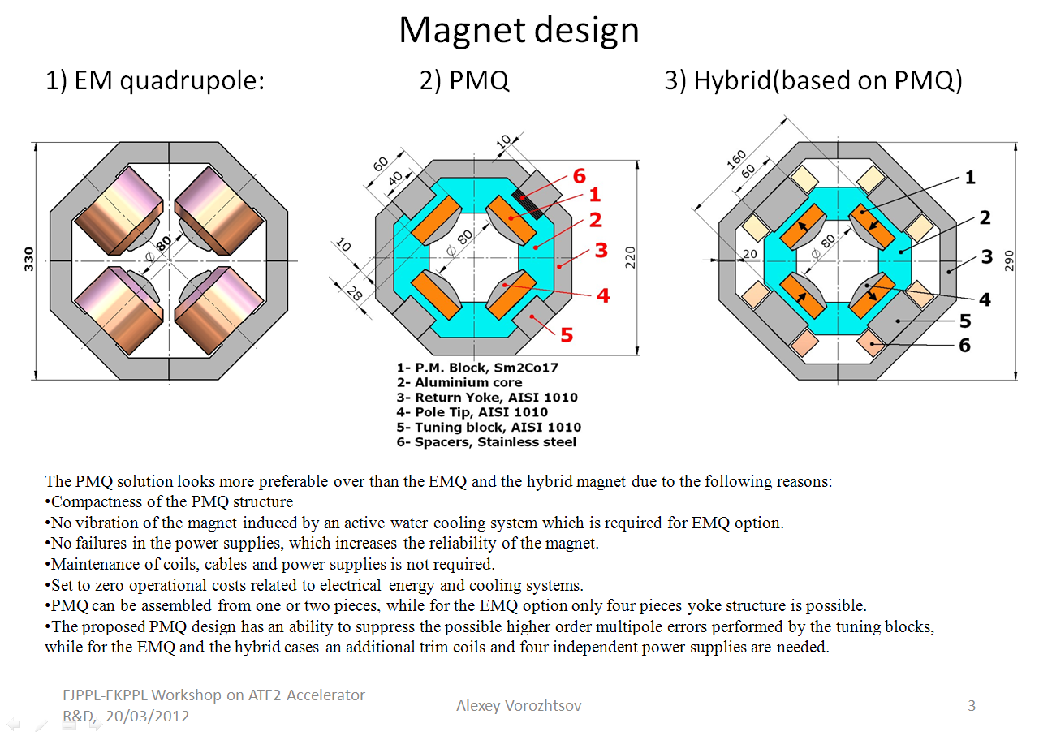
…from FJPPL-FKPPL WS on ATDF2 in March 2012:
14th ATF2 Project Meeting 26-27 June 2012: A. Bartalesi, M. Modena, A. Vorozhtsov on “New Final Doublets”

Slide 28
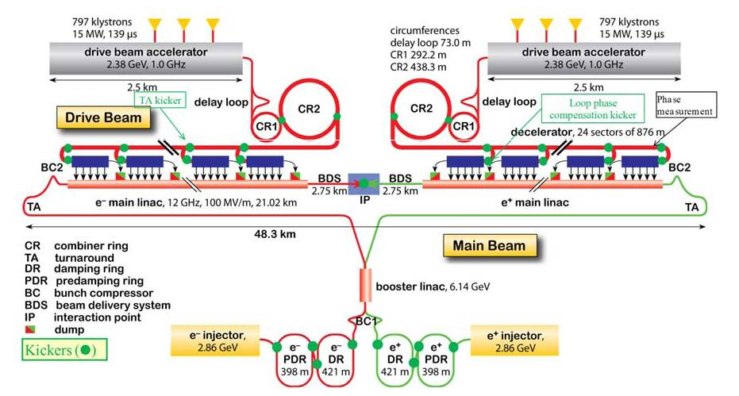
Proposal from CERN
Introduction and Motivation
We propose to install a first prototype stripline kicker, together with the inductive adders for the pulsed power supplies, for testing in a straight section of the extraction line of ATF2. This kicker system is being designed to extract horizontally the beam from the CLIC Damping Rings. The main objective of these tests is the validation of the proposed design from the field stability, field homogeneity and impedance points of view
Several challenging kicker systems are required to inject the beam into and extract the beam from the PDRs and DRs
In order to achieve both low beam coupling impedance and broadband impedance matching to the electrical circuit, striplines have been chosen for the kicker elements
A set of protoype striplines will be built by the Spanish company Trinos Vacuum Projects under the Centro de Desarrollo Tecnológico e Industrial (CDTI) program in collaboration with the IFIC and the CIEMAT Accelerators groups
12 January 2012, KEK,14th ATF TB/SGC Meeting
Notes:
ALBA test: beam impedance and field homogeneity with a dc power supply
ATF2 test: beam impedance and filed homogeneity but with a pulsed generator (inductive adder)

Slide 29
Proposal from CERN
Introduction and Motivation
Specifications for the CLIC DR, CLIC PDR and ATF2
Parameter | CLIC PDR |  | CLIC DR |  | ATF2
 | 1 GHz | 2 GHz | 1 GHz | 2 GHz | 1-bunch |  | 3-bunch |  | 20-bunch
Beam energy (GeV) | 2.86 |  | 2.86 |  | 1.30
Total kick deflection angle (mrad) | 2.0 |  | 1.5 |  | 1.5
Aperture (mm) | 40 |  | 20 |  | 20
Effective length (m) | 3.4 |  | 1.7 |  | 1.7
Field rise time (ns) | 428 | 1000 | 560 | 1000 | 560/1000
Field fall time (ns) | 428 | 1000 | 560 | 1000 | 560/1000
Pulse flat top duration (ns) | 900 | 160 | 900 | 160 | 900/160
Extraction field inhomogeneity (%) | ±0.1 (3.5 mm) |  | ±0.01 (1mm) |  | ±0.01 (1mm)
Repetition rate (Hz) | 50 |  | 50 |  | 1.56
Vacuum (mbar) | 10⁻¹⁰ |  | 10⁻¹⁰ |  | 10⁻¹⁰
Pulse voltage per stripline (kV) | ± 17.0 |  | ± 12.5 |  | ± 5.5
Stripline pulse current (A) | ± 335 |  | ± 250 |  | ± 115
Longitudinal coupling impedance (Ω) | < 0.05 |  | < 0.05 |  | < 0.05
Transverse coupling impedance (kΩ/m) | < 200 |  | < 200 |  | < 200
Peak beam current (A) | 70 | 50 | 110 | 120 | 60 | 30 |  | 20
Bunch length (ps) | 10 | 14 | 6 | 5.3 | 16.7
Notes:
Field homogeneity over 3.5 mm or 1mm radius

Slide 30
Proposal from CERN
Proposed Schedule and Commissioning
We have essentially finalized the cross section design of the striplines. Once the beam coupling impedance study is finished, the striplines will be manufactured by December 2012. The tests planned by 2013 are the following:
Laboratory test at CERN: verification of the stripline dimensions, field homogeneity, longitudinal and transverse beam coupling impedance, vacuum performance and high voltage performance.
Tests and measurements at ALBA: using d.c. power supplies instead of a pulse generator, to determine transverse beam coupling impedance and, if possible, longitudinal beam coupling impedance. Field homogeneity measurements will be carried out with the d.c. power supplies and a closed bump.
It is planned that two inductive adders will be built and tested by 2014: hence our goal is that the kicker striplines and the two inductive adders are installed in ATF2 during 2014.
We anticipate being able to commission the kicker system immediately after the kicker has been installed
12 January 2012, KEK,14th ATF TB/SGC Meeting

Slide 31
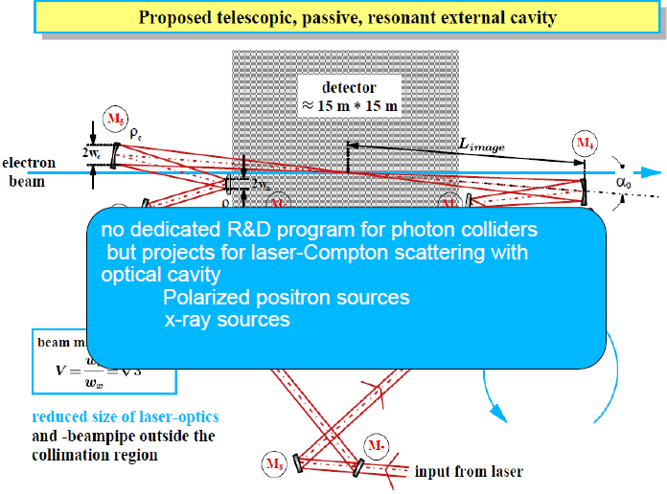
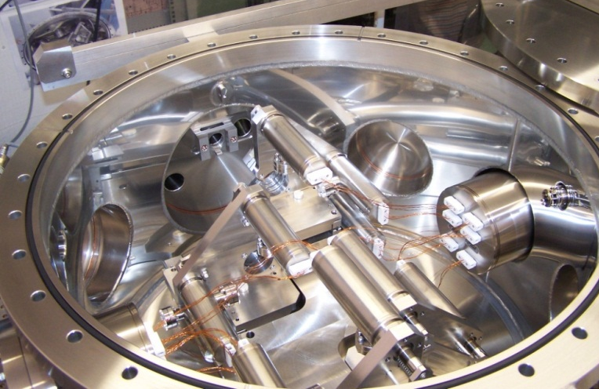
Proposal：Gamma-gamma R&D
Apply the Grant for Scientific Researches,
In-kind contribution (LAL)
Establish the fundamental technology for Photon LC
several 10 m scale high power Optical Cavity
(100 m for PLC)
Laser cavity system at ATF-EXT line
Realize several micron laser

Slide 32
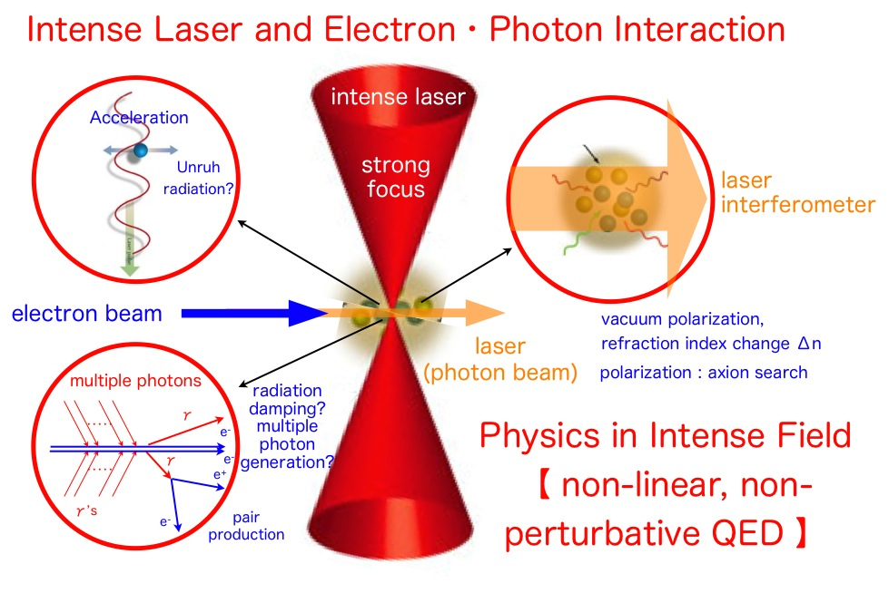
Proposal：High Field Physics
Apply the Grant for Scientific Researches
ATF2 small beam
Development
300 TW laser
Detector

