Slide 1
ILC RTML Lattice Design
Vivoli, N. Solyak, V. Kapin
Fermilab

Slide 2
OUTLINE
RTML Layout
Latest changes in central region (ERTL/PRTL)
Return Line Dog-Legs design (ELTL/PLTL)
ML Treaty point definition and matching
Earth curvature in Return Lines (ELTL/PLTL)
Bunch Compressor design requirements
Other sections of RTML
Magnet count and Heat Load/Cost estimation
Summary

Slide 3
RTML Functions
ERTML
PRTML
Transport the beams from DRs to start of Main Linacs
Collimation of Beam halo
Polarization control
Bunch Compression and acceleration
Avoid emittance dilution
Beam diagnostic, coupling correction, dump, etc…

Slide 4
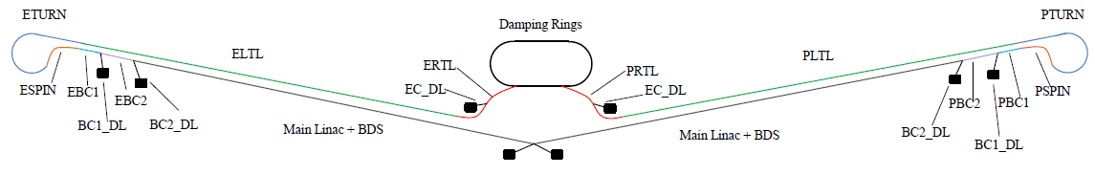
RTML Beamlines
ERTL/PRTL: Electron/Positron Ring-to-Line from DR to Main Tunnel (+ Dump Line)
ELTL/PLTL: (E/P) Long-Transfer-Line
ETURN/PTURN: (E/P) Turn-Around
ESPIN/PSPIN: (E/P) Spin rotator
EBC1/PBC1: (E/P) 1st stage of Bunch Compressor (+ Dump Line)
EBC2/PBC2: (E/P) 2nd stage of Bunch Compressor (+ Dump Line)

Slide 5
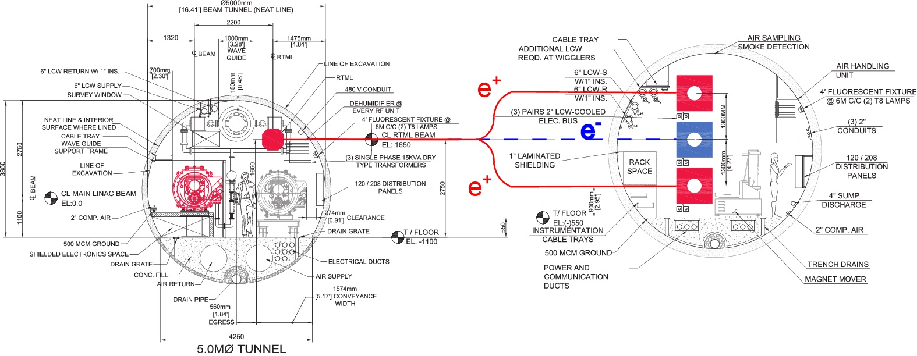
ERTL/PRTL (Central Region)
Increased distance between DR and Main Tunnel.
For first stages only bottom Positron Damping Ring built and vertical dogleg to reach PRTML in Main Tunnel.
For luminosity upgrade 2 positron Damping rings and 2 doglegs.
Replace last 2 bends in vertical dogleg with 2 septum magnets and merger.

Slide 6
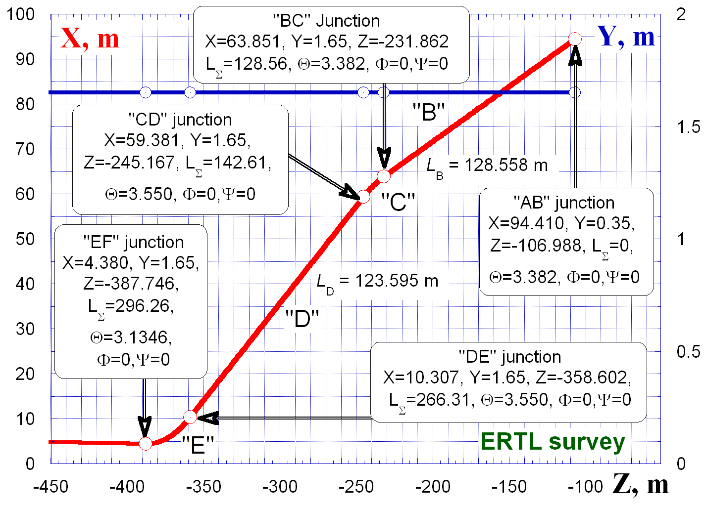
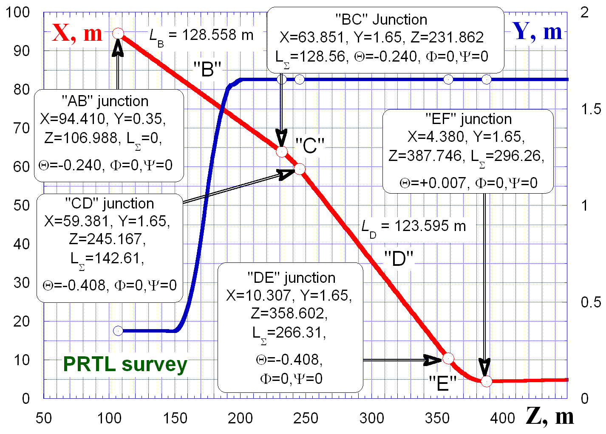
RTML Central Region Design
Origin at IP.
Main beam trajectory Θ = 7mrad.
Extraction line from DR, A.
Straight sections B,D.
Horizontal arcs C,E.
Extraction Line for early beam dump in section D.
Vertical dogleg in Section B of PRTL, plane geometry for ERTL.
Geometry of beamlines imposed by other areas (sources, DR injection lines, BDS Tunnel).

Slide 7
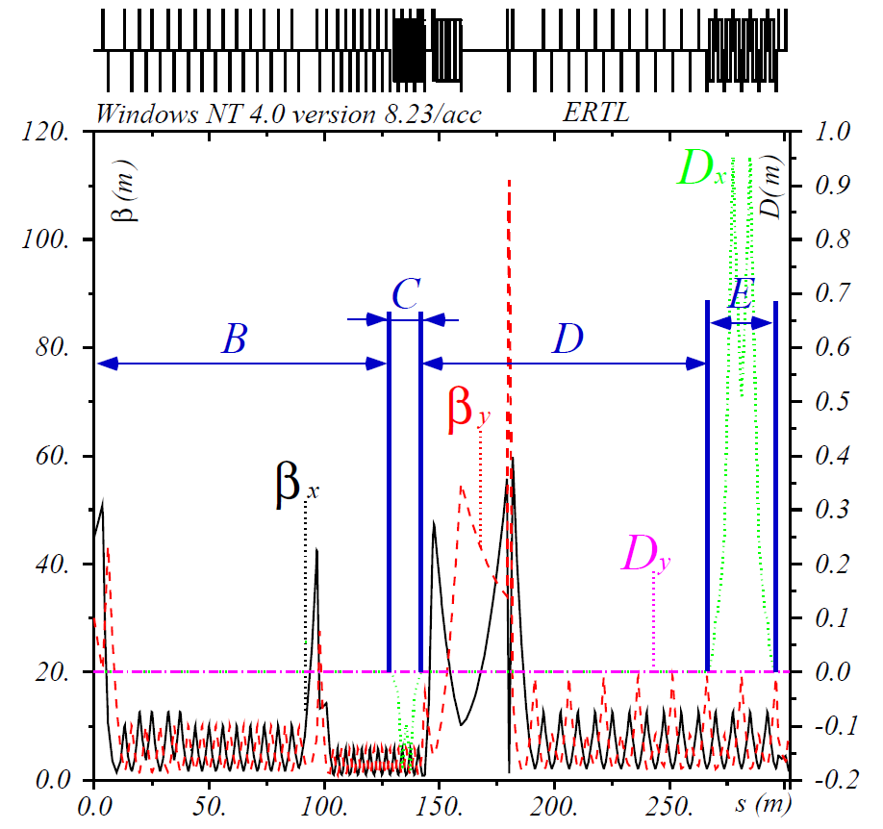
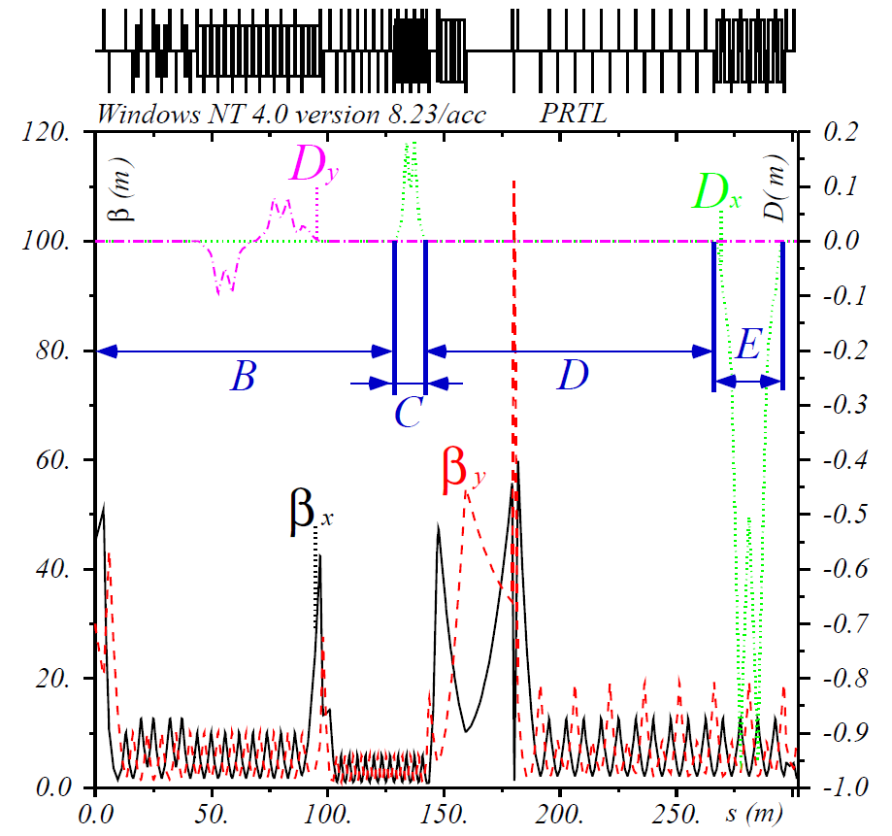
RTML Central Region Lattice
Section A is extraction line from DR.
Straight sections B,D (FODO lattice).
Horizontal arcs C,E (FODO + BENDs lattice).
Arc E shares tunnel with spin rotator.
Vertical dogleg in Section B of PRTL.
Extraction line in section D.
Skew quadrupole correction, beam diagnostic and collimation moved to ELTL/PLTL.

Slide 8
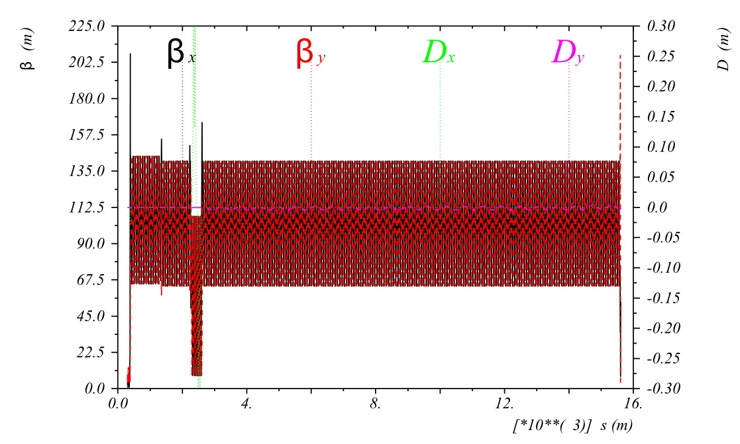
RTML Long Transfer line
Coupling correction, diagnostic and collimator section in first part.
Mainly FODO lattice (45°/45°) with vertical curvature.
Horizontal dogleg at positron target location.

Slide 9
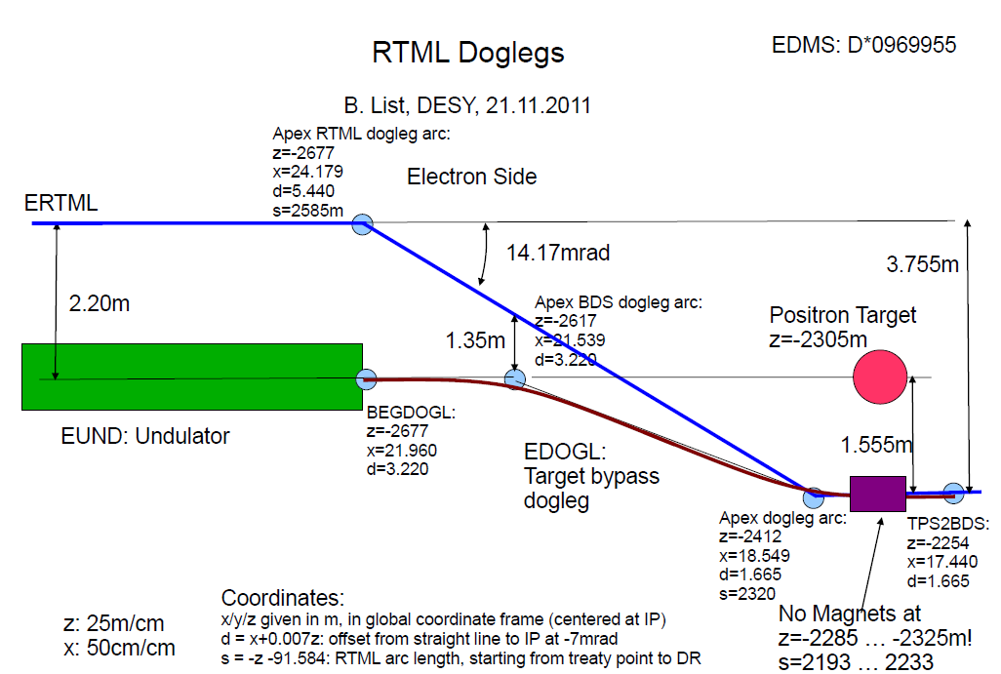
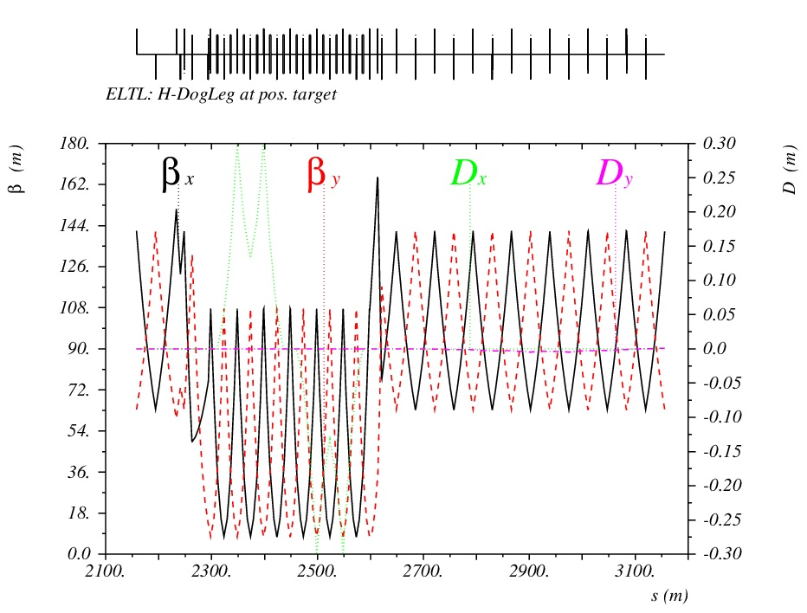
ELTL/PLTL Dogleg design
Dogleg of positron source to by-pass positron target.
ERTML follows geometry of positron source/BDS systems.
Radiation from positron target requires magnet free zone.
FODO+BEND lattice used.

Slide 10

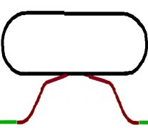


ML/DR treaty points matching
Treaty Point | TERTML2ML | TEML2PS | TPS2EBDS | TPRTML2ML | TPML2BDS
 | Electron RTML to Main Linac | Electron Main Linac to Positron Source (Undulator Section) | Positron Source (Undulator Section) to Electron BDS | Positron RTML to Main Linac | Positron Main Linac to BDS
Geometry
x [m] | 104.5245011 | 26.540 | 17.440 | 94.62043163 | 17.433
y [m] | 0 | 0 | 0 | 0 | 0
z [m] | -14471.78005 | -3331.319 | -2253.464 | 13279.10984 | 2252.514
θ [rad] | -0.0070 | -0.0070 | -0.0070 | -3.1346 | -3.1346
φ [rad] | 0 | 0 | 0 | 0 | 0
ψ [rad] | 0 | 0 | 0 | 0 | 0
d [m] | 3.220 | 3.220 | 1.665 | 1.665 | 1.665
Optics Functions
α_{x} [1] | -1.142 | -2.402 | -2.402 | -1.142 | -2.402
β_{x} [m] | 52.67 | 51.33 | 51.33 | 52.67 | 51.33
η_{x} [m] | 0 | 0 | 0 | 0 | 0
η'_{x} [1] | 0 | 0 | 0 | 0 | 0
α_{y} [1] | 1.279 | 0.4888 | 0.4888 | 1.279 | 0.4888
β_{y} [m] | 70.74 | 9.395 | 9.395 | 70.74 | 9.395
η_{y} [m] | 0 | 0 | 0 | 0 | 0
η'_{y} [1] | 0 | 0 | 0 | 0 | 0
Input: |  | ELIN |  | PLIN
Main Linac Length [m] |  | 11140.734 |  | 11026.866
Reference: | ILC SCRF Cryogenics parameters
 | D00000000975575
Geometrical matching of the 2 RTML beam lines is made by tuning the cell length of the Long Transfer Line FODO lattice and the bending angles in the horizontal and vertical doglegs upstream the Turn Around.
Hor. & Ver. Doglegs
Hor. & Ver. Doglegs
ELTL FODO system
PLTL FODO system
e- Main Linac
e+ Main Linac
A. Vivoli, N.Solyak, V.Kapin, ILC RTML Lattice Design
10

Slide 11
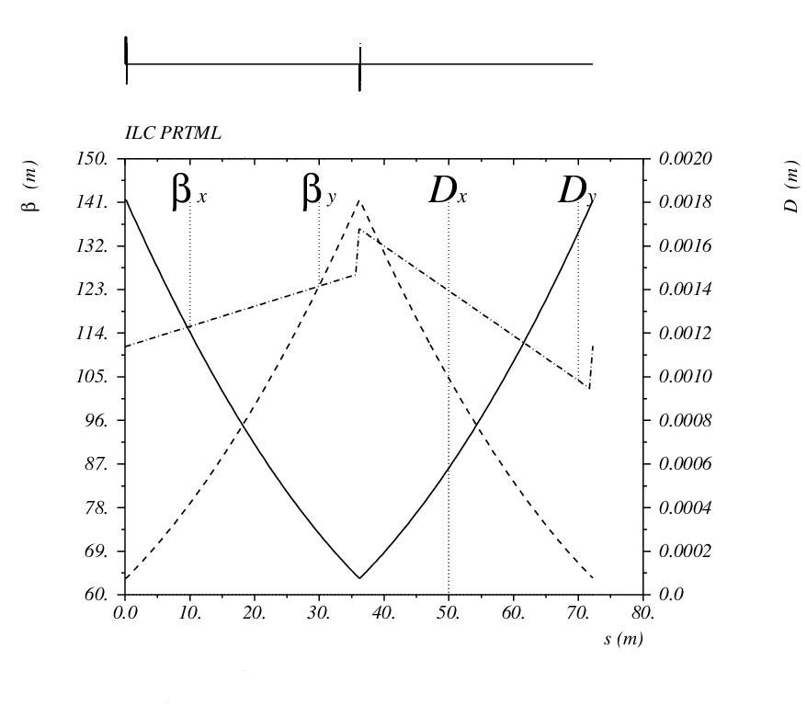
Earth curvature in ELTL/PLTL
For Cryogenic requirements main linacs need to follow the curvature of the Earth.
Long Trasnsfer Lines are located in the same tunnel with ML’s, then they need to be curved.
Vertical correctors
Geometric curvature of the beamlines is realized in the vacuum chamber and the beam orbit is curved by means of vertical dipole correctors at each quadrupole of the FODO lattice. A small vertical dispersion is then created and propagated along the line. The first 4 correctors and the last 4 correctors are used to match the curved section to the straight lines.

Slide 12
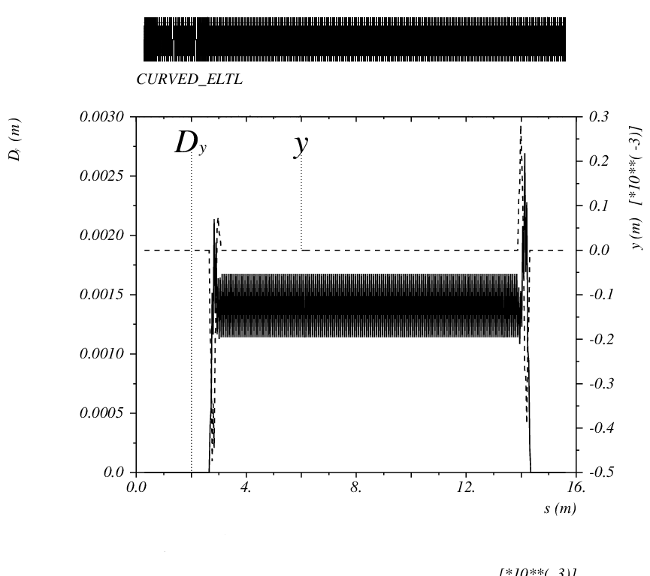
Earth curvature in ELTL/PLTL
Vertical offset and dispersion of beams in curved ELTL/PLTL
Vertical correctors for dispersion matching
Straight line
Straight line

Slide 13
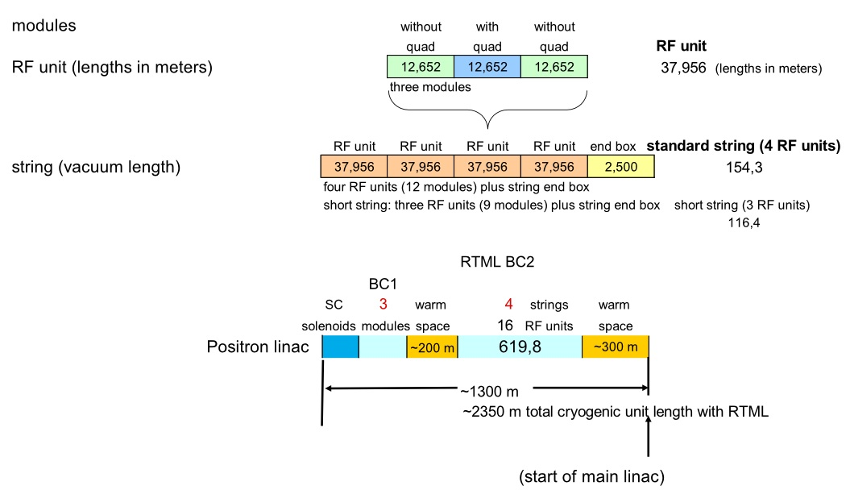
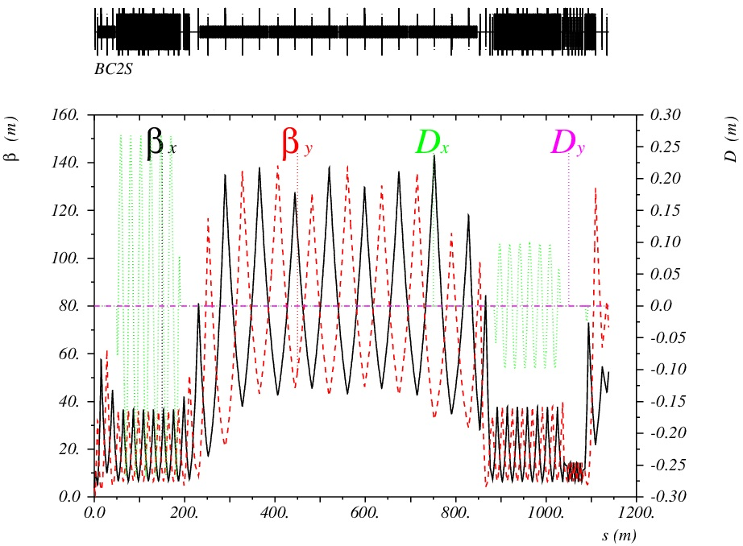
Bunch Compressor
2 stage BC design selected (more tunability, possibility of σz < 220μm).
Use of 16 RF units in BC2 RF (416 RF cavities) to reduce gradient.
Use 3 cryo-modules with quad (24 RF cavities) for BC1.
New output parameters from DR.

Slide 14
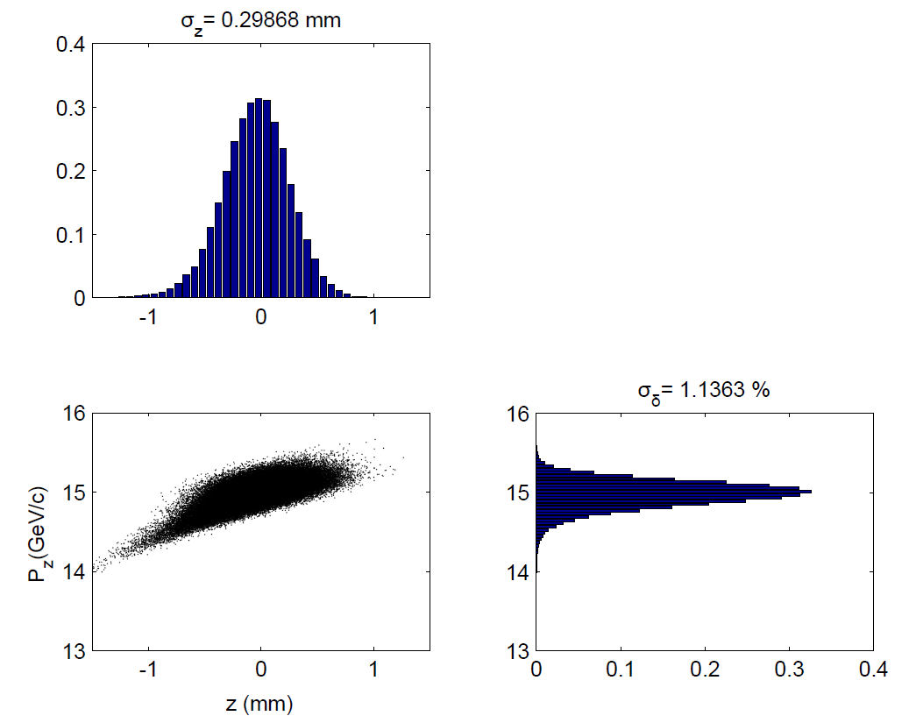
Bunch Compressor
Final longitudinal phase space for bunch compression at nominal operation mode (5 Hz, Ecm = 500 GeV).
New parameter optimization of BC wigglers done by S. Seletskiy (more details in his talk).

Slide 15
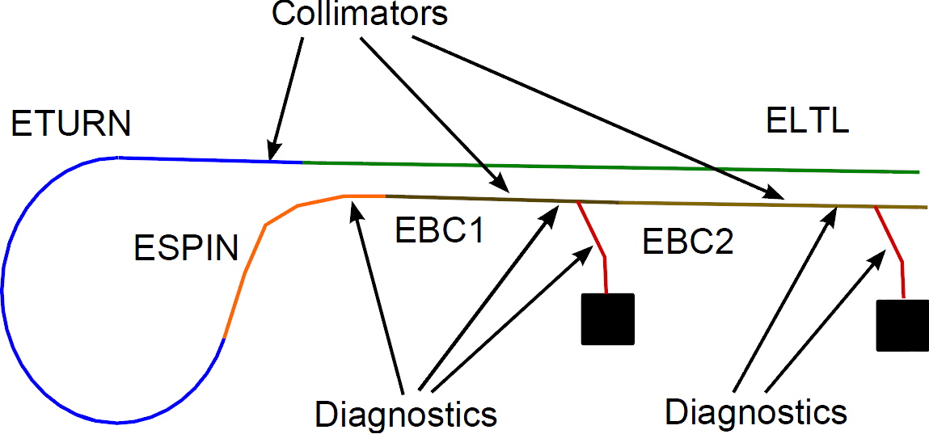
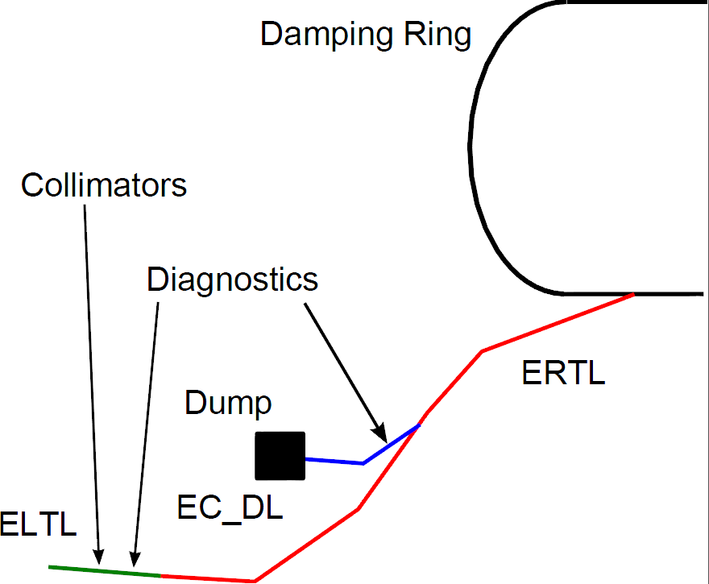
Collimators+Diagnostic+Extraction lines
3 Extraction lines in each side of RTML: DR exit, BC1 end, BC2 end.
4 Collimation sections: beginning of LTL, Turn-around dogleg, BC wigglers.
7 Diagnostic sections: beginning of LTL, end of Spin rotator, end of BC1 and BC2 and in each extraction line.
Skew quadrupole sections at beginning of LTL and at end of Spin Rotator.

Slide 16
Extraction lines
Extraction System can extract full beam for tune up or make fast bunch extraction.
Extraction lines in RTL and BC1 can dump entire beam (220 Kw, @ 5GeV). Extraction line in BC2 can only dump 1/3 of beam power (@ 15 GeV).
Extraction line at BC1 can dump compressed and uncompressed beam (E=4.8-5 Gev, σ_{E} = 0.11-1.42%), while the one at BC2 needs large energy acceptance.
New design of extraction lines by S. Seletskiy (more details in his talk).

Slide 17
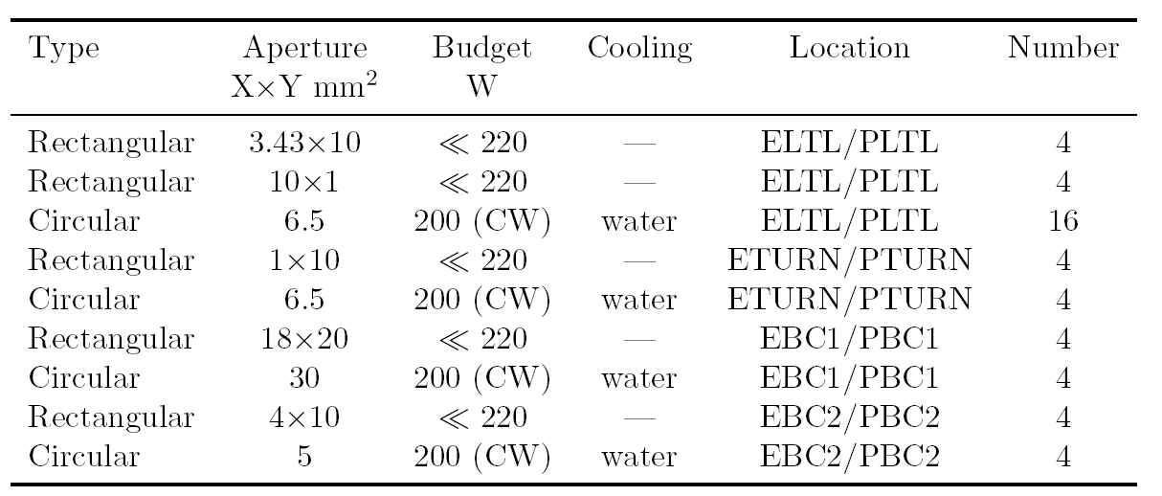
Collimator sections
Collimation is performed by adjustable-aperture rectangular (spoiler) and fixed-aperture circular (absorber) collimators.
Spoilers are 0.6 RL titanium, with budget << 10⁻³ beam power (estimated halo), very small portion of energy deposited.
Absorbers are ~20 RL, with budget ~200 W (estimated halo), full halo absorption.
System in LTL for betatron collimation, other 3 for energy collimation.

Slide 18
Collimator sections
Betatron collimation with couple of horizontal spoilers (@ focusing quad) and vertical spoilers (@ defocusing quad) separated by 90° fase advance. Absorbers are after each spoiler.
Betatron collimation is performed @ 10 σ_{x} and 60 σ_{y}.
Request to change collimation to 6 σ_{x} and 34 σ_{y} like in BDS. Wakefield effects from such collimators to be evaluated (maybe possible using tapered collimators).
Energy collimation is performed @ 10 σ_{δ} in Turn-Around and 6 σ_{δ} in the wigglers.
In Turn-Around spoilers are at opposite dispersion position separated by I matrix in betatron phase. In wigglers they are at same dispersion and separated by -I in betatron phase.

Slide 19
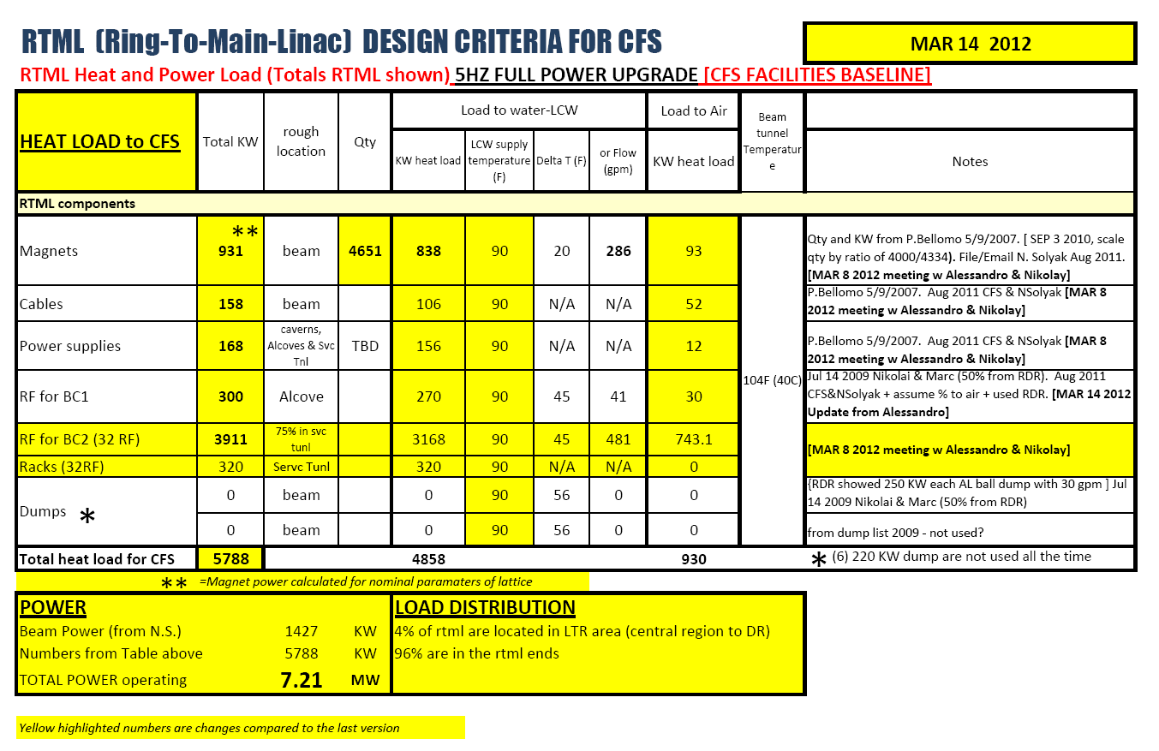
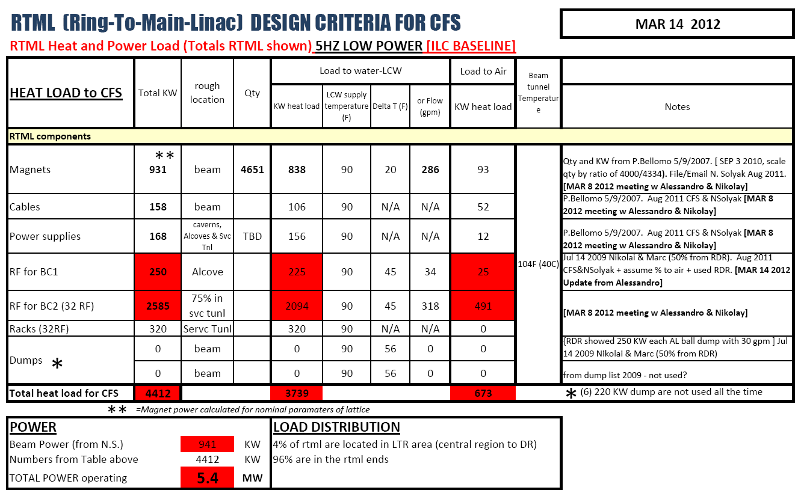
Magnet count and Heat Load/Cost estimation
Magnet count and Heat & Power Load for RTML estimated with RDR parameters.

Slide 20
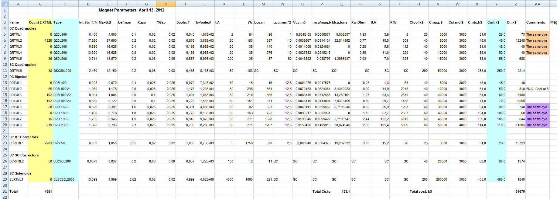
Magnet count and Heat Load/Cost estimation
Cost for RTML magnets & PS estimated using RDR data.

Slide 21
Summary and outlook
The RTML lattice is almost in the TDR configuration.
Earth curvature in return lines have been designed.
Geometrical matching of DR/ML Treaty points have been performed, optics matching almost done.
Renovated design and simulation of BC have been performed.
Design of extraction lines has been renovated.
Magnet count and Heat Load/Cost estimations completed.

Slide 22
Thanks for your attention.

Slide 23
BACK UP SLIDES

Slide 24
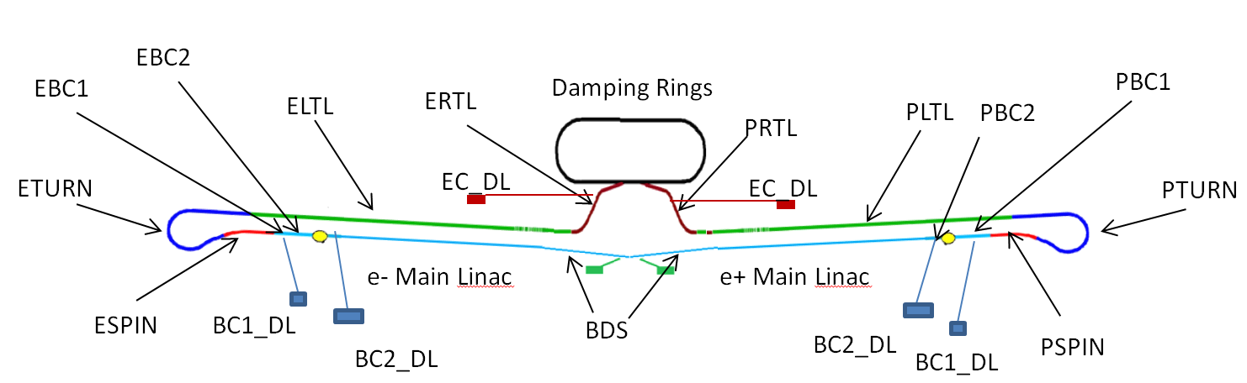
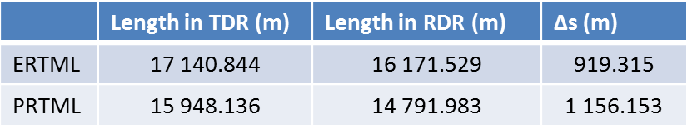
Layout
RTML LAYOUT
Lines EC_DL and BC1_DL have same lattice design.

