Slide 1

SRF Technical Status and Future R&D
Rong-Li Geng
Jefferson Lab & GDE

Slide 2
Acknowledgement
Many thanks to the following colleagues for providing information to me in preparing the slides presented in this talk: Sebastian Aderhold(DESY), Andre Anders(LBNL), Claire Antoine(SACLAY), Lance Cooley(FNAL), Charlie Cooper(FNAL), Eckhard Elsen(DESY), Fabien Eozenou(SACLAY), Fumio Furuta(Cornell), Jie Gao(IHEP), J.K. Hao(PKU), Hitoshi Hayano(KEK), Georg Hoffsttatter(Cornell), Camille Ginsburg(FNAL), Kexin Liu(PKU),Olivier Napoly(SACLAY), Aliaksandr Navitski (DESY), Sam Posen(Cornell), Jiyuan Zhai(IHEP).
Recent reviews on the ILC SCRF technology and ILC main linac design have been given by Akira Yamamoto (GDE PM for SCRF). Some slides on ILC SRF status are borrowed from Akira’s talks at LINAC12 and ASC12.

Slide 3
Outline
ILC SRF technical status
  Cavity gradient
  Cryomodule system testing
  Beam operation of cryomodules in SRF linacs
Future SRF R&D for linear collider
  Field emission understanding and control
  Very high gradient with high Q0
  Inexpensive SRF fabrication and processing
  Fundamental issues
Summary

Slide 4
Outline
ILC SRF technical status
  Cavity gradient
  Cryomodule system testing
  Beam operation of cryomodules in SRF linacs
Future SRF R&D for linear collider
  Field emission understanding and control
  Very high gradient with high Q0
  Inexpensive SRF fabrication and processing
  Fundamental issues
Summary

Slide 5
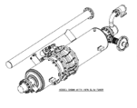

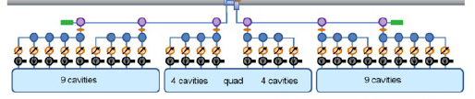
SCRF Technology Required
Parameters | Value
C.M. Energy | 500 GeV
Peak luminosity | 2x10³⁴ cm⁻²s⁻¹
Beam Rep. rate | 5 Hz
Pulse duration | 1 ms
Average current | 5.8 mA (in pulse)
Av. field gradient | 31.5 MV/m +/-20%
# 9-cell cavity | 16024 (x 1.1)
# cryomodule | 1,855
# Klystron | ~400
Cavity Performance requirement:
  G = 35 MV/m +/- 20 %
  Q0 = 0.8 E10

Slide 6
Technical Goals for TD Phase
SCRF Technology
  Cavity: High Gradient R&D to:
    35 MV/m with 50% yield by 2010 , and 90% by 2012 (TDR)
    Manufacturing with cost effective design
  Cryomodule performance including HLRF, and LLRF
System Test with ILC-like Beam
  ILC-like beam acceleration
    9 mA: FLASH
    1 ms: STF2 - Quantum Beam
    Ultra-low beam emittance: Cesr-TA, ATF
    Ultra-small beam size at Final FOcusing: ATF2

Slide 7
Global Plan for SCRF R&D
Year | 07 | 2008 |  | 2009 |  | 2010 |  | 2011 | 2012
Phase | TDP-1 |  |  |  |  |  | TDP-2
Cavity Gradient in v. test to reach 35 MV/m | → Yield 50% |  |  |  |  |  | → Yield 90%
Cavity-string to reach 31.5 MV/m, with one-cryomodule |  | Global effort for string assembly and test (DESY, FNAL, INFN, KEK)
System Test with beam acceleration |  |  | FLASH (DESY) , NML/ASTA (FNAL) QB, STF2 (KEK)
Preparation for Industrialization |  |  |  |  | Production Technology R&D
Communication with industry: | 1st Visit Venders (2009), Organize Workshop (2010) 2nd visit and communication, Organize 2nd workshop (2011) 3rd communication and study contracted with selected vender (2011-2012)
We are here

Slide 8
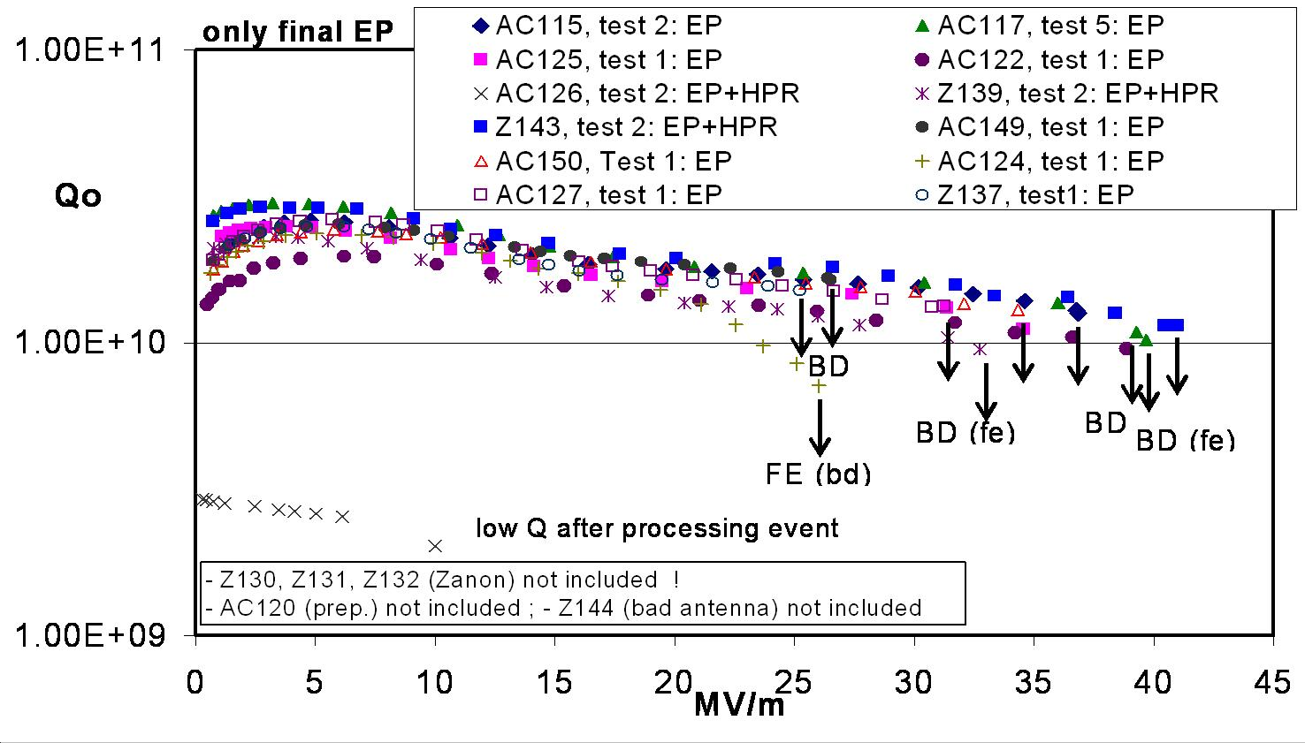
Global Cavity Gradient Results - EU
DESY data, D. Reschke et al., SRF2009, TUPPO051.

Slide 9
Global Cavity Gradient Results - Americas
JLAB data, R.L. Geng et al., IPAC2011, MOPC111.

Slide 10
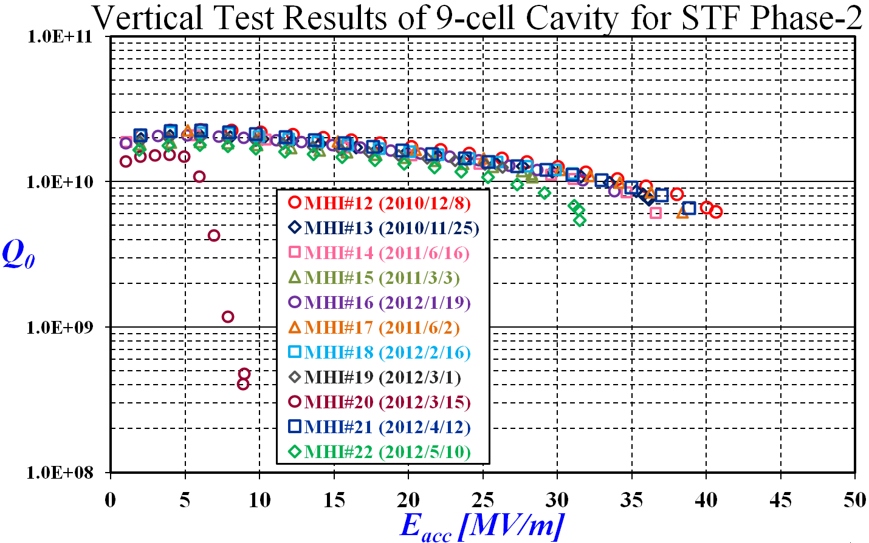
Global Cavity Gradient Results - Asia
KEK data, Y. Yamamoto et al., IPAC2012, WEPPC013.

Slide 11



Gradient Limit Understanding and Control
Optimized baseline surface processing and treatment create high performance surface of Eacc > 38 MV/m.
Repeatable EP controls gradient scatter
(2008-2010)
Geometrical defects cause quench and
limit gradient < 20 MV/m (more on next slide)
ILC R&D Goal
Hpk 160-180 mT

Slide 12

Gradient Limit Understanding and Control
Gradient yield of 100% achieved at an average gradient of 39 MV/m when allowing post-cycle repair
(2008-2010)
+ mechanical polishing at Cornell & FNAL (2010-2011)
Geometrical defects cause quench and
limit gradient < 20 MV/m (more on next slide)
ILC R&D Goal
Mechanical abrasive polishing removes geometrical defects and raises gradients
Hpk 160-180 mT
Average gradient 39 MV/m

Slide 13
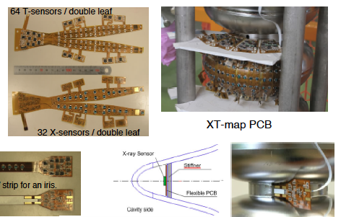
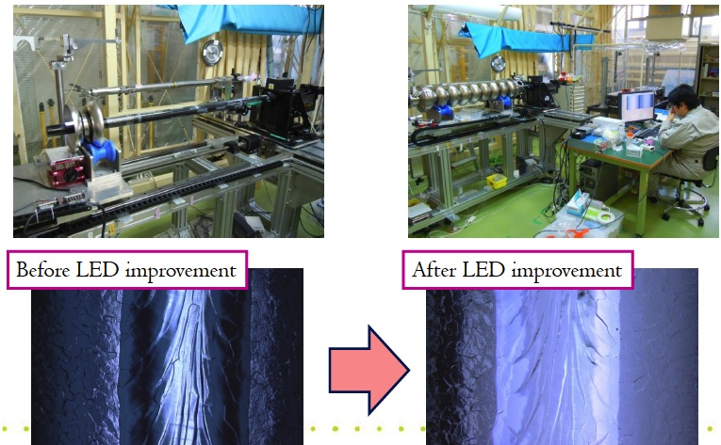
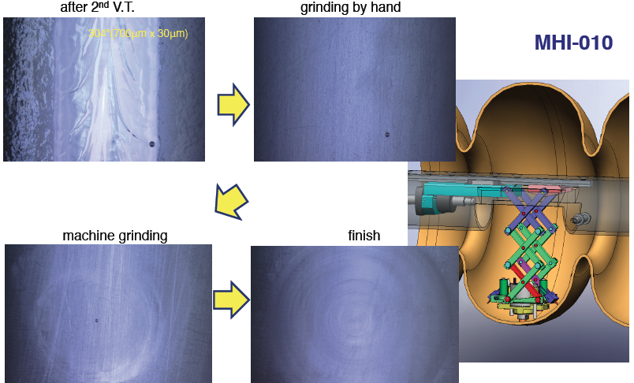
Gradient Limit Understanding and Control
Technology in progress:
Localization during test
+ Optical inspection
+ Local repairing
Guided repair at KEK
Cavity | Repaired at (EP/ MT/ LG) | Tested at | Bef. | Aft. | Year
MHI-08 | KEK (LG) | KEK | 16 | 27 | 2009
MHI-14 | KEK (LG) | KEK | 13 | 37 | 2011
MHI-15-1 | KEK (LG) | KEK | 23 | 33 | 2011
MHI-15-2 | KEK (LG) | KEK | 29 | 36 | 2011
MHI-15-3 | KEK (LG) | KEK | 18 | 36 | 2012
MHI-16 | KEK (LG) | KEK | 21 | 34 | 2012
MHI-19 | KEK (LG) | KEK | 26 | 37 | 2012
HIT-2 | KEK (LG) | KEK | 35 | 41 | 2012
Blue: Repaired after the 1st cycle process
Red: Satisfy ILC requirements

Slide 14
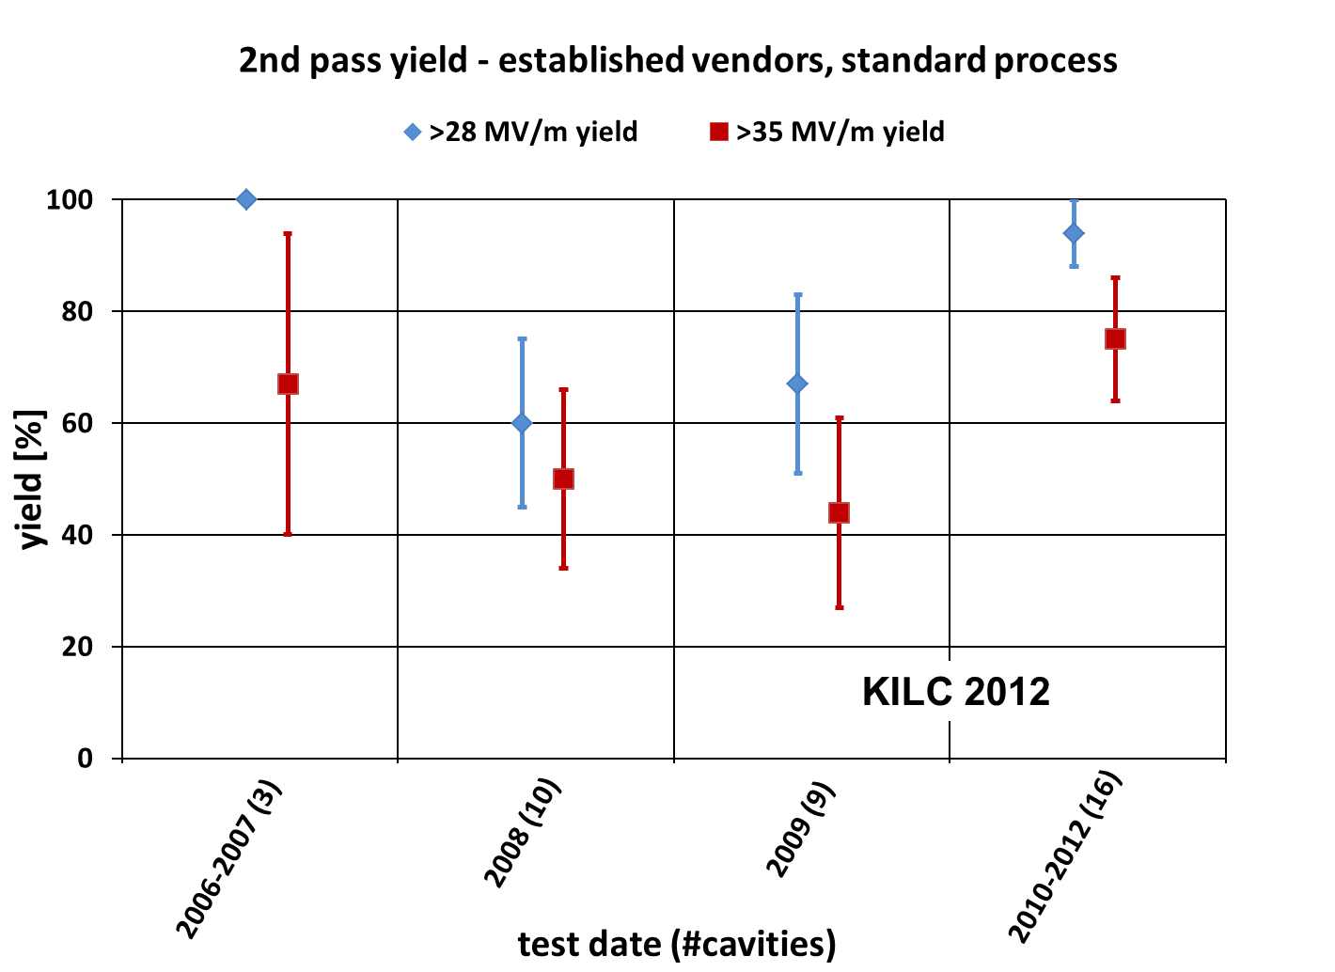
Global Progress in Cavity Gradient Yield
(94+/-6)% acceptable for ILC mass production

Slide 15
Demonstration of 90% Yield at 38 MV/m w/ Q0 ≥ 8E9
Cavities built by one vendor with experience of many cavities and close feedback with lab
Same yield can be expected if other vendors are given similar level of practice in fabrication and seek feedback from labs
R.L. Geng et al., IPAC2011, MOPC111.

Slide 16
Global ILC 9-Cell Cavity R&D Experiences
Labs | #9-cell cavities fabricated | Regional and world total
KEK | 38
IHEP | 1 (2 new under fabrication)
PKU | 4 | Asia total 43
FNAL | 70 (80 ordered)
JLab | 7 (1 new under fabrication) In addition 112 7-cells
Cornell | 1 | Americas total 78
DESY | 200 (800 for XFEL) | EU total 200
 |  | World total 321 (9-cell only) 433 (9-cell & 7-cell)

Slide 17
Gradient Summary
Baseline surface processing and handling procedure optimized and standardized.
  Added optical inspection for fabrication QA.
  Allowed data-driven second-pass processing.
Steady gradient yield progress made in past 5 years on a global basis (tracked by Global Cavity Database).
  According to the current yield definition
    94% yield at gradient acceptable for ILC mass production (> =28 MV/m with average gradient AG=35 MV/m) on global basis.
  Further yield improvement can be expected when allowing repair
    100% yield at >31 MV/m (w/ AG=39MV/m) demonstrated in Americas region
    New progress being made with post-cycle local repair technology in Asia region
    Repair can be included in procedure if cost effectiveness justified
Qualified vendors for cavity fabrication and labs for cavity processing in place in all regions

Slide 18
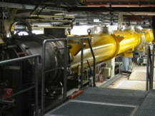
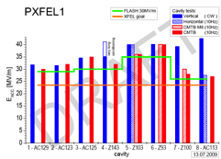
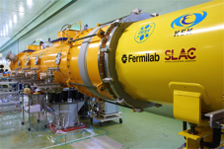
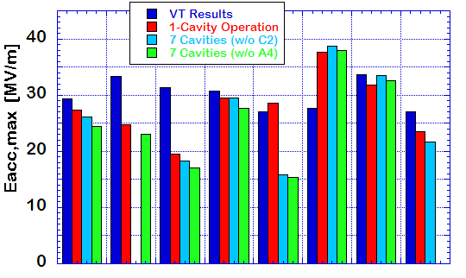
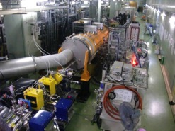
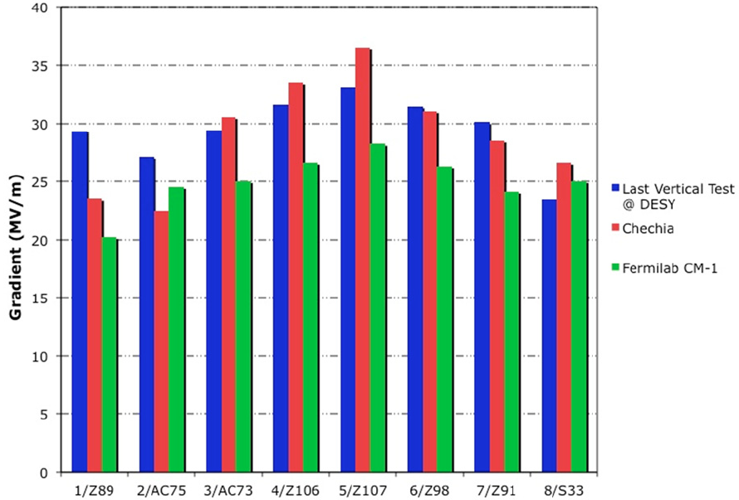
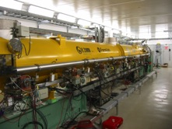
Progress in SCRF System Tests
DESY: FLASH
  SRF-CM string + Beam,
    ACC7/PXFEL1 < 32 MV/m >
  9 mA beam, 2009
  800μs, 4.5mA beam, 2012
KEK: STF
  S1-Global: complete, 2010
    Cavity string : < 26 MV/m>
  Quantum Beam : 1 ms
  CM1 + Beam, in 2014
FNAL: NML/ASTA
  CM1 test complete
  CM2 operation, in 2012
  CM2 + Beam, in 2013

Slide 19
FLASH 9mA Expt achievements:
2009-mid 2012
High beam power and long bunch-trains (Sept 2009)
Metric | ILC Goal | Achieved
Macro-pulse current | 9mA | 9mA
Bunches per pulse | 2400 x 3nC (3MHz) | 1800 x 3nC 2400 x 2nC
Cavities operating at high gradients, close to quench | 31.5MV/m +/-20% | 4 cavities > 30MV/m
Gradient operating margins (Feb 2012)
Metric | ILC Goal | Achieved
Cavity gradient flatness (all cavities in vector sum) | 2% ΔV/V (800μs, 5.8mA) (800μs, 9mA) | <0.3% ΔV/V (800μs, 4.5mA) First tests of automation for Pk/Ql control
Gradient operating margin | All cavities operating within 3% of quench limits | Some cavities within ~5% of quench (800us, 4.5mA) First tests of operations strategies for gradients close to quench
Energy Stability | 0.1% rms at 250GeV | <0.15% p-p (0.4ms) <0.02% rms (5Hz)

Slide 20
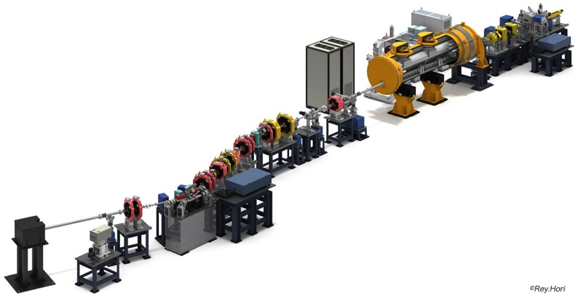
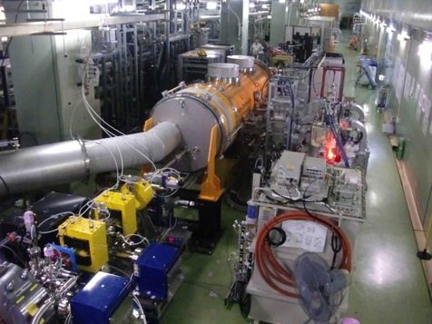
STF Quantum-Beam experiment
KEK-STF
Quantum-Beam Accelerator
Beam acceleration (40 MV) and transport for 1 ms, successful !
April, 2012
High-flux X-ray by Inverse-Comton scattering
10mA electron beam （40MeV, １ｍｓ, ５Ｈｚ）
4-mirror laser resonator cavity
head-on collision with beam
photocathode RFgun
Capture cryomodule ( 2 SC cavities )
collision point
(Laser, electron beam)
Target: 1.3 x 10¹⁰ photons/sec 1%bandwidth
2012. Feb : cool-down started,
April : beam acceleration

Slide 21
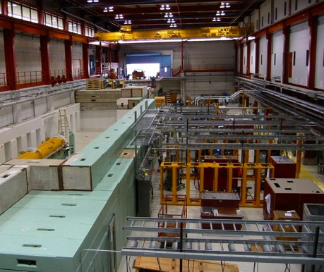
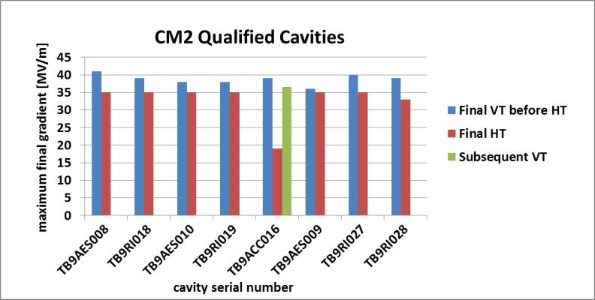
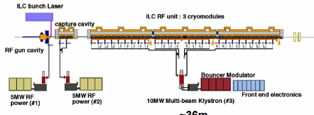
CM Test in Progress at Fermilab
CM-2 expected to reach the system test, in 2012
  7 cavities reached > 35 MV/m in VT (Jlab), > 33 MV/m in HT (Fermi),
  Expect > 30 MV/m on average in CM test

Slide 22
Progress in Industrial Participation to
ILC Cavity Production
year | # 9-cell cavities qualified | # of Labs reaching 35 MV/m processing | # of Industrial manufacturers reaching 35 MV/m fabrication
2006 | 10 | 1 DESY | 2 ACCEL, ZANON
2011 | 41 | 4 DESY, JLAB, FNAL, KEK | 4 RI, ZANON, AES, MHI,
2012 | (45) | 5 DEY, JLAB, FNAL, KEK, Cornell | 5 RI, ZANON, AES, MHI, Hitach
Recent Progress in Industry/Lab
  Niowave-Roark/Fermilab (TB9NR004): reached 30 MV/m (Nov. 2011)
  Hitachi/KEK (HIT02): reached 41 MV/m with HOM (April, 2012)
  Toshiba/KEK (TOS-02): reached 35 MV/m w/o HOM (March 2011)
  Accel (RI)/Cornell (A9) : reached 40 MV/m w/ HOM, vertical EP (April, 2012)
  DESY (LG- ) : reached > 45 MV/m w/ large-grain (2011~12)
  IHEP-KEK: 1st cavity (LL, large-grain, no-end) reached 20 MV/m,
  PKU-JLab: Cavity (Tesla, fine-grain) reached 28 MV/m,
Progress in EXFEL (updated by W. Singer : the 2nd EP at DESY, as of Sept. ‘12)
  RI: 4 reference cavities with Eacc > 28 MV/m, (~ 39 MV/m max.)
  Zanon: 4 reference cavities with Eacc > 30 MV/m ( ~ 36 MV/m max.)

Slide 23
Outline
ILC SRF technical status
  Cavity gradient
  Cryomodule system testing
  Beam operation of cryomodules in SRF linacs
Future SRF R&D for linear collider
  Field emission understanding and control
  Very high gradient with high Q0
  Inexpensive SRF fabrication and processing
  Fundamental issues
Summary

Slide 24
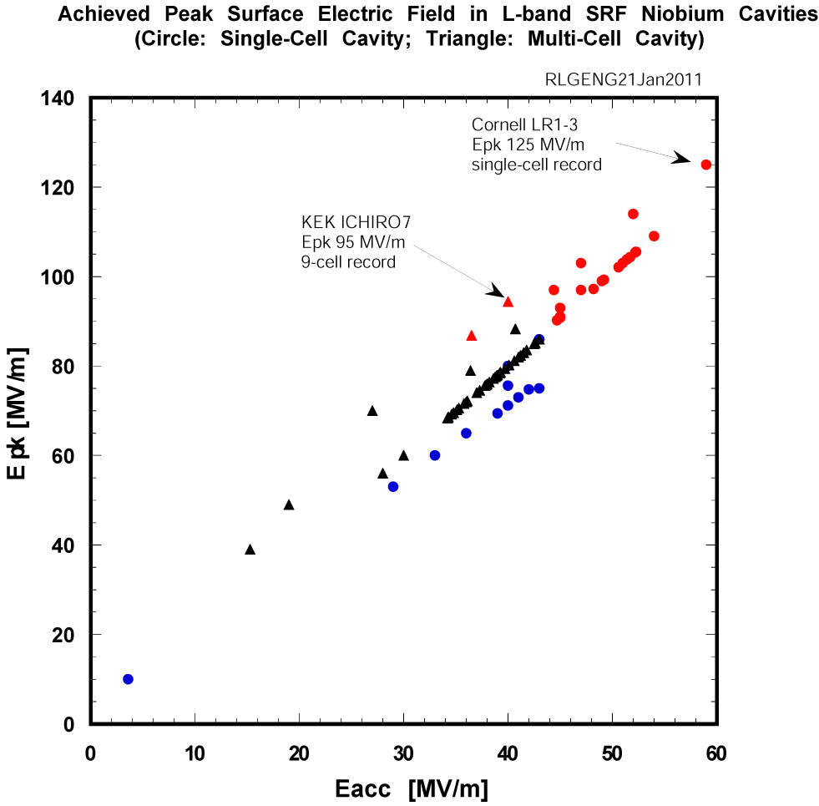

Field Emission Understanding and Control
Intensive R&D in past years resulted in reduced field emission
  Post-EP cleaning
  No longer a main limit for vertical test
But still not under complete control
  Causes additional cryo loss
  Risk increases rapidly with peak surface electric field due to exponential nature of the process
Critical issue for accelerator operation
  Dark current
  Radiation damage to electronics
  Beam line activation from neutron
For ILC operation Epk average 63 MV/m and up to 76 MV/m
  For XFEL, Epk 47 MV/m
  For CEBAF upgrade, Epk 42 MV/m
ILC 1 TeV
ILC 500 GeV
XFEL
CEBAF 12 GeV
CEBAF 4 GeV

Slide 25
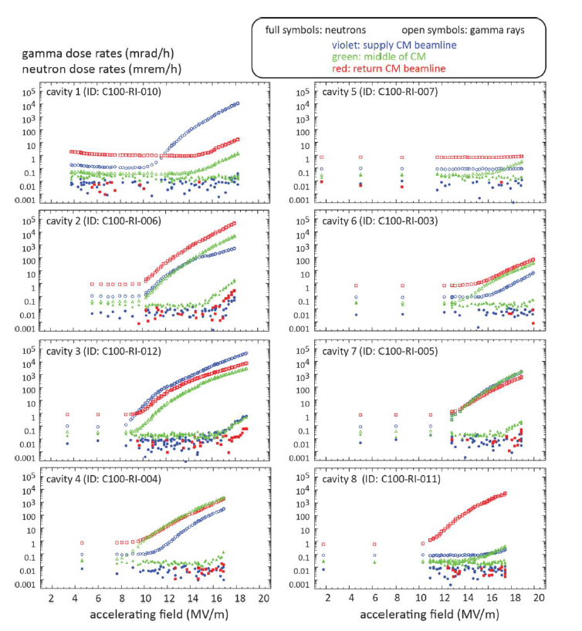
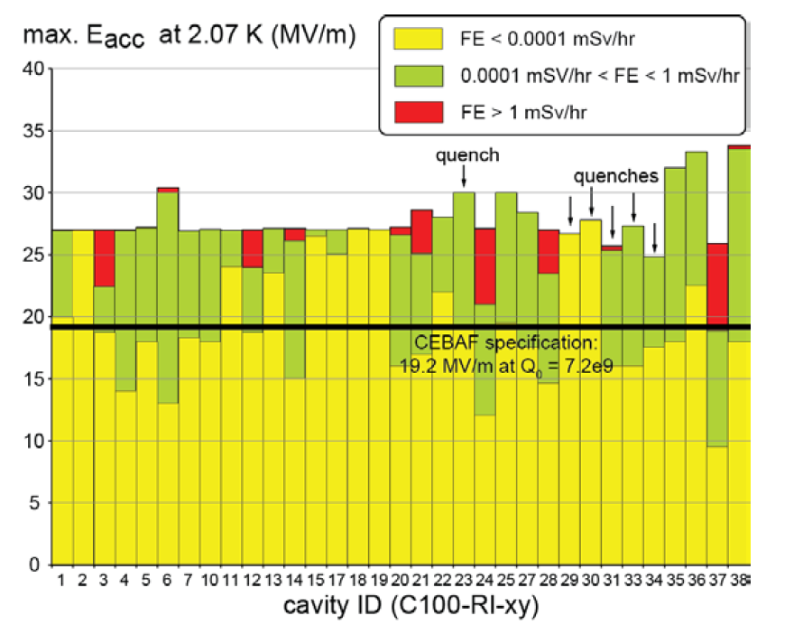
Field Emission Understanding and Control
CEBAF upgrade cavities: From vertical test to operation in accelerator tunnel
Final surface processing essentially the same as that for ILC baseline
Cavities and cryomodules met project spec
Field emission recognized in some modules
  Field emission onset change
  Sometimes beam-line component activation
Similar observations in other labs
F. Marhauser, JLAB-TN-12-044

Slide 26
Future R&D on Field Emission
Near term goal: Reduce field emission reliably up to a surface electric field of 80 MV/m in 9-cell cavity so as to insure operation of cryomodules at average gradient of 31.5 MV/m with acceptable field emission induced cryogenic loss and field emission induced radiation dose
  (Cryogenic loss due to FE) / (Cryogenic loss due to dynamic + static heat) per cryomodule < 10%
  Dark current per cavity < 50 nA
Long term goal: Push the field emission onset gradient reliably beyond Epk = 50 MV/m in 9-cell cavities; Demonstrate Epk = 100-120 MV/m in 9-cell cavities
  Requires deeper fundamental understanding of FE phenomenon
  Requires advanced surface processing
    “mirror finish”
    In-situ processing

Slide 27
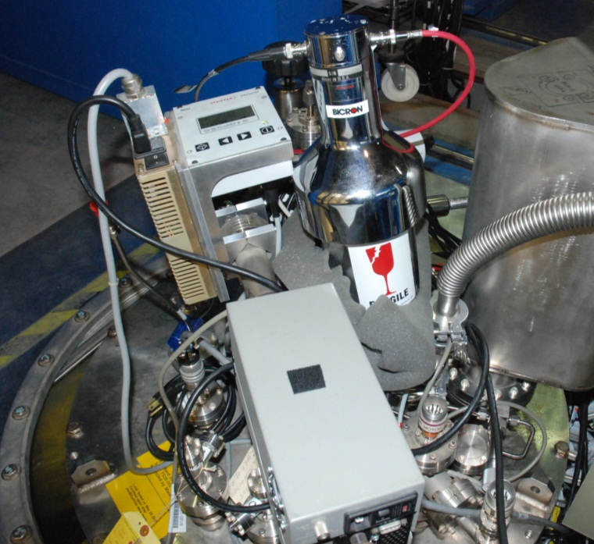
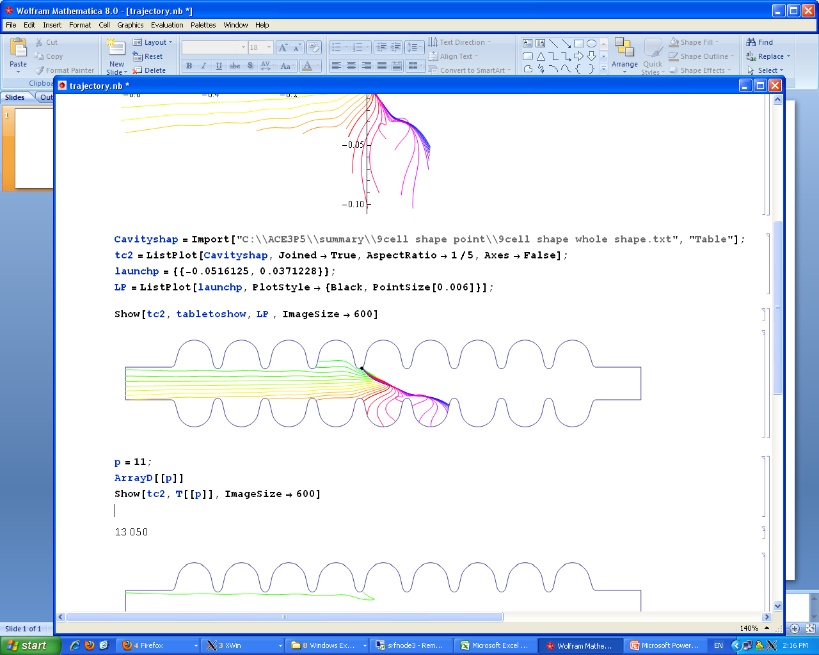
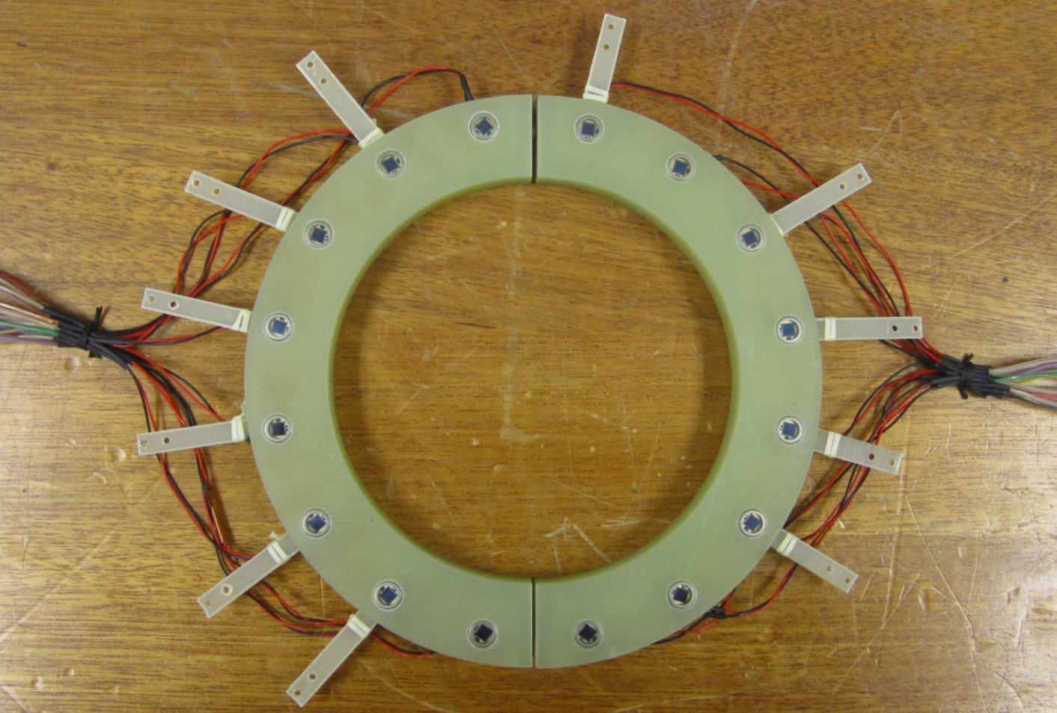
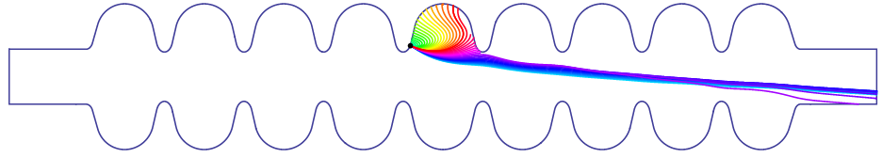
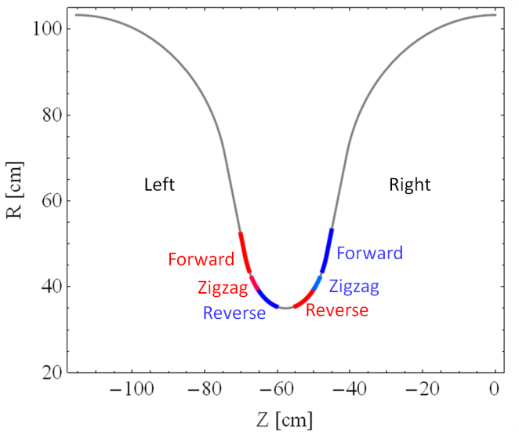
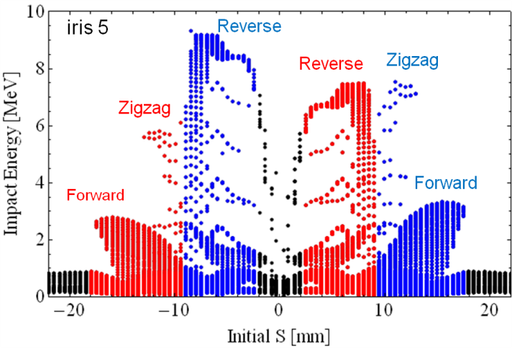
Locating Field Emitter in 9-cell Cavity
Emission in region
>>> “Reverse type”
Emission in region >>> “Zigzag type”
Emission in region >>> “Forward type”
IR5
Impact position VS impact energy distribution

Slide 28
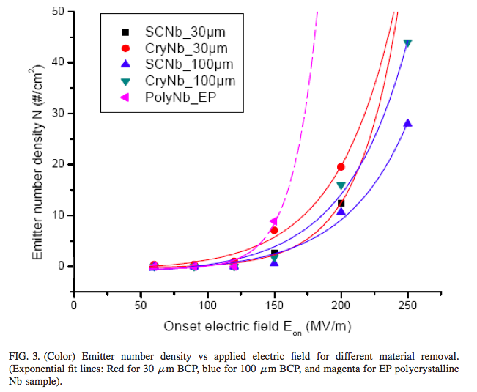
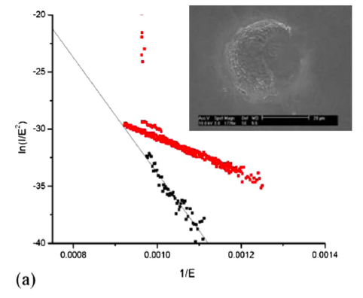
Fundamental FE Studies
Creation of emitter by microdischarge
A. Dangwal Pandey et al., PRST-AB 12, 023501 (2009)
Difference between BCP and EP treated Nb surface

Slide 29
Very High Gradient with High Q0
Save linac capital and operation cost by raising gradient and Q0
Relative Linac Cost
Qo = 2e9
Qo = 1e10
Cryo-Plant Cost
~ (Load)^1.0
Qo = 5e10
~ (Load)^0.6
Linac Gradient (MV/m)
Chris Adolphsen, ALCPG2011.

Slide 30
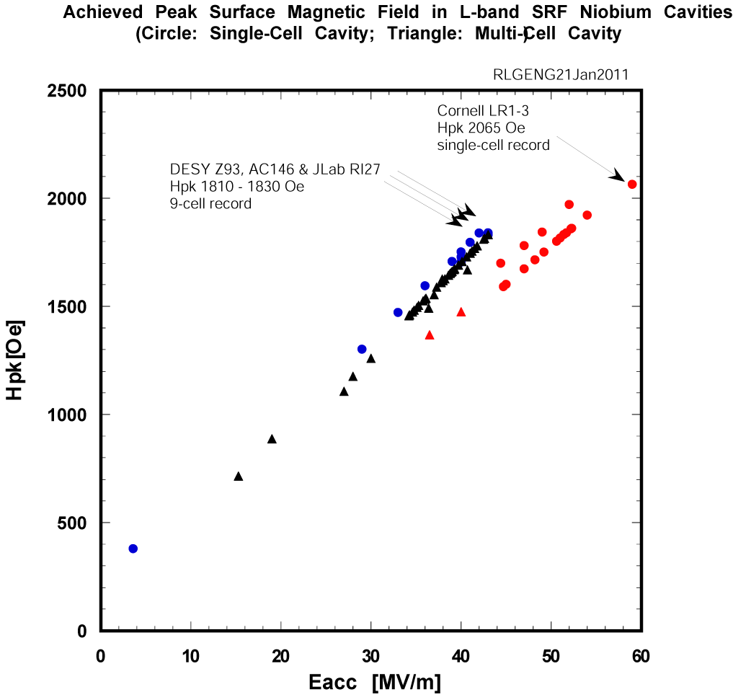
DESY AC155, AC158
Hpk 1910-1950 Oe
New 9-cell record
Recent cavity results established that a peak surface magnetic field of 190-200 mT is possible and practical
45 MV/m in TTF shape means effectively > 50 MV/m in Re-entrant, low-loss or ICHIRO, and Low-Surface-Field shape cavities
In fact, this is already shown in many 1-cell cavities
ILC 1 TeV
ILC 500 GeV
XFEL
CEBAF 12 GeV
CEBAF 4 GeV

Slide 31
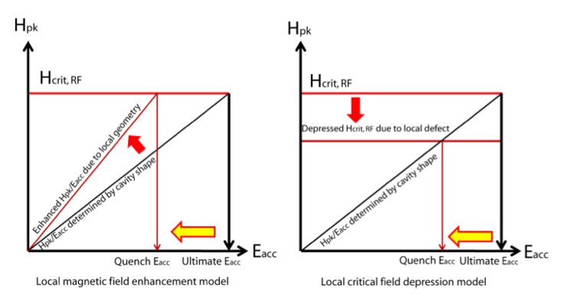
High Gradient via New Shapes
Ratio of Hpk/Eacc solely determined by shape
Lowering Hpk/Eacc for higher gradient up to critical RF magnetic field (material property)
Three cavity shapes under evaluation
  Low-loss (KEK, JLab, IHEP)
  Re-entrant (Cornell)
  Low-Surface-Field (JLab/SLAC)
Baseline shape
New shape

Slide 32
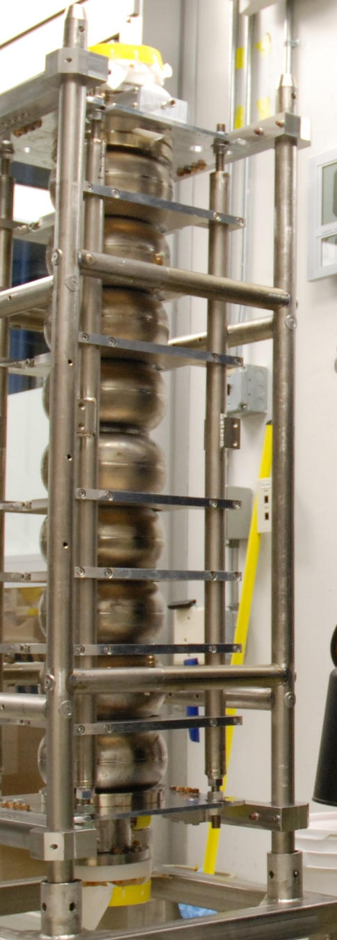
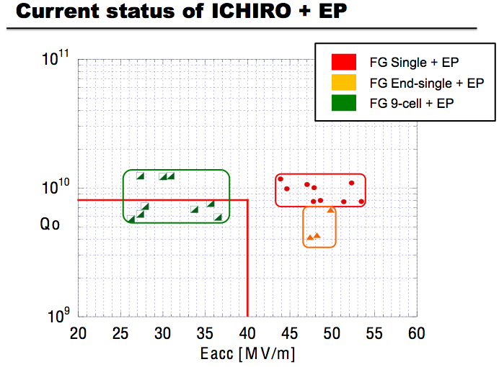
KEK 9-cell cavity ICHIRO7 achieved 40 MV/m gradient (potential > 50 MV/m)
under collaboration between KEK and JLab
Eacc 40 MV/m
-> Epk 95 MV/m
F. Furuta et al., SRF2011, TUPO014 (2011).

Slide 33
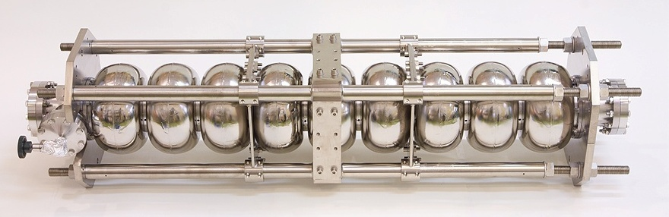
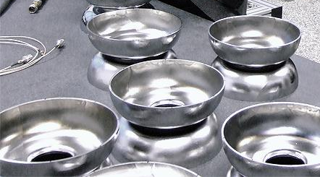
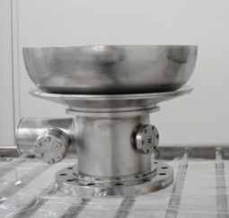
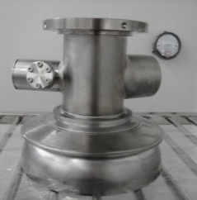
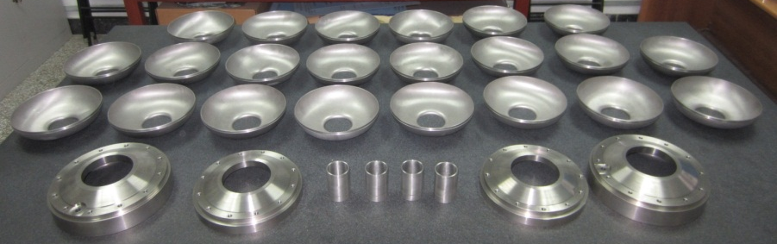
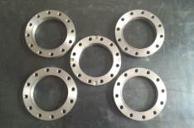
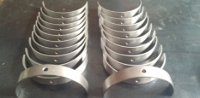
IHEP 1.3 GHz 9-cell Cavities
Low-loss large grain cavity (w/o HOM)(IHEP-01)
  20 MV/m (CBP + CP), in collaboration with KEK and JLAB
Low-loss large grain cavity (IHEP-02)
  cold test in 2013, in collaboration with FNAL
TESLA-like fine grain cavity (IHEP-03)
  cold test in 2013, in collaboration with KEK
Courtesy: J.Y. Zhai, J. Gao
IHEP, CAS

Slide 34
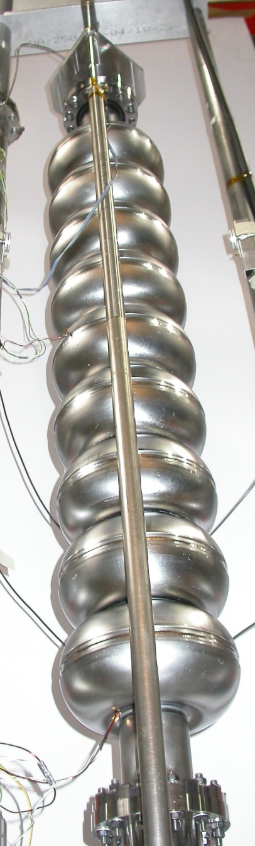
High gradient R&D w/ Re-entrant 9cell at Cornell
History of Re-entrant 9-cell
VT | cavity | date | Eacc max [MV/m] | Qo at Eacc max | process
1 | LR9-1 | 12-Jul-07 | 24.23 | 1.23E+10 | VEP200um, 600C bake(Jlab), VEP20um, 115C bake
2 | LR9-1 | 31-Jan-08 | 14.59 | 1.05E+10 | VEP20um, 115C bake
3 | LR9-1 | 15-May-08 | 15.35 | 1.05E+10 | VEP20um, 115C bake
4 | LR9-1 | 2-Apr-09 | 29.70 | 4.12E+09 | Tumbling80um, VEP200um, 600C bake(Jlab), VEP20um, 115C bake, Q-disease
5 | LR9-1 | 2-Feb-10 | 27.49 | 9.39E+09 | 600C bake(Jlab), VEP, 115C bake
6 | LR9-1 | 6-Apr-10 | - | - | Re-HPR, 115C bake, RF cable/probe failure
7 | LR9-1 | 17-Apr-10 | 27.91 | 7.80E+09 | retune 4%, re-HPR only
Courtesy: F. Furuta, Cornell Univ.

Slide 35
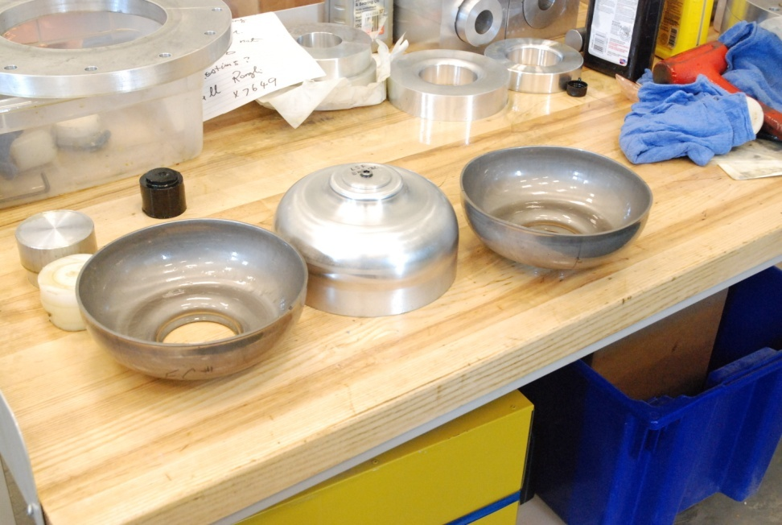
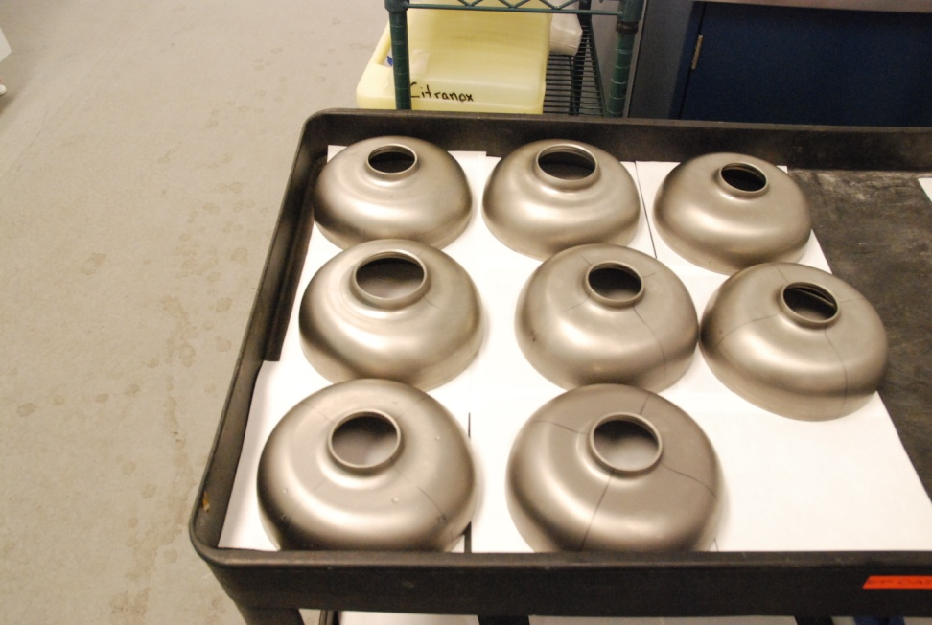
First LSF 9-cell Cavity Fabrication at JLAB
LSF RF design by Z. Li, C. Adolphsen, SLAC
Feature:
Lowering Hpk/Eacc without raising Epk/Eacc
low cell-cell coupling
  need better stiffening
First cavity test expected in 2013, Use proven JLAB high gradient procedure

Slide 36
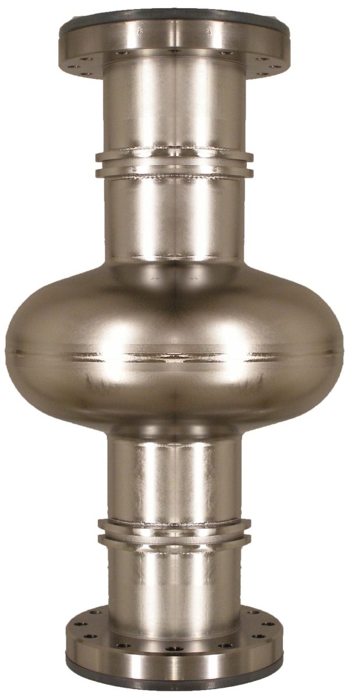
High Gradient via Materials
Ultimate gradient limit set by RF critical magnetic field
  Nb, 240 mT predicted by superheating theory
    Ultimate gradient 60 MV/m
    ~210 mT (~90% theoretical limit) achieved
      One 1-cell 1.3 GHz re-entrant cavity (R.L. Geng et al., PAC2007)
      One 2-cell 1.3 GHz cavity (K. Watanabe et al., KEK cERL, 2012)
    195 mT (~80% theoretical limit) achieved
      One 9-cell 1.3 GHz TTF-shape large grain cavity (D. Reschke et al., SRF2011)
  Nb3Sn, 400 mT predicted by superheating theory
    Ultimate gradient 100 MV/m
    Vapor diffusion
      Was investigated 20 years ago
      New efforts restarted at Cornell
        First 1-cell 1.3 GHz coating this month

Slide 37
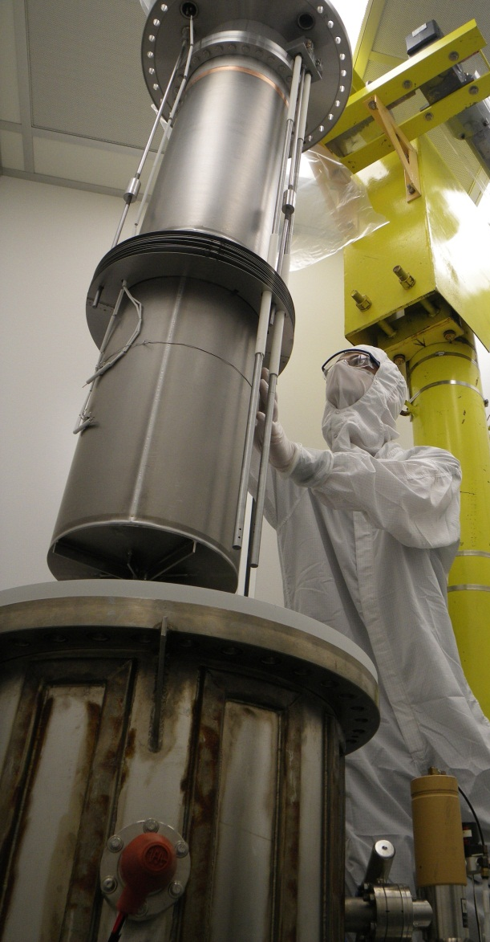
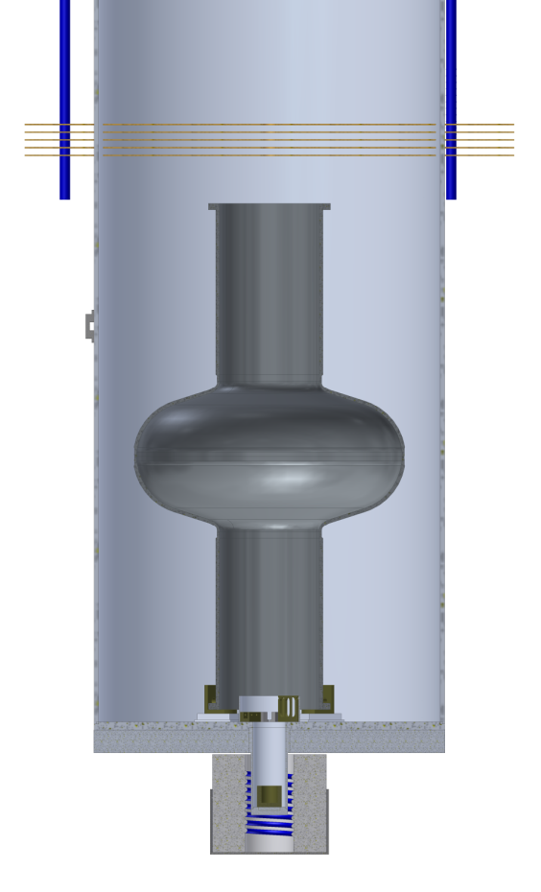
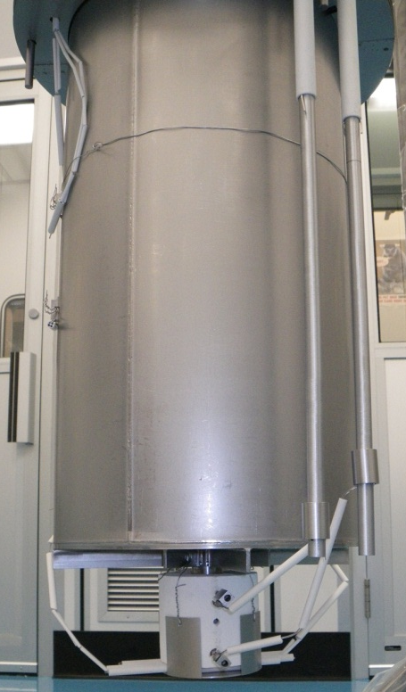
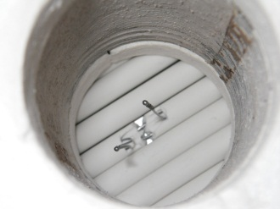
Nb₃Sn Coating Chamber
Cornell University
Coating chamber is inserted into UHV furnace. Separate vacuum system keeps furnace free from tin contamination
Flange to UHV furnace
Copper transition weld from stainless to Nb
Cavity Temp Thermo-couples
Tungsten Supports
Heat Shields
Heater Power
Heater Temp Thermo-couples
Tin Heater
Nucleation Agent
Witness Sample
Tin Container
UHV Furnace
Courtesy Sam Posen, Cornell

Slide 38
High Gradient via Multi-Layer
Theory by Gurevich, APL 88, 012511(2006)
Potential for magnetic limit 500-1000 mT
  Ultimate gradient up to 200 MV/m
Insulating layer nm thick
Thin film coated cavities
Higher-T_{c}SC: NbN, Nb₃Sn, etc
Coating techniques
  Several paths being explored at ANL (ALD), CERN (sputtering, HIPIMS), JLAB (ECR, CVD), LBNL (HIPIMS)
Requires RF evaluation of samples at low temperature
  Several apparatus being developed at CERN (Quadrupole resonator), Cornell (TE cavity), JLAB (SIC cavity)
Nb
Insulating
layers

Slide 39






Coating Infrastructures
Cavity ALD at ANL
High-impulse deposition at LBNL
Film deposition at JLab
CED at AASC, 1st coated Nb-Cu cavity in hand, 2012

Slide 40

Very High Gradient with High Q0
For 1 TeV upgrade, high gradient and high Q0 are required for lowering capital and operation cost
Goal: G=45 MV/m @ Q0=2E10
Several 1.3 GHz 9-cell Nb cavities have achieved Q0=1E10 for G= 40-45 MV/m
Large-grain Nb promises higher Q0
Recent L-band 1-cell Nb cavities demonstrated much higher Q0 after high temperature furnace treatments with various exposed media
4.6E10 at 2K & Hpk=90 mT, 1.5 GHz, LG Nb at JLAB (P. Dhakal et al., IPAC2012 )
7E10 at 2K & Hpk=42 mT, 1.3 GHz at FNAL (A. Grassellino, CW SRF linac w/s, 2012 )
FNAL 1-cell
1.3 GHz, 2K
JLAB 1-cell
1.5 GHz, 2K
PKU 1-cell
1.3 GHz, 2K

Slide 41

High Q0 via Large Grain Nb
D. Reschke et al., SRF2011, THPO046 (2011).

Slide 42




High Q0 via Large-Grain Nb
1-cell Q0~2E10 @ 2K & 42 MV/m, PKU/JLAB collaboration, 2007
9-cell PKU2 Q0=2E10 @ 2K & 20 MV/m, PKU/JLAB collaboration, 2010-2011
Cavity limited by quench due to fabrication defect
New 9-cell PKU4 with improved weld, 2012
To be processed and tested at KEK this year
Courtesy J.K. Hao, K.X. Liu, Peking University
Improved weld

Slide 43
Inexpensive SRF Fab. & Proc.
SRF cost effectiveness expected to improve with the size of production volume
  Subject of ILC SRF industrialization
  XFEL production unique opportunity for understanding
    Inspection QA/QC
    Second-pass re-processing scheme
    Percent of cavities needing “guided repair”
Several paths being explored in terms of cavity fabrication and processing
  Seamless cavity
  Mechanical abrasive polishing
  Vertical electropolishing

Slide 44


Slide 45

Automated Optical Inspection

Slide 46
Seamless Cavity
Initial work at DESY progressed over years
  Best 9-cell seamless cavity (by welding three 3-cell seamless units) Z164 reached 34 MV/m
    Limited by quench
    Thorough instrumented testing has been done at JLab
    Results being compared with welded cavities (talk to be presented November 2012 TTC meeting)
Other labs (FNAL, JLAB, KEK) are interested in further development
Cost saving by reducing number of EBW steps
Further cost saving if technology is used for Nb-Cu clad material or copper in association with Nb coating
  Aligned interest with multi-layer (earlier slides)
  Potential exists in US labs

Slide 47

Mechanical Abrasive Polishing CBP
Clear demonstration of effectiveness in repairing low performing cavity in hand
10 cavity set under process at FNAL to evaluate suitability for adoption as baseline
“Mirror finish” achieved in 9-cell at FNAL and JLAB.
R&D at FNAL aims for recipe of “zero chemistry” following CBP
Same machine exists at Cornell, FNAL, JLAB, and U. Hamburg (available for DESY)
3rd AES production cavities baseline vs. CBP
Courtesy C. Cooper, FNAL

Slide 48

1st achievement of 40MV/m w/ VEP + TESLA 9-cell
Eacc max=38MV/m, Qo = 9.0e9
Rad ~1.0mR/hr, Limited by quench.
Processed by additional VEP(5um), USC, HPR, and 120C bake.
Courtesy F. Furuta, Cornell U.

Slide 49




Vertical Electropolishing at SACLAY

Slide 50
Fundamental SRF Issues
Critical RF field
Nature of quench below critical RF field
  Magnetic field enhancement effect
  Role of flux entry?
Non-linear surface resistance (Q-drop)
Origin of “residual resistance”
Origin of field emitters and their behaviors under high electric RF field
Other related issues at high gradient
  Higher order mode coupler multipacting
  Lorentz force detuning

Slide 51



What Is Reason for Quench Limit in Gradient Range of 35-45 MV/m?
Cavity RI27 quench at 43 MV/m
OST predicted quench area shown in box
No observable feature on site

Slide 52

Development since 2004 ITRP recommendation of SRF for ILC
Björn Wiik
vision
R&D needed
TDR by 2012
17.5-20 GeV Linac
Under construction
Under construction
ITRP Recommendation
Higgs-like boson discovery
Continued progress in SRF gradient : breakthrough of 45 MV/m in 1-cell, ~60 MV/m record; 45 MV/m in 9-cell
GDE began in 2005. Since then, gradient yield at 35 MV/m steadily improved; ALSO steady progress in gradient envelope
New SRF Test Facilities in operation: STF at KEK first beam; NML at Fermilab first US module expects testing at <35 MV/m>
Upgrade of CEBAF to 12 GeV at JLAB, 80 cavities final process essentially ILC style, cryomodule w/ beam met spec
FLASH operation and construction of European XFEL underway, cavity mass production started, 800 cavities total

Slide 53
Summary
Understanding of gradient limitation and scattering much improved in past five years
Progress has been made in gradient yield as well as in gradient envelope in 1-cell & 9-cell cavities
ILC production cavity gradient yield goal now met
  90% at average 35 MV/m allowing +/-20%
ILC cryomodule operation gradient w/ beam now met
Future SRF R&D identified
  Control field emission reliably
  High gradient cavity with high Q0
  Inexpensive SRF fabrication and processing

