Slide 1
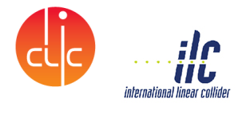
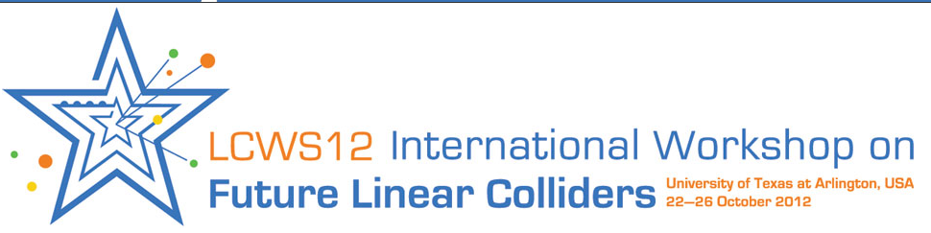
CERN CFS resources for Linear Colliders 2013-2017
J.Osborne (CERN) for CFS

Slide 2
CLIC Implementation studies: Civil Engineering and Services 2012-2017
J.Osborne (CERN) for CFS
Note : this study includes the new Rebaselining exercise that has started

Slide 3
CLIC Implementation studies: Project Implementation Plan 2012-2017
J.Osborne (CERN) for CFS

