Slide 1
Project Cost Basis and Schedule Summary
G. Dugan
LCWS12

Slide 2
Cost and schedule summary
Presentations:
ILC Cost Methodology (15)- G. Dugan
ILC Cost Basis (15) – G. Dugan
ILC Schedule (15) – E. Patterson (slides from M. Gastal)
CLIC Schedule and Cost (45) – P. Lebrun
This summary:
  Common features: scope, methodology
  ILC specific: Escalated RDR Value, schedule
  CLIC specific: 500 GeV scenarios, CDR Value, schedule

Slide 3
Scope of the estimates
Included in ILC TDR:
  The cost estimate covers only the construction cost for the 500 GeV accelerator systems as detailed in the TDR.
  Costs for upgrading the machine to 1 TeV are not included, except the cost of those systems which would be very difficult to provide after construction of the 500 GeV machine (e.g., beam dumps, BDS length).
Included in CLIC CDR:
  The basic parameters for the CLIC CDR study are optimized for a collision energy of 3 TeV and a peak luminosity of 2 E34 cm⁻² s⁻¹
  The study includes a first stage at 500 GeV, for which a single drive-beam production complex is sufficient to power both main linacs.
  Two staging scenarios have been studied and costed.
Not included in either estimate:
  Detectors, project engineering, design, and R&D prior to construction authorization, beam commissioning, pre-operation, operation, de-commissioning, taxes, contingency, and escalation during project construction.
  Also excluded in CLIC estimate: computing, general lab services and administration

Slide 4
Value Estimating Methodology and Costs
Both estimates use the Value estimating methodology:
  The Value of a component is defined as the lowest reasonable estimate of the procurement cost of an item with the required specification, and in the appropriate quantity, based on production costs in a major industrial nation.
  The Labor associated with a component or activity is defined as “explicit” labor, which may be provided by the collaborating laboratories and institutions, or may be purchased from industrial firms.
The currency unit used for CLIC Value is CHF (Dec. 2010). Conversions from costs estimated in other currencies are done on the basis of exchange rates.
The currency unit used for ILC Value is USD (Jan. 2012) (“ILCU”). Conversions from costs estimated in other currencies are done on the basis of OECD purchasing power parity indices.
The CLIC CDR has a published cost.
The ILC TDR cost is still in the review process. However, for reference, the RDR costs can be re-stated in terms of 2012 USD (“ILCU”).

Slide 5
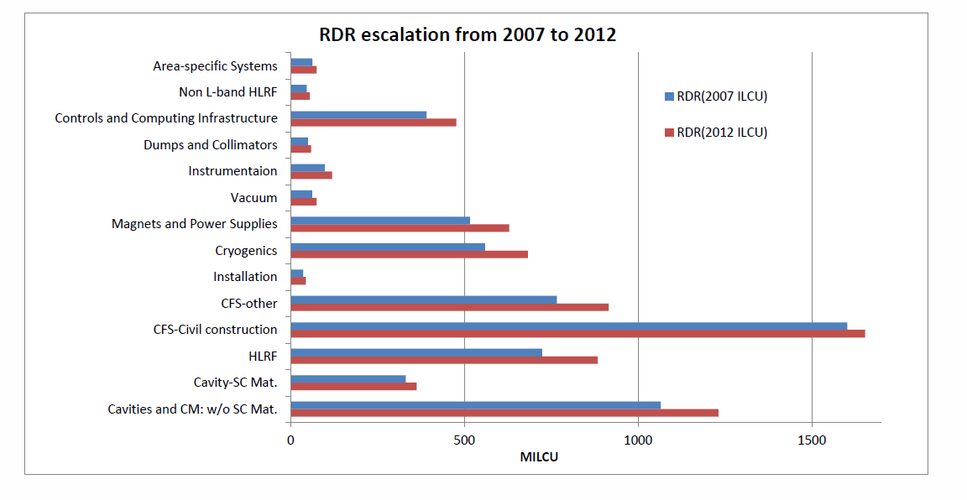
ILC RDR Value estimate, re-stated in 2012 ILCU
7268 MILCU (2012).
6312 MILCU (2007).
Total ILC RDR estimate:
Explicit Labor: 14,200 FTE-years
Average escalation: 15%

Slide 6
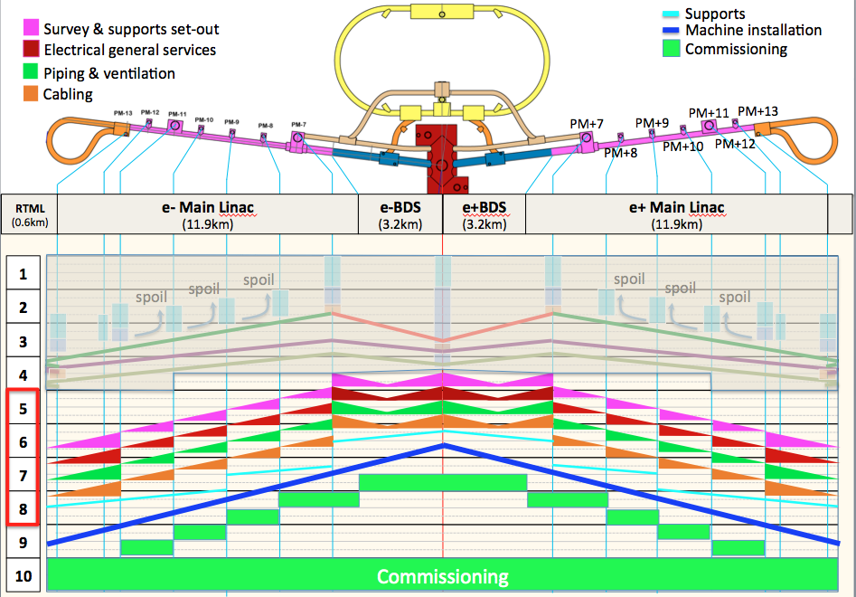
Flat Topography ILC schedule

Slide 7
Scope of the CLIC CDR study
Changes in CDR Volume 3 [3/3]
Two alternative staging scenarios
  Each with three stages: 500 GeV, ~1.5 TeV and 3 TeV
  Scenario A: « optimized for luminosity in the first stage »
  Scenario B: « optimized for lower entry cost »
  First and last stages of scenario A are identical to CDR Volume 1
  Reuse of 80 MV/m structures in scenario A limits the energy of the second stage to 1.4 TeV
  Scenario B has nominal bunch charge at all stages, resulting in
    Use of final (100 MV/m) gradient structures already at 500 GeV
    Shorter main linacs (2 x 4 sectors)
    Lower installed RF power in the main-beam and drive-beam production complexes

Slide 8
CLIC Value by PBS/WBS domain
8.3 +1.9 -1.4 BCHF
7.4 +1.7 -1.3 BCHF
Labor: Scaling to CLIC @ 500 GeV
  Assume Person/Material ratio is the same as for LHC construction
    Scenario A 15700 FTE.years
    Scenario B 14100 FTE.years

Slide 10
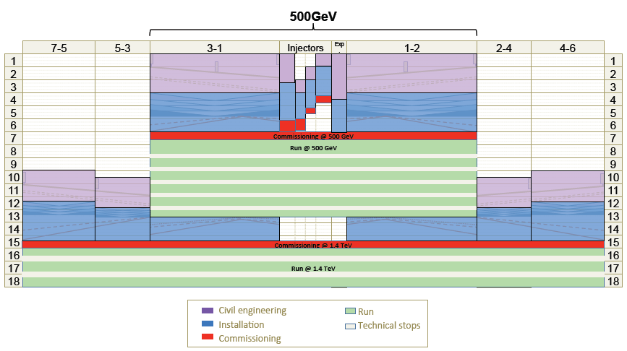
Overall CLIC construction schedule - Scenario A
K. Foraz
Years

Slide 11
Conclusions
Both ILC and CLIC cost estimates have similar generic scope definitions and both use the value estimating methodology.
ILC TDR cost estimate not yet available
  Escalated RDR is 7.3 BUSD (2012) + 14,200 FTE-years.
  Schedule: 9 years from project start to beam commissioning
CLIC CDR cost estimate published
  500 GeV scenario A: 8.3 +1.9 -1.4 BCHF (2011) +15,700 FTE-years
  500 GeV scenario B: 7.4 +1.7 -1.3 BCHF (2011) +14,100 FTE-years
  Schedule: 6 years from project start to beam commissioning
  Scaled value for CLIC at 1.5 TeV CM gives access to incremental cost above 500 GeV of ~4 MCHF/GeV CM

